Slide 1

Lilo & Stitch: Leadership in Diverse Groups
Presented By: Kiara Benavides & Hailey Baldwin
Notes:
HAILEY

Slide 2
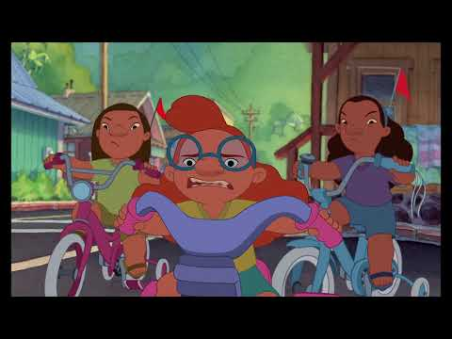
{INSERT LILO & STITCH VIDEO FOR INTRO}
Notes:
KIARA
Let them know if audio issues

Slide 3
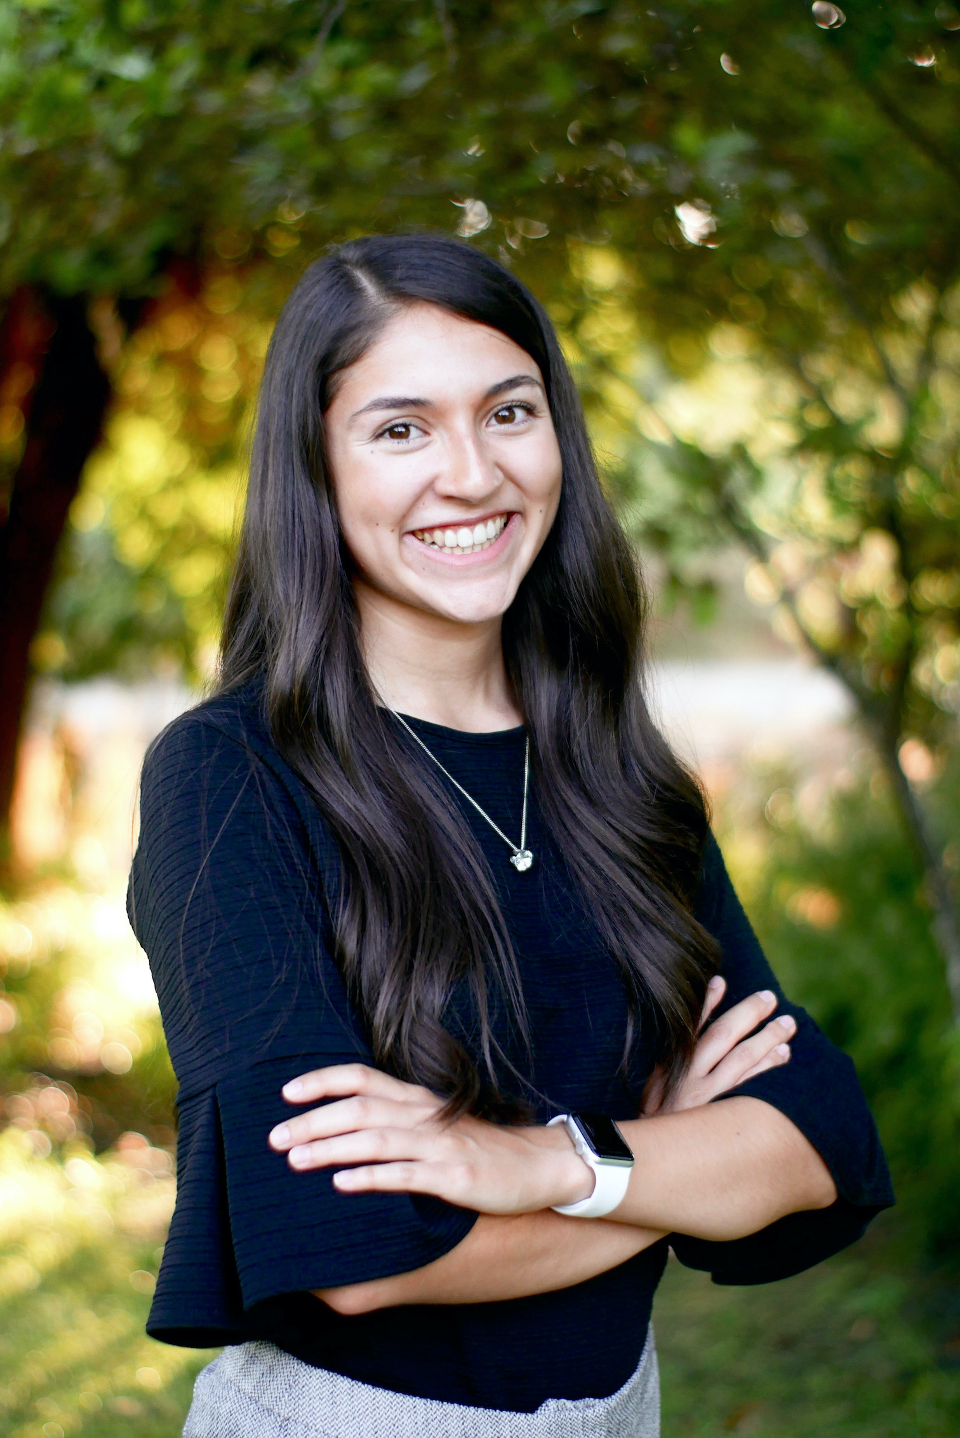

Kiara Benavides
Third Year Agriculture Science Major- Cal Poly, SLO
  Minor in Agribusiness
Career Goals: Ag. Teacher
Fun Fact: I swam with whale sharks on my last trip to Cabo San Lucas!

Slide 4
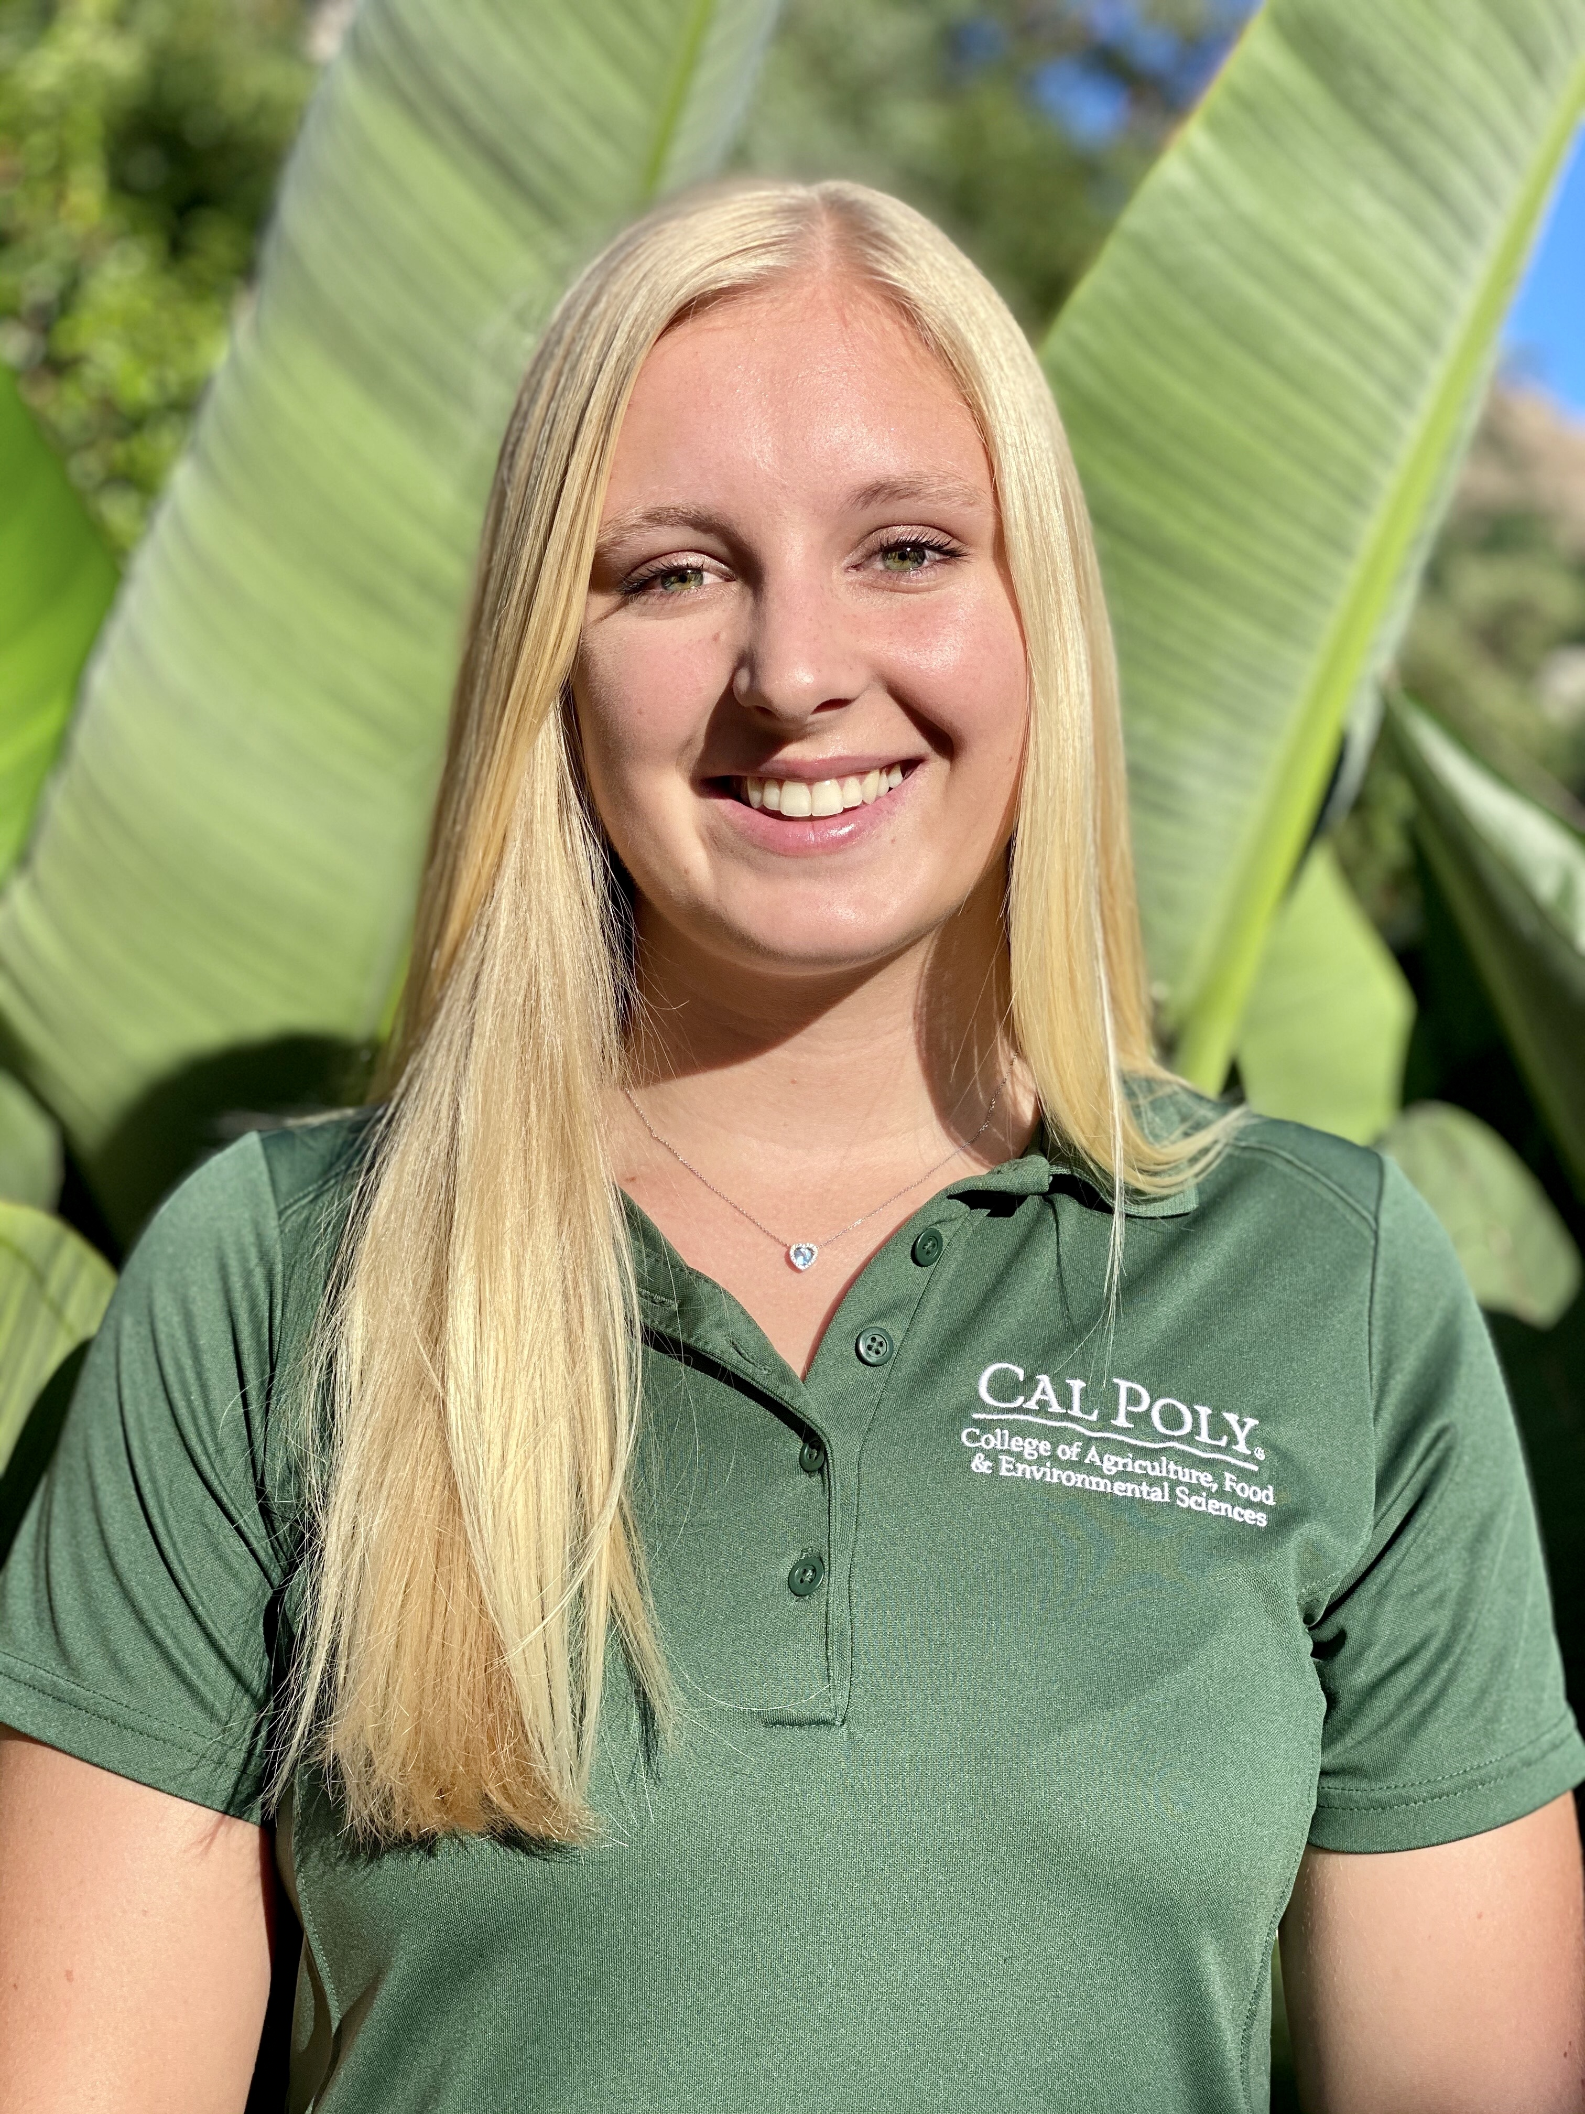

Hailey Baldwin
Fourth year Agriculture Science Major- Cal Poly, SLO
  Minor in Agribusiness
Career Goals: Ag. Teacher
Fun Fact: I snorkeled with sea turtles in Hawaii two summers ago!

Slide 5
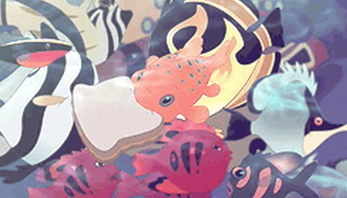
Workshop Expectations
Feel free to ask questions.
Participate enthusiastically!
*IMPORTANT*: BE RESPECTIFUL & MINDFUL!
Notes:
HAILEY
Our workshop today focuses on topics that are more sensitive, be respectful and mindful of what you are saying.
Also before we get started, please have a piece of paper and pencil available to participate in our icebreaker.

Slide 6
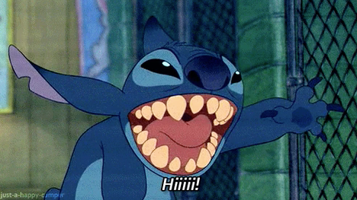
Workshop Objective
We will learn how to foster diversity into our Agriculture Ambassador Teams by identifying activities and events that are inclusive to students with disabilities.
Notes:
KIARA

Slide 7

Confront Stereotypes Icebreaker
On a piece of paper make a T-chart that looks like this..
Fill in the first column with a common identifier that applies to you.
Fill in the second column with a common stereotype about that group or identifier that does not apply to you (whether it be positive or negative).
ASK QUESTIONS if you need clarifying!
I am... | But I am not...
I am an alien, but I am not green.
Notes:
HAILEY / Music
I am a college student, but I don't spend all my time partying.
I am Asian, but I am not good at math.
I am Mexican, but I do not like spicy food.
You will have 2 minutes to come up with as many ideas that apply to yourself as you can, and then we will have a few people share out with the group if they're comfortable (3 people).
Have at least three people share.
We all have stereotypes that relate to our identifiers or characteristics but not all stereotypes are accurate.

Slide 8
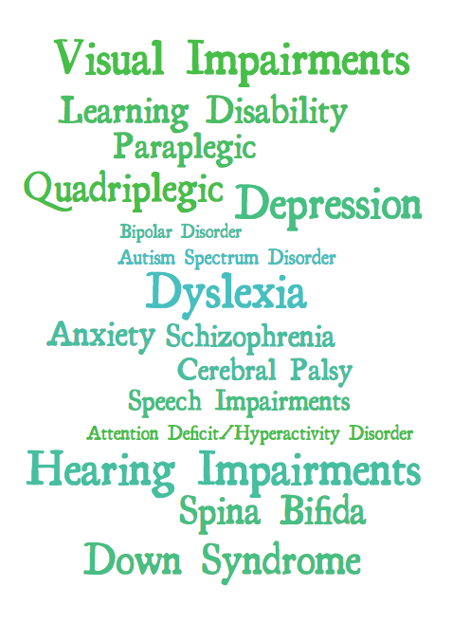
How confident are you with your knowledge in this list of terminology?
Notes:
KIARA
Out of five fingers, with 5 being most confident and 1 not knowing anything at all.

Slide 9
Mental Disabilities
Notes:
KIARA (whole section)

Slide 10

Autism Spectrum* Disorder
Developmental disability- impacts normal development of the brain
Impacts social interaction/communication skills
  Difficulty relating to others, engaging with friends, or may be overwhelmed by new experiences.
  However, they do have a desire to interact with others.
Uneven intellectual development
  Areas of intellectual ability may be super strong (genius even).
  Other areas such as cognitive functional and language abilities may be weak.
Notes:
Suggestion #1 for working with people with autism:
Transitioning from activity to activity can be difficult; allow for a tour of the facility in which program takes place. Allow participant to sit and watch activity before participating.
Suggestion #2 for working with people with autism:
Talk with a parent/guardian to find out what motivates the participant. Include these reinforcers in program and activities.
The puzzle ribbon was adopted in 1999 as the universal sign of autism awareness. ... The Autism Awareness Ribbon — The puzzle pattern reflects the complexity of the autism spectrum. The different colors and shapes represent the diversity of the people and families living with the condition.

Slide 11

Notes:
https://youtu.be/DAPkOxRnh4c
About 2 to 3 minutes

Slide 12
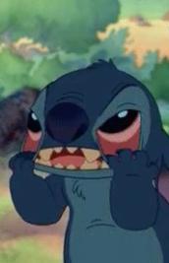
Anxiety Disorder
Real, serious medical conditions.
  They are the most common & pervasive mental disorders in the U.S.
"anxiety disorder"= specific psychiatric disorders that involve extreme fear or worry
Signs and Symptoms:
  Feeling nervous, irritable or on edge
  Having a sense of impending danger, panic or doom
  Having an increased heart rate
  Breathing rapidly (hyperventilation), sweating, and/or trembling
  Feeling weak or tired
  Difficulty concentrating
  Having trouble sleeping
  Experiencing gastrointestinal (GI) problems
Treatment: Therapy - local support groups.
Notes:
Anxiety disorder Includes generalized anxiety disorder, panic disorder/panic attacks, agoraphobia, social anxiety disorder, separation anxiety, and specific phobias.
Not if too many people - Pair Share: Do you have any personal experiences related to either Autism Spectrum Disorder or Anxiety Disorder, about either you or someone you know or met?

Slide 13
Physical Disabilities
Notes:
HAILEY (full section)

Slide 14


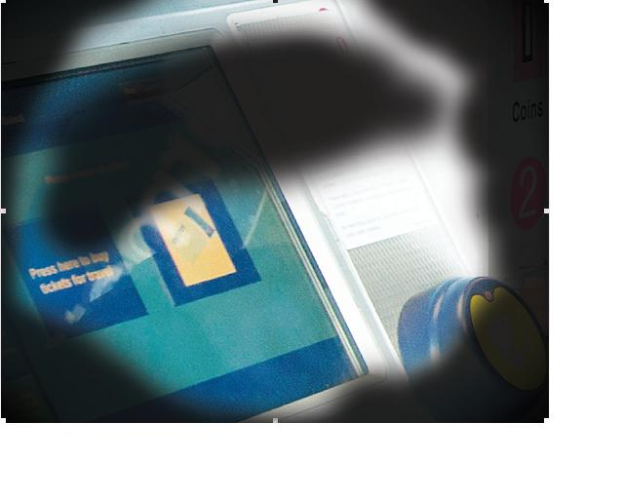
Visual Impairments
A decrease in the ability to see to a certain degree that causes problems not fixable by usual means, such as glasses.
In the US, 4 terms describe different levels of vision impairment and blindness:
  Partially sighted= person has partial vision, either in one or both eyes.
  Low vision= severe visual impairment in which visual acuity is 20/70 or poorer in the better-seeing eye and cannot improve with glasses or contacts (examples on right).
  Legally blind= a person has a corrected vision of 20/200 in their best-seeing eye.
  Totally blind= complete loss of sight.
Diabetic retinopathy can cause blurred or patchy vision
Glaucoma can result in tunnel vision, where all side vision is lost, and only central vision remain.
Notes:
Legally Blind: If visual aids such as glasses can correct a person’s vision to 20/20, they are not considered legally blind.
Blind walking Stick
A white cane is a device used by many people who are blind or visually impaired. A white cane primarily allows its user to scan their surroundings for obstacles or orientation marks, but is also helpful for onlookers in identifying the user as blind or visually impaired and taking appropriate care.

Slide 15
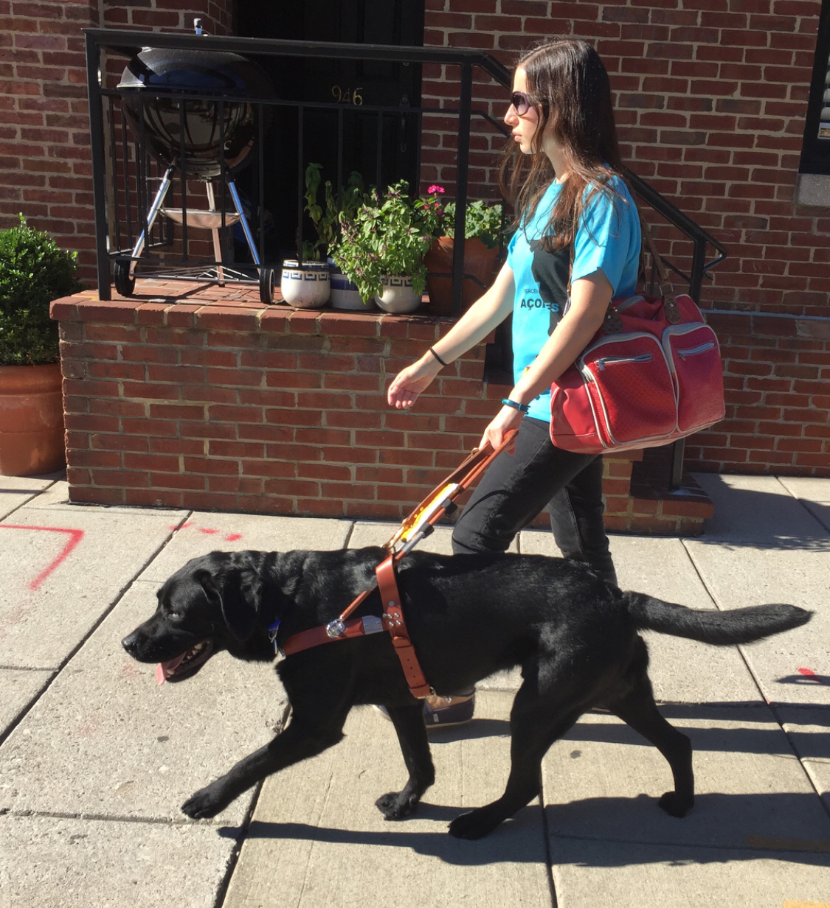
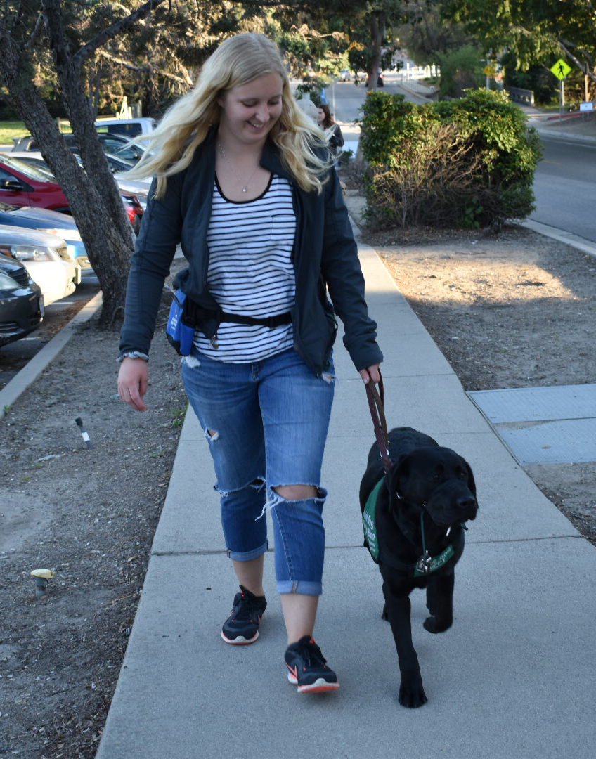
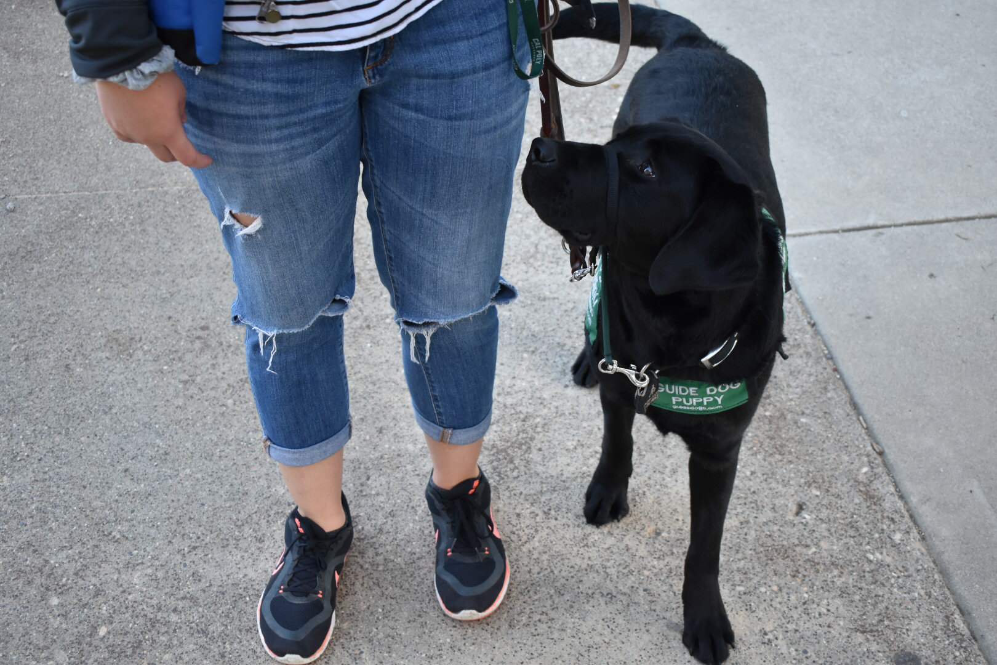
Guide Dogs for the Blind
Notes:
Initial cost for Guide Dog = $50,000. Ongoing cost = $1,200 a year. Estimated working span = 8 years. Total cost for a guide dog = $59,600.

Slide 16
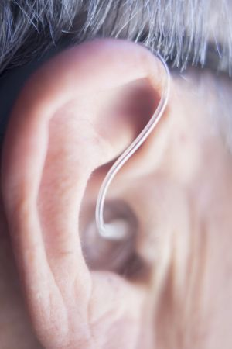
Hearing Impairments
Hearing impairment, deafness, or hearing loss refers to the total or partial inability to hear sounds.
  Mild: problems understanding speech, especially if there is a lot of noise around.
  Moderate: may need a hearing aid.
  Severely deaf: rely on lip-reading to communicate with others.
  Profoundly deaf: can hear nothing at all and can find themselves totally reliant on lip-reading or sign language.
​
Hearing aids = wearable devices that assist hearing. Do not cure deafness but amplify the sound that enters the ear so that the listener can hear more clearly.​
ASL (American Sign Language)- language that uses signs made with the hands, facial expressions, and body postures, but no sounds.

Slide 17
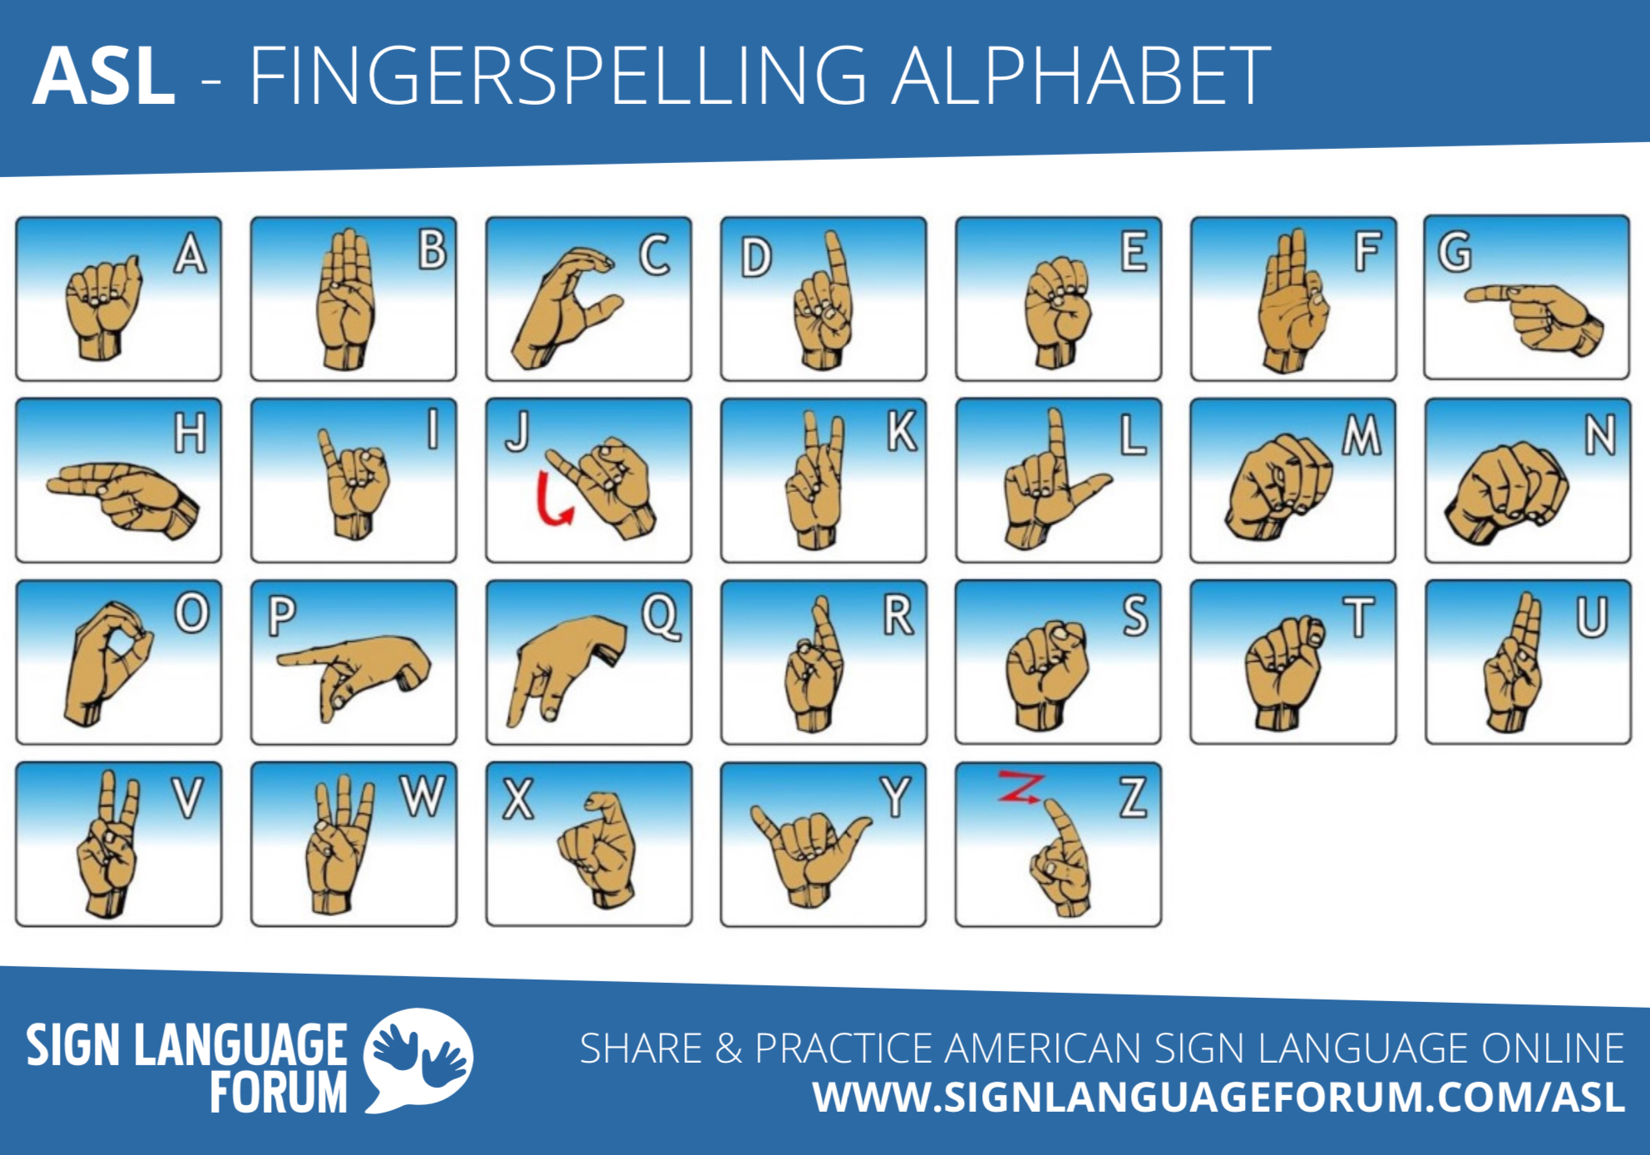

Learn How to Sign Your Name!
Notes:
KIARA

Slide 18

First U.S. Signing STarbucks- Inclusivity & Accessibility
https://www.sacbee.com/news/nation-world/national/article220514425.html
Notes:
HAILEY
https://www.sacbee.com/news/nation-world/national/article220514425.html

Slide 19
Mental & Physical Disabilities
Notes:
HAILEY

Slide 20
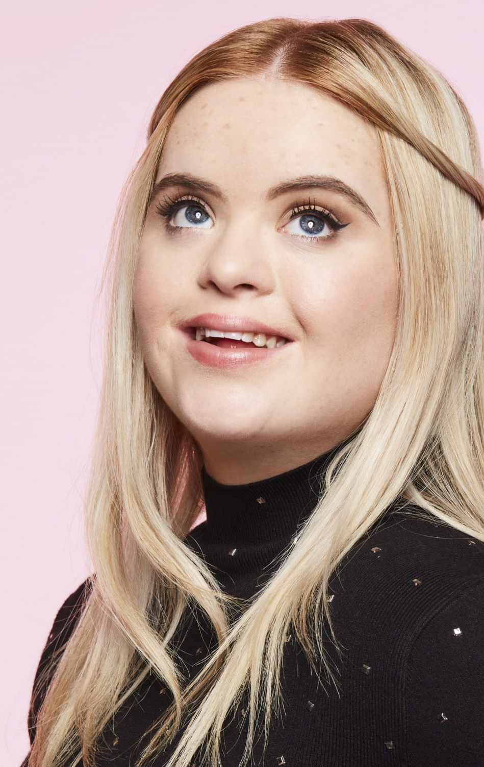
Down Syndrome
Chromosomes: small packages of "genes" in the body.
  Determine how a baby’s body forms during pregnancy and how the baby’s body functions as it grows in the womb and after birth.
Condition in which a person has an extra chromosome, called chromosome 21
  This extra copy changes how the baby’s body and brain develop, which can cause both mental and physical challenges for the baby.
  Occurs in about 1 in every 700 babies.
Most people with Down Syndrome have cognitive delays that are mild to moderate.
Individuals with Down syndrome are living longer than ever before.
Notes:
HAILEY
A top model with Down’s Syndrome is blazing a trail for others with disabilities, her mother said.
Kate Grant, 20, from Cookstown in Co Tyrone, has become a brand ambassador for cosmetics giant Benefit.

Slide 21
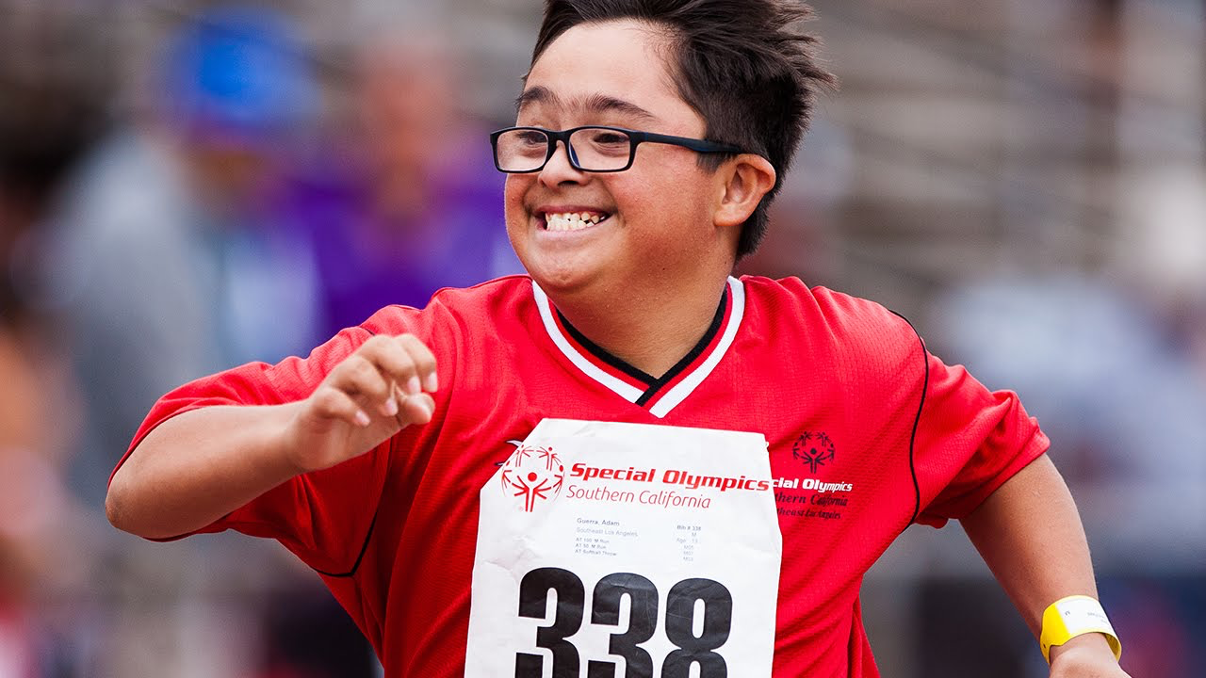

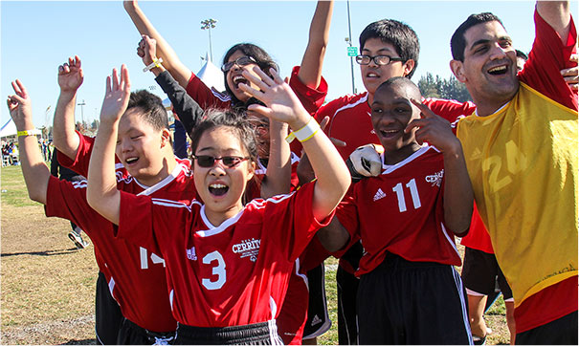
Special Olympics
Notes:
KIARA
Special Olympics athletes are people who are 8 years old or older and who have an intellectual disability. There is no upper age limit, and in fact, nearly one-third of our athletes are age 22 or older.
Whole Group Share: Does anyone have any volunteer or work experience with organizations, similar to Special Olympics or Guide Dogs for the Blind, that works with people with disabilities?

Slide 22
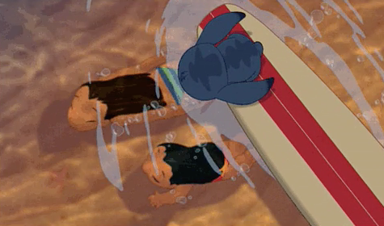
Scavenger Hunt!
We will give everyone an incorrect term for a disability on a notecard.
Posted and Hidden around the room are the matching, correct terms for that disability.
If you need help, ask us or those around you for advice.
We will have 3 minutes to complete this activity, then we will ask a few people if they want to share out their match.
Any questions?
Notes:
Person-first language
o Make sure to put the person first, not the disability
o Say “the PERSON/CHILD with a disability” not “disabled child”
➢ Avoid using labels
o Labels are debilitating
o Labels make people more aware of the difference
➢ Positively acknowledge differences
o Find ways to celebrate/include differences when appropriate and possible

Slide 23
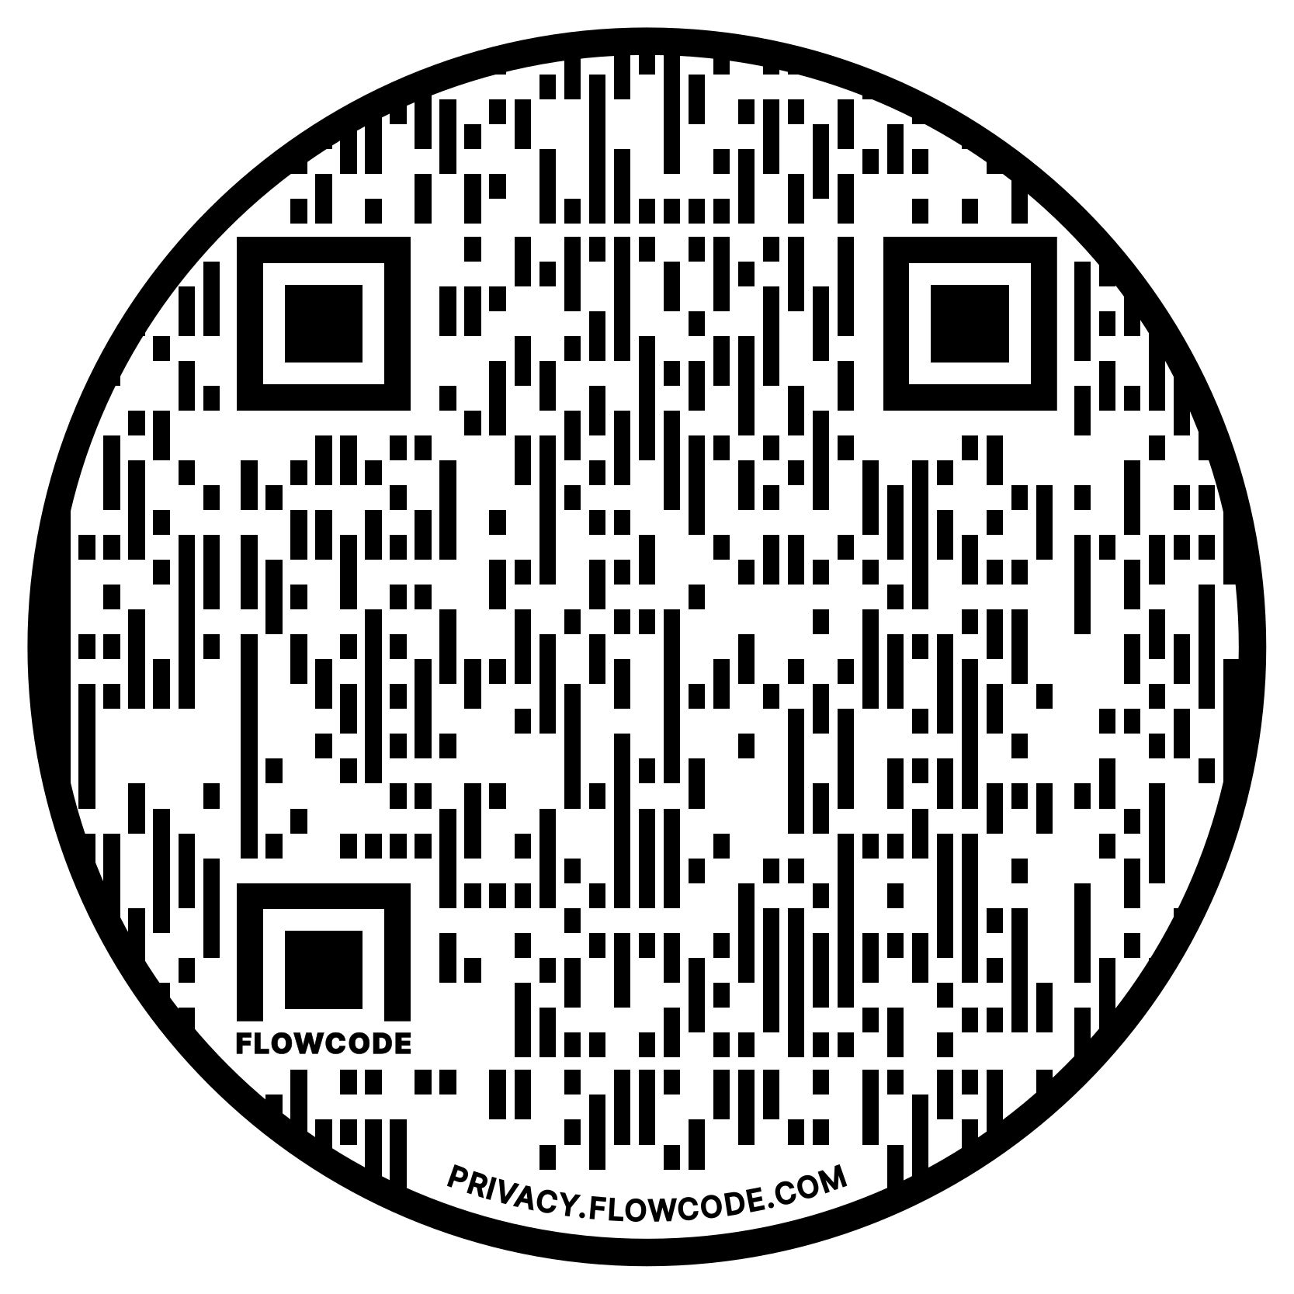
Disability Terminology Chart
Notes:
KIARA / music for 30 sec for people to read over the terminology chart
Person-first language
o Make sure to put the person first, not the disability
o Say “the PERSON/CHILD with a disability” not “disabled child”
➢ Avoid using labels
o Labels are debilitating
o Labels make people more aware of the difference
➢ Positively acknowledge differences
o Find ways to celebrate/include differences when appropriate and possible
Group Share: Have a few students identify an appropriate/inappropriate term that surprised them.

Slide 24
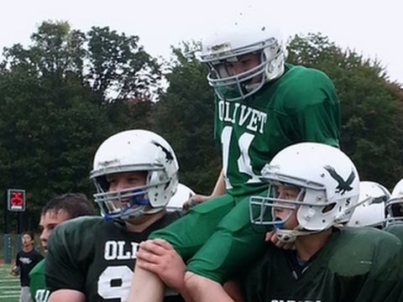
https://www.upworthy.com/watch-an-entire-team-of-teenage-football-players-do-something-very-unexpected
Notes:
HAILEY
So how did that make you feel or what you gained from that video?

Slide 25
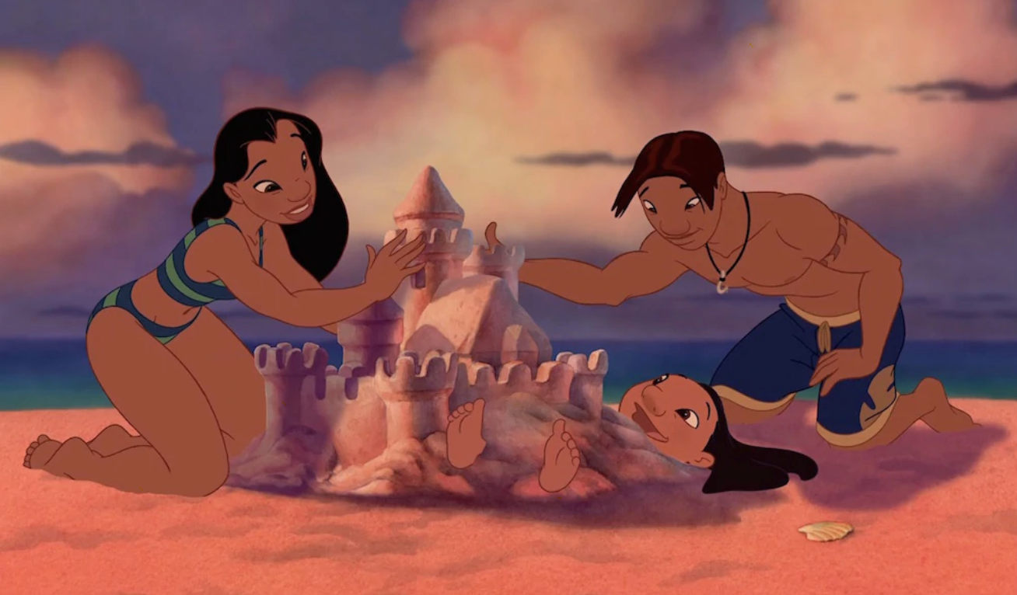
Strategies for Inclusion
Ask for as much information as possible on registration forms to ensure that you are prepared - allows you to provide reasonable accommodations
Setting ground rules prior to activities to address the whole group rather than specific people in minority groups
When dividing large groups into smaller groups, don’t divide them based on identifiers such as gender, race, age, ability, etc.
Make sure the room or facilities are Americans with Disabilities Act (ADA) friendly
Seek help from your advisor or campus resources for assistance
Notes:
KIARA
Surveys Ex: If you know that some attendees have Allergies, you can prepare alternative meals
Possible questions: Do you have any dietary restrictions? Do you need any special accommodations?
Ground rules Ex: If you're doing an icebreaker, set groundrules to address the whole group, not specially
Dividing groups good Ex: types of shoes, birthdays, coffee vs tea, favorite fruits, wearing jewlery or not
DRC- disability resource center

Slide 26
ADA Friendly Room Setups
For a School or Classroom Setting
Do's
Don'ts
Flexibility in use
Simple and intuitive use
Perceptible Information
Low physical effort
Adequate size and space for 'approach and use' into design of a facility
Narrow entrances
Hard to open doors
No wheelchair-accessible tables available
Non-flexible classroom layout
Non-accessible information
Non-accessible parking
Notes:
KAIRA
The actual standards are very specific and complicated, if you need them you can find them online or ask us for them separately.

Slide 27
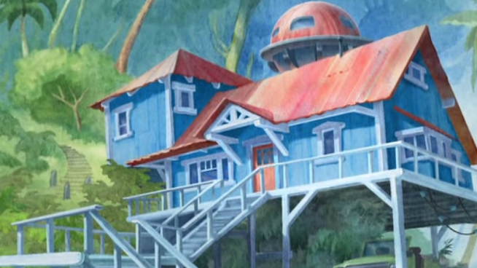
Notes:
HAILEY
- stairs make it unable to access
- door makes it difficult to get inside

Slide 28
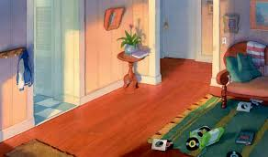
Notes:
Hailey
- hall looks narrow, especially for someone in a wheelchair to turn around
- make sure the rugs are down
- Don't have things strewn around the floor.
- lightswitch are good because at appropriate level.
- is coat hanger low enough for someone in wheelchair to access.

Slide 29
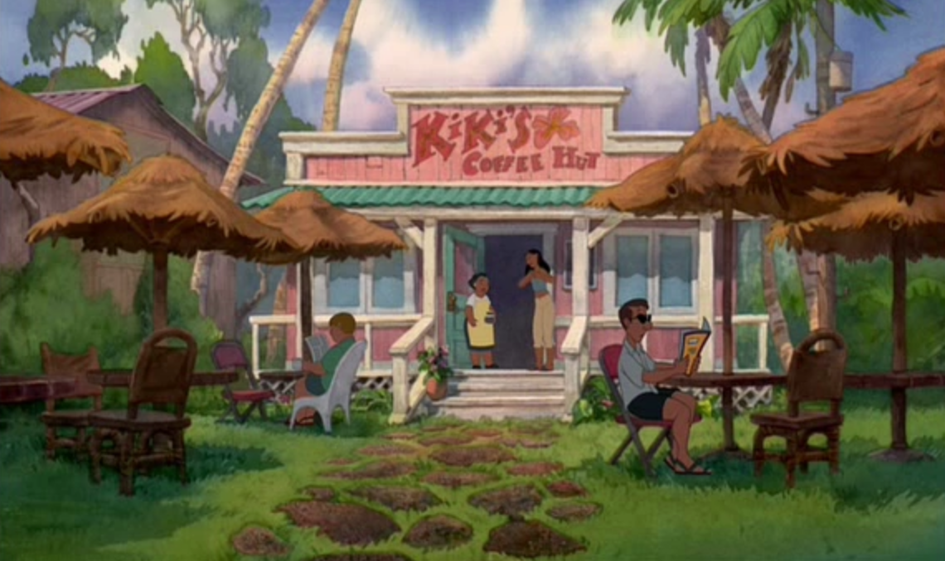
Notes:
HAILEY
- stone path
- outdoor seating- tables are very close to one another
- if there are stairs, there should also be a ramp.

Slide 30
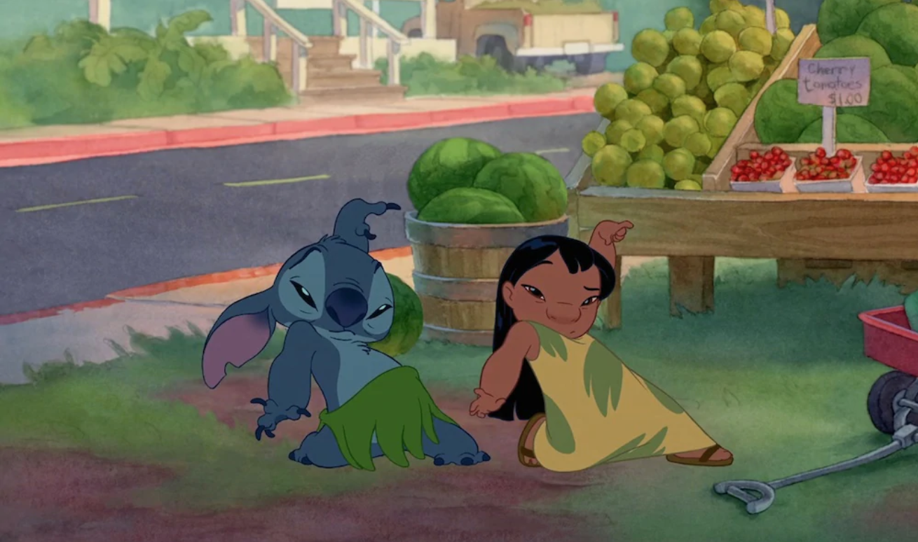
Kahoot Review Activity
Notes:
https://create.kahoot.it/details/78324a8f-2567-4ed8-8c01-b61f3e89b541
NEW LINK BELOW
https://create.kahoot.it/share/leadership-in-diverse-groups/78324a8f-2567-4ed8-8c01-b61f3e89b541

Slide 31

Sources
https://www.msjc.edu/asc/documents/ADA_Requirements_for_Classroom_Seating.pdf
Jordan, D. & Ramsing, R. (2017). Leadership in leisure services: Making a difference (4th Edition). State College, PA: Venture Publishing, Inc.
Anderson, L. & Kress, C. B. (2003). Inclusion: Including people with disabilities in parks and recreation opportunities. State College, PA: Venture Publishing, Inc.
Notes:
- make sure the videos are working, cut them to be only the parts we want
- prepare the slides we are presenting

Slide 32

Want to Share This Presentation?

