Slide 1
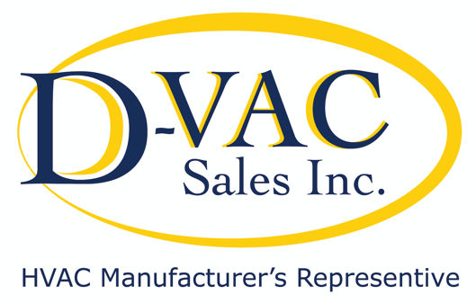

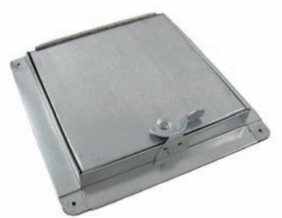
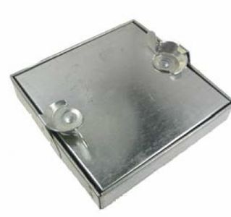
NEWS & MORE
VOL. 1, ISSUE 5
September 2020
AirZoe's access door with tab lock frame is used to access the inside of rectangular ductwork.
Double paneled with front and back metal plates, and 1” insulation.
AirZoe's Press On Hinge & Cam (H) is used to provide easy access into rectangular ductwork. Double paneled with front and back metal plates, and 1” insulation
Galvanized Embossed & Insulated Case 7/8 OD Sweat Connections Horizontal or Vertical Installation High Performance
2 Year Warranty
H2O Coil # | Width | Height | Depth | Supply | Conn
HPX-2-1425 | 14 ¼” | 10” | 22’ | 12 ½” X 19” | 7/8 OD
HPX-2-1750 | 17 ½” | 10” | 22” | 15 ½” X 19” | 7/8 OD
HPX-2-1975 | 19 ¾” | 10” | 22” | 17 ¾” X 19” | 7/8 OD
HPX-2-2125 | 21 ¼” | 10” | 22” | 19 ¼” X 19” | 7/8 OD
HPX-2-2250 | 22 ½” | 10” | 22” | 20 ½” X 19” | 7/8 OD
HPX-2-2450 | 24 ½” | 10” | 22” | 22 ½ X 19” | 7/8 OD
SALES@DVACHVAC.COM
D-VAC
516-256-1313
200B VERDI STREET
FARMINGDALE NY 11735

