Slide 1
2022 Freedom Rights Movement Stakeholder Engagement Strategy & Communications Plan v.5

Slide 2
Document Control
DOCUMENT CONTROL
Document Owner |  | Bath-Sheba van den Berg |  | Location master version document - Laptop
About this version |  | Issued as draft following feedback from Keith Wilson and Eva Chipiuk
Document History
Version Number | Summary of changes made |  |  |  |  | Author |  | Revision Date
V08 | Eva Edits and photos added |  |  |  |  | Bath-Sheba van den Berg |  | Oct 16, 2022
Distribution
Limited to: Eva Chipiuk Keith Wilson Stu Bethan/Jerome O’Sullivan Chris Barber Tamara Tom M Danny Bulford

Slide 3
Purpose, Scope and Objectives
To provide a baseline of a consistent narrative for horizontal human-sourced information (H-Info) stakehodler engagement
To translate legal ease of POEC into layperson language
To defeat the mainstream media and far left narrative
Understand the extent to which each stakehodler group is likley to be impacted by POEC
Strategy for engagement of stakeholder groups in the 2022 Freedom Rights Movement
Communications plan

Slide 4
Engagement Strategy and Comms Plan Governance
Bath-Sheba van den Berg
Advisor
Eva Chipiuk
Lead
H-Info
Bethan/Jerome
Tom/Danny
Freedom Board
Keith W
Stu
Circles of Influence (Alternative Media Networks, Social Media Platforms and H-Info)

Slide 5
2022 Freedom Rigths Movements Stakehodler Map
External
Executive (government)
Mainstream media
Medical Experts
Commercial Interest Groups
2022 Freedom Rights Movement
External influence
Freedom Convoy
People of Colour
Truckers
Protestors
Veterans
Ordinary Canadians
NGOS
CFN
CCF
CCLA
New Democracy Fund
Human Rights Commission
Veterans for Freedom
Police on Guard
Justice Centre
Legal Processes
Criminal Charges
Misconduct case
Judicial Reviews
Loss of livelihood
POEC
Charter Rights
Employment Rights

Slide 6
Freedom Rights Movement External Stakeholder Groups
Government
Foreign influence groups & foreign governments
Bigpharma
Commercial groups
Political elite
Billionaires
Some civil servants
Canadians
Political parties
Anti-anti-vaxxers
Anti-protestors
Pro-hate groups
Anti-Hate network
Mainstream media
Medical Experts
Judges

Slide 7
Freedom Rights Movement Internal Stakeholder Groups
Families
Fathers
Mothers
Youth
Some civil servants
Alternative media groups
Freedom Convoy
Truckers
Ordinary Canadians
Working class
Minorities Group
Politicians
Lawyers
Doctors and Nurses (medical personnel)
Veterans
Active Military Personnel
Police
NGO
Quebecers
Indigenous
Metis

Slide 8
2022 Freedom Rights Stakeholder Prioritisation (not completed – for understanding only)
Government Opposition
Freedom Convoy Group Lawyers
High
Jeremy Mackenzie
Address concerns
Active full-time involvement
EA JR Lawyers
General Population
Alternative Media
Trudeau/Cabinet
Impact
of the programme on this stakeholder or group
Medical Experts
Press / Media
Keep informed
Partial involvement
Jayne Scharf
Low
Low
Influence
of this stakeholder or group on the success of the programme
High

Slide 9
Communication Needs for 2022 Freedom Rights Movement stakeholders
Address Concerns
Active full time involvement
Impact
Active full time involvement
Keep Informed
Partial Involvement
Keep informed
Address concerns
Partial involvement
Influence
COMMITMENT
INVOLVEMENT
SUPPORT
UNDERSTANDING
AWARENESS
Quadrant 1
Quadrant 2
Quadrant 3
Quadrant 4

Slide 10
Alignment of Freedom Rights Movement Communication Tools
Address concerns
Active full time involvement
Targeted briefings/tweets
Regular 1:1 meetings
discussion forum
Respond to their influences
Daily social media activity with consistent messaging
Impact
of the 2022 Freedom Rights Movement on this stakeholder or group
Quadrant 2
Quadrant 4
Keep informed
Partial involvement / Active engagement
Q&A
Interviews (social media)
Video production
Respond/engage for dialogue if beneficial
Quadrant 1
Quadrant 3
Influence
of this stakeholder or group on the success of the 2022 Freedom Rights Movement

Slide 11
Communication Channels Explained
The Channels where information regarding the 2022 Canadian Freedom Rigths Movement is most frequently streamed, the good, the bad and ugly.

Slide 12
Communication Channels - Youtube
Rupa, Tom Marazzo, Viva Frei, Dean Blundell, True North, Rebel, Jordan Peterson, Russel Brandt, Fox (Tucker Carlson), Unheard, V4F, JP Morgan, Live from Shed, Emergencies Act Inquiry (Stu), Canadians for Truth , the Post millennial , Joe Rogan, Bridge City News, Breaking Point, Clyde Do Something,

Slide 13
Communication Channels – Facebook
Freedom Convoy, Jayne Scharf

Slide 14
Communication Channels - Rumble
Viva Frei

Slide 15
Communications Channels - Twitter
Benjamin Dichter, Andy Lee, Clyde Dosomething, Stu (PETRIFIED COVID PARENT, Justin Trudeau's Ego), Live from the Shed, Emergencies Act Inquiry (Stu), Ezra Sheila Gunn Reid, Viva Frei, Bridge City News, Canadians for Truth (Theo Flurry), Jamie Sale, Nadine Ness, Keith Wilson, Eva Chipuik, Freedom Convoy 2022, Tom Marazzo, Keean Bexte (counter-signal), Tom Quiggin, Andrew Lawton, Canada Proud, The Pleb (truckdriverpleb), Harrison Faulkner (Truth North journalist) Elie Cantin-Nantel (French Canadian true north), Maxime Bernier, Vishnu Gupt (patriotic canadian), Canada Marches (James Topp), Honking for Freedom (BJ Dichter); The democracy fund; Free to Fly - fighting for gods freedom); Jay Bhattarcharya, Julie Ponesse, the Court Cat (report on court cases) Bruce Pardy, The post millennial, David Amber (criminal Lawyer), Brett Wienstan, Rupa S, Derek Smith

Slide 16
Communication Channels - Substack
Margaret Anna Alice, Tessa Lena

Slide 17
Communication Channels - Instagram
POC4FreedomConvoy, Police on Guard for Thee, CFN, Roman Barber, Freedom Convoy 2022 (not our clients), Canada Proud, Rob Primo

Slide 18
Communications Channels - TikToc
Jeremy Mackenzie (Ragingdissident), Chris Barber, Palminder Singh, Brigette Belton, PPL Watcher, PatriotSmoothie, Indie News Now, Freedoms for Freedom, Freedoms fight for Canada (Bethan)

Slide 19
Communications Channels - Tumblr
Any noteworthy?

Slide 20
Communications Channels – Vimeo
Any noteworthy?

Slide 21
Communications Channels - LinkedIn
Any noteworthy?

Slide 22
Communications Channels - bloggers
Susan Stanfield, Anti Hate Network, Rex Murphy

Slide 23
Mainstream Media
Rupa Subramanya (National Post), Brian Lilly, Rachel Aiello, Rachel Gilmore

Slide 24
International News
BBC
New York Times
New York Post
Fox News
Sky News
The EPOCH Times

Slide 25
Communications Approach
Proposed messaging for stakeholder groups
The messages will be consistent for all stakeholder groups
There will be a baseline set of vocabulary to employ irrespective of context (lexicon)
The frequency of messaging will be organic (cannot control viral nature of H-Info on social media platforms)
Preferred cadence: daily dialogue, hashtags, take up space with messaging, twice weekly interviews, blogs
Promotional material (production)

Slide 26
2022 Freedom Rights Movement Stakeholder Defined
The 2022 Freedom Rights Movement is the umbrella term that includes anyone and everyone that disagreed with the government approach to and measures in managing the control of the spread of COVID-19 (the overreach, going too far, oppresive, suppresive)
Our narraitve: inclusive and spectrum approach
Governement Measures/Approach/Actions (examples)
Lockdowns
Mask mandates (masks exemptions)
COVID-19 vaccination mandates (medical exemption's)
Definition of ‘fully vaccinated’
Boosters campagin
Isolation / quarantine
Travel restrictions
Employment conditions
Loss of livelihood

Slide 27
Audience
The audience is anyone on the spectrum of positioning vis a vis the government COVID-19 measures
There is no left or right – only a spectrum that can include mixed positions (e.g. pro-COVID-19 vaccine, anti-mask, pro-COVID-19 vaccine for adults and only 2 doses, anti-booster and anti-COVID-19 for children

Slide 28
Audience
The biggest audience are those who believe that ‘enough is enough’
The only ‘them and us’ is those who supported EA invocation versus those who did not.

Slide 29
Lexicon – The Freedom Rights Movement
2022 Freedom Rights Movement or Freedom Rights Movement
Canadian Protestors
Families
Diverse (different ethnic, religious backgrounds, ages, professions, economic classes, gender, gay pride flag)
Indigenous Participation
Not Organized, instead it was Coordinated like a Logistical Operation in a Humanitarian Aid/Relief situation, or Volunteer (Volunteer Lead)
Logistic Rooms
Variety of different Not For Profit and NGOs present
Different Factions vying to help
Peaceful protests
Humanitarian relief
Peaceful political dissidents

Slide 30
Lexicon – The Hurt / Grievances
Togetherness – Broken/divided
Hope – Taken away
Future - Uncertainty
Canadian Civilians – Punished by government violence and state sponsored use of force
Victims – We are all victims

Slide 31
Lexicon – The Hurt / Grievances
Cruel Treatment and Punishment
Suffered Loss – Irrevocable loss (health, mental health, financial loss, family and friends, reputation)
Harm and damages suffered
Threats, hate and incitement of hatred (anti-protestors, media, PM)
Defamatory statements

Slide 32
Lexicon – Government Violence/Use of Force against innocent civilians
Police Blockades
State sponsored violence towards its people
RCMP appeared and act like paramilitary forces
Sawed off wooden dowels used to beat people with
Rifle pointed at women’s heads
Beaten with a rifle
Media systemic racism (by not covering stories from ethnic, religious and other monitory groups)

Slide 33
Lexicon – Government Violence/Use of Force against innocent civilians
Police horse trampled indigenous woman
Excessive and cruel use of force
Cruel punishment
Inhumane treatment
Handcuffed protestors and drove them 30 minutes away in minus 25 temperatures with no access to public transportation
Frozen bank accounts (cannot pay bills, bad credit score, cannot buy medicine for children)
Physical injuries
Post Traumatic Stress
Loss of livelihood, financial and economic violence
Dehumanized

Slide 34
Messaging Approach
Always refer to 2022 Freedom Rights Movement or Freedom Rights Movement as the overall, so when talking about the Truckers or Convoy be sure to include that they are groups or elements of the overall 2022 Freedom Rights Movement (could be a catalsyt but was more the vehicle, an embodiment of hope for people that considered that the government had overreached in its approach to managing COVID-19.
Always refer to COVID-19 vaccines (not just vaccines)
Avoid using term ‘pandemic’ and instead focus on the words of the measures used by the government (always bring focus to government actions, that is approach and measures).

Slide 35
Messaging Approach
When discsussing the Freedom Convoy or the Jan-Feb Ottawa Protests, include wording: grassroots, not organised, spontanoues, organic, a movemnet of ordinary people coming together in response to government’s COVID-19 measures (not just mandates, but measures, actions, approach)
When mentioning ‘truckers’ include ‘ordinary Canadians’, families, working class, upper class, minority groups, people of colour, indigenous.
No national security problem

Slide 36
Messaging Approach
Be empathetic
No name calling
Consider the other side, avoid telling poeple that they are going to die because of the COVID-19 vaccines
Avoid the fear, spreading fear
Hang onto hope and appeal to hope and ’togetherness’ - our Canadian values make up our Canadian identity (see next slide)

Slide 37
Canadian Identity = Canadian Values
Human dignity, togetherness, inclusive, multicultural, hardworking, community, compassionate, helping, volunteer, innovators (no canadian identiy – many nations), freedom (true north strong and free) - honesty
Despite our differences, we worked together.
Redefine and Reaffirm our Canadian identify
Opportunity to understand collectively what it means to be Canadian

Slide 38
Togetherness
Both sides of the coin – that is the pro and anti both value togetherness
Friendships
Sincerity
Effort
Right to Livelihood (everyone)
Stability and Certainty
Kindness
Compassion

Slide 39
Find common ground – a healing plan
We all want to be healthy
We all want to live a meaningful and fulfilling life
We all want to provide for and spend time with our families
We all want to be happy
We all lost something
We are all hurting
What can we do work together again while respecting each other differences? What common ground do we have?
Stop the punishment
Stop the suffering
Stop the dehumanization of our neighbours

Slide 40
Rhetroic to being called a minority group
The 2022 Freedom Rights Movemnet includes minorities groups, that is people of colour, ethnic minorities, religious minorities, indiegnous, metis
History tells us that the majority never advanced humankind
Examples of selfless leadership, minority voice that suffered for the sake of advancing freedom rights: Gortius, Mandela, Maclom X, Ghandi, Rosa Parks, Wangari, Lionel Johnson, Viola Damson, Arunchalam Muruganantham (Padman)
They all remind us of our humanity, the importance of human dignity, alleaviate human suffering, live free from punishment and value togetherness

Slide 41
Hurt Caused by Government approach to managing COVID-19
Name-calling
Divided people, divided families
Caused suffering, to everyone (irrespective of COVID-19 vacciation status)
Attacked the livelihoods of people
Punishing
Changed Canadian culture from valuing freedom rights to punishing, hurting and hating members in our community
Incited hatred
Incited fear and intimidation
Insincerity

Slide 42
A borrowed message from Lisa Bildy
“Stability is important right now. People who have been through hard times often experience moral clarity and growth in character. If that is you, use it to speak truthfully and bodly, but not cruelly . Help others find their humanity and build bridges where possible…
This is not the time to be accelerationist or seek revenge. It is however a time for accountability, and we should not ‘move on’ without acknowledging and learning from the mistakes that have been made. Tenacity and dogged determination are needed, but so is discernment.”

Slide 43
A borrowed message from Pierre Pollievre
“I don’t think the political class understands how much suffering there is in this country right now…. The political class has had a wonderful two years. They have had an unbelievable amount of power and a tremendous amount of comfort. All of their homes have gone up 50% in value and their stock portfolio up until recently has been inflated. So they are looking down at the working class as “what are you complaining about, you have never had it so good?” That is the exact opposite for the working folks. If you don’t own a home before 2019 likelihood you will never own a home. They are looking for an explanation and for hope.
People feel like they have lost control of their lives and there are devastating personal consequences to it. When they speak out or hold a protest, instead of the PM saying, “you know what, I know your suffering, I’m sorry we will work harder to make your life better.” What he says is your a nasty, fringe element. So people feel like they are under attack from a big bullying government that takes their money and tells them what to do.
It was absolutely unscientific and malicious. If anyone is going to spread a virus, it’s sure as hell not the guy whose siting alone all day in a truck. It was never about medical science, it was about political science. It was about demonizing a small minority for political gain.”

Slide 44
Q & A on POEC – What it is
The Public Order Emergency Commission is a public inquiry governed by the Emergencies Act and set per section 63 of the Emergencies Act which states that
  63 (1) The Governor in Council shall, within sixty days after the expiration or revocation of a declaration of emergency, cause an inquiry to be held into the circumstances that led to the declaration being issued and the measures taken for dealing with the emergency.
  Marginal note: Report to Parliament
  (2) A report of an inquiry held pursuant to this section shall be laid before each House of Parliament within three hundred and sixty days after the expiration or revocation of the declaration of emergency.
***THIS IS THE REAL LEGISTLATED MANDATE FROM THE EMERGENCIES ACT.***

Slide 45
Q & A on POEC – How it works and timelines
The public inquiry will be a little like court, but a less formal.
It will take place from October 13 to November 25 at the Library and Archives building in downtown Ottawa.
The inquiry will be televised and reported on by various legacy media and alternative media outlets.
We encourage everyone in Canada to watch to learn about the events that lead to the federal government invoking one of the most powerful tools they have to use. You can visit the POEC website: Public Order Emergency Commission (POEC)
The outcome of the POEC will be a Report which is due on February 20, 2023.
Justice Paul Rouleau has been selected as the Commissioner at the public inquiry. Justice Rouleau is a Court of Appeal judge in Ontario.

Slide 46
Q & A on POEC – The Mandate/Mission
On April 25, 2022 the Governor in Council (the executive branch, government) set up the POEC by way of an Order in Council with a mandate that is different than what is stated in section 63 of the EA.
The April 25, 2022 Order states that:
  direct the Commissioner to examine and report on the circumstances that led to the declaration of a public order emergency being issued by the federal government and the measures taken by the Governor in Council by means of the Emergency Measures Regulations and the Emergency Economic Measures Order for dealing with the public order emergency that was in effect from February 14 to 23, 2022.
  direct the Commissioner to examine issues, to the extent relevant to the circumstances of the declaration and measures taken, with respect to
  the evaluation and goals of the convoy and blockades, their leadership, organization and participants,
  the impact of domestic and foreign funding, including crowdsourcing platforms,
  the impact, role and sources of misinformation and disinformation, including the use of social media,
  the impact of the blockades, including their economic impact, and (E) the efforts of police and other responders prior to and after the declaration, (iii) direct the Commissioner to set out findings and lessons learned, including on the use of the Emergencies Act and the appropriateness and effectiveness of the measures taken under the Emergency Measures Regulations and the Emergency Economic Measures, and to make recommendations, as pertains to the matters explained in the Public Inquiry, on the use or any necessary modernization of that Act, as well as on areas for further study or review, […]”
***NOTICE THIS IS QUITE DIFFERENT THEN WHAT IS REQUIRED UNDER SECTION 63 OF THE EMERGENCIES ACT***
Commissioner Rouleau mentioned it in his Opening Remarks that they have 2 mandates (s 63 and Order)

Slide 47
Q& A on POEC – Our Narrative/The Question
The purpose of the POEC is to uncover whether or not the government was justified in invoking the Emergencies Act.
Whether there were reasonable and probable grounds to invoked the Emergencies Act
Section 2 of the CSIS Act must be satisfied in order to invoke the Emergencies Act - there must be ‘threats to the security of Canada’ listed generally as: 1. espionage or sabotage, 2. foreign influenced activities detrimental to Canada, 3. threats or use of acts of serious violence for purposes of achieve political, religious or ideological objectives in Canada (IMVE), or 4. sedition/subversion
Section 2 of CSIS Act states:
  threats to the security of Canada means
  (a) espionage or sabotage that is against Canada or is detrimental to the interests of Canada or activities directed toward or in support of such espionage or sabotage,
  (b) foreign influenced activities within or relating to Canada that are detrimental to the interests of Canada and are clandestine or deceptive or involve a threat to any person,
  (c) activities within or relating to Canada directed toward or in support of the threat or use of acts of serious violence against persons or property for the purpose of achieving a political, religious or ideological objective within Canada or a foreign state, and
  (d) activities directed toward undermining by covert unlawful acts, or directed toward or intended ultimately to lead to the destruction or overthrow by violence of, the constitutionally established system of government in Canada,
  but does not include lawful advocacy, protest or dissent, unless carried on in conjunction with any of the activities referred to in paragraphs (a) to (d). (menaces envers la sécurité du Canada)
***THE PROTEST DID NOT MEET ANY OF THOSE CRITERIA AND THERE WERE NO FACTORS TO SUGGEST OR POINT TO ANY OF THESE***

Slide 48
Commissioner Rouleau’s Opening Comments
“Uncovering the truth is an important goal. When difficult events occur that impact the lives of Canadians, the public has a right to know what happened.”
"A commission's recommendations may be modest or wide-ranging. They may be directed at a range of audiences, including government, public bodies and the private sector.”
"It's also important to understand what commissions of inquiry do not do. They do not make findings of legal liability. They do not determine whether individuals have committed crimes. While inquiries seek to uncover the truth, they are not trials. Questions of civil and criminal liability are decided by courts and not commissions."
“While this is not an adversarial proceeding, I recognize that different points of view will be forcefully advanced.”
“This is to be expected and will help ensure that a clear picture of the events is presented and the decisions made or not made by key actors are fully analyzed.”
“While this is not an adversarial proceeding, I recognize that different points of view will be forcefully advanced. This is to be expected and will help ensure that a clear picture of the events is presented and the decisions made or not made by key actors are fully analyzed.”
Great to use his own words to describe the process, limitations, expectations, etc.

Slide 49
Q& A on POEC – Who is participating
20 Participant groups (with approx. 40 Participants in total) have been granted direct standing to participate in the POEC. This means that they can present evidence, provide testimony, call witnesses and cross-examine POEC witnesses.
Granted standing: Government of Canada, Government of Alberta, Government of Saskatchewan, Government of Manitoba, City of Ottawa, City of Windsor, Ottawa Police Service, Ontario Provincial Police, Canadian Association of Chiefs of Police, National Police Federation, Peter Sloly, Freedom Rights Group (Tamara Lich, Chris Barber, Daniel Bulford, Tom Marazzo, Sean Tiessen, Miranda Gassinor, Joseph Janzen, Dale Enns, Ryan Mihilewicz and Freedom 2022 Human Rights and Freedoms not-for-profit- corporation, Ottawa Businesses (Action Sandy Hill, Byward Market Business Improvement Area, Lowertown Community Areas, Sparks Street Business Improvement Area, Vanier Business Improvement Area and Vanier Community Association), Insurance Bureau of Canada, The National Crowdfunding and Fintech Association, Canadian Constitution Foundation and Professor Ryan Alford, The Democracy Fund with Citizens for Freedom and Justice Centre for Constitutional Freedoms, Canadian Civil Liberties Association, The Criminal Lawyers’ Association & The Canadian Council of Criminal Defence Lawyers.
There will also be witnesses, who are not necessarily participants who will provide written and oral testimony.

Slide 50
POEC - Your opportunity to tell the truth on harm/violence suffered as a result of the Emergencies Act having been invoked
The POEC is also a forum for Participants and Canadians to tell the truth about what people suffered and endured after the Emergencies Act was invoked including: police actions towards the people, including beatings, police blockades, kettling, and state sponsored violence.
It is a fact-finding process for six weeks, with a one week policy review.
It is an opportunity to tell the story so that this never happens again.

Slide 51
POEC – Tell the story of diversity, inclusion and representation of all Canadians
The POEC is also an opportunity to share with the world at large that the people present in Ottawa and around Canada who were silent supporters, active supporters, observers, and protestors.
That the 2022 Freedom Rights Movement was diverse, inclusive and representative of all Canadians, including race, ethnic background, indigenous, different religious backgrounds, sexual orientation, gay pride, age, grandparents, young families, economic class, the working class, the poor and underrepresented, the elite and wealthy, gender, men, women, nonbinary, people with disabilities.
All peoples participated from all backgrounds across the country, from every province and territory.

Slide 52
POEC – Tell the story of peaceful protestors and human rights or freedom rights defenders
That the protest was peaceful
Humanitarian aid relief
Volunteership
Happiness
Human rights defenders
Freedom rights defenders
Peaceful political dissidents
Using humour to understand

Slide 53
POEC – how to share your story - October 31, 2022 and Survey
Opportunity to share your views:
https://publicorderemergencycommission.ca/share-your-views/ and contact: freedomrightsca@prontonmail.com
It’s Go Time for the Public Inquiry – time for freedom loving Canadians to help ensure that the true comes out and that Trudeau’s and the legacy media’s lies do NOT prevail about the Freedom Convoy and what really happened – expose the abuses of government and put another nail in the Trudeau Liberal’s political coffin.
Live map volunteers needed – to do the view reviews and data entry to make the interactive map as complete as possible for all locations and dates and times from many angles – more footage needed too
Submit written statements to the Public Inquiry – go to Inquiry website – you make written submissions about how you were impacted by the mandates and how positive and important it was Canadians to come together in Ottawa last January and February to hold the line for our rights and freedoms, the Charter, and to say no to government overreach into our lives, jobs, families, and bodies.
Scope of Confidentiality Undertaking -- Only witnesses testifying and lawyers participating in the inquiry hearing have signed it – it only applies for when you have access to the database of documents from government and others – nothing that you know and would want to say is restricted now or in the future – anything that is already in the public domain is not restricted either – nothing will get destroyed
Please watch the Inquiry livestream – check the POEC website for details when announced – if you hear a government official lying and know of footage or anything that contradicts it let us know so we can get it to the legal team
We are going to be relying heavily on social media and doing daily reports about the events in the inquiry – please use your social media reach to get the information far and wide – we have to counter the BS narrative that the government and their captured legacy media will be spreading
Ottawa People’s Commission -- Encourage Ottawa residents/business who saw the convoy as a positive for Ottawa and Canada to attend and speak either in person or virtually in the Ottawa’s People’s Commission on October 5 at 7:00 pm. Please register and help get the truth out
WE REALLY WANT TO START ENCOURAGING PEOPLE TO EMAIL US DIRECTLY AT freedomrightsca@protonmail.com so we know exactly how many submissions we get in support. They can send directly to Commission as well. But please send a copy to us, we will then put it in a package for the POEC.

Slide 54
Other Q & A
Can PEOC be postponed? No. Pursuant to the Emergencies Act, a report must be produced within 360 days after the revocation and so the deadline for the report is Feb 20, 2023.
Factual Review vs Policy Review: The Public Order Emergency Commission also has a policy scope wherein it will be looking at all of the evidence, including expert evidence, in order to make policy-related recommendations. This is a consultative process and will be take place for one week after November 25, 2022, when the Factual Finding process has drawn to a close.

Slide 55
The Confidentiality Undertaking - 1
Only witnesses testifying and lawyers representing participants in the Public Order Emergency Inquiry have signed the Confidentiality Undertaking and it applies only to them
The Confidentiality Undertaking applies mainly to accessing the Public Order Emergency Database and documents produced to witnesses and their lawyers at the Inquiry so to protect any sensitive information that may be needed to be redacted (removed) before shared with the public as an exhibit
No documents or information are considered confidential that is already publicly
No documents or information can be destroyed that is already public
No documents or information can be destroyed or removed from their owner (the person who owns the documents and information)
The Confidentiality Undertaking does not apply to documents and information already in the possession of people
The Confidentiality Undertaking does not apply to documents and information that are publicly available

Slide 56
The Confidentiality Undertaking - 2
What witnesses testify orally at the Inquiry will not be considered confidential so long as already publicly available and not referring to information provided by the Inquiry which may be considered too sensitive to share with the public
The Confidentiality Undertaking does not prevent the participant or witness from discussing their information or experiences outside of the Public Order Emergency Commission
When a document becomes an exhibit (entered into evidence) at the hearing then the Confidentiality Undertaking no longer applies

Slide 57
Other Parallel Proceses
Judicial Review
Section 62 of the Emergencies Act Parliamentary Review (Parliament branch)
Ottawa People’s Commission
[enter others]

Slide 58
The Emergencies Act Judicial Review Federal Court case - What is that?
What is a Judicial Review? It is a mechanism of holding the government (executive branch) to account by taking a government decision to court for the judiciary (judges) to review and decided whether the government was justified in making that decision. If the court finds that the government was not justified in the decision, then the court can find that the government’s decision was ultra vires (outside the powers) or unlawful.

Slide 59
The Emergencies Act Judicial Review Federal Court case - Who?
After the government (the executive branch) invoked the Emergencies Act , there were four applications made to the Federal Court in Ottawa for a judicial review of the government’s decision to invoke the EA.
The four applications were brought by the following four groups:
  Canadian Civil Liberties Association
  Canadian Constitution Foundation
  Canadian Frontline Nurses and Kristen Nagle
  Four Persons: Jeremiah Jost, Vincent Gircys, Edward Cornell and Harold Ristau.
An application can only be brought by a person that has been directly impacted and suffered harm as a result of the government’s decision or an organization with public interest standing.
Edward Cornell and Vincent Gircys had their bank accounts frozen. Jeremiah Jost suffered physical harm and witnessed the horse trampling of the indigenous woman and Reverand Ristau suffered as a result of practicing his religious beliefs.
These four cases are being case managed together and a hearing has not yet been scheduled, perhaps in March 2023. The federal court in Ottawa will review all of the evidence available on the record regarding the government’s decision to invoke the Emergencies Act.

Slide 60
Some thoughts…
Canada is a country that does not support captial punishment, torture, inhumane treatment, insults, injury, or simply being mean to others - so if that stands true then how can Canada support police beatings and kettling of Canadian civilians?
There should be a zero tolerance always for state sponsored beatings of and violence towards civilians.
Rule of law and seperation of powers being tested, that is seperation of executive (cabinet, governor in council, prime minister), legislative (parliamenty, house of commons, senate) and judiciary (our courts).
Challenge with POEC, is that the executive is examining the actions of the exeuctive
Positive aspect of Judicial Review cases, the Judiciary examining the actions of the Exeuctive (independence)
Positive of the Parliamentary Review process (section 62 of EA) is that it is independent from Executive.
Checks and Balances in a democracy ….

Slide 61
Daily Rituals
Post live link to POEC on your feed/platforms and name the witness to be testifying
Consider your stakeholder engagement and priorities (interview, targeted messaging, online meeting/face-off to quell opponents)
Include targeted messaging as per these slides
Include target photos as per these slides (tbd)
Live posting during hearings
Daily digest - end of day

Slide 62
Their Narrative
Illegal protest
Insufficient municipal and provincial resources (police)
EA invocation justified because:
Violence (s.2c of CSIS act) – honking, idling, diesel, beating up a homeless person, microaggressions, trucks are weapons, breaking health regulations, economic loss (businesses, food industry)
Sedition (s2d of CSIS act) – MOU to overthrow the government, white supremacist, confederate flags, nazi flag, desecration of national monument and terry fox monument

Slide 63
Our Narrative - Who we are and why the protest
Peaceful protest, lawful protest (Charter Right)
Human/Freedom Rights defendants
Peaceful political dissidents
Protest objective: end all mandates, why? Because government went too far, enough is enough (overreach) and lack of accountability and transparency of currently government for past five years
Demanding good governance

Slide 64
Our Narrative - Government Violence towards peaceful protestors and Canadian civilians
State sponsored siege of the protestors from February 6 to February 20
Siege defined: an operation in which a police or other force surround a place and cut off essential supplies, with the aim of compelling the surrender of the defenders. A police blockade with the intent of conquering by attrition, or a well-prepared assault.

Slide 65
Our Narrative - Government Siege of its people
What happened in Ottawa to the peaceful protestors, the freedom rights defenders Feb 6 – Feb 14
food taken away (business shut)
fuel taken away (heating supply)
left to freeze to death (no fuel in vehicles to keep warm = death, cold injuries)
Access blocked to toilets forcing people to urinate and defecate in the sewers
Police threatened to kill protestors’ dogs
Government services threatening seize children from their parents and put them into orphanages
Access/entry points blocked with police cars, and equipment.
Trucks and vehicles were trapped inside the ‘blue zone’ (core, minus parliament) = siege zone (outside of red zone, and in between red and green zone, green zone being from golden triangle beyond and including Coventry) - image to follow

Slide 66
Our Narrative - Government violence towards it people – Feb 16 to Feb 20 and beyond
What happened in Ottawa to the peaceful protestors after EA invoked Feb 14 – Feb 20
Bank accounts frozen (joint accounts to spouses, could not pay for medicine, mortgage, irrevocable financial loss, permanent credit score rating damaged, violence of human right – right to livelihood, charter right violation
Horse trampling
Police and RCMP and special tactical forces beat and tortured men and women
Rifles pointed at their heads
Zipped tied behind their backs
Beaten to the ground with their rifles and sawed-off wooden dowels
Thrown into a van and driven 20 km away in the freezing cold without access t public transportation
Property damaged

Slide 67
Our Narrative - Charter Rights and Grave Human Rights Violations and other breaches
  are ultra vires the provision of the Emergencies Act or any other enabling statute or instrument;
  are ultra vires s.91 of the Constitution Act, 1867;
  violate s.96 of the Constitution Act, 1867;
  violate s.2(b), s.2(c), s.2(d), s.6, s.7, s.8, s.9, s.12 and s.15 of the Charter;
  violate s.1 of Canadian Bill of Rights S.C. 1960, c. 44;
  violate constitutional principles, specifically rule of law, constitutionalism, parliamentary sovereignty, separation of powers, and contractual expectations (hereinafter “constitutional principles”);
  violate the preamble of the Emergencies Act;
  violate the International Covenant on Civil and Political rights, specifically Articles 1(2), 2, 4,5 7,8, 9, 10(1), 12(1), 16, 17, 18, 19, 22(1), 26 and 47;
  violate the International Covenant on Economic, Social and Cultural Rights, specifically Articles 1(2), 2(2), 3, 4, 5, 6(1), 11(1) and 25; and
  violate international law obligations, specifically principles of customary international law including the general principle of the rule of law, the principle of non-discrimination, the United Nations Declaration of Human Rights, freedom from fear and international human rights norms (hereinafter “international law obligations”).
  violate the Vienna Convention on the Law of Treaties.

Slide 68
Red Zone
The Designation of Protected Places as per section 6 of the February 15 Regulations is an abuse of state powers to secure and restrict access to public locations by using force, peace officers including Royal Canadian Mounted Police, police dogs, and intimidation tactics. Further, in the alternative, it violates s.7 of the Charter right to liberty and personal security by authorising the designation of any area as protected and to secure those aeras by force in a vague, arbitrary, overbroad and grossly disproportionate manner not in conformity with the principles of fundamental justice. Furthermore, it violates Articles 9, 10(1), 12 (1) and 18 of the International Covenant on Civil and Political Rights by depriving anyone from the conditions for every human being to enjoy civil and political freedom and freedom from fear.

Slide 69
Freezing of Bank Accounts
Interferences with personal property pursuant to s. 2 of the February 15 Economic Order have no reasonable and probable grounds for the same reasons as plead regarding the Valentine’s Day Declaration itself. Further, in the alternative, they violate s. s.8 of the Charter and cannot be demonstrably justified in a free and democratic society, pursuant to s.1 of the Charter. Further, they violate s.1 of the Canadian Bill of Rights in that ever person has the right to enjoyment of property and the right no to be deprived thereof except by due process of the law. Further, they violate Articles 1(2), 4, 5, 16,17, 26 and 47 of the International Covenant of Civil and Political and Articles 1(2), 3, 4, 5, 6(1), 11(1) and 25 of the International Covenant of Economic and Social Rights in that the freezing and removal of access to personal property inter alia personal bank account, funds, capital, capital assets and digital assets is unlawful interference with a person’s right to privacy and violates the inherent right of all peoples to enjoy and utilize fully and freely their wealth and resources. Furthermore, it violates International Covenant on Civil and Political Rights by depriving anyone from the conditions for every human being to enjoy civil and political freedom and freedom from fear. Further, these inferences are inconsistent with constitutional principles, specifically rule of law and contractual expectations and international law obligations.

Slide 70
FINTRAC
Compelling the unregulated financial sector to register with FINTRAC and report suspicious transaction and share information in the same manner as regulated financial services do per the Proceeds of Crime (Money Laundering) and Terrorist Financing Act and Proceeds of Crime (Money Laundering) and Terrorist Financing Regulations pursuant to s.4 of the February 15 Economic Order unlawfully delegates the powers of the Parliament to legislate to the Executive and violates s.91 of the Constitution Act, 1987 and the Statutory Instruments Act R.S.C., 1985, c. S-22 by infringing on the jurisdiction of Parliament stated herein. Further the delegation of Parliament’s jurisdiction is inconsistent with constitutional principles, namely parliamentary sovereignty, separation of powers, and rule of law.

Slide 71
Human Rights Organizations - Canada
CCF
CCLA
JCCF
New Democracy Fund
Canada Human Rights Commission
Anti-Hate Network

Slide 72
Human Rights Organisations – International
Human Rights Watch
Amnesty International
ICRC
Transparency International
UNHRC
Human Rights Without Frontiers International
Front Line Defenders
Minority Rights Group International
Notes:
25 International Human Rights Organizations | Human Rights Careers
15 Indigenous Human Rights Organizations to Follow | Human Rights Careers

Slide 73
List of Human Rights Stakeholders - Canadian

Slide 74
List of Human Rights Stakeholders - Europe

Slide 75
List of Human Rights Stakeholders - United Kingdom

Slide 76
List of Human Rights Stakeholders - International

Slide 77
Some media examples of police brutality
Kenyan police under investigation for beating demonstrators | CNN
Hundreds Injured in Thai Protests - The New York Times (nytimes.com)
Hong Kong Protests: Complaints Against Police Soar To 1,300; Higher Than Total For Previous Three Years (ibtimes.com)
Lahore tops with 177 incidents of police torture in six months | Lahore Nama (wordpress.com)
With 300+ Human Rights Defenders Killed Last Year, Global Activists Hammer Out New Action Plan to End Widespread Repression (commondreams.org)

Slide 78
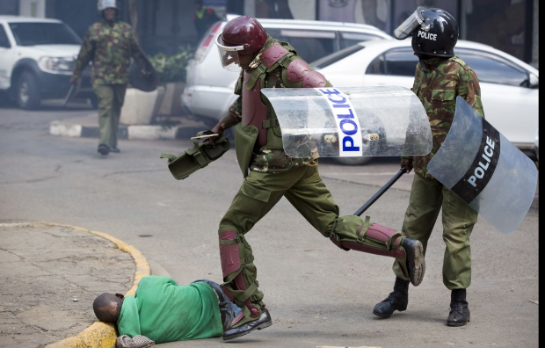
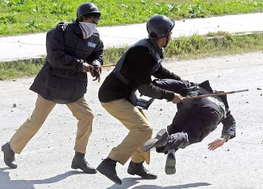
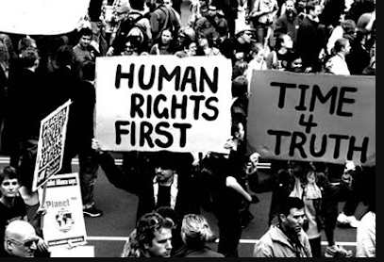
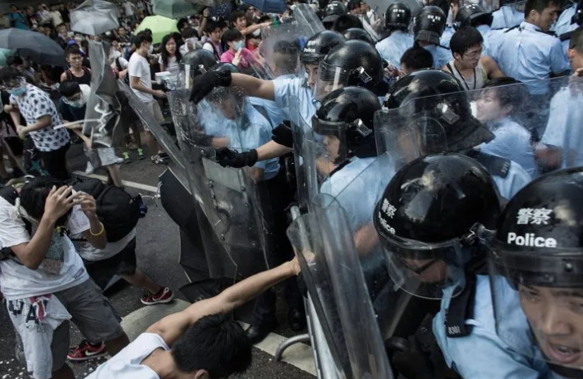
Images – World

Slide 79
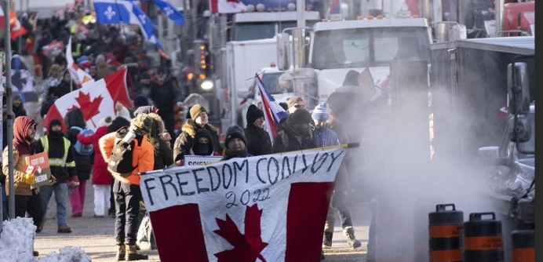
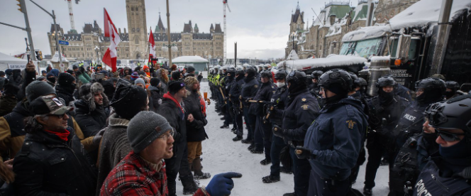
Images – Canada – available google search

Slide 80
FOLLOWING SLIDES SOCIAL MEDIA IMAGES – CANADA
*warning – will give you goosebumps

Slide 81
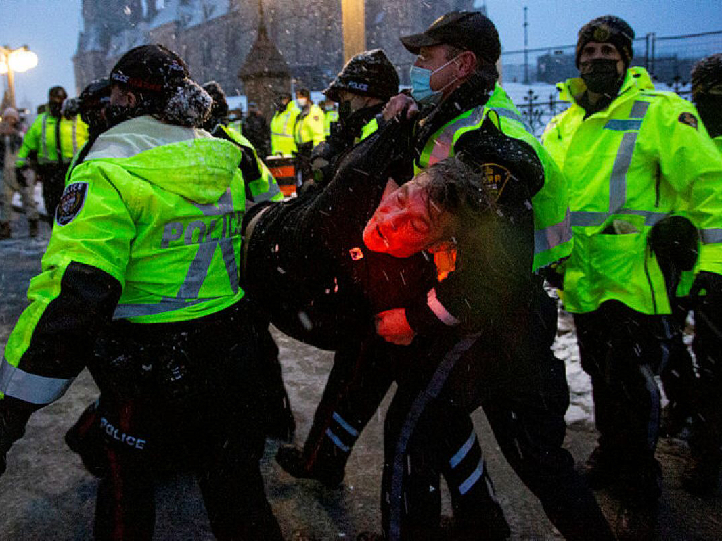
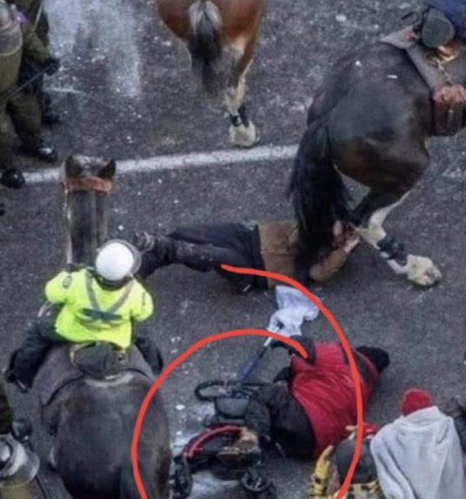

Slide 82
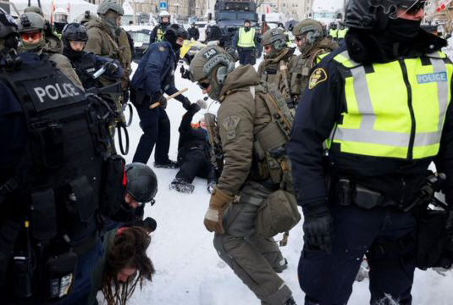
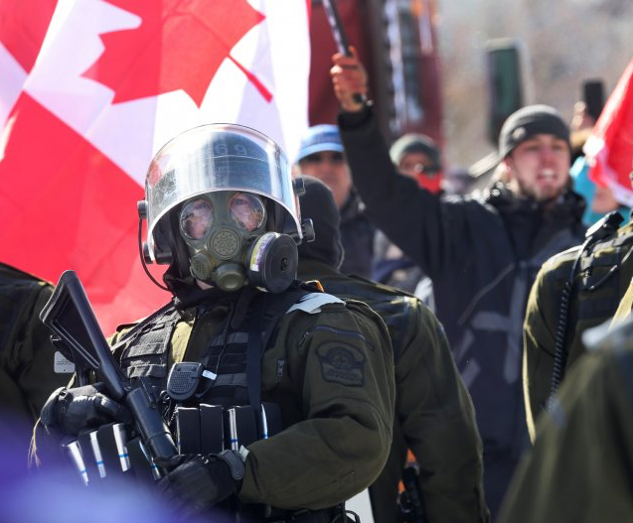
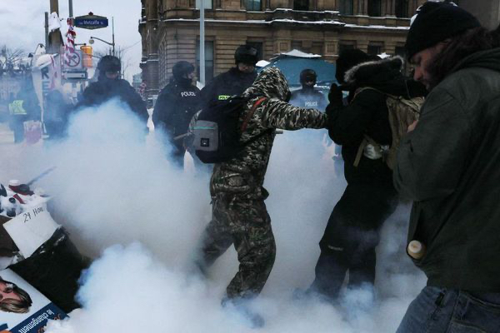

Slide 83
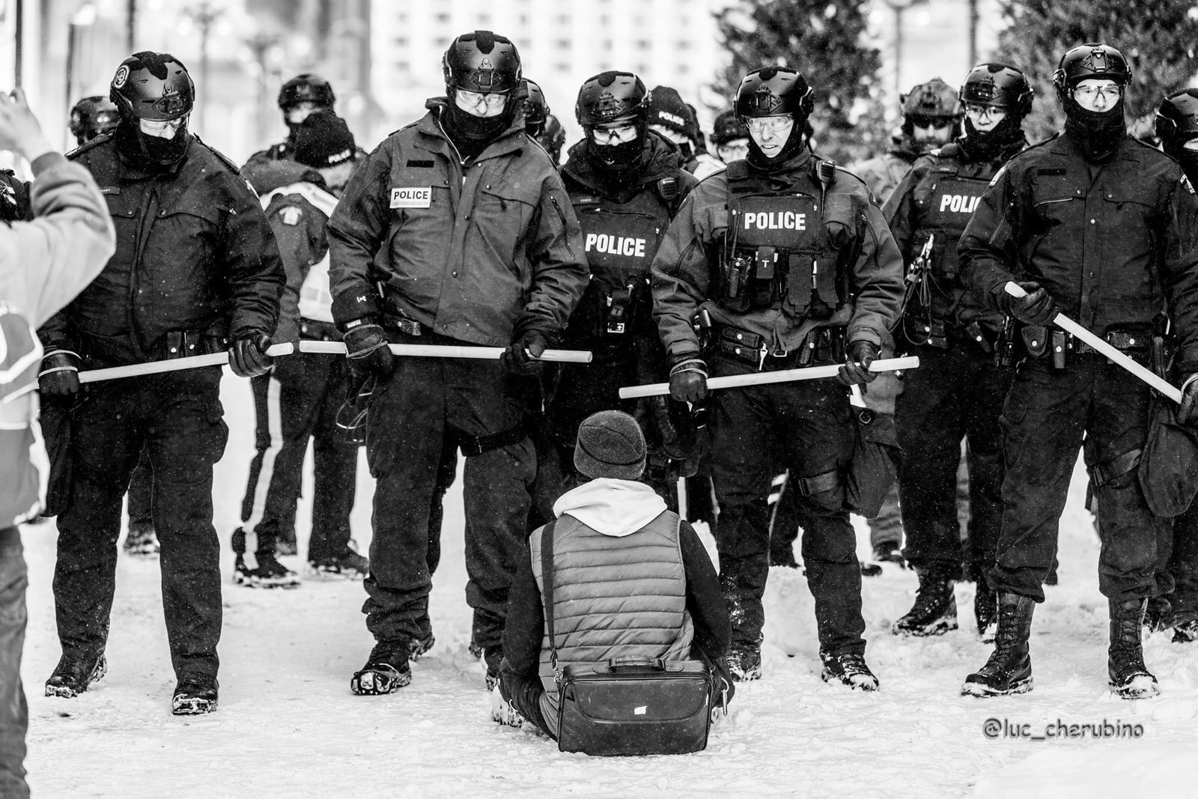

Slide 84
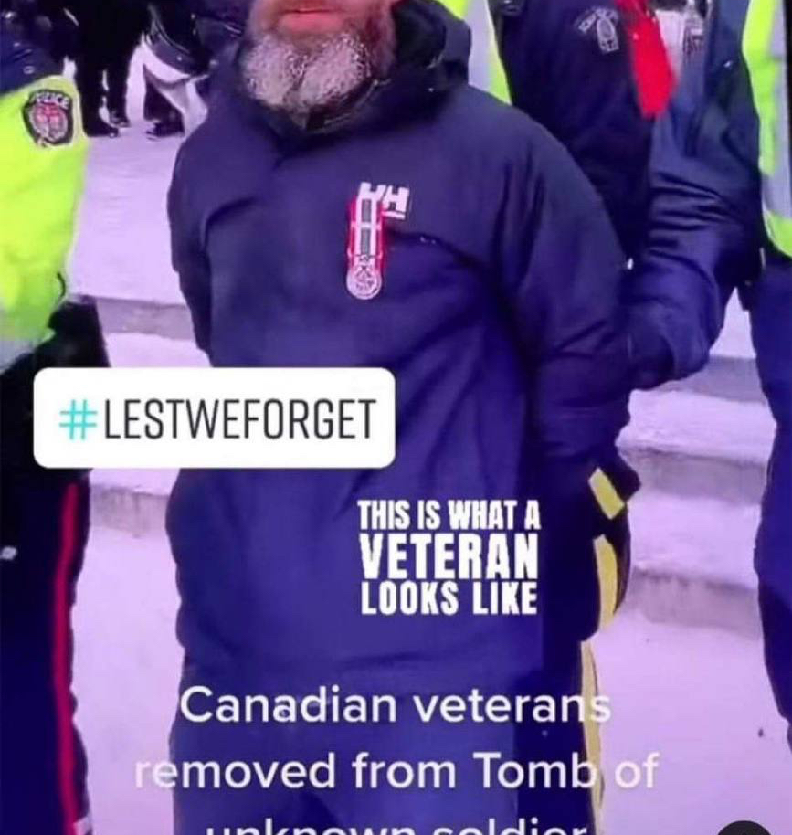
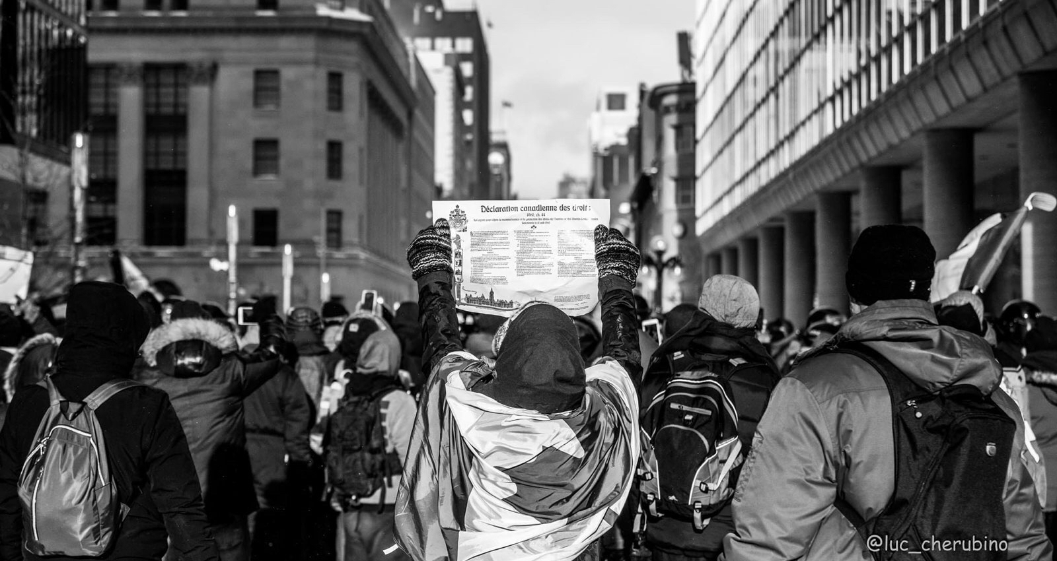
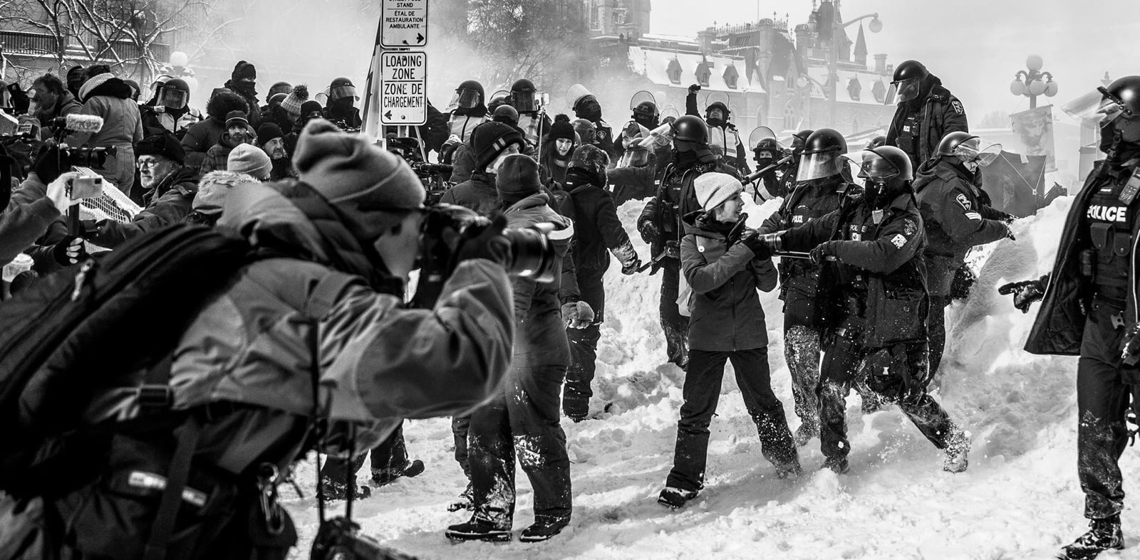

Slide 85
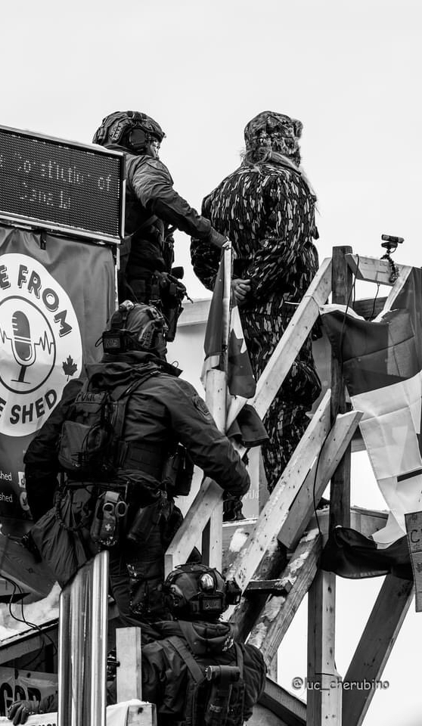
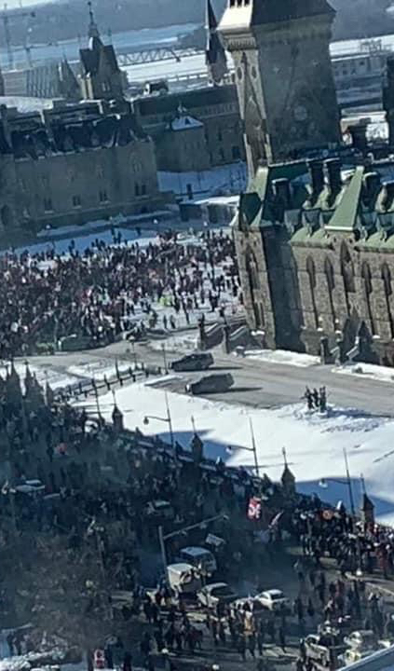
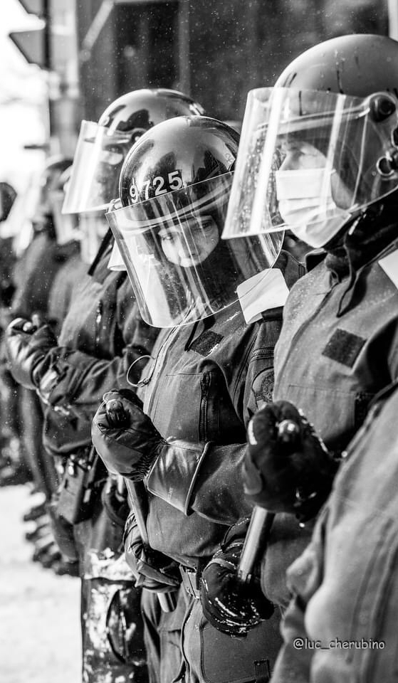

Slide 86
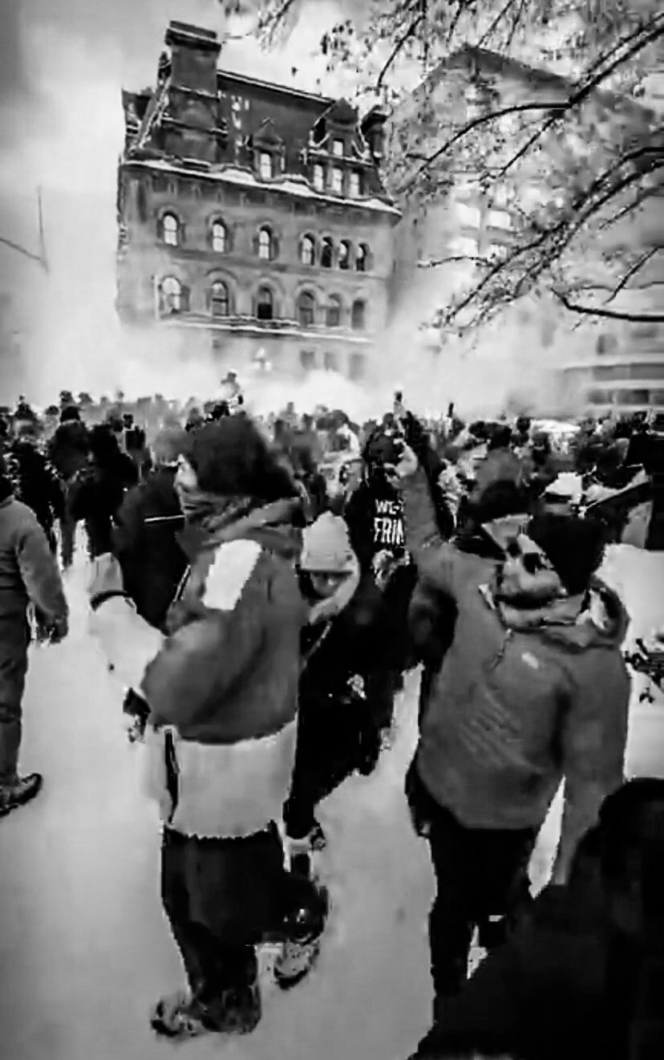
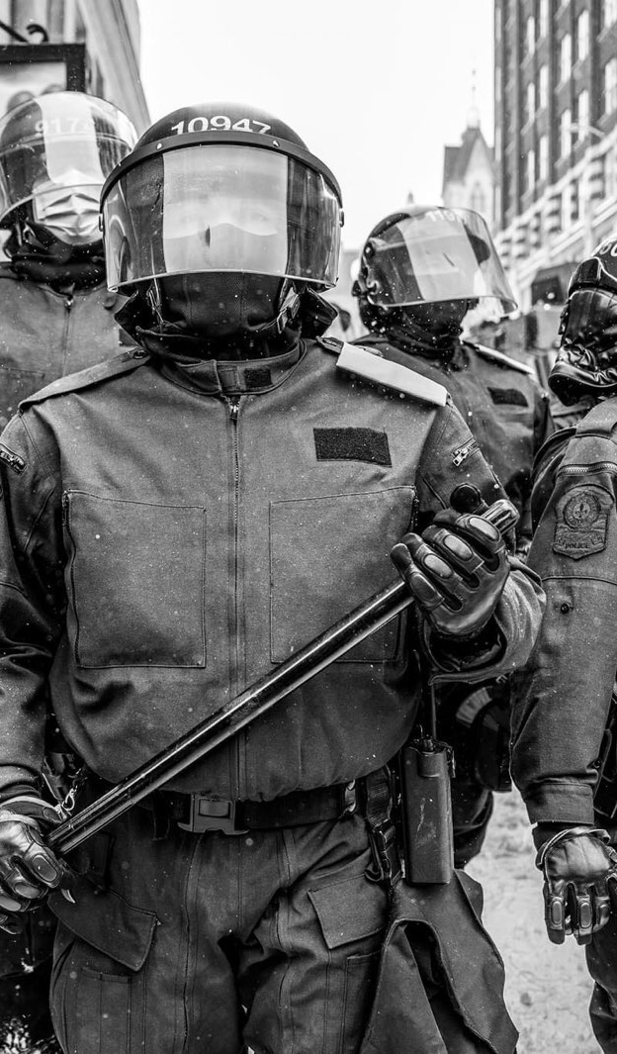
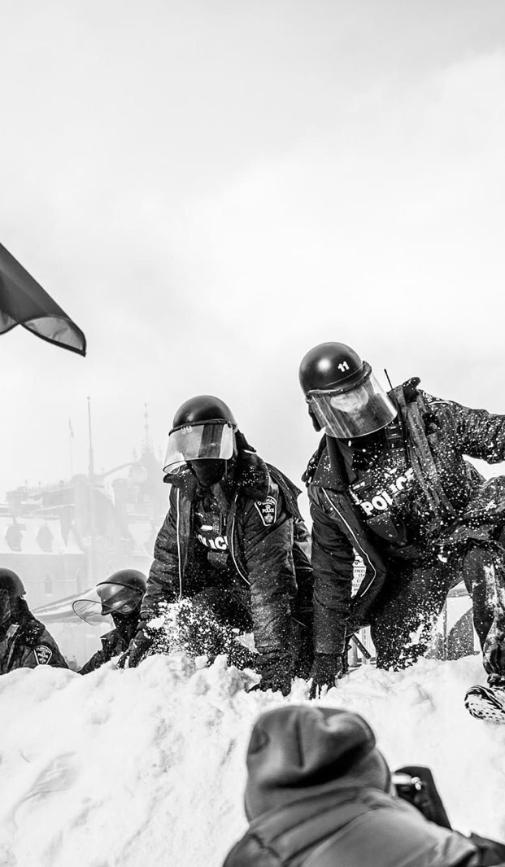

Slide 87
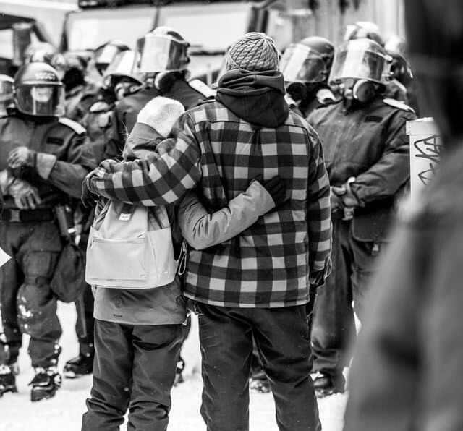
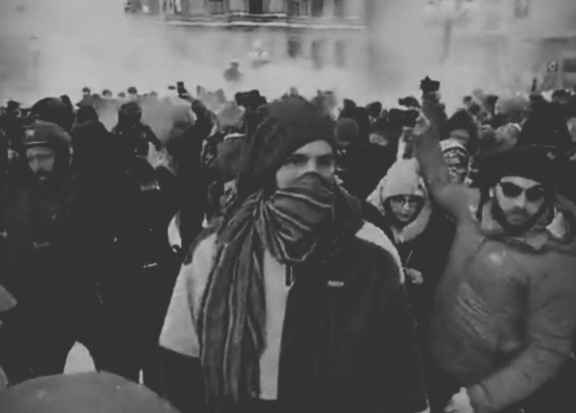
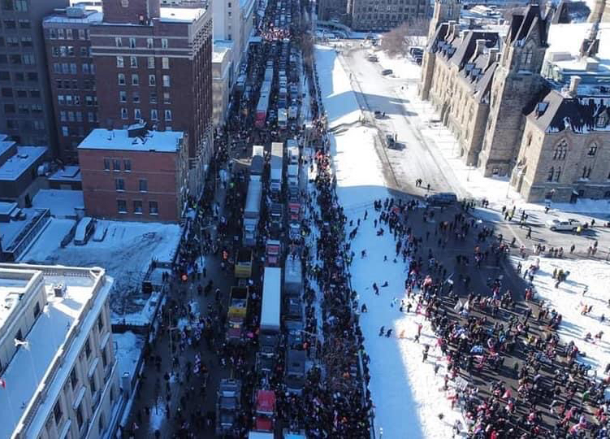

Slide 88
SSR – Security Sector Reform
Policy and Research | DCAF – Geneva Centre for Security Sector Governance
Global Protest Tracker - Carnegie Endowment for International Peace

