Slide 1
Apprenticeships
If you have real passion for a career.......... be willing to serve an apprenticeship; it's the best way to learn.
Randy West

Slide 2
What Are Apprenticeships?
Employees who learn a trade from experienced staff
Paid and paid holidays
Gain a recognised qualification
Notes:
Get class view on what they think an apprenticeship is

Slide 3
Who Can Apply?
Anyone over 16
But can’t be in full time education
Doesn’t matter if you have been registered unemployed or had a different career
Notes:
Explain who can apply

Slide 4
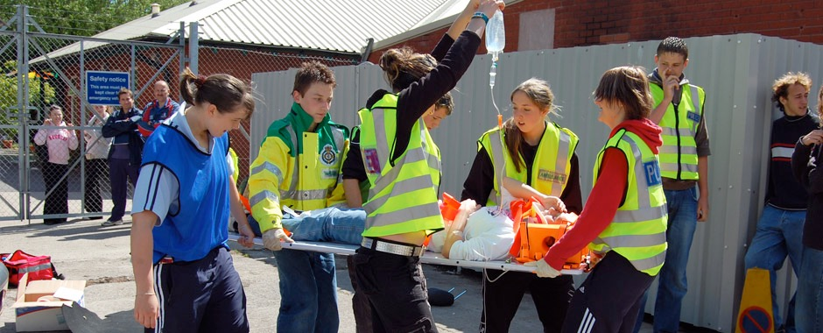
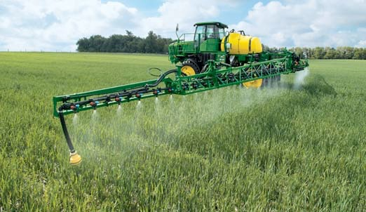
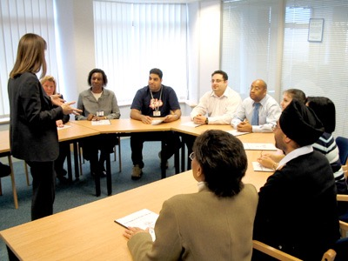
Types Of Apprenticeships
Notes:
Give a flavour of different types of apprenticeships available

Slide 5
Training
Carried out on the job
By experienced staff
Minimum 30 hours per week
Remainder of time spent at a local college working toward a work based qualification
Notes:
Explain what training would be given

Slide 6
Benefits
Pay - £4.15 per hour minimum if under 19 or in first year otherwise minimum wage
Paid holidays
Qualification at the end
Notes:
Highlight very low pay in first year but no debt being incurred whilst training
Holidays will probably only be 4 weeks

Slide 7
Different Levels
Intermediate (5 good GCSE passes equivalent) -
Level 2 qualification and functional skills
Advanced (2 A level passes equivalent) -
Level 3 qualification and functional skills
Higher (NVQ4 or foundation degree) -
Level 4, 5 qualification and functional skills
Degree (M.A. or B. A.) -
Level 6, 7 qualification and functional skills
Qualifications are transferable
Notes:
Discuss different levels and their equivalents
Explain that functional skills are maths and English taught on top of the apprenticeship skills.
Explain foundation degree
Explain what transferable qualifications are

Slide 8
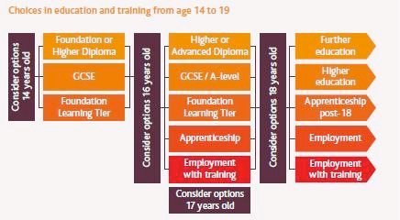
Different Times
Notes:
Highlight when each level is available and the other choices to be considered at that time

Slide 9
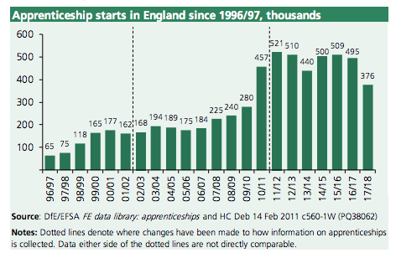
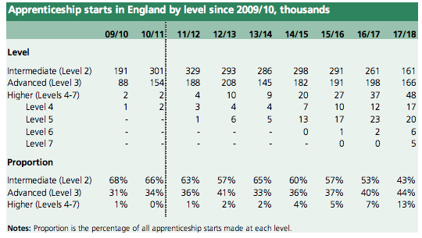
Apprenticeships v Uni
393,000 apprenticeship starts in 2018/19
561,000 applied for university in 2018/19
Notes:
Describe the trend toward more higher level apprenticeships but fewer apprenticeships overall

Slide 10
Applying
Either
Directly
Or
Register with www.apprenticeships.org.uk
Can match by occupation, employer, keyword, college, location
Application form is re-usable for multiple applications
Notes:
Explain the application process

Slide 11
Support & Advice
Online - www.apprenticeships.org.uk
https://www.gov.uk/apprenticeships-guide/overview
nationalhelpdesk@findapprenticeship.service.gov.uk
Many others - Google check
Phone - apprenticeship adviser
Notes:
Show where to find help and support - explain that this is constantly changing so always worth checking online.

