Slide 1
BUDGETING
Don’t leave it too late to start!
WizeUp Financial Education
WizeUp with Jack Petchey

Slide 2
What is a Budget?
WizeUp Financial Education
WizeUp with Jack Petchey

Slide 3
WizeUp Financial Education
WizeUp with Jack Petchey

Slide 4
WizeUp Financial Education
WizeUp with Jack Petchey

Slide 5
Stating the Obvious
a) If income > expenses = ability to save
b) If expenses > income = need to make a decision
WizeUp Financial Education
WizeUp with Jack Petchey

Slide 6
Simple Budget
List Income (monthly)
List priority outgoings (monthly)
Wages or salary
Loan
Grant
Rent
Fees
Bills
WizeUp Financial Education
WizeUp with Jack Petchey

Slide 7
Money Saving Budget
Include as much detail as possible in order to avoid surprise expenses.
Set up an emergency fund to cover surprises.
Ensure that you budget for the fun stuff!
WizeUp Financial Education
WizeUp with Jack Petchey

Slide 8
Money Saving Budget
List Income (Annual)
List necessary expenditure (Annual)
Student loan
Grant or bursary
Sponsorship
Scholarship
Parents contribution
Job income
Savings
Overdraft facility
Emergency fund
Rent
Tuition fees
Contents insurance
Travel
Laundry
Toiletries
Stationery
Minimum debt repayments
Food
Utilities
WizeUp Financial Education
WizeUp with Jack Petchey

Slide 9
Prioritise
WizeUp Financial Education
WizeUp with Jack Petchey

Slide 10
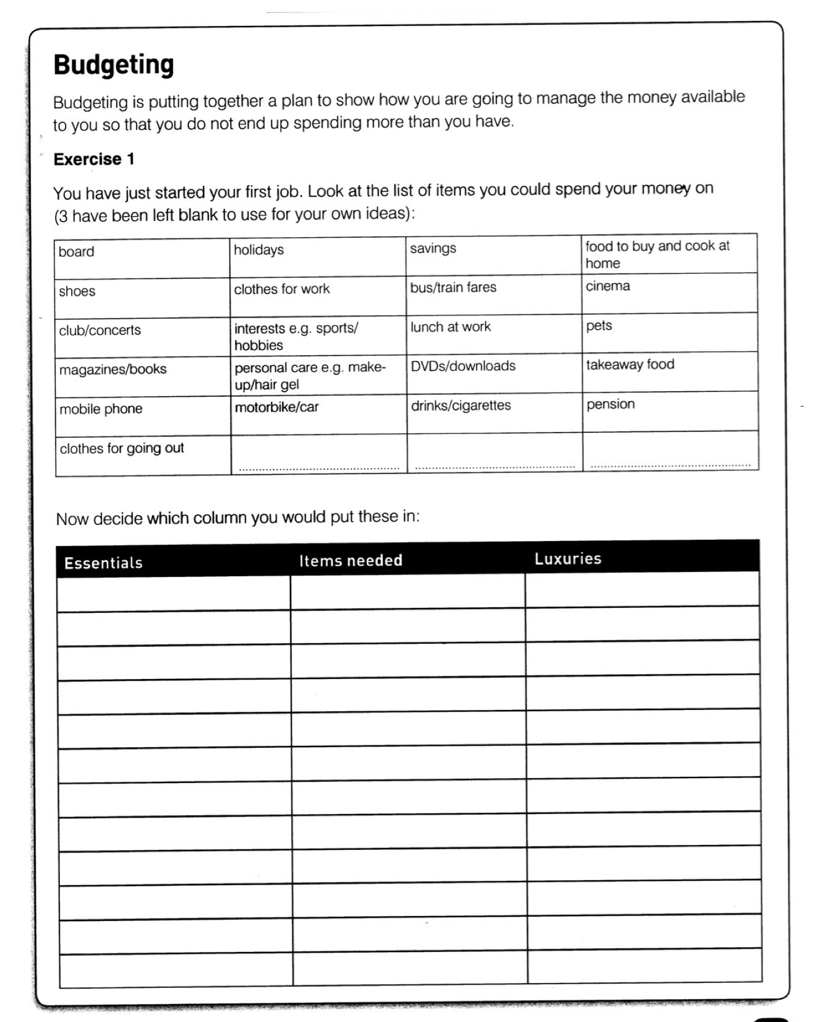
WizeUp Financial Education
WizeUp with Jack Petchey

Slide 11
Cost Comparison
Monthly cost of a one bedroom flat:
Place | Cost | % increase from cheapest
Hull | £400 | 0%
Derby | £450 | 12%
Blackburn | £500 | 25%
Leicester | £550 | 37%
Sevenoaks | £900 | 125%
Chalfont St. Giles | £1,200 | 300%
Chelsea | £2,100 | 425%
WizeUp Financial Education
WizeUp with Jack Petchey

Slide 12
Cost Comparison
A small shop of identical products was carried out at different supermarkets
Supermarket | Cost | % increase from cheapest
Lidl | £18.45 | 0%
Aldi | £18.45 | 0%
Asda | £20.03 | 8.5%
Tesco | £21.77 | 18%
Sainsburys | £22.10 | 20%
Morrisons | £22.65 | 23%
Waitrose | £24.79 | 34%
WizeUp Financial Education
WizeUp with Jack Petchey

Slide 13
Cost Comparison
SIM only - At least 20gb data per month
Supermarket | Cost | % increase from cheapest
Talk Mobile | £9.95 | 0%
ID Mobile | £10.00 | 0.5%
Three | £12.00 | 21%
Giff Gaff | £15.00 | 51%
O2 | £18.00 | 81%
Sky | £20.00 | 101%
EE | £21.00 | 111%
WizeUp Financial Education
WizeUp with Jack Petchey

Slide 14
Money Saving Budget
Income | Weekly | Annually | One Off | Expenditure | Weekly | Annually | One Off
Tuition Fee Loan |  | £3,000 |  | Emergency |  | £1,000
Maintenance loan |  | £3,000 |  | Accommodation |  | £2,700
Grant |  | £1,200 |  | Books |  | £300
Bursary |  | £1,000 |  | Insurance |  | £65
Job | £45 | £1,395 |  | TV License |  | £139
Parents support | £25 | £775 |  | Food | £35 | £1,085
Stuff sold on ebay |  |  | £65 | Going Out | £25 | £775
 |  |  |  | Travel | £14 | £434
 |  |  |  | Laundry | £3 | £93
 |  |  |  | Phone | £5 | £155
 |  |  |  | Laptop |  |  | £400
 |  |  |  | Course Fees |  | £3,000
 | Total | £10,370 | £65 |  | Total | £6,746 | £400
 | Grand total | £10,435 |  |  | Grand total | £9,746
 | Income over expenditure |  | £689 | Can be spent on luxuries
WizeUp Financial Education
WizeUp with Jack Petchey
Notes:
Go through budget and how to annualise earnings or spending.

Slide 15
Money Saving Budget
Calculate the difference
If income > expenditure
If expenditure > income
WizeUp Financial Education
WizeUp with Jack Petchey

Slide 16
What If I Don’t?
You might muddle through but…
You are unlikely to be able to pay for unexpected events
You will be forced to borrow more money
Saving will be difficult
You will always be playing catch up
WizeUp Financial Education
Notes:
Discuss options if budget doesn’t add up
Earn more - spend less
Budget doesn’t have to add up to work

Slide 17
Notes:
Film showing some first year university students discussing their budgets and ways to save money
Option to play budgeting games at end or do a quiz.

