Slide 1
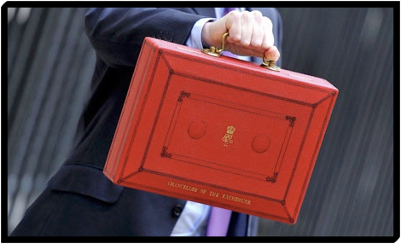
Budgeting
A Budget tells us what we can’t afford, but it doesn’t stop us from buying it.....
William Feather
Notes:
Everyone needs to budget
Mistakes when young are easy to overcome so worth trying now

Slide 2
What is a budget?
Notes:
Get class views on what a budget is
Budget doesn’t have to be financial - any finite resource
Impress that the students are already very good budgeters when it comes to time

Slide 3
Notes:
Alarm clock analogy
Choice to get up or hit snooze button - no right or wrong decision
Choosing snooze just delays getting up and there may be consequences

Slide 4
Stating the obvious....or is it?
a) If income > expenses = ability to save
b) If expenses > income = debt spiral
Notes:
Ask class what debt spiral is
Story of ocean finance - consolidating debt.
Ask how they can do it cheaper
Encourage class to think about time value of money and not just APR

Slide 5
Simple Budget
List Income (monthly)
List priority outgoings (monthly)
Wages or salary
Loan
Grant
Rent
Fees
Bills
Notes:
Ask class what the downside to a simple budget is
Too simplistic
Not enough categories

Slide 6
Money Saving Budget
Include as much detail as possible in order to avoid surprise expenses.
Set up an emergency fund to cover surprises.
Ensure that you budget for the fun stuff!
Notes:
Explain why an emergency fund is important
Easy to budget if nothing goes wrong
Being able to sort out a problem without using 3rd party help = independence

Slide 7
Money Saving Budget
List Income (Annual)
List necessary expenditure (Annual)
Emergency fund
Rent
Tuition fees
Contents insurance
Travel
Laundry
Toiletries
Stationery
Minimum debt repayments
Food
Utilities
Student loan
Grant or bursary
Sponsorship
Scholarship
Parents contribution
Job income
Savings
Overdraft facility
Notes:
Encourage class to come up with their own categories

Slide 8
Notes:
Discuss priorities and how these can be influenced.
Good time to give our worksheet on prioritising.

Slide 9
Money Saving Budget
Income | Weekly | Annually | One Off | Expenditure | Weekly | Annually | One Off
Tuition Fee Loan |  | £3,000 |  | Emergency |  | £1,000
Maintenance loan |  | £3,000 |  | Accommodation |  | £2,700
Grant |  | £1,200 |  | Books |  | £300
Bursary |  | £1,000 |  | Insurance |  | £65
Job | £45 | £1,395 |  | TV License |  | £139
Parents support | £25 | £775 |  | Food | £35 | £1,085
Stuff sold on ebay |  |  | £65 | Going Out | £25 | £775
 |  |  |  | Travel | £14 | £434
 |  |  |  | Laundry | £3 | £93
 |  |  |  | Phone | £5 | £155
 |  |  |  | Laptop |  |  | £400
 |  |  |  | Course Fees |  | £3,000
 | Total | £10,370 | £65 |  | Total | £6,746 | £400
 | Grand total | £10,435 |  |  | Grand total | £9,746
 | Income over expenditure |  | £689 | Can be spent on luxuries
Notes:
Go through budget and how to annualise earnings or spending.

Slide 10
Money Saving Budget
Calculate the difference
If income > expenditure
If expenditure > income
Notes:
Discuss options if budget doesn’t add up
Earn more - spend less
Budget doesn’t have to add up to work

