Slide 1

Starting a Business
“Your work is going to fill a large part of your life, and the only way to be truly satisfied is to do what you believe is great work. And the only way to do great work is to love what you do.”
Steve Jobs

Slide 2

Notes:
All successful businesses start with an idea

Slide 3

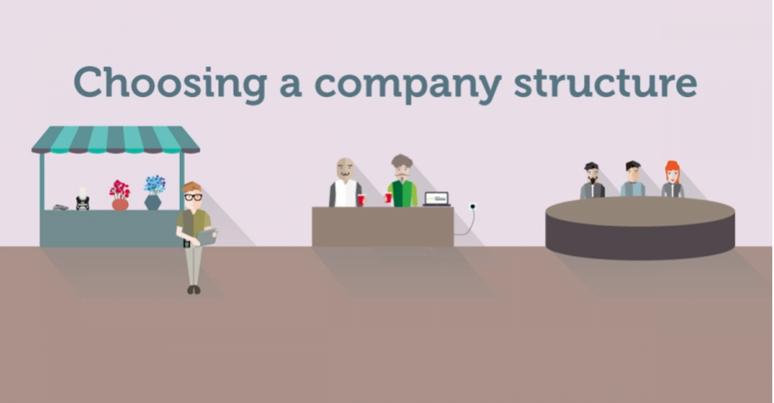
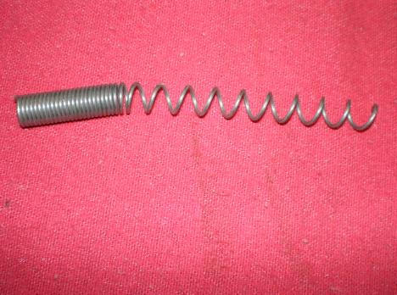





Then…
Notes:
Once you have the idea get some experience - might save you costly mistakes.
Know who your target market is and who your competitors are.
Write a business plan - you can get help with this.
Nurture your business - don’t rush it and don’t over extend when it starts to do well.
Explain the different company structures
Sole trader
Partnership
Limited company - will explain these structures later

Slide 4
Business Plan
Summary
Who are you?
What are you selling?
Who are your customers?
Where is your market?
Market research
Marketing
Competition and comparison
USP
Logistics
Costs/Pricing
Financial forecasts
Back up plan
Notes:
Go through the points which constitute a business plan

Slide 5

Getting Help
For 18 - 30 year olds
Enterprise programme
Free training and mentoring
Notes:
Get help from the Prince’s trust - aimed specifically at young people

Slide 6

Getting Help
Enterprise programme
Delivered in colleges nation-wide
Run in conjunction with businesses
Notes:
Peter Jones enterprise (yes off of Dragon’s Den) - delivered in local colleges.

Slide 7

Getting Help
Government backed
Assigned mentor
Get up to £1,274 over 26 weeks
Government backed startup loan from £500 to £25,000
Fixed interest rate of 6%
Notes:
Enterprise allowance - small grant plus a (relatively) cheap startup loan

Slide 8

Getting Help
Business manager
Experienced
Overdrafts
Loans
Notes:
High street banks and some building societies will give free advice

Slide 9

Getting Help
Friends and family will have your back
Great source of experience
Cheap funding
Cheap casual help
Notes:
Don’t be too proud to ask for help from family and friends

Slide 10
Getting Finance
Bootstrapping
Friends and family
Grants
Enterprise agencies
Micro loans
Bank Loans
Angels
Venture Capital
Notes:
Bootstrapping - doing it all yourself - sell stuff to raise money
Micro loans - very small amounts of startup capital - check internet for availability (might be quite high APR)
Angels - people who give you money in return for equity in your company.
Similar to angels but tend to be looking for fast return
Local authorities and businesses interested helping the community

Slide 11
Structure
 | What Happens To The Profits?
Sole Trader | Keep them as part of your income and pay tax accordingly
Partnership | Share them with each partner paying their share of tax
Limited Company | Owned by the company - 20% tax on profits - Dividends to share holders
Notes:
Explain where the profits go and who pays what in tax

Slide 12
Structure
 | Do I have to pay VAT?
Sole Trader | Yes - if the turnover is more than £85,000
Partnership | Yes - if the turnover is more than £85,000
Limited Company | Yes - if the turnover is more than £85,000
Notes:
VAT explanation

Slide 13
Structure
 | Do I have to register the company?
Sole Trader | With HMRC as sole trader
Partnership | With HMRC as partnership
Limited Company | With companies house and with HMRC
Notes:
Registering with HMRC (Her Majesty’s Revenue and Customers) for tax purposes.

Slide 14
Structure
 | How are accounts managed?
Sole Trader | By yourself or accountant through self assessment
Partnership | By partners or accountant through self assessments
Limited Company | Generally through accountant. Returns need to be made quarterly.
Notes:
Managing accounts - explain who does what. Accountancy Financial education and employability skills will be anything from £600 per year upwards.

Slide 15
Structure
 | What are the benefits?
Sole Trader | Very simple. Your decisions. Your profits
Partnership | Mutual support. Complimentary skills. Share all profits.
Limited Company | Not total liability. Corporation tax is only 20%. Offset many costs.
Notes:
Benefits of each structure
Corporation tax is 20% but then you have to pay income tax on a salary if you draw one.

Slide 16
Structure
 | What are the drawbacks?
Sole Trader | Total liability Could be paying 40% tax on profits Lonely!
Partnership | Total liability Could be paying 40% tax on profits All decisions have to be agreed
Limited Company | All decisions have to be agreed. Lots of deadlines to meet. Staff care.
Notes:
The shortcomings of each structure
Encourage students to look at the pros and cons or each.
It is possible to move from one structure to another.

