Slide 1
Cv writing
Make a good first impression on paper

Slide 2
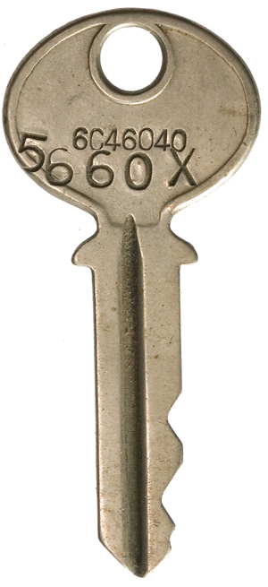
What is a C.V?

Slide 3
Make sure you.....
Include clear, up to date contact details
Make sure phone number has a voice-mail attached to it
Use a professional sounding email address - not goofykid@mymail.com
No need to include home address

Slide 4
Make sure you.....
Word-process your C.V.
Print on good quality A4 white paper
At least 120g/m2
Print in high quality, not draft

Slide 5
Make sure you.....
Word-process your C.V.
Use a good font - Times, Arial, Verdana are good
Use 12 point with 14 point for headings, use bold sparingly
Keep it to one page
Use an uncluttered layout
Use good English in short, concise sentences. Bullet points are good

Slide 6
Make sure you.....
Write in reverse chronological order
Most recent experience first
Put key-words on the left of the page
Focus on skills relevant to the job
Include details of charity or voluntary work
Try to demonstrate teamwork or organisational skills

Slide 7
Make sure you.....
Use strong action words
Led, actioned, created, changed, built, influenced
Check spelling mistakes and punctuation
Get somebody to proof read it
Send a covering letter
Send it to the right person! Research

Slide 8
Research different types of CV

Slide 9
Covering letter
Always send one with your C.V.
Use good quality paper - at least 120g/m2
Contact information in top right hand corner
Addressee in top left hand corner
Always address to a person
Date it

Slide 10
Other types of CV
Email
Online form
Video

