Slide 1
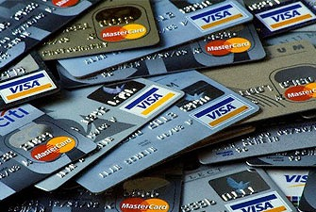
CREDIT CARDS
A necessary evil?
WizeUp Financial Education
WizeUp with Jack Petchey

Slide 2
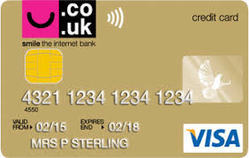
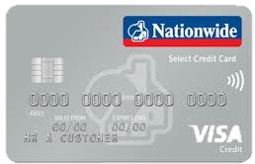
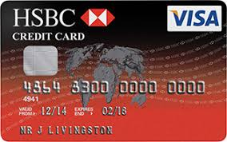
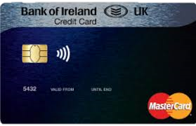
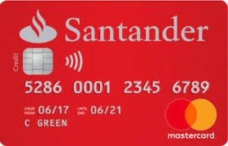
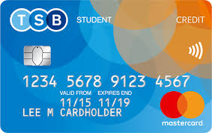
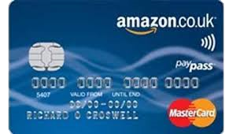
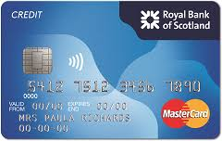
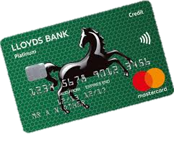
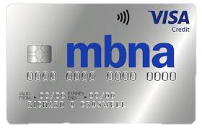
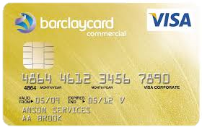
WizeUp Financial Education
WizeUp with Jack Petchey
Notes:
Lots of different credit cards on the market

Slide 3
Remember
You won’t get one before you are 18
APR likely to be high
Almost certainly a low initial credit limit
Minimum payment likely to be higher than on a standard credit card
Purchase protection on items > £100
WizeUp Financial Education
WizeUp with Jack Petchey

Slide 4
Managing Your Account
Paying off outstanding balance means no interest charges
Minimum payment goes down along with your balance
You will be asked to set up a direct debit for the minimum payment
Cancel unused cards
WizeUp Financial Education
WizeUp with Jack Petchey

Slide 5
Direct Debit
Allows the company you have set up the direct debit with to approach your bank and ask for a sum of money
Provided you have the money in your account your bank will pay the company
Used to pay a regular non-standard bill eg Phone
WizeUp Financial Education
WizeUp with Jack Petchey

Slide 6
Standing Orders
By setting one up you will pay the same amount at the same time each period to the same company
It will only be paid as long as you are below your overdraft limit
Typically used to make regular payments eg mortgage, savings
You need to know the other parties bank details - account name, number, bank and sort-code
WizeUp Financial Education
WizeUp with Jack Petchey

Slide 7
D.D. v S.O.
Example - £500 balance, 20% APR, minimum repayment 1% of balance + interest, 2.25% of balance or £5
1% of balance + interest = £5 + £8.33 = £13.33
2.25% of balance = £11.25
or £5
WizeUp Financial Education
WizeUp with Jack Petchey

Slide 8
D.D. v S.O.
If only the minimum payment is made each month how long does it take to repay the debt and how much interest is paid?
Direct Debit for decreasing minimum payment.
12 years 10 months
Interest costs - £571.
WizeUp Financial Education
WizeUp with Jack Petchey

Slide 9
D.D. v S.O.
What happens if the direct debit is cancelled an a standing order is set up for £13.33 each month?
Time to repay now is 4 years 9 months.
Interest costs are now - £249
WizeUp Financial Education
WizeUp with Jack Petchey

Slide 10
D.D. v S.O.
What happens if the Standing Order is for fixed payment of £20 per month?
What happens if the Standing Order is for fixed payment of £30 per month?
2 years 8 months.
Interest costs - £135.
1 years 8 months.
Interest costs - £82.
WizeUp Financial Education
WizeUp with Jack Petchey

Slide 11
A well run account will increase your credit rating quicker than anything else.......
WizeUp Financial Education
WizeUp with Jack Petchey

