Slide 1
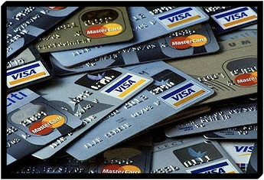
Credit Cards
You want 21% tax-free? Pay off your credit cards..............
Andrew Tobias
Notes:
Take a straw poll of students on who are likely to want to use a credit card

Slide 2
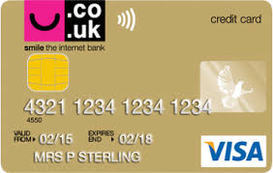
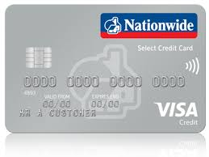
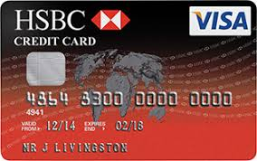
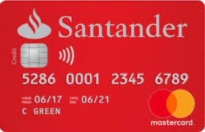
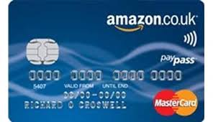
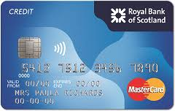
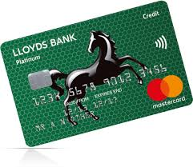
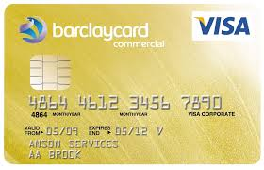
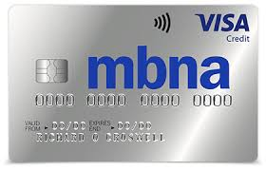
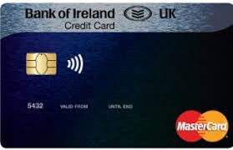
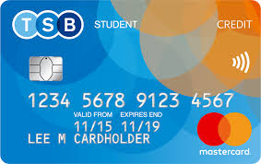
Notes:
Lots of different credit cards on the market

Slide 3
Remember...
Student credit card is linked to student account.
APR likely to be high.
Almost certainly a low initial credit limit.
Minimum payment likely to be higher than on a standard credit card.
Purchase protection on items >£100.
Notes:
Students credit card will have some drawbacks
But also some advantages

Slide 4
Managing your account
Paying off outstanding balance means no interest charges
Minimum payment goes down along with your balance .
You will be asked to set up a direct debit for the minimum payment.
Cancel unused cards.
Notes:
Managing account properly is paramount.
Interest is only charged on outstanding balance after payment.
Minimum payment will decrease with account balance.
Direct debit will be set up so minimum payment can be taken every month.

Slide 5
Allows the company you have set up the direct debit with to approach your bank and ask for a sum of money
Provided you have the money in your account your bank will pay the company
Used to pay a regular non-standard bill eg Phone
Notes:
Explain what a direct debit is.
When is it used.
Do students use one now?

Slide 6
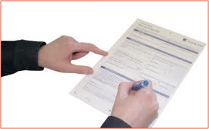
Standing Orders
By setting one up you will pay the same amount at the same time each period to the same company
It will only be paid as long as you are below your overdraft limit
Typically used to make regular payments eg mortgage, savings
You need to know the other parties bank details - account name, number, bank and sort-code
Notes:
Explain what a standing order is.
When might it be used?
Do any students use one?

Slide 7
d.d. v s.o.
Example - £500 balance, 20% APR, minimum repayment 1% of balance + interest, 2.25% of balance or £5
1% of balance + interest = £5 + £8.33 = £13.33
2.25% of balance = £11.25
or £5
Notes:
Go through this example stage by stage - give time for questions.
Find out how long students think it will take to repay the debt if minimum payment ONLY is made every month.

Slide 8
d.d. v s.o.
If only the minimum payment is made each month how long does it take to repay the debt and how much interest is paid?
Direct Debit for decreasing minimum payment.
12 years 10 months
Interest costs - £571.
Notes:
Long time
Interest = more than purchase

Slide 9
d.d. v s.o.
What happens if the direct debit is cancelled an a standing order is set up for £13.33 each month?
Time to repay now is 4 years 9 months.
Interest costs are now - £249.
Notes:
Explain that changing from DD to SO is free and all people are doing is cutting out the reducing minimum payment.
Find out how much of reduction students think this will make.

Slide 10
d.d. v s.o.
What happens if the Standing Order is for fixed payment of £20 per month?
2 years 8 months.
Interest costs - £135.
What happens if the Standing Order is for fixed payment of £30 per month?
1 years 8 months.
Interest costs - £82.
Notes:
This shows that the best way to repay debt is with regular payments as much as students can realistically afford.
Never just pay the minimum payment.
Change DD for SO and put a reasonable fixed amount on it.

Slide 11
A well run account will increase your credit rating quicker than anything else.......
Notes:
This will have a huge positive impact on credit ratings.

