Slide 1
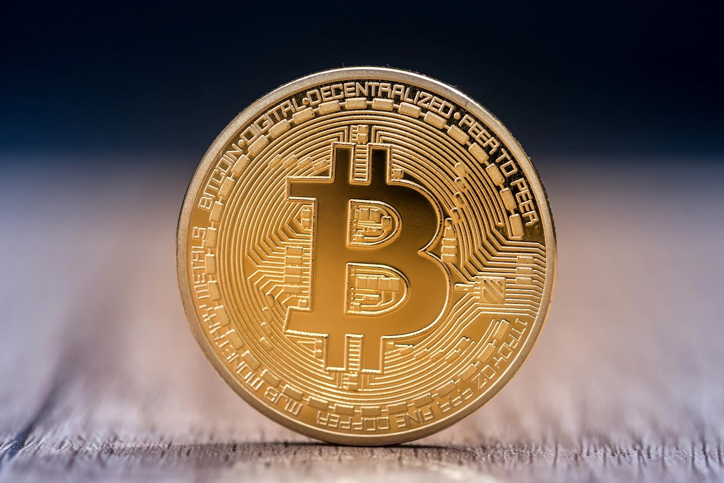
Cryptocurrencies
“Everything you don’t understand about money,
combined with everything you don’t know about computers.”
John Oliver H.B.O.
Notes:
Cryptocurrencies are a natural extension of the cash - chip and pin - contactless - cycle but how do they differ from the money in our pockets and bank accounts?

Slide 2
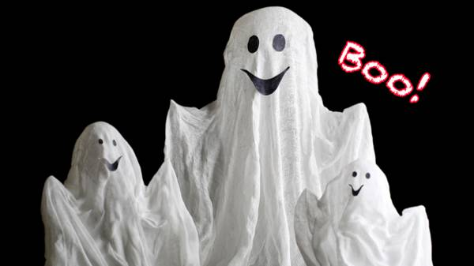
Do you believe in ghosts?
Seen?
Heard?
Felt?
Stories?
Notes:
Ask students who believe in ghosts?
Why?
Have they seen one? Heard one? Felt one? Or just heard plausible stories about them?
What would it take to convince the non believers?

Slide 3
Do you believe in Bitcoin?
Seen?
Heard?
Felt?
Stories?
Notes:
Ask how many students believe in Bitcoin - probably all.
What is the difference between bitcoin and ghosts?
Probably not much!

Slide 4
Why has money got a value?
History
Central Bank
Regulation
Trust
Notes:
Think about why £5 is worth £5
Intrinsic value is about 1p - its plastic!
It’s worth a fiver because everyone believes and trusts it is.
The Government guarantees that it is.
If it starts to lose value then the government, through the central bank can defend the currency.
This didn’t happen overnight - its was built firstly through the gold standard and good practices.
This took many centuries.

Slide 5
Why has Bitcoin got a value?
Some trust
No regulation
?
No history
Notes:
1 Bitcoin is currently worth almost £40,000
Why?
It has only been in existence since 2009 so very little history.
There are certain things you can buy with it but not much.
It is outside of central bank and government control so there is no external regulation.
It’s value is there purely on supply and demand.
This makes it very volatile

Slide 6
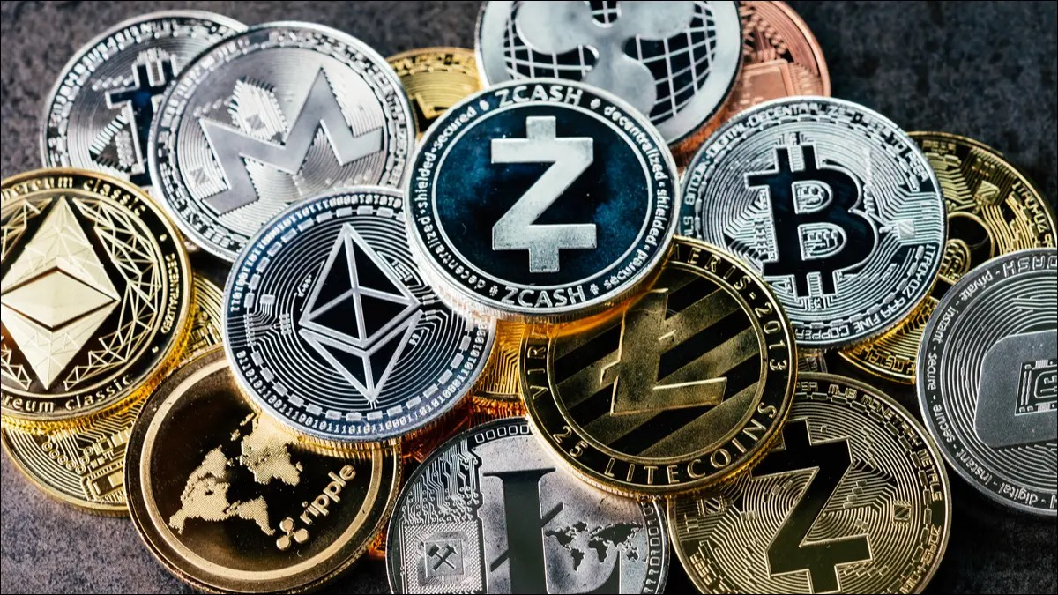
What are cryptocurrencies?
Digital file
Created using cryptography
8,000 different cryptocurrencies
Most are worthless
Not regulated
Run on a public ledger - Blockchain
Stored in wallets often in exchanges
Notes:
Cryptocurrencies are just really complex digital files which can’t be seen, held or touched.
They are created using cryptography which is the study of secure communications techniques like WhatsApp.
Anyone can create a cryptocurrency - there are already more than 8,000 of them.
Most of them are worthless.
There is no central control of transactions but everything is kept on a central ledger called blockchain.
The crypto are stored in a virtual wallet which are often held by the exchange where there are traded.

Slide 7
What are cryptocurrencies?
Created by ‘mining’ or
proof of stake
Mining extremely expensive
Takes masses of electricity
about 150,000 kWh - not green!
Proof of stake - certain amount
of crypto validated periodically
Much cheaper but big stakeholders can have too much control.
Notes:
Units of cryptocurrencies can be created by ‘mining’ which involves using computer power to solve complicated mathematical problems that generate coins.
Although anyone can mine them the process takes lots of computing power and electricity.
Currently it takes about 150,000 kWh of electricity to mine one bitcoin.
They can also be created by ‘proof of stake’.
Coins exist in wallets and are validated and sold by a group of trustees.
Very low cost but large stakeholders could have a large portion of the market and too much control.

Slide 8
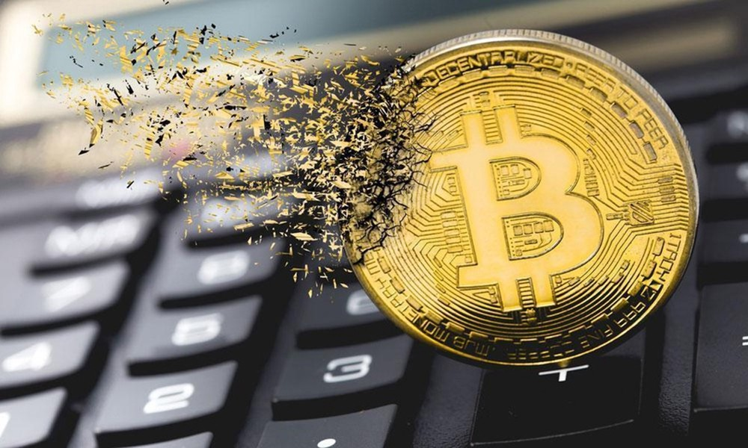
Dangers of cryptocurrencies
No intrinsic value
Not regulated
Hugely volatile
Open to cyber attacks
Pump and dump
Not well understood so there
are lots of scams
Money laundering
Notes:
Even paper money has some intrinsic value (1p)
Cryptocurrencies have no intrinsic value whatsoever.
Because countries don’t use them to pay for international trade the number of cryptocurrencies in circulation is tiny.
Because they are unregulated they are hugely volatile and can double or halve in value in a single day.
Big players can pump and dump - buy cheap then talk up a new crypto, enticing speculators to buy before selling all their stock at inflated prices.
Because everything is ‘virtual’ the system is open to cyber attacks - less so in mining but more so in accessing wallets.
There are lots of people who have bought cryptocurrencies without really understanding them for fear of missing out. This makes them extremely vulnerable to scams. If anyone receives a phone call guaranteeing profits it will be a scam.
Although there is no evidence that cryptocurrencies are any more accessible to money launderers than regular banking the lack of regulation means that new clients may not be checked as thoroughly meaning that money launderers are likely to be attracted..

Slide 9
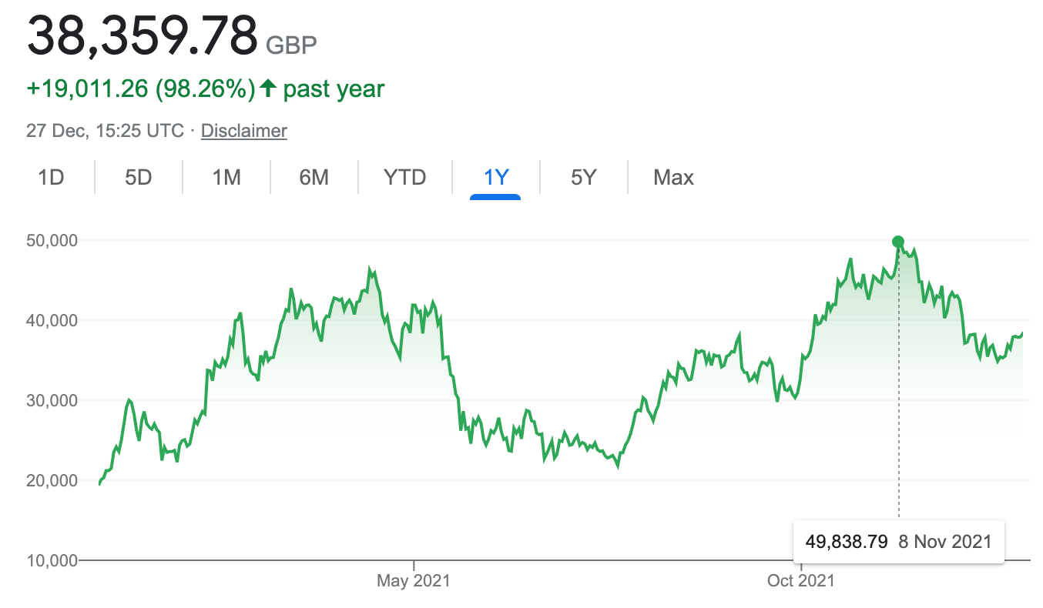
Bitcoin volatility
Notes:
This is the price movement in £ over the last year
Went from £42,000 on May 8th to £24,500 on May 23rd

Slide 10
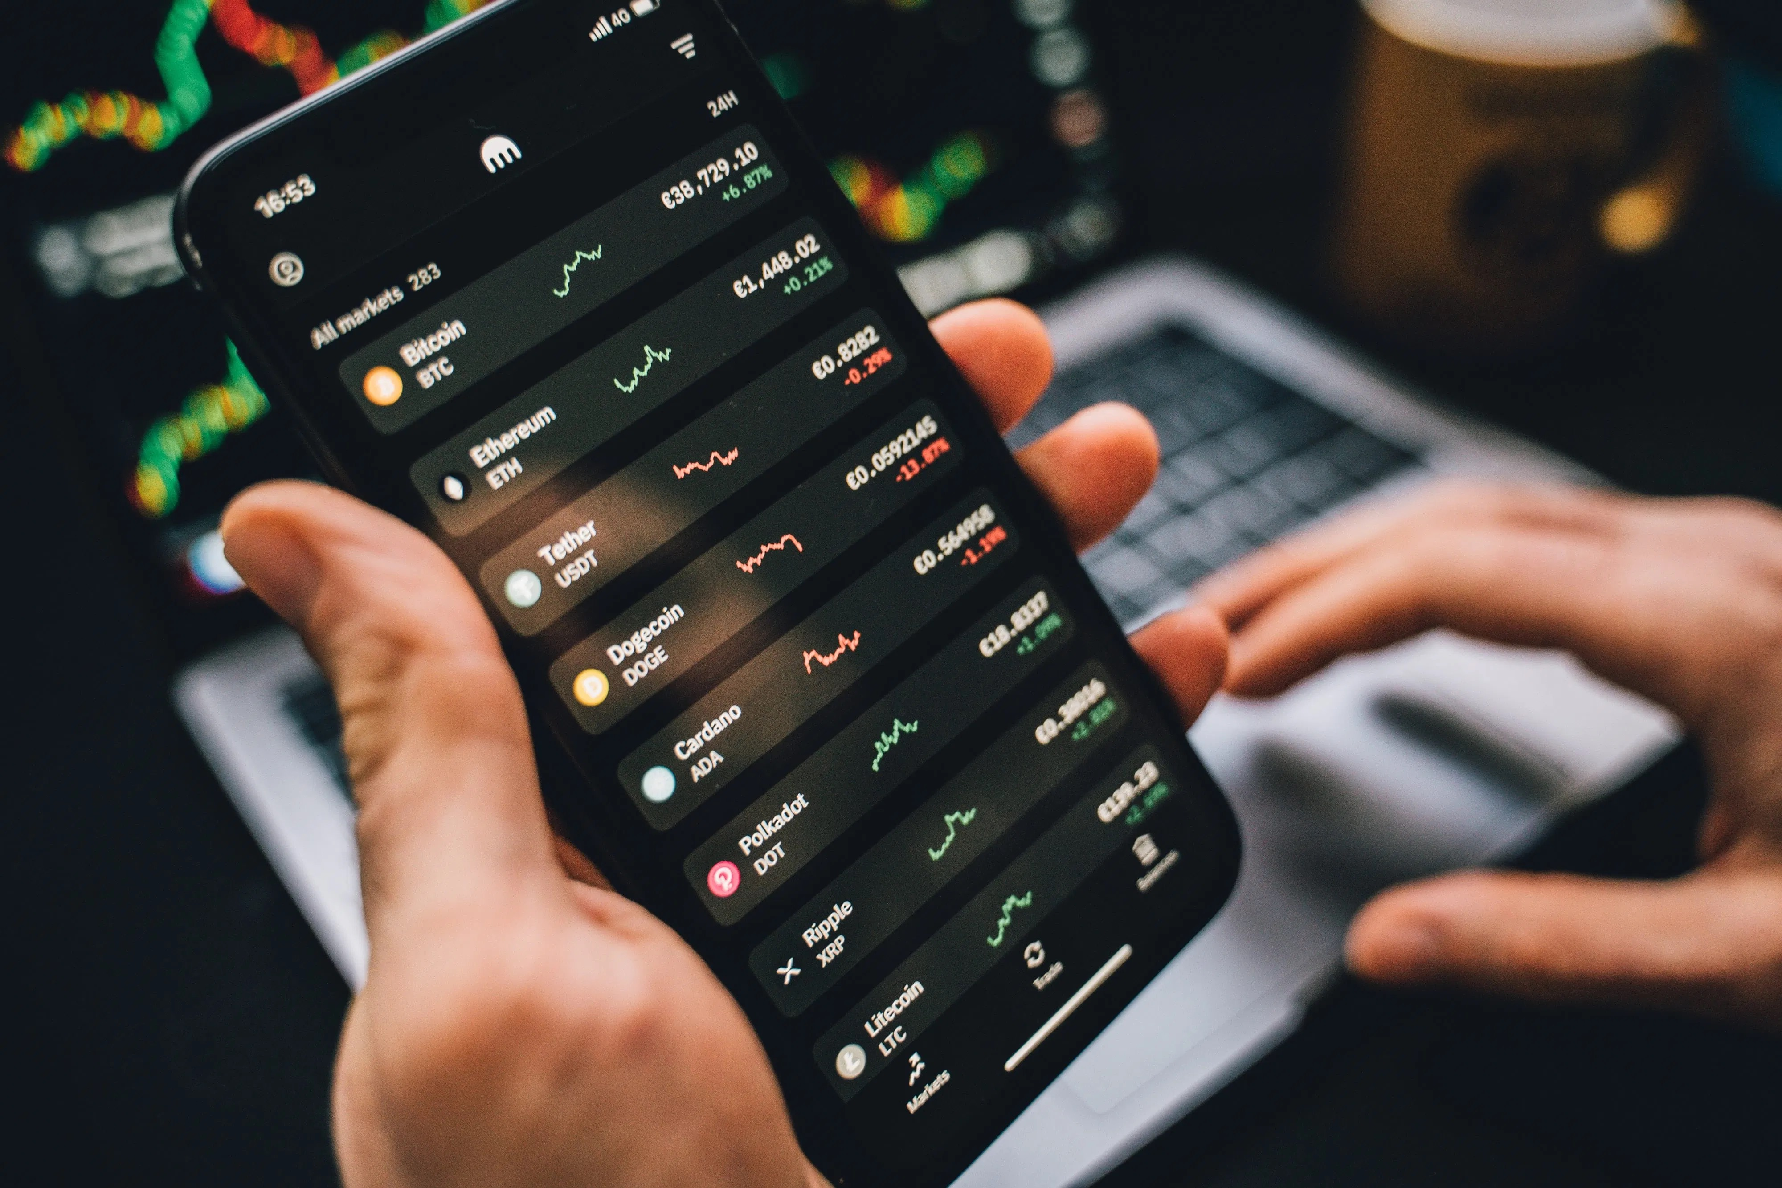
Still want to try?
The Financial Conduct Authority
has banned UK based exchange
from trading crypto.
Research, research, research
Open a dummy trading account
e.g. eToro
Form a strategy
Know what you are prepared
to lose - virtual money
Practice and build up skills, knowledge and experience
Notes:
The FCA has banned Binance - largest crypto exchange in the world based in the U.K.
This is because of concerns over money laundering and also because it would be a regulated company operating in non regulated crypto.
Research and read as much stuff as you can find.
When you are confident you know how the whole scheme works, including getting your money out again then open a dummy trading account. An example is eToro.
Even though this is virtual money treat it as the real thing.
Set yourself a limit of what you can lose - stick to it.

Slide 11
Only then….
Think about your market
How are you going to fund it?
Not with credit - EVER
What exchange - Coinbase largest
How will you store your crypto?
Set up and control your own wallet
Be prepared to lose all of your money - if you aren’t prepared
for this - don’t trade
Notes:
What cryptocurrency will you trade?
Depending on the cryptocurrency you may buy whole coins or fractions of coins.
What exchange will you trade in - Coinbase based in the USA is the most trusted.
They may all charge different fees.
Some may be more helpful and/or more secure than others.
Can you set up and control your own wallet - eg Coinbase wallet
Not everyone can make money - if it doesn’t work don’t chase it.

Slide 12
Good luck!
Notes:
What cryptocurrency will you trade?
There are many different vehicles to trade for each crypto - futures, leveraged (eg Finance for Bitcoin), forks - learn about all of them.
What exchange will you trade in?
They may all charge different fees.
Some may be more helpful than others.
Some may be more secure than others.
Can you control your wallet - eg coinbase wallet
Not everyone can make money - if it doesn’t work don’t chase it.

