Slide 1
FIRST IMPRESSIONS
You can only make one first impression
WizeUp Financial Education

Slide 2
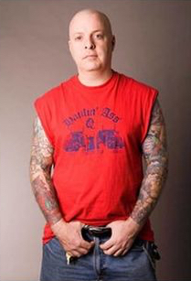
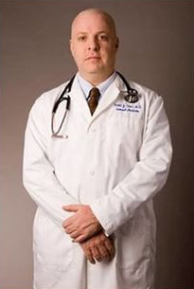
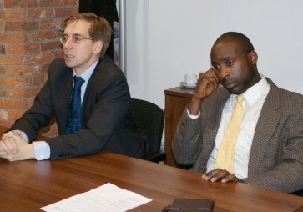
This is Bob
Bob is 42 years old
WizeUp Financial Education
WizeUp with Jack Petchey
Notes:
Two ways to get support
Loans - repayable from student loan company (government agency)
Bursaries and scholarships - non repayable from companies, universities

Slide 3
First Impressions
First impressions formed in first 7 seconds
55% based on appearance
Weak handshake not good - shyness
Don’t lay your hands on the table - controlling
Maintain eye contact - confident
Don’t stare - aggressive
Don’t tap or fidget - nervous
Don’t leave your phone on the table - lack of engagement
Don’t run late - unreliable and disorganised
WizeUp Financial Education
WizeUp with Jack Petchey
Notes:
Two ways to get support
Loans - repayable from student loan company (government agency)
Bursaries and scholarships - non repayable from companies, universities

Slide 5
Faults
Late
Didn’t phone ahead
Didn’t know the name of the person she was seeing
Impatient
Threw bag
Talking on phone in interview room
Sat down to shake hands
Complained about last employer
Wasn’t proactive in finding work
Belittled previous jobs
Doesn’t stay at any job very long
Didn’t get on with workmates
Phone not switched off - answers it!
Her answers are inconsistent
Blames others
WizeUp Financial Education
WizeUp with Jack Petchey
Notes:
Two ways to get support
Loans - repayable from student loan company (government agency)
Bursaries and scholarships - non repayable from companies, universities

Slide 6
Online
Test the tech - Organised
Find a distraction free area - Professional
Dress smartly & appropriately - Serious
Be on time but not early - Gatecrash
Have some questions written down - Prepared
Speak slowly - Internet connection
WizeUp Financial Education
WizeUp with Jack Petchey
Notes:
Two ways to get support
Loans - repayable from student loan company (government agency)
Bursaries and scholarships - non repayable from companies, universities

