Slide 1
FLAT SHARING
Fun, pitfalls and possible problems
WizeUp Financial Education

Slide 2
Flat and House Sharing
Reduce the cost of renting
Split living costs
Make new friends
WizeUp Financial Education
WizeUp with Jack Petchey

Slide 3
Before Moving In
Guarantor
WizeUp Financial Education
WizeUp with Jack Petchey

Slide 4
Before Moving In
WizeUp Financial Education
WizeUp with Jack Petchey

Slide 5
Before Moving In
WizeUp Financial Education
WizeUp with Jack Petchey

Slide 6
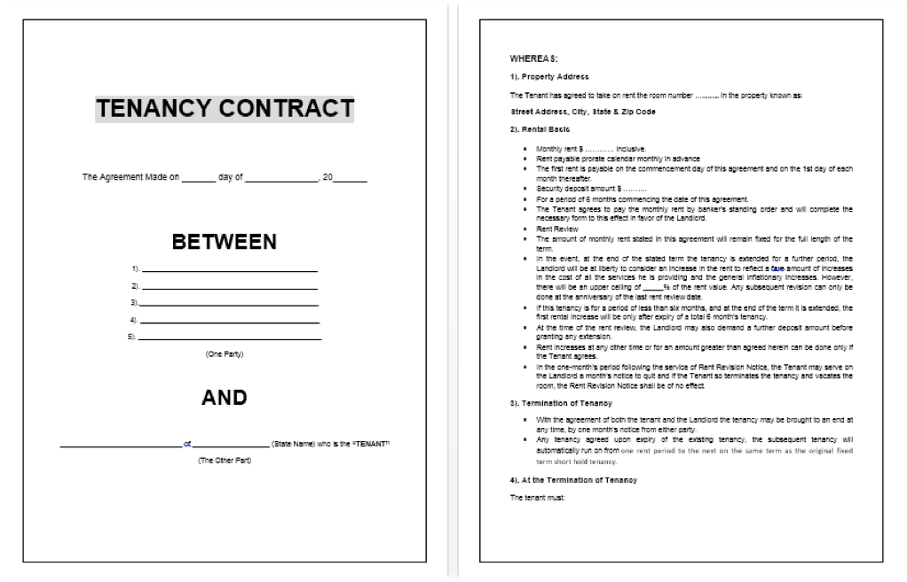
Before Moving In
WizeUp Financial Education
WizeUp with Jack Petchey

Slide 7
Your Rights
Fundamental rights don’t change regardless of tenancy agreement
You must be given contact details of landlord
Entitled to notice of entry except in an emergency
Landlord can’t change locks without notice
Landlord can’t cut off utilities
Landlord can’t go through your possessions
Landlord can’t open your mail
Landlord can’t threaten you physically or verbally
Property must be clean and safe when you move in
Building and furniture must be in good repair when you move in
Furnishings must meet safety regulations
Landlord must fix all repairs promptly
WizeUp Financial Education
WizeUp with Jack Petchey

Slide 8
Your Responsibilities
You must pay your rent on time
You must pay all of your household bills
You must repair all damages caused by you or those living with you
You must keep the flat secure, locking windows and doors and setting the alarm
You must keep the flat clean and tidy
You must return the flat in the same state as you found it at the end of your tenancy
WizeUp Financial Education
WizeUp with Jack Petchey

Slide 9
Possible Problems
Single or joint tenancy? -
Whose name on the bill?
Only one TV license?
Evicting a flat mate
Leaving early
Insurance
WizeUp Financial Education
WizeUp with Jack Petchey

Slide 10
Coping With Flatmates
Take other people’s habits into consideration
Sort out a parking arrangement
Having people stay
Shopping
Cleaning
Bills
WizeUp Financial Education
WizeUp with Jack Petchey

Slide 11
Before Moving Out
WizeUp Financial Education
WizeUp with Jack Petchey

