Slide 1
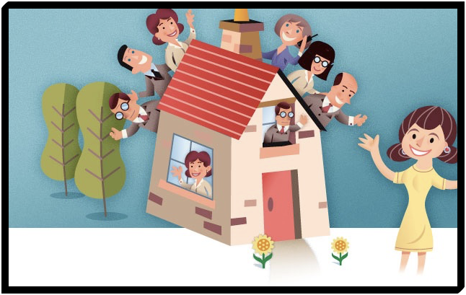
Flat & House Sharing
Why?
Reduce the cost of renting
Split living costs
Make new friends
Notes:
Most university students will have to move out of halls and into a flat in year 2,3 and 4
Friends you make when flat sharing can be lifelong friends
Can be miserable if you don’t get on.

Slide 2
Before moving in
Guarantor
Notes:
You will need to find a guarantor before moving in.
Guarantor will pay rent if you can’t
If you have a joint tenancy then the guarantor will have to cover ALL people under the joint tenancy.

Slide 3
Before moving in
Notes:
Make a list of EVERYTHING in the flat with photos
Put down condition
Everyone should sign including the landlord
Beware a ready made sheet from landlord

Slide 4
Before moving in
Deductions
Notes:
Deposit will be about 1 month rent and payable in advance
Money must be paid into the tenancy deposit scheme by landlord
TDS is government backed
Beware landlord who isn’t aware of TDS

Slide 5
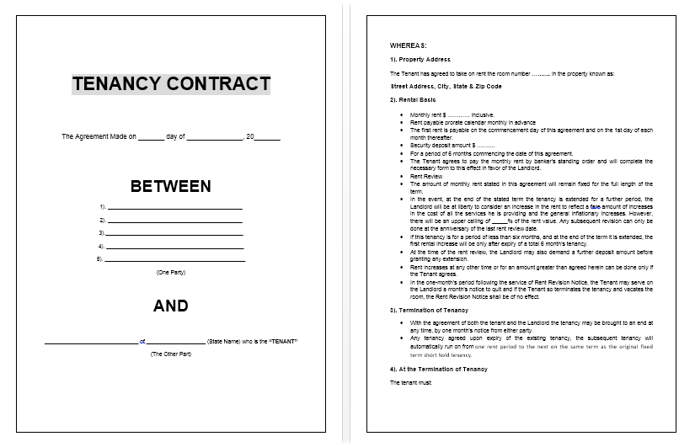
Before moving in
Notes:
No legal need for written tenancy agreement
Discuss single tenancy and joint tenancy with students

Slide 6
Your Rights
Fundamental rights don’t change regardless of tenancy agreement
You must be given contact details of landlord
Entitled to notice of entry except in an emergency
Landlord can’t change locks without notice
Landlord can’t cut off utilities
Landlord can’t open your mail
Landlord can’t go through your possessions
Landlord can’t threaten you physically or verbally
Property must be clean and safe when you move in
Building and furniture must be in good repair when you move in
Furnishings must meet safety regulations
Landlord must fix all repairs promptly
Notes:
Go through one or two of these depending on time - not all.

Slide 7
Your Responsibilities
You must pay your rent on time
You must pay all of your household bills
You must repair all damages caused by you or those living with you
You must keep the flat secure, locking windows and doors and setting the alarm
You must keep the flat clean and tidy
You must return the flat in the same state as you found it at the end of your tenancy
Notes:
Again go through one or two but you should cover…
If locks and alarms have been left tenant MUST use them when the flat is empty.
Failure to do so means landlord can prosecute.

Slide 8
Possible problems
Single or joint tenancy? -
Whose name on the bill?
Only one TV license?
Evicting a flat mate
Leaving early
Insurance
Notes:
Go through each point

Slide 9
Coping with flatmates
Take other people’s habits into consideration
Sort out a parking arrangement
Having people stay
Shopping
Cleaning
Bills
Notes:
Talking first means these unlikely to happen.
Avoid confrontation.

Slide 10
Before moving out
Notes:
Landlord can legally make deductions
Breakages
Cleaning
Unpaid rent

