Slide 1

General taxation
Notes:
We will all pay around £1 million in tax throughout our lives.
Probably our biggest life ‘spend’
You’ve been paying it for years.

Slide 2
Name The Taxes
ICLAAPT/IAGSN/AXT
CAPITAL GAINS TAX
Notes:
Going to start with tax anagrams
Capital Gains Tax - see if anyone knows what it is.
Payable on things that you have bought to make a profit - second homes, shares, etc.
You get an annual allowance
You only pay tax on the portion above your annual allowance.
£8bn pa raised

Slide 3
Name The Taxes
MNOCEI/AXT
INCOME TAX
Notes:
Income tax
Ask how old you have to be to pay it - no age limit - as soon as you earn enough you pay it.
Explain roughly how it works but there is a whole separate topic on this.
£185bn pa raised

Slide 4
Name The Taxes
MASTP/UDYT
STAMP DUTY
Notes:
Stamp duty.
Payable when you buy a house or shares.
Amount varies with value.
£15bn pa raised

Slide 5
Name The Taxes
AENHITIECRN/AXT
INHERITANCE TAX
Notes:
Inheritance tax
Odd one out - paid by an estate not an individual.
There is an allowance - this is bigger on properties than on effects.
£4bn pa raised

Slide 6
Name The Taxes
AVT
VAT
Notes:
VAT
Ask what current rate is
Ask if it payable on all goods.
£145 bn pa raised

Slide 7
Name The Taxes
UEFL/UDYT
FUEL DUTY
Notes:
Fuel duty
Included in the cost of petrol and diesel
Will disappear as we move across to electric vehicles.
£30bn pa raised

Slide 8
Name The Taxes
HOAOLLC/UDYT
ALCOHOL DUTY
Notes:
Alcohol duty
Payable on beer, wine and spirits.
Amount is dependent on volume of alcohol.
£12.5bn pa raised

Slide 9
Name The Taxes
OADR/UNDF/CIENELS
ROAD FUND LICENSE
Notes:
Road fund license
Payable on all but electric cars annually
Amount is higher in first year and is determined by CO2 emissions.
Will disappear as we move across to EVs
£6bn pa raised

Slide 10
Name The Taxes
LUCIONC/AXT
COUNCIL TAX
Notes:
Council tax
Everyone pays it except students.
Amount varies with house size and location
Spent on local amenities
£34bn pa raised

Slide 11
Name The Taxes
PITRANOOROC/AXT
CORPORATION TAX
Notes:
Corporation tax
Paid by companies in UK on their profits.
£55bn pa raised.

Slide 12
Direct Taxes | Indirect Taxes
Income Tax (£185bn) | VAT (£145bn)
Capital Gains Tax (£8bn) | Fuel Duty (£30bn)
Stamp Duty (£15bn) | Alcohol Duty (£12.5bn)
Inheritance Tax (£4bn) | Road Fund License (£6bn)
Council Tax (£34 bn)
Corporation Tax (£55bn)
Notes:
All these taxes can be divided into direct taxes - no individual choice - you earn it you pay it!
Or indirect taxes. Some personal choice - don’t want to pay it don’t buy or use it!

Slide 13
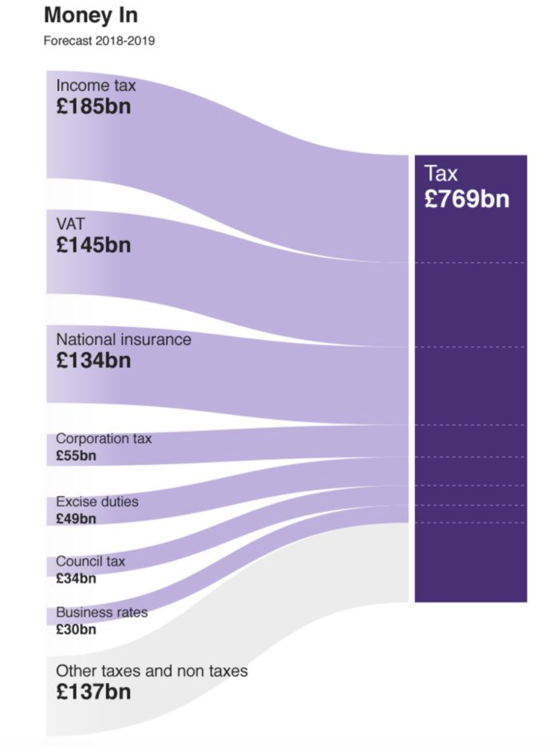
Notes:
Overall income is around £770bn per year

Slide 14




Where does it go?
Notes:
Ask students where they think it is spent and then go through one by one.

Slide 15
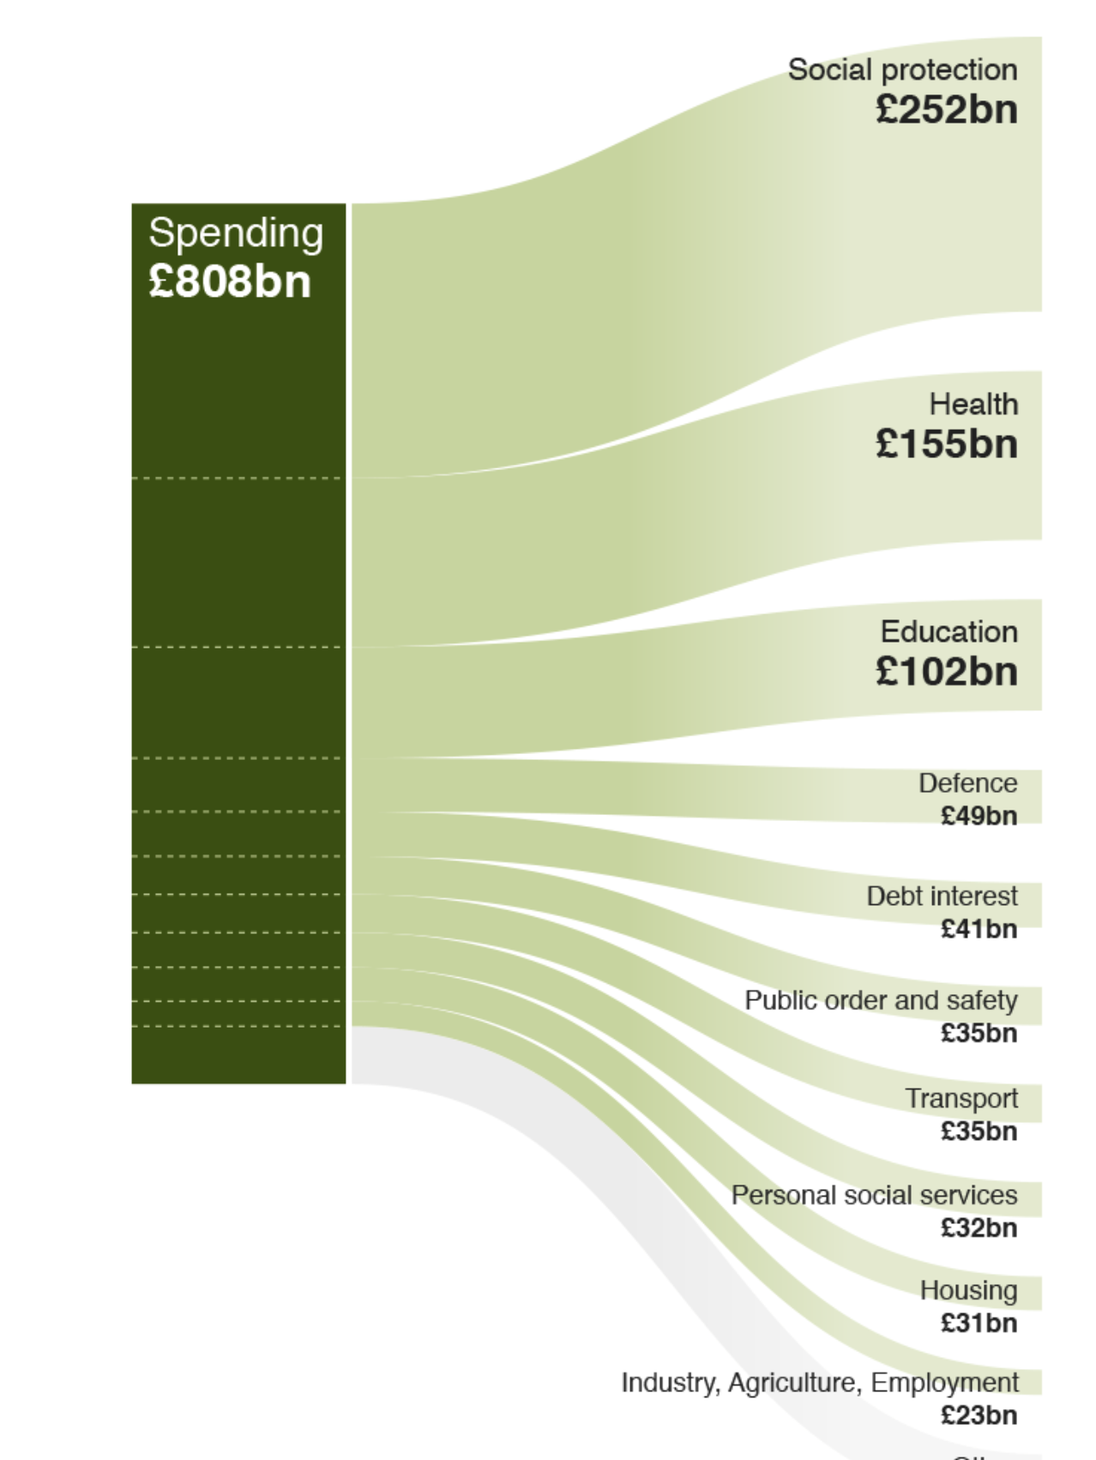
Notes:
Total spend is over £800bn so more going out than coming in.
Revenue likely to fall as EVs come to the fore.
Should this be replaced with other taxes - increase income tax or VAT?
Should some services be cut to balance the budget?
Opportunity for class debate

