Slide 1

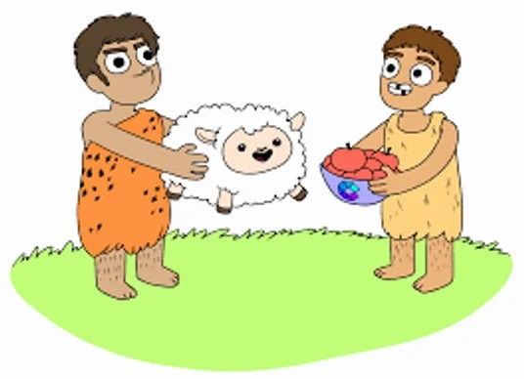
THE HISTORY OF MONEY
CHANGES OVER TIME
WizeUp Financial Education

Slide 2
WizeUp Financial Education

Slide 3
Barter -
About 11,000 Years Ago
WizeUp Financial Education

Slide 4
Tokens -
About 4,000 Years Ago
WizeUp Financial Education

Slide 5
Money Box -
About 3,500 Years Ago
WizeUp Financial Education

Slide 6
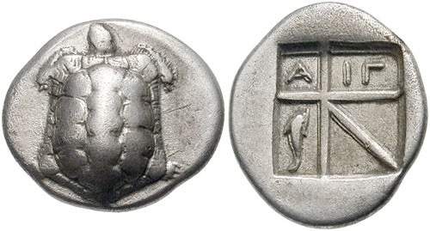
First Coins -
About 2,500 Years Ago
greek drachm from 2,500 years ago
WizeUp Financial Education

Slide 7
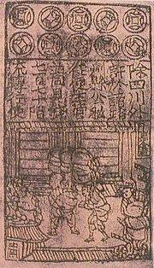
First Paper Money -
About 1,000 Years Ago
Jiaozi - first banknote
WizeUp Financial Education

Slide 8
Goldsmiths - Earliest Banks
About 500 Years Ago
WizeUp Financial Education

Slide 9
About 400 Years Ago
WizeUp Financial Education

Slide 10
Decimalisation -
About 50 years Ago
WizeUp Financial Education

Slide 11
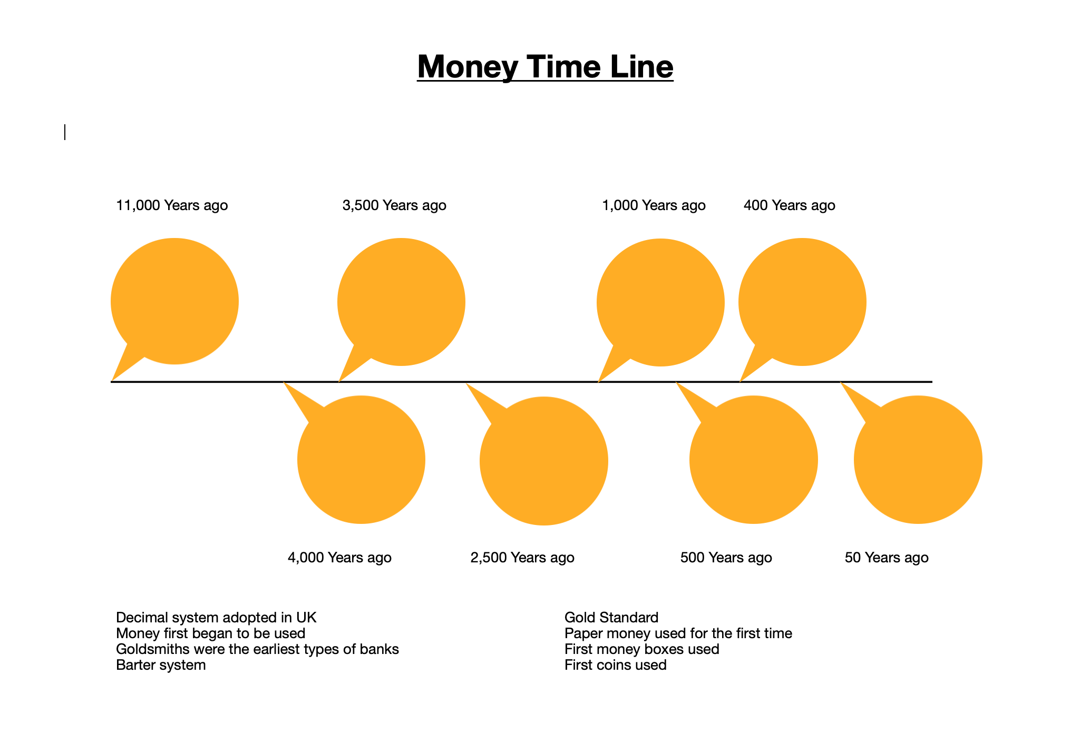
WizeUp Financial Education
WizeUp Financial Education

