Slide 1
The history of money
Changes over time
Notes:
Cash and contactless payments have been around for a short space of time.

Slide 2
Notes:
This might be the last generation to use cash.
Ask how much a £20 note is worth.
<1p - so why do we accept its face value?

Slide 3
Barter - about 11,000 years ago
Notes:
The first transactions done by swapping goods of services - bartering
Longest surviving transactional process
No fixed exchange rate - ie how many shaves of corn = 1 sheep
Wealth couldn’t be stored
Weather could rob people of their crops and ‘money’
Might need to third party if seller does not want buyers goods

Slide 4
Tokens - about 4,000 years ago
Notes:
Tokens started to be used 4,000 years ago
Not just pebbles but metal too
Lots of work done on pebbles to make them difficult to copy - counterfeit
These could be stored and swapped for services.

Slide 5
Money Box - about 3,500 years ago
Notes:
People wanted to save
First money box 3,500 years ago
Started life as clay bee hives
Early example of recycling

Slide 6
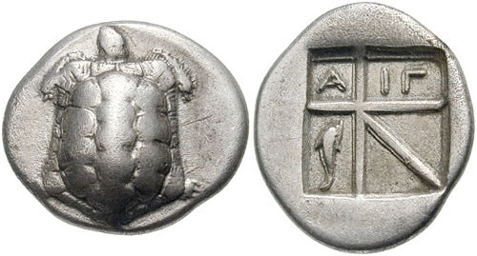
First Coins - about 2,500 years ago
greek drachm from 2,500 years ago
Notes:
Tools became more advanced so counterfeiters able to copy tokens.
So first coins came in 2,500 years ago
Elaborate and had an intrinsic value - hard to copy
Rounded so easier to handle
Different coins had different values.

Slide 7
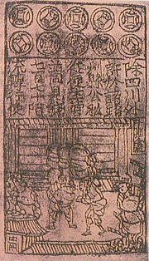
First Paper Money - about 1,000 years ago
Jiaozi - first banknote
Notes:
As wealth grew hoards of coins were very heavy and difficult to transport
1,000 years ago paper money introduced in China
Elaborate but difficult to persuade people to give up silver and gold for paper
Didn’t catch on

Slide 8
Goldsmiths - Earliest Banks - about 500 years ago
Notes:
Goldsmiths were in UK
Made plates, cutlery, jewellry from precious and precious metals
These were stored in vaults which were guarded 24/7
Offered to look after peoples money in return for a small fee
This made them the first banks

Slide 9
About 500 years ago
Notes:
People were still reluctant to use paper money
Government came up with an idea whereby people could exchange paper money for its value in gold.
This was the gold standard.
Confidence in paper money grew.
Lasted until 20th century.

Slide 10
Decimalisation - 1969
Notes:
Up until this point there were 20 shillings in a pound and 12 pennies in a shilling.
Some companies used guineas - very confusing for trade.
In 1969 we moved across to current system
Difficult for people to adapt - conversion charts everywhere and shops had to show two prices - old and new money.

Slide 11
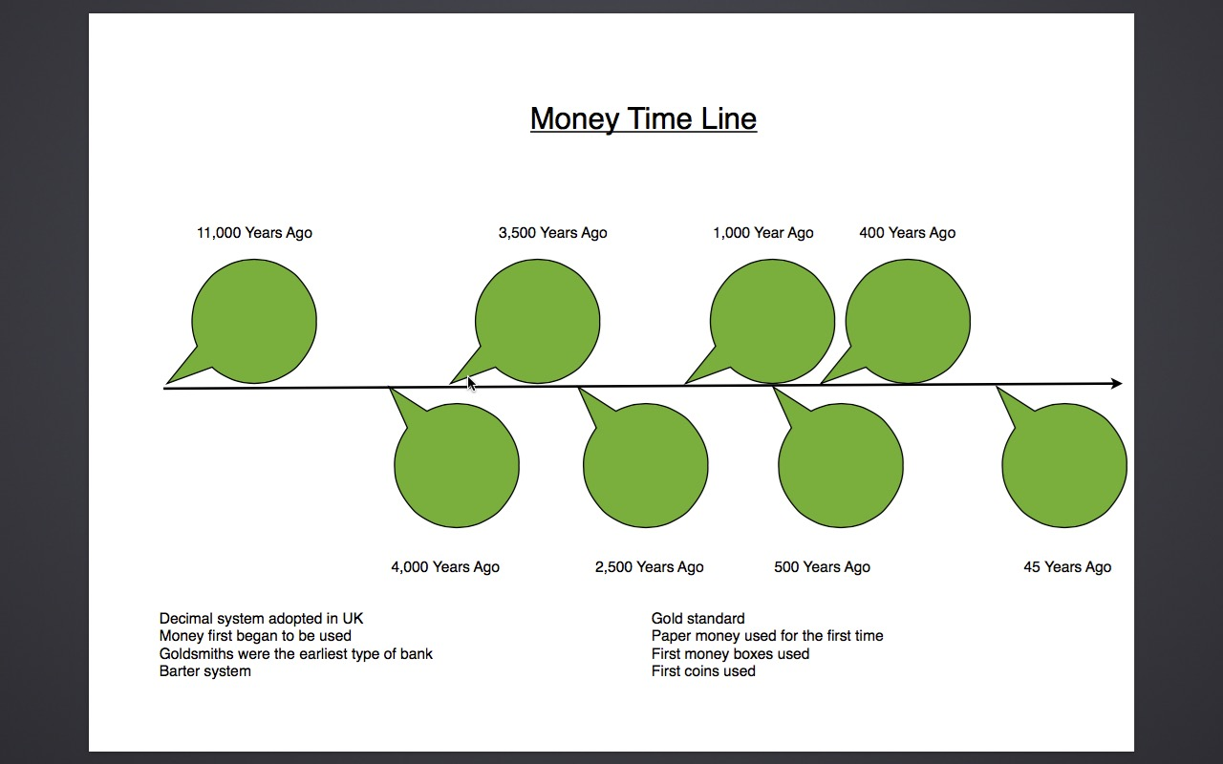
Notes:
Ask students to fill in time line

Slide 12
Notes:
Answers

Slide 13
Wizeupfinancialeducation.co.uk
Twitter: @wizeupme

