Slide 1
Income tax & national insurance
Notes:
This is the largest tax you will pay
No minimum age to start paying income tax

Slide 2
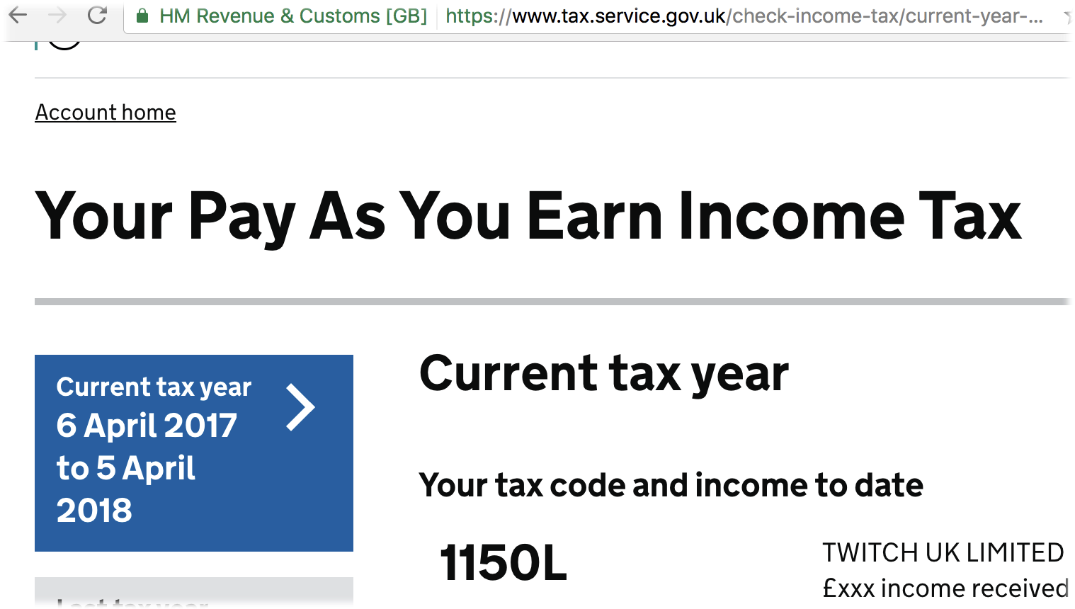
Income Tax
Notes:
Ask how many people are working
Ask if they look at their payslips
If they do ask them what their tax code is

Slide 3
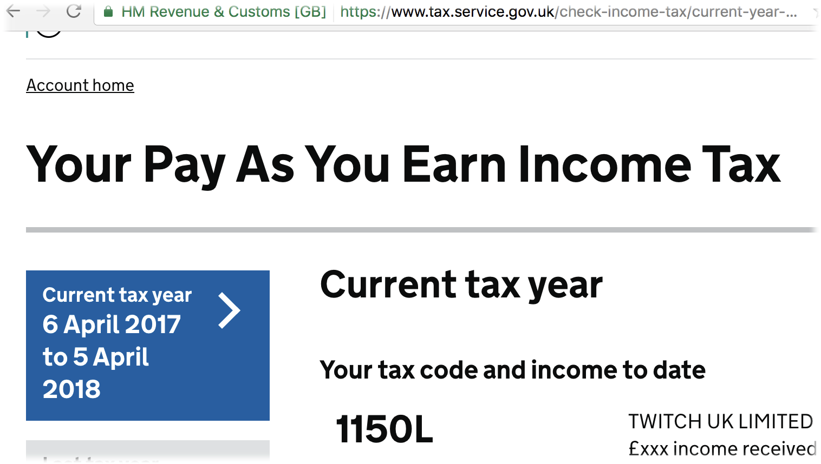
Personal allowance
Everyone gets a personal allowance
You don’t pay tax on your personal allowance
You can find out how much your personal allowance is through your tax code
This year it is £12,500 (Code 1250X)
Notes:
Tax code tells us what our personal allowance is
Take off the letter at the end and replace it with a 0
That’s the amount of money we can earn every year without paying tax
If it’s wrong it’s you responsibility to get it sorted

Slide 4
How much do you pay?
Depends how much income you have.
Up to personal allowance = 0%
Basic rate on next £37,500= 20%
Higher rate on £37,501 - £150,000 over personal allowance = 40%
Top rate on anything above £150,000 over personal allowance = 45%
Notes:
Amount of tax paid goes up with income.
Nothing on amount up to personal allowance
20% on next £37,500 = basic rate
40% on next portion up to £150k = higher rate
45% on anything over £150k = top rate
Bonuses and perks are all taxable

Slide 5
EXAMPLE
Earnings are £62,000, tax code is 1250L
0% on first £12,500 = 0
20% on next £37,500 = £7,500
40% on final £12,000 (£62,000 - £12,500 - £37,500) = £4,800
So the tax bill for that tax year would be £7,500 + £4,800 = £12,300
Notes:
Go through example - find out with show of hands what students think the take home pay will be

Slide 6
£62,000
£12,300
£49,700
Notes:
Graph showing the same thing
Gross pay is before any stoppages
Net pay is after all stoppages - not just income tax
May have to pay student loan repayments and national insurance too

Slide 7
PAYE
If you work for an employer tax will be deducted from salary each month -
Pay As You Earn (PAYE)
On the example this would be £1,025.00 each month
Notes:
Tax is deducted by your employer (if you are employed by one)
They do the calculation we have just done and divided the tax due by 12 and then deduct this amount every month
If you are self employed then you have to ensure that you keep enough money back to pay what you owe.

Slide 8
National Insurance
If you work for an employer it is deducted directly from earnings
Go towards your state-pension
Given a N.I. number at age 16
Can earn £8,632 without paying N.I.
12% of earnings between £8,632 and £50,024*
2% of earnings above £50,024
*You pay a lower rate if you are a member of a company scheme
Notes:
This is deducted by your employer or you have to pay it yourself annually if you are self employed
Can be up to 12% but will be less if you have a company pension
NI goes toward your state pension
Currently starts aged 66 and is about£170 per week
Company or personal pensions are different and can be claimed from 55
Amount varies depending on pot size

Slide 9
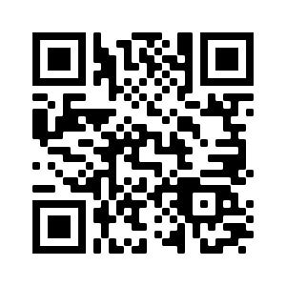
Wizeupfinancialeducation.co.uk
Twitter: @wizeupme

