Slide 1
Interview technique
The importance of first impressions
Notes:
With perhaps 200 people going for the same job you need to have a strong interview technique to make the most of any opportunity.

Slide 2
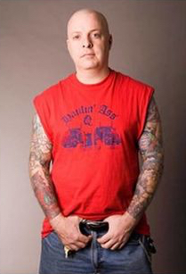
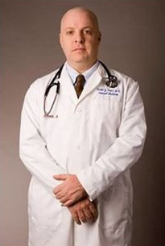
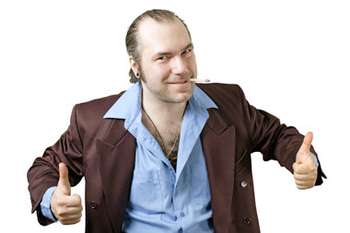
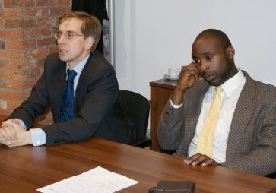
This is Bob
Bob is 42 years old
Notes:
Ask students what they think Bob does for a living
Ask students who they would buy a used car off of
Ask students who they would ask back for a second interview

Slide 3
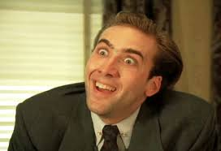
First impressions
First impressions formed in first 7 seconds
55% based on appearance
Weak handshake not good - shyness
Don’t lay your hands on the table - controlling
Maintain eye contact - confident
Don’t stare - aggressive
Don’t tap or fidget - nervous
Don’t leave your phone on the table - lack of engagement
Don’t run late - unreliable and disorganised
Notes:
Things that we look for when making a first impression

Slide 4
Before you go….
Re-read your C.V. and covering letter
Think about your skills and how they fit
Research the company
Structure, market position, management style, size, income streams, core business, major competitors
Prepare a few general questions
Prepare a strong 1 min pitch
Think about how you could improve
Practice with dummy interviews
Notes:
The interviewer will have a copy of your CV so worth re-reading it before you go in
Think about your skill set and how its suited to the job
Always know what type of question you might ask
You will probably be asked to ‘tell us something about yourself’ - be prepared
Even if it doesn’t go well think about the things you could improve then go and practise them

Slide 5
Before you go….
Test the route
Check for disruptions
Dress smartly & appropriately
Brush your teeth
Arrive 10 minutes early - no more
Turn off your mobile before you go in
Don’t worry if you feel a bit nervous
Notes:
Never be late but don’t get to the office too early either
Get to the area early and find a coffee shop to prepare and get ‘in the zone’
Mints in your pocket or bag may help confidence
Nerves are normal - they are not negative - it’s because this matters
Better prepared = less nerves

Slide 6
Dress
Men
2 piece suit - in blue, black or dark grey
Plain, long sleeved shirt
Avoid bright or character tie
Dark socks
Black leather shoes
Black belt
Traditional watch
Minimal jewellery - certainly no earrings
Notes:
Don’t take a gamble on too much Jewellery - chance interviewers might take a wrong first impression

Slide 7
Dress
Men
Women
Trousers are fine
Knee length skirt - no slits
Minimal jewellery
Business-like footwear. No extremes
Plain tights
Small handbag
Notes:
Conservative is best - avoid fashion statements (unless you’re after a job in fashion!)

Slide 8
In the interview
Try to be proactive and ask your own questions
Give the interviewer your full attention
Make sure you understand what has been said
Maintain eye contact
Smile, relax, don’t fidget & don’t slouch
Stay alert & confident
Don’t speak in a monotone
Be clear and precise
Notes:
Go through points

Slide 9
Questions you might be asked
What experience do you have that will benefit the job?
What are your greatest strengths and weaknesses?
What interests you most about the job?
What are your biggest accomplishments?
Can you work well under pressure?
Where do you see yourself in 3-5 years time?
How do you handle criticism?
What can you do for us that somebody else can’t?
How do you take direction?
Do you prefer working alone or with others?
Why do you want this job?
What motivates you?
What are your career goals?
How would you describe yourself?
Notes:
No need to go over all of the questions
Two or three of these are bound to crop up
Have answers already prepared

Slide 10
Questions you might ask
What would the key tasks and responsibilities be?
What support and guidance be?
What would the reporting line be?
What training would there be?
What are the future strategies for the department or company?
Questions you shouldn’t ask
Anything controversial
How long will the interview be?
What is the salary?
How much holiday is there?
Notes:
These are some of the questions you might
Never look at watch or ask about money until the topic is raised by the interviewer (possibly third interview)

Slide 11
Afterwards...
Finish by saying how much you would like the job
Get business cards from all of the interviewers
Thank the interviewers by name
Take notes right away
Write thank you letters within 24 hours
Notes:
If you are given business cards lay them out on the desk in front of you in order - then you can use them to remember names
Make personal notes on the back of the card afterwards
Always write to thank them for the opportunity even if it’s a bad interview

Slide 12
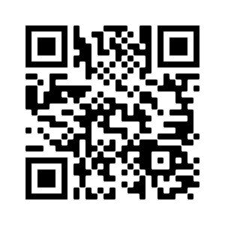
Wizeupfinancialeducation.co.uk
Twitter: @wizeupme

