Slide 1
PENSIONS
FROM PERSONAL PENSIONS TO STATE PENSIONS
WizeUp Financial Education
WizeUp with Jack Petchey

Slide 2
What Is a Pension?
Its a pot or pots of money which you save whilst you are working which can be used to support yourself after retirement
WizeUp Financial Education
WizeUp with Jack Petchey
Notes:
Ask if students have a definition of a pension.
Explain what a pension is.

Slide 3
Choices After Retirement
Scraping by - State pension
Managing - State + small work pension
Managing well - State + good work pension
Having a fabulous retirement - State + great pensions
Helping your children - State + great pensions
WizeUp Financial Education
WizeUp with Jack Petchey
Notes:
These are the general choices that you might have.
What would you prefer.
The later you leave it to look at your choices the less there will be.

Slide 4
Types Of Pension
State pension
Workplace pension
Personal pensions
Stakeholder pensions
Self-invested personal pensions (SIPPs)
NEST pensions
Multi-employer pension schemes
Pensions for the self-employed
Your first pension – the options
WizeUp Financial Education
WizeUp with Jack Petchey
Notes:
Explain there are lots of different types of pension.
Everyone can have more than one.
We will look at state pension and workplace pensions including NEST pensions and personal pensions

Slide 5
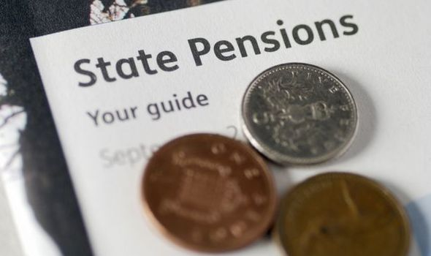
State Pension
Regular payment
Amount varies with N.I. contributions
35 years for maximum amount
£179.60 is maximum amount
Currently payable at 66
Difficult to live on this alone
WizeUp Financial Education
WizeUp with Jack Petchey
Notes:
Almost everyone gets a state pension although not everyone gets the same amount.
You pay into your state pension through national insurance contributions which are taken from your salary every month by your employer.
You need to have paid 35 years of contributions to get a full state pension.
Ask if anyone knows the state pension amount. Tell them what it is.
Ask if anyone knows the age at which you can get your state pension. Tell them it is 66 although this age is rising. It is likely to be over 70 by the time these students get there.
Why is that fair? Life expectancy.
Not about when you get it - more about how long you receive it for.

Slide 6
National Insurance
If you work for an employer it is deducted directly from earnings
Go towards your state-pension
Given a N.I. number at age 16
Can earn up to £8,632 without paying N.I.
12% of earnings between £8,632 and £50,024*
2% of earnings above £50,024
*You pay a lower rate if you are a member of a company scheme
WizeUp Financial Education
WizeUp with Jack Petchey
Notes:
This is deducted by your employer or you have to pay it yourself annually if you are self employed
Can be up to 12% but will be less if you have a company pension
NI goes toward your state pension

Slide 7
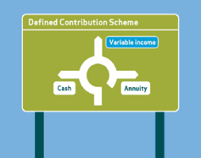
Workplace Pension
Pot built up using your contributions and your employer’s contributions.
Your contributions are tax free!
Money is invested by a pension fund.
Size of your pot depends on how much has been
put in and how the investments have fared.
You can access the money from 55
You can take 25% of pot value as a lump sum tax free
The remainder will be used to pay you a monthly allowance.
If you leave the job before retirement you can leave the pension where it is or transfer it.
WizeUp Financial Education
WizeUp with Jack Petchey
Notes:
Often known as defined contribution scheme.
You pay into the scheme - often employers will match what you put in.
Contributions are tax free.
Employers will deduct your contributions from your monthly salary before tax.
This amount is usually a percentage of your earnings although you can choose to pay more in.
The money is managed by a pension fund on behalf of the company.
The pot size will depend on three things:
Size of your contributions
Size of your employers contributions
Growth of the pension fund.
This money can be drawn down from 55 but not before.
When you draw down your pension (at 55 or later) you can take up to ¼ of your pension pot as a tax free lump sum.
The remainder will be paid as a monthly payment, just like a salary and you will be taxed on this bit in the normal way.
If you leave the company you can do several things with your pension:
Leave it where it is - it will continue to grow.
Move it to your new company scheme.
Transfer it to a personal pension scheme - you can choose the pension fund who manages it.
If a company goes bust you pension pot is safe - it can’t be used to pay off the company debt.
Don’t try to manage it yourself though.

Slide 8
NEST Pension
NEST is a simple Government backed pension scheme
Both you and your employer contribute to your pension while you are working
Your employer must enrol you in a NEST scheme
if there is no company pension scheme as long
as you are 22 and earning more than £10,000
You can transfer out of a NEST scheme into another pension scheme
You can access your NEST pension at 55
WizeUp Financial Education
WizeUp with Jack Petchey
Notes:
These were set up by the government to be used by small employers who don’t run their own pension scheme.
Every employee has to be offered a company scheme or a NEST pension by the time they are 22.
Works in a similar way to the defined contribution scheme we looked at earlier.
You can transfer your pension pot into another scheme when you want.

Slide 9
Pension Options
For Self Employed
State - No effort, low income
Ordinary personal pensions - common, fairly cheap
Stakeholder pensions - flexible, cheap
Self-invested personal pensions - lots of options, you are in control, expensive
WizeUp Financial Education
WizeUp with Jack Petchey
Notes:
These would be some of the options for people who are self employed.
Stakeholder pensions are very simple - pay in when you have it - don’t pay in when you can’t afford it.
They are cheap to run and popular with self employed people.
SIPP’s are more complicated and expensive but you can buy shares and property to put in your SIPP.
Careful though - you don’t own these things even though you bought them - your pension does.

Slide 10
What Are Your Dreams
For Retirement?
Make a list of what you want to do after you retire
Travel?
Hobbies and interests?
Family?
Buy a holiday home?
WizeUp Financial Education
WizeUp with Jack Petchey
Notes:
Get students to make a list of the things they think would be nice to do after they retire.

Slide 11
What Are Your Dreams
For Retirement?
How much per year will that cost?
Multiply that by 25
Thats roughly how much you will need in your pension pot.
WizeUp Financial Education
WizeUp with Jack Petchey
Notes:
Get them to think about the cost of doing these things - class discussion?
Then add everything up.
Multiply by 25 and this is roughly the size of the pension pot they will need.

Slide 12
Compounding Effect
Compounding is your friend
Start early for maximum effect
TO HAVE A PENSION POT OF £400,000 AT AGE 60
WILL COST £230 A MONTH IF YOU START AT 17
WILL COST £306 A MONTH IF YOU START AT 22
WILL COST £413 A MONTH IF YOU START AT 27
WILL COST £568 A MONTH IF YOU START AT 32
ASSUMES NET 5% RETURN EVERY YEAR
WizeUp Financial Education
WizeUp with Jack Petchey
Notes:
Talk about compounding effect and how this works for you in a pension.
Simple message - earlier you start saving the smaller the monthly contributions are.

