Slide 1
PRESENTING
Make an effective presentation
WizeUp Financial Education
WizeUp with Jack Petchey

Slide 2
Understand the subject and don’t be sidetracked
Have a clear idea of what you are going to say and why
Know your audience
Age: younger = shorter attention span
Size: smaller = longer
Experience: Will they understand the subject matter or will it be too simple or too difficult?
It’s normal to be nervous!
Final prices:
Beforehand
WizeUp Financial Education
WizeUp with Jack Petchey
WizeUp with Jack Petchey

Slide 3
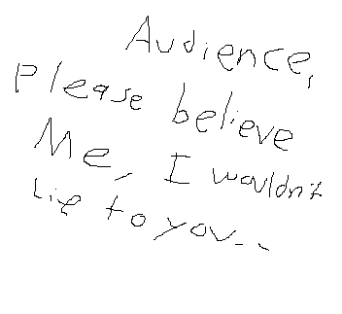
Preparation
Good preparation = planning + practice
This means 75% less nerves and 95% less mistakes
Know what you are trying to do
Inform?
Inspire?
Entertain?
Demonstrate?
Persuade?
Final prices:
WizeUp Financial Education
WizeUp with Jack Petchey
WizeUp with Jack Petchey

Slide 4
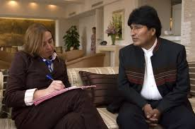
Research
What are your sources?
WizeUp Financial Education
WizeUp with Jack Petchey
WizeUp with Jack Petchey

Slide 5
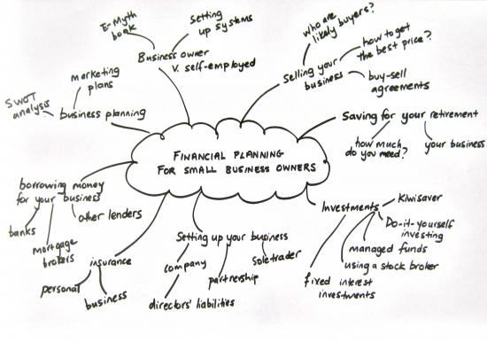
Brainstorm
Use a large piece of paper - A3 is good
Write anything down
Link similar topics with lines
Then arrange the material into groups and a logical format
Make sure you remember an introduction and a finish
Final prices:
WizeUp Financial Education
WizeUp with Jack Petchey
WizeUp with Jack Petchey

Slide 6
Don’t include slides, props or presentation techniques
Just write the words!
Make sure there is a beginning, a middle and an end
Allow for questions
Practice this before moving on
2D Script
WizeUp Financial Education
WizeUp with Jack Petchey
WizeUp with Jack Petchey

Slide 7
Blend in your presentation method
You can use…….
Slides
Case studies Stories
Examples Quotes Statistics
3D Script
Props Questions
Acronyms
Break it down into small sections with something fun in between
WizeUp Financial Education
WizeUp with Jack Petchey
WizeUp with Jack Petchey

Slide 8
Slides
Keep to a minimum - no more than 1 every 2 minutes
Keep simple
Minimal text
Use…
Bullet points
Colour
Pictures
Cartoons
WizeUp Financial Education
WizeUp with Jack Petchey
WizeUp with Jack Petchey

Slide 9
Practice!
In the 3D form
You don’t need an audience at first - use your phone to film it
Get an idea of timing
Use body language
When you are ready get a friend to watch
Accept criticism and refine the presentation
Final prices:
WizeUp Financial Education
WizeUp with Jack Petchey
WizeUp with Jack Petchey

Slide 10
Delivery
Final prices:
You are well prepared
Relax and enjoy it!
Emphasise the things you
do well
Smile and make eye contact
WizeUp Financial Education
WizeUp with Jack Petchey
WizeUp with Jack Petchey

Slide 11
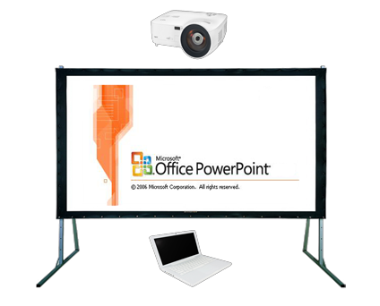
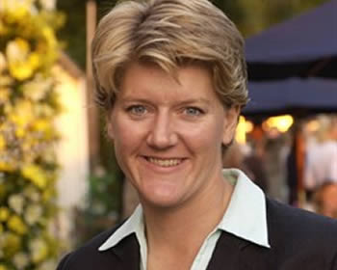
Secrets of success
Test the tech
Relax and be enthusiastic
Take things out of your pockets
Move around
Speak slowly!
Speak to the audience - not the screen
Don’t read from the slides
Try to use names when talking to the audience
WizeUp Financial Education
WizeUp with Jack Petchey
WizeUp with Jack Petchey

Slide 12
Finally!
Presentations will generally
take 20% longer to deliver
than when you rehearse
People will remember………
10% of what they read
20% of what they hear
Final prices:
50% of what they hear AND see
30% of what they see
70% of what they say
90% of what they say AND do
WizeUp Financial Education
WizeUp with Jack Petchey
WizeUp with Jack Petchey

