Slide 1
Presenting
Make an effective presentation
Notes:
Everyone will have to make a presentation at some point.

Slide 2
Beforehand
Identify the subject and don’t be sidetracked
Have a clear idea of what you are going to say and why
Research your audience
Age: younger = shorter attention span
Size: smaller = longer
Experience: Will they understand the subject
matter or will it be too simple?
It’s normal to be nervous!
Notes:
Before you start to do anything find out who you are talking to, for how long and about which subject.

Slide 3
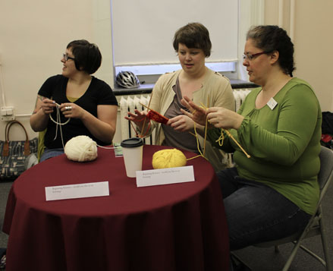
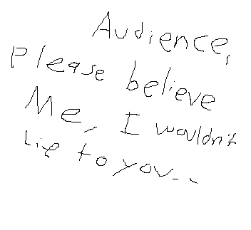
Preparation
Good preparation = Planning + Practice
Good preparation = 75% less nerves + 95% less mistakes
What are your aims?
Inform
Inspire
Entertain
Demonstrate
Persuade
Notes:
Preparation is everything.
List what your aims are

Slide 4
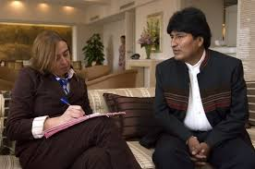
Research
Sources?
Notes:
Decide where you are going to research

Slide 5
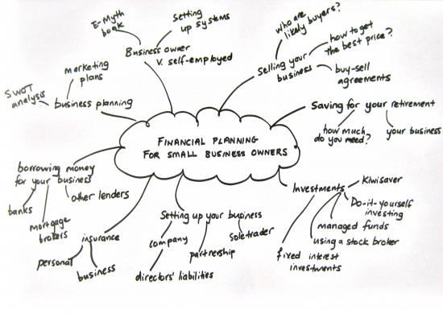
Brainstorm
Use a large piece of paper - A3 is good
Write anything down!
Link like topics with lines
Arrange into subject matter and then into a logical format
Notes:
Start to write
Brainstorming brings everything together on one page
Link things after
Then group things after into a logical format

Slide 6
2D Script
Don’t include slides, props or presentation techniques
Just write the words!
Make sure there is a beginning, a middle with headed sections and an end
Allow for questions at the end
Practice in rough first
Notes:
Write a script which doesn’t include slide and props
It should flow with a logical progression
Don’t lose sight of your aims

Slide 7
Turn it into a 3D Script
Blend in your presentation method
You can use
Slides
Case studies Stories
Examples Quotes Statistics
Props Questions
Acronyms
Break it down into small sections with something fun in between
Notes:
Once script is complete start adding things to bring it alive
This will lengthen the presentation by 10-15%
For younger audiences put more activities in
For older audiences put a story in every 15-20 minutes to break it up

Slide 8
Now practice!
In the 3D form
You don’t need an audience at first
Get an idea of timing
Use body language
When you are happy get a friend to watch
Accept criticism and refine the presentation
Notes:
Once you are happy start to practice
This will give you an idea of timing but in reality it will take 25% longer in real life
Get somebody to watch when you feel confident
Get feedback and refine the process
Look for slides that you can get out on if you start to run out of time

Slide 9
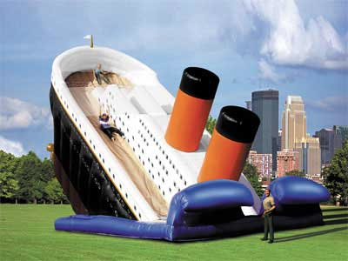
Slides
Keep to a minimum
No more than 2 different fonts
Keep simple
Not too much text on one slide
Use:
Bullet points
Colour
Pictures
Cartoons
Notes:
Keep slides to a minimum
Pictures worth 100 words
Careful not to make too gaudy

Slide 10
Delivery
You are well prepared - relax and enjoy it!
Smile and make eye contact with the audience
Try to make an impact in the first 10-15 seconds
Story or funny quote but not a joke
If people chat over you just stop and look at them
If you can’t answer a question - say so and go back after
Emphasise the things you do well!
Notes:
If you have prepared it will go well
Talk to the audience
You want them to listen to you not read the slides
Tell them who you are and what you are going to talk about
Tell them when they can ask questions

Slide 11
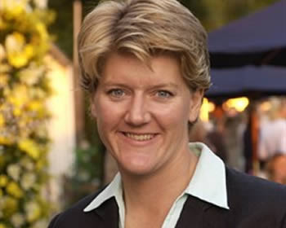
Secrets of success
Appear relaxed and enthusiastic
Turn off mobile phone!
Take things out of your pockets
Speak to the audience - not the screen
Don’t just read the slide!
Vary the pitch and tone of your voice
Try to address the audience by name
Use name badges or name plaques
Notes:
Try to relax and have a conversation with the audience
Don’t have things in your pockets
Don’t read off of the slide - they are there to support what you say not replace it.
Try to use names if possible

Slide 12
Secrets of success
Move around but don’t block the screen
Leave plenty of time to set up
Test aids first
Notes:
Test aids before - make sure everything is working.
If possible set up a laptop in front of you so you don’t have to turn around
Move around

Slide 13
Remember....
Presentations will generally take 20% longer to deliver than when you rehearse
People will remember:
10% of what they read
20% of what they hear
30% of what they see
50% of what they hear AND see
70% of what they say
90% of what they say AND do
Notes:
Younger audience means making it more interactive.

Slide 14
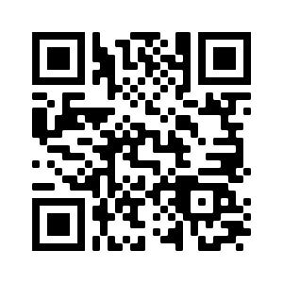
Wizeupfinancialeducation.co.uk
Twitter: @wizeupme

