Slide 1
Saving & investing

Slide 2

Saving & Investing
Notes:
Savings for the short term (under 2 years) and normally have something in mind.

Slide 3
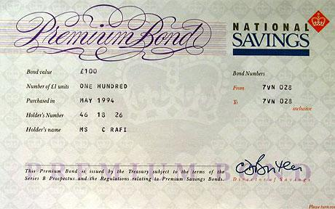
Saving

Slide 4
Do you use deals?

Slide 5
Things that might help after school
Automatic saving apps - Plum, Cleo
0% overdraft on student account
Budget sheet or app
Olio
Cashback apps
Student deals / Totum card
Amazon Prime student
Camelcamelcamel
16-25 railcard / coachcard
Kapten

Slide 6
Investing

Slide 7

Investment Products

