Slide 1
SETTING UP A BUSINESS
Fail to prepare – prepare to fail
WizeUp with Jack Petchey

Slide 2
WizeUp Financial Education
WizeUp with Jack Petchey

Slide 3
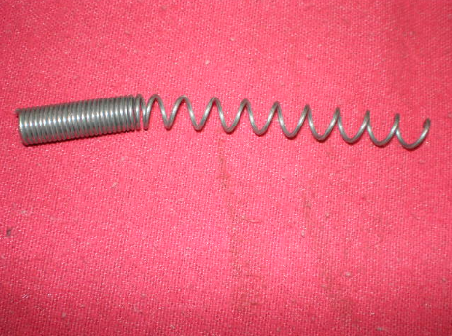
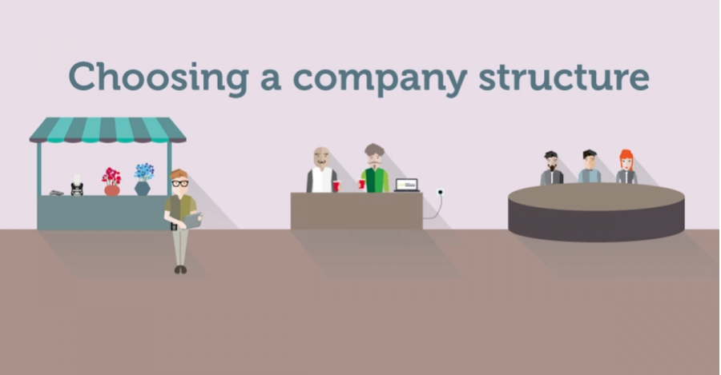
Then
WizeUp Financial Education
WizeUp with Jack Petchey

Slide 4
Business Plan
Summary
Who are you?
What are you selling?
Who are your customers?
Where is your market?
Market research
Marketing
Competition and comparison
USP
Logistics
Costs/Pricing
Financial forecasts
Back up plan
WizeUp Financial Education
WizeUp with Jack Petchey

Slide 5
Getting Help
WizeUp Financial Education
WizeUp with Jack Petchey

Slide 6
Getting Finance
Bootstrapping
Friends and family
Grants
Enterprise agencies
Micro loans
Bank Loans
Angels
Venture Capital
WizeUp Financial Education
WizeUp with Jack Petchey

Slide 7
Profits
 | What Happens To The Profits?
Sole Trader | Keep them as part of your income and pay tax accordingly
Partnership | Share them with each partner paying their share of tax
Limited Company | Owned by the company - 20% tax on profits - Dividends to share holders
WizeUp Financial Education
WizeUp with Jack Petchey

Slide 8
VAT
 | Do I have to pay VAT?
Sole Trader | Yes - if the turnover is more than £85,000
Partnership | Yes - if the turnover is more than £85,000
Limited Company | Yes - if the turnover is more than £85,000
WizeUp Financial Education
WizeUp with Jack Petchey

Slide 9
Register
 | Do I have to register the company?
Sole Trader | With HMRC as sole trader
Partnership | With HMRC as partnership
Limited Company | With companies house and with HMRC
WizeUp Financial Education
WizeUp with Jack Petchey

Slide 10
Accounts
 | How are accounts managed?
Sole Trader | By yourself or accountant through self assessment
Partnership | By partners or accountant through self assessments
Limited Company | Generally through accountant. Returns need to be made quarterly.
WizeUp Financial Education
WizeUp with Jack Petchey

Slide 11
Benefits
 | What are the benefits?
Sole Trader | Very simple. Your decisions. Your profits
Partnership | Mutual support. Complimentary skills. Share all profits.
Limited Company | Not total liability. Corporation tax is only 20%. Offset many costs.
WizeUp Financial Education
WizeUp with Jack Petchey

Slide 12
Drawbacks
 | What are the drawbacks?
Sole Trader | Total liability Could be paying 40% tax on profits Lonely!
Partnership | Total liability Could be paying 40% tax on profits All decisions have to be agreed
Limited Company | All decisions have to be agreed. Lots of deadlines to meet. Staff care.
WizeUp Financial Education
WizeUp with Jack Petchey

