Slide 1


Student Finance
Some debts are fun when you are acquiring them but none are fun when you set about retiring them..............
Ogden Nash
Notes:
This is for English universities only
Others in uk similar but not the same
Not available for overseas universities

Slide 2


Student Finance
Two types of financial support for students
Loans - repayable
Bursary/Scholarship - non-repayable
Notes:
Two ways to get support
Loans - repayable from student loan company (government agency)
Bursaries and scholarships - non repayable from companies, universities

Slide 3
Applying
When?
Earliest - February for that year, Latest - 9 months after the start of the academic year
Where?
Online
How often?
Every year - but if circumstances haven’t changed its one click online not the full process.
Notes:
Application process begins the end of the February that your course starts
Usually begins online in school or college
Parents will need to be involved
Application is only for one year - not whole course
Personal details need to be updated as they change
Then just a mouse click for subsequent applications

Slide 4

Loans for tuition fees
Maximum £9,250 per year
Full time
Maximum £11,100 per year
Accelerated course
Maximum £6,935 per year
Part time
Universities achieving TEF (Teaching Excellence Framework) status will be allowed to increase their fees in line with inflation - capped at £9,250 for 2020/21
Paid directly to your college or university each term
25% - 25% - 50%
Notes:
Loan will be in 2 parts.
1 to pay for tuition fees and 1 to pay for living costs.
Go through figures.
You can only borrow up to course fee
Universites can’t charge more than these maximums even if they are in TEF.

Slide 5

Loans for living costs
Maximum £7,747 per year
Minimum £3,410 per year
Notes:
Living costs - maintenance loan - there is a maximum and minimum.
Living at home is the most cost effective alternative.
No bills
Good chance that you will get somewhere between these two extremes.
Exactly where depends on household income

Slide 6
Loans for living costs
Maximum £9,203 per year
Minimum £4,289 per year
Notes:
Living away from home but not London.
Have to pay rent, bills, food, travel, entertainment out of this
Rents will vary a lot from place to place
Unlikely to cover real costs

Slide 7

Loans for living costs
Maximum £12,010 per year
Minimum £5,981 per year
Notes:
Expensive to live in London
Higher loan amount but higher rents and cost of living

Slide 8
Loans for living costs
Summary from April 2020
Living at home
Maximum £7,747 Minimum £3,224 per year
Living and studying outside London
Maximum £9,203 Minimum £4,289 per year
Living and studying in London
Maximum £12,010 Minimum £5,981 per year
Paid directly to your bank account - ⅓ each term
Notes:
Go through summary.
This element not available to non UK students

Slide 9
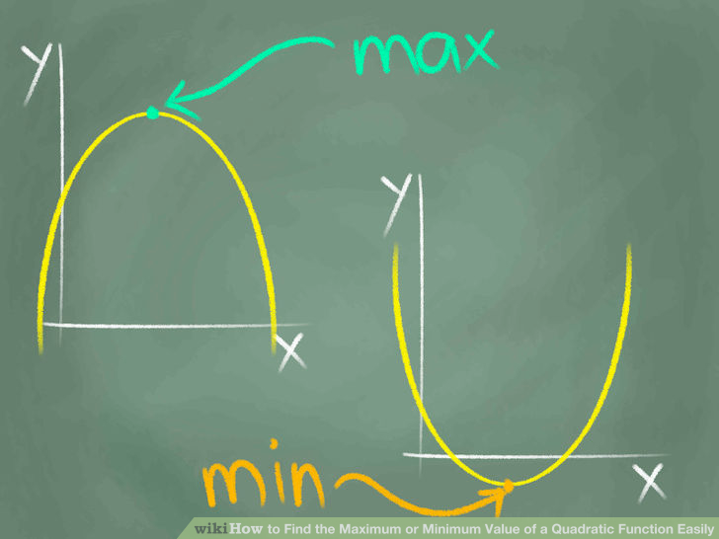
Loans for living costs
If combined household
income of
<£25,000
If combined household
income of
>£69,000 (varies)
Notes:
Exact amount of maintenance loan depends on household income.
Household income = salaries, interest on savings, dividends, benefits, pensions - everything except child maintenance payments.
For maximum loan HI needs to be less than £25k
If more than £59k (69k London) then only minimum.
More dependents living at home moves these amounts up

Slide 10




Loans for living costs
Other circumstances which may affect the amount you can borrow are if:
Notes:
Other things to increase the amount you can borrow.
Having own kids
Being a carer
Having physical or learning difficulties (more later)
Living alone

Slide 11



What will it cost?
Whilst at Uni…….
RPI +3%
Currently 2.6% for academic year 2020/21) + 3%
This is fixed at March RPI for the following academic year
If you take an average loan out of £45,000 it could cost you £2,520 per year just in interest at todays rates!
Notes:
Will be charged compound interest (interest on interest)
Whilst at uni -
3% over RPI (measure of inflation) - currently 5.6%
This is fixed annually (April for the March RPI) for the following academic year.
Average loan of £45k will cost more than £2.5k at the moment.
Bigger loan = more interest, smaller loan = less interest

Slide 12

What will it cost?
After graduation……
Earnings < £26,575 = RPI
£26,575 < Earnings < £47,835 = RPI + up to 3%
Earnings > £47,835 = RPI + 3%
Notes:
After uni interest amount depends on your earnings before tax

Slide 13


Repaying the loan
Depends on………
<£26,575 no repayments
> £26,575 you will have 9% of your earnings above £26,575 deducted.
If interest rates remain at current levels you will have you earn > £52,000 before you pay off any principal on a loan of £45,000
Notes:
Have to pay back 9% of earnings over threshold amount
This isn’t voluntary
Obligation to pay still there even if you work abroad.
In real terms you need to be earning >£52k just to cover interest

Slide 14


Student Loan
Student Tax
X
Notes:
Acts like a loan in some ways:
Principal given in expectation of repayment
Interest applied
Doesn’t act like a loan in other ways
Repayment doesn’t increase with increased principal
Has no bearing on credit rating
Better to think of it as a 9% tax on earnings above threshold amount and not a loan that needs to be repaid.

Slide 15



When will it all end?
Jennifer Aniston
Matthew McConaughey
30 years after loan repayments are due to commence. (April after graduation.)
At this point the loan is cancelled and the debt wiped out.
Notes:
There is an end date irrespective of outstanding debt.
30 years after graduation outstanding debt is wiped out.
So aged 51 there will be no more student debt
JA and MMC both 51

Slide 16
Disabled Student Allowance
Apply via DirectGov
Extra support will be available to those students with a mental health problem, long term illness or any other disability.
Specialist equipment allowance Up to £5,849 for the whole course
Non-medical helper allowance Up to £23,258 a year
General allowance Up to £1,954 a year
Notes:
Go through figures on slide

Slide 17

Bursary/Scholarship
College
University
Employer
Notes:
Scholarships given by faculty of university
Anyone can apply
Unlikely to be 100%
Bursaries given by companies
Work for them from 18 - they put you through university.
Graduate with no debt - cost is having to work for a period of time with same company
Might stifle choices

Slide 18
Ed Flack - e.flack@wizeup.me
THANK YOU!
www.wizeup.me
Twitter - @wizeupme

