Slide 1
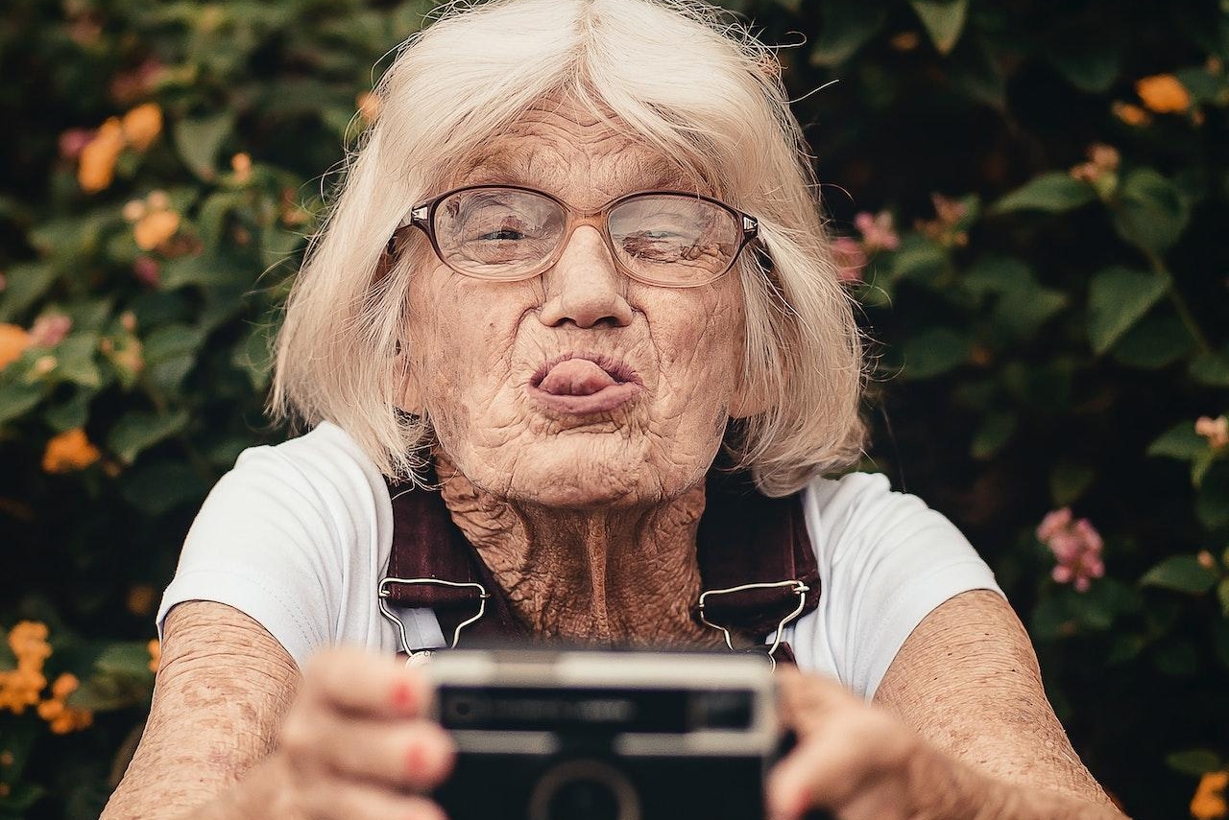
Pensions
Your life after retirement
WizeUp Financial Education
WizeUp with Jack Petchey
WizeUp with Jack Petchey

Slide 2
Let’s think about the future for a minute
Who wants to retire?
How much money do you want to have when you retire?
What do you want to do once you retire?
When do you want to retire?
When do you think you need to think about pensions?
WizeUp Financial Education
WizeUp with Jack Petchey
WizeUp with Jack Petchey

Slide 3
Here’s what we’ll cover today
What is a pension?
Why should you care?
Types of pensions
Pension calculator
Effect of inflation
Types of pensions: details
WizeUp Financial Education
WizeUp with Jack Petchey
WizeUp with Jack Petchey

Slide 4
What is a pension and
why should you care?
Why you should care…
Retirement age: 66
Payment: £200/m (employer matched)
Starting age: 21
Pension pot at 66: ~ £267k
Using £50k per year: lasts until 71
Starting age: 35
Pension pot at 66: ~£170k
Using £50k per year: lasts until 69
What it is…
Money that you store away while you work so that you can contribute towards supporting yourself and your family once you retire
WizeUp Financial Education
WizeUp with Jack Petchey
WizeUp with Jack Petchey

Slide 5
Remember your retirement plans
How much do you think it will cost?
Multiply that number by 25…
That is how much money you will need in your pension pot when you retire
What’s your number?
WizeUp Financial Education
WizeUp with Jack Petchey
WizeUp with Jack Petchey

Slide 6
You have 3 choices
after retirement
Scrape-by
State pension
Manage
State + (good) work pension
Thrive
State + great pensions
Which one would you choose?
WizeUp Financial Education
WizeUp with Jack Petchey
WizeUp with Jack Petchey

Slide 7
Types of Pension
Regular payment
Can withdraw at 66
Amount varies
35 years for max
Currently ~ £9,500 p.a.
You and your employer contribute
Tax free
Access at 55 (25% lump sum)
State Pension
Workplace Pension
NEST Pension
Self-employed Pension
Government backed scheme
Eligible for 22+ earning £10k+
Access at 55
State
Personal pension
Stakeholder pension
SIPPs
Tax free
Access at 55 (25% lump sum)
WizeUp Financial Education
WizeUp with Jack Petchey
WizeUp with Jack Petchey

Slide 8
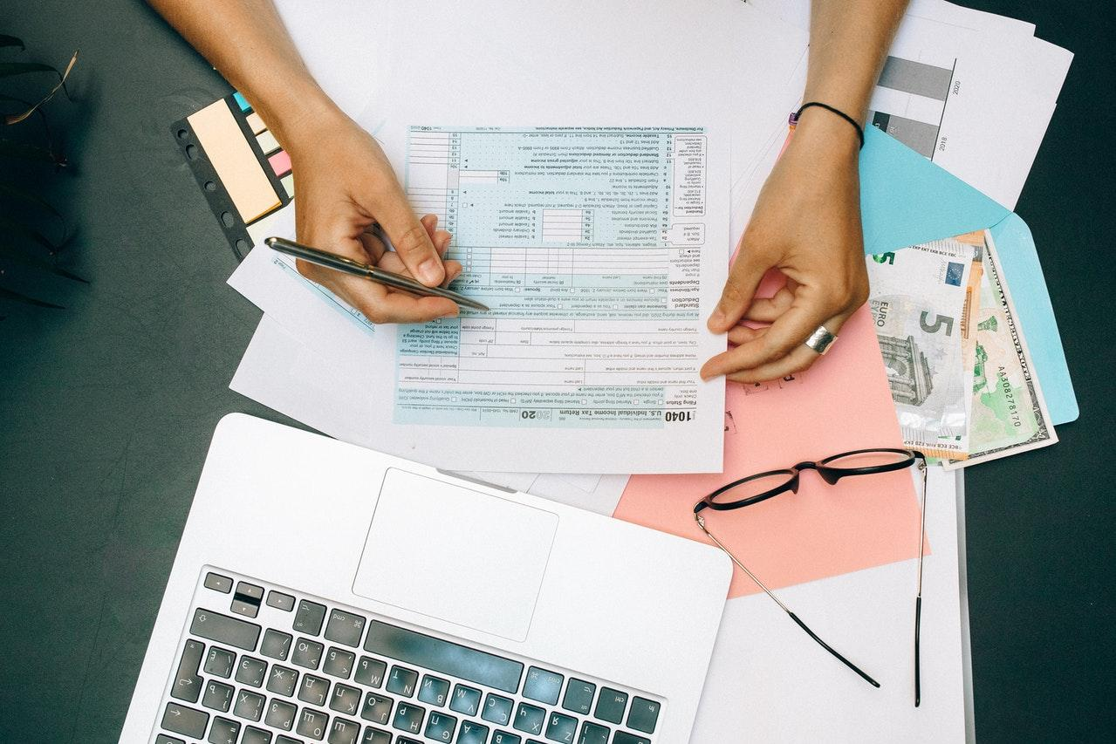
National Insurance contributions
Linked to National Insurance number
Contribute to state pension
Deducted automatically by employer
12% NI on earnings £12,750 to £50,024 (unless in company scheme)
2% NI on earnings >£50,024
WizeUp Financial Education
WizeUp with Jack Petchey
WizeUp with Jack Petchey

Slide 9
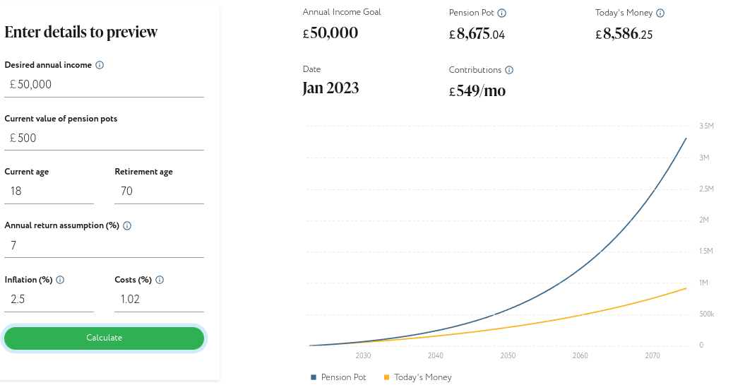
Pension calculator - starting now
Retirement age: 70
Annual pension: £50,000
Annual return: 7%
Starting age: 18
Contribution: £549 /m
WizeUp Financial Education
WizeUp with Jack Petchey
WizeUp with Jack Petchey

Slide 10
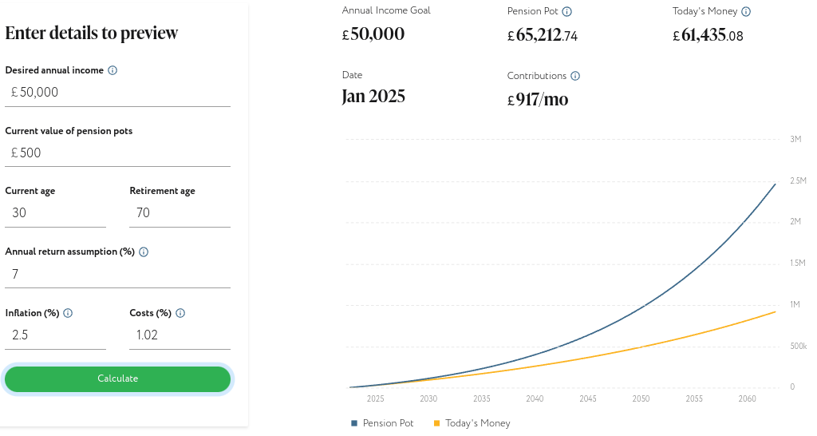
Pension calculator - starting at 30
Retirement age: 70
Pot goal: £50,000
Annual return: 7%
Starting age: 30
Contribution: £917/m
Increase of £368/m
WizeUp Financial Education
WizeUp with Jack Petchey
WizeUp with Jack Petchey

Slide 11
Activity
What have we learned so far?
PENSIONS
WizeUp Financial Education
WizeUp with Jack Petchey
WizeUp with Jack Petchey

Slide 12
You should have
something like this
Regular payment
Can withdraw at 66
Amount varies
35 years for max
Currently ~ £9,500 p.a.
You and your employer contribute
Tax free
Access at 55 (25% lump sum)
State pension
State pension
Workplace pension
PENSIONS
State
Personal pension
Stakeholder pension
SIPPs
Tax free
Access at 55 (25% lump sum)
NEST Pension
Self-employed pension
Government backed scheme
Eligible for 22+ earning £10k+
Access at 55
WizeUp Financial Education
WizeUp with Jack Petchey
WizeUp with Jack Petchey

Slide 13
Inflation affects your pension
Remember
Inflation amount varies over time
Your pension pot will NOT have the same value when you retire as it does in today’s money
Consider this as part of your overall investment and retirement strategy
WizeUp Financial Education
WizeUp with Jack Petchey
WizeUp with Jack Petchey

Slide 15
wizeupfinancialeducation.co.uk
Thanks!
For more resources see
www.wizeupfinancialeducation.co.uk
WizeUp Financial Education
WizeUp with Jack Petchey

