Slide 1
Year 13 - Session 2
Credit cards & credit scores
WizeUp with Jack Petchey

Slide 2
wizeupfinancialeducation.co.uk
Twitter: @wizeupme
WizeUp with Jack Petchey

Slide 3
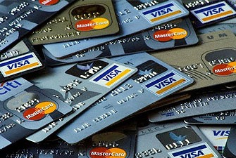
CREDIT CARDS
A necessary evil?
WizeUp with Jack Petchey

Slide 4
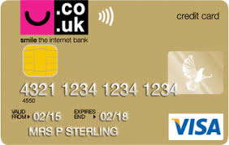
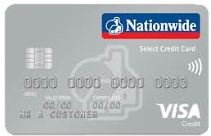
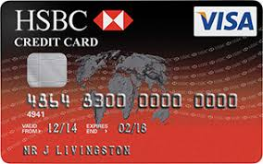
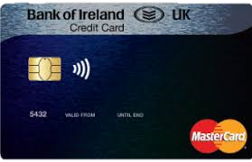
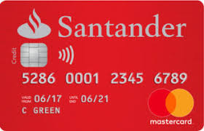
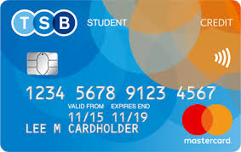
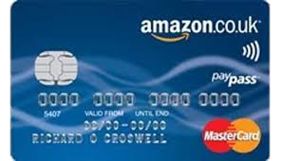
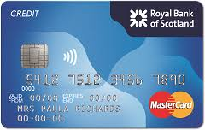
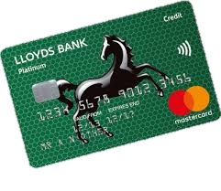
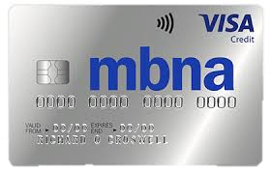
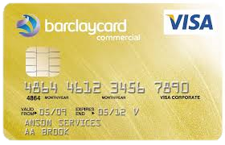
WizeUp with Jack Petchey
Notes:
Lots of different credit cards on the market

Slide 5
Remember
You won’t get one before you are 18
APR likely to be high
Almost certainly a low initial credit limit
Minimum payment likely to be higher than on a standard credit card
Purchase protection on items > £100
WizeUp with Jack Petchey

Slide 6
Managing Your Account
Paying off outstanding balance means no interest charges
Minimum payment goes down along with your balance
You will be asked to set up a direct debit for the minimum payment
Cancel unused cards
WizeUp with Jack Petchey

Slide 7
Direct Debit
Allows the company you have set up the direct debit with to approach your bank and ask for a sum of money
Provided you have the money in your account your bank will pay the company
Used to pay a regular non-standard bill eg Phone
WizeUp with Jack Petchey

Slide 8
Standing Orders
By setting one up you will pay the same amount at the same time each period to the same company
It will only be paid as long as you are below your overdraft limit
Typically used to make regular payments eg mortgage, savings
You need to know the other parties bank details - account name, number, bank and sort-code
WizeUp with Jack Petchey

Slide 9
D.D. v S.O.
Example - £500 balance, 20% APR, minimum repayment 1% of balance + interest, 2.25% of balance or £5
1% of balance + interest = £5 + £8.33 = £13.33
2.25% of balance = £11.25
or £5
WizeUp with Jack Petchey

Slide 10
D.D. v S.O.
If only the minimum payment is made each month how long does it take to repay the debt and how much interest is paid?
Direct Debit for decreasing minimum payment.
12 years 10 months
Interest costs - £571.
WizeUp with Jack Petchey

Slide 11
D.D. v S.O.
What happens if the direct debit is cancelled an a standing order is set up for £13.33 each month?
Time to repay now is 4 years 9 months.
Interest costs are now - £249
WizeUp with Jack Petchey

Slide 12
D.D. v S.O.
What happens if the Standing Order is for fixed payment of £20 per month?
What happens if the Standing Order is for fixed payment of £30 per month?
2 years 8 months.
Interest costs - £135.
1 years 8 months.
Interest costs - £82.
WizeUp with Jack Petchey

Slide 13
A well run account will increase your credit rating quicker than anything else.......
WizeUp with Jack Petchey

Slide 14
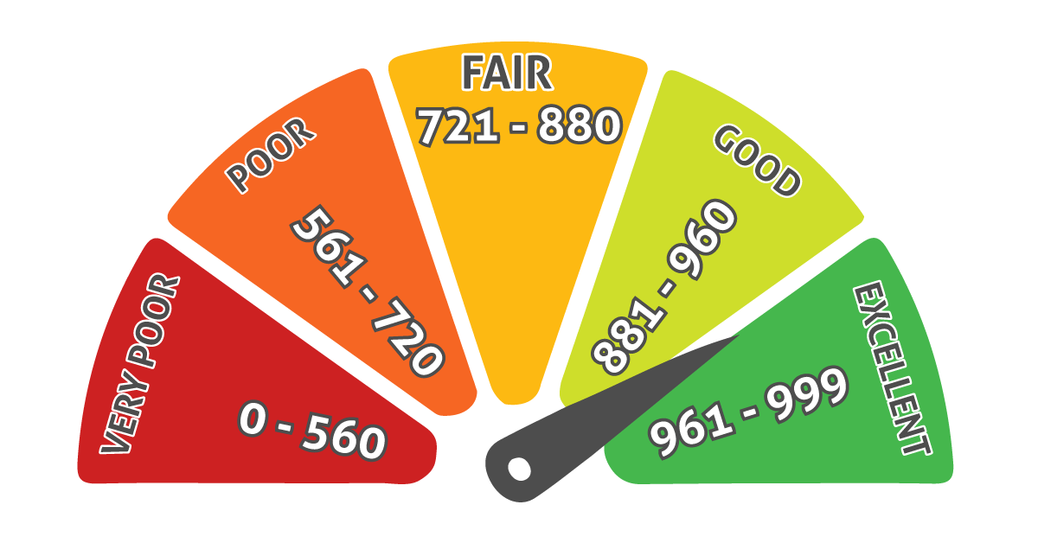
CREDIT SCORES
Keep your eye on the number
WizeUp with Jack Petchey

Slide 15
Credit Scores
You acquire one at 18 when you receive a service before paying for it.
Your rating is continually updated.
3 main ratings agencies in UK - Experian, Equifax, Callcredit.
Affects your ability to to buy, rent and borrow.
Good account management = good rating.
WizeUp with Jack Petchey

Slide 16
How Is It Calculated?
No one method.
But roughly.
35% based on payment history
30% based on outstanding debt
15% based on length of credit history
10% based on recent enquiries on your report
10% based on types of credit in use
Highest score is generally 999
WizeUp with Jack Petchey

Slide 17
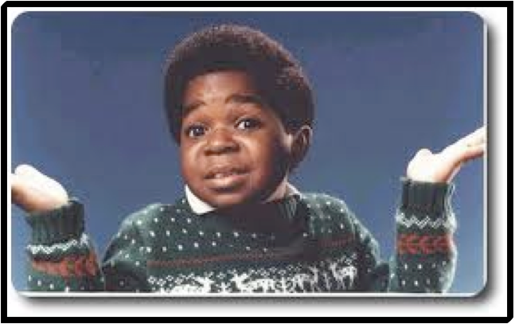
Who Is Bothered?
Banks.
Employers.
Lenders.
TV Companies (Sky, Virgin etc).
Telephone companies.
Credit card companies.
WizeUp with Jack Petchey

Slide 18
What Will They Know?
Credit agency files.
Payday loan data.
History with some TV/phone/energy companies.
WizeUp with Jack Petchey

Slide 19
What Won’t They Know?
Race, religion.
Income & savings.
Parking or driving fines.
Medical or criminal history.
Student loans.
Relatives.
Declined applications.
WizeUp with Jack Petchey

Slide 20
Best Way To Build One
Open a bank account early.
Get on the electoral register.
Run a credit card account perfectly.
Don’t take out silly loans you can’t repay.
Don’t miss a bill or a repayment.
Check your score regularly
WizeUp with Jack Petchey

Slide 21
Benefits Of A Good One
Get loans and pay for goods easily.
Get Services when you want them.
Cheaper interest rates.
WizeUp with Jack Petchey

Slide 22
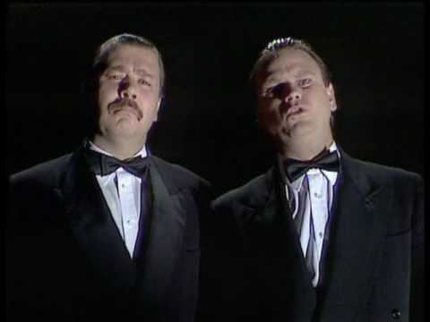
How To Protect One
Keep up all minimum payments.
Never be late.
Don’t put in lots of applications close together .
Don’t break a pre-arranged limit.
Don’t leave a card at it’s limit.
Don’t use joint accounts.
Cancel unused cards and accounts.
Check your credit file regularly.
WizeUp with Jack Petchey

Slide 23
Year 13 Quiz on Student Finance, Starting a Business,
Credit Cards and Credit Ratings
https://forms.office.com/r/m2568YVzYr
WizeUp with Jack Petchey

Slide 24
wizeupfinancialeducation.co.uk
Twitter: @wizeupme
WizeUp with Jack Petchey

