Slide 1

Sing Out Strong
Go to France 2026

Slide 2
What We know So Far
Due to the complexities around booking flights, we will not be offering the option of group travel booking
There are a number of hosted rooms available.
If you wish to stay in a hotel or gite/apartment you will need to book this indepenently
All participants who wish to attend will need to pay their Performance Fee to hold their place for the weekend. This will be £XXXX.
All participants wishing to be hosted by a family need to confirm when booking to allow a family to be allocated
Once everyone has confirmed their travel details, we will support booking transportation to and from the relevant airports
You will be responsible for your own travel insurance

Slide 3
Travel Options
Eurostar – 9 months in advance
EasyJet – 12 months in advance
Ryanair – 9 months in advance
Non budget airlines – 11 months in advance
BA Flights, Jet2 and EasyJet have been released (see following slides)
It’s really hard with the budget airlines to predict what they are going to do as their routes and timings change every year as they move with travel trends or change routes and airports if the airport or countries changes their fees/taxes etc. i.e. they added a lot of routes from Bristol this year but they also took away 3 or 4! So it does make forward planning almost impossible.
Eurostar is far more predictable but again we need to wait to get the timetable and fares.
Ferry Crossings for July 2026 have not yet been released
The scheduled airlines such as KLM or Aer Lingus might be an option with an indirect flight from Bristol or Birmingham airport to Perpignan – journey around 8 hours.

Slide 4
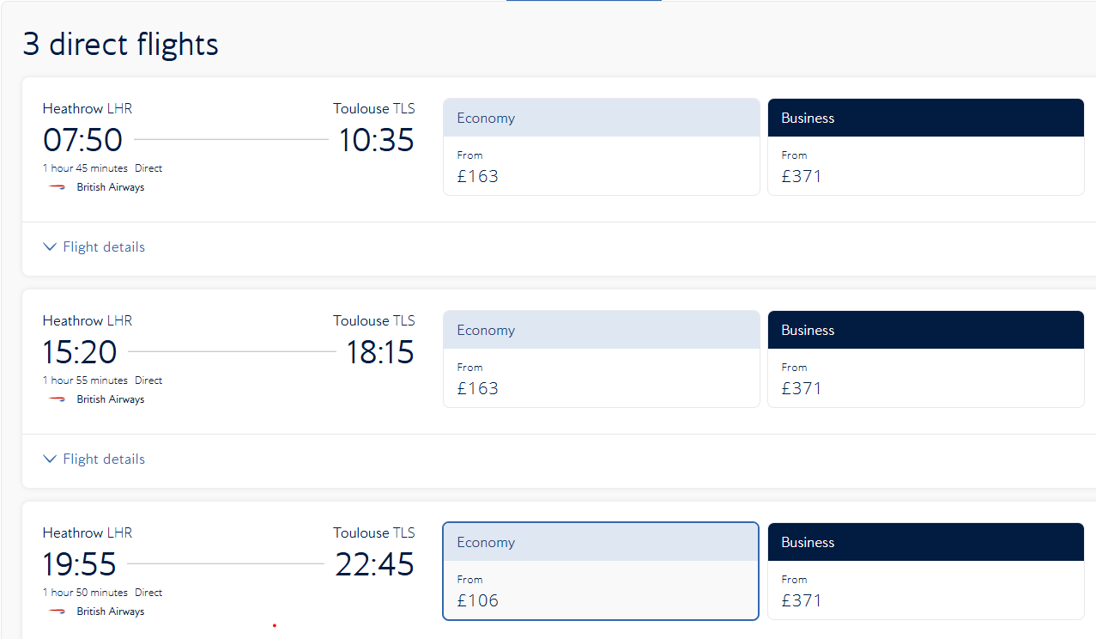
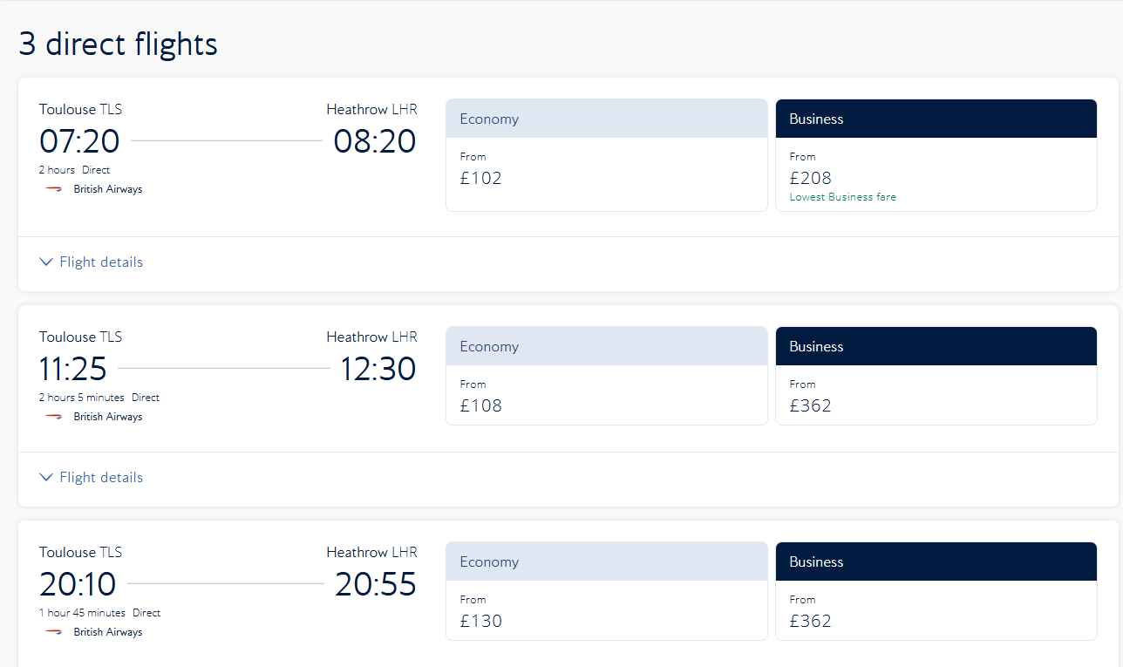
BA Flight Options
Heathrow to Toulouse Option
Toulouse to Heathrow Options
Note : These prices will change as flight prices change based on the number of seats left

Slide 5
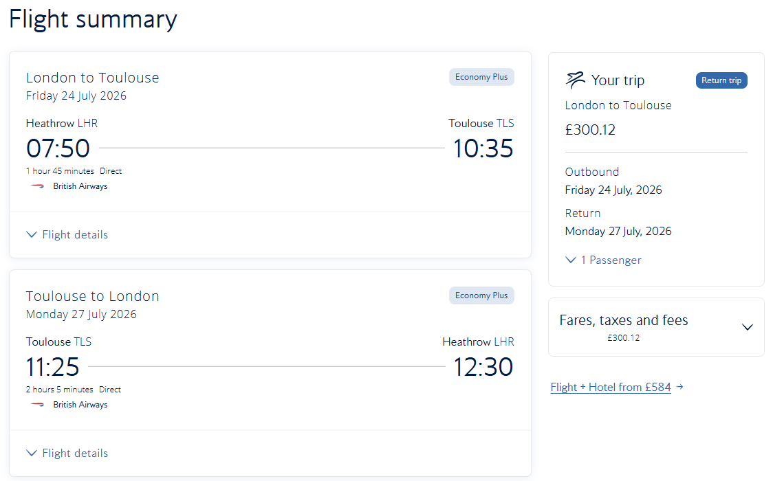
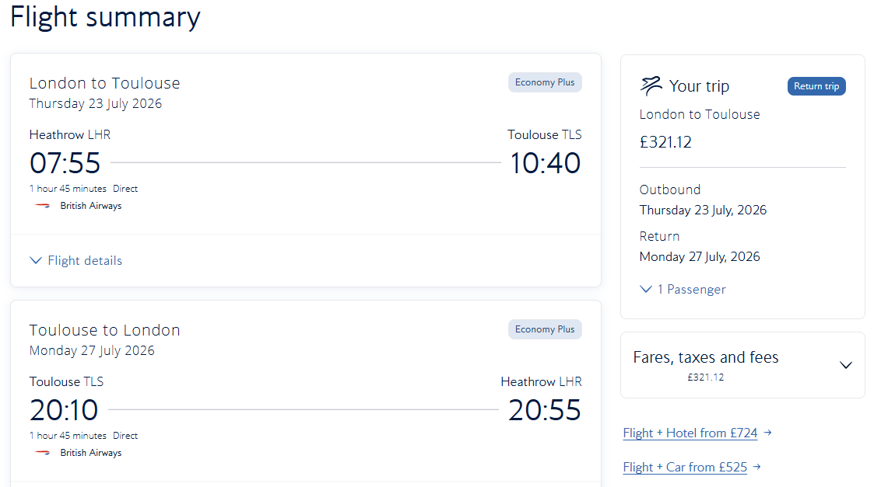
Example BA Flights
Leaving Friday 24th July : Returning Monday morning 27th July
Leaving Thursday 23rd July : Returning Monday evening 27th July

Slide 6
BA Flight
Option to cost checked baggage and seat selection
Excluding transport cost to Heathrow
Excluding transport cost from Heathrow
Excluding transport cost from Toulouse
Excluding transport cost to Toulouse
Excluding accommodation
Coach from Herefordshire would need to depart around 1:00am in the morning to Heathrow
Check in 3 hours before flight
Flight duration 1 hour 45 mins
Arrive Toulouse 10:35 allow 1 hour through security
11:35 Coach from Toulouse to per circa 2 ½ hours arrive in Perpignan 2:00pm

Slide 7
Routing based on what we know for 2025 but some routes for 2026 not released yet
Other Flight Options
Eurostar – 9 months in advance
EasyJet – 10 months in advance
Ryanair – 9 months in advance
Non budget airlines – 11 months in advance

Slide 8
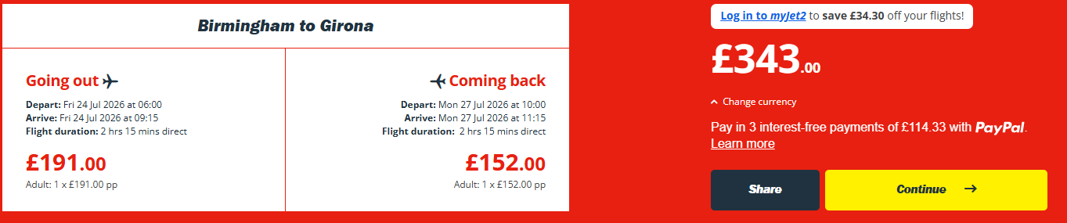
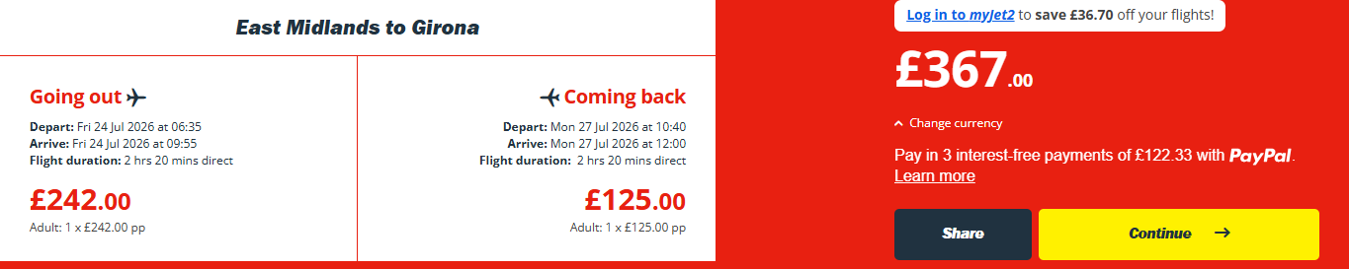
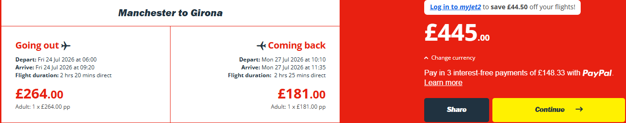
Jet2 Options to Girona
Note : checked baggage not included

Slide 9
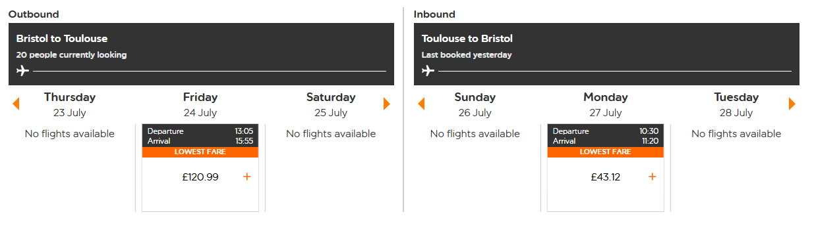
EasyJet Options
Note : checked baggage not included

Slide 10
Accommodation
Nice hotel, just out of town. hasn’t opened bookings for next year yet. 15 rooms : Le Chatelet - ST PAUL DE FENOUILLET – France
  We would look at this hotel and staying with families
    There are other stunning properties, but you would need to consider your own transport

Slide 11
Accommodation Options
Hotels
Small apartments in the centre of Saint-Paul-de-Fenouillet
Large villas outside of the centre
Limited hotels

Slide 12
Small apartments in town
Sleeping 2-4 people
Prices from £140 - £461
https://www.booking.com/Share-IgcCqA
https://www.booking.com/Share-cp6dxr
https://www.booking.com/Share-dcGTwID
https://www.booking.com/Share-Whr1T8

Slide 13
Small Properties – 3.5-6 miles out of town
Sleeping 2-4 people
Prices from
https://www.booking.com/Share-NVMeDWe

Slide 14
Apartments & Villas
Set of 4 apartments. Sleeping : 10 in total
Pyrenees Mon Amour - Holiday Rental near Galamus Gorges & Cathar Castle | Pyrénées Mon Amour - Holiday Rental near Galamus Gorges & Cathar Castle
Villa : 6 miles away : £2746 – 3 Double Rooms, 1 : 1 Double, 4 single : https://www.booking.com/Share-XhQnjUg

Slide 15
Car Hire
https://www.europcar.co.uk/en-gb
Things to consider
Most will require drivers to be over 26
All drivers will need to be named
Consider:
The level of cover you have,
Including Excess, Breakdown insurance ;
Glass; theft etc
How much luggage space you’ll have
Full cover would be circa £100 per day for a standard car size for 4 people excluding fuel

Slide 16
Tourist Information Sites
Agly Fenouillèdes Tourisme

