Slide 1






Financial Freedom Challenge
Presents
By
Alex Barrón

Slide 2

Welcome!
We want to welcome you to the Financial Freedom Challenge!

Slide 3
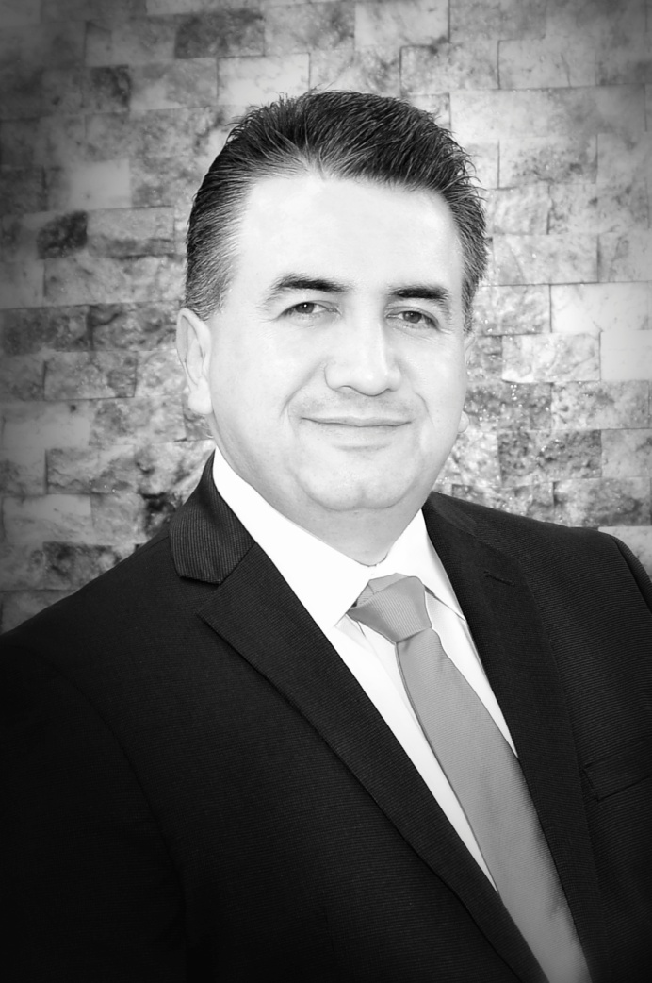
Who is Alex Barrón?
Origin
Born in El Paso, TX 1973. Lived in Cd. Juárez, Mexico, El Paso, TX and Bay Area, CA
Education – 1990-2001
1990 – Agape Christian Academy
1995 – UTEP 4.0 GPA Civil Engineering, Top 10 Senior
1996 – Stanford University – M.S. Structural Engineering
2001 – Stanford University – Eng. Construction Mgmt
Wall Street Career – 2001-Present
2001-2003 - Franklin Templeton Investments
2004-2007 - JMP Securities
2007-2009 - Agency Trading Group
2010- Present - Housing Research Center LLC
2017 – Present – Diamond Crest Capital LLC
President & Founder
2012 - Dare to Dream Foundation
2014 - Financial Freedom & Success Institute LLC
Interests
Finances & Investments, Personal Development
Compassionate Capitalism, Financial Freedom,
Exotic Cars, Traveling, Music, Dancing
Personal Motto – “Dare to Dream!”

Slide 4
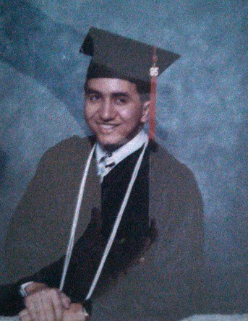
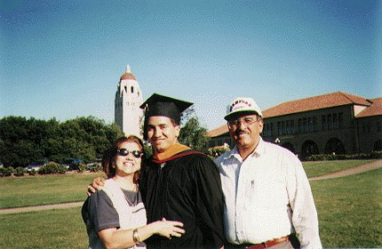
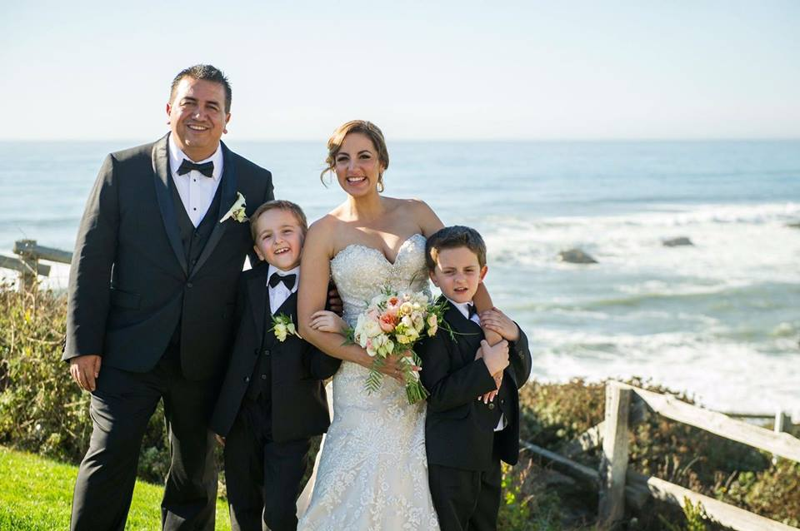
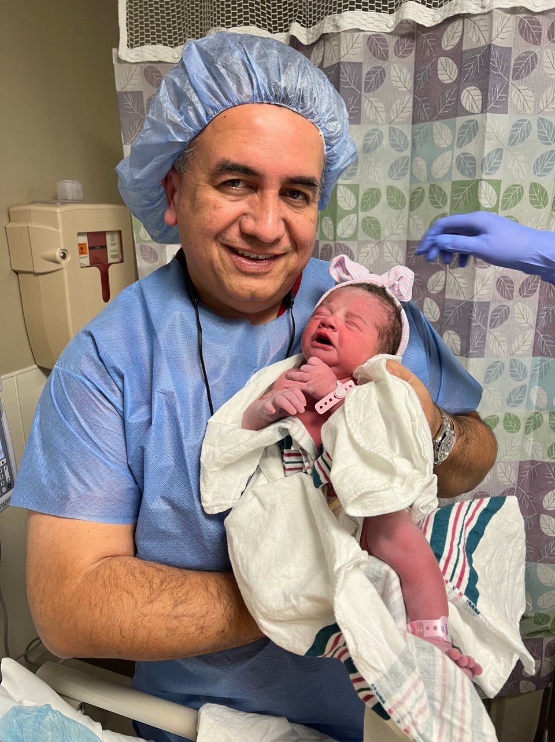
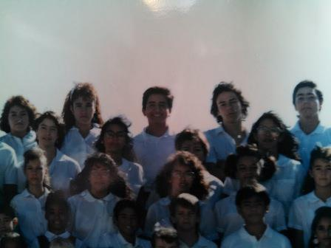

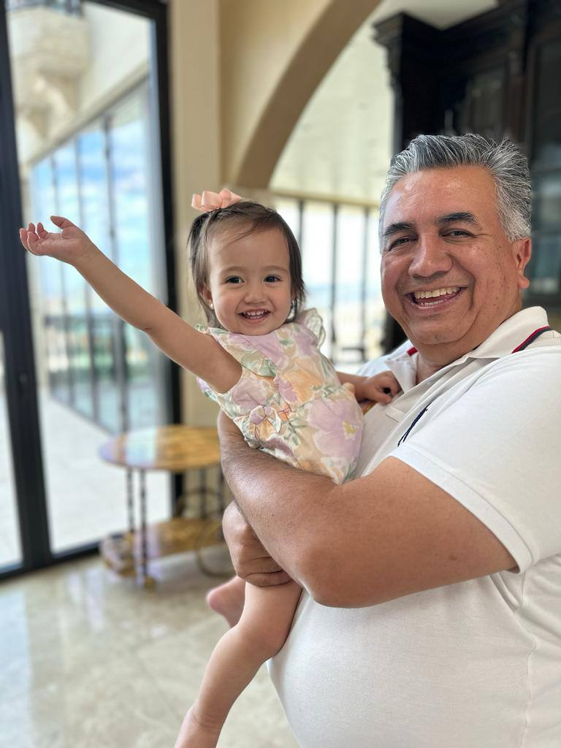
Alex Barrón’s Story
Student → Graduate Single → Family Man
Graduate at UTEP, Stanford
Family Man
Born in El Paso, TX 1973.
Agape Christian Academy – High School, 1990
UTEP – Civil Engineering, Top 10 Senior, 4.0 GPA
Stanford University – Masters, 1996, Eng. 2001
Proud Son, Loving Husband, Happy Father

Slide 5

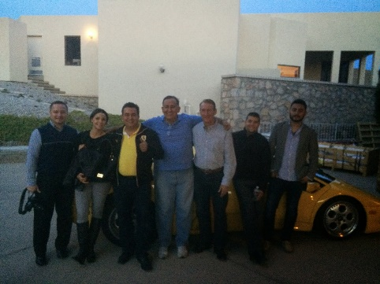
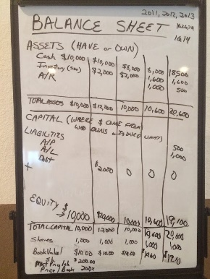
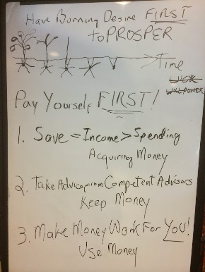
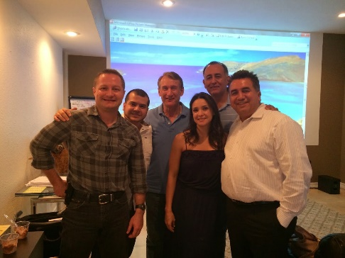
Alex Barrón’s Story
Employee → Entrepreneur → Investor → Teacher
Wall Street Employee -> Entrepreneur
Investor -> Mentor
Franklin Templeton Investments: 2001-2003
JMP Securities: 2004-2007
Agency Trading Group: 2007-2009
Housing Research Center: 2010 - Present
Diamond Crest Capital: 2017-Present
Options 12 Investment Club
Financial Freedom Seminar
Wall Street Investments Course

Slide 6
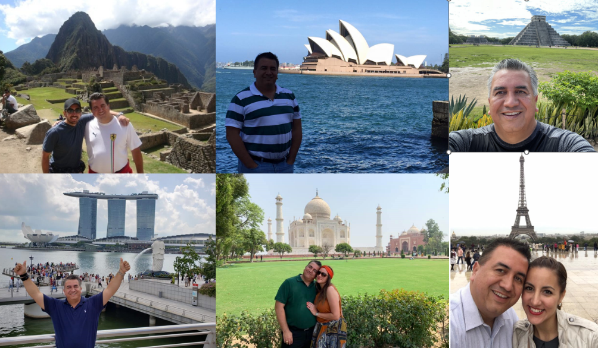
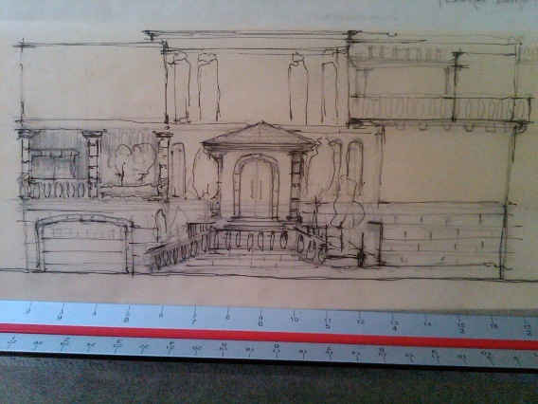
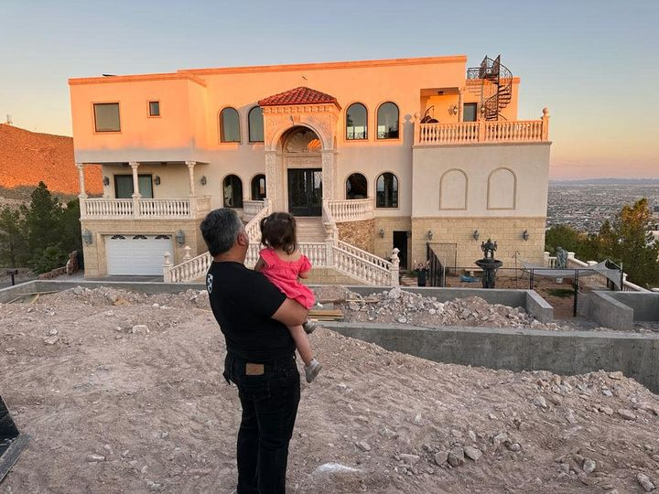



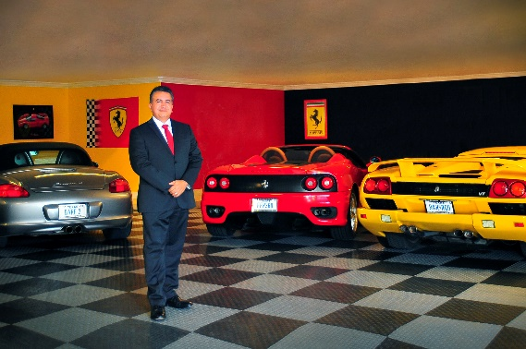
Alex Barrón’s Story
Family Man with a Great Vision to Reach Life Goals
Turning Dreams & Goals Into Reality
World Travel, Exotic Cars
Travelled the World (over 50 countries), Own Exotic Cars since age 35,
Built 10,000 SF, Dream Home at 40 – Now working on HQ

Slide 7
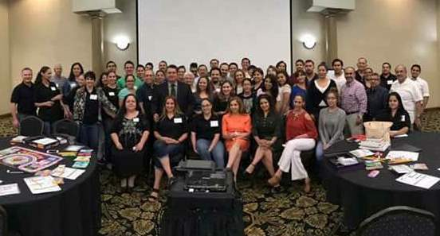



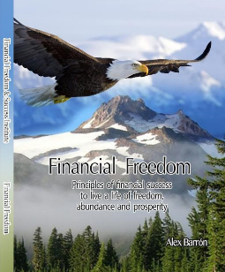
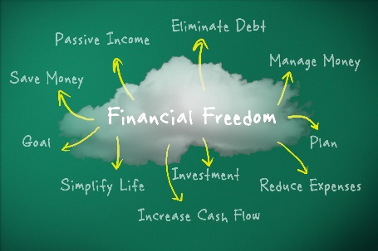
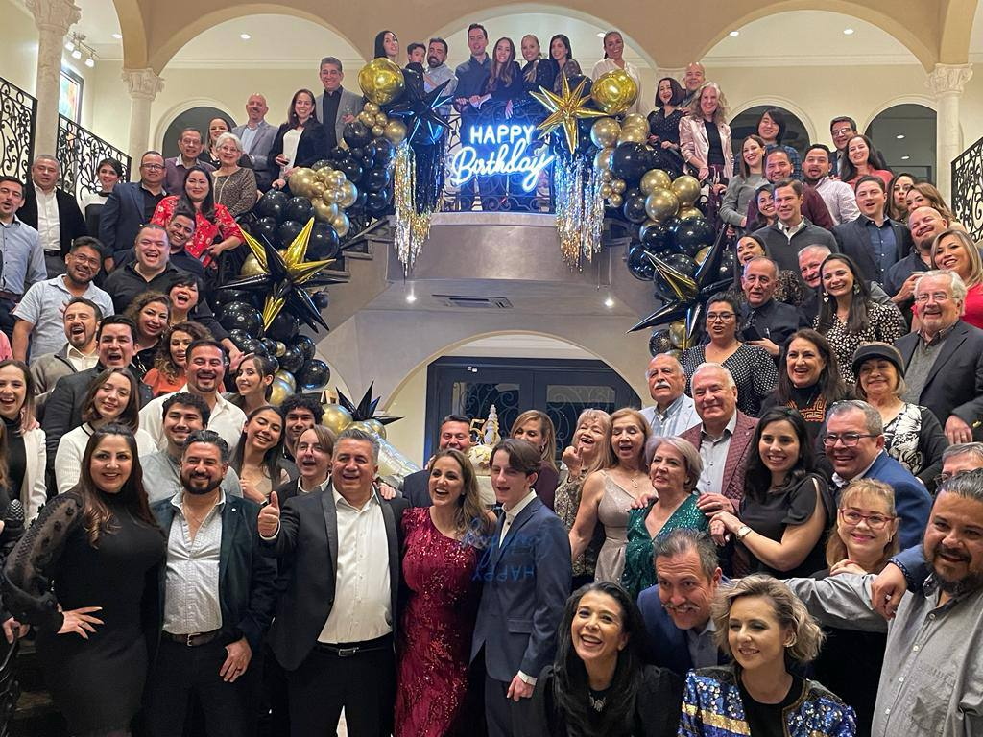
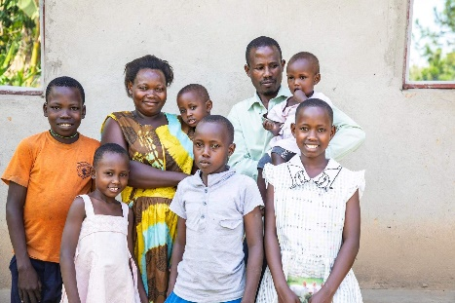

Alex Barrón’s Story
Christian Capitalist on a Mission and Destiny
Share Financial Freedom and Success Principles with the World
Fulfill the Great Commission and help Children Escape Poverty
Financial Freedom & Success Institute
Bank on Yourself Professional, Wealth Heritage
Teach Financial Freedom, Teach Entrepreneurship
University of Success, Success Conference Cruise
Dare to Dream Foundation
Fulfill the Great Commission, Compassionate Capitalism,
Help Poor Children, Bring Education,
Personal Motto – “Dare to Dream!”

Slide 8
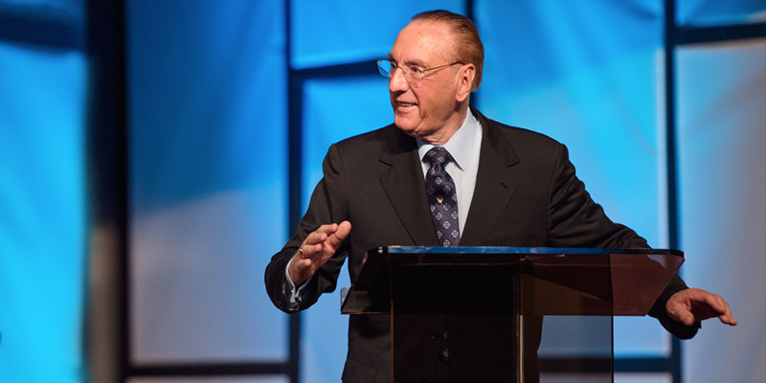



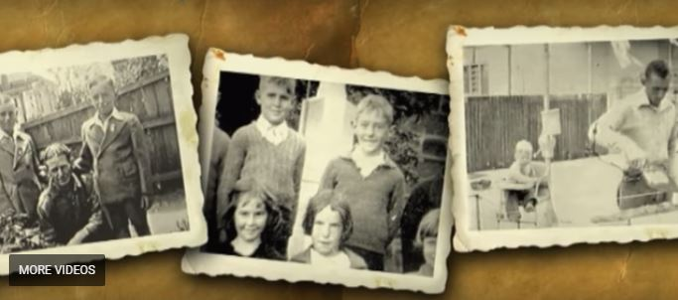
How it All Began?
Alex attended Success Seminar by Peter J. Daniels - 1994
Illiterate poor bricklayer at age 26
Went out of business 3x!
Became a multi millionaire real estate businessman at age 38!
How did he do it???
www.peterjdaniels.org

Slide 9









I Started Investing in Myself

Slide 10
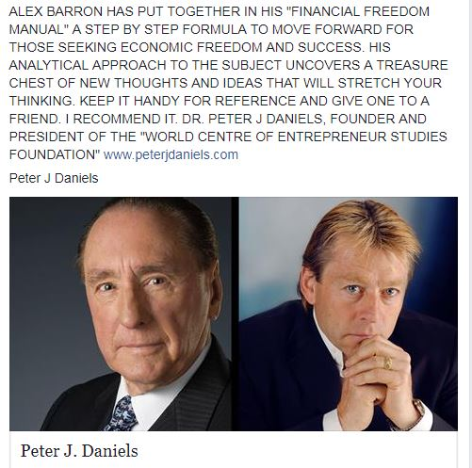
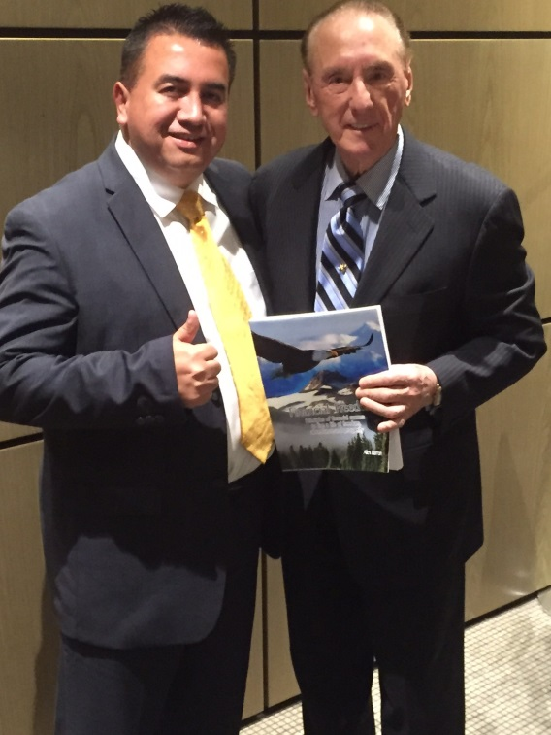
After 20 Years of Study

Slide 11
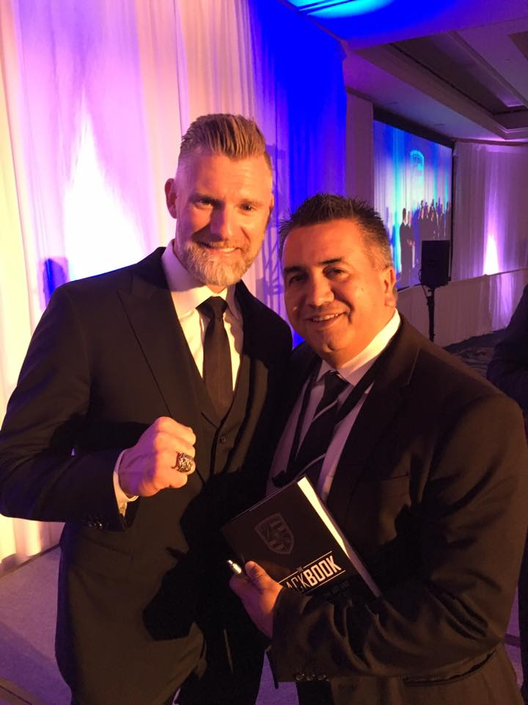

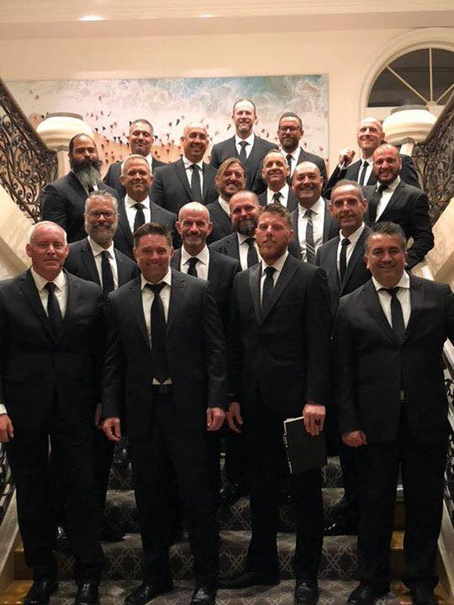

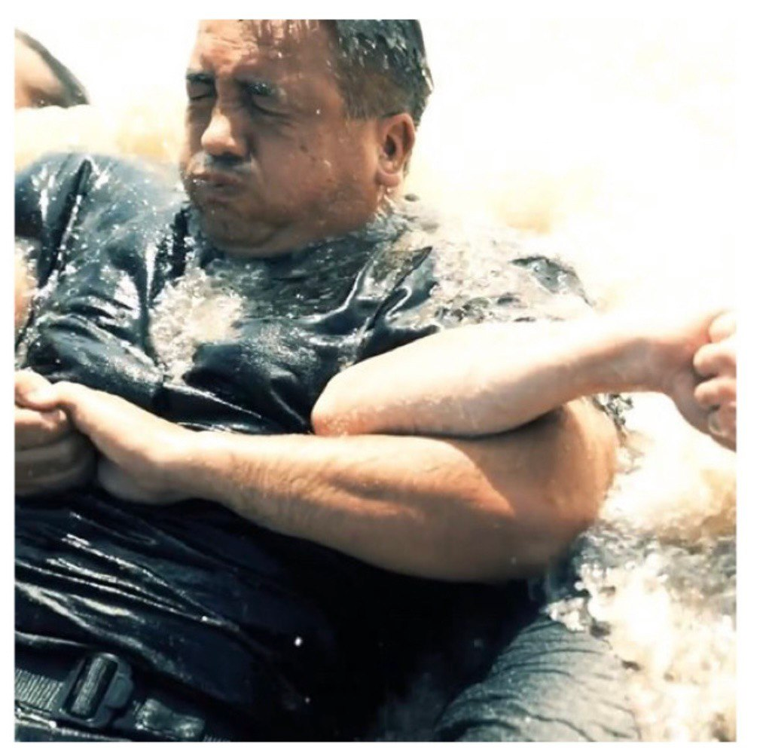
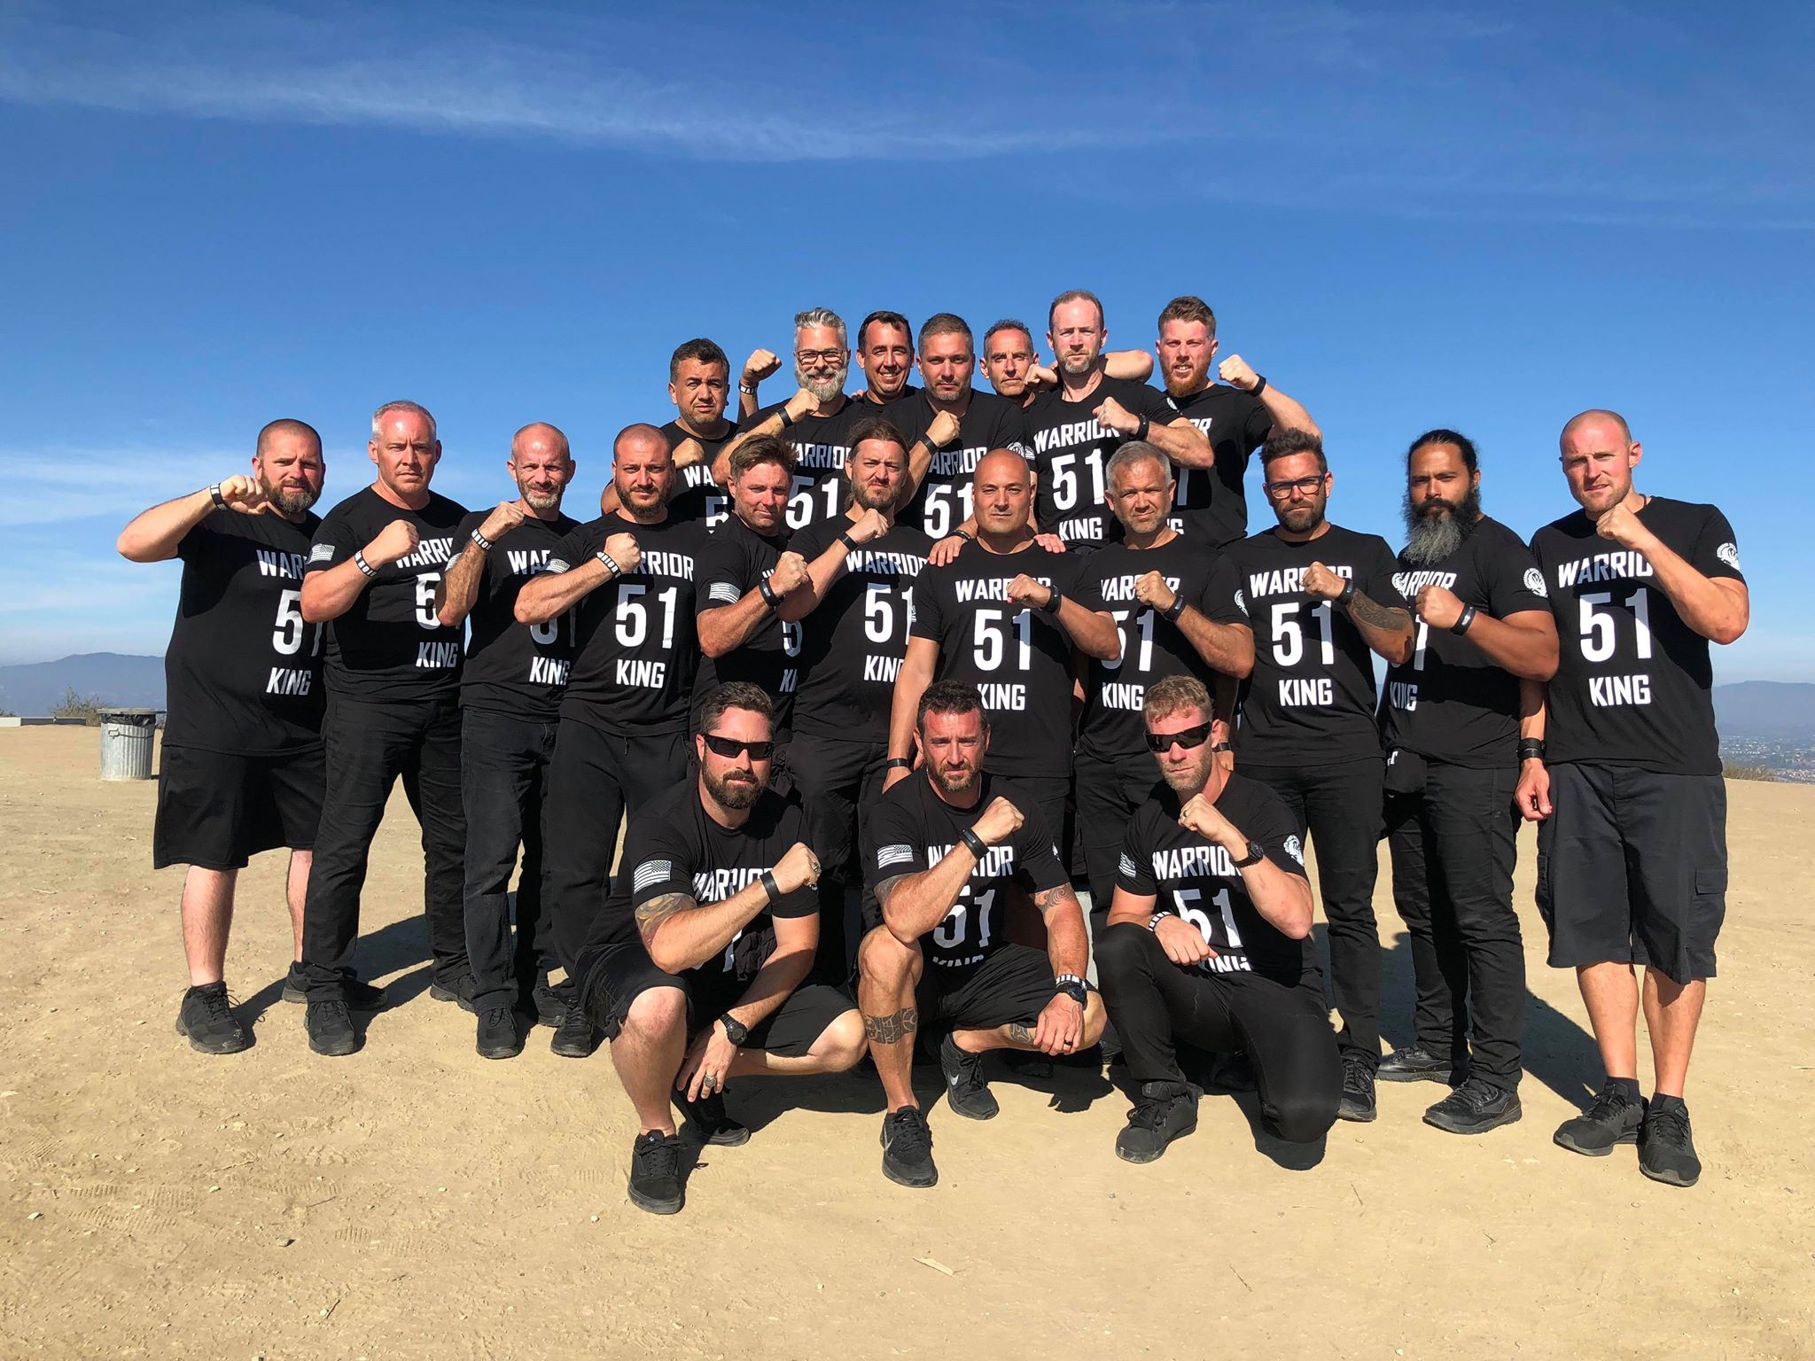
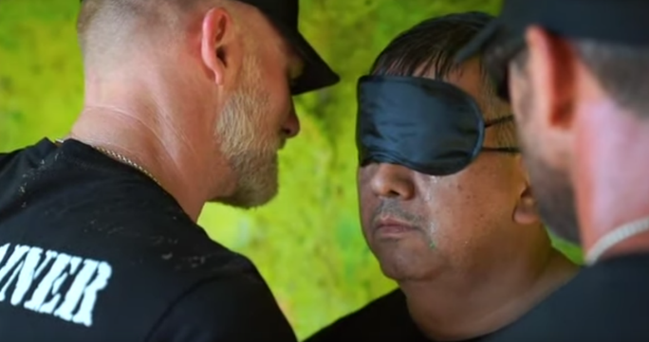
Warrior Week 51 Graduate

Slide 12

Financial Freedom
Seminar Began in 2012

Slide 13
Our Seminars
Our purpose is to share Financial Freedom thru Educational seminars to help people fulfill their calling and live the life they always dreamed of.
Financial Seminars
Personal Development
1.) Financial Freedom Seminar
2.) Financial Security Seminar
3.) Wall Street Investments Seminar
4.) Roadmap to Financial Success for Entrepreneurs
5.) Financial Freedom Challenge
1.) University of Success
2.) Annual Success Conference Cruise
3.) Destiny of the 3rd Millennium
4.) Millionaire with a Purpose

Slide 15





THE AMERICAN DREAM
Buy the House and Car of Your Dreams
Enjoy Financial Freedom & Success
Happy Relationship
Give Your Family a Better Life
Enjoy a Pleasant Retirement
Without Worrying about $$
Be Successful in Life and
Be Financially Free!

Slide 16






THE SAD REALITY
Couples Fight Over Money
& Eventually Divorce
They Owe their Cars, Home, Credit Cards and Student Loans
They are Educated but They Don’t Make Enough
Work a lot and Spend Little time with the Family
Don’t have a
Stable Retirement Income
and Worry about $$
Uncertainty and
Financial Slavery!

Slide 17

Why do So Few Make It?
How Did We Get Here?
5%?
95%?

Slide 18
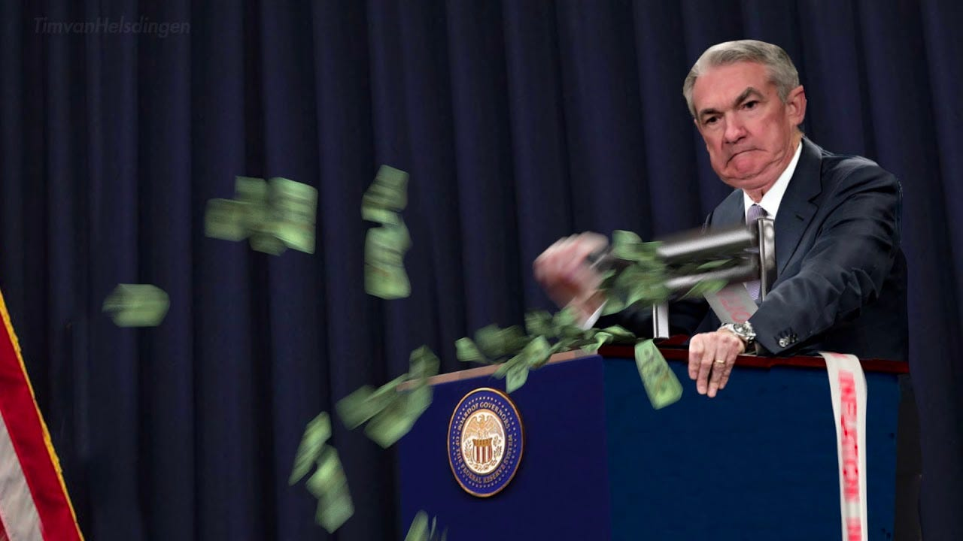
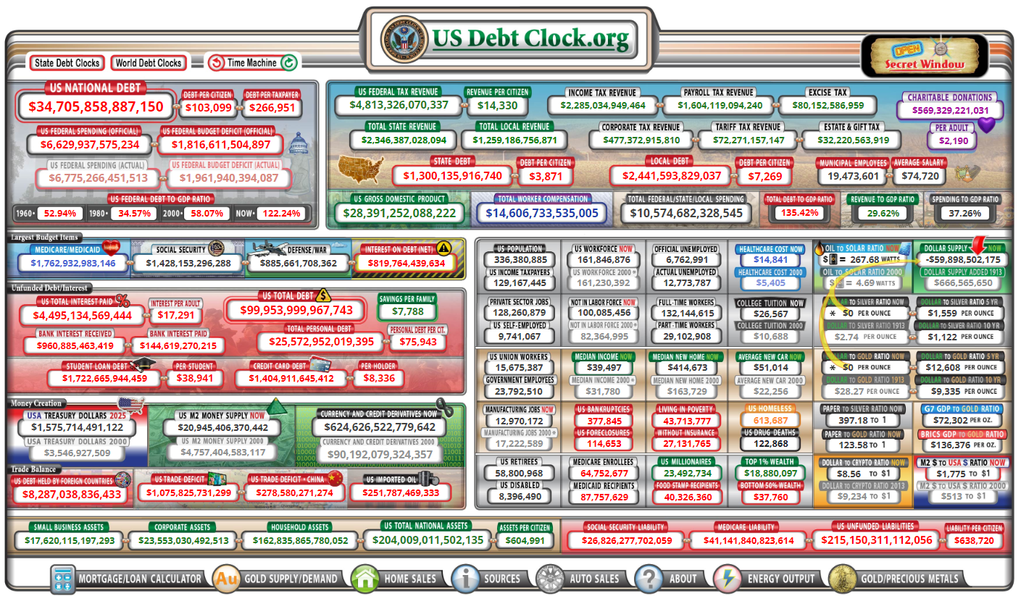
Today’s Problems
Fed printing money
Government deficit spending
National debt going way up
Inflation is Rampant
Interest rates are High
Housing is unaffordable
Is University degree worth
it anymore?

Slide 19

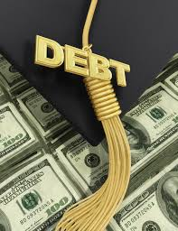




Is This What the
American Dream is all about?
They Have Many Debts and Money is Never Enough
They Work Hard with No Rest
How to Save for Children’s Education?
Stressed about Finances?
Worried About Having Enough for Retirement?
Investments Are Not Working?

Slide 20

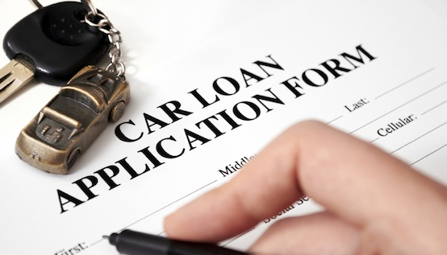



People are Full of Debts
Credit Cards
Auto Loans
There is Not Enough Money – Financial Stress
Home Mortgage
Student Loans

Slide 21

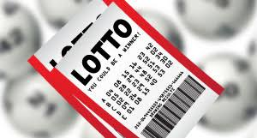



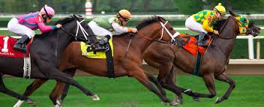
Many think the solution is simply
Making More Money
They believe it is a matter of having “good luck”.
But more money without understanding is soon gone.

Slide 22




What Should I Invest In?
Stock Market? Cryptos? Real Estate?

Slide 23
Traditional Financial Advice
Focused on Financial Products where the advisor gets paid a fee or commission
Mutual Funds, IRA’s, 401ks, 403b, 529 plans
Life Insurance – Term, Whole, IUL
Annuities
Offered by 99.9% Financial Advisors
Without any proof or evidence in their own life of where it will get you

Slide 24
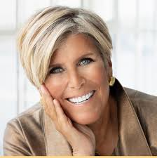
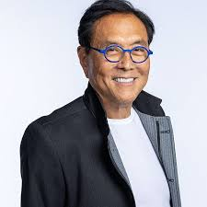
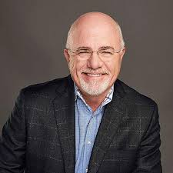
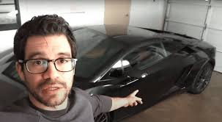
Modern Financial Gurus
Sell you books
Sell you videos
Sell you courses
Upsell you to more courses
Masterclasses
Masterminds
But at the end of the day you have to figure it out on your own
No evidence of how they “did it” other than selling books and courses
No/False guarantees that it will work for you

Slide 25

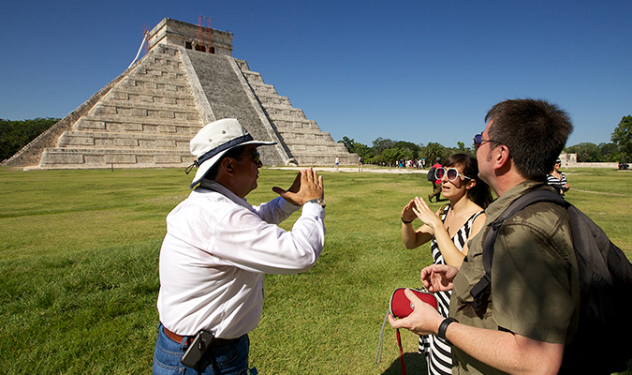
What is Financial Freedom Challenge?
I Can Sell You a Map to Your Destination
OR I Can Be Your Tour Guide and Help Take You There

Slide 26


What is Financial Freedom Challenge?
With a Coach by Your Side
It is like a Hurdles Race or Obstacle Course

Slide 27
What is Financial Freedom Challenge?
Financial Freedom Challenge is:
A mental Framework of How Money Works to help you manage your money better.
A Proven System to help you Take Control of your Finances.
A Mindset to help you Make Better Financial Decisions.
A Mathematical Formula to help you Get out of Debt ASAP and save you tens or hundreds of thousands of dollars!
It is the fastest way to get onto the Road to Financial Freedom!

Slide 28
What is Financial Freedom Challenge?
Financial Freedom Challenge is:
A set of Tools & Challenges designed to help you figure out how to achieve your financial goals and measure your progress.
A Roadmap of How to Achieve Financial Freedom and Financial Success, step by step!
A Manifesto of how Life Insurance, Investments and Entrepreneurship/Business can help provide you the Wealth you desire to change the world.
An Opportunity to work with a Financial Coach 1:1 to help you achieve your personal and business goals.

Slide 29
Who is this For?
This course is for any individual, couple, or business owner who:
Wants to maximize their chances of financial success and minimize chances of failure
Wants to reach their financial goals
Wants to exit the rat race of life
Wants to leave scarcity behind and wants to grow their wealth consistently to reach prosperity
Wants to invest in themselves to grow

Slide 30


How This Can Help You
Without Financial Education
No Control Over Money
Driving without a dashboard
Without a GPS, at random.
1.) Don’t know where you are.
2.) Don’t know where you are going.
3.) Don’t know how to get there.
4.) No idea how fast you are going.
5.) No idea how much gas you have left.
6.) Don’t know how far you have traveled.
7.) No visibility how much longer it will take to reach your destination.

Slide 31


How This Will Help You
After Financial Freedom Challenge
With Financial Education
Drive WITH a dashboard & GPS – You are the Captain of your Cruise ship.
1.) Know where you are.
2.) Know where you are going.
3.) Know how to get there.
4.) Know how fast you are going.
5.) Know how much gas is left.
6.) Know how long it will take to get there.
7.) Have greater clarity about your numbers and direction.

Slide 32
How This Will Help You
After Financial Freedom Challenge
Without Financial Education

Slide 33


The Real Benefits
Greater Clarity of Direction
Peace of Mind
Unity with your Spouse
Vision of the Future
Sense of Purpose and Destiny
Ability to Measure Progress
Greater Joy for Living
Less Money Wasted on Interest and More Money Working for You!
Increase in Earnings, Cash Flow, Net Worth and Wealth Heritage!

Slide 34

The Possibility RoadMap From
Financial Slavery to Freedom & Success
+$
LEGACY!
Foundation
FREEDOM!
Enjoy it All, Share with Others
Impact
Wealth Heritage
PROSPERITY!
Become Your Own Bank
Think and Grow Wealthy
Business
Investments
Financial Freedom!
Passive Income > Expenses
The Debt Trap!
18
Critical Decisions!
65
time
ABUNDANCE!
Invest in Yourself
Save
Get out of Debt
Financial Security!
Debt Free!
Net Interest = 0
Financial Slavery!
Net Income < 0
Traditional Solution?
Buy Term, Invest in 401k, IRA
-$
The Pit of Desperation
Pay Yourself First!
Net Income > 0

Slide 35
What is the Value?
Upon completing this course you will receive the following:
Life lessons from a successful entrepreneur learned over 30 years of education, business and investment experience.
Clear Understanding of How Money Works.
Frameworks to better manage your finances and ensure Success.
Ability to make better Decisions in life.
Certainty that you are exchanging your life for something of lasting value and permanence to leave a legacy.
Clarity of the Direction you are taking.
Confidence to achieve your Goals and Life Vision.
Happier personal, marriage, family and spiritual life.
Value: $$?

Slide 36
What is the Investment?
There are 5 investments you need to be ready to make:
Time: 12 Weeks – 2 Hours of Class Time
Energy: Complete Homework Assignments & 20 Challenges – the more you put in, the more you get out
Coaching: 7 x 1-2 Hour Coaching Sessions 1:1 – My standard consulting rate is $1,000/Hour (Value $10,000+)
Willingness to Change: Make Hard Decisions & Commitments along the way – this is how you grow
Money: 3 Options –
  Course Only - $1,000 or 4 payments of $300/mo or 12 payments of $100/mo
  Personal Coaching - $2,500 or 4 payments of $700/mo or 12 payments of $250/mo
  Personal & Business Coaching - $5,000 or 4 payments of $1,400/mo or 12 payments of $500/mo
The Return?: Invaluable!

Slide 37

What is the Guarantee?
If you feel this is not for you simply ask for a 100% refund before May 31.
No questions asked.

Slide 38
What You Will Get With
Financial Freedom Challenge
An Intensive Course That Can Transform the Rest of Your Life Through Financial Education
Who is it For?
Benefits
People of all ages.
Normal People - You don't need to know about finance, accounting or economics.
Anyone in debt who has a desire to learn how to be debt free quickly.
People who have a desire to prosper and get ahead.
Entrepreneurs and Investors.
How Money Works.
How To Increase Your Income.
How to Control Your Expenses.
The Formula To Get Out of Debt In A Short Time And Save Tens of Thousands Of Dollars.
How To Achieve All Your Financial Goals!
The Secret to Financial Success and More!

Slide 39
What you will Learn in
Financial Freedom Challenge
You Will Learn:
INTRODUCTION: THE PROBLEM AND THE POSSIBILITY
The American Dream vs. The Sad Reality
Are You Drifting or In Control?
Why the Traditional Script Does Not Work
How most people get into Debt & Why they never get out of debt.
The Possibility Map to become Financially Free and Prosperous!
How to Achieve Financial Freedom – the 12 Requirements.
The Financial Framework of How Money Works
The 5 Investments Required to Succeed

Slide 40
What you will Learn in
Financial Freedom Challenge
You Will Learn:
WEEK 1: YOUR FINANCIAL MINDSET - THE ROLE OF MONEY IN YOUR LIFE
Why is Money Important?
What is Money?
The History of Money
Why it is Essential to Change your Financial Mindset
Your Financial Foundation – Your Core Beliefs Around Money
Are God and Money Compatible?
Getting Clear about your Purpose, Values and Priorities in Life
The Stages of Financial Progress
CHALLENGE No. 1: Don’t Miss Any Classes & Do ALL Homeworks
CHALLENGE No. 2: Your Intro Interview & Financial Assessment

Slide 41
What you will Learn in
Financial Freedom Challenge
You Will Learn:
WEEK 2: MONEY IS A GAME – UNDERSTANDING THE BIG PICTURE
WHERE ARE YOU? Your Starting Point
The Game of Life and how to win in Finances.
Your Balance Sheet – Assets vs. Liabilities.
CHALLENGE No. 3: Get Your Financials In Order - Your Initial Balance Sheet & Income Statement
WHERE DO YOU WANT TO GO? – Your Ideal Vision
The Vision – What is Financial Freedom for You?
Designing a Financial Vision for Your Future
The 6 Steps to Achieve Anything you Desire.
How to Reach Your Dreams, Desires and Goals in Life.
CHALLENGE No. 4: Find Ways to Generate 10% Margin
CHALLENGE No. 5: Identify Assets to Liquidate

Slide 42
What you will Learn in
Financial Freedom Challenge
You Will Learn :
WEEK 3: HOW MONEY WORKS – 12 AREAS OF $ FOCUS
YOUR SELF
YOUR SPOUSE & FAMILY
YOUR RESULTS & MAJOR PURCHASES
BANKS & DEBTS
PROTECTION & INSURANCE
RESERVES
7. LIFE INSURANCE
8. YOUR INVESTMENTS
9. YOUR BUSINESS
10. LEGAL, ACCOUNTING & TAXES
11. YOUR GIVING
12. YOUR ESTATE & LEGACY

Slide 43
What you will Learn in
Financial Freedom Challenge
You Will Learn:
WEEK 3: HOW TO GET THERE
The Secret of Financial Success.
How and Why You Should Pay Yourself First.
How to Make More Money.
4 Levels of Creating Wealth.
How to Spend Money More Effectively.
The Relationship Between Balance Sheet & Income Statement
How to Increase Your Net Worth Consistently.
CHALLENGE No. 6: Set Up Pay Your Self First Account
CHALLENGE No. 7: Pay Yourself 10% Minimum
CHALLENGE No. 8: Buy a Gold/Silver Coin Every Paycheck

Slide 44

What you will Learn in
Financial Freedom Challenge
WEEK 3:
WHY YOU MUST INVEST IN YOUR SELF & PAY YOURSELF FIRST
The Most Important Asset.
The Secret of Financial Success.
How and Why You Should Pay Yourself First.
How To Make More Money.
How To Increase Your Net Worth Constantly.
QUESTION: What is Your Ideal Vision for Your Personal Life?
WHY YOU SHOULD INVEST IN YOUR RELATIONSHIPS
How to Invest in Your Marriage.
How to Invest in Your Children.
How to Invest in Your Parents.
How to Spend Money Effectively.
QUESTION: What is Your Ideal Vision for Your Family?

Slide 45
What you will Learn in
Financial Freedom Challenge
WEEK 4: WHY WE GET INTO DEBT
YOUR EXPENSES & MAJOR PURCHASES
The Money Script and the Pit of Desperation
Why We Get into Debt
How to Spend Money Effectively.
How to make a Budget that works.
How to Keep Control of your Money.
How to Buy a house.
How to Buy a Car.
CHALLENGE No. 9: Self Reflection – How You Got Here

Slide 46
What you will Learn in
Financial Freedom Challenge
WEEK 5: HOW TO GET OUT OF DEBT ASAP
BANKS & DEBTS; RESERVES
The Clay Tablets
The Purpose of Reserves
How Debt Works and Why It Is So Difficult To Get Out Of It.
The Formula to Get Out of Debt ASAP.
Examples from Real Life.
CHALLENGE No. 10: Create Your Debt Freedom Plan; Pay Off Debt No. 1, Set 10-Year Goals

Slide 47
What you will Learn in
Financial Freedom Challenge
WEEKS 6-7: HOW AND WHY BECOME YOUR OWN BANK
PROTECTION & INSURANCE
Defining your Family Values.
How to Protect Your Assets.
How to Protect Your Family & Leave a Heritage.
How to Transfer Your Assets.
How to Make Your Life Count & Change the World.
HOW TO BECOME YOUR OWN BANK
How to Replace Your Bank and Become Your Own Bank.
How to Grow Your Wealth Consistently.
How to Create Generational Wealth & Impact Future Generations.
How to maximize your PUA.
Real Life Cases and Testimonials.
CHALLENGE No. 11: Your Wealth Heritage Plan

Slide 48
What you will Learn in
Financial Freedom Challenge
WEEK 8: MAKE MONEY WORK FOR YOU
YOUR INVESTMENTS
15 Essential Principles Before You Invest
4 Types of Investments
How to Grow Your Capital
How to Choose Your Investments
How to Accelerate Your Financial Freedom
How to Generate Passive Income & Make Money Work for You
CHALLENGE No. 12: Define Your Investment Plan
CHALLENGE No. 13: Find 10 Ways to Make More $ / Sign up for a Course

Slide 49
What you will Learn in
Financial Freedom Challenge
WEEK 9: BECOME/ GROW AS AN ENTREPRENEUR
YOUR BUSINESSES
The Benefits of Owning Your Own Business.
The Differences Between an Employee and a Business Owner.
How to Start your Business.
How to Get Financing for Your Business.
How to Grow Your Business.
CHALLENGE No. 14: Think of 10 New Ways to Grow Your Business – Update Your Business Plan
CHALLENGE No. 15: Find a Mentor/Role Model and Listen/Read for 30 days

Slide 50
What you will Learn in
Financial Freedom Challenge
WEEK 10: ACCOUNTING, TAXES, LEGAL
GOVERNMENT & TAXES
Our Responsibilities as Citizens
Capitalism vs. Socialism
ACCOUNTING
Why Having a Book keeper is essential
How to Stay on Top of Your Financials
Cash Flow Projections
YOUR ESTATE & YOUR LEGACY
Estate Planning 101 – Wills & Trusts
What is your final Destiny
What will be your Legacy to the world
CHALLENGE No. 16: Set up an Appointment with Professionals – CPA, Attorney, Estate Planning Consultant

Slide 51
What you will Learn in
Financial Freedom Challenge
WEEK 11: THE JOY OF GIVING
HOW TO GIVE GENEROUSLY
Why We Need to be Thankful and Help Others.
How to Give Effectively.
When to Give
Tithing vs. Giving from a Biblical perspective
Pay it Forward!
CHALLENGE No. 17: Give to a Cause that Inspires You
CHALLENGE No. 18: Work on Financial Vision Board

Slide 52
What you will Learn in
Financial Freedom Challenge
WEEK 12: SUMMARY: HOW TO ACHIEVE FINANCIAL FREEDOM
Review of Financial Freedom Concepts.
The Best Way to Share Financial Freedom.
Testimonials & Reflection.
Graduation Ceremony – Financial Freedom Challenge #1
Conclusion:
Next Steps to Achieve Financial Freedom
CHALLENGE No. 19: Set Overall Financial Goals
CHALLENGE No. 20: Exit Interview & Results Achieved

Slide 53
Financial Freedom & Success Institute
Founded in 2014 by Alex Barrón
Slogan: “¡Dare to Prosper!”
Web: alexbarron.com/
Facebook: https://www.facebook.com/daretoprosper1/
Twitter: @daretoprosper
Telephone: (415) 425-6434
Email: abarron@alexbarron.com
Office: 11 Diamond Crest, El Paso TX 79902

Slide 54
Reviews
“Very motivating – you think differently about how to manage your money to reach your goals”
“Worth the investment of time – 100% recommended.”
“Everyone should take this seminar.”
“Excellent seminar – very profound but practical.”
“The best investment of your time!! You will get a great return on your investment.”

Slide 55


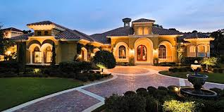

Are you Ready to Get on the
Road to Your Financial Freedom?

Slide 56

Questions?

Slide 57
Financial Education is the Key
You Need to Learn
How Money Works!

Slide 58









The Stages of Life
+$
5. Legacy
4. Retirement &
Enjoy Life
3. Work, Earn $,
Save & Invest
2. Education
& Preparation
The Goal is to Be Prepared for the Next Stage in Life
1. Formation
-$
0
18
25
time
65
85

Slide 59
The Two Primary Phases of Money
+$
The Goal is to Make Sure There is More than Enough in Retirement
FINANCIAL FREEDOM?
2. DISTRIBUTION
1. ACCUMULATION
The Goal of Retirement is having a secure income without losing your savings
FINANCIAL INSECURITY?
-$
0
18
25
time
65
85
Active Income $
Passive Income $

Slide 60

How did we get here?
Bad Programming!
We are programmed since were young! We were given a Script!
By Who? Parents, Religion, School, Government, Friends, Society
They tell us to be successful we must:
Go to school and Study hard
Get good grades
Get a good job
Work hard
Make money & pay taxes
Buy whatever makes us happy
Maintain a good credit score
Don’t pay off your home – interest is tax deductible
Use “good debt” to get ahead in life

Slide 61
The Debt Trap
+$
18
Critical Decisions!
65
time
Student Loan
Consumption – Credit Cards
Wedding and Honeymoon – Credit Card
The Debt Trap!
Traditional Solution?
Work for 40 years and Retire
Buy Term, Invest the difference in mutual funds, 401k, IRA
Car Loan
New Home Mortgage
Small Business Loan
-$
Consolidation Loan
The Pit of Desperation

Slide 62
The Possibility RoadMap From
Financial Slavery to Freedom & Success
+$
LEGACY!
Foundation
FREEDOM!
Enjoy it All, Share with Others
Impact
Wealth Heritage
PROSPERITY!
Become Your Own Bank
Think and Grow Wealthy
Business
Investments
Financial Freedom!
Passive Income > Expenses
The Debt Trap!
18
Critical Decisions!
65
time
ABUNDANCE!
Invest in Yourself
Save
Get out of Debt
Financial Security!
Debt Free!
Net Interest = 0
Financial Slavery!
Net Income < 0
Traditional Solution?
Buy Term, Invest in Mutual Funds, 401k, IRA
-$
The Pit of Desperation
Pay Yourself First!
Net Income > 0

Slide 63
SOLUTION: We Need to Take
Control of our Life & Finances
Asleep, Drifting thru Life
Awake, Taking Control
We followed the script they gave us…
We go drifting thru life.
We need to wake up
And take control of our life.

Slide 64

The Requirements
What you Need to Do is:
1.) Wake Up & Take Control: Realize you have been drifting in your financial life, without any plan or direction. Then wake up and decide to take back control of your financial life.
2.) Develop Burning Desire & New Mindset: Develop desire to change direction, desire to become financially free, and adopt a new attitude and mindset that no one will stop you.
3.) Assess Your Current Position: Understand where you are, and how you got here.
4.) Set Financial Vision & Goals: Have a clear idea where you want to go, what you want & why you want it.
5.) Mind the Gap & Count the Cost: Understand the distance you need to travel and be willing to pay the price to achieve it.
6.) Make the Commitment: Then have courage, make the commitment and have the persistence to make it a reality.

Slide 65
The Requirements
What you Need to Do is:
7.) Financial Education: Understand & learn how money works.
8.) Adopt New Script: Replace your old script with a new one that will serve you.
9.) Financial Plan: Develop a step by step plan to achieve Financial Freedom.
10.) New Decisions: Make better decisions every day that lead you forward.
11.) Take Daily Action: You need to make progress every day towards your goals until you achieve Financial Freedom.
12.) Celebrate Your Results & Wins: Financial Freedom is a process, a lifestyle, a journey, not just a destination. Celebrate your victories along the way!
This is what the Financial Freedom Seminar is all about. It is a roadmap towards a new life!

Slide 66
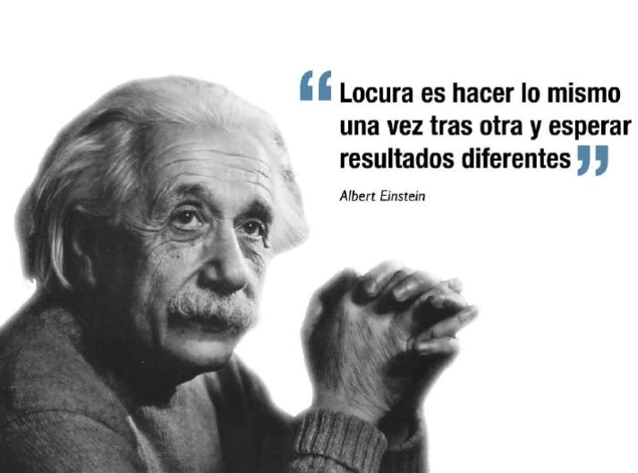
We need a new Script!
Insanity if doing the same thing over and over again and expecting a different result
.

Slide 67
We Need a New Script!
To Get Ahead in Life = SPEND AND GET IN DEBT!!!
GO TO UNIVERSITY = Student Loans
CONSUME = I Earn to Spend
BORROW = Get into Credit Card Debt & Make Minimum Payments
GET A JOB = Limited Income and Pay Taxes
BUY A NEW CAR = Get a Car Loan
BUY A NEW HOME = Get a 30 Year Mortgage
To Get Ahead in Life = PRODUCE, DARE TO PROSPER AND BE FINANCIALLY FREE!
INVEST IN YOUR SELF = I Go to University of Success to Learn Principles to Succeed in Life
BE A PRODUCER = I Focus on Creating something of Value.
PAY YOURSELF FIRST = A Part of All I Earn is Mine to Keep; I Save & Succeed
BE YOUR OWN BOSS = I Believe in Myself; I Work for Yourself, My Own Business provides me Unlimited Income
BE YOUR OWN BANK = I am My Own Bank. I Finance my Major Purchases and Pay the Interest to Myself.
BECOME DEBT FREE ASAP = I Focus on Paying Debt Quickly and Staying Debt Free.

Slide 68
We Need a New Script!
To Get Ahead in Life = SPEND AND GET INTO DEBT!!!
¿NOT MAKING ENOUGH MONEY? = Study a Masters
HAVE KIDS = Pay their School, University, Weddings
PROTECT YOUR FAMILY = Use a Term Insurance, Whole Life, Universal Life, or Indexed Life
INVESTMENT = Invest in the stock market or real estate with borrowed money
RETIREMENT PLAN = Use a 401k, IRA, y depend on social security
To Get Ahead in Life = PRODUCE, DARE TO PROSPER & BE FINANCIALLY FREE!!
THINK AND GROW RICH = I Develop New Mindsets & Skillsets, Ideas & Abilities; I Turn on My Dream Machine; I Sell on Commission
BE AN EXAMPLE = I Invest Time into My Family, I am a Role Model and Example; I provide for my children’s Education & Teach Them to be Financially Free.
PROTECT YOUR FAMILY AND ESTATE = I am a Provider and Protect my Family. I Will Leave a Wealth Heritage That Will Last for Many Generations
INVEST IN YOUR OWN BUSINESS = I Don’t Risk My Money. I Take Control of My Finances and Invest In My Own Business First. I Don’t Speculate with Leverage.
BECOME FINANCIALLY FREE = I Generate Passive Income > Expenses; I Focus on Legacy & Impact

Slide 69
A New Script!
I AM A PRODUCER
God gave me Dominion – Control over my Self: Thoughts, Emotions, Actions
God gave me the Power to Decide, Act & to Speak
God gave me the Power to Create Wealth – to Produce, Multiply and Grow
God gave me a Mind that has infinite creative capacity and can generate Wealth beyond my wildest dreams.
I AM MY NO. 1 INVESTMENT
I invest in My Self first every day
I am worth investing in because I produce the highest ROI
I am Committed to my development
I AM MY OWN BOSS
I believe in myself, I work for myself
I am a Leader, I Market Myself
I Invest in my Business first
I AM FINANCIALLY FREE
I Dare to Prosper
I am Debt Free
I am Financially Free!
I AM MY OWN BANK
I pay myself first
I am a protector, I am a role model
I am a saver, and my own banker
I AM A GENEROUS GIVER
I honor the Lord with the firstfruits of all my increase
God has blessed me so I can be a blessing

Slide 70
The 12 Areas of Life
We can Break Down Life into 12 Main Areas.
Each Area May have more Categories.
YOUR SELF
BANKING & FINANCING
BUSINESS
FAMILY
INVESTMENTS
RESERVES
LIFESTYLE & PURCHASES
LEGAL &
TAXES
PROTECTION
ESTATE &
LEGACY
YOUR OWN BANK
GIVING

Slide 71
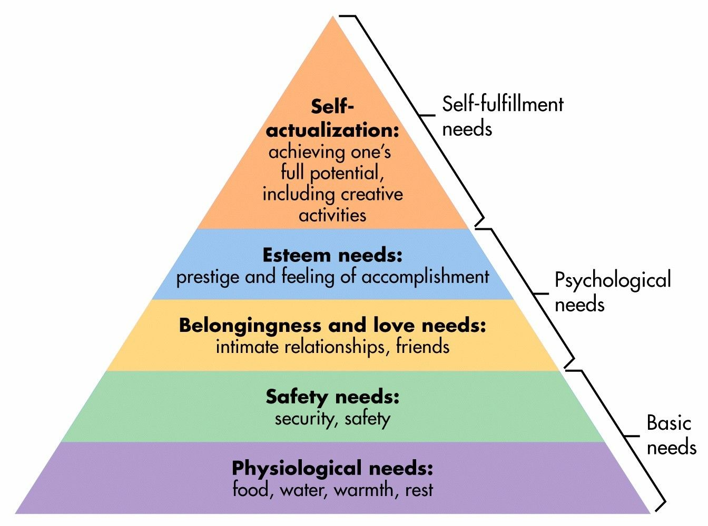
Hierarchy of Needs
Maslow’s Hierarchy of Needs
Financial Hierarchy of Needs
Legacy
Giving for Impact
Financial Freedom
My money works for me
Prosperity
My assets & income are growing
Abundance
I make more than enough – I can save
Security
Steady income - Living paycheck to paycheck
Survival
Begging money to eat & basic needs

Slide 72
The Dimension of Money
The Dimension of MONEY is critical to understand:
There are 3 Key Financial Statements that are
interconnected.
Cash Flow
Statement
Balance Sheet
Income
Statement

Slide 73
The 3 Financial Statements
Each of the 3 Financial Statements has 3 parts.
Cash Flow
Statement
Balance Sheet
Income
Statement
INVESTMENTS
FINANCING
OPERATIONS
ASSETS -
LIABILITIES
= EQUITY
INCOME
- EXPENSES
= NET INCOME

Slide 74

WHO ARE YOU?
WHO DO YOU HAVE TO BECOME?

Slide 75
The “Success Formula”
Most gurus say: BE -> DO -> HAVE
But it is not so simple
Who do I need to BECOME? Change the Script / Self-Image
What do I need to BELIEVE? Change the Paradigm
What do I need to KNOW? Acquire a Correct Mental Framework
How do I need to THINK? Acquire the Right Mindset
WHAT do I WANT? Develop a Clear Burning Desire and Vision
WHY do I Want it? Have a Clear Purpose and Motivation
Am I COMMITTED to Getting it? This is the KEY to Transformation!
Do I have a PLAN in place that is Possible? Can you see the way?
Have I set GOALS, Milestones with detailed Activities? These are the steps to get to your destination.
Am I Doing the Daily WORK required? Take Massive Action Daily!
This will guarantee RESULTS!!! The only thing that matters is Results!

Slide 76
Key Questions
Am I Able? You have the Potential. With 1:1 Coaching we will make sure you do the assignments – we will do them together.
Am I Willing to Pay the Price? That is up to you. Only you can decide what is best for you and decide to do the work.
Can I Succeed? YES!! Our focus will be on getting you Proven Measurable RESULTS!
Alone vs. Coaching? I Believe Working with a Coach is better than going it alone – the choice is yours…

Slide 77

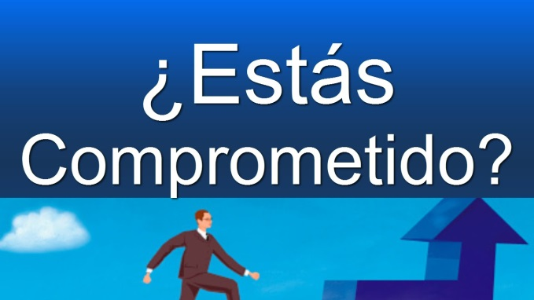
Are You Interested?
¿Or are you Committed?
Someone Interested
Someone Committed
Will do whatever is Convenient.
Is willing as long as it is easy and it costs nothing.
Is in his comfort zone and not willing to change.
Does not take risks and plays not to lose.
Will Do Whatever is Necessary.
Is willing to pay the Price of Success to achieve his Dreams and Goals in life!
Gets out of his comfort zone on purpose – willing to make the necessary changes.
Takes Calculated Risks and Wins!
Are You Committed?

Slide 78
Next Steps – SIGN UP!
1.) Decide if you want to Register for the 12-week class.
2.) Choose a Payment Plan -1x or 3-mo or 12-mo
3.) Register with Ana – ana@financial-freedom.org or (915) 504-4225
4.) Set up your Initial Interview this Week!

Slide 79



Questions? Comments?

Slide 80
Why People Don’t Succeed in $
If we Increase our Liabilities our Expenses will Go up.
If we Increase our Expenses our Liabilities will Never go Down.
Cash Flow
Statement
Balance Sheet
Income
Statement
INVESTMENTS
+ SELF
+ BANK
Checking
Savings
+ YOUR FAMILY
+ PURCHASES
FINANCING
Credit Cards
Store Credit
ASSETS
YOUR SELF
BANK
YOUR FAMILY
PURCHASES
LIABILITIES
Mortgage
Car Loans
Children’s Education
INCOME
Salary
- EXPENSES
Expenses
Basic Living
Quality of Life
Family
- Purchases
EQUITY
NET INCOME

Slide 81
The Key to Financial Success
If we Increase our Income and Decrease our Expenses our Net Income will Go up
Cash Flow
Statement
Balance Sheet
Income
Statement
INVESTMENTS
+ SELF
+ BANK
Checking
Savings
+ YOUR FAMILY
+ PURCHASES
FINANCING
Credit Cards
Store Credit
ASSETS
YOUR SELF
BANK
YOUR FAMILY
PURCHASES
LIABILITIES
Mortgage
Car Loans
Children’s Education
INCOME
Salary
- EXPENSES
Expenses
Basic Living
Quality of Life
Family
- Purchases
EQUITY
Pay Yourself First!
NET INCOME

Slide 82
The Ultimate Goal of Financial Freedom
Eliminate your Liabilities & Maximize Net Income
Cash Flow
Statement
Balance Sheet
Income
Statement
INVESTMENTS
+ SELF
+ BANK
Checking
Savings
+ YOUR FAMILY
+ PURCHASES
FINANCING
Credit Cards
Store Credit
ASSETS
YOUR SELF
BANK
YOUR FAMILY
PURCHASES
LIABILITIES
Mortgage
Car Loans
Children’s Education
INCOME
Salary
- EXPENSES
Expenses
Basic Living
Quality of Life
Family
- Purchases
EQUITY
Pay Yourself First!
NET INCOME

Slide 83
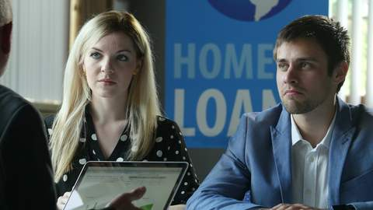

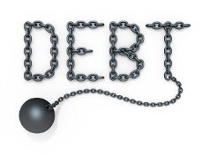
What is the Problem with the Banks?
Banks control your life through interest!
Have you ever tried to qualify for a loan
You need a job
You need enough income
You need a good credit score and good credit history
You need a W-2 and paystubs
Provide other documentation – Bank Statements, K-1’s, 1099’s, tax returns, etc.
Subjective Review (bank-to-bank human standards) Requirements package is not flexible or business-friendly.
An Appraisal - in the case of buying a house.
Money in hand to pay for closing costs, liquidity.
Title costs, closing costs, etc.
“Getting a loan from your financial institution is a process that requires time and a lot of documentation. You go through a lot to be able to meet all the requirements that your lender asks of you to be able to use their money. You borrow from others and pay their fees, service charges and possibly high interest rates because you don't have access to your own money.” – Dwayne Burnell

Slide 84
Most People try to Save, Invest,
Spend and Get out of Debt in many separate places at the same time
CREDIT CARD
INCOME
UNIVERSITY (529)
CREDIT CARD 2
RETIREMENT (401k)
LINE OF CREDIT
RETIREMENT (IRA)
BANK CHECKING ACCOUNT
STUDENT LOANS
PERMANENT LIFE INSURANCE
TERM LIFE INSURANCE
STOCK MARKET INVESTMENT
CAR LOAN
BUSINESS
CAR LOAN 2
BILLS
WANTS
CONSUMPTION
REAL ESTATE INVESTMENT
HOME MORTGAGE

Slide 85

Key Lesson #1 is to
Pay Yourself First!
Save Before You Spend
INCOME
BANK CHECKING ACCOUNT
BANK SAVINGS ACCOUNT
Pay Yourself
FIRST!
10%+
For Short-Term
Needs & Wants
For Long-Term
Needs & Wants
Use 2 Separate Accounts

Slide 86

Key Lesson #2:
Become Your Own Bank
Concentrate Your Assets into One “Wealth Heritage” Account
UNIVERSITY (529)
RETIREMENT (401k)
BANK SAVINGS ACCOUNT
RETIREMENT (IRA)
YOUR “WEALTH HERITAGE” ACCOUNT
PERMANENT LIFE INSURANCE
We will call it the “Wealth Heritage” Account
STOCK MARKET INVESTMENT

Slide 87
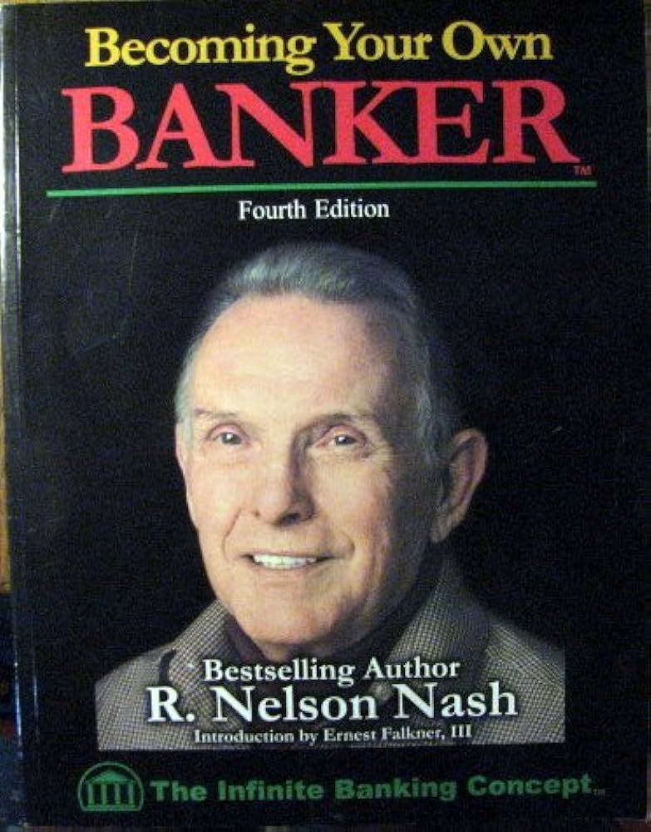
The Infinite Banking Concept:
It’s About Financing & Control, Not Investing
“This is not about investing. It's about how we finance things in life. It is not a "get rich" quick procedure. On the contrary, it requires a lot of planning. Learn to think beyond that of the current generation.”
– R. Nelson Nash
“The whole truth goes through three stages. First, they ridicule it. Second, it is violently opposed. Third, it is accepted as obvious.”
Arthur Schopenhauer
www.infinitebanking.org

Slide 88
Your “Wealth Heritage”
Account has 3 Functions
1. PROTECTION – This Comes From Life Insurance:
Whole + Term + Paid Up Additions (PUA)
YOUR “WEALTH HERITAGE” ACCOUNT
3. LINE OF CREDIT - This Replaces the Need for Borrowing From Commercial Banks
1. PROTECTION
2.
SAVINGS
2. SAVINGS – This Replaces the Need for Bank Savings Accounts, College Savings Accounts & Retirement Accounts
This “Wealth Heritage” Account becomes the Foundation of your Financial Security Strategy
3.
LINE OF CREDIT

Slide 89
Turn your IBC Account into
“Your Own Bank”
INCOME
1.) Pay Yourself FIRST!
10%+
YOUR “WEALTH HERITAGE” ACCOUNT
BANK CHECKING ACCOUNT
BANK SAVINGS ACCOUNT
2.) Borrow From Yourself
BILLS
WANTS
CONSUMPTION
PAY INTEREST AND DEBT
PAY DOWN DEBT ON PURCHASES
3.) Pay Extra Principal Each Month

Slide 90
Key Lesson #3: Lend to Yourself and Focus On Paying Off One Debt at at Time
“YOUR OWN BANK”
Policy Loans
SAVINGS
1. PROTECTION
2. SAVINGS
3. LINE OF CREDIT
INCOME
EXPENSES
X
CHECKING
Credit Cards
Car Loans
Ask for a loan on “Your Own Bank” so that you eliminate debts faster.
Pay your loans to “Your Own Bank” later.
Student Loans
Mortgage

Slide 91
Key Lesson #3: Lend to Yourself and Focus On Paying Off One Debt at at Time
“YOUR OWN BANK”
Policy Loans
SAVINGS
1. PROTECTION
2. SAVINGS
3. LINE OF CREDIT
INCOME
EXPENSES
X
EXPENSES
Credit Cards
Car Loans
X
Ask for a loan on “Your Own Bank” so that you eliminate debts faster.
Pay your loans to “Your Own Bank” later.
Student Loans
Mortgage

Slide 92
Key Lesson #3: Lend to Yourself and Focus On Paying Off One Debt at at Time
“YOUR OWN BANK”
Policy Loans
SAVINGS
1. PROTECTION
2. SAVINGS
3. LINE OF CREDIT
INCOME
EXPENSES
X
EXPENSES
Credit Cards
Car Loans
X
X
Ask for a loan on “Your Own Bank” so that you eliminate debts faster.
Pay your loans to “Your Own Bank” later.
Student Loans
Mortgage

Slide 93
Key Lesson #3: Lend to Yourself and Focus On Paying Off One Debt at at Time
“YOUR OWN BANK”
Policy Loans
SAVINGS
1. PROTECTION
2. SAVINGS
3. LINE OF CREDIT
INCOME
EXPENSES
X
EXPENSES
Credit Cards
Car Loans
X
X
Ask for a loan on “Your Own Bank” so that you eliminate debts faster.
Pay your loans to “Your Own Bank” later.
Student Loans
X
Mortgage

Slide 94
Key Lesson #4: Once you are Bank Debt Free, Repay the Policy Loan
“YOUR OWN BANK”
SAVINGS
1. PROTECTION
2. SAVINGS
3. LINE OF CREDIT
INCOME
Repay Policy Loans
EXPENSES
Ask for a loan on “Your Own Bank” so that you eliminate debts faster.
Repay your loans back to “Your Own Bank” later.

Slide 95
Benefits of “Become Your Own Bank"
The Initial Benefit is Protecting your Family.
Your Savings Will Grow Constantly and will Pay you Dividends and Interest.
Your Line of Credit will Replace your Bank Loan and Save you Interest.
Your Debt starts to get eliminated and this Accelerates the Process to Get Out of Debt!
Your “Wealth Heritage” account Replaces your Bank and from here on out you don’t need it.

Slide 96

Your “Wealth Heritage”
Account Grows Over Time
1. PROTECTION – As Time Goes By Your Life Insurance Will Grow
3. LINE OF CREDIT – As Time Goes By Your Ability to Borrow Will Grow
YOUR “WEALTH HERITAGE” ACCOUNT
1. PROTECTION
2. SAVINGS – As Time Goes By Your Savings (Cash Value) Will Grow
2.
SAVINGS
Your “Tree of Wealth” Account Grows and Grows!
3.
LINE OF CREDIT

Slide 97
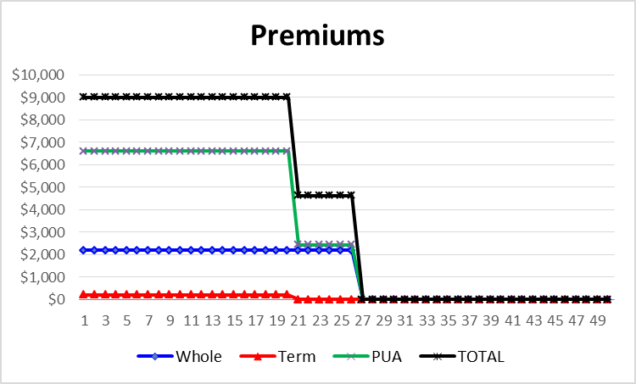
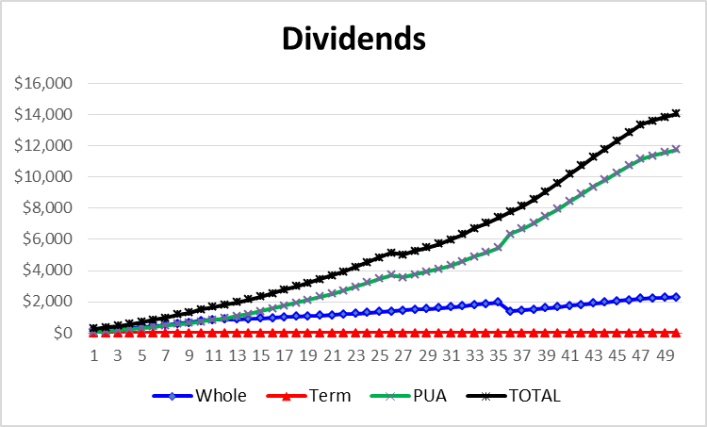
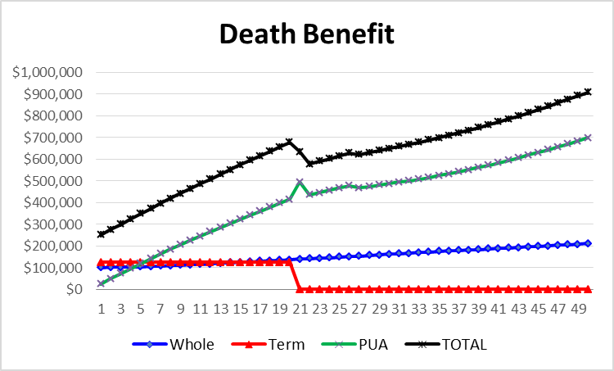

3 Components of Your Own Bank Insurance

