Slide 1

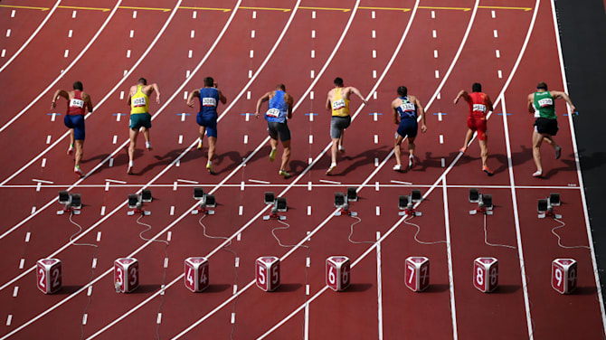




Financial Freedom Challenge
Presents
By
Alex Barrón

Slide 2

HOW DID WE GET HERE?!

Slide 3
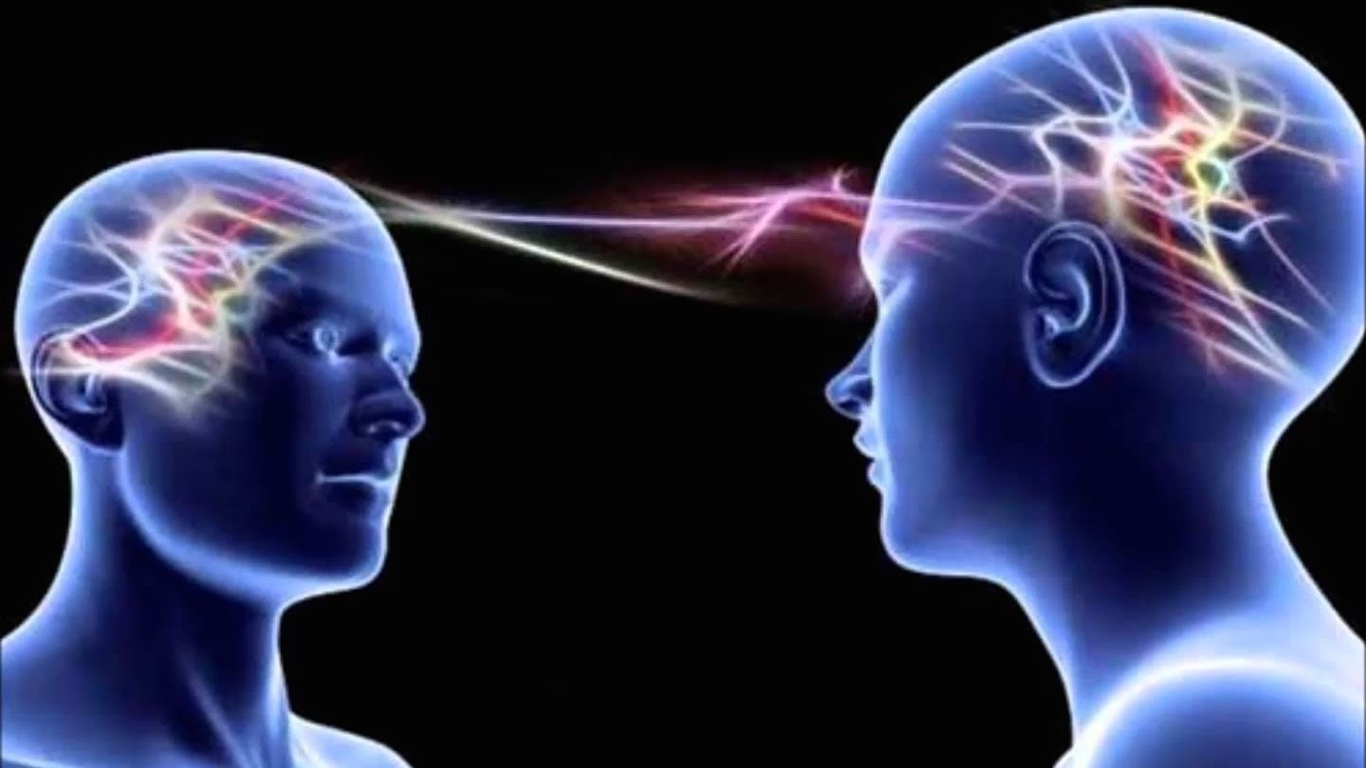
How did we get here?
Bad Programming!
We are programmed since were young! We were given a Script!
By Who? Parents, Religion, School, Government, Friends, Society
They tell us to be successful we must:
Go to school and Study hard
Get good grades
Get a good job
Work hard
Make money & pay taxes
Buy whatever makes us happy
Pay our debts
Repeat – We don’t get ahead!

Slide 4
The Economic Life of a Human Being
+$
18
30
65
0
Critical Decisions!
time
-$

Slide 5
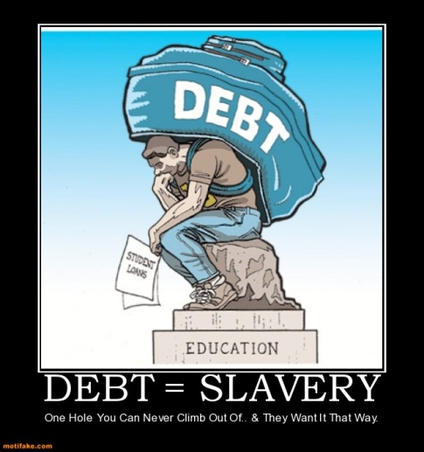
Programmed to be a Student
SCRIPT: TO GET AHEAD IN LIFE YOU NEED TO GET A UNIVERSITY DEGREE!
Get into Debt by acquiring Student Loans.
This is where the Financial Slavery begins.
Spend $10,000-$50,000/yr on tuition, room & board.
Over 4-5 years this can become $40,000-$250,000 of student loans or more.
That is before going to graduate school.

Slide 6
The Economic Life of a Human Being
+$
18
Critical Decisions!
65
0
time
Student Loan
Critical Decisions!
Get a Degree? Yes or No?
Yes? What Field?
Yes? What University?
Yes? How to Pay for it?
Study Masters?
Study Ph.D.?
The Debt Trap Begins!
-$

Slide 7
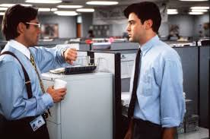


Programmed to Be an Employee
SCRIPT: TO MAKE MONEY YOU NEED A JOB!
After they graduate, most people look for… a JOB!
A safe, secure, “high paying” job, with great benefits, and an ability to go up the corporate ladder over time.
Critical Decisions!
Where to Work?
Where to Live?
What is Income?

Slide 8

Programmed to Be a Taxpayer
SCRIPT: IT IS YOUR DUTY TO PAY THE GOVERNMENT TAXES ALL YOUR LIFE!
As an Employee you immediately become a Taxpayer!
Income Tax Since 1913
Progressive Tax Code
You must pay “your fair share” of Income Taxes
Employers collect payroll taxes before you see the money

Slide 9

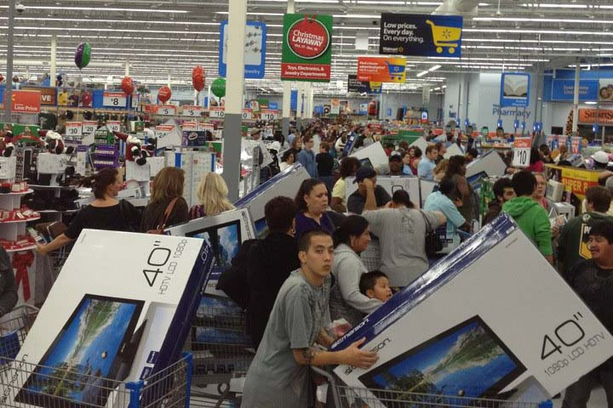
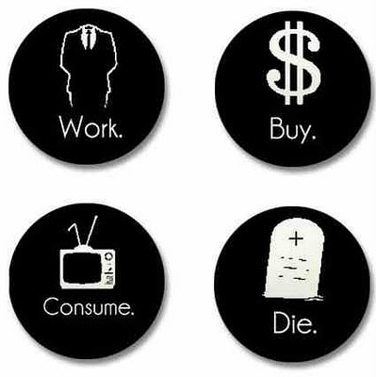
Programmed to be a Consumer
SCRIPT: YOU NEED TO SPEND MONEY TO BUY THINGS THAT MAKE YOU HAPPY!
Once a person has a Job, the first thing people want to do with their money is spend it to BUY THINGS!
That is what money is for, right?!
“I deserve it!” and the monthly payments are really low… plus they offer 0% interest financing!

Slide 10
The Debt Trap
+$
18
Critical Decisions!
65
0
time
Student Loan
Consumption – Credit Cards
Critical Decisions!
What should I buy for black Friday?
How can I get access to more money?
How Can I get the latest and greatest gizmo?
The Debt Trap Continues!
-$

Slide 11




How Much Do You Spend on Cars?
SCRIPT: YOU NEED A NEW CAR TO ENJOY LIFE!
If you spend $40,000 to buy a new new car
Every 5 years
Over a 50 year lifespan = 10 cars
Pay 10% interest
How much money do you spend over a lifetime?
How much do you need to earn pretax?
$40,000 + $11,000 = $51,000 x 10 x 2 = $1,020,000!

Slide 12
The Debt Trap
+$
18
Critical Decisions!
65
0
time
Student Loan
Consumption – Credit Cards
Critical Decisions!
What model car should I buy?
If new what features should I include?
How should I finance it?
Car Loan
The Debt Trap Continues!
-$

Slide 13




How Much Do People
Spend on Weddings?
Wedding Rings
Wedding Dress
Bachelor(ette) Party
Rehearsal Dinner
Wedding Hall
Flowers, Music
Wedding Dinner & Party
Wedding Reception
Honeymoon
$10,000-$100,000?+

Slide 14
The Debt Trap
+$
18
Critical Decisions!
65
0
time
Student Loan
Consumption – Credit Cards
Critical Decisions!
How much on the ring?
How much on the dress?
Where to get married?
How many guests to invite to the wedding?
Where to go for honeymoon?
Car Loan
The Debt Trap Continues!
Wedding and Honeymoon – Credit Card
-$

Slide 15




How Much Will You Spend on Homes?
If you buy a new home for $250,000
Every 10 years
Over a period of 40 years = 4 homes
Paying 5% interest
How much interest will you pay over a lifetime?
How much must you make before taxes?
$260,000 + $513,000 = $773,000!
Principal + Interest = Total Payments

Slide 16
The Debt Trap
+$
18
Critical Decisions!
65
0
time
Student Loan
Consumption – Credit Cards
Critical Decisions!
What kind of home? New or used?
What size of home?
Where?
What upgrades to include?
What kind of financing?
Car Loan
The Debt Trap Continues!
Wedding and Honeymoon – Credit Card
New Home Mortgage
-$

Slide 17
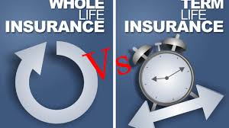

Programmed to Buy
Traditional Life Insurance
SCRIPT: Buy Term and Invest the Difference!
Today most of the people who sell life insurance typically offer:
Term Insurance (10-30 years)
Whole Life (permanent – takes 15 years to break even)
Variable or Universal – Eats away money

Slide 18


Programmed to Be a Passive Investor
While Saving for Retirement
SCRIPT: Invest in the Stock Market for Retirement!
Buy Term and Invest the Difference
Buy & Hold Mentality
Buy for the “Long Term”
Dollar Cost Average
“The Stock Market Makes 10-12% per year”
Buy Mutual Funds
Get an IRA or 401(k)

Slide 19

Where Does All the Money Go?
Universities – Tuition. Gone to educate people.
Government – Taxes. This money is gone before you even see it!
Banks – Interest. Every time you borrow you pay interest until the loans are paid off.
Insurance Companies – Premiums. Most people have to pay health insurance, car insurance, home or renter’s insurance, life insurance, etc.
Merchants – Consumption. Everyone has to eat, pay utilities, buy clothes, pay for a car, gas and maintenance, etc.

Slide 20
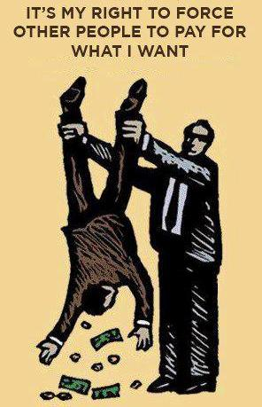
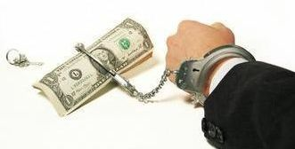
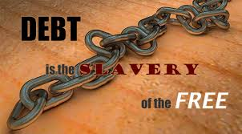
What is the Cost of Being a Financial Slave?
How much money goes out of your pocket in
Tuition
Taxes
Purchases
Consumption
Premiums
Interest
Investment Fees and
Lost Opportunity Cost
Over your lifetime??

Slide 21
The Traditional Script Does Not Work!
To Get Ahead in Life = SPEND & GET INTO DEBT!!!
Go to University = Student Loans
Get a Job = Limited Income and Pay Taxes
Get a New Car = Car Loan
Spend on What you Like = Credit Cards
Buy a New Home = Mortgage
Don’t Have Enough Money = Study a Masters or Ph.D.
Have Kids = Pay School, University, Wedding
Retirement Plan = 401k, IRA, Mutual funds
Premature Death = Term Insurance

Slide 22

How Much is Left for You?
To Pay off your Home?
To Start a Business?
To Invest in Opportunities?
To Travel?
To Enjoy Your Retirement?
To Help Out Others?
To Leave an Inheritance?

Slide 23
The Debt Trap
+$
18
Critical Decisions!
65
time
Student Loan
Consumption – Credit Cards
Wedding and Honeymoon – Credit Card
The Debt Trap!
Car Loan
New Home Mortgage
Small Business Loan
-$
Consolidation Loan
The Pit of Desperation

Slide 24
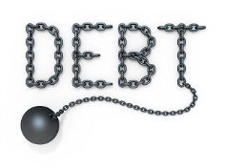
Getting Into Debt is Easy
What is Debt? Borrowing money to buy today with the promise to repay in the future with interest.
Typical Debt Progression:
  School Loan
  Car Loan
  Credit Cards
  Home Mortgage
  Store Credit
  Small Business Loan
  Commercial Lease
  Commercial Real Estate Loan

Slide 25
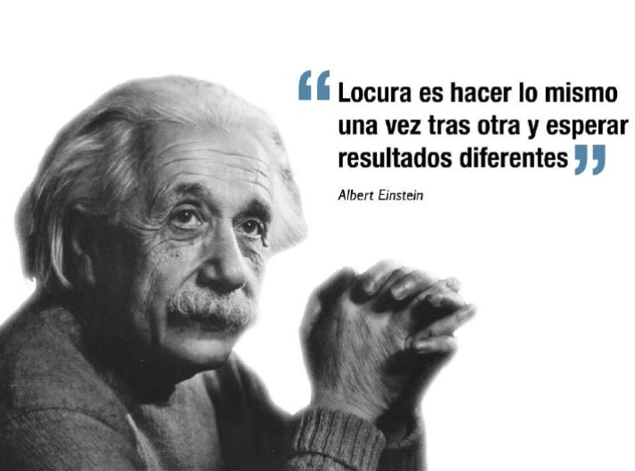
We need a new Script!
Insanity if doing the same thing over and over again and expecting a different result
.

Slide 26
We Need a New Script!
To Get Ahead in Life = SPEND AND GET IN DEBT!!!
GO TO UNIVERSITY = Student Loans
CONSUME = I Earn to Spend
BORROW = Get into Credit Card Debt & Make Minimum Payments
GET A JOB = Limited Income and Pay Taxes
BUY A NEW CAR = Get a Car Loan
BUY A NEW HOME = Get a 30 Year Mortgage
To Get Ahead in Life = PRODUCE, DARE TO PROSPER AND BE FINANCIALLY FREE!
INVEST IN YOUR SELF = I Go to University of Success to Learn Principles to Succeed in Life
BE A PRODUCER = I Focus on Creating something of Value.
PAY YOURSELF FIRST = A Part of All I Earn is Mine to Keep; I Save & Succeed
BE YOUR OWN BOSS = I Believe in Myself; I Work for Yourself, My Own Business provides me Unlimited Income
BE YOUR OWN BANK = I am My Own Bank. I Finance my Major Purchases and Pay the Interest to Myself.
BECOME DEBT FREE ASAP = I Focus on Paying Debt Quickly and Staying Debt Free.

Slide 27
We Need a New Script!
To Get Ahead in Life = SPEND AND GET INTO DEBT!!!
¿NOT MAKING ENOUGH MONEY? = Study a Masters
HAVE KIDS = Pay their School, University, Weddings
PROTECT YOUR FAMILY = Use a Term Insurance, Whole Life, Universal Life, or Indexed Life
INVESTMENT = Invest in the stock market or real estate with borrowed money
RETIREMENT PLAN = Use a 401k, IRA, y depend on social security
To Get Ahead in Life = PRODUCE, DARE TO PROSPER & BE FINANCIALLY FREE!!
THINK AND GROW RICH = I Develop New Mindsets & Skillsets, Ideas & Abilities; I Turn on My Dream Machine; I Sell on Commission
BE AN EXAMPLE = I Invest Time into My Family, I am a Role Model and Example; I provide for my children’s Education & Teach Them to be Financially Free.
PROTECT YOUR FAMILY AND ESTATE = I am a Provider and Protect my Family. I Will Leave a Wealth Heritage That Will Last for Many Generations
INVEST IN YOUR OWN BUSINESS = I Don’t Risk My Money. I Take Control of My Finances and Invest In My Own Business First. I Don’t Speculate with Leverage.
BECOME FINANCIALLY FREE = I Generate Passive Income > Expenses; I Focus on Legacy & Impact

Slide 28
A New Script!
I AM A PRODUCER
God gave me Dominion – Control over my Self: Thoughts, Emotions, Actions
God gave me the Power to Decide, Act & to Speak
God gave me the Power to Create Wealth – to Produce, Multiply and Grow
God gave me a Mind that has infinite creative capacity and can generate Wealth beyond my wildest dreams.
I AM MY NO. 1 INVESTMENT
I invest in My Self first every day
I am worth investing in because I produce the highest ROI
I am Committed to my development
I AM MY OWN BOSS
I believe in myself, I work for myself
I am a Leader, I Market Myself
I Invest in my Business first
I AM FINANCIALLY FREE
I Dare to Prosper
I am Debt Free
I am Financially Free!
I AM MY OWN BANK
I pay myself first
I am a protector, I am a role model
I am a saver, and my own banker
I AM A GENEROUS GIVER
I honor the Lord with the firstfruits of all my increase
God has blessed me so I can be a blessing

Slide 29
Moment to Reflect
¿WHY Are You Here?
Take time this moment to:
Think about why are you interested in learning about money?
Write about where you are right now?
What are the things you are struggling with?
What is motivating you to want to take this challenge?
Write What do you hope to learn by the time you finish taking this course?

Slide 30



Questions? Comments?

