Slide 1

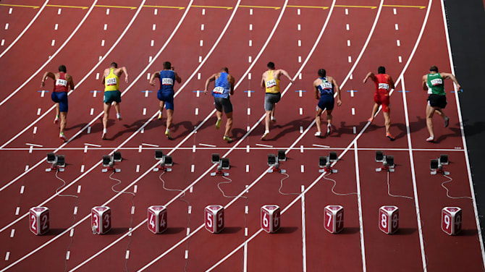




Financial Freedom Challenge
Presents
By
Alex Barrón

Slide 2
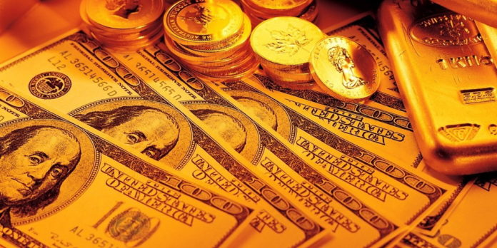
THE HISTORY OF MONEY &
WHY WE CARE ABOUT MONEY

Slide 3



Why Do You Work?
Why do you work?
  To Make Money
Why do you need money?
  To earn a living?
  To survive?
  To put food on the table?
  To put the kids through college?
  To save for retirement?

Slide 4
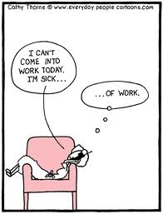
Could You Stop Working
If You Wanted To?
If yes, why don’t you do it?
If no, why not?
What would happen?
What is the worst case
scenario?

Slide 5

What is Financial Freedom?
Financial Freedom is the ability to Generate enough money to
Do whatever you want,
Be whatever you want,
Buy whatever you want,
Go wherever you want,
With Whoever you want
Whenever you want,
Without Having to Work to generate money or Worry about running out of money.
Financial Freedom means that Money is working for you instead of You working for money.

Slide 6
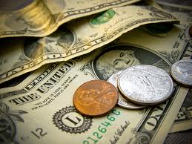
What is Money?
What is Money?
Money is the medium by which earthly success is measured.
Money makes possible the enjoyment of the best the earth affords.
Money is plentiful for those who understand the simple laws which govern its acquisition.
Money is governed today by the same laws which controlled it when prosperous men thronged the streets of Babylon, six thousand years ago.
- The Richest Man in Babylon

Slide 7
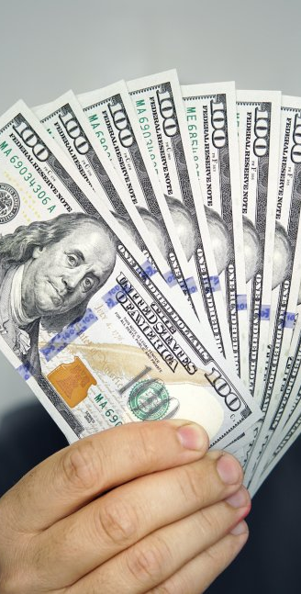
Why is Money So Important?
We don’t have to be a genius to understand that Money is an important part of life.
It is said that “money makes the world go around”.
Yet why is money so important?
Why do we strive every day to earn money?
Why do we spend so much time and effort to acquire it?
Why do we invest so much emotional energy around money:
  worrying about it,
  stressing about it,
  getting angry about it when someone cheats us out of it, or
  getting happy when we find a good value or receive unexpected money?
It is important to lay a foundation of basic understanding of what money is, what it is for, why it is important, and how we can get more before we go too far in this course.

Slide 8

Money Represents Your Life
Think about how you acquire Money.
Most people exchange TIME for MONEY.
And what is Time?
All of us have a certain number of days on this earth.
  Each day has 24 hours.
  Each hour has 60 minutes.
  Each minute has 60 seconds.
Think of each grain of sand in the hourglass as representing a second of your life.
  Time is irreplaceable.
  It is a scarce and finite resource.
  Time is simply a way to measure your Life on earth.
Life is expressed in terms of Time.
We exchange our Time for Money to get the things we need and want.
So in a nutshell, Money represents a portion of our Life that we exchanged.
THAT is WHY MONEY is SO IMPORTANT!

Slide 9

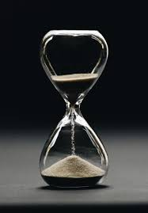
Money Matters
Why Do We Care About Money?
“Your money IS your life - just as surely as is the irreplaceable time you spent earning it.” – The Privateer
“Remember that money is only time well spent; if you have enough time you can always earn more money; but money cannot buy you personal time.” - Peter J. Daniels

Slide 10


The History of Money
Before Money Existed People Hunted or Gathered Food to Survive.

Slide 11
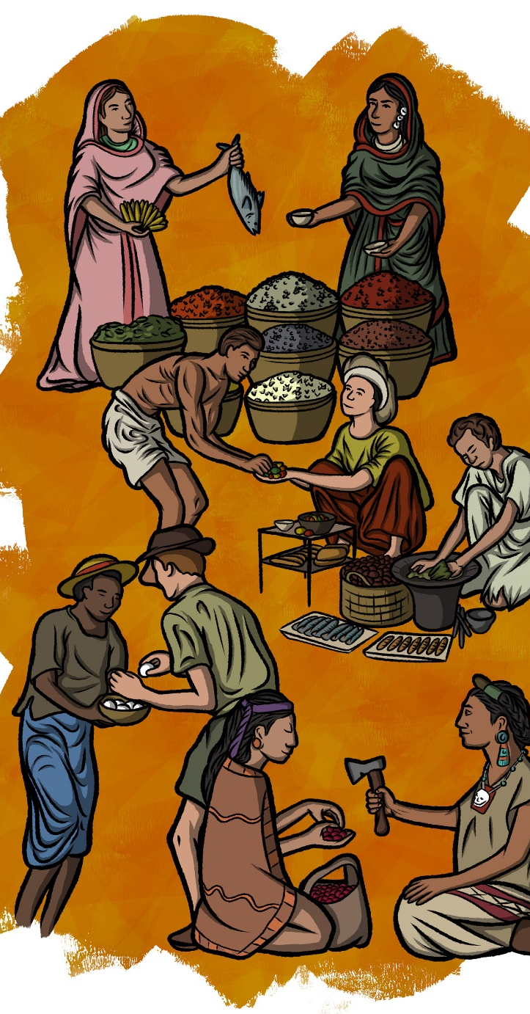
The History of Money
Eventually people began to Trade or Barter with one another.
But what happens if what you offer is not of interest to the other person?
How do you Exchange with them?

Slide 12
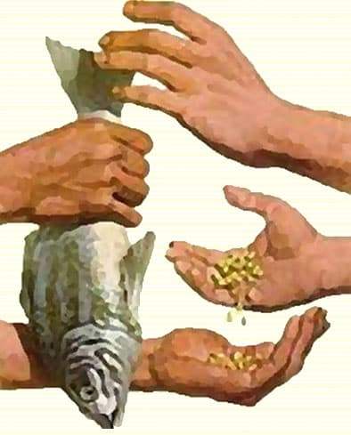
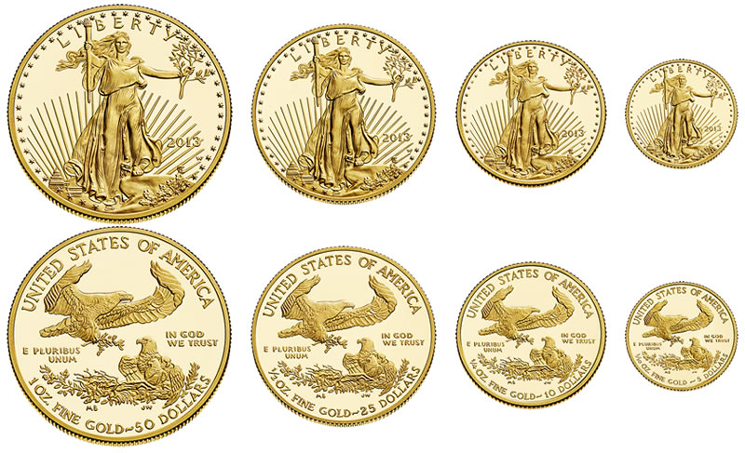
What is Money?
The Qualities of Money
A Medium of Exchange
A Measure of Value
A Store of Value
Be widely Accepted as a Means of Payment
Also
Rare
Easy to Transport

Slide 13
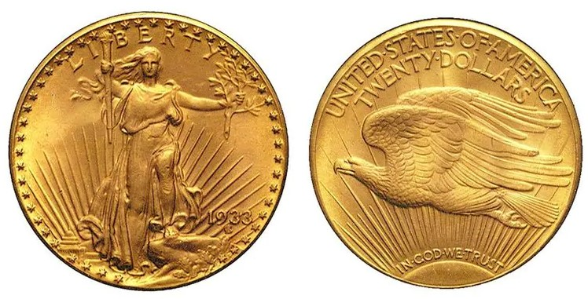
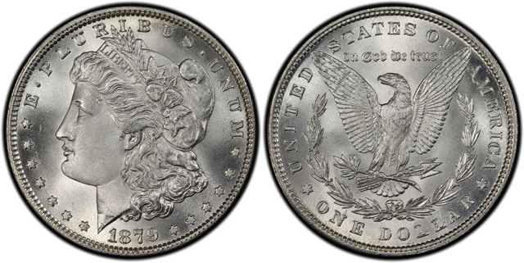

Why Gold & Silver are Money
Money is Gold and Silver Coins
"No State shall enter into any Treaty, Alliance, or Confederation; grant Letters of Marque and Reprisal; coin Money; emit Bills of Credit; make any Thing but gold and silver Coin a Tender in Payment of Debts; pass any Bill of Attainder, ex post facto Law, or Law impairing the Obligation of Contracts, or grant any Title of Nobility."
- US Constitution Article 1, Section 10
The Qualities of Money
A Medium of Exchange
A Measure of Value
A Store of Value
Be widely Accepted as a Means of Payment

Slide 14
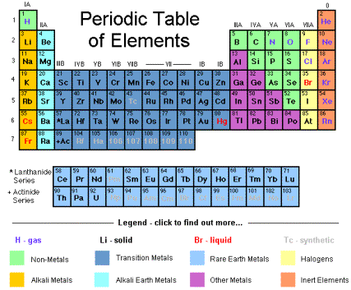
Gold and Silver in Chemistry
Gold and Silver have unique qualities not found by other elements in the Periodic Table.

Slide 15
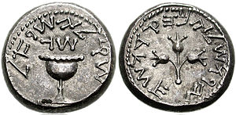
Gold and Silver Coins as Money in Biblical History
In the Bible we read Abraham was very rich.
2 “Abram was very rich in livestock, in silver, and in gold.”
– Genesis 13:2
Later on after his wife Sarah died, Abraham wanted to purchase a parcel of land to use it as a burial site. He paid for it with money using silver shekels.
12 Then Abraham bowed himself down before the people of the land;
13 and he spoke to Ephron in the hearing of the people of the land, saying, “If you will give it, please hear me. I will give you money for the field; take it from me and I will bury my dead there.”
14 And Ephron answered Abraham, saying to him,
15 “My lord, listen to me; the land is worth four hundred shekels of silver. What is that between you and me? So bury your dead.”
16 And Abraham listened to Ephron; and Abraham weighed out the silver for Ephron which he had named in the hearing of the sons of Heth, four hundred shekels of silver, currency of the merchants.”
– Genesis 23:12-16

Slide 16
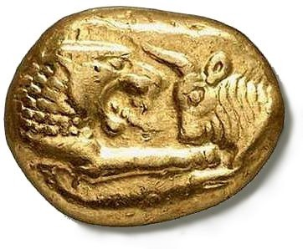
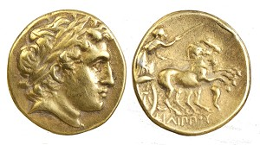
Gold and Silver Coins were Used Throughout History
The first gold coins were produced during the 6th century BC in Lydia – which is now part of western Turkey.
With the passage of time, men began to perfect the art of making coins that were more consistent in shape, purity, and weight.
The problem is that men
always look for ways to
Devalue the money.
Trust in the Integrity of the Money is
Essential to Commerce and Prosperity.

Slide 17
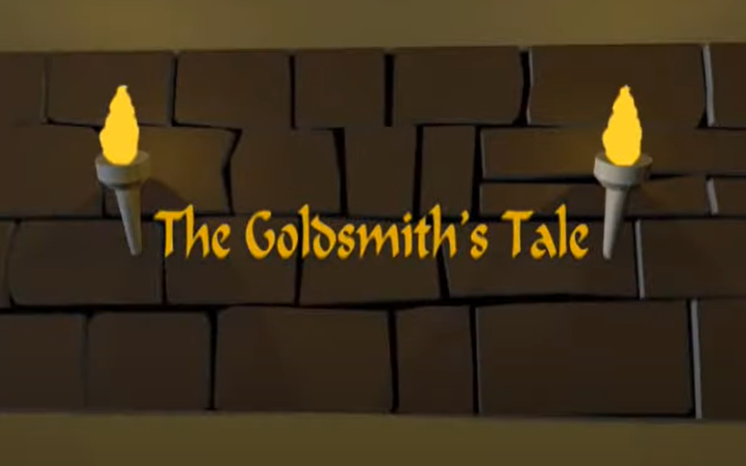
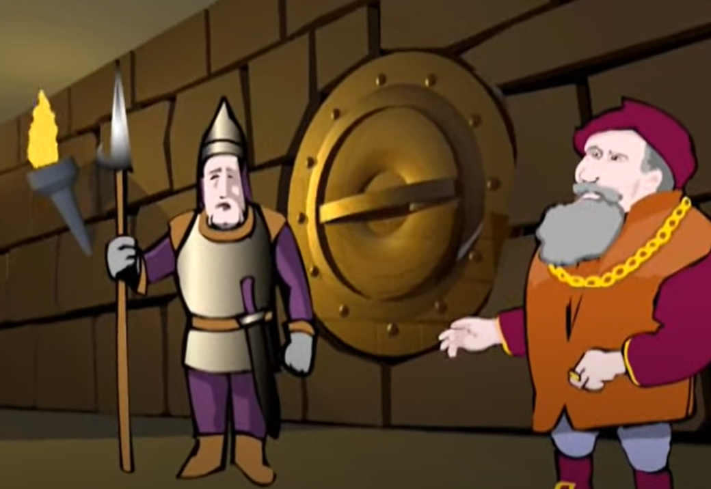
The Story of Banks and Paper Money
https://www.youtube.com/watch?v=3HdmA3vPbSU
1.) The goldsmiths would store their gold in a vault.
2.) The people wanted to store their gold in a safe place.

Slide 18
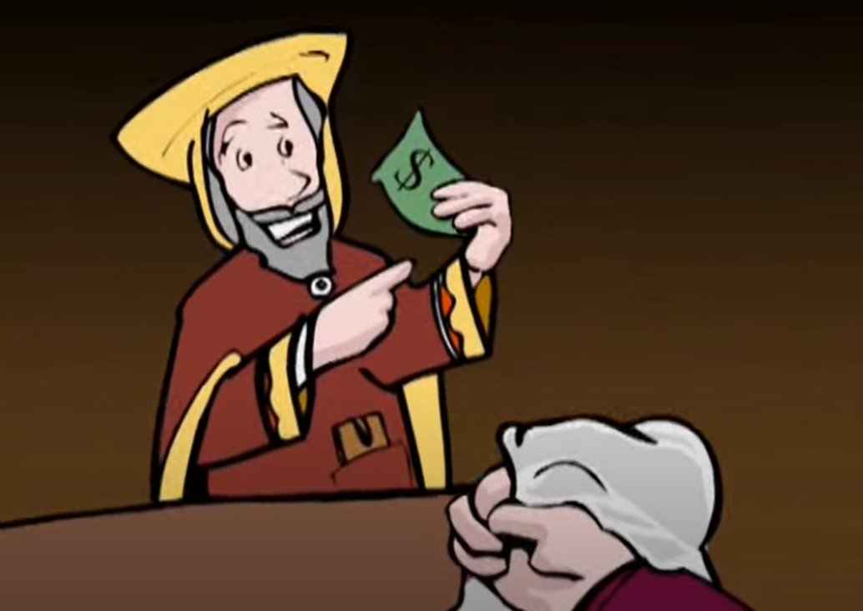
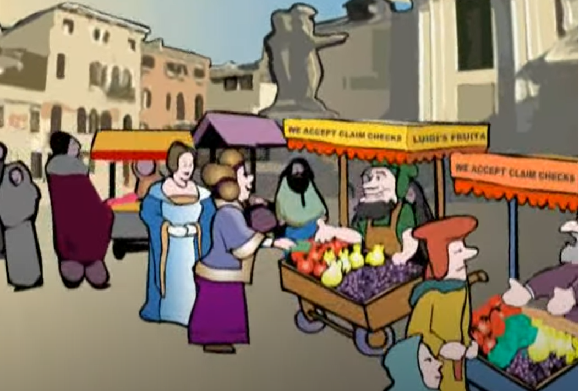
Where Does Paper
Money Come From?
https://www.youtube.com/watch?v=3HdmA3vPbSU
3.) The goldsmith would give people a receipt for their gold.
4.) The people would buy and sell using the paper receipts – it was more convenient than coins.

Slide 19
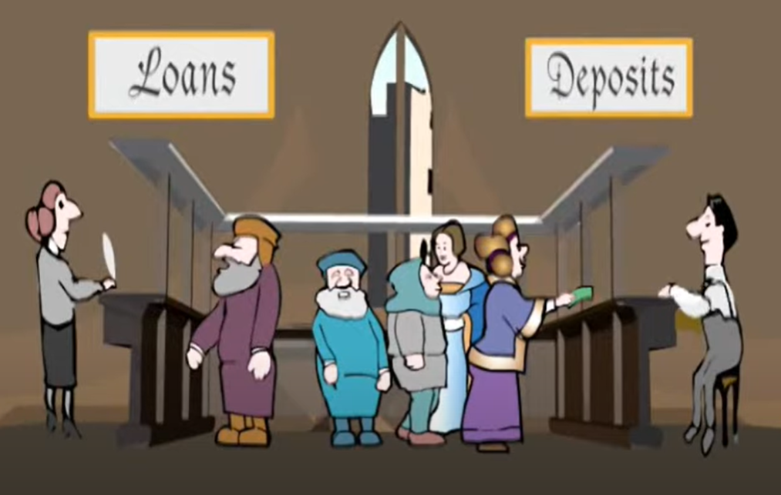
What do Banks Do?
https://www.youtube.com/watch?v=3HdmA3vPbSU
5.) People trusted their banker and deposited their gold and got paid interest.
6.) The goldsmith banker would lend people gold in the form of paper and would charge interest.

Slide 20
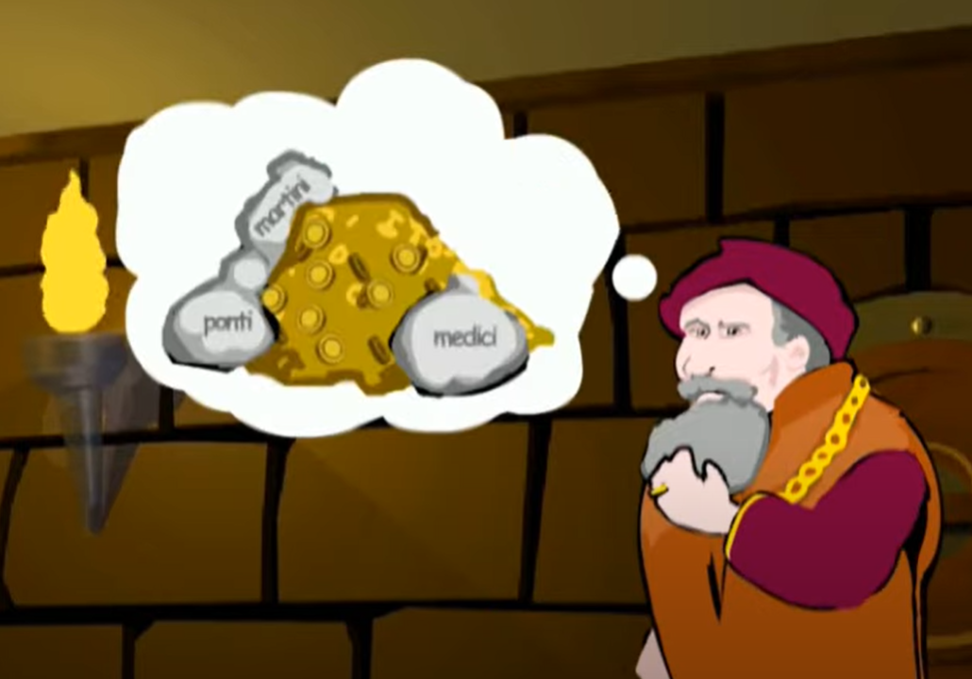
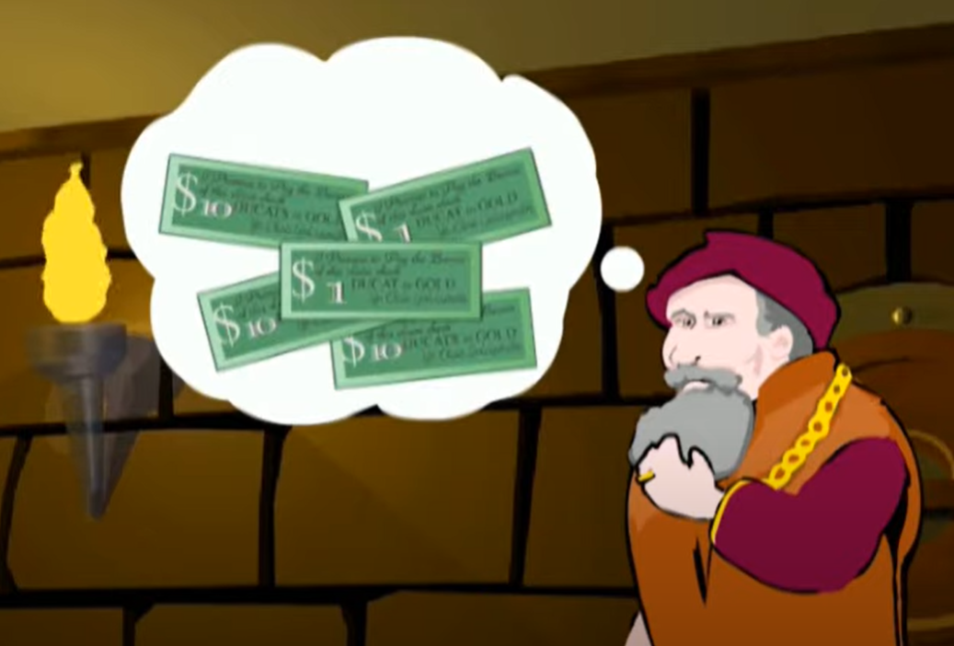
The Fundamental
Flaw of Banking
https://www.youtube.com/watch?v=3HdmA3vPbSU
7.) The goldsmith noticed people would leave their gold stored in the vault and preferred to use bills.
8.) The problem was the banker began to lend more paper than the gold he had in his vault backing up the bills in circulation.

Slide 21
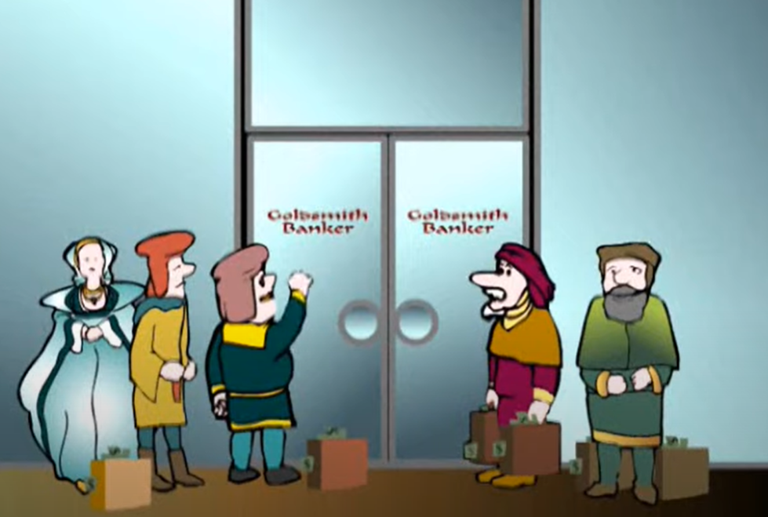
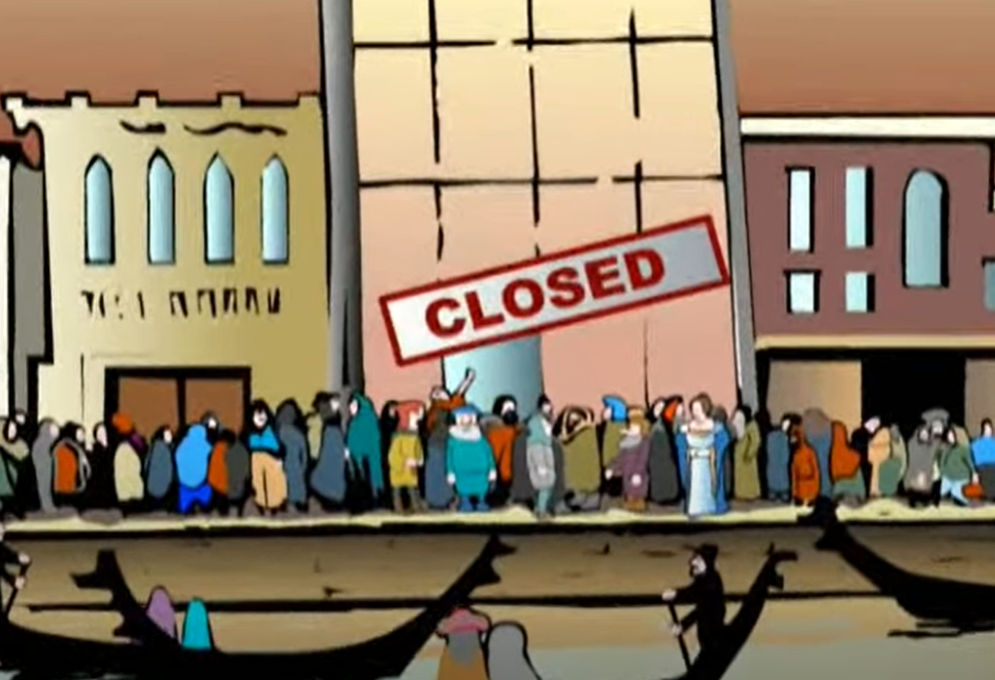
Why Banks Fail
https://www.youtube.com/watch?v=3HdmA3vPbSU
9.) The people began to suspect their gold was not safe and demanded it back.
10.) The problem was the bank did not have it and had to shut down. The bank failed and people lost their money.

Slide 22
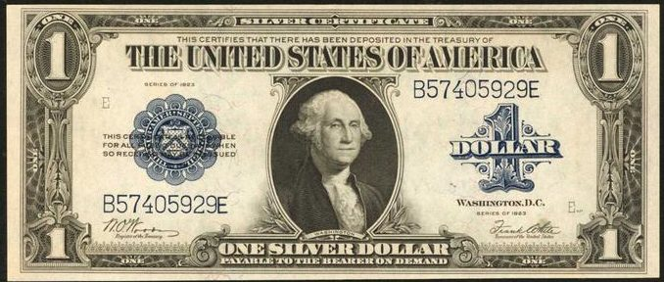
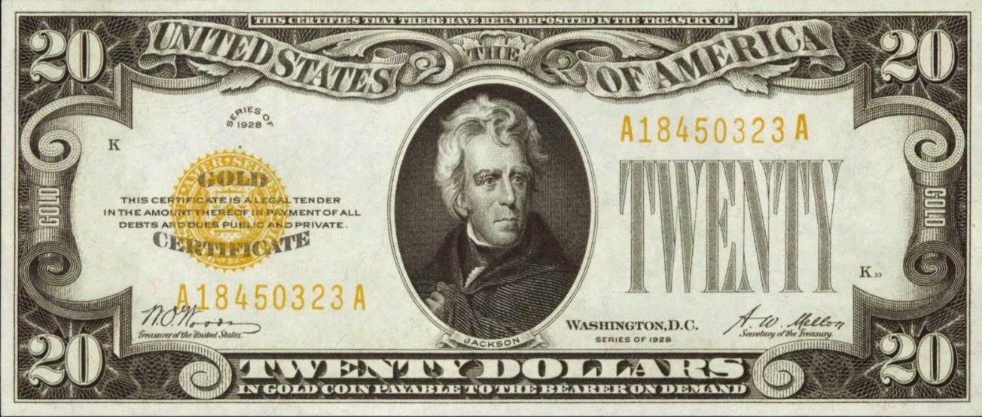
The First Dollar Bills
This was the original paper money
Paper money first began as Certificates backed up by Gold and Silver.

Slide 23
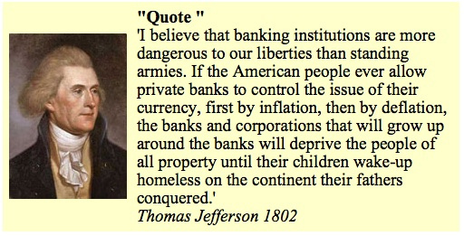
What is NOT Money
Why Banks are Dangerous
Thomas Jefferson and the founding fathers knew the dangers of paper currency. This is why they specifically stated in the US Constitution that money was Gold and Silver COINS, not paper money.
But history repeats itself… and we pay the price for our ignorance.

Slide 24
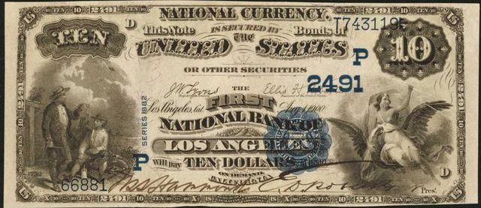
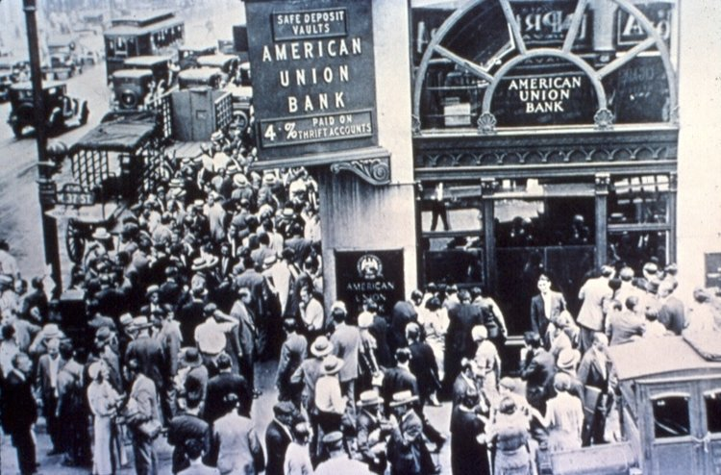
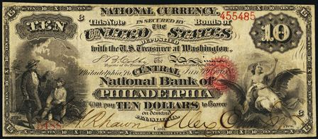
Why Banks are Dangerous
Eventually paper money became just paper bills
Each bank began to print its own paper bills… BUT they were not backed up by gold and silver.
This generated bank runs and the Panic of 1819, 1837, 1857, 1873, 1893, and 1907.

Slide 25
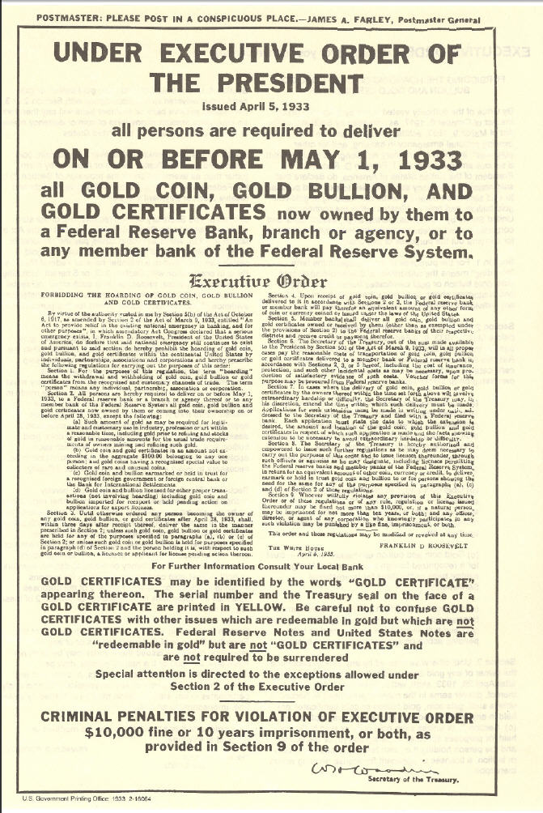
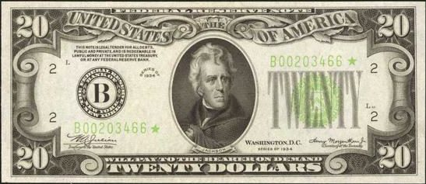
The Government Replaces Gold for Paper
The Executive Order of 1933
They confiscated all the gold with criminal penalty if it was not turned in.
And they changed it for bills issued by the Federal Reserve – Federal Reserve Notes

Slide 26
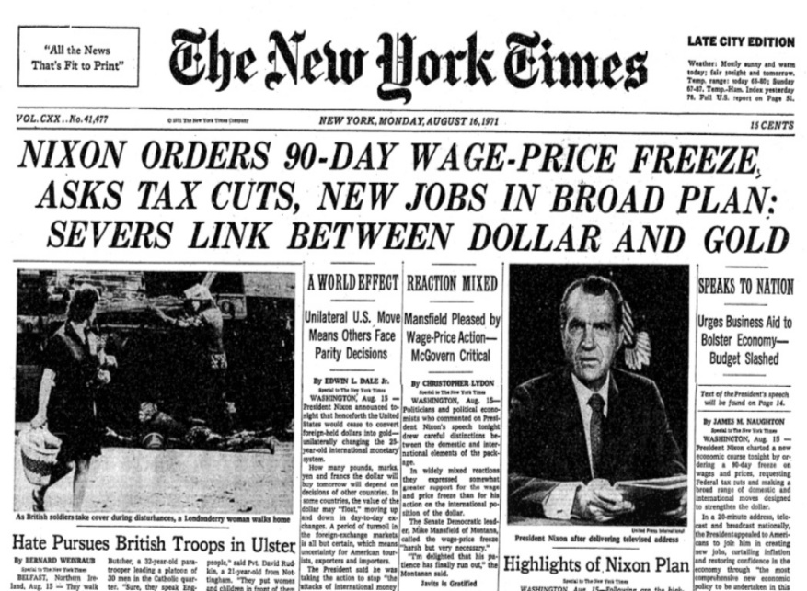
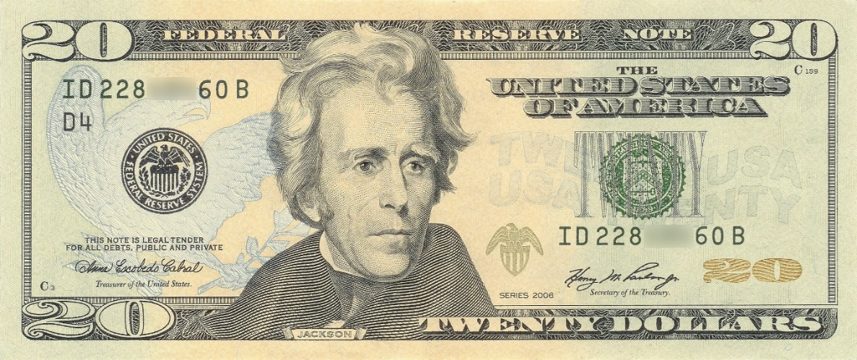
The Government Eliminates the Gold Link
Executive Order of 1973
Later they cut the link from the dollar to gold completely del dólar and the inflation began
And the Federal Reserve started to print more and more bills and to raise the interest rate.

Slide 27
How the Government Creates Money
There are only 4 Ways the Government Can Get Money.
1.) They Can Raise Taxes.
2.) They Can Borrow Money directly.
3.) They Can Print Money.
4.) They Get Credit From the Fed.

Slide 28
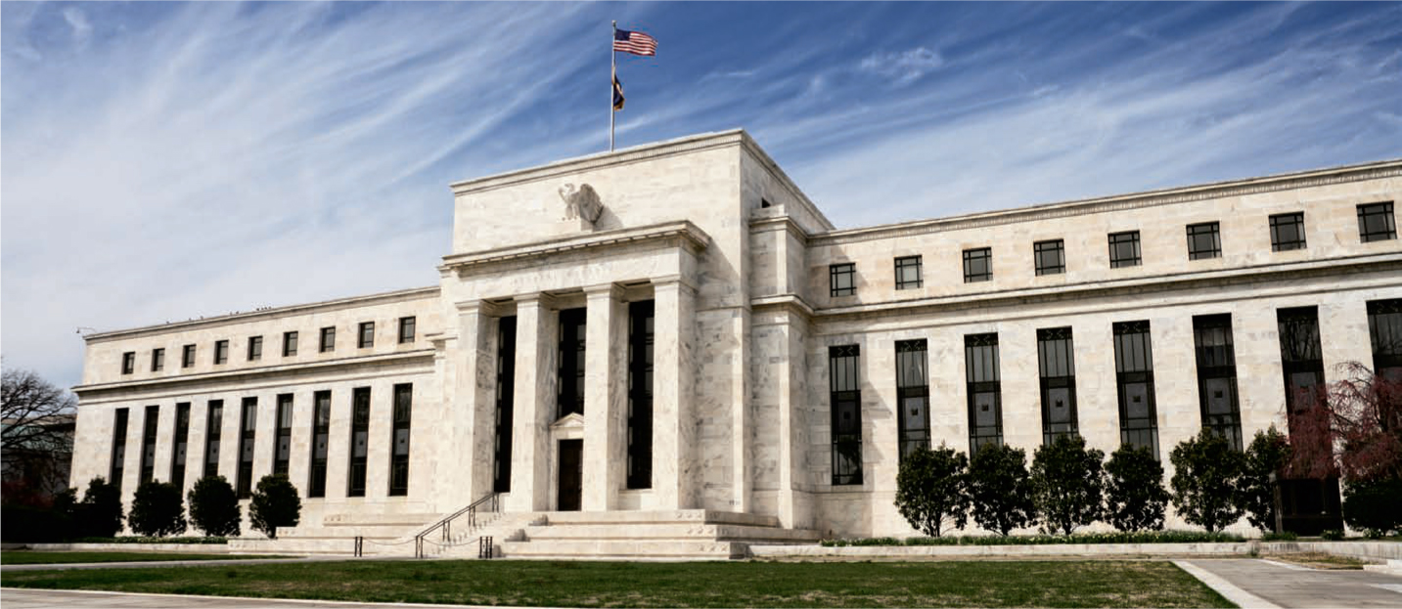
What is the Federal Reserve?
The Federal Reserve was created in 1913. Their job is to:
1.) Regulate Banks.
2.) Issue (print) Money.
3.) Control Interest Rates.
4.) Try to Maximize Employment.

Slide 29
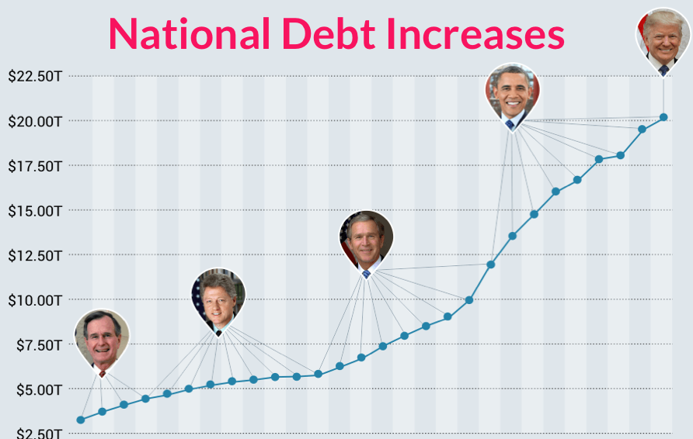
Why The National Debt Goes Up
The Government spends more money than what it collects in taxes, so it borrows from the Fed.
The Fed keeps printing $Trillions of dollars.
The National Debt is growing every year!
The $US Dollar is becoming worthless.

Slide 30
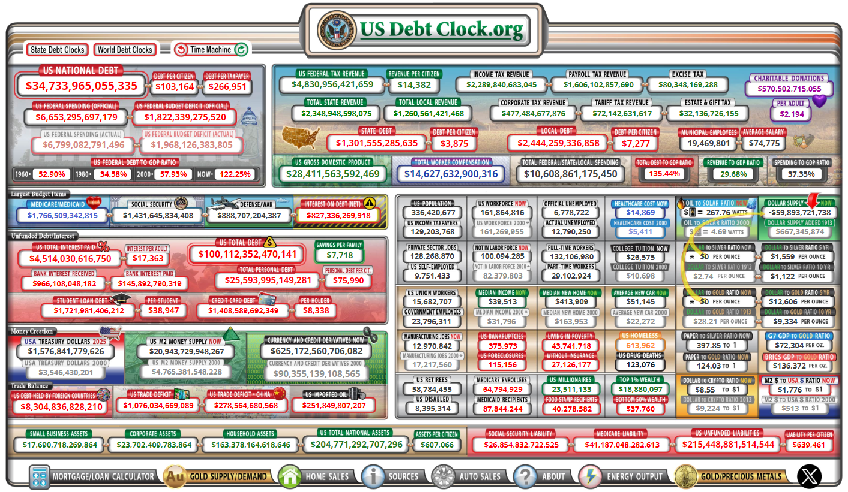
The US Debt is Out of Control

Slide 31
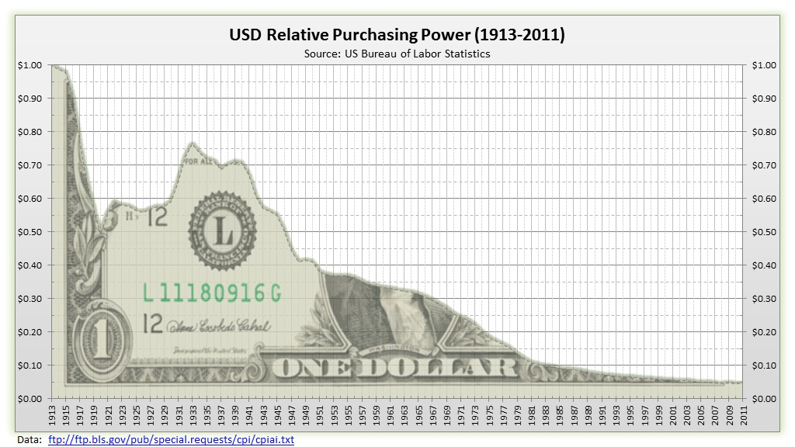
The Value of the US Dollar is Going Down

Slide 32
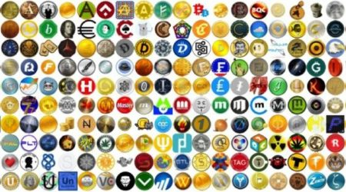

Crypto Currencies are
Not the Answer Either
There are over 23,000+ Now
So far over 14,000 have failed
There are new ones every day
Many are scams
Most will be worth $0
The Qualities of Money?
A Medium of Exchange?
A Measure of Value?
A Store of Value?
Widely Accepted as a Means of Payment?

Slide 33
What is Credit?
Credit is the ability for you to Borrow money from a bank to pay for goods.
Credit is created by a bank out of thin air based on your ability repay with Money.
Banks regulate the amount of credit they will issue you based on your Credit History.
Don’t confuse Credit with Money or Wealth.

Slide 34

Money, Wealth and Riches
What is Wealth?
Wealth is a power. With wealth many things are possible. One may ornament the home with the richest of furnishings. One may sail the distant seas. One may feast on the delicacies of far lands. One may buy the ornaments of the gold worker and the stone polisher. One may build a temple for God. One may do all these things and many others in which there is delight for the senses and gratification for the soul. – George S. Clason
Wealth, like a tree, grows from a tiny seed. The first copper you save is the seed from which your tree of wealth shall grow. The sooner you plant that seed the sooner shall the tree grow. – George S. Clason

Slide 35
Money, Wealth and Riches
What is Wealth?
Wealth is measured in time, not dollars. The number of
days you can survive, without physically working and still
maintain your standard of living. – Robert Kiyosaki
Wealth is the product of man's capacity to think. – Ayn Rand
Wealth is a thought... – Peter J. Daniels
Wealth is created through the Positive Mental Attitude, culture, work, knowledge, ability and the moral character of the people under a government or state that guarantees freedom of private enterprise and respects and protects the rights of the life and property of each individual. The fundamental ingredients to acquire it are: thought, work, natural resources, credit and fair taxes. Money, or the means of exchange, must have a recognized and acceptable value. – W. Clement Stone

Slide 36
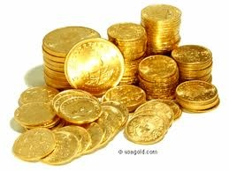
Money, Wealth and Riches
What are True Riches?
"Trust not in oppression, and become not vain in robbery: if riches increase, set not your heart upon them.“ – Psalms 62:10
"For ye know the grace of our Lord Jesus Christ, that, though he was rich, yet for your sakes he became poor, that ye through his poverty might be rich.“ – 2 Corinthians 8:9
“For we brought nothing into this world, and it is certain we can carry nothing out. And having food and raiment let us be therewith content. But they that will be rich fall into temptation and a snare, and into many foolish and hurtful lusts, which drown men in destruction and perdition. For the love of money is the root of all evil: which while some coveted after, they have erred from the faith, and pierced themselves through with many sorrows.“
– 1 Timothy 6:7-10

Slide 37
Reflection
Take a moment to think:
What is Financial Freedom?
What is Money?
What is Gold?
What is Credit?
What is Paper Money?
What are Riches?
What is True Wealth?

Slide 38

Questions?

