Slide 1

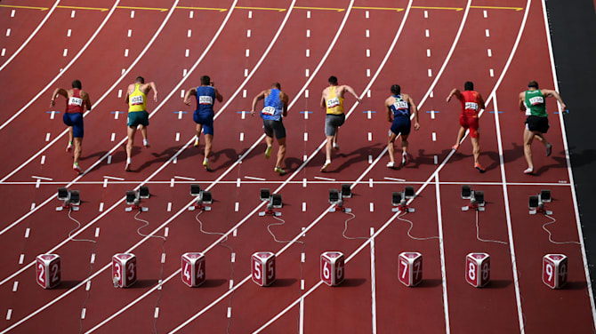




Financial Freedom Challenge
Presents
By
Alex Barrón

Slide 2
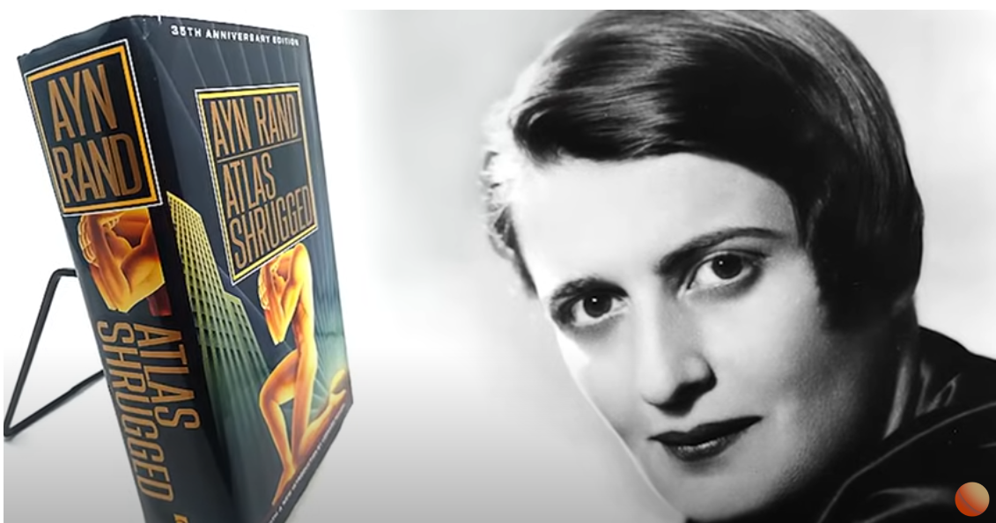
WHAT IS MONEY?
By Ayn Rand

Slide 3
Introduction
Atlas Shrugged, this is a novel by Ayn Rand. And it’s probably the most important novels ever written.
I’m just now getting through this book, an audio book form and I recently stumbled across, what’s called the “money speech”.
And I think it is one of the best descriptions of money I have ever heard so I thought it would be useful for me to come on the show today and just read it in at full.
It’s about a 15-minute speech, roughly five pages in the book in this version of Atlas Shrugged is between pages 410 and 415.
It’s a fiction novel.
There’s a conversation going on between a few of the characters and I’m just going to jump into this, it’s out of context, but this is a long diatribe by one of the main characters named Francisco d’Anconia.
And so I’m going to jump into this right now and I hope you guys enjoy.

Slide 4
What is the Root of Money?
“So you think that money is the root of all evil?” said Francisco d’Anconia.
“Have you ever asked what is the root of money?
Money is a tool of change, which can’t exist unless there are goods produced and men able to produce them.”

Slide 5
What is Money?
Money is the material shape of the principle that men who wish to deal with one another must deal by trade and give value for value.
Money is not the tool of the moochers, who claim your product by tears, or of the looters, who take it from you by force.
Money is made possible only by the men who produce.
Is this what you consider evil?

Slide 6
Money is Used for Exchange
When you accept money in payment for your effort, you do so only on the conviction that you will exchange it for the product of the effort of others.
It is not the moochers or the looters who give value to money.
Not an ocean of tears nor all the guns in the world can transform those pieces of paper in your wallet into the bread you will need to survive tomorrow.
Those pieces of paper, which should have been gold, are a token of honor — your claim upon the energy of the men who produce.
Your wallet is your statement of hope that somewhere in the world around you there are men who will not default on that moral principle which is the root of money.
Is this what you consider evil?

Slide 7
What is the Root of Production?
Have you ever looked for the root of production?
Take a look at an electric generator and dare tell yourself that it was created by the muscular effort of unthinking brutes.
Try to grow a seed of wheat without the knowledge left to you by men who had to discover it for the first time.
Try to obtain your food by means of nothing but physical motions — and you'll learn that man's mind is the root of all the goods produced and of all the wealth that has ever existed on earth.

Slide 8
How is Money Made?
But you say that money is made by the strong at the expense of the weak?
What strength do you mean?
It is not the strength of guns or muscles.
Wealth is the product of man's capacity to think.
Then is money made by the man who invents a motor at the expense of those who did not invent it?
Is money made by the intelligent at the expense of the fools?
By the able at the expense of the incompetent?
By the ambitious at the expense of the lazy?
Money is made — before it can be looted or mooched — made by the effort of every honest man, each to the extent of his ability.
An honest man is one who knows that he can’t consume more than he has produced.

Slide 9
Every Man Owns His Mind
To trade by means of money is the code of the men of good will.
Money rests on the axiom that every man is the owner of his mind and his effort.
Money allows no power to prescribe the value of your effort except the voluntary choice of the man who is willing to trade you his effort in return.
Money permits you to obtain for your goods and your labor that which they are worth to the men who buy them, but no more.
Money permits no deals except those to mutual benefit by the unforced judgment of the traders.
Money demands of you the recognition that men must work for their own benefit, not for their own injury, for their gain, not their loss — the recognition that they are not beasts of burden, born to carry the weight of your misery — that you must offer them values, not wounds — that the common bond among men is not the exchange of suffering, but the exchange of goods.

Slide 10
What Money Demands
Money demands that you sell, not your weakness to men's stupidity, but your talent to their reason.
It demands that you buy, not the shoddiest they offer, but the best that your money can find.
When men live by trade — with reason, not force, as their final arbiter — it is the best product that wins, the best performance, the man of best judgment and highest ability — and the degree of a man's productiveness is the degree of his reward.
This is the code of existence whose tool and symbol is money.
Is this what you consider evil?

Slide 11
Money is a Tool
But money is only a tool.
It will take you wherever you wish, but it will not replace you as the driver.
It will give you the means for the satisfaction of your desires, but it will not provide you with desires.
Money is the scourge of the men who attempt to reverse the law of causality — the men who seek to replace the mind by seizing the products of the mind.

Slide 12
What Money Can’t Do
Money will not purchase happiness for the man who has no concept of what he wants.
Money will not give him a code of values, if he's evaded the knowledge of what to value, and it will not provide him with a purpose, if he's evaded the choice of what to seek.
Money will not buy intelligence for the fool, or admiration for the coward, or respect for the incompetent.
The man who attempts to purchase the brains of his superiors to serve him, with his money replacing his judgment, ends up by becoming the victim of his inferiors.
The men of intelligence desert him, but the cheats and the frauds come flocking to him, drawn by a law which he has not discovered: that no man may be smaller than his money.
Is this the reason why you call it evil?

Slide 13
Money and Inheritances
Only the man who does not need it is fit to inherit wealth – the man who would make his own fortune no matter where he started.
If an heir is equal to his money, it serves him; if not, it destroys him.
However, you look on and you cry that money corrupted him. Did it?
Or did he corrupt his money?
Do not envy a worthless heir, his wealth is not yours and you would have done no better with it.
Do not think that it should have been distributed among you.
Loading the world with fifty parasites instead of one would not bring back the dead virtue which was the fortune.
Money is a living power that dies without its root.
Money will not serve the mind that cannot match it.
Is this the reason why you call it evil?

Slide 14
What is the Source of Your Money
Money is your means of survival.
The verdict you pronounce upon the source of your livelihood is the verdict you pronounce upon your life.
If the source is corrupt, you have damned your own existence.
Did you get your money by fraud?
By pandering to men's vices or men's stupidity?
By catering to fools in the hope of getting more than your ability deserves?
By lowering your standards?
By doing work you despise for purchasers you scorn?
If so, then your money will not give you a moment's or a penny's worth of joy.
Then all the things you buy will become, not a tribute to you, but a reproach; not an achievement, but a reminder of shame.
Then you will scream that money is evil.
Evil, because it would not pinch-hit for your self-respect?
Evil, because it would not let you enjoy your depravity?
Is this the root of your hatred of money?

Slide 15
Money is an Effect
Money will always remain an effect and refuse to replace you as the cause.
Money is the product of virtue, but it will not give you virtue and it will not redeem your vices.
Money will not give you the unearned, neither in matter nor in spirit.
Is this the root of your hatred of money?

Slide 16
The Love of Money
Or did you say that it’s the love of money that's the root of all evil?
To love a thing is to know and love its nature.
To love money is to know and love the fact that money is the creation of the best power within you, and your passkey to trade your effort for the effort of the best among men.
It is the person who would sell his soul for a nickel who is loudest in proclaiming his hatred of money — and he has good reason to hate it.
The lovers of money are willing to work for it.
They know they are able to deserve it.

Slide 17
Is Money Evil?
Let me give you a tip on a clue to men's characters: the man who damns money has obtained it dishonorably; the man who respects it has earned it.
Run for your life from any man who tells you that money is evil.
That sentence is the leper's bell of an approaching looter.
So long as men live together on earth and need means to deal with one another, their only substitute, if they abandon money, is the muzzle of a gun.

Slide 18
What Money Demands of You
Money demands of you the highest virtues if you wish to make it or to keep it.
Men who have no courage, pride or self-esteem, men who have no moral sense of their right to their money and are not willing to defend it as they defend their life, men who apologize for being rich — will not remain rich for long.
They are the natural bait for the swarms of looters that stay under rocks for centuries, but come crawling out at the first smell of a man who begs to be forgiven for the guilt of owning wealth.
They will hasten to relieve him of the guilt — and of his life, as he deserves.

Slide 19
A Society of Criminals
Then you will see the rise of the men of the double standard — the men who live by force, yet count on those who live by trade to create the value of their looted money — the men who are the hitchhikers of virtue.
In a moral society, these are the criminals, and the statutes are written to protect you against them.
But when a society establishes criminals-by-right and looters-by-law — men who use force to seize the wealth of disarmed victims — then money becomes its creators' avenger.
Such looters believe it safe to rob defenseless men once they've passed a law to disarm them.
But their loot becomes the magnet for other looters, who get it from them as they got it.
Then the race goes, not to the ablest at production, but to those most ruthless at brutality.
When force is the standard, the murderer wins over the pickpocket.
Then that society vanishes, in a spread of ruins and slaughter.

Slide 20
Money is the Barometer
Do you wish to know whether that day is coming?
Watch money.
Money is the barometer of a society's virtue.
When you see that trading is done, not by consent, but by compulsion — when you see that in order to produce, you need to obtain permission from men who produce nothing — when you see that money is flowing to those who deal, not in goods, but in favors — when you see that men get richer by graft and by pull than by work, and your laws don't protect you against them, but protect them against you — when you see corruption being rewarded and honesty becoming a self-sacrifice — you may know that your society is doomed.
Money is so noble a medium that it does not compete with guns and it does not make terms with brutality.
It will not permit a country to survive as half-property, half-loot.

Slide 21
Destroyers Destroy Money
Whenever destroyers appear among men, they start by destroying money, for money is men's protection and the base of a moral existence.
Destroyers seize gold and leave to its owners a counterfeit pile of paper.
This kills all objective standards and delivers men into the arbitrary power of an arbitrary setter of values.
Gold was an objective value, an equivalent of wealth produced.
Paper is a mortgage on wealth that does not exist, backed by a gun aimed at those who are expected to produce it.
Paper is a check drawn by legal looters upon an account which is not theirs: upon the virtue of the victims.
Watch for the day when it bounces, marked: ‘Account overdrawn’.

Slide 22
Who is Destroying the World?
When you have made evil the means of survival, do not expect men to remain good.
Do not expect them to stay moral and lose their lives for the purpose of becoming the fodder of the immoral.
Do not expect them to produce, when production is punished and looting rewarded.
Do not ask, ‘Who is destroying the world?’
You are.

Slide 23
Money is the Lifeblood of Civilization
You stand in the midst of the greatest achievements of the greatest productive civilization, and you wonder why it's crumbling around you, while you're damning its lifeblood — money.
You look upon money as the savages did before you, and you wonder why the jungle is creeping back to the edge of your cities.
Throughout men's history, money was always seized by looters of one brand or another, whose names changed, but whose method remained the same: to seize wealth by force and to keep the producers bound, demeaned, defamed and deprived of honor.

Slide 24
Is Money Evil?
That phrase about the evil of money, which you mouth with such righteous recklessness, comes from a time when wealth was produced by the labor of slaves — slaves who repeated the motions once discovered by somebody's mind and left unimproved for centuries.
So long as production was ruled by force, and wealth was obtained by conquest, there was little to conquer.
Yet through all the centuries of stagnation and starvation, men exalted the looters as aristocrats of the sword, as aristocrats of birth, as aristocrats of the bureau, and despised the producers as slaves, as traders, as shopkeepers — as industrialists.

Slide 25
The Self-Made Man
To the glory of mankind, there was, for the first and only time in history, a country of money — and I have no higher, more reverent tribute to pay to America, for this means: a country of reason, justice, freedom, production, achievement.
For the first time, man's mind and money were set free, and there were no fortunes-by-conquest, but only fortunes-by-work, and instead of swordsmen and slaves, there appeared the real maker of wealth, the greatest worker, the highest type of human being — the self-made man — the American industrialist.

Slide 26
To Make Money
If you ask me to name the proudest distinction of Americans, I would choose — because it contains all the others — the fact that they were the people who created the phrase “to make money".
No other language or nation had ever used these words before;
Men had always thought of wealth as a static quantity — to be seized, begged, inherited, shared, looted or obtained as a favor.
Americans were the first to understand that wealth has to be created.
The words ‘to make money’ hold the essence of human morality.

Slide 27
Prosperity vs. Loot
Yet these were the words for which Americans were denounced by the rotted cultures of the looters' continents.
Now the looters' credo has brought you to regard your proudest achievements as a hallmark of shame, your prosperity as guilt, your greatest men, the industrialists, as blackguards, and your magnificent factories as the product and property of muscular labor, the labor of whip-driven slaves, like the pyramids of Egypt.
The rotter who simpers that he sees no difference between the power of the dollar and the power of the whip ought to learn the difference on his own hide — as, I think, he will.

Slide 28
Money is The Root of all Good
Until and unless you discover that money is the root of all good, you ask for your own destruction.
When money ceases to be the tool by which men deal with one another, then men become the tools of men. Blood, whips and guns – or dollars.
Take your choice — there is no other — and your time is running out.

Slide 29
New Script – New Thoughts
NEW IDENTITY: I AM A PRODUCER!
The Root of Money is Production
Wealth is the Product of My Capacity to Think
Money is Made by the Effort of Honest Men – to the Extent of their Ability
An Honest Man Can’t Consume More Than He has Produced
Money is Obtained by Trading Value with Other Men
Money is a Tool That Can Take Me Wherever I wish
But it will Not replace me as the Driver

Slide 30
New Script – New Thoughts
NEW IDENTITY: I AM A PRODUCER!
Money is an Effect – I am the Cause
Money is the Product of Virtue
I am Willing to Work for Money
I deserve the Money I Earn
I obtain my Money Honorably
Gold is True Money – An Objective Value of Wealth Produced
I Make Money
Money is Good, not Evil

Slide 31
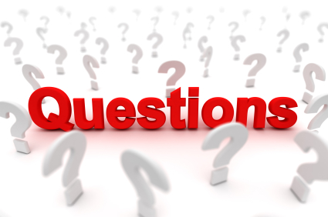
Questions?

