Slide 1


by
Financial Freedom & Success Institute
Presents
Alex Barrón

Slide 2
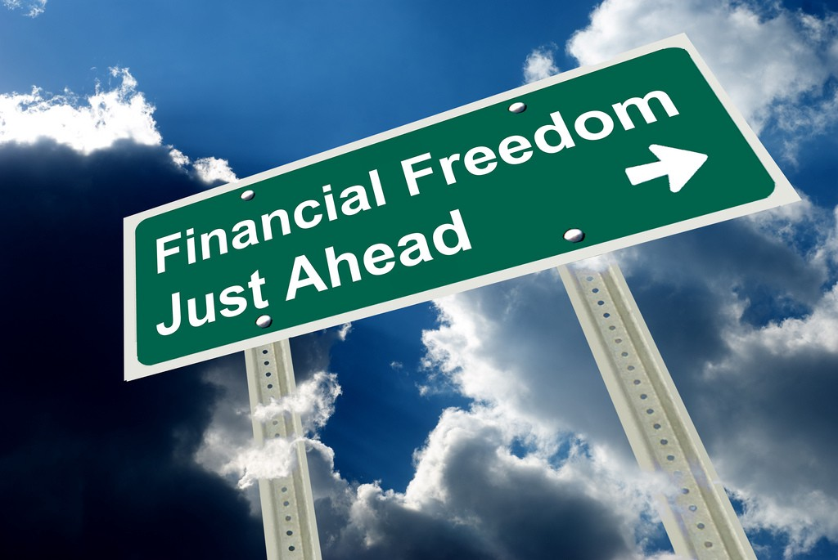
WHERE DOES MONEY COME FROM?
WHY WE NEED FINANCIAL EDUCATION?

Slide 3

What Does Financial Success Mean to You?
What comes to mind when you hear the words
  “Financial success”?
  “Prosperity”?
  “Abundance”?
Wealth:
  Money, Riches, Investments, Gold, Diamonds?
Property:
  Homes, Land, Cars, Business?
Experiences:
  Vacations, Travel, Time to do whatever you want?
Feelings:
  Freedom, Security, Satisfaction, Accomplishment, Be your own boss, Fulfillment?

Slide 4
How Do You “Get There”?
Work:
  Work hard, Good safe secure job, Benefits, Climbing the corporate ladder?
Knowledge:
  Education, Training, Skills, Graduate School?
Relationships:
  Born into the right family, marriage, business relationships (it’s not what you know… it’s who you know), networking, schmoozing, kissing up, etc.
Luck:
  Good looks, Good luck, Take a risk and Win?

Slide 5
There is a Better Way to “Get There”
Financial Success is NOT random or based on luck.
It is a science that can be taught and can be learned!
It requires
  A Desire to Learn
  Investing the Time to Learn
  Meditating on what you learn
  Putting into practice or action what you learn
In this seminar we will discuss the:
  WHAT – desire you want to accomplish
  HOW – steps to achieve it
  WHY – motive why you want this
Without a clear understanding of WHAT you want and WHY you want it, the HOW, WHEN, and WHERE don’t matter as much…

Slide 6
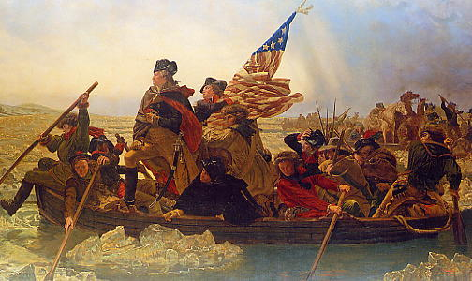
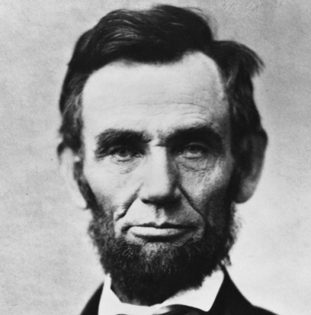
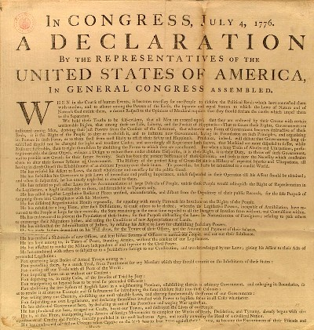
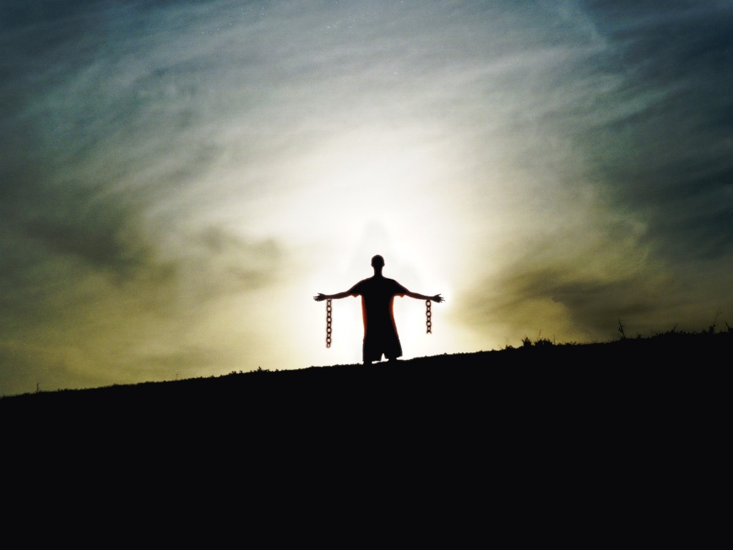
Our Forefathers Fought to
Give Us Freedom!
War for Independence
Civil War to Abolish Slavery

Slide 7
Modern Slavery =
Financial Bondage
Although we think we are “free” men and women, the reality is we are modern-day slaves.
Why? Can you stop working tomorrow?
Why Not? – DEBT!
Would you willingly become someone’s physical slave?
Yet you have become a financial slave to the system – e.g. credit cards!
You Must FIGHT for your own Freedom, your Future, your Family and ultimately your DESTINY!
You can be free from debt and the control of money over your life.
Like losing weight – No one else can do it for you.
YOU Have to Fight For Your Own Financial Freedom!
ONLY YOU CAN DO IT!
It takes determination, but you CAN DO IT!

Slide 8


The Seeds of Failure and Success
What do you “see”?
  A Fruit
What do you “see” now?
The Tree that created the fruit

Slide 9
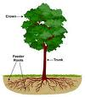
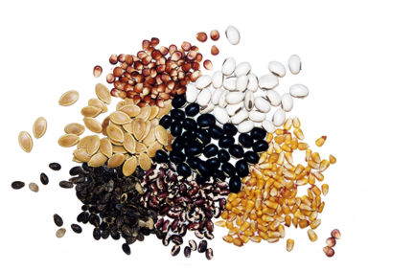
The Seeds of Failure and Success
What do you “see” this time?
  The “invisible” roots?
And now?
  The seeds that created the tree

Slide 10
Cause and Effect
Most people see the Effect, but never take the time to Think about the Cause behind the effect.
People “see” a beautiful building, a growing business, or a successful person and assume its due to good luck.
People see poverty and starvation in Africa or war in the Middle East and assume it is the result of unfortunate circumstances.
There is a “Cause” behind the Effect.
There is a “Tree” that gave birth to the Fruit.
In life, we “see” the Fruit. We don’t “see” the Seed that created the Fruit.

Slide 11
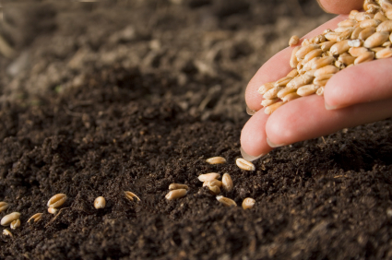


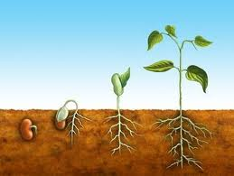
The Laws of Seedtime and Harvest

Slide 12
The Laws of Seedtime and Harvest
The seed is first, then the harvest. You cannot harvest if you do not plant a seed first. It is always this way: A then B, not B then A.
To grow the seed needs the right environment. The seed cannot grow unless you plant it, water it, fertilize it, let the sun warm it, and give it the proper environment for it to grow.
The seed needs to stay planted to grow. You cannot pluck it up every other day to see if it is growing. You need to trust that even when you are not seeing results, they are happening in the invisible world.
A seed will produce fruit after its own kind. In other words, an apple seed will result in an apple tree that gives apples. A walnut will result in a walnut tree that yields walnuts. You cannot plant an apple seed and expect walnuts. Life does NOT work that way.
The process takes time and patience. A seed will not turn into a tree overnight. And a tree will not yield fruit overnight either. Both take time. This requires patience, persistence, perseverance, and faith that in due time the results will come to pass.
SEED => FRUIT
CAUSE => EFFECT
DREAM => REALITY
INPUT => OUTPUT
INVISIBLE => VISIBLE

Slide 13
Thoughts Become Reality
The Beliefs, Values, Attitudes, Character, Thoughts, (invisible mental seeds) plus the Methods, Habits, Thought Patterns, and Financial Statements (invisible soil, heat and water) that are needed to transform your Dreams into Reality!
You will learn to understand and “see” how the “invisible” world works that allows you to achieve the “visible” results that you want.
It all starts in the mind… and eventually your thoughts transform themselves into their physical equivalents.

Slide 14
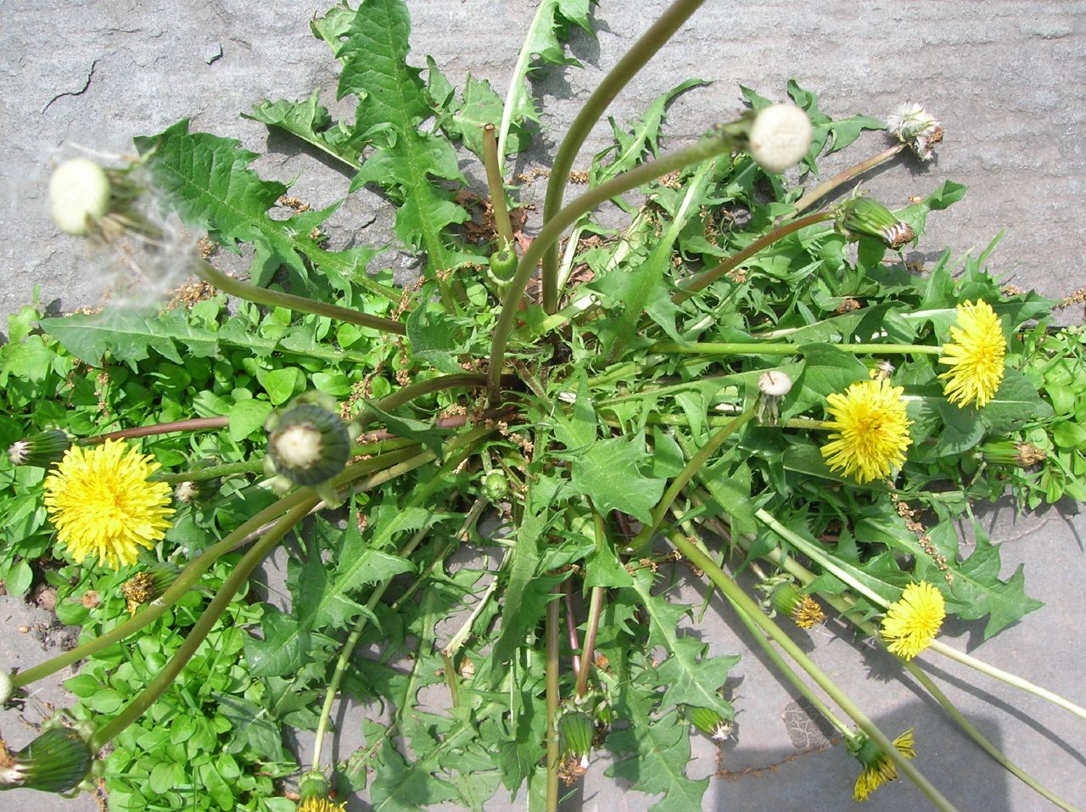

Thoughts Bear Fruit After Their Kind
Financial Failure? OR
Financial Success?

Slide 15
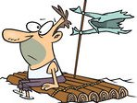

Thoughts Bear Fruit After Their Kind
Financial Failure? OR
Financial Success?

Slide 16
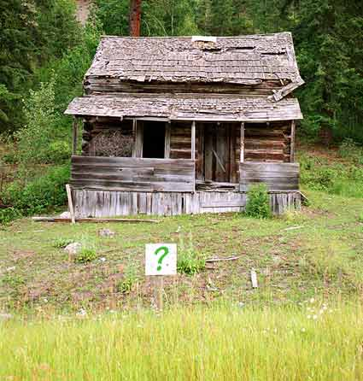
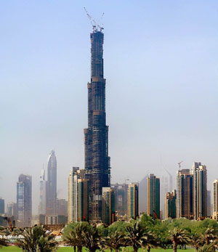
Thoughts Bear Fruit After Their Kind
Financial Failure? OR
Financial Success?

Slide 17
What is Financial Literacy?
What is missing from educated people who struggle financially in their education is not how to make money, but how to spend money.
What you do with the money once you make it, how to keep people from taking it from you, how long you keep it, and how hard that money works for you.
Most people don't understand cash flow. A person can be highly educated, professionally successful and be financially illiterate.
- Robert Kiyosaki

Slide 18
Invest in Your Financial Intelligence
“Money is one form of power. But what is more powerful is financial education.
Money comes and goes, but if you have the education about how money works, you gain power over it and can begin building wealth.
Learn how money works so you can make it work for you.
Be financially competent.
Intelligence solves problems and produces money. Money without financial intelligence is money soon gone.
Illiteracy, both in words and numbers, is the foundation of financial struggle. If people are having difficulties financially, there is something that they cannot read, either in numbers or words.
- Robert Kiyosaki

Slide 19
Change Starts One at a Time
Change Starts with YOU!
  We often want circumstances to change. We want others to change. We vote for politicians who promise change. Yet the reality is that change and prosperity starts one at a time! It all starts with YOU!
"Change begins with the simple step of changing yourself.“ – Tony Robbins
How to Change?
We need to develop:
  A New Mindset
  A New Mentality
  A New Perspective
  A New Understanding
  A New Dream
  A New Motivation
  New HABITS!

Slide 20
Are you Ready for Change?
"How to Create Lasting Change
  Raise Your Standards
  Change Your Limiting Beliefs
  Change Your Strategy“
  – Tony Robbins
"Permanent changes are quite possible. Such changes require predetermined planning and meticulous and continued discipline to overcome the bias towards a particular direction.”
- Peter J. Daniels
Change takes time…
  A tree is not born overnight and does not give fruit overnight. It is the same with your wealth tree. It takes time, effort, investment – it takes years… but it’s worth it!
Are you ready for change?
  In life the only thing that is constant is Change!
BREAKTHROUGH THOUGHT: You are either moving forward or you’re moving backward and being left behind.

Slide 21
The Prosperity of All Depends on YOU
The prosperity of a country depends on the prosperity of each state.
The prosperity of each state depends on the prosperity of each city.
The prosperity of each city depends on the prosperity of each business and church.
The prosperity of each business and church depends on the prosperity of each family.
The prosperity of each family depends on the prosperity of each individual.
Your individual prosperity is the foundation that can change your life, your family, your church, your business, your city, your state, your country, and ultimately change the world!

Slide 22

Where Do You See Yourself?
What will you be doing?
Where will you live?
What will you have accomplished?
Can you really picture it in your mind?
Do you have a plan to get there?
Are you taking steps to get there?
Or are you just drifting through life wondering what will happen from day to day?
In 1 year?
In 3 years?
In 5 years?
In 10 years?
In 25 years?
In 50 years?

Slide 23
Laying the Foundations of
Financial Success
Laying the Foundations
  Beliefs
  Motives
  Attitudes
  Values
  Character
  Thoughts
  Emotions
  Habits
That Lead to Financial Success
  our dreams,
  our visions,
  our goals and
  our plans which lead to our achievements in life

Slide 24
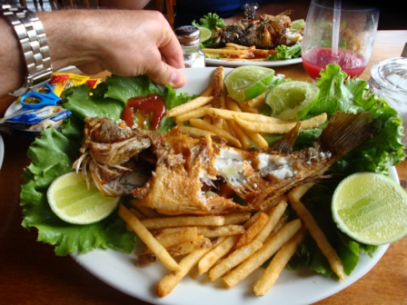
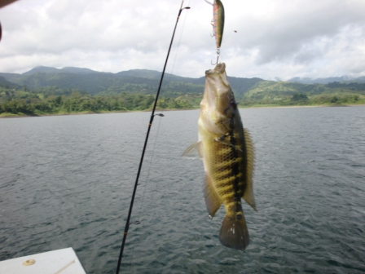
Teach a Man How to Fish
“Give a man a fish – Feed him for a day…”
“Teach a man how to fish - Feed him for a lifetime.” – Steven Covey

Slide 25

Where Does Wealth &
Financial Freedom Come From?
Wealth Comes from Inside YOU!
KEY #1: God Gives You the Power to Make Wealth! Deuteronomy 8:18
“And you shall remember the LORD your God, for it is He who gives you power to get wealth, that He may establish His covenant which He swore to your fathers, as it is this day.” – King James Version
God gives you the ability to produce wealth – New International Version
God gives you power to be successful – New Living Translation
God gives you the power to gain wealth – Berean Study Bible
God is giving you power to make wealth – New American Standard
God gives you the power to become rich – Good News Translation

Slide 26
God Put You on Earth for a Reason
God Made You in His Image.
26 And God said, Let us make man in our image, after our likeness: and let them have dominion over the fish of the sea, and over the fowl of the air, and over the cattle, and over all the earth, and over every creeping thing that creepeth upon the earth.
27 So God created man in his own image, in the image of God created he him; male and female created he them.
28 And God blessed them, and God said unto them, Be fruitful, and multiply, and replenish the earth, and subdue it: and have dominion over the fish of the sea, and over the fowl of the air, and over every living thing that moveth upon the earth.
- Genesis 1:26-28
God wants you to be Fruitful & Multiply.
God wants you to Have Dominion on earth.

Slide 27
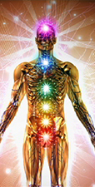
NEW IDENTITY #1:
I AM A PRODUCER
God gave you:
A Spirit – an Identity, a Will to Decide & Commit and a Conscience
A Soul – a Personality, a Character & a Temperament
A Mind – To Think, Reason & Imagine
A Subconscious Mind – To Believe & Form Habits
A Heart – To Desire & Feel
A Body – To Move, to Communicate and Act
God has given you amazing Powers you have yet to discover and put to use to create unlimited Wealth.
Say to yourself: I am a Producer. I am a Producer.

Slide 28
Humans Have Special Capabilities
God Made You Special. He Gave you Power.
We can Think.
We can Imagine.
We can Reason.
We can Create.
We can Dream.
We can Plan.
We can Choose.
We can Decide.
We can Remember.
We can Speak.
God wants you to be Fruitful & Multiply.
God wants you to Have Dominion.

Slide 29
Reflection
Take a moment to think:
What is Financial Success for you?
What have you done to make money until now?
Where do you see yourself in the future?
Who is responsible for your prosperity?
Had you considered where wealth really comes from?

Slide 30
New Script – New Thoughts
NEW IDENTITY: I AM A PRODUCER!
God has given me the Power to Make Wealth
God has given me Dominion here on earth
God wants me to be Fruitful
God wants me to Multiply my resources
I am made in God’s Image
I have the Power to Choose and to Decide
I am Responsible for myself and my Life

Slide 31

Questions?

