Slide 1
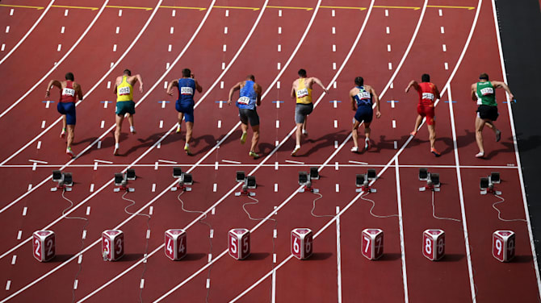
Financial Freedom Challenge
Presents
By
Alex Barrón

Slide 2
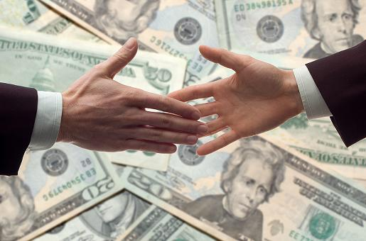
ENTREPRENEURSHIP & BUSINESS

Slide 3
Entrepreneurship
“Entrepreneurs are the lifeblood of any nation.” – Peter J. Daniels
How Can You Become Rich?
You can be Born into wealth
You can Inherit wealth
You can Marry into wealth
You can Create your own wealth by becoming
An Investor or
A Business Owner
I recommend the latter because it is how the majority of wealthy Americans became rich.
It is under your control.
The odds are much higher and are in your favor.

Slide 4
How did the Wealthy Become Rich?
Andrew Carnegie – Steel
Rockefeller – Oil
Edison – Light Bulb
Henry Ford – Automobile
J Paul Getty – Oil
Bill Gates – Microsoft
Steve Jobs – Apple
Jeff Bezos – Amazon
Elon Musk – Tesla
Zuckerberg – Facebook
Brinn – Google
All of these Billionaries became rich by starting a business in a new industry!
Wealth comes from Ideas – Solving problems, providing new products to the marketplace.

Slide 5
America – Land of Opportunity
Many people come to America seeking the American Dream.
In America, it is NOT about what status or social class you are BORN into, but what you MAKE of yourself.
America provides Equal Opportunity not Equal Results.
Many focus on “income inequality” and claim it is not “fair” for some to have more than others. Yet anyone can start a business.

Slide 6
Socialism vs. Capitalism
SOCIALISM
CAPITALISM
State is in Control of the economy. The state is ruled by a strong man and the economy by rich oligarchs.
State operates by centralized planning.
State owns all property.
State’s job is to redistribute wealth.
State’s job is to assign jobs, and determine demand.
State controls prices.
State’s goal is to make everyone equal financially – yet everyone ends up equally poor.
Individuals are there to serve the society.
The focus is on the Individual not the Collective society.
The basis of the economy is Division of Labor. Everyone focuses on what they are best at.
Every person is free to choose what they do with their life – what they study, where they work, and how much money they make.
People are free to start their own business.
Personal property rights are protected.
It is understood and accepted that each person is responsible for himself and his income is a function of his own efforts.

Slide 7
Why do Entrepreneurs Become Wealthy?
Wealth comes from
1.) Having a new and good Ideas
2.) Solving a problem or providing a new product to the marketplace.
3.) Betting on the idea, Taking a risk, and Executing to make it happen and working hard to make it profitable.
4.) Entrepreneurs invest TIME, ENERGY and CAPITAL.
5.) Entrepreneurs create and retain EQUITY.

Slide 8
Where do You Get Capital?
To start a business you don’t always need Capital, but generally you do.
There are 2 Types of Capital: Equity or Debt
EQUITY:
To access Capital, you can draw on your Savings.
You can team up with others as Partners and sell them a portion of your Equity.
DEBT:
You can Borrow money from others (friends, family)
You can borrow from a bank.
You can Mortgage your Home.

Slide 9
A New Business Takes Work
To make your business work you must be the First and Main Employee.
You must work hard – typically long hours 60-80 hours per week or more.
You will initially take on a lot of roles – salesperson, manager, book keeper, production, fulfillment, etc.
If you treat your business like a hobby – it will cost you money and you will lose money.

Slide 10
The Purpose of a Business
The main purpose of a business is to Make Money.
You MUST make a profit ASAP.
A business that can’t make a profit will eventually fail.
A business that is profitable can Grow if the profits are reinvested or if it can bring in additional capital.

Slide 11
Leverage your Time
You can’t Do everything all the time.
At some point you will have to Hire other people or outsource non-essential aspects of the business to others.
You hire Employees to leverage your Time.
You hire Salespeople to help bring in clients.
You hire partners and vendors who have skills that you don’t or can do things cheaper and faster than you can.
You have to learn to Delegate responsibility and tasks to others.
You have to Train them how to do their Job properly then Manage them. You have to Trust them to do it right – just as you would do it.

Slide 12
What Can You Sell?
A business can consist of anything you can SELL:
PRODUCT
SERVICE
KNOWLEDGE
EXPERIENCE
Ideally it is something that is not a commodity and has something unique that others can’t easily copy and replicate. That way you can charge a Premium and not compete on Price.

Slide 13
How Do You Start and Company?
Typically the Founder will come up with an Idea.
The Founder will create a product or service that fills a Need and adds Value to Customers.
The Founder will begin to tell others about it and tries to Sell it.
Many businesses start from home from the “garage”.
Once they begin to grow, the Founder will rent some space to have an office, showroom, retail space or warehouse where customers can come.

Slide 14
How Do You Raise Capital to Grow?
Many fast growing start-ups need outside capital to grow.
This can come from an Angel Investor – who will invest Seed capital.
Then the company can obtain Venture Capital in a Round 1 Capital Raise at a higher valuation.
Then after some time, they can do a Round 2 Capital Raise at a higher valuation.
Eventually, many companies decide to hire Investment Bankers to take them Public.
Ultimately the Initial Public Offering (IPO) is a way for a company to raise capital from the Public.

Slide 15
Raising Capital via Shark Tank?
Many start up companies have tried to raise capital via Shark Tank – a popular show on CNBC.
The founders present their idea to Shark investors who ask questions.
The goal is to sell a part of the company for a portion of Money. For example $100,000 for 20% of the Equity.
The real purpose is to get the Shark to help grow the company by making Introductions that help help grow Sales quickly.

Slide 16
Main Questions on Shark Tank
Most of the Questions that come up are:
What are your Sales in the last year?
What is your cost to manufacture and what is the price of the thing you are selling?
What is the profit margin?
How quickly are the sales growing?
What other competitors are doing something similar?
Is there a patent to protect the IP?
How can the Shark add Value?
What is the Valuation implied by the raise?
Get an Offer, Negotiate – then Deal or no deal?
EXECUTE and Make Money!!

Slide 17
Main Mistakes on Shark Tank
Most of the Mistakes that founders make are:
They only have an idea for a product, but have not matured to making money as a company.
They are too early – not enough sales to demonstrate consumers like it.
They have a weak or too strong personality (talks too much and doesn’t listen)
Doesn’t know their numbers.
Has no patents to protect their idea.
Is too greedy in what they ask in $ or offer too little in %.
Doesn’t know when to take a deal because they focus on the % rather than the size of the opportunity.

Slide 18
Crowdfunding
Another way to raise money is through Crowdfunding.
This is a means to raise capital from small investors using social media and the internet to advertise your company.
For example look at www.startengine.com

Slide 19
Why Start Your Own Business?
Having your own business can be the greatest Investment you can make.
A business can make you more money than a job.
A business can multiply your income faster than almost any other investment you can make.
However, a business also carries a lot of risk and requires a strong commitment to make it succeed.
Generally all businesses require a lot of time to be successful. You can expect to invest 60-80 hrs per week or more! This is called “Sweat Equity”.

Slide 20
Supply Begets Demand
You need to SELL something that is in Demand
Say’s Law says: “Supply Begets Demand”.
If you come up with something that satisfies a Need or Desire people will Demand it (want it).
You must be able to clearly communicate what this does for people? What need does it solve?
Does it Produce PLEASURE or eliminate PAIN?

Slide 21
Elements of a Successful Business
1. Advertising: This requires letting other people know about your product.
Old Media
New Media
Newpapers
Bill boards
Radio
TV ads
Magazines
Social Media ads
Google Search Links
Email campaigns
Funnels

Slide 22
Elements of a Successful Business
2. Marketing: This requires communicating a Message to the marketplace.
Get people interested in what you have to say.
You can use a Webinar, Live Presentation, Zoom call, Funnel, etc.
The main point here is that you have to capture your audience’s Attention – that is the most difficult thing these days!
There is too much Noise – your message has to stand out and reach your potential customers quickly and effectively!
The most important tool these days is the cell phone.

Slide 23
Elements of a Successful Business
3. Pitch: This requires the ability to convince your prospect that they need what you have to offer and that you are the right person to buy it from.
When you have the opportunity to pitch someone you only have so much time to convert them that the Value you provide is worth more than the Money they will pay.
You need to convince them before their attention turns to something else.
You only have 1 chance at a first impression – make it count!
Your goal is to stand out so that the buyer will make a subconscious and conscious decision that they want to BUY!

Slide 24
Elements of a Successful Business
4. Make an Offer: After you present your product, service or what you are selling, you have to make an offer.
The idea is to make an irresistible offer that the client will accept.
This could be by adding more things on top of the basic thing, or offering an incentive or discount if they take action.
Sometimes there are other factors that will play a role – for example if there is limited inventory or a special occasion coming up.
You can use special financing or special pricing if they buy more than one.

Slide 25
Elements of a Successful Business
5. Close the Sale: After you present your product, and your offer, if your client seems interested ASK for the Sale.
You want a Yes or No answer.
Anything else like “Let me think about it” indicates you didn’t close the deal.

Slide 26
Elements of a Successful Business
6. Collect the Money: After your client agrees to Buy and gives you YES – then ask how they want to Pay.
You can offer various means to collect the money:
Cash
Check
Credit Card
Wire transfer
Etc.
If you don’t collect the cash you have not guaranteed the sale is made.
After you collect it send a receipt confirming the order.

Slide 27
Elements of a Successful Business
7. Production: Production can happen Before or After you make a sale depending on your business model.
Production requires creating the product, delivering the service, producing the experience or transferring the knowledge by creating a video, book or webinar.

Slide 28
Elements of a Successful Business
8. Fulfillment: After you have produced your product, you have to Deliver it to the client.
This could involve making sure the client gets what he ordered.
Paying attention to the packaging.
Delivering the product on time.
Follow up to make sure your client is satisfied.

Slide 29
Elements of a Successful Business
9. Customer Service: Customer service and customer retention is part of the total experience your client will receive.
This could cause them to come back, write a positive review and recommend you to others.
Of if they have a bad experience and you can’t resolve it, they could decide to never come back or post a negative review and tell others to not buy from you.

Slide 30
Elements of a Successful Business
10. Accounting: You need to make sure that you track every dollar that comes in and out of your business.
Hire a book keeper to keep your accounting in line every month.
You have to document everything – best to use a checking account, credit card, and avoid cash.
You have to track your inventory, your sales, your costs, everything to know if you are profitable and what is your cash position.

Slide 31
Elements of a Successful Business
11. Taxes: When you first open your business, the first thing you need to do is get a Tax ID from the IRS.
Then you need to register your business with the State to get a State sales tax ID as well.
You must keep careful track of all taxes:
Payroll Taxes
Sales Taxes
Unemployment taxes
Franchise taxes
And be sure to pay them on time to avoid late fees, penalties and interest.
You must file all tax paperwork on time to stay out of trouble.

Slide 32
Elements of a Successful Business
12. Sales: Nothing happens without Sales.
In many ways sales is the most important factor in the success of a business.
You can have everything else right, but if you aren’t selling your business will fail and close.
More sales can solve a lot of problems.
Without sufficient sales you have to scramble to look for ways to cut costs, layoff workers, etc.
Profitability is the No. 1 Goal of any business – don’t get caught up simply with growing sales!

Slide 33
Elements of a Successful Business
13. Costs: The second element of profitability after Sales is watching the costs.
You have to do your best to try to watch your costs and inefficiency wherever possible.
Just because you have money coming in, it doesn’t mean you can now spend it all on a fancy office, fancy car, fancy furniture, fancy trips, etc.
Many businesses fail because they spend way more than they are bringing in sales.

Slide 34
Elements of a Successful Business
14. Employees: Your employees are part of our Team. Invest in them.
Don’t see them as a cost – rather see them as an investment.
They are real people who also have families to feed.
Reward them for a job well done.
Let them go if they are not doing a good job or treating your customers right. They are a reflection of your business.

Slide 35
Elements of a Successful Business
15. Professional Vendors: Every business will have various vendors that are part of our Team.
This could be your:
Attorney
CPA
Book keeper
Marketing team
Outsourced Sales teams

Slide 36
Elements of a Successful Business
16. Suppliers: Every business will have various suppliers and subcontractors that will provide your raw ingredients.
This could be your:
Materials Suppliers
Equipment Vendors
Subcontractors
Choose them carefully and Take care of them because they are part of your Supply Chain.
If they fail to deliver their parts on time you will not be able to deliver to your clients either.

Slide 37
Conclusion: Become Your Own Boss Own Your Own Business!
Starting a business is challenging.
Owning a business is a wonderful experience and can be very profitable.
Running a business is not easy and requires constant attention.
There is no such thing as being a “passive” business owner. Someone has to watch it.
Closing down a business can feel like a failure but at times it may be necessary if you keep losing money.
Selling a business can be a way to monetize what you have created and create Wealth for you and your family.
Become Your own Boss; Own Your Own Business!

