Slide 1

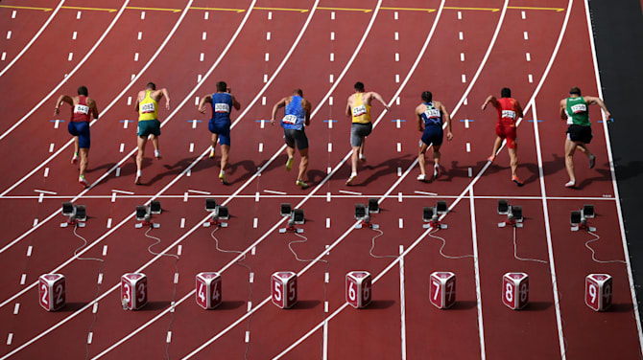




Financial Freedom Challenge
Presents
By
Alex Barrón

Slide 2

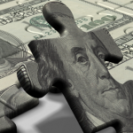
THE GAME OF LIFE

Slide 3
The Game of Life
Life is a Game.
It has Players (you and others around you)
It has Team Captains (your boss or other leaders)
Teams (families, businesses, organizations)
Spectators (people who are on the sidelines watching)
Fans (friends who want you to win)
Foes (haters who want you to lose)
Coaches (teachers, mentors)
Rules (how you play the game)
Goals (what constitutes progress)
Scorecards (to measure where you stand)
Boundaries (what is right vs. wrong)
Penalties (cost of making a mistake)

Slide 4
No One is Born an Expert
You Have to Learn How to Play the Game.
You have to Learn the Language
You have to Learn the Rules
You have to Learn how to Score a Goal
You have to Pick who is on your Team
You have to Learn to be a Team player
You have to Learn to Differentiate who are your Fans and who are your Foes
You have to Learn to Read the Scorecard
You have to Learn how to Avoid Penalties
You have to Select good Coaches
You have to Practice over and over again
The sooner you Learn, the better off your will be!

Slide 5
Finances are a Game
Finances are a Game also.
It has Players (you and others)
It has Team Captains (your boss or other leaders)
Teams (families, businesses, organizations)
Spectators (people who are on the sidelines watching)
Fans (friends who want you to win)
Foes (haters who want you to lose)
Coaches (teachers, mentors)
Rules (how you play the game)
Goals (what constitutes progress)
Scorecards (to measure where you stand)
Boundaries (what is right vs. wrong)
Penalties (cost of making a mistake)

Slide 6
The 4 Dimensions of Life
In Life There are 4 Dimensions:
Time
Areas
of Life
Stages
of Reality
Money

Slide 7
1.) The Dimension of Time
Everything we do is a function of TIME:
There are 3 time frames we must always keep in mind.
Past
Present
Future
We cannot change our Past.
We live in the Present.
What we think, decide, feel and act today will affect our Future.
If we want a better life tomorrow, we must work on that Today!

Slide 8
2.) The Dimension of Money
The Dimension of MONEY is critical to understand:
There are 3 Key Financial Statements that are
interconnected.
Cash Flow
Statement
Balance Sheet
Income
Statement

Slide 9
2.) The 3 Financial Statements
Each of the 3 Financial Statements has 3 parts.
Cash Flow
Statement
Balance Sheet
Income
Statement
INVESTMENTS
FINANCING
OPERATIONS
ASSETS -
LIABILITIES
= EQUITY
INCOME
- EXPENSES
= NET INCOME

Slide 10
3.) The 3 Stages of Reality
Most things in life go through 3 stages.
The Key to Realizing it is to Not Skip the Middle Stage but instead to spend more Time there.
Conception
In Mind or Heart
Communication
or Mental Model
Physical
Manifestation or Reality

Slide 11
4.) The 12 Areas of Life
We can Break Down Life into 12 Main Areas.
Each Area May have more Categories.
YOUR SELF
BANKING & FINANCING
BUSINESS
RELATIONSHIPS
INVESTMENTS
RESERVES
LIFESTYLE & PURCHASES
LEGAL &
TAXES
PROTECTION
ESTATE &
LEGACY
YOUR OWN BANK
GIVING

Slide 12


The 4 Balance Sheets of Life
In Life There are 4 Balance Sheets:
Intangible Balance Sheet
Results Balance Sheet
Financial Balance Sheet
Legacy Balance Sheet

Slide 13

Key Lessons From Rich Dad
“Money without financial intelligence is money soon gone.”
“It’s now how much money you make, it’s how much money you keep.”
“Rich people acquire Assets.”
“The poor and middle class acquire liabilities, but they think they are assets.”
  - Robert Kiyosaki

Slide 14

What is a Balance Sheet?
Assets (Good)
Liabilities (Bad)
Equity
“If you want to be rich, simply spend your life buying assets. If you want to be poor or middle class, spend your life buying liabilities. Its not knowing the difference that causes most of the financial struggle.”
– Robert Kiyosaki

Slide 15
Breakthrough Thought:
Do Not Confuse Assets & Liabilities!
Assets: An asset puts money in your pocket
Liabilities: A liability takes money out of your pocket
Net Worth: The difference between Assets and Liabilities
“If you want to be rich, accounting could be the most important subject you should learn.”
– Robert Kiyosaki

Slide 16
What’s in a Financial Balance Sheet?
ASSETS
Cash, Gold
Life Insurance
Stocks, Bonds
Real Estate
PURCHASES
House
Cars
Furniture
LIABILITIES
Mortgage
Car Loan
Credit Card Debt
Student Loans
Other Debt
EQUITY
= Net Worth

Slide 17
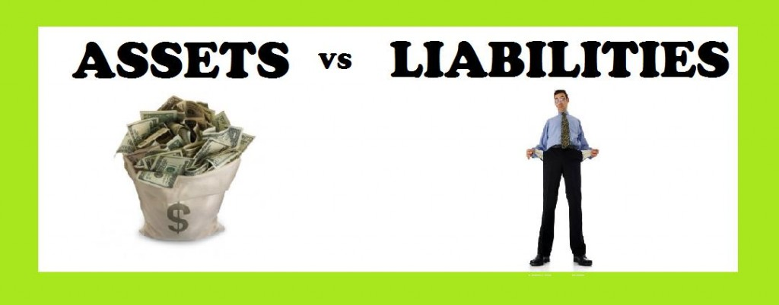
How to Determine Net Worth?
EQUITY = ASSETS + PURCHASES - LIABILITIES
NET WORTH = OWN - OWE
"Your Net Worth consists of what you own minus what you owe.“ – Paul J. Meyer

Slide 18
Balance Sheet for Most People
ASSETS
LIABILITIES
FINANCIAL ASSETS
Job
Checking Account $1,000
PURCHASES
Car $30,000
Home $160,000
==========================
TOTAL ASSETS $191,000
“GOOD” LIABILITIES
Student Loan $50,000
“BAD” LIABILITIES
Credit Cards $20,000
Car Loan $40,000
Home Mortgage $155,000
===========================
TOTAL LIABILITIES $265,000
NET WORTH = ($74,000)

Slide 19
The Goal of Financial Freedom!
ASSETS
LIABILITIES
FINANCIAL ASSETS
Job
Checking Account $1,000
PURCHASES
Car $30,000
Home $160,000
==========================
TOTAL ASSETS $191,000
“GOOD” LIABILITIES
Student Loan $50,000
“BAD” LIABILITIES
Credit Cards $20,000
Car Loan $40,000
Home Mortgage $155,000
===========================
TOTAL LIABILITIES $265,000
NET WORTH = ($74,000)

Slide 20

What’s in Your Intangible Balance Sheet?
Intangible Assets
Education
Work Ethic
Job
Business
Decisions
Opportunities
Reputation
Experience
LIABILITIES
Limiting Beliefs
Negative Attitudes
Fear, Worry, Dishonesty
Procrastination
Indecision
EQUITY
= People Blessed
+Goals Reached
+ Legacy = Destiny

Slide 21
Your Intangible Balance Sheet
“BE” ASSETS
Reliability
Honesty
Faithfulness
Punctuality
Persistence
Commitment
“BE” LIABILITIES
Unreliable
Dishonesty
Unfaithfulness
Always Late
Easily Give Up
Lack of Commitment
EQUITY
= ??

Slide 22
Your Intangible Balance Sheet
“BELIEVE” ASSETS
Money is a Tool
Stewardship Mentality
God’s Will is Prosperity
God Has a Purpose for My Life
“BELIEVE” LIABILITIES
Money is Evil
Ownership Mentality
Poverty is Humility
No idea of God’s Will for your Life
EQUITY
= ??

Slide 23
Your Intangible Balance Sheet
“THINK” ASSETS
Positive Mental Attitude (PMA)
Abundance Mentality
Positive Perspective = How You “See” the World
Recognize Opportunities
“THINK” LIABILITIES
Negative Mental Attitude
Scarcity Mentality
Fear, Worry, Doubt, Insecurity
Greed, Jealousy
Can Only “See” Limitations
EQUITY
= ??

Slide 24
Your Intangible Balance Sheet
“KNOW” ASSETS
Education
Knowledge
Information
Skills
Experience
“KNOW” LIABILITIES
Ignorance
Lack of Education
Lack of Know How
Lack of Desire to Learn
Lack of Experience
EQUITY
= ??

Slide 25
Your Intangible Balance Sheet
“DO” ASSETS
Opportunity
Decision Making
Action!
“DO” LIABILITIES
Procrastination
Indecision
Inaction
Analysis Paralysis
EQUITY
= ??

Slide 26
Your Intangible Balance Sheet
“PEOPLE” ASSETS
Family
Mentors
Clients
Co-Workers
Employees
Suppliers
“PEOPLE” LIABILITIES
“Small Minded” People
Negative People
Negative Influences
EQUITY
= ??

Slide 27
Your Intangible Balance Sheet
“HAVE” ASSETS
Job or Work
Business
Real Estate
Home
Cars
Insurance
“HAVE” LIABILITIES
Loans
Debt
Mortgage
Credit Cards
Leases
Taxes
EQUITY
= ??

Slide 28
Your Intangible Net Worth
“EARN” ASSETS
Name
Reputation
Track Record
Experience
Credit History
INTANGIBLE EQUITY
= People Benefitted
= Riches, Net Worth, Money
= Abundance, Blessings, Prosperity, Success, Freedom, Peace of Mind
= Estate, Inheritance, Legacy, Destiny

Slide 29
What’s in a Results Balance Sheet?
ASSETS
Body
Health
Spiritual Life
Education
Relationships
Properties
Businesses
Investments
Bucket List
LIABILITIES
Illnesses
Past Mistakes
Failed Relationships
Bad Decisions
Failures in Life
Financial Losses
EQUITY
= Net Worth

Slide 30
“Real” Balance Sheet - Bad
ASSETS
LIABILITIES
“INTANGIBLE” ASSETS
Hard Work Ethic
Honesty
Family
Health
Traditional Education
FINANCIAL ASSETS
Job
Checking Account $1,000
PURCHASES
Car $30,000
Home $200,000
===================================
TOTAL ASSETS $231,000
“INTANGIBLE” LIABILITIES
Victim Mentality, Comfort Zone
Bad Habits, Addictions, Wrong Friends
Fears, Doubts, Insecurity
Bad Attitudes, Character Flaws
“GOOD” LIABILITIES
Student Loans $80,000
“BAD” LIABILITIES
Credit Cards $20,000
Car Loan $40,000
Home Mortgage $195,000
====================================
TOTAL LIABILITIES $335,000
NET WORTH = ($104,000)

Slide 31
“Ideal” Balance Sheet - Good
ASSETS
LIABILITIES
“INTANGIBLE” ASSETS
YOU ARE YOUR BEST INVESTMENT!
Prosperity and Abundance Mindset
Positive Mental Attitude
Dreams, Vision, Purpose, Goals, Destiny, Direction in Life, Sense of Destiny
Work on Your Business
FINANCIAL ASSETS
Checking Account $100,000
Savings Account $100,000
“Your Own Bank” Policy $1,000,000
Your Own Business $1,000,000
Investments $1,000,000
Real Estate Investments $700,000
PURCHASES
Car $100,000
Home $1,000,000
=======================================
TOTAL ASSETS $5,000,000
“INTANGIBLE” LIABILITIES
“GOOD” LIABILITIES
Student Loans $0
Investment Loans $0
“BAD” LIABILITIES
Credit Cards $0
Car Loans $0
Home Mortgage $0
=========================================
TOTAL LIABILITIES $0
NET WORTH = $5,000,000

Slide 32
What’s in a Legacy Balance Sheet?
ASSETS
Heritage & Legacy
Wealth & Protection
Legal & Asset Protection
Philanthropy
Destiny
Eternity
LIABILITIES
Bad Memories
No Protection
No Will
Problems & Debts
Broken Promises
Time Poorly Spent
EQUITY
= Net Worth

Slide 33
What’s in Wealth & Protection?
LIFE INSURANCE
Death Benefit
  Whole Life
  Term Life
  Paid Up Additions
Beneficiaries
Instructions in Trust/Will What to do with Death Benefit
LIABILITIES
Policy Loans
EQUITY
= Net Death Benefit

Slide 34

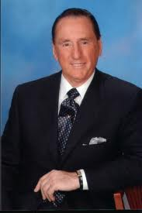


CONCLUSION: How Is Your Balance Sheet?
What is Your Net Worth?

Slide 35
Where are you Today?
ASSESSMENT: Identify Your Starting Point. Your Reality Today.
1.) What Does your Financial Balance Sheet look like currently?
What are your Assets?
What are your Liabilities?
2.) What Does Your Income Statement look like?
What are your Income sources?
What is your Expense History for the last 2 months?
3.) What Does your Intangible Balance Sheet look like?
What are your greatest Assets?
What are you greatest Liabilities?
4.) How is your Legacy Balance Sheet?
Will your family be protected if something happened to you?

Slide 36

Questions? Thoughts?

