Slide 1

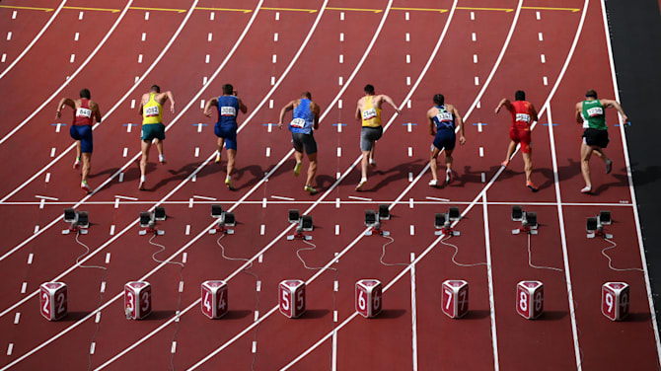




Financial Freedom Challenge
Presents
By
Alex Barrón

Slide 2

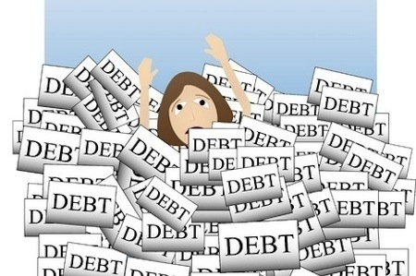
LESSON 3: WHY DO WE GET INTO DEBT?

Slide 3
The Debt Trap
+$
18
Critical Decisions!
65
time
Student Loan
Consumption – Credit Cards
Wedding and Honeymoon – Credit Card
The Debt Trap!
Car Loan
New Home Mortgage
Small Business Loan
-$
Consolidation Loan
The Pit of Desperation

Slide 4
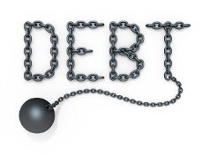
Getting Into Debt is Easy
What is Debt? Borrowing money to buy today with the promise to repay in the future with interest.
Typical Debt Progression:
  School Loan
  Car Loan
  Credit Cards
  Home Mortgage
  Store Credit
  Small Business Loan
  Commercial Lease
  Commercial Real Estate Loan

Slide 5
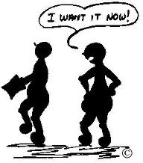
Why Do People Borrow?
“Debt is never the real problem, it is only symptomatic of the real problem ― greed, self-indulgence, impatience, fear, poor self-image, lack of self-worth, lack of self-discipline, and perhaps many others.” ― Ron Blue.
Borrowing is Pulling the Future Forward.
Someday the Future Becomes the Present.
It is Easy to Get Into Debt. Getting Out of Debt is NOT so easy.

Slide 6
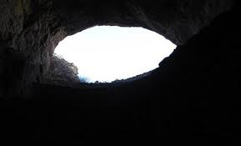
Debt is a Hopeless Pit
“Youth would take short cuts to wealth and the desirable things for which it stands. To secure wealth quickly youth often borrows unwisely. Youth, never having had experience, cannot realize that hopeless debt is like a deep pit into which one may descend quickly and where one may struggle vainly for many days. It is a pit of sorrow and regrets where the brightness of the sun is overcast and night is made unhappy by restless sleeping." ― George S. Clason

Slide 7
Why Can Credit be Dangerous?
“Credit gives the appearance of wealth without being wealth itself.
At the end, after paying sometimes two and three times more for the purchase than necessary (after taking into account interest payments), he who depends on credit ends with little or nothing to show for their money.
The appearance of wealth can only be temporarily maintained when everything goes well and personal finances are running at an optimal level.
Dependence on credit creates only a facade of wealth, a lifestyle beyond your real possibilities. It is a life that will prevent you from building personal wealth you'll need to ensure a comfortable retirement.
The deception of the lifestyle of "buy now, pay later" appeals strongly to a generation accustomed to instant gratification.” – John Cummuta

Slide 8
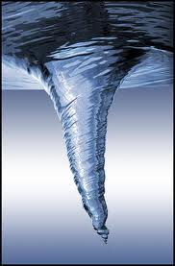
The Vortex of Debt
When people begin to feel desperate about their debt situation, ironically the first thing they typically do is to get into MORE debt, digging up one hole to cover another.
This provides a temporary relief, but in a little bit proves to be a TRAP sucking you further and deeper into a hole!

Slide 9
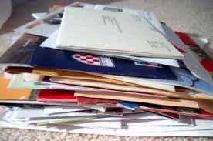
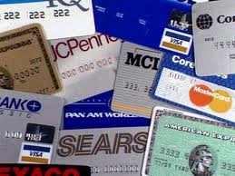
Refinancing or More Credit is NOT a Solution
Many people are tempted by credit card applications where they are “Pre-Approved”.
These can provide a low introductory interest rate of 0-3.99% that later converts to 18-30%!
Beware and Throw them away without opening them!
Others will suggest to Refinance your Home or get a HELOC.

Slide 10
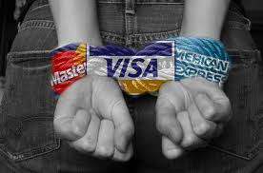
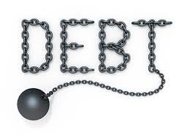
Debt is a Form of Slavery
"The rich ruleth over the poor, and the borrower is servant to the lender.“ - Proverbs 22:7.
" "But ah! Think what you do when you run into debt; you give to another power over your liberty. If you cannot pay on time, you will be ashamed to see your creditor; you will be in fear when you speak to him; you will make poor pitiful sneaking excuses, and by degrees, come to lose your veracity, and sink into base, down-right lying..." ― Benjamin Franklin

Slide 11
Thoughts on Debt
"Owe no man anything, but to love one another: for he that loveth another hath fulfilled the law."― Romans 13:8.
"Young men starting in life should avoid running into debt. There is scarcely anything that drags a person down like debt. It is a slavish position to get in.
Debt robs a man of his self-respect, and makes him almost despise himself.
Getting in debt for what you eat and drink and wear is to be avoided.“― P.T. Barnum
"Do not get in debt. Become a saver all your life.” – John Haggai
"Greater debt means more financial uncertainty.“ – Robert Kiyosaki

Slide 12
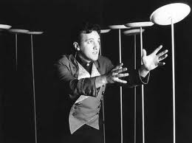
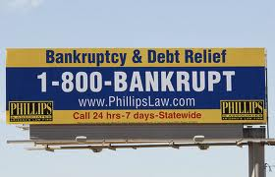
Bankruptcy is NOT a Solution
When people are in debt up to their eyeballs, they try to juggle their debt payments like those who spin plates in the air.
Disaster is just around the corner as soon as they lose their job or their business slows down.
Beware of Bankruptcy! It is NOT a Solution.

Slide 13

WHY Are You in Debt?
“So, if you find yourself in debt, your first question is not, "How do I get out of debt?" Ask first of all, "Why am I in this situation?" and answer that question.” – Ron Blue
Read: The Camel Trader of Babylon (Chapter 8 – The Richest Man in Babylon)

Slide 14
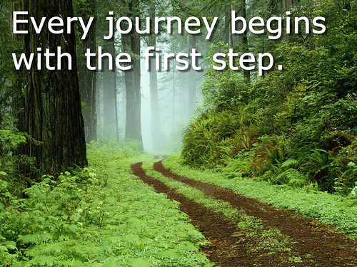
The First Step Towards Financial Freedom
Ask Yourself: “Do I have the soul of a slave? Or the soul of a free man?”
“Where the determination is, the way can be found!”
Have you a desire to repay the just debts you owe? If thou contentedly let the years slip by and make no effort to repay, then thou hast but the contemptible soul of a slave. No man is otherwise who cannot respect himself and no man can respect himself who does not repay honest debts.

Slide 15
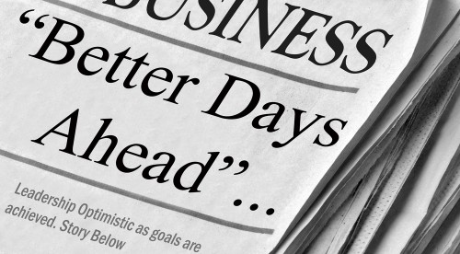

Don’t Lose Hope! We CAN Change The Future if We ACT Now!!!
America’s best days are NOT behind it! They are Ahead!
We need to make immediate changes.
We need a new mentality.
We MUST improve our financial condition.
There is Hope.
Our Future depends on ALL of us
We must Preserve our Heritage, our Liberty, and our Way of Life
We owe it to future generations to change to survive what is ahead.

Slide 16



Questions? Comments?

