Slide 1

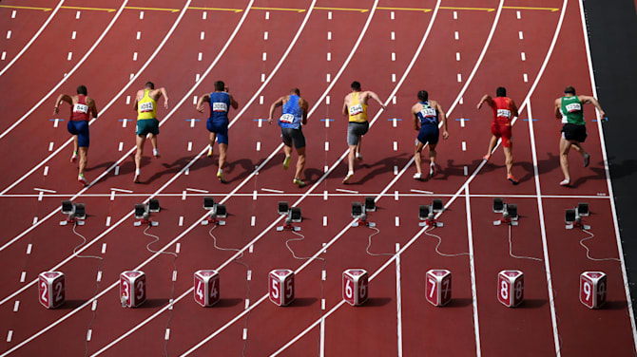




Financial Freedom Challenge
Presents
By
Alex Barrón

Slide 2


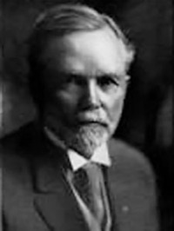
The Richest Man in Babylon by George S Clason

Slide 3
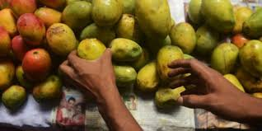
The Camel Trader of Babylon
The hungrier one becomes, the clearer one's mind works— also the more sensitive one becomes to the odors of food.
Tarkad, the son of Azure, certainly thought so. For two whole days he had tasted no food except two small figs purloined from over the wall of a garden. Not another could he grab before the angry woman rushed forth and chased him down the street. Her shrill cries were still ringing in his ears as he walked through the market place. They helped him to retrain his restless fingers from snatching the tempting fruits from the baskets of the market
women.

Slide 4
The Camel Trader of Babylon
Never before had he realized how much food was brought to the markets of Babylon and how good it smelled. Leaving the market, he walked across to the inn and paced back and forth in front of the eating house. Perhaps here he might meet someone he knew; someone from whom he could borrow a copper that would gain him a smile from the unfriendly keeper of the inn and, with it, a liberal helping. Without the copper he knew all too well how
unwelcome he would be.
In his abstraction he unexpectedly found himself face to face with the one man he wished most to avoid, the tall bony figure of Dabasir, the camel trader. Of all the friends and others from whom he had borrowed small sums, Dabasir made him feel the most uncomfortable because of his failure to keep his promises to repay promptly.

Slide 5
The Camel Trader of Babylon
Dabasir's face lighted up at the sight of him.
-"Ha! 'Tis Tarkad, just the one I have been seeking that he might repay the two pieces of copper which I lent him a moon ago; also the piece of silver which I lent to him before that. We are well met. I can make good use of the coins this very day. What say, boy? What say?“
Tarkad stuttered and his face flushed. He had naught in his empty stomach to nerve him to argue with the outspoken Dabasir.

Slide 6
The Camel Trader of Babylon
-"I am sorry, very sorry," he mumbled weakly, "but this day I have neither the copper nor the silver with which I could repay.“
-"Then get it," Dabasir insisted. "Surely thou canst get hold of a few coppers and a piece of silver to repay the generosity of an old friend of thy father who aided thee whenst thou wast in need?"
“Tis because ill fortune does pursue me that I cannot pay.“
-"Ill fortune! Wouldst blame the gods for thine own weakness. Ill fortune pursues every man who thinks more of borrowing than of repaying. Come with me, boy, while I eat. I am hungry and I would tell thee a tale."

Slide 7
The Camel Trader of Babylon
Tarkad flinched from the brutal frankness of Dabasir, but here at least was an invitation to enter the coveted doorway of the eating house.
Dabasir pushed him to a far corner of the room where they seated themselves upon small rugs.
When Kauskor, the proprietor, appeared smiling, Dabasir addressed him with his usual freedom:
-"Fat lizard of the desert, bring to me a leg of the goat, brown with much juice, and bread and all of the vegetables for I am hungry and want much food. Do not forget my friend here. Bring to him a jug of water. Have it cooled, for the day is hot."

Slide 8
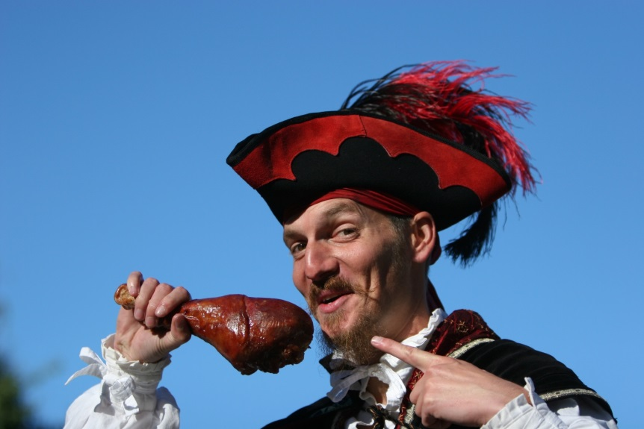
The Camel Trader of Babylon
Tarkad's heart sank. Must he sit here and drink water while he watched this man devour an entire goat leg? He said nothing. He thought of nothing he could say.
Dabasir, however, knew no such thing as silence. Smiling and waving his hand good-naturedly to the other customers, all of whom knew him, he continued: “I’ll tell you a story.”
Other diners brought their food and crowded in a semicircle. They crunched noisily in the ears of Tarkad and brushed him with their meaty bones. He alone was without food. Dabasir did not offer to share with him nor even motion him to a small corner of the hard bread that was broken off and had fallen from the platter to the floor.

Slide 9
The Camel Trader of Babylon
-"The tale that I am about to tell," began Dabasir, pausing to bite a goodly chunk from the goat leg, "relates to my early life and how I came to be a camel trader. Didst anyone know that I once was a slave in Syria?"
-"When I was a young man," continued Dabasir after another vicious onslaught on the goat leg, "I learned the trade of my father, the making of saddles. I worked with him in his shop and took to myself a wife. Being young and not greatly skilled, I could earn but little, just enough to support my excellent wife in a modest way. I craved good things which I could not afford. Soon I found that the shop keepers would trust me to pay later even though I could not pay at the time.

Slide 10
The Camel Trader of Babylon
Being young and without experience I did not know that he who spends more than he earns is sowing the winds of needless self-indulgence from which he is sure to reap the whirlwinds of
trouble and humiliation. So I indulged my whims for fine raiment and bought luxuries for my good wife and our home, beyond our means.
"I paid as I could and for a while all went well. But in time I discovered I could not use my earnings both to live upon and to pay my debts. Creditors began to pursue me to pay for my extravagant purchases and my life became miserable. I borrowed from my friends, but could not repay them either. Things went from bad to worse.

Slide 11
The Camel Trader of Babylon
My wife returned to her father and I decided to leave Babylon and seek another city where a young man might have better chances..
"For two years I had a restless and unsuccessful life working for caravan traders. From this I fell in with a set of likeable robbers who scoured the desert for unarmed caravans. Such deeds were unworthy of the son of my father, but I was seeing the world through a colored stone and did not realize to what degradation I had fallen.
"We met with success on our first trip, capturing a rich haul of gold and silks and valuable merchandise. This loot we took to Ginir and squandered.

Slide 12
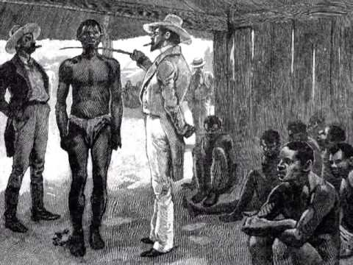
The Camel Trader of Babylon
"The second time we were not so fortunate. Just after we had made our
capture, we were attacked by the spearsmen of a native chief to whom the
caravans paid for protection. Our two leaders were killed, and the rest of us
were taken to Damascus where we were stripped of our clothing and sold as
slaves.
"I was purchased for two pieces of silver by a Syrian desert chief. With my hair shorn and but a loin cloth to wear, I was not so different from the other slaves. Being a reckless youth, I thought it merely an adventure until my master took me before his four wives and told them they could have me for a eunuch.

Slide 13
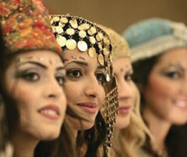
The Camel Trader of Babylon
Then, indeed, did I realize the hopelessness of my situation. These men of the desert were fierce and warlike. I was subject to their will without weapons or means of escape.
"Fearful I stood, as those four women looked me over. I wondered if I could
expect pity from them. Sira, the first wife, was older than the others. Her face was impassive as she looked upon me. I turned from her with little consolation. The next was a contemptuous beauty who gazed at me as indifferently as if I had been a worm of the earth. The two younger ones
tittered as though it were all an exciting joke.

Slide 14
The Camel Trader of Babylon
"It seemed an age that I stood waiting sentence. Each woman appeared willing for the others to decide. Finally Sira spoke up in a cold voice.
“Of eunuchs we have plenty, but of camel tenders we have few and they are a worthless lot. Even this day I would visit my mother who is sick with the fever and there is no slave I would trust to lead my camel. Ask this slave if he can lead a camel.‘
"My master thereupon questioned me, 'What know you of camels?‘
"Striving to conceal my eagerness, I replied, I can make them kneel, I can load them, I can lead them on long trips without tiring. If need be, I can repair their trappings."

Slide 15
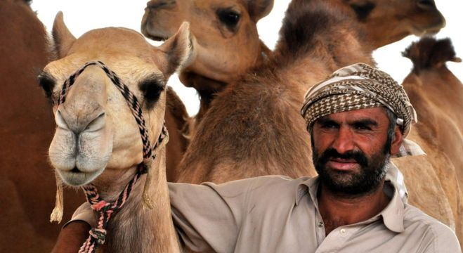
The Camel Trader of Babylon
“The slave speaks forward enough, observed my master.
If thou so desire, Sira, take this man for thy camel tender.‘ "So I was turned over to Sira and that day I led her camel upon a long journey to her sick mother.
I took the occasion to thank her for her intercession and also to tell her that I was not a slave by birth, but the son of a freeman, an honorable saddle maker of Babylon. I also told her much of my story. Her comments were disconcerting to me and I pondered much afterwards on what she said.

Slide 16
The Camel Trader of Babylon
“How can you call yourself a free man when your weakness has brought you to this? If a man has in himself the soul of a slave will he not become one no matter what his birth, even as water seeks its level? If a man has within him the soul of a free man, will he not become respected and honored in his own city in spite of his misfortune?‘
"For over a year I was a slave and lived with the slaves, but I could not become as one of them. One day Sira asked me, 'In the eventime when the other slaves can mingle and enjoy the society of each other, why dost thou sit in thy tent alone?‘
"To which I responded, 'I am pondering what you have said to me. I wonder if I have the soul of a slave. I cannot join them, so I must sit apart.'

Slide 17
The Camel Trader of Babylon
“I, too, must sit apart,' she confided. 'My dowry was large and my lord married me because of it. Yet he does not desire me. What every woman longs for is to be desired. Because of this and because I am barren and have neither son nor daughter, must I sit apart. Were I a man I would rather die than be such a slave, but the conventions of our tribe make slaves of women.‘
“What think thou of me by this time?' I asked her suddenly, 'Have I the soul of a man or have I the soul of a slave?‘
“Have you a desire to repay the just debts you owe in Babylon?' she parried.

Slide 18
The Camel Trader of Babylon
“Yes, I have the desire, but I see no way.‘
“If thou contentedly let the years slip by and make no effort to repay, then thou hast but the contemptible soul of a slave. No man is otherwise who cannot respect himself and no man can respect himself who does not repay honest debts.‘
“But what can I do who am a slave in Syria?‘
“Stay a slave in Syria, thou weakling.‘
“I am not a weakling,' I denied hotly.
“Then prove it.‘
“How?'

Slide 19
The Camel Trader of Babylon
“Does not thy great king fight his enemies in every way he can and with every force he has? Thy debts are thy enemies. They ran thee out of Babylon. You left them alone and they grew too strong for thee. Hadst fought them as a man, thou couldst have conquered them and been one honored among the townspeople. But
thou had not the soul to fight them and behold thy pride hast gone down until thou art a slave in Syria.‘
"Much I thought over her unkind accusations and many defensive phrases I worded to prove myself not a slave at heart, but I was not to have the chance to use them. Three days later the maid of Sira took me to her mistress.

Slide 20
The Camel Trader of Babylon
“My mother is again very sick,' she said. 'Saddle the two best camels in my husband's herd. Tie on water skins and saddle bags for a long journey. The maid will give thee food at the kitchen tent.' I packed the camels wondering much at the quantity of provisions the maid provided, for the mother dwelt less than a day's journey away. The maid rode the rear camel which followed and I led the camel of my mistress. When we reached her mother's house it was just dark. Sira dismissed the maid and said to me:
“Dabasir, hast thou the soul of a free man or the soul of a slave?'

Slide 21
The Camel Trader of Babylon
“The soul of a free man,' I insisted.
“Now is thy chance to prove it. Thy master hath imbibed deeply and his chiefs are in a stupor. Take then these camels and make thy escape. Here in this bag is raiment of thy master's to disguise thee. I will say thou stole the camels and ran away while I visited my sick mother.”
“Thou hast the soul of a queen,' I told her. 'Much do I wish that I might lead thee to happiness.”
“Happiness,' she responded, 'awaits not the runaway wife who seeks it in far lands among strange people. Go thy own way and may the gods of the desert protect thee for the way is far and barren of food or water!”

Slide 22
The Camel Trader of Babylon
"I needed no further urging, but thanked her warmly and was away into the night. I knew not this strange country and had only a dim idea of the direction in which lay Babylon, but struck out bravely across the desert toward the hills. One camel I rode and the other I led. All that night I traveled and all the next day, urged on by the knowledge of the terrible fate that was meted out
to slaves who stole their master's property and tried to escape.”

Slide 23
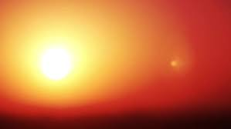
The Camel Trader of Babylon
"Late that afternoon, I reached a rough country as uninhabitable as the desert. The sharp rocks bruised the feet of my faithful camels and soon they were picking their way slowly and painfully along. I met neither man nor beast and could well understand why they shunned this inhospitable land.
"It was such a journey from then on as few men live to tell of. Day after day we plodded along.
Food and water gave out. The heat of the sun was merciless. At the end of the ninth day, I slid from the back of my mount with the feeling that I was too weak to ever remount and I would surely die, lost in this abandoned
country.

Slide 24
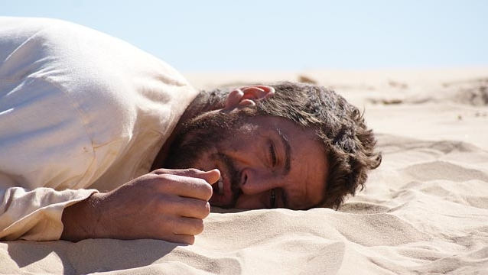
The Camel Trader of Babylon
"I stretched out upon the ground and slept, not waking until the first gleam of daylight.
"I sat up and looked about me. There was a coolness in the morning air. My camels lay dejected not far
away. About me was a vast waste of broken
country covered with rock and sand and
thorny things, no sign of water, naught to
eat for man or camel.
"Could it be that in this peaceful quiet I faced my end? My mind was clearer than it had ever been before. My body now seemed of little importance. My parched and bleeding lips, my dry and swollen tongue, my empty stomach, all had lost their supreme agonies of the day before.

Slide 25
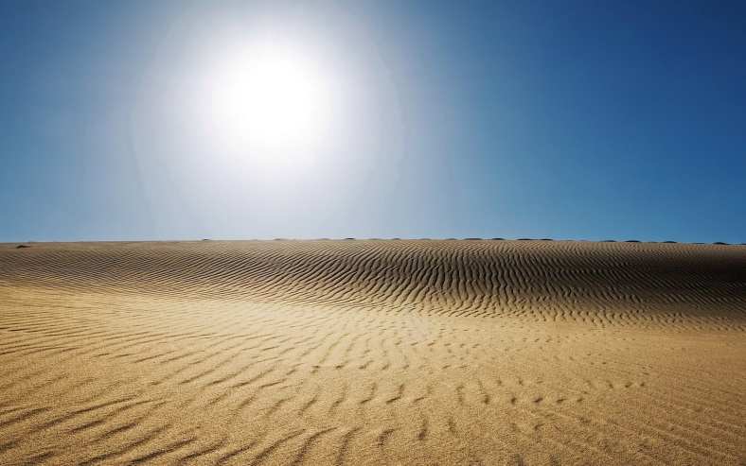
The Camel Trader of Babylon
"I looked across into the uninviting distance and once again came to me the question, 'Have I the soul of a slave or the soul of a free man?' Then with clearness I realized that if I had the soul of a slave, I should give up, lie down in the desert and die, a fitting end for a runaway slave.
"But if I had the soul of a free man, what then? Surely I would force my way back to Babylon, repay the people who had trusted me, bring happiness to my wife who truly loved me and bring peace and contentment to my parents.

Slide 26
The Camel Trader of Babylon
“Thy debts are thine enemies who have run thee out of Babylon,' Sira had said. Yes it was so. Why had I refused to stand my ground like a man? Why had I permitted my wife to go back to her father?
"Then a strange thing happened. All the world seemed to be of a different color as though I had been looking at it through a colored stone which had suddenly been removed.

Slide 27
The Camel Trader of Babylon
"Die in the desert! Not I! With a new vision, I saw the things that I must do. First I would go back to Babylon and face every man to whom I owed an unpaid debt. I should tell them that after years of wandering and misfortune, I had come back to pay my debts as fast as the gods would permit. Next I should make a home for my wife and become a citizen of whom my parents should be proud.
"My debts were my enemies, but the men I owed were my friends for they had trusted me and believed in me.

Slide 28
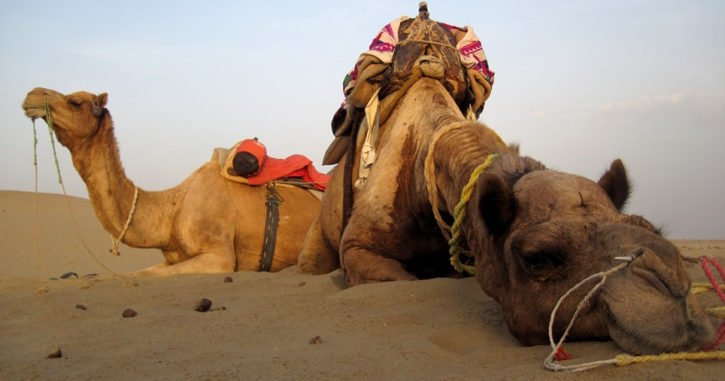
The Camel Trader of Babylon
"I staggered weakly to my feet. What mattered hunger? What mattered thirst? They were but incidents on the road to Babylon. Within me surged the soul of a free man going back to conquer his enemies and reward his friends. I thrilled with the great resolve.
"The glazed eyes of my camels brightened at the new note in my husky voice. With great effort, after many attempts, they gained their feet. With pitiful perseverance,
they pushed on toward the north
where something within me said we
would find Babylon.

Slide 29
The Camel Trader of Babylon
"We found water. We passed into a more fertile country where were grass and fruit. We found the trail to Babylon because the soul of a free man looks at life as a series of problems to be solved and solves them, while the soul of a slave whines, 'What can I do who am but a slave?”
"How about thee, Tarkad? Dost thy empty stomach make thy head exceedingly clear? Art ready to take the road that leads back to self respect? Canst thou see the world in its true color? Hast thou the desire to pay thy honest debts, however many they may be, and once again be a man respected in Babylon?"

Slide 30
The Camel Trader of Babylon
Moisture came to the eyes of the youth. He rose eagerly to his knees.
-"Thou has shown me a vision; already I feel the soul of a free man surge within me.“
-"But how fared you upon your return?" questioned an interested listener.
-"Where the determination is, the way can be found" Dabasir replied. "I now had the determination so I set out to find a way. First I visited every man to whom I was indebted and begged his indulgence until I could earn that with which to repay. Most of them met me gladly. Several reviled me but others offered to help me.

Slide 31
The Camel Trader of Babylon
One indeed did give me the very help I needed. It was
Mathon, the gold lender. Learning that I had been a camel tender in Syria; he sent me to old Nebatur, the camel trader, just commissioned by our good king to purchase many herds of sound camels for the great expedition. With him, my knowledge of camels I put to good use. Gradually I was able to repay
every copper and every piece of silver. Then at last I could hold up my head and feel that I was an honorable man among men."

Slide 32
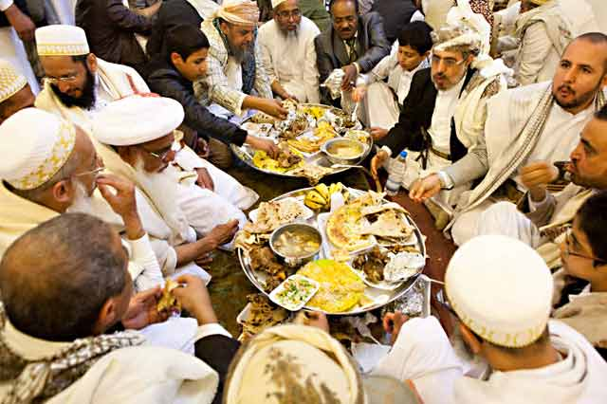
The Camel Trader of Babylon
Again Dabasir turned to his food. "Kauskor, you snail," he called loudly to be heard in the kitchen, "the food is cold. Bring me more meat fresh from the roasting. Bring thou also a very large portion for Tarkad, the son of my old friend, who is hungry and shall eat with me."
So ended the tale of Dabasir the camel trader of old Babylon. He found his own soul when he realized a great truth, a truth that had been known and used by wise men long before his time.

Slide 33
The Camel Trader of Babylon
It has led men of all ages out of difficulties and into success and it will continue to do so for those who have the wisdom to understand its magic power. It is for any man to use who reads these lines.
WHERE THE DETERMINATION IS, THE WAY CAN BE FOUND

