Slide 1
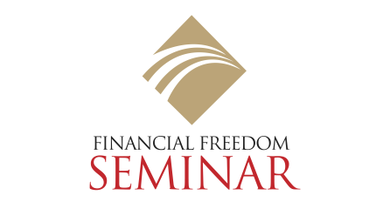
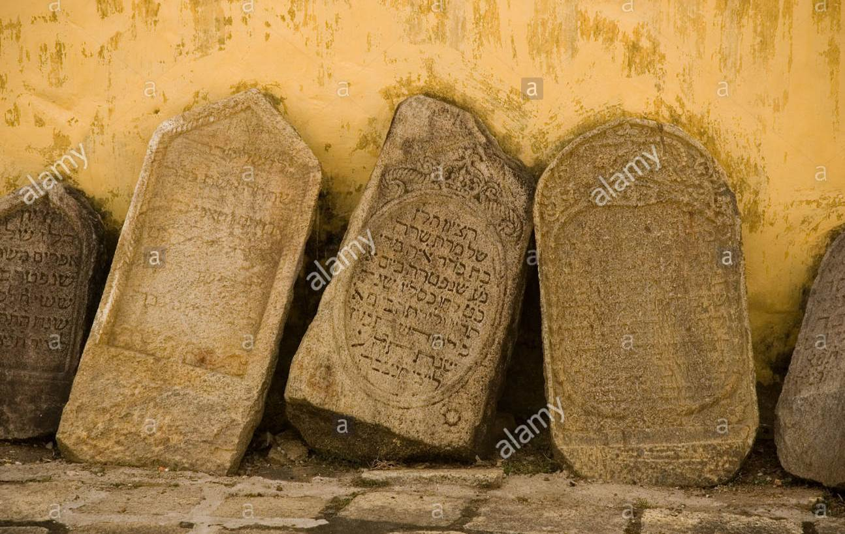
The Clay Tablets from Babylon
St. Swithin's College
Nottingham University
Newark-on-Trent
Nottingham
Professor Franklin Caldwell,
Care of British Scientific Expedition,
Hillah, Mesopotamia.
October 21, 1934.
My dear Professor:
The five clay tablets from your recent excavation in the ruins of Babylon arrived on the same boat with your letter. I have been fascinated no end, and have spent many pleasant hours translating their inscriptions. I should have answered your letter at once but delayed until I could complete the translations which are attached.

Slide 2
The Clay Tablets from Babylon
The tablets arrived without damage, thanks to your careful use of
preservatives and excellent packing.
You will be as astonished as we in the laboratory at the story they relate. One expects the dim and distant past to speak of romance and adventure. “Arabian Nights" sort of things, you know. When instead it discloses the problem of a person named Dabasir to pay off his debts, one realizes that conditions upon this old world have not changed as much in five thousand years as one might expect.

Slide 3
The Clay Tablets from Babylon
It's odd, you know , but these old inscriptions rather “rage” me, as the
students say. Being a college professor, I am supposed to be a thinking human
being possessing a working knowledge of most subjects.
Yet, here comes this old chap out of the dust-covered ruins of Babylon to
offer a way I had never heard of to pay off my debts and at the same time
acquire gold to jingle in my wallet.
Pleasant thought, I say, and interesting to prove whether it will work as well
nowadays as it did in old Babylon. Mrs. Shrewsbury and myself are planning to try out his plan upon our own affairs which could be much improved.
Wishing you the best of luck in your worthy undertaking and waiting eagerly
another opportunity to assist, I am
Yours sincerely,
Alfred H. Shewsbury,
Department of Archaeology.

Slide 4
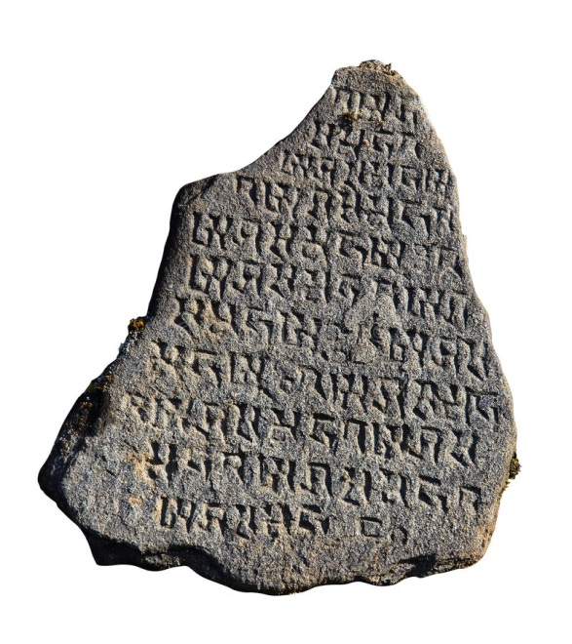
The Clay Tablets from Babylon
Tablet N° 1
Now, when the moon becomes full, I, Dabasir, who am but recently returned from slavery in Syria, with the determination to pay my many just debts and
become a man of means worthy of respect in my native city of Babylon, do here engrave upon the clay a permanent record of my affairs to guide and assist me
in carrying through my high desires.
Under the wise advice of my good friend Mathon,
the gold lender, I am determined to follow an exact
plan that he doth say will lead any honorable man out of debt into means and self respect.

Slide 5
The Clay Tablets from Babylon
This plan includeth three purposes which are my hope and desire.
First, the plan doth provide for my future prosperity.
Therefore one-tenth of all I earn shall be set aside as my own to keep. For Mathon speaketh wisely when he saith:
"That man who keepeth in his purse both gold and silver that he need not spend is good to his family and loyal to his king.
"The man who hath but a few coppers in his purse is indifferent to his family and indifferent to his king.

Slide 6
The Clay Tablets from Babylon
"But the man who has nothing in his purse is unkind to his family and is disloyal to his king, for his own heart is bitter.
"Therefore, the man who wished to achieve must have coin that he may keep to jingle in his purse, that he have in his heart love for his family and loyalty to his king.“
Second, the plan doth provide that I shall support and clothe my good wife who hath returned to me with loyalty from the house of her father. For Mathon doth say that to take good care of a faithful wife putteth self-respect into the heart of a man and addeth strength and determination to his purposes.

Slide 7
The Clay Tablets from Babylon
Therefore seven-tenths of all I earn shall be used to provide a home, clothes to wear, and food to eat, with a bit extra to spend, that our lives be not lacking in pleasure and enjoyment.
But he doth further enjoin the greatest care that we spend not greater than seven-tenths of what I earn for these worthy purposes. Herein loath the success of the plan.
I must live upon this portion and never use more nor buy what I may not pay for out of this portion.

Slide 8
The Clay Tablets from Babylon
Tablet N° 2
Third, the plan doth provide that out of my earnings my debts shall be paid.
Therefore each time the moon is full, two-tenths of all I have earned shall be divided honorably and fairly among those who have trusted me and to whom
I am indebted. Thus in due time will all my indebtedness be surely paid.
Therefore, do I here engrave the name of every man to whom I am indebted and the honest amount of my debt.

Slide 9
The Clay Tablets from Babylon
Fahru, the cloth weaver, 2 silver, 6 copper.
Sinjar, the couch maker, 1 silver.
Ahmar, my friend, 3 silver, 1 copper.
Zankar, my friend, 4 silver, 7 copper,
Askamir, my friend, 1 silver, 3 copper.
Harinsir, the Jewelmaker, 6 silver, 2 copper.
Diarbeker, my father's friend, 4 silver, 1 copper.
Alkahad, the house owner, 14 silver.
Mathon, the gold lender, 9 silver.
Birejik, the farmer, 1 silver, 7 copper.
(From here on, disintegrated. Cannot be deciphered.)

Slide 10
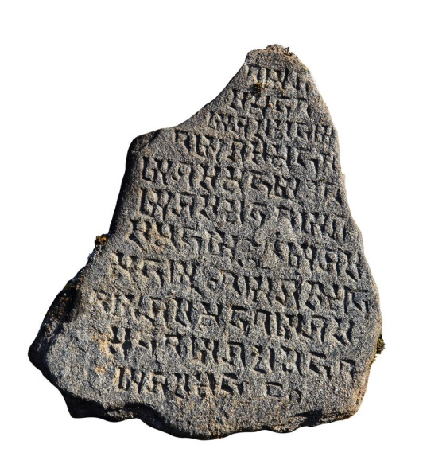
The Clay Tablets from Babylon
Tablet N° 3
To these creditors do I owe in total one hundred and nineteen pieces of silver and one hundred and forty-one pieces of copper. Because I did owe these sums and saw no way to repay, in my folly I did permit my wife to return to her father and didst leave my native city and seek easy wealth elsewhere, only to find disaster and to see myself sold into the degradation of slavery.
Now that Mathon doth show me how I can repay my
debts in small sums of my earnings, do I realize the
great extent of my folly in running away from the
results of my extravagances.

Slide 11
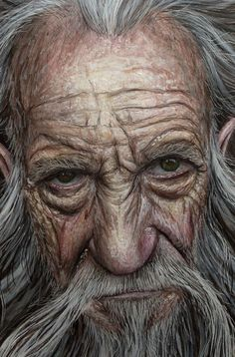
The Clay Tablets from Babylon
Therefore have I visited my creditors and
explained to them that I have no resources with which to pay except my ability to earn, and that I intent to apply two tenths of all I earn upon my indebtedness evenly and honestly. This much can I pay but no more. Therefore if they be patient, in time my obligations will be paid in full.
Ahmar, whom I thought my best friend, reviled me bitterly and I left him in humiliation.
Birejik, the farmer, pleaded that I pay him first as he didst badly need help.
Alkahad, the house owner, was indeed disagreeable and insisted that he would make me trouble unless I didst soon settle in full with him.

Slide 12
The Clay Tablets from Babylon
All the rest willingly accepted my proposal. Therefore am I more determined than ever to carry through, being convinced that it is easier to pay one's just debts than to avoid them.
Even though I cannot meet the needs and demands of a few of my creditors I will deal impartially with all.

Slide 13
The Clay Tablets from Babylon
Tablet N° 4
Again the moon shines full. I have worked hard with a free mind. My good wife hath supported my intentions to pay my creditors. Because of our wise determination, I have earned during the past moon, buying camels of sound wind and good legs, for Nebatur, the sum of nineteen pieces of silver.
This I have divided according to the plan. One-tenth have I set aside to keep as my own, seven-tenths have I divided with my good wife to pay for our living. Two-tenths have I divided among my creditors as evenly as could be
done in coppers.

Slide 14
The Clay Tablets from Babylon
I did not see Ahmar but left it with his wife. Birejik was so pleased he would kiss my hand. Old Alkahad alone was grouchy and said I must pay faster. To which I replied that if I were permitted to be well fed and not worried, that alone would enable me to pay faster. All the others thanked me and spoke well of my efforts.
Therefore, at the end of one moon, my indebtedness is reduced by almost four pieces of silver and I possess almost two pieces of silver besides, upon which no man hath claim. My heart is lighter than it hath been for a long time.

Slide 15

The Clay Tablets from Babylon
Again the moon shines full. I have worked hard but with poor success. Few camels have I been able to buy.
Only eleven pieces of silver have I earned.
Nevertheless my good wife and I have stood by the plan even though we have bought no new raiment and eaten little but herbs. Again I paid ourselves one-tenth of the eleven pieces, while we lived upon seven-tenths. I was surprised when Ahmar commended my payment, even though small. So did Birejik. Alkahad flew into a rage but when told to give back his portion if he did not wish it, he became reconciled. The others, as
before, were content

Slide 16
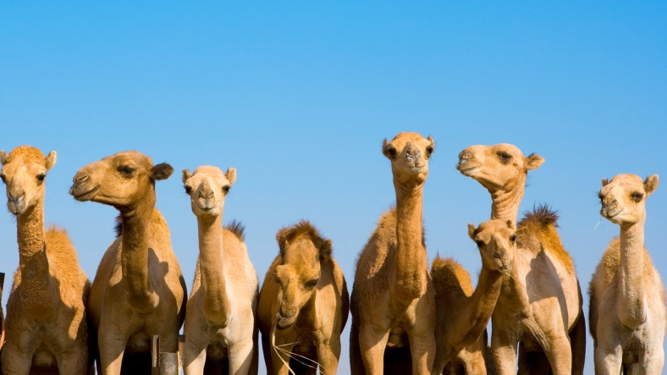
The Clay Tablets from Babylon
Again the moon shines full and I am greatly rejoiced. I intercepted a fine herd of camels and bought many sound ones, therefore my earnings were forty-two pieces of silver. This moon my wife and myself have bought much needed sandals and raiment Also we have dined well on meat and fowl.
More than eight pieces of silver we have paid to our creditors.
Even Alkahad did not protest.

Slide 17
The Clay Tablets from Babylon
Great is the plan for it leaded us out of debt and gives us wealth which is ours to keep.
Three times the moon had been full since I last carved upon this clay. Each time I paid to myself one-tenth of all I earned. Each time my good wife and I have lived upon seven-tenths even though at times it was difficult. Each time have I paid to my creditors two-tenths.

Slide 18
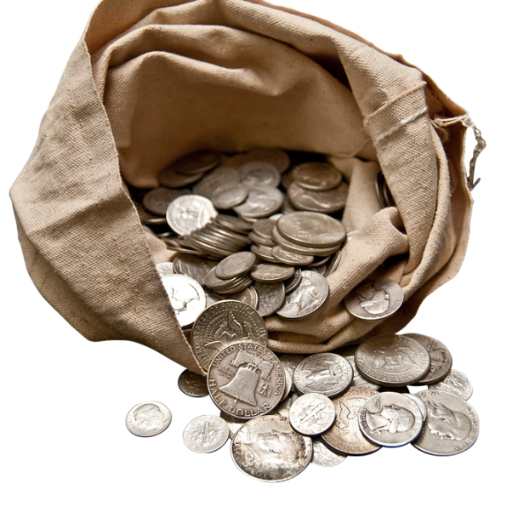
The Clay Tablets from Babylon
In my purse I now have twenty one pieces of silver that are mine. It market my head to stand straight upon my shoulders and market me proud to walk among my friends.
My wife kept well our home and is becomingly gowned.
We are happy to live together.
The plan is of untold value. Hath it not made an honorable man of an ex-slave?

Slide 19

The Clay Tablets from Babylon
Tablet N° 5
Again the moon shines full and I remember that it is long since I carved upon the clay. Twelve moons in truth have come and gone. But this day I will not neglect my record because upon this day I have paid the last of my debts.
This is the day upon which my good wife and my thankful
self celebrate with great feasting that our determination hath been achieved.
Many things occurred upon my final visit to my creditors that I shall long remember. Ahmar begged my forgiveness for his unkind words and said that I was one of all others he most desired for a friend.

Slide 20

The Clay Tablets from Babylon
Old Alkahad is not so bad after all, for he said, "Thou wert once a piece of soft clay to be pressed and molded by any hand that touched thee, but now thou art a piece of bronze capable of holding an edge. If thou needs silver or gold at any time come to me."
Nor is he the only one who holded me in high regard. Many others speak
deferentially to me.
My good wife looked upon me with a light in her eyes that doth make a man
have confidence in himself.

Slide 21
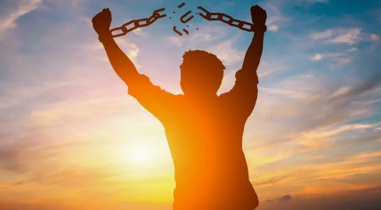
The Clay Tablets from Babylon
Yet it is the plan that hath made my success. It hath enabled me to pay all my debts and to jingle both gold and silver in my purse. I do commend it to all who wish to get ahead. For truly if it will enable an ex-slave to pay his debts and have gold in his purse, will it not aid any man to find independence? Nor am I, myself, finished with it, for I am convinced that if I follow it further it will make me rich among men.

Slide 23
The Clay Tablets from Babylon
St. Swithin's College
Nottingan University
Newark-on-Trent
Nottingham
November 7th, 1936.
Professor Franklin Caldwell,
Care of British Scientific Expedition,
Hillah, Mesopotamia.
My dear professor:
If, in your further digging into those ruins of Babylon, you encounter the ghost
of a former resident, an old camel trader named Dabasir, do me a favor. Tell
him that his scribbling upon those clay tablets, so long ago, has earned for
him the life long gratitude of a couple of college folks back here in England.

Slide 24
The Clay Tablets from Babylon
You will possibly remember my writing a year ago that Mrs. Shrewsbury and myself intended to try his plan for getting out of debt and at the same time having gold to jingle. You may have guessed, even though we tried to keep it from our friends, our desperate straits.
We were frightfully humiliated for years by a lot of old debts and worried sick for fear some of the trades-people might start a scandal that would force me out of the college. We paid and paid—every shilling we could squeeze out of income—but it was hardly enough to hold things even. Besides we were forced
to do all our buying where we could get further credit regardless of higher costs.

Slide 25
The Clay Tablets from Babylon
It developed into one of those vicious circles that grow worse instead of better. Our struggles were getting hopeless. We could not move to less costly rooms because we owed the landlord. There did not appear to be anything we could do to improve our situation.
Then, here comes your acquaintance, the old camel trader from Babylon, with a plan to do just what we wished to accomplish. He jolly well stirred us up to follow his system. We made a list of all our debts and I took it around and showed it to everyone we owed.

Slide 26
The Clay Tablets from Babylon
I explained how it was simply impossible for me to ever pay them the way things were going along. They could readily see this themselves from the figures. Then I explained that the only way I saw to pay in full was to set aside twenty percent of my income each month to be divided pro rata, which would pay them in full in a little over two years. That, in the meantime, we would go on a cash basis and give them the further benefit of our cash
purchases.
They were really quite decent. Our greengrocer, a wise old chap, put it in a way that helped to bring around the rest. "If you pay for all you buy and then pay some on what you owe, that is better than you have done, for ye isn't paid down the account none in three years."

Slide 27
The Clay Tablets from Babylon
Finally I secured all their names to an agreement binding them not to molest us as long as the twenty percent of income was paid regularly. Then we began scheming on how to live upon seventy percent. We were determined to keep that extra ten percent to jingle. The thought of silver and possibly gold was most alluring.
It was like having an adventure to make the change. We enjoyed figuring this way and that, to live comfortably upon that remaining seventy percent. We started with rent and managed to secure a fair reduction. Next we put our favorite brands of tea and such under suspicion and were agreeably surprised how often we could purchase superior qualities at less cost.

Slide 28
The Clay Tablets from Babylon
It is too long a story for a letter but anyhow it did not prove difficult. We managed and right cheerfully at that. What a relief it proved to have our affairs in such a shape we were no longer persecuted by past due accounts.
I must not neglect, however, to tell you about that extra ten percent we were supposed to jingle. Well, we did jingle it for some time. Now don't laugh too soon. You see, that is the sporty part. It is the real fun, to start accumulating money that you do not want to spend.
There is more pleasure in running up such a surplus than there could be in spending it.

Slide 29
The Clay Tablets from Babylon
After we had jingled to our hearts' content, we found a more profitable use for it. We took up an investment upon which we could pay that ten percent each month. This is proving to be the most satisfying part of our regeneration. It is the first thing we pay out of my check.
There is a most gratifying sense of security to know our investment is growing steadily. By the time my teaching days are over it should be a snug sum, large enough so the income will take care of us from then on.

Slide 30
The Clay Tablets from Babylon
All this out of my same old check. Difficult to believe, yet absolutely true. All our debts being gradually paid and at the same time our investment increasing. Besides we get along, financially, even better than before. Who would believe there could be such a difference in results between following a
financial plan and just drifting along.
At the end of the next year, when all our old bills shall have been paid, we will have more to pay upon our investment besides some extra for travel.
We are determined never again to permit our living expenses to exceed seventy percent of our income.

Slide 31
The Clay Tablets from Babylon
Now you can understand why we would like to extend our personal thanks to that old chap whose plan saved us from our "Hell on Earth.“ He knew. He had been through it all. He wanted others to benefit from his own bitter experiences. That is why he spent tedious hours carving his message upon the clay. He had a real message for fellow sufferers, a message so important that after five thousand years it has risen out of the ruins of Babylon, just as true and just as vital as the day it was buried.
Yours sincerely,
Alfred H. Shrewsbury,
Department of Archaeology.

