Slide 1

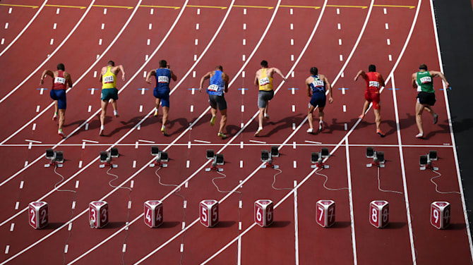




Financial Freedom Challenge
Presents
By
Alex Barrón

Slide 2


PROTECTION FOR THE
UNKNOWN FUTURE - INSURANCE

Slide 3

In This World There is a Lot of Uncertainty
To mitigate against catastrophic risks people buy insurance.
Many Types of Insurance:
  Car Insurance - Accident
  Home Insurance - Fire
  Property Insurance - Theft
  Health Insurance – Illness
The Purpose of Insurance: To eliminate exposure to a small probability of losing a large amount of $ by exchanging a small certain amount of $ (the premium).

Slide 4
Insurance is Protection
Don’t be Cheap. You don’t “save” money by not having insurance.
You expose yourself to unnecessary loss.
Having protection may seem like a “waste of money” until something happens. Then you will be glad you had it.
Insurance is a form of “investment” to protect you from a large loss that you can’t afford to cover on your own.

Slide 5
Don’t Waste Money
Some types of insurance are a true “waste of money” because they odds that something bad will happen and that you will be covered are very low.
Read the fine print of what exactly is covered and under what circumstances.
Raise your deductibles and save money – keep a reserve to cover them when necessary.

Slide 6





