Slide 1






Financial Freedom Challenge
Presents
By
Alex Barrón

Slide 2


WHAT IS LIFE INSURANCE?

Slide 3

TWO INEVITABLE RISKS

Slide 4

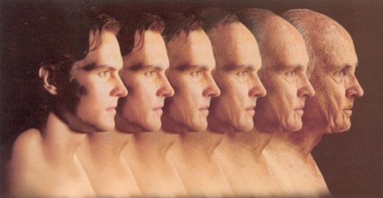
Two Things Are Sure in Life
1.) We will get Old
2.) We will Die
What are you doing to be prepared for when that moment comes?

Slide 5

If You Die Unexpectedly,
Who Will Take Charge of Your Family?
The average life expectancy is now 75 years for men and 80 for women.
If you died unexpectedly, would you have everything ready?
Would your family be economically protected in case you are missing?
Do not leave it for “Later".
"A Life Insurance is a product of "love“ rather than "need"because it fills, with love, the financial responsibility of the person who dies to their loved ones." - Dwayne Burnell

Slide 6

Life Insurance is a Gift of Love
Life insurance protects human life value by creating an estate. When the person who is covered by the insurance (the “insured”) dies, a definite sum of money (a “death benefit”) is paid to the beneficiary.
“What can be done with love and vision is to own an adequate amount of life insurance.” – Wayne Burnell

Slide 7

What is Life Insurance?
Life Insurance is a contract where a premium is exchanged for a death benefit.
3 Factors Affect the Cost of Life Insurance:
Age - The younger a person is, the less the insurance costs. The insurance increases with age.
Health - The better health a person has, the less insurance costs. A smoker pays a lot more.
Sex - Women tend to have a longer life expectancy than men, so women pay less than men.

Slide 8
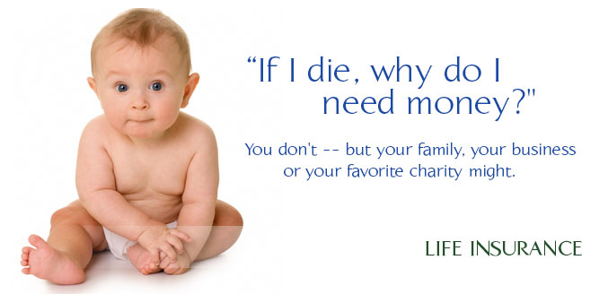
Why Life Insurance?
5 Key reasons why people buy life insurance:
Family Protection - The death benefit protects your family from a financial burden: funeral expenses, pay your debts (house), cover the education of your children and replace your income in case of premature death.
Financing - To "Pay Yourself" the interest that you would pay to a financial institution.
Retirement Income - Provide a stable income for your retirement.
Tax Advantages
- The income can be Tax free.
5. Asset Protection.
-In case of a lawsuit.

Slide 9
Family Protection – A gift of love in case of a premature death.
We're all going to die some day ... it's just a matter of when.
Life insurance (Temporary or Permanent) Will protect your family and provide them with a tax-free payment (the Death Benefit) of the amount you purchased.
This money can cover funeral expenses, pay your mortgage, help your family get out of debt, pay your children's tuition, and replace your income if it is invested properly.
Think about how long it would take you to save this same amount of money.
Make this a priority - Everyone should have at least one temporary policy. Why play them with $0 protection?
The younger and healthier you get, the lower the annual cost.

Slide 10
Parties to the Contract
The Insurance Company: This is the company that provides the insurance coverage. They receive and invest the premiums, commits to the death benefit, and pays out the death benefit to the beneficiaries.
The Policy Owner: The policy owner creates the policy, is responsible to pay the premiums, controls the money in the policy, and decides who will be the beneficiaries – primary and contingent. They have the ultimate control of what happens to the policy
The Insured: The insured is the life that is being insured. When this person dies, that triggers the payment of the death benefit to the beneficiary. Unless they are the same person as the policy owner, they don’t have access to the money in the policy.
The Beneficiary: The beneficiary is the person or party who receives the death benefit upon the death of the insured.

Slide 11
How Life Insurance Works
Insurance Company
Policyholder/Owner
Contracts with Insurance Company
to take out
insurance policy
Beneficiary
Receives the death benefit on death of insured person
Insurance Policy
Insured Person
The life on which the policy is taken out.
Policyholder must have an insurable interest on the life of the insured.

Slide 12
What are the Components of a Life Insurance Policy?
PREMIUM
A premium must be paid on a regular basis – monthly, quarterly or yearly.
DEATH BENEFIT
The death benefit is the amount of money that you want the insurance company to pay your beneficiaries should you pass away.
CASH VALUE
The cash value of the policy is the amount of money that would be available to you if you decided to cancel and forfeit the policy at any time. It is also the amount of money that you can borrow against.
DIVIDENDS
A dividend is in essence excess premium which is analogous to a profit or net income of a company. The insurance company will return this money to the policy holders. Since it is technically a “return of premium” it is non-taxable. Dividends make the cash value grow.

Slide 13

What is an Insurable Interest?
Life insurance may be purchased on someone other than the owner of the policy.
The principle of insurable interest is that the person buying the insurance must have an incentive that the person being insured remain alive.
It is possible to own an insurance contract on someone else:
Spouse,
Sibling(s),
Child(ren),
Grandchild(ren),
Niece(s), Nephew(s), or
Business partner(s).
– Dwayne Burnell

Slide 14
4 Types of Life Insurance
There are 4 Basic Types of Life Insurance:
  Term Life Insurance - Your "Rent" the policy for a period of time - typically 10-30 years.
  Whole Life Insurance - The policy is permanent and remains in force until the death, as long as the premiums are paid each year, until the contract is paid. It has fixed premiums, pays dividends, accumulates money (redemption value), and can borrow.

Slide 15
4 Types of Life Insurance
  3. "Your Own Bank" Insurance - It is a permanent insurance that is a combination of a whole life policy, a term life rider, and additional optional coverages called Paid Up Additions (like mini whole lifes). It allows you to save and borrow. It has a low fixed payment, but gives you the opportunity to make additional optional contributions to grow the coverage over time. The focus is on the Living Benefits - which allow you to use the money in the policy for many purposes while you are alive.

Slide 16
4 Types of Life Insurance
There are 4 Basic Types of Life Insurance:
  4. Universal Life Insurance - It is a combination of temporary insurance and an investment fund. In the end, the cost of temporary insurance increases and the investment is eaten up.
  We DO NOT recommend this one! We will explain why later.

Slide 17
1. Term Life Insurance
Pros:
Monthly Cost (premiums) is Low.
High Death Benefit.
Death Benefit is Tax Free.
Mental peace in case of accident or premature death.
Cons:
Expires after a period of time - typically 10-30 years.
If the person does not die, all the money is lost.
After the initial term, the cost to renew are very high so most people cancel when it is needed most.
It has no cash value.
You can not borrow against it.

Slide 18
1. Term Life Insurance

Slide 19
1. Term Life Insurance

Slide 20
2. Whole Life Insurance
Pros:
Death Benefit is Tax Free.
Peace of Mind - the benefit is for life. It never expires.
Pays Dividends that can be reinvested.
The cash value grows every year.
You have it when it is most needed - in the final years.
You do not lose all the money.
The initial cost is recovered after a few years.
Offers legal asset protection against predators and creditors.
You can borrow the cash after a few years.
Savings Plan Creates Discipline.
Cons:
Monthly Cost (premiums) is High, but stable for the Death Benefit.
Commission is high for the agent.
Cash yield is "low", but tax free and always positive. Typically 2-4% per year.

Slide 21
2. Whole Life Insurance

Slide 22
2. Whole Life Insurance

Slide 23
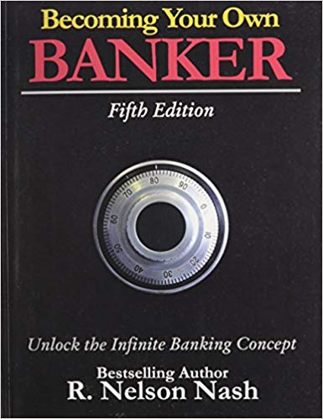
3. “Be Your Own Bank” Concept
Nelson Nash introduced the concept known as:
“Infinite Banking” or “Become Your Own Banker”
  A method of using permanent life insurance to finance all your large purchases.
  Requires a "Capitalization Period" to Accumulate Cash Value - This is your Capital that you can borrow.
  You can borrow against your policy.
  Pay back "To Yourself" with Interest instead of a bank.

Slide 24
3. “Be Your Own Bank” Concept
Pros:
Death Benefit is Tax Free.
Peace of Mind - the benefit is for life. It never expires.
Pays Dividends that can be reinvested.
The Cash Value increases every year and much faster than a Whole Life.
You have it when it is most needed - in the final years.
You do not lose all the money. The initial cost is recovered after a few years - faster than in Whole Life.
Offers legal asset protection.
You can borrow the cash after just a few months.
Automatic Savings Plan. Commission low for the agent.
Commission low for the agent.
The Death Benefit grows quickly the more you buy Paid-Up Additions.
Can replace the need for a 401(k), IRA, traditional insurance, or a 529 plan.
Cons:
  Very few agents know it exists or how it works and thus don’t typically offer it.
  It requires a medical examination.
  Becoming approved takes between ~3-4 weeks.

Slide 25
How does a “Become Your Own Bank” type Life Insurance plan work?
3 Components
  Base Insurance (Whole Life) +
  Temporary Insurance (Term Life) +
  Paid-Up Additional (PUA) Insurance
3 Functions
  Life Insurance – It offers protection in case of death or a terminal illness.
  Savings Plan – Base Insurance and PUA accumulate Cash Value – which grows constantly every year.
  Line of Credit – You can borrow money against your Cash Value.

Slide 26
Comparison of the 3

Slide 27
Insurance Comparison
Traditional Insurance
Temporary
Male, 40 years old
Death Benefit: $200,000
Term: 20 years
Cost: $457 x 20 = $9,139
Cash Value = $0
Death Benefit
@ 75 years old = $0
Mutual Fund Value
= $154,296 +/- ???
Permanent (Whole Life)
Male, 40 years old
Death Benefit: $200,000
Term: Never Expires
Cost: $4,670 x 35 years = $163,435
Cash Value @ 75 years = $261,212
Death Benefit
@ 75 years = $375,357

Slide 28
Insurance Comparison
Permanent (Whole Life)
“Become Your Own Bank” Insurance
Information
Male, 40 years
Initial Death Benefit: $200,000
Total Cost $4,670 x 35 years = $163,435
Cash Value @ 75 years = $261,212
Death Benefit
@ 75 years = $375,357
Information
Male, 40 years
Initial Death Benefit: $200,000
Total Cost: $1,533 + $6,000 PUA x 20 years = $150,660
Cash Value @ 75 years = $382,389
Death Benefit
@ 75 years = $549,818

Slide 29
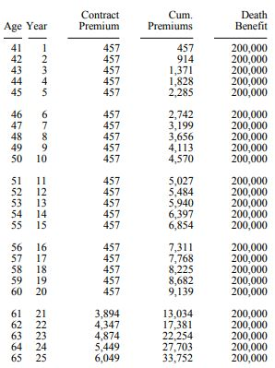
1. Term Life Insurance

Slide 30
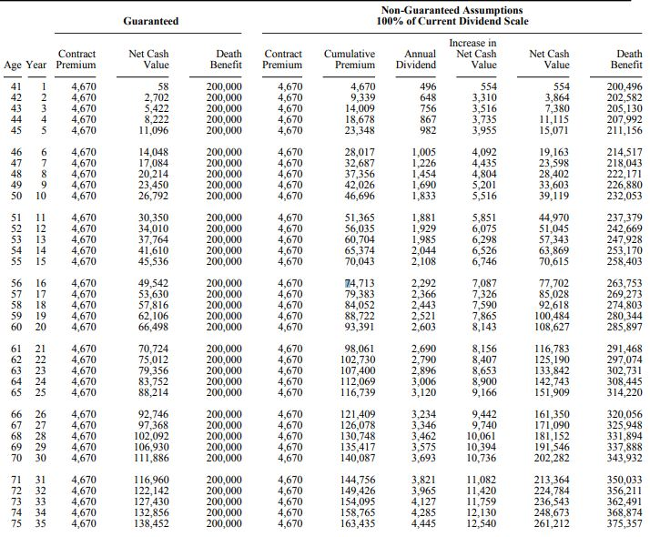
2. Whole Life Insurance

Slide 31
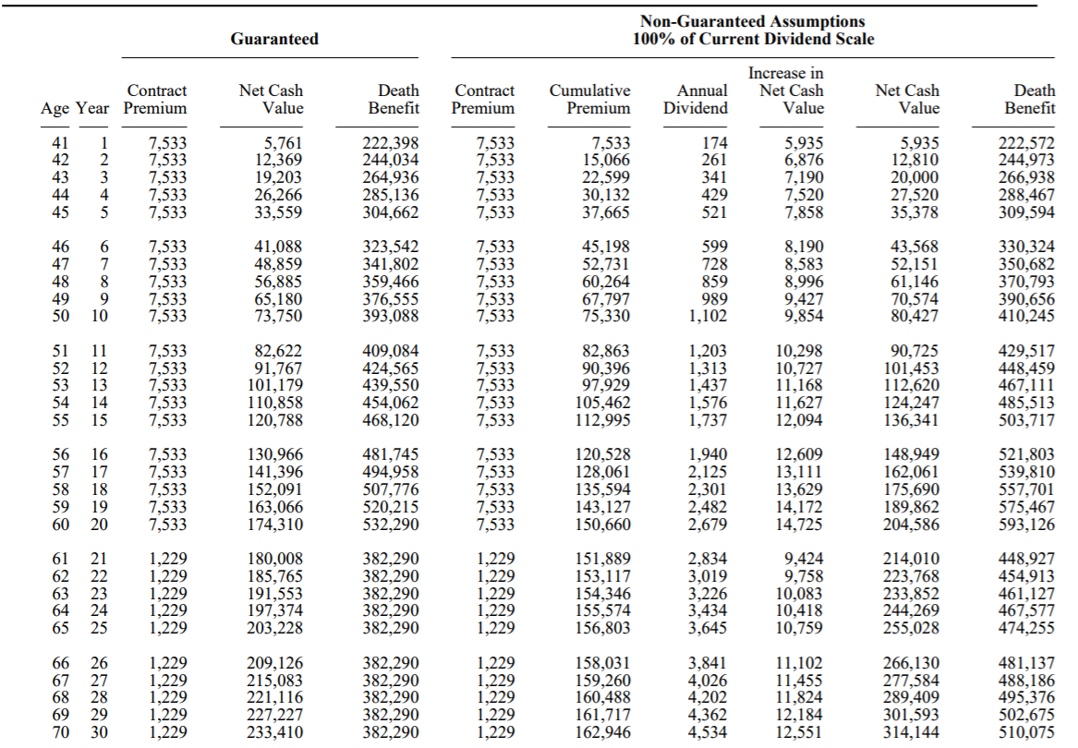
3. “Be Your Own Bank”
Life Insurance

Slide 32
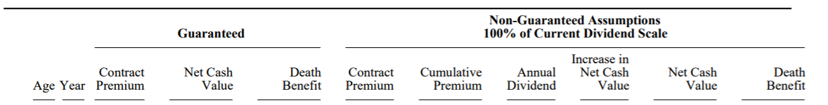
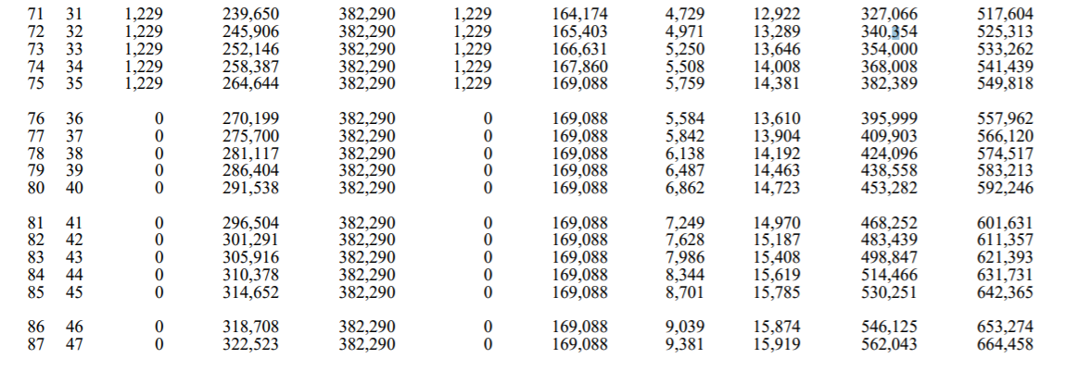
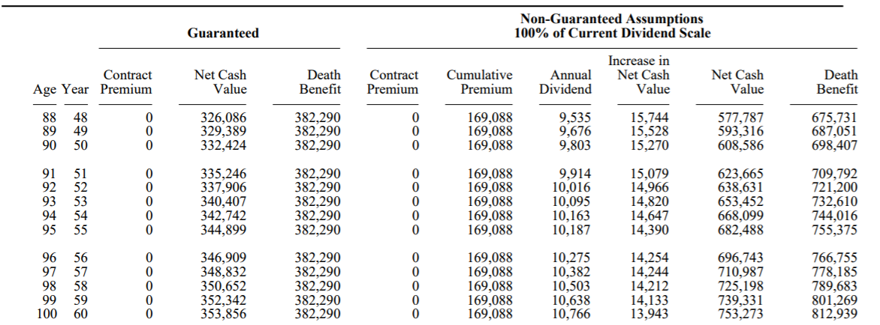
3. “Be Your Own Bank” Life Insurance

Slide 33
4. Two Types of
Life Insurance To Avoid
There are 2 different types of life insurance we don’t recommend – they are based on the Stock Market:
Universal Life Insurance
Variable Life Insurance
We would strongly urge most people considering buying life insurance to not use – Universal and Variable Life insurance! If you have one already, we can help you can exchange it.

Slide 34
Why Not Universal or Variable Life Insurance?
There are two primary reasons why you should avoid universal and variable life insurance.
The Term Will Eventually Eat Into the Cash Value.
The term insurance in the policy is cheap in the initial years.
As time goes by the cost of the term insurance begins to go up and eats into the cash value of the policy.
Once you get past 65, the cash value of the policy will go down unless you put in more money. If you don’t the cash value will eventually be consumed by the cost of the premium in order to keep the policy alive.

Slide 35
Why Not Universal or Variable Life Insurance?
There are two primary reasons why you should avoid universal and variable life insurance.
2. The Product is Based on Investment in Stocks, Indexes or Options, not Bonds or Loans.
Whole life policies are generally based on bonds or loans and depend on interest income.
Universal and Variable life policies are invested in the stock market or index options. They promise “higher returns” in the good years and 0% downside in the bad years.
We find that the returns illustrated are usually very high – for example 7% vs. a more realistic long-term return of 4-5% in the market. This overstates the potential upside in the policy.
The guaranteed return is usually less than 1%.
If the stock market does not perform as expected, your policy won’t work as illustrated.

Slide 36
Why Not Universal or Variable Life Insurance?
“Most products today are not in your best interest, but are designed to be in the best interest of the insurance companies.”
Universal Life is a combination of annual term insurance and a savings element. The amount of cash value will determine usually for how long the policy will last or stay in force. As you get older the term insurance cost goes up, the premium is withdrawn from the cash value. If the cash value is not sufficient to pay the term cost your policy may terminate unless you pay in additional premiums.
As long as you have money in the bucket, you have no problem with the policy. However, if the money runs out, as it will in many of the policies, you lose your money and the insurance.
Many people have not only lost their money but many have also lost or will lose their insurance.” - Thomas W. Young

Slide 37
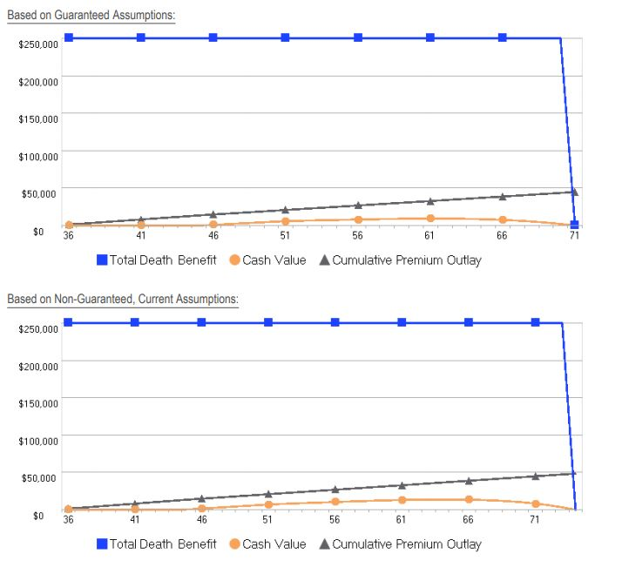
IUL Illustration - $250,000

Slide 38
Best to Avoid Universal Policies
It is definitely not worth the risk involved in losing everything you will put into these policies.
They are typically marketed by agents who don’t understand the risks and companies who don’t explain them to their agents.
It is best to not use a risk-based asset class (stocks & options) to provide the protection of a safe product (life insurance).

Slide 39
Insurance Comparison

Slide 40
Insurance Comparison

Slide 41
Insurance Comparison
“Your Own Bank” vs. Whole Life Insurance
Benefits
Total Cost: $207,827 vs. $206,404 = +1% more
Cash Value @ 75 years = $373,398 vs. $348,306 = +7% More!
Final Death Benefit = $579,718 vs. $539,209 = +8% More!
More Flexibility: Minimum Payment $482 vs. $149/mo = -69% less!
More Cash Value from Year One: $4,308 vs. $780 = 452% More!!!

Slide 42




