Slide 1
2018 Mid-year meeting
Arizona State Knights of Columbus
Friday, November 30
Sierra Vista, AZ
Hosted by Councils 4584 & 10799

Slide 2
Knight’s Prayer
Our Lady, Queen of the Knights, bless all the activities of our Order. Keep us true to our pledge, to extend the kingship of thy divine son on earth.
Through Thine intercession, win for us the grace, ever to exemplify in our public and private lives, the virtues that should characterize those especially dedicated to the service of the heavenly court.
Make us always aware that as your Knights, we are constantly observed, our faith judged, and our Order appreciated.
Accept, O Mary, this renewed pledge of fealty and devotion, of Thy Servants, the Knights of Columbus.

Slide 3


Slide 4
District & Council Membership
Current Status and Plans to become star

Slide 5
training
Fraternal Training Portal
Supreme Offered Webinars
Council Officers & Membership

Slide 6

Fraternal Training Portal
Fraternal Training Portal
  Getting To It
    Access available through Officers Online’s Fraternal Training
    Full membership access through: www.kofc.org/trainingmicrosite
  What You Get
    Access to currently announced / scheduled / archived webinars offered by Supreme
    Officer position training (GK, DGK, DD, etc.) for interested members (or current position holders)
NEW

Slide 7
Fraternal Training Portal
Supreme Webinars
  Currently Scheduled
    Title: Your Story, Your Council, Your Faith in Action
    Date: Tuesday, December 11, 2018 - 8:30 p.m. Eastern
  Access To:
    History of the K of C
    Webinar Archive
    Earning the Star Council Award
    Charitable Outreach
    Fraternal Benefits
    Membership Recruitment
    Building the Domestic Church
    Public Relations
    Safe Environment

Slide 8
Council Officer Training
State Deputy Initiative for Training
  Council Officers Training and
  Financial Secretary Training
To occur at least twice each per fraternal year
Organizational Meeting June 30, 2018
  Response was overwhelming – Thank you
Mid-Year Meeting December 2, 2018
  Again I hope the response will also be overwhelming – Thank you in advance.

Slide 9
Supreme Representative Training
October 22 thru October 25, 2018
  Tucson – October 22nd & 23rd
    Roy Champeau Council: 34
    Chief Judge John M. Roll Chapter: 36
    Total: 70
  Phoenix – October 24th & 25th
    Fray Francisco Garces Council: 37
    Fr. John Hanley Council: 45
    Total: 82

Slide 10
Silver Rose
2018 Tour Results
2019 Tour Consideration

Slide 11
2018 Silver Rose Tour
Arizona Tour Began September 16, 2018
  Where: St. John Neumann’s, Yuma, AZ
    California jurisdiction transferred the Silver Rose to Arizona at the 9:30 mass.
  Tour Results by District (in the order received):
    District No: Days Viewers
    18: 3 Days 2,100
    2: 3 Days 171
    1: 5 Days 848
    3: 3 Days 315
    31: 4 Days 2,000
    7: 1 Day 500
    23: 2 Days 1,600
    24: 1 Day 180
    20: 2 Days 186
    21: 2 Days 160
    12: 3 Days 265
    Total: 8,325

Slide 12
2018 Silver Rose Tour
Silver Rose at the Arizona Rosary Celebration
  Tucson October 20, 2018
    St. Elizabeth An Seton 1,700
  Phoenix October 21, 2018
    Phoenix Convention Center 4,500
2018 Silver Rose Tour Total: 14,525
Arizona Tour Ended Monday October 22, 2018
  Where: Holbrook, AZ
  Arizona jurisdiction transferred the Silver Rose to New Mexico

Slide 13
2019 Silver Rose Tour
Silver Rose Route 1 schedule should be available by the end of January.
DD’s talk to your councils! Get them enthused about hosting, or even co-hosting, the Silver Rose at their parish, school or council.
Best yet! Talk to a DD or GK that has hosted the Silver Rose. Learn how the Silver Rose moved them or their parishioners.
Get Involved!
Vivat Jesus!

Slide 15
MEMBER RETENTION
LEN RHEAUME
LRHEAUME@MSN.COM
602-738-5607

Slide 16
MEMBER RETENTION
RECRUITMENT AND RETENTION GO HAND IN HAND
TAKE STOCK OF LAPSED MEMBERS ON A MONTHLY BASIS
RETENTION COMMITTEE SHOULD ATTEMPT CONTACT EVERY MONTH
MAKE THE CONTACTS LIKE RE-RECRUITING
USE THE RESOURCES FROM SUPREME AS WELL AS YOUR BENEFITS AGENT
IF SUSPENSIONS ARE NEEDED, ENSURE THAT PROPER PROCEDURES ARE USED

Slide 17
MEMBER RETENTION
15 DAYS BEFORE BILLING PERIOD- FIRST NOTICE
IF DUES NOT RECEIVED IN 30 DAYS- SECOND NOTICE
IF DUES NOT RECEIVED IN 30 DAYS-RETENTION COMIMTTEE ATTEMPS TO CONTACT MEMBER FOR RESOLUTION-OFFER ALTERNATIVES
KNIGHT ALERT LETTER SENT AFTER COMMITTEE CONTACT
15 DAYS AFTER KNIGHT ALERT LETTER, FORM 1845 (INTENT TO RETAIN)
COUNCIL HAS 60 DAYS TO ATTEMPT TO RETAIN
FORM 100 TO SUSPEND SENT UP TO 90 DAYS AFTER FORM 1845

Slide 18
MEMBER RETENTION
REMEMBER THAT OUR GOAL IS TO RETAIN OUR MEMBERS, NOT TO LOSE THEM.

Slide 19
MEMBER RETENTION
LEN RHEAUME
LRHEAUME@MSN.COM
602-738-5607

Slide 21

MEMBERSHIP
Arizona Knights of Columbus
Mid-Year Meeting
November 30-December 2, 2018
Sierra Vista, Arizona

Slide 22

MEMBERSHIP
2018-2019 Membership Game Plan Review
Memberships plan this year
involved 7 Strategies:
Increase Communication
Build a Membership Team
Makeover State Website
Promote eMembership
Implement Shepherd Program
Practice AMP Philosophy
Improve Incentives

Slide 23




MEMBERSHIP
Strategy 1: Increase Communication
@KofCMembership
AZ DIRECTORY
INCREASED DD
ATTENDANCE
KOCOA
MONTHLY
NEWSLETTER

Slide 24
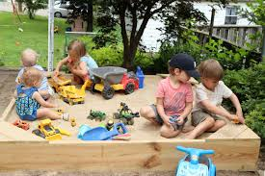
MEMBERSHIP
Strategy 2: Build A Membership Team

Slide 25
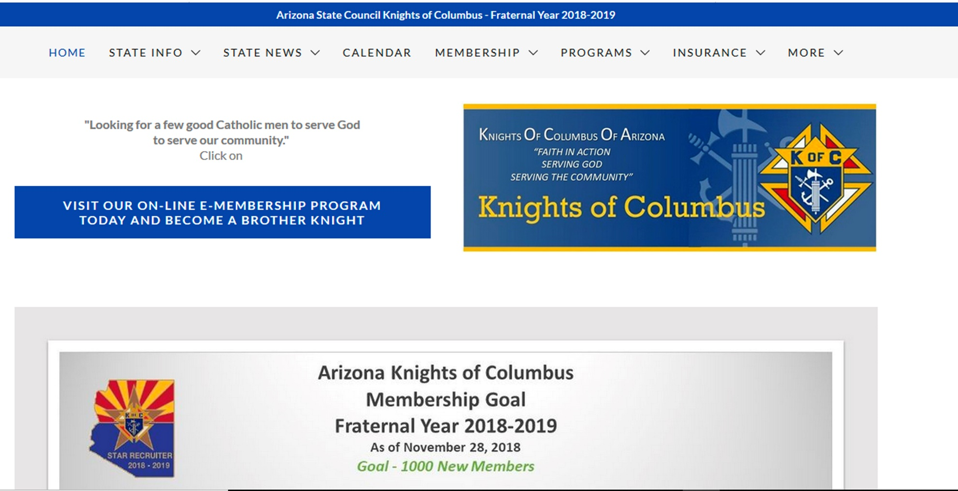
MEMBERSHIP
Strategy 3: Make-over State Web Site

Slide 26
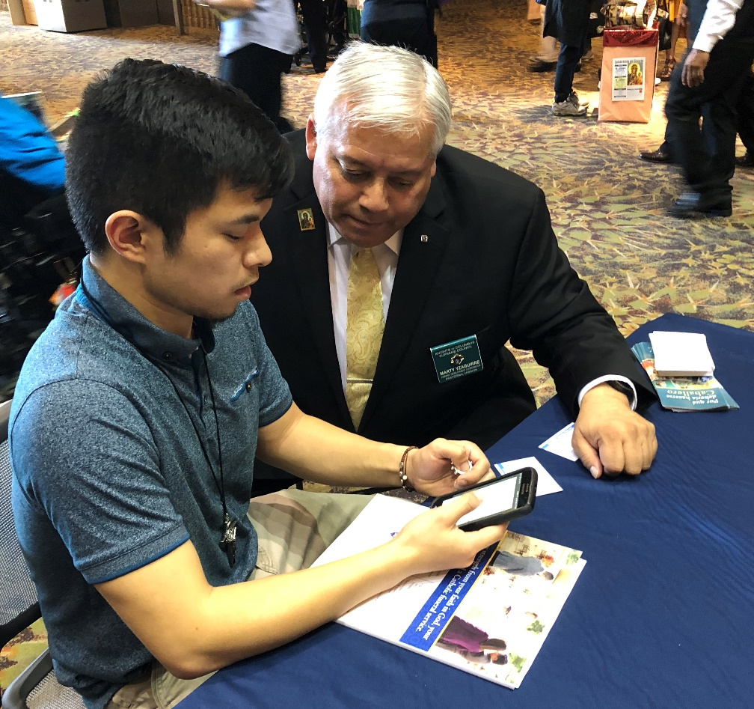
MEMBERSHIP
Strategy 4: Promote eMembership
NEW eMEMBERS
JUL18 5
AUG18 16
SEP18 12
OCT18 11
NOV18 10
Y-T-D TOTAL: 55

Slide 27
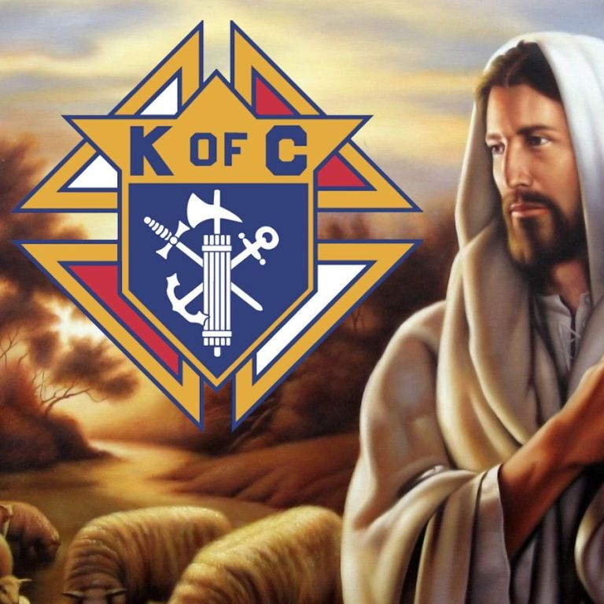
MEMBERSHIP
Strategy 5: Implement Shepherd Program

Slide 28

MEMBERSHIP
Strategy 6: Practice AMP Philosophy
ALTAR
SUPPORT
MEMBERSHIP
GROWTH
PROGRAMS

Slide 29
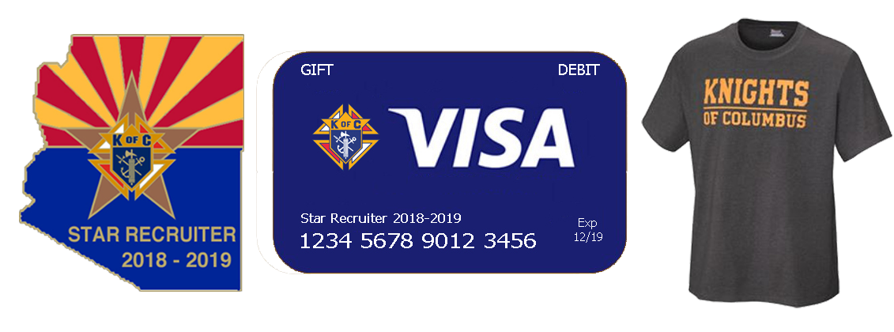
MEMBERSHIP
Strategy 7: Improve Incentives

Slide 30
MEMBERSHIP
Supreme Circle of Honor-Membership Goals
Intake Goal: 950/355
Star Councils: 26/1 Qualifier
(#17036 at 325% Membership & 100% Insurance)
New Council Development: 2/1
Reactivations: 3/1

Slide 31
MEMBERSHIP
00863 01158 01189 01729
03395 03419 04260 04426
04737 05313 05471 05542
06612 06788 07114 07243
07306 07513 07562 07646
07912 07949 08090 08091
08105 08358 08540 08813
09312 09380 09446 09485
09801 09995 10915 11116
11858 11912 12144 12338
12375 12708 12737 13024
13435 13497 13568 14033
14089 14139 14157 14185
14340 14583 14610 14621
15497 15576 15704 16776
ACTIVE ARIZONA COUNCILS
WHICH HAVE NOT RECORDED
ANY MEMBERSHIP ADDITIONS
DURING THE CURRENT
FRATERNAL YEAR…
62

Slide 32
MEMBERSHIP
DISCUSSION:
BEST PRACTICES

Slide 33
MEMBERSHIP
Remember to…
ABR!

Slide 35
2018-19 AZ Jurisdiction ACTION Plan – A review
Mario Vassallo
State Secretary
Cell: 520-481-1250
Email: statesecretary@kofc-az.org

Slide 36
Action Plan Flowdown
Supreme Plan
…
ALASKA
ALBERTA
ARIZONA
WYOMING
…
District 1
District 2
District 3
District 33
…
…
…
Council 7646
Council 8854
Council 14121
Council 15325

Slide 37
General Goals – FY 2018-19
Membership Goals
  950 new members
  Be at 55% (520) new members by Dec 31
    We’re currently at 37.4% (355)
  Offer incentives for Councils, Recruiters & DDs
    3 in 3 Church Drives
    Fast Start Council & Recruiter Incentive
    Star Recruiter Incentives
  Achieve
    26 Star Councils
      Serious stumbling blocks: Safe Environment Training & New SP-7
    4 Star Districts
    2 All-Star Districts

Slide 38
General Goals – FY 2018-19
New Council Development
  Supreme Goal: 2 Council
    Council 1729 (Somerton)
Online Membership/Young Adult Focus
  100 new E-members during FY 18-19
    55 new E-members
    Supreme Goal: 14 e-members per month
  Promote the KofC among Millennials
  Encourage E-membership at Council level
  Expand recruitment efforts among
    RCIA Groups
    Life Teen
    College Campuses

Slide 39
General Goals – FY 2018-19
Hispanic/Ethnic Membership Growth
  Convert 3 of the 11 NCD targets into Hispanic Councils
    Council 1729 (Somerton)
    Holy Family Parish – Phoenix
    San Luis – Membership Drives to start soon.
  Reactivating Inactive Spanish Speaking Councils
    Council 6858 (St. Margaret Mary Parish, Tucson)
  Re-invigorate the Round Table Program to aid HD

Slide 40
General Goals – FY 2018-19
Training & Leadership Development
  DD Training at State Org & Mid-Year Meetings
    June 2018 Org Meeting
    Nov-Dec 2018 Mid-Year Meeting
  Regional Meetings
    4 meetings held in October (2 – Tucson; 2 – Phoenix)
    We plan on having others in the Spring 2019
  Council Level Training by State Membership Team
    Held during June State Organization Meeting
    Held during Nov-Dec State Mid-Year Meeting

Slide 41
General Goals – FY 2018-19
Activities through our Faith In Action Program
  Ultrasound Initiative
    Raised over $13,500 since July 1, 2018
    In the process of purchasing one Ultrasound Machine
    Well on our way to buy a second
  ARC - Increase Council Participation
    72 Councils participated in the 2018 ARC
    About the same participation as previous years
  Establish Corporate Mass & 5th Sunday Rosary Program at each active Council
  PWID Program – Increase Council Participation
    Councils are still sending in their forms & checks
  State Charity Raffle – Increase Council Participation

Slide 42
General Goals – FY 2018-19
Vivat Jesus!

Slide 43
DD Reimbursement

Slide 44
DD Reimbursement
Missing/wrong:
Council #
Name, address
Not signed
No District #
All documents in PDF format- no exceptions
Cancelled Checks -are not the receipts
Purpose of the Council visit

Slide 45
Action Plan

