Slide 1
2018 Mid-year meeting
Arizona State Knights of Columbus
Friday, November 30
Sierra Vista, AZ
Hosted by Councils 4584 & 10799

Slide 2
Knight’s Prayer
Our Lady, Queen of the Knights, bless all the activities of our Order. Keep us true to our pledge, to extend the kingship of thy divine son on earth.
Through Thine intercession, win for us the grace, ever to exemplify in our public and private lives, the virtues that should characterize those especially dedicated to the service of the heavenly court.
Make us always aware that as your Knights, we are constantly observed, our faith judged, and our Order appreciated.
Accept, O Mary, this renewed pledge of fealty and devotion, of Thy Servants, the Knights of Columbus.

Slide 4
District & Council Membership
Current Status and Plans to become star

Slide 5
training
Fraternal Training Portal
Supreme Offered Webinars
Council Officers & Membership

Slide 6
Fraternal Training Portal
Fraternal Training Portal
Getting To It
Access available through Officers Online’s Fraternal Training
Full membership access through: www.kofc.org/trainingmicrosite
What You Get
Access to currently announced / scheduled / archived webinars offered by Supreme
Officer position training (GK, DGK, DD, etc.) for interested members (or current position holders)
NEW

Slide 7
Fraternal Training Portal
Supreme Webinars
Currently Scheduled
Title: Your Story, Your Council, Your Faith in Action Date: Tuesday, December 11, 2018 - 8:30 p.m. Eastern
Access To:
History of the K of C
Webinar Archive
Earning the Star Council Award
Charitable Outreach
Fraternal Benefits
Membership Recruitment
Building the Domestic Church
Public Relations
Safe Environment

Slide 8
Council Officer Training
State Deputy Initiative for Training
Council Officers Training and
Financial Secretary Training
To occur at least twice each per fraternal year
Organizational Meeting June 30, 2018
Response was overwhelming – Thank you
Mid-Year Meeting December 2, 2018
Again I hope the response will also be overwhelming – Thank you in advance.

Slide 9
Supreme Representative Training
October 22 thru October 25, 2018
Tucson – October 22nd & 23rd
Roy Champeau Council: 34
Chief Judge John M. Roll Chapter: 36
Total: 70
Phoenix – October 24th & 25th
Fray Francisco Garces Council: 37
Fr. John Hanley Council: 45
Total: 82

Slide 10
Silver Rose
2018 Tour Results
2019 Tour Consideration

Slide 11
2018 Silver Rose Tour
Arizona Tour Began September 16, 2018
Where: St. John Neumann’s, Yuma, AZ
California jurisdiction transferred the Silver Rose to Arizona at the 9:30 mass.
Tour Results by District (in the order received):
District No: Days Viewers
18: 3 Days 2,100
2: 3 Days 171
1: 5 Days 848
3: 3 Days 315
31: 4 Days 2,000
7: 1 Day 500
23: 2 Days 1,600
24: 1 Day 180
20: 2 Days 186
21: 2 Days 160
12: 3 Days 265
Total: 8,325

Slide 12
2018 Silver Rose Tour
Silver Rose at the Arizona Rosary Celebration
Tucson October 20, 2018
St. Elizabeth An Seton 1,700
Phoenix October 21, 2018
Phoenix Convention Center 4,500
2018 Silver Rose Tour Total: 14,525
Arizona Tour Ended Monday October 22, 2018
Where: Holbrook, AZ
Arizona jurisdiction transferred the Silver Rose to New Mexico

Slide 13
2019 Silver Rose Tour
Silver Rose Route 1 schedule should be available by the end of January.
DD’s talk to your councils! Get them enthused about hosting, or even co-hosting, the Silver Rose at their parish, school or council.
Best yet! Talk to a DD or GK that has hosted the Silver Rose. Learn how the Silver Rose moved them or their parishioners.
Get Involved!
Vivat Jesus!

Slide 15
MEMBER RETENTION
LEN RHEAUME
LRHEAUME@MSN.COM
602-738-5607

Slide 16
MEMBER RETENTION
RECRUITMENT AND RETENTION GO HAND IN HAND
TAKE STOCK OF LAPSED MEMBERS ON A MONTHLY BASIS
RETENTION COMMITTEE SHOULD ATTEMPT CONTACT EVERY MONTH
MAKE THE CONTACTS LIKE RE-RECRUITING
USE THE RESOURCES FROM SUPREME AS WELL AS YOUR BENEFITS AGENT
IF SUSPENSIONS ARE NEEDED, ENSURE THAT PROPER PROCEDURES ARE USED

Slide 17
MEMBER RETENTION
15 DAYS BEFORE BILLING PERIOD- FIRST NOTICE
IF DUES NOT RECEIVED IN 30 DAYS- SECOND NOTICE
IF DUES NOT RECEIVED IN 30 DAYS-RETENTION COMIMTTEE ATTEMPS TO CONTACT MEMBER FOR RESOLUTION-OFFER ALTERNATIVES
KNIGHT ALERT LETTER SENT AFTER COMMITTEE CONTACT
15 DAYS AFTER KNIGHT ALERT LETTER, FORM 1845 (INTENT TO RETAIN)
COUNCIL HAS 60 DAYS TO ATTEMPT TO RETAIN
FORM 100 TO SUSPEND SENT UP TO 90 DAYS AFTER FORM 1845

Slide 18
MEMBER RETENTION
REMEMBER THAT OUR GOAL IS TO RETAIN OUR MEMBERS, NOT TO LOSE THEM.

Slide 19
MEMBER RETENTION
LEN RHEAUME
LRHEAUME@MSN.COM
602-738-5607

Slide 21
MEMBERSHIP
Arizona Knights of Columbus
Mid-Year Meeting
November 30-December 2, 2018
Sierra Vista, Arizona

Slide 22
MEMBERSHIP
2018-2019 Membership Game Plan Review
Memberships plan this year
involved 7 Strategies:
Increase Communication
Build a Membership Team
Makeover State Website
Promote eMembership
Implement Shepherd Program
Practice AMP Philosophy
Improve Incentives

Slide 23
MEMBERSHIP
Strategy 1: Increase Communication
@KofCMembership
AZ DIRECTORY
INCREASED DD
ATTENDANCE
KOCOA
MONTHLY
NEWSLETTER

Slide 24
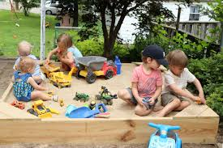
MEMBERSHIP
Strategy 2: Build A Membership Team

Slide 25
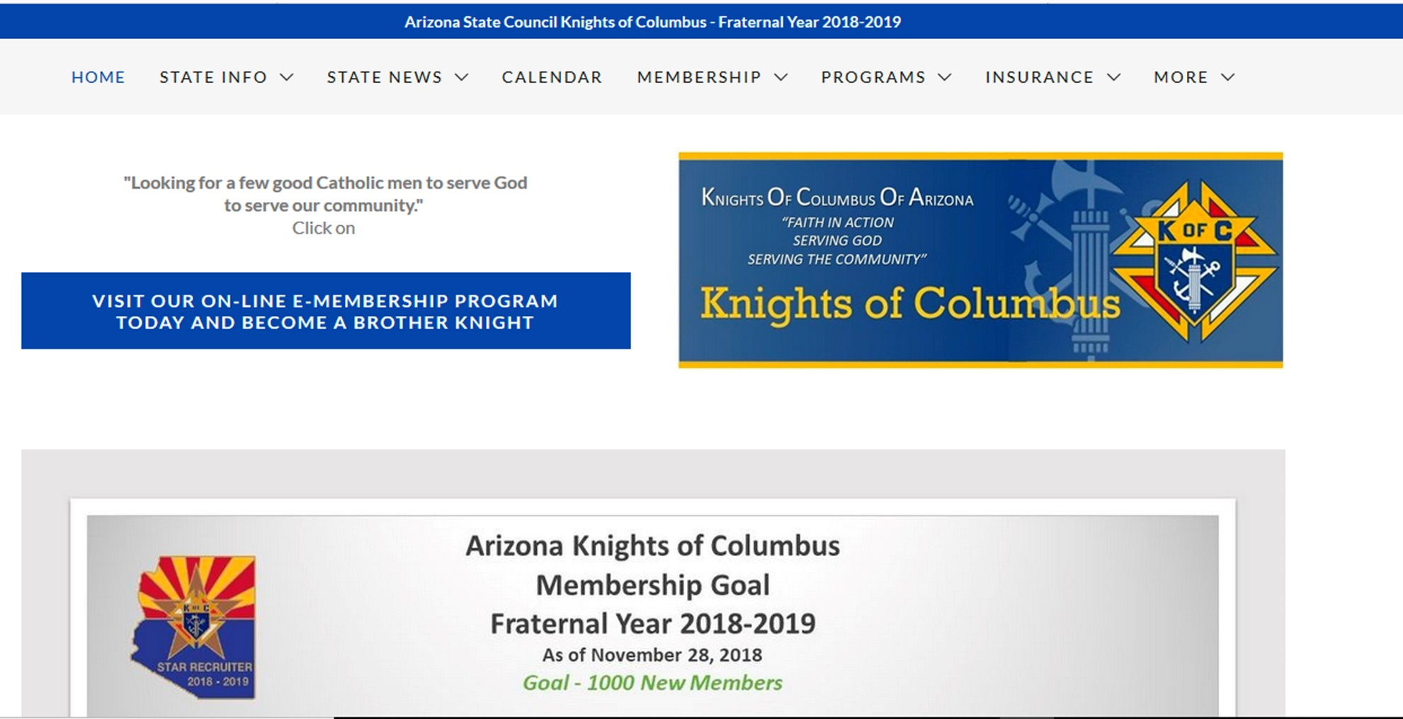
MEMBERSHIP
Strategy 3: Make-over State Web Site

Slide 26
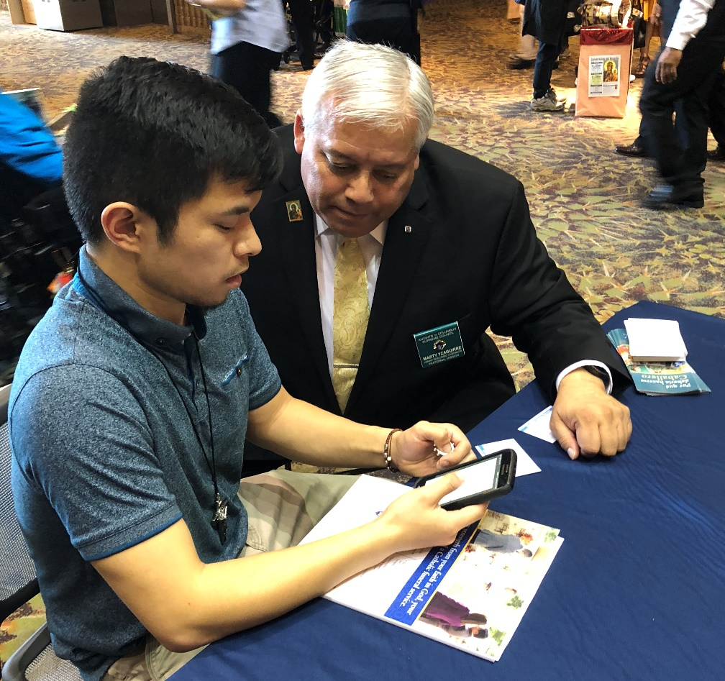
MEMBERSHIP
Strategy 4: Promote eMembership
NEW eMEMBERS
JUL18 5
AUG18 16
SEP18 12
OCT18 11
NOV18 10
Y-T-D TOTAL: 55

Slide 27
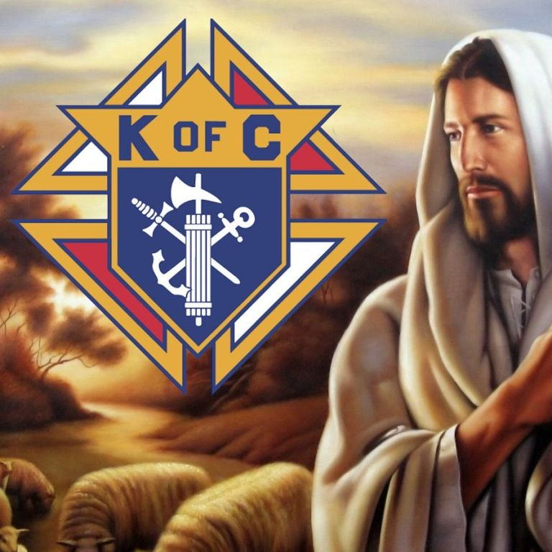
MEMBERSHIP
Strategy 5: Implement Shepherd Program

Slide 28
MEMBERSHIP
Strategy 6: Practice AMP Philosophy
ALTAR
SUPPORT
MEMBERSHIP
GROWTH
PROGRAMS

Slide 29
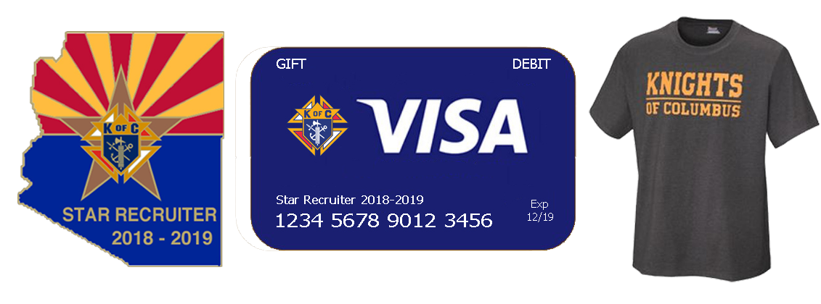
MEMBERSHIP
Strategy 7: Improve Incentives

Slide 30
MEMBERSHIP
Supreme Circle of Honor-Membership Goals
Intake Goal: 950/355
Star Councils: 26/1 Qualifier
(#17036 at 325% Membership & 100% Insurance)
New Council Development: 2/1
Reactivations: 3/1

Slide 31
MEMBERSHIP
00863 01158 01189 01729
03395 03419 04260 04426
04737 05313 05471 05542
06612 06788 07114 07243
07306 07513 07562 07646
07912 07949 08090 08091
08105 08358 08540 08813
09312 09380 09446 09485
09801 09995 10915 11116
11858 11912 12144 12338
12375 12708 12737 13024
13435 13497 13568 14033
14089 14139 14157 14185
14340 14583 14610 14621
15497 15576 15704 16776
ACTIVE ARIZONA COUNCILS
WHICH HAVE NOT RECORDED
ANY MEMBERSHIP ADDITIONS
DURING THE CURRENT
FRATERNAL YEAR…
62

Slide 32
MEMBERSHIP
DISCUSSION:
BEST PRACTICES

Slide 33
MEMBERSHIP
Remember to…
ABR!

Slide 35
2018-19 AZ Jurisdiction ACTION Plan – A review
Mario Vassallo
State Secretary
Cell: 520-481-1250
Email: statesecretary@kofc-az.org

Slide 36
Action Plan Flowdown
Supreme Plan
…
ALASKA
ALBERTA
ARIZONA
WYOMING
…
District 1
District 2
District 3
District 33
…
…
…
Council 7646
Council 8854
Council 14121
Council 15325

Slide 37
General Goals – FY 2018-19
Membership Goals
950 new members
Be at 55% (520) new members by Dec 31
We’re currently at 37.4% (355)
Offer incentives for Councils, Recruiters & DDs
3 in 3 Church Drives
Fast Start Council & Recruiter Incentive
Star Recruiter Incentives
Achieve
26 Star Councils
Serious stumbling blocks: Safe Environment Training & New SP-7
4 Star Districts
2 All-Star Districts

Slide 38
General Goals – FY 2018-19
New Council Development
Supreme Goal: 2 Council
Council 1729 (Somerton)
Online Membership/Young Adult Focus
100 new E-members during FY 18-19
55 new E-members
Supreme Goal: 14 e-members per month
Promote the KofC among Millennials
Encourage E-membership at Council level
Expand recruitment efforts among
RCIA Groups
Life Teen
College Campuses

Slide 39
General Goals – FY 2018-19
Hispanic/Ethnic Membership Growth
Convert 3 of the 11 NCD targets into Hispanic Councils
Council 1729 (Somerton)
Holy Family Parish – Phoenix
San Luis – Membership Drives to start soon.
Reactivating Inactive Spanish Speaking Councils
Council 6858 (St. Margaret Mary Parish, Tucson)
Re-invigorate the Round Table Program to aid HD

Slide 40
General Goals – FY 2018-19
Training & Leadership Development
DD Training at State Org & Mid-Year Meetings
June 2018 Org Meeting
Nov-Dec 2018 Mid-Year Meeting
Regional Meetings
4 meetings held in October (2 – Tucson; 2 – Phoenix)
We plan on having others in the Spring 2019
Council Level Training by State Membership Team
Held during June State Organization Meeting
Held during Nov-Dec State Mid-Year Meeting

Slide 41
General Goals – FY 2018-19
Activities through our Faith In Action Program
Ultrasound Initiative
Raised over $13,500 since July 1, 2018
In the process of purchasing one Ultrasound Machine
Well on our way to buy a second
ARC - Increase Council Participation
72 Councils participated in the 2018 ARC
About the same participation as previous years
Establish Corporate Mass & 5th Sunday Rosary Program at each active Council
PWID Program – Increase Council Participation
Councils are still sending in their forms & checks
State Charity Raffle – Increase Council Participation

Slide 42
General Goals – FY 2018-19
Vivat Jesus!

Slide 43
DD Reimbursement

Slide 44
DD Reimbursement
Missing/wrong:
Council #
Name, address
Not signed
No District #
All documents in PDF format- no exceptions
Cancelled Checks -are not the receipts
Purpose of the Council visit

Slide 45
Action Plan

