Slide 1
Mid-year meetiing
Arizona State Knights of Columbus
Saturday, December 1
Sierra Vista, AZ
Hosted by Councils 4584 & 10799

Slide 2
Rosary
Apostles Creed
I believe in God, the Father Almighty, Creator of heaven and earth; and in Jesus Christ, His only Son, our Lord:
Who was conceived by the Holy Spirit, born of the Virgin Mary;
suffered under Pontius Pilate, was crucified, died and was buried. He descended into hell;
the third day He rose again from the dead;
He ascended into heaven, is seated at the right hand of God the Father Almighty; from thence He shall come to judge the living and the dead.
I believe in the Holy Spirit, the Holy Catholic Church, the communion of Saints, the forgiveness of sins, the resurrection of the body, and life everlasting. Amen.

Slide 3
Rosary
Joyful Mysteries
  Annunciation
  Visitation
  Nativity
  Presentation
  Finding of Jesus in the Temple

Slide 4
Salve Regina
Hail Holy Queen, Mother of Mercy, our life our sweetness and our hope. To thee do we cry, poor banished children of Eve; To thee do we send up our sighs, mourning and weeping in this valley of tears. Turn then, most gracious advocate, thine eyes of mercy toward us and after this our exile show unto us the blessed fruit of thy womb, Jesus.
O clement, O loving, O sweet Virgin Mary!

Slide 5
Let us pray.
O God, whose only begotten Son, by his Life, Death and Resurrection, has purchased for us the rewards of eternal life, grant, we beseech thee, that we who meditate on these mysteries of the most holy Rosary of the blessed Virgin Mary, may imitate what they contain and obtain what they promise, through the same Christ our Lord. Amen.

Slide 6


Slide 7
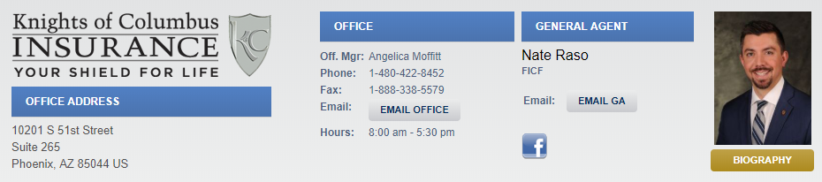
General Agent
www.azknights.com

Slide 9
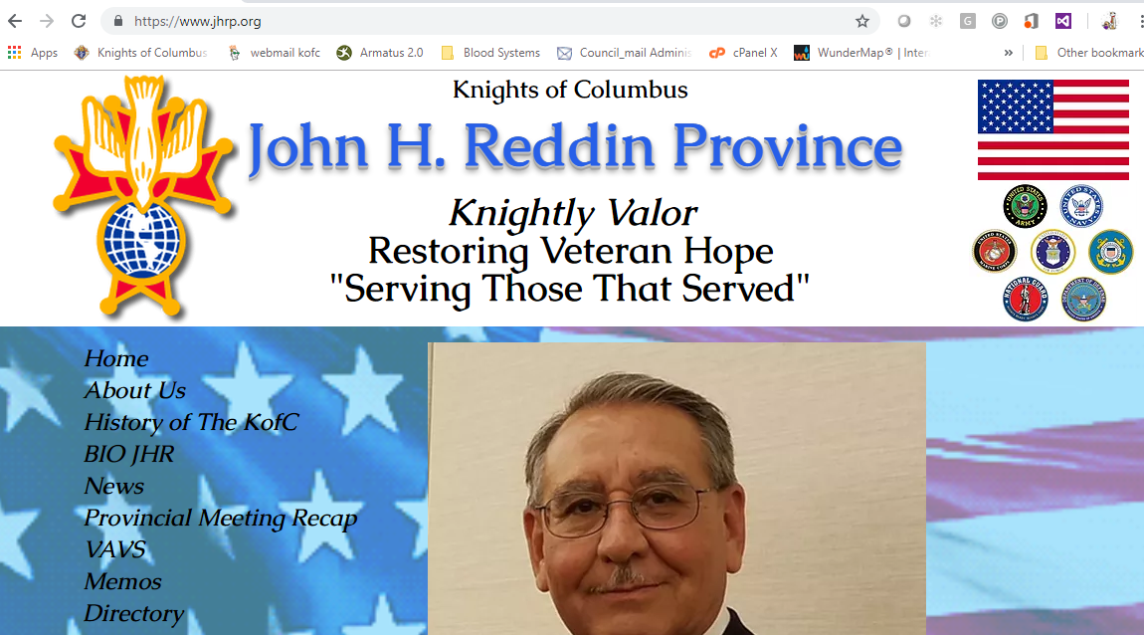
Fourth Degree
New Uniform
Next Exemplification:
  16 February – Gilbert
  June 2019 – Diocese of Tucson
New website
http://jhrp.org

Slide 10
Fourth Degree
Saint Joseph’s Youth Camp
Restoring Veterans Hope
  Looking for donations for next year
    Donations from Councils, Assemblies or personnel donations gladly accepted
    Make checks payable to AZ District Master
    Send donations to:
      Bryant Sayers
      AZ District Master
      719 Norraine Lane
      Huachuca City AZ 85616

Slide 12
Arizona state charity raffle
2018 Mid Year Meeting
Sierra Vista, AZ

Slide 13
State Charity Raffle
Dennis Sullivan - Director
denpsulli@aol.com
480-201-5556
Richard Armanini – Co-Director
REArmani@cox.net or richard.armanini@gmail.com
480-818-1774

Slide 14
State Charity Raffle
2018 resulted in $343,782 in ticket sales.
  A 2% over 2017.
2019 goal $355,000 - a 3.2% overall increase
Raffle has grown tremendously over the past years. Thanks to each councils individual efforts and strong leadership.
Success comes from all across the state.
Small Councils contribute in a big way!!!

Slide 15
AZ State Charity Raffle
# Councils with less than 50 members | Total Sales -50 | Members in – 50 councils | Average sold per council - 50 | Sales per member
20 | $50,015 | 905 | $2,501 | $55
# councils over 50 members | Total Sales +50 | Members in + 50 councils | Average sales per council + 50 | Sales per member
93 | $293,785 | 15,895 | $3,159 | $18
Total council that sold tickets | Total Sales | Total members | Average sales - state councils | Sales per member
113 | $343,780 | 16,800 | $3,042 | $20
Smaller Councils CONTRIBUTE in a big way , but it take ALL Councils to make this happen!!!

Slide 16
AZ State Charity Raffle
All CASH Prizes for 2019:
  1st Prize: $10,000 2nd Prize: $7,000
  3rd Prize: $5,000 4th Prize: $3,000
  5th Prize: $2,000 6th Prize: $1,000
  7th Prize: $500 8th Prize: $500
  9th Prize: $500 10th Prize: $500
Winners will be notified within 2 – 3 days and tentative winners list will be posted on the website by Thursday 5/23/19

Slide 17
2018 Charity Raffle - Disbursements

Slide 18
AZ State Charity Raffle: New Incentive Plan:
In Incentive Plan should be a source of encouragement to increase sales / productivity.
New for 2019 is a true incentive plan based upon minimum sales and minimum sales increases.
The incentive is calculated from the State’s half of total sales (the state’s 50%) and can be used to help councils with their expenses, assessments and/or recognition of individual efforts (shirts, hats, plaques, certificates, etc.). No cash may be given to any individual or individuals.
The incentive check is mailed to the council Financial Secretary.
The incentive plan requires a minimum council sales of $1,000 to be eligible.

Slide 19
AZ State Charity Raffle – Incentive Plan
Council with 2018 sales from:
  $1,000 to $5,000 must increase by 10% to earn the 10% charity $ incentive
  $5,001 to $10,000 must increase by 7.5% to earn the 10% charity $ incentive
  $10,001 to $15,000 must increase by 5% to earn the 10% charity $ incentive
  $15,001 and above must increase by 2.5% to earn the 10% charity $ incentive

Slide 20
AZ State Charity Raffle
Council Participation incentive Plan:
  Your charity(s) still gets 50% of your council’s sales dollars.
  Maximum of 5 charities (Please consider reducing to 3 maximum).
  Your Council decides how to use the incentive dollars it earns.
  Councils that meet their sales goals get to share in the success of their charity fund raffle campaign.

Slide 21
AZ State Charity Raffle
Example:
Council | Council Sales $ | % Increase required | Minimum 2019 Sales Goal | Charity(s) Dollars | 10.0% of Council Charity Sales $
xyz | $1,000.00 | 10% | $1,100 | $550 | $55.00
abc | $5,001.00 | 7.5% | $5,377 | $2,689 | $268.90
qrs | $10,001.00 | 5% | $10,501 | $5,250.50 | $525.05
stu | $15,001.00 | 2.5% | $15,376 | $7,688.01 | $768.80
Examples:

Slide 22
AZ State Charity Raffle
Raffle Sales workshops will be available and a new electronic meeting tool is in the works to allow group or individual viewing of the workshop materials.
Raffle Director will travel to YOU physically or electronically (your choice) to help conduct a sales workshop.
Webinars (4 programs) to be available on state website KofC-AZ.org
Raffle Sales Guide contains great INFORMATION and SALES TOOLS that can be key to the success for a Council’s campaign.

Slide 23
AZ State Charity Raffle
Tickets, two sided Posters and sales guides are packed by council and wrapped by district.
Please make sure to take yours with you and distribute to your councils by the end of January. Please do not drop them in the church office unless you make arrangements for the Grand Knight or Raffle Chairman to pick them up in the office.
Posters and sales guides will also be posted on the website for your councils to print as needed.
Lastly, the AZ K of C thanks you and your councils for your efforts for the 2018 AZ State Charity Raffle and my personal thanks for your cooperation and enthusiasm for this yearly charity fund raising campaign.

Slide 24
Successful Charity Raffle Tip:
#1 Key to success: Mail 2 – 3 books of tickets to every K of C Brother in your Council!!!!!!
Top Councils routinely do this every year and succeed!
“The only place where success comes before work is in the dictionary.” Coach Vince Lombardi

Slide 25
Future of the Charity Raffle Program
Sales Goal of $500,000 by 2022
How about a top cash prize of $25,000? If so, how can we get there?
NEW RAFFLE DIRECTOR needed by 2021 campaign…need to allow training for the program. Please contact me if interested.

Slide 26
Vivat Jesus!

Slide 28
Arizona Rosary Celebration
44th Annual
October 19 & 20, 2019
ORGANIZATION
EXECUTIVE COMMITTEE
State Chairman: Larry Costanzo, FSM, FSW, PSD
        lcostanzo1@cox.net
  State Co-Chairman: Larry Becker, PSD
        azlarry@cox.net
CO-CHAIRS PHOENIX:
  Danny Haywood dhaywood65@gmail.com
  Greg Mattingly gmattingly3855@live.com
  CO-CHAIRS TUCSON:
    Al Tucker altucker33@yahoo.com
    Frank Islas frank.tucsonazrosary@gmail.com
    Karen McEwen kmcewen@seastucson.org

Slide 29
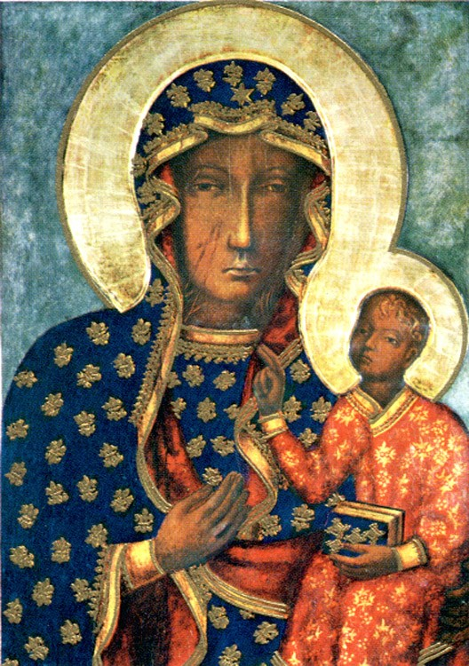
Arizona Rosary Celebration
44th Annual
October 19 & 20, 2019
This past October we honored Mary under her title of:
Our Lady of Czestochowa

Slide 30
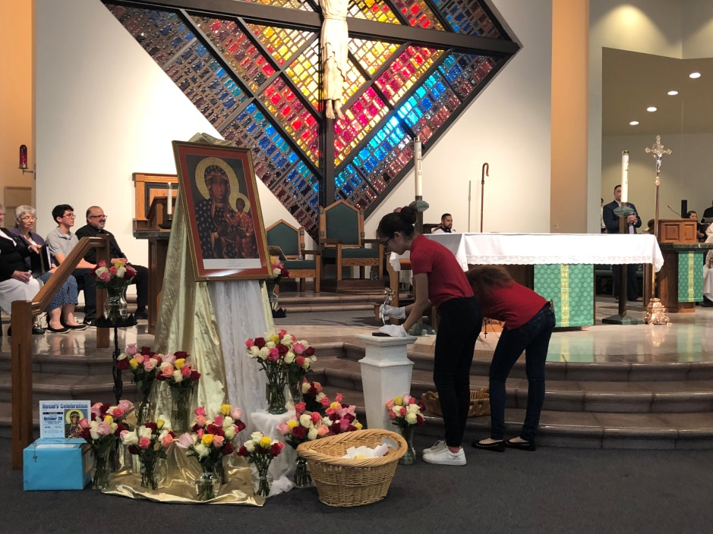
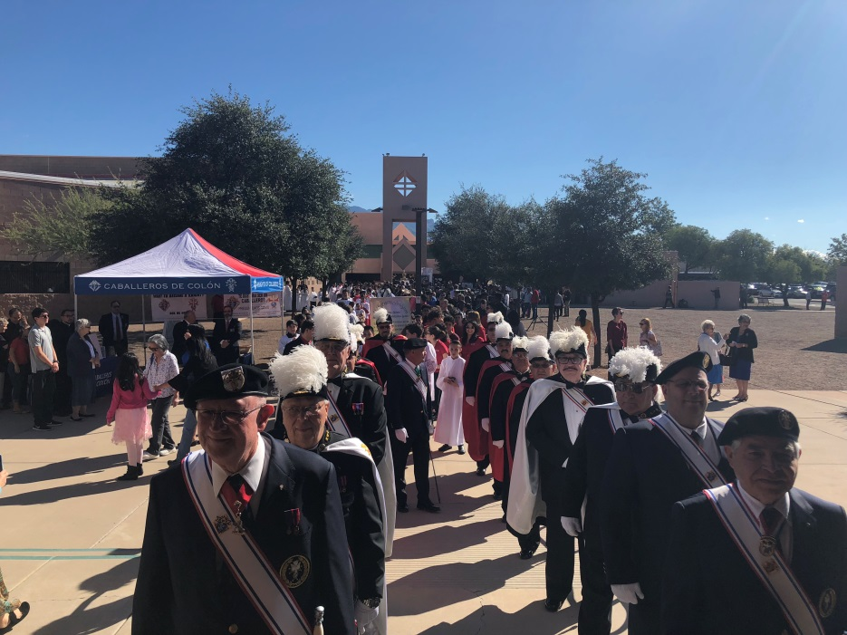
Arizona Rosary Celebration
44th Annual
October 19 & 20, 2019
TUCSON, ARIZONA
Saturday, October 20, 2018
10:00 a.m. to 12:15 p.m.
Saint Elizabeth Ann Seton Catholic Church
Most Rev. Edward Weisenburger
Bishop of Tucson, Presiding
Keynote Speaker:
  Most Reverend Patrick Zurek
Attending: 1700
Yuma Attendance: ?

Slide 31
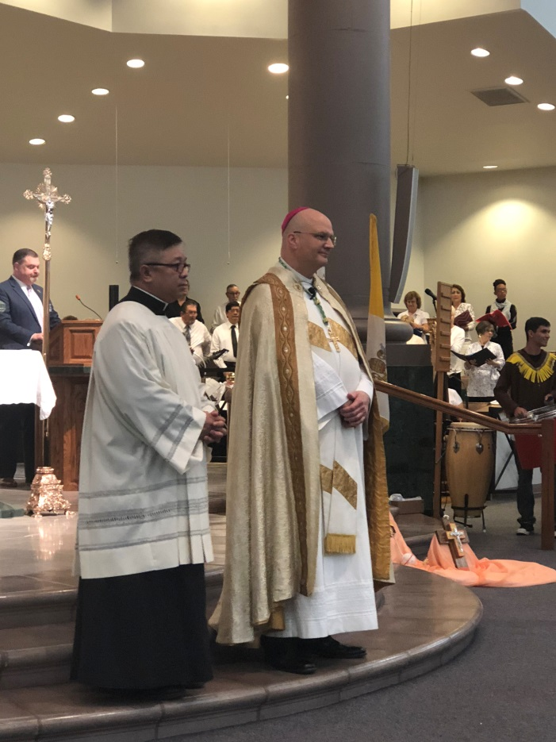
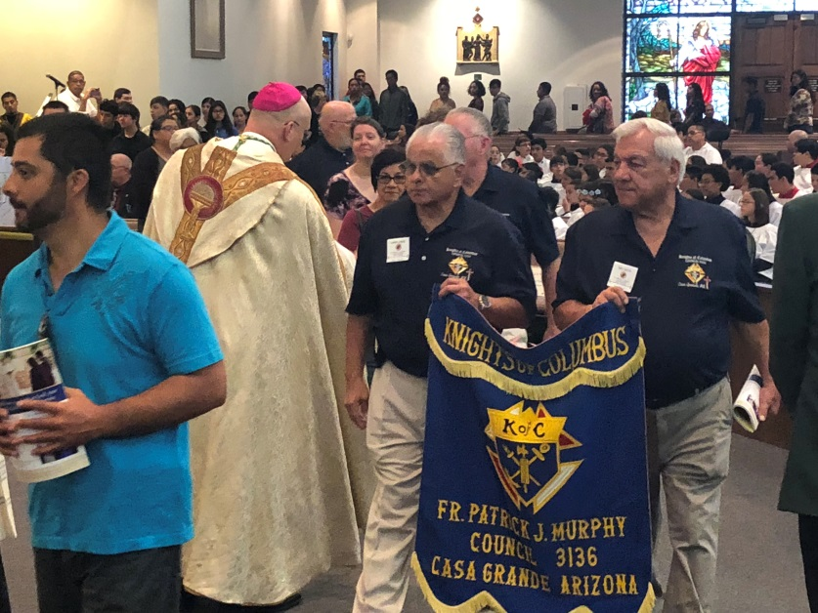
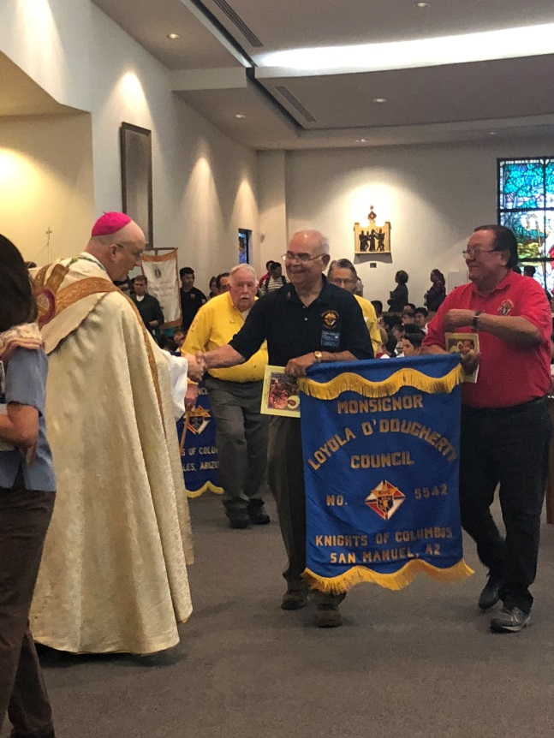
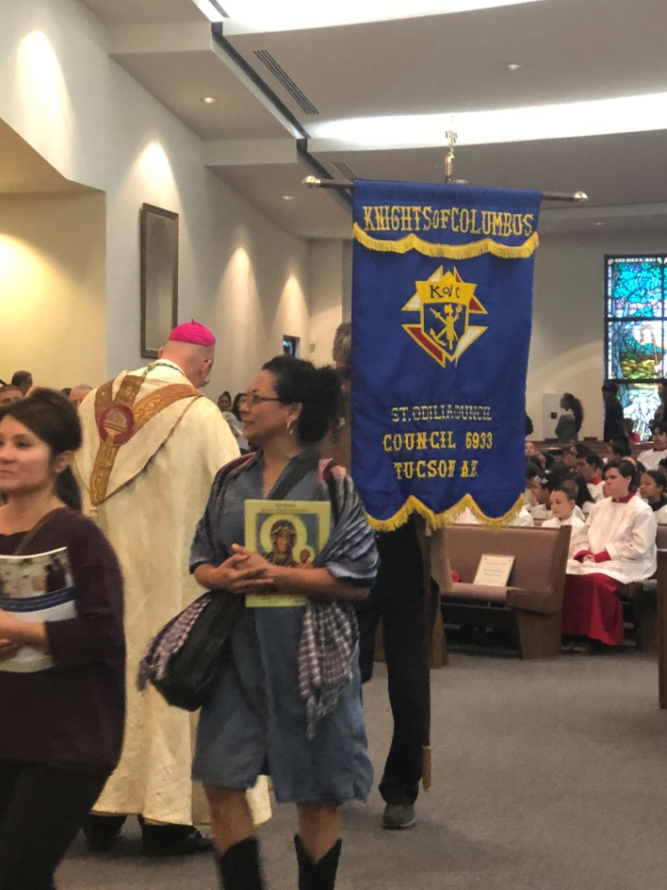
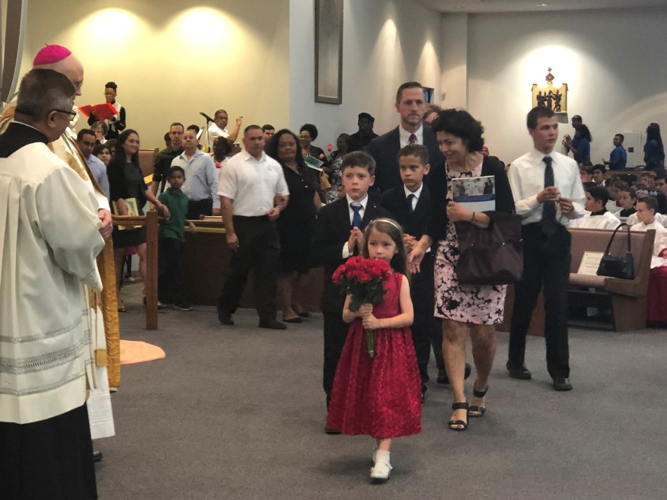
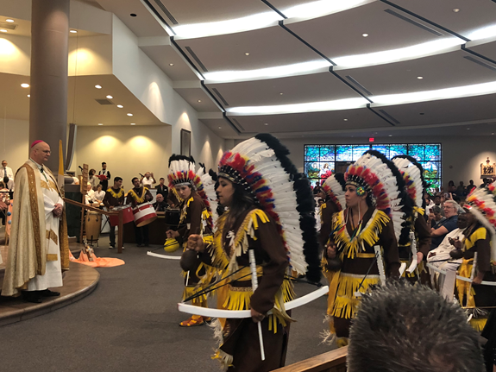

Slide 32
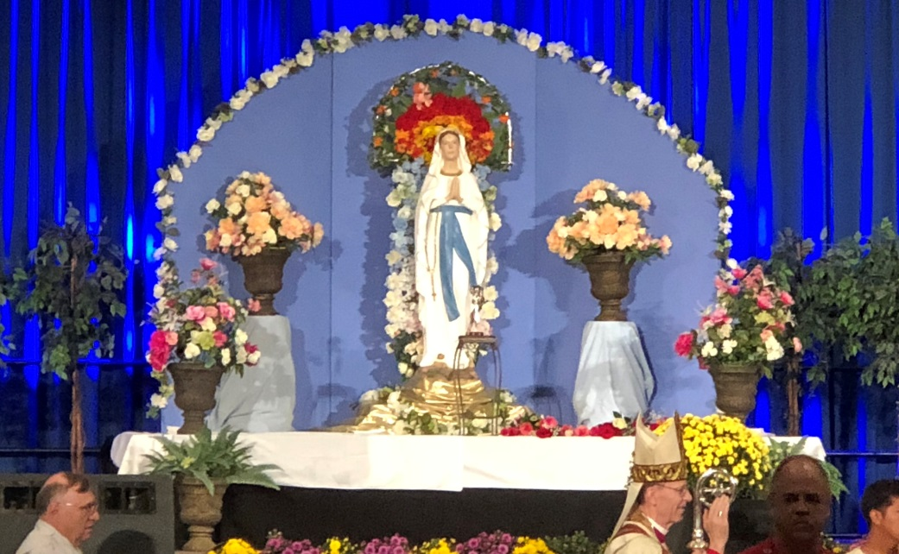
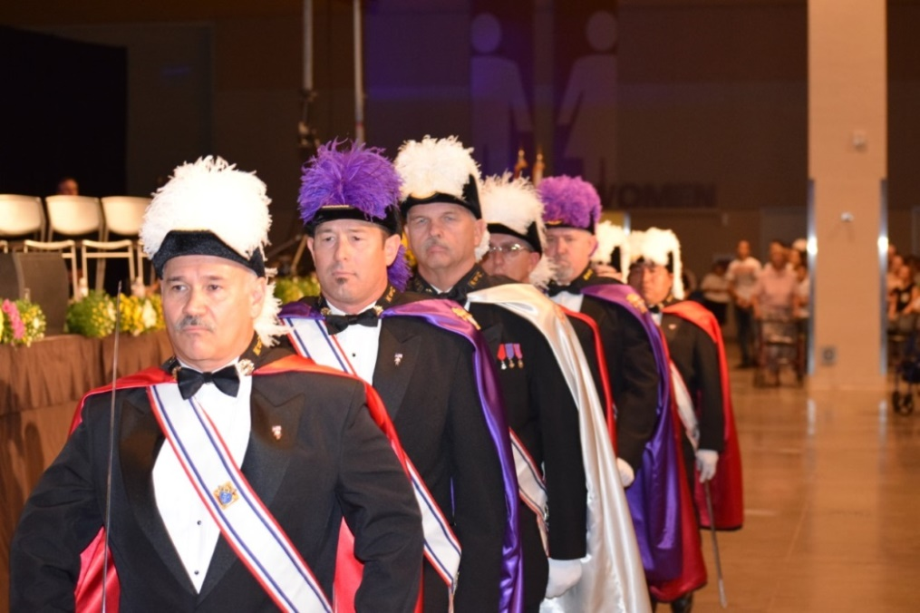
Arizona Rosary Celebration
44th Annual
October 19 & 20, 2019
PHOENIX, ARIZONA
Sunday, October 21, 2018
2:00 p.m. to 4:15 p.m.
Most Rev. Thomas J. Olmstead
Bishop of Phoenix Presiding
Keynote Speaker:
  Most Reverend Patrick Zurek
Attending: 4500

Slide 33
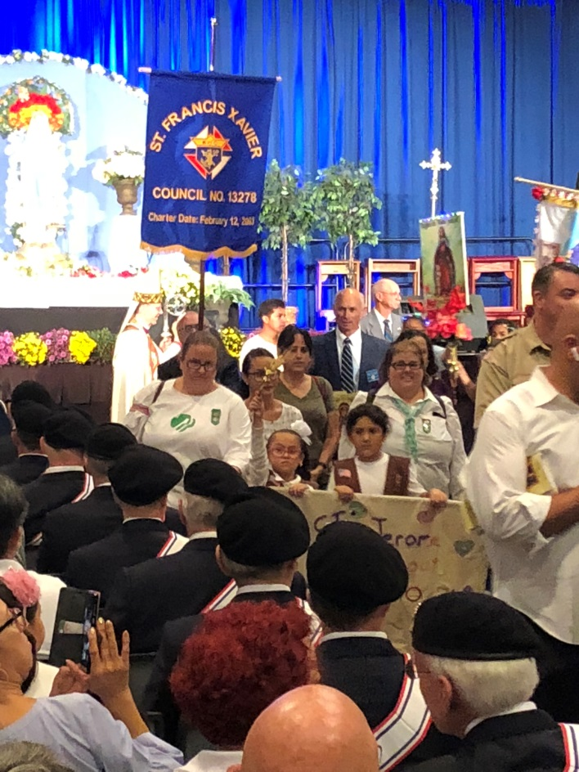
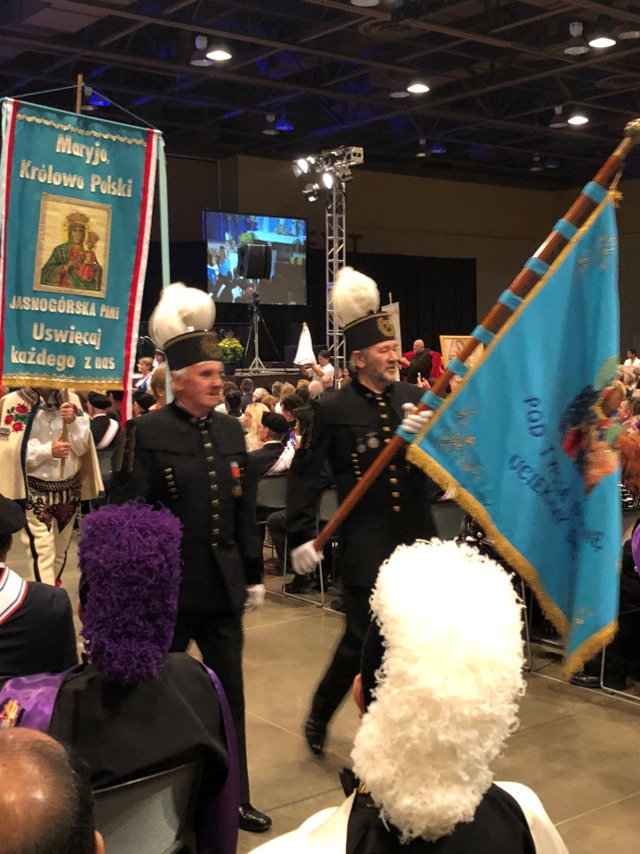
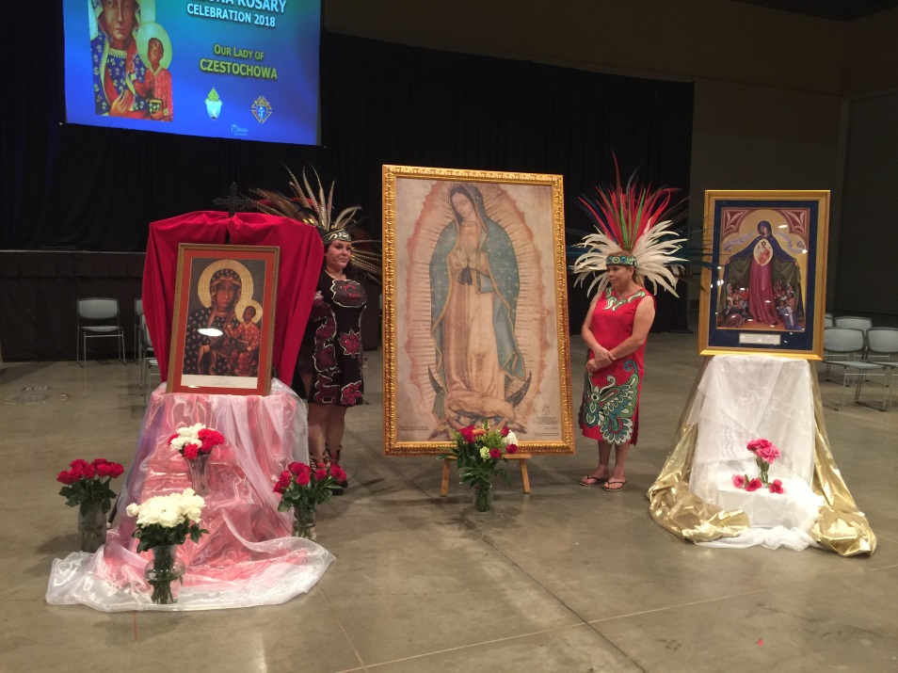
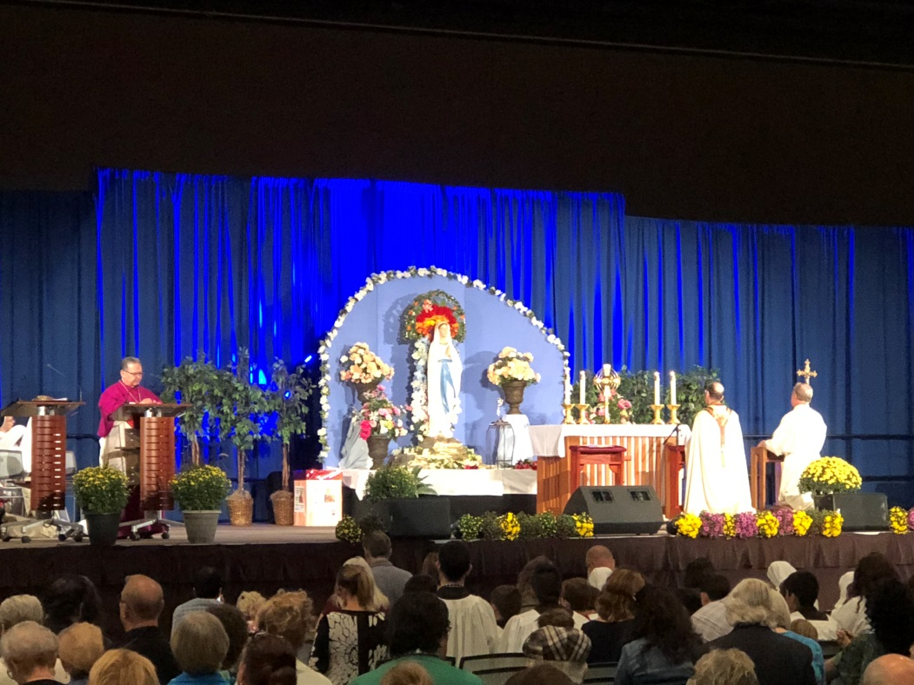
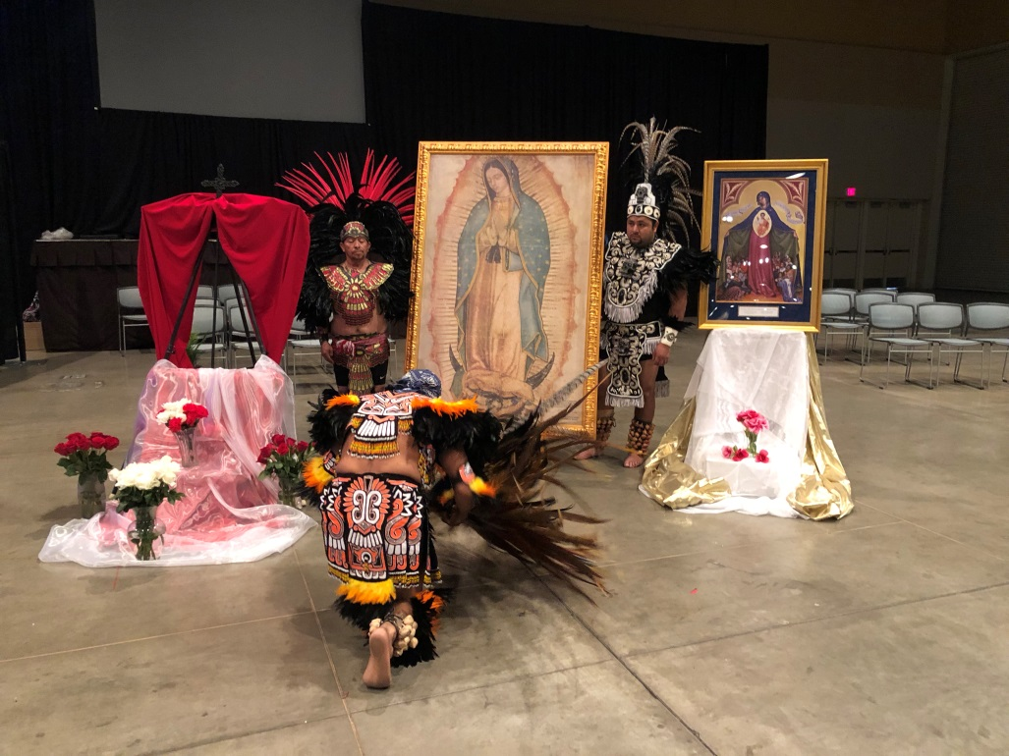

Slide 34
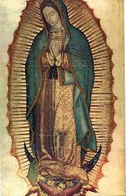
Arizona Rosary Celebration
44th Annual
October 19 & 20, 2019
ARIZONA ROSARY CELEBRATION 2019
We will honor Mary under her title of:
Our Lady of Guadalupe
Celebrating the Diocese of Phoenix 50th Anniversary as their Patroness
* The image to the Right is not the approved image for 2019

Slide 35
Arizona Rosary Celebration
44th Annual
October 19 & 20, 2019
We need your help!!
We need your assistance:
  Prayers
  Assistance on committees
  Councils to step up as Backups for all chairs (Tucson/Phoenix)
  We need an Assigned Rep for each Council in the State:
    Will pass on news on happenings of the Rosary Celebration to the Councils and your Parishes.
  We need our councils to be more involved in promoting ARC in each of our parishes!
    This is our commitment in “Building the Domestic Church”
  Help sell Ads and Solicit Donors from our local communities, back of our parish bulletins is a great source.
  Every council should have Rosary Celebration in budget

Slide 36
Arizona Rosary Celebration
44th Annual
October 19 & 20, 2019
PROGRAM BOOK
Chairman Rick Garrison
Primary source of income
  No outside funding from diocese/grants – only ad sales
What we need:
  Ads and donors from many sources:
    Parishes, Parish bulletin advertisers, barber shop, restaurants, stores, doctors, individual donors, patrons:
    If businesses and other supporters do not want to advertise, they can be take part in our Donor Program for $100 they will still be recognized in the book
    (No insurance and must be pro-life)
    72 of 146 Councils (49%) / 30 of 42 Assemblies (71 %) participation
  WE NEED ADS FROM EVERY COUNCIL AND ASSEMBLY!!
  We now have a 501(c)(3) designation so donations are
  tax deductible according to law

Slide 37
Arizona Rosary Celebration
44th Annual
October 19 & 20, 2019
AVERAGE ANNUAL EXPENSES
Program Book/Flyers Printing $21,448.00
Event Expenses: Phoenix/Tucson $53,842.00
  (Convention Center, Audio Visual, Facilities, pins, meals, etc)
  Total Expenses $77,490.00
  Total Income $78,402.00
  Net $ 911.00
  We need $7,000 to reserve the Convention Center

Slide 38
Arizona Rosary Celebration
44th Annual
October 19 & 20, 2019
AD SALES
  Every Council & Assembly should pick a Ad Sales chairman
  Councils & Assemblies should have an ad expensed in every years budget
  Begin to sell NOW to Businesses, Friends, Organizations, in order to get this advertising budgeted in their 2019 budgets
  Program Book Ad Cutoff Date: September 6, 2019
  EVERY COUNCIL AND ASSEMBLY ACTIVE!

Slide 39
Arizona Rosary Celebration
44th Annual
October 19 & 20, 2019
As Knights we devote ourselves to the Blessed Mother in all her titles and the Rosary through our First Degree, lets put our words into action Gentleman!
LETS BE THE LEADERS IN 2019!

Slide 40
Arizona Rosary Celebration
44th Annual
October 19 & 20, 2019
Flyers and information about AZ Rosary Celebration will on our new web site and are updated as needed.
Web Site:
www.AzRosary.net
Email:
azrosary@yahoo.com

Slide 42
Vivat Jesus!

Slide 44
Ultrasound Initiative

Slide 45
Office of Youth protection compliance
Tom Kato
Arizona State Advocate

Slide 46
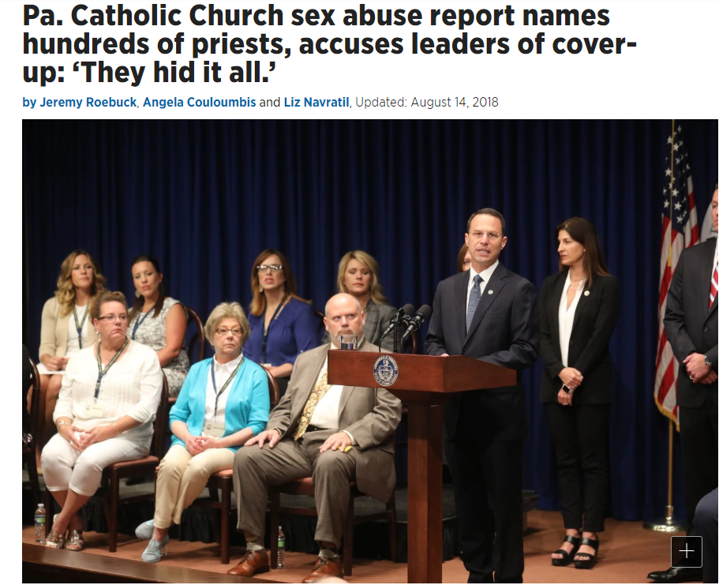
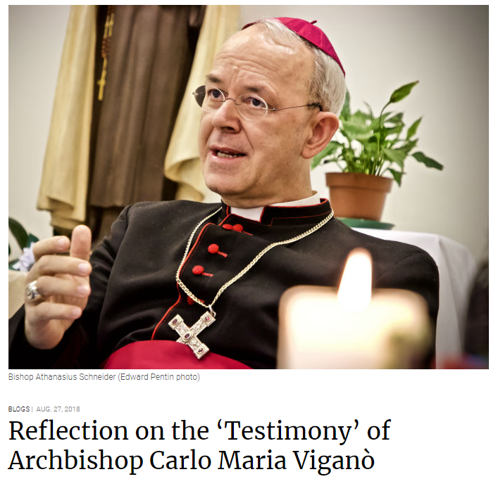
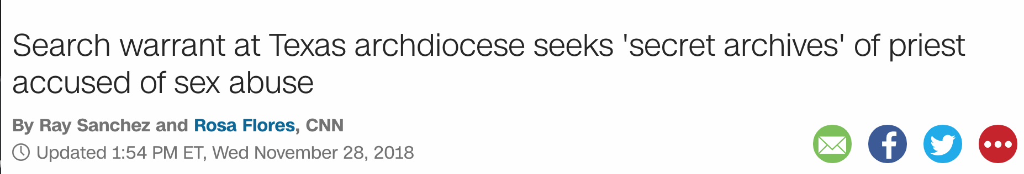
Why compliance?

Slide 47
Steps to follow
File Report of Officers Chosen for the Term (185) – Should be done online!
File Service Program Personnel Report (365) – Should be done online!
VALID EMAIL ADDRESS IS MANDATORY!
  Program Director
  Faith Director
  Community Director
  Family Director
    All align with Faith in Action!
Grand Knights and Directors will receive email from Praesidium Armatus to take classes

Slide 48

Why needed?

Slide 49
Where we stand
98 Grand Knights in Compliance
  26 not in compliance
  27 Councils - No 185 filed
57 Program Directors in Compliance
  67 not in compliance
46 Community Directors in Compliance
  78 not in compliance
49 Family Directors in Compliance
  75 not in compliance
30 Councils in full compliance
  94 not in compliance

Slide 50
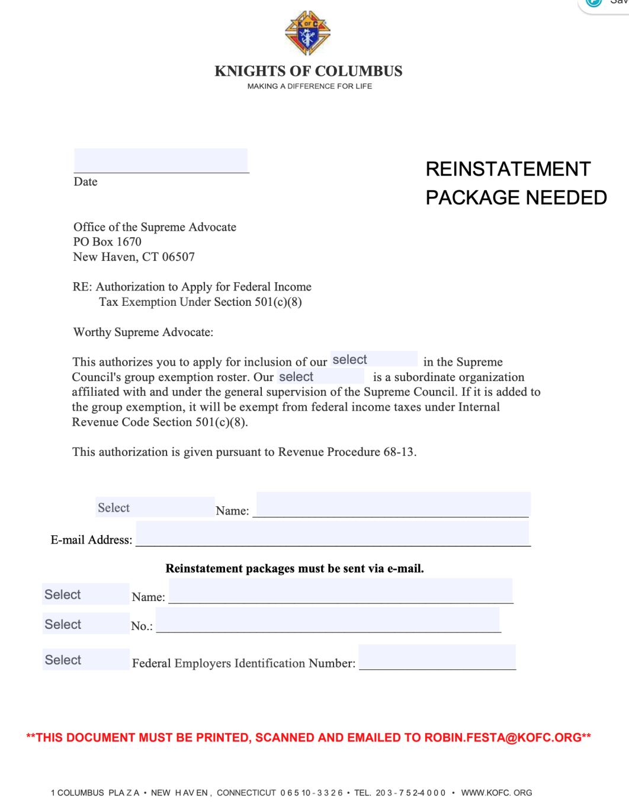
Taxes and EIN
Councils are a 501(c)(8)
Councils who have NOT filed for 3 consecutive years will have their status revoked.
Fill out Supreme Council EIN Authorization Form
https://www.kofc.org/au/apps/oo/cm/en/odr/resources/EIN_Authorization_Letter.pdf

Slide 51
Form 990
990-N (e-Postcard)
  Annual Gross Receipts up to $50,000
Form 990-EZ
  Annual Gross Receipts up to $200,000
Must be filed by November 15 if following Fraternal Calendar

Slide 53
Breakout Sessions
District Deputy Responsibilities
Council Action Plans Review
District Action Plans
Membership Growth Plans

Slide 54
State Officer Reports
State Warden
State Advocate
State Treasurer
State Secretary
Immediate Past State Deputy
State Deputy

Slide 55
Angelus
Leader: The Angel of the Lord declared unto Mary.
All: And she conceived of the Holy Spirit.
All: Hail Mary…..
Leader: Behold the handmaid of the Lord.
All: Be it done unto me according to thy word.
All: Hail Mary…..
Leader: And the Word was made Flesh.
All: And dwelt among us.
All: Hail Mary…..
Leader: Pray for us, O Holy Mother of God.
All: That we may be made worthy of the promises of Christ.
Leader: Let us pray.
All: Pour forth, we beseech thee, O Lord, Thy grace into our hearts, that we, to whom the Incarnation of Christ, thy Son, was made known by the message of an Angel, may by His Passion and Cross be brought to the glory of His Resurrection, through the same Christ our Lord.
All: Amen.

Slide 57
eMembership
Larry Becker, PSD
State Online Membership Chairman
480.760.5122
azlarry@cox.net

Slide 58
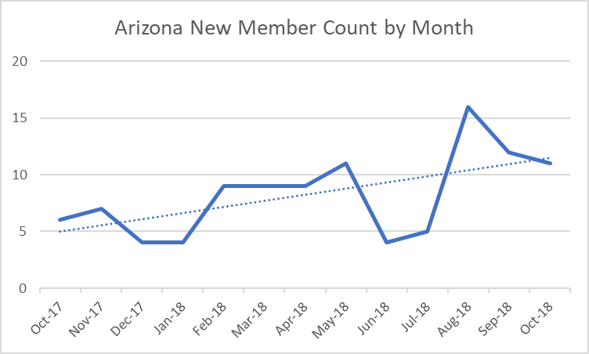
eMembership
As of November 28, 2018
2018-19 Fraternal Year Arizona Intake = 55
Total Arizona Online Members = 117
Average Age = 47 years old

Slide 59
eMembership
Conversion Rate to Traditional Councils = 37 (34%)
This should be 75%
There are 70 Online Members waiting to be invited join a traditional council!
Grand Knights & Financial Secretaries find available Online Members on the “Prospect” tab, on the Supreme website’s Officers Online page.

Slide 60

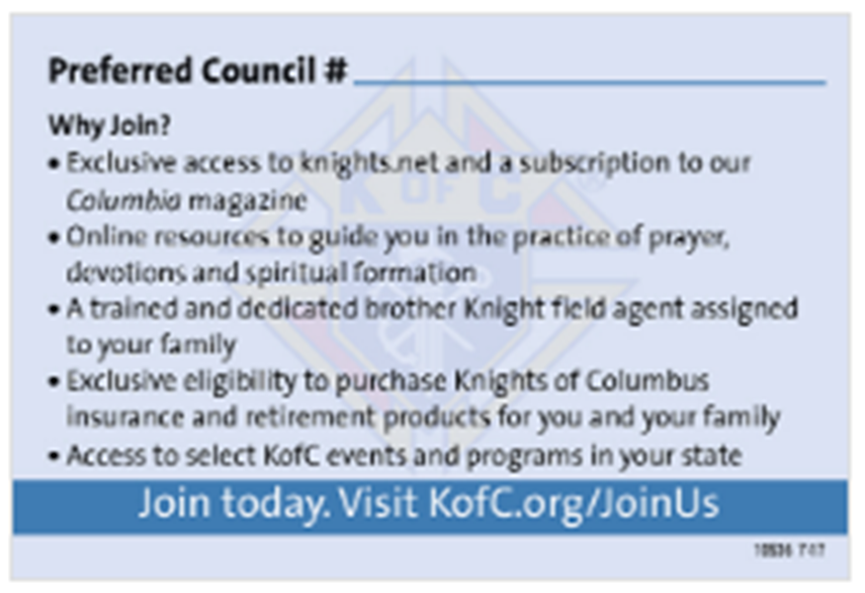
eMembership
The “Join Us” Business Card #10536 is one of the most powerful recruiting tools in your toolbox!
It works 24/7, never goes to sleep, & has the information for your prospects to join your council!
Proposers write their member number on the card so they will receive their VIP points & incentives!
Councils will receive “New Member” credit & possibly new “Insured” member credit, as well!
Every council member should have 10 pre-filled “Join Us” business cards with them at all times to recruit new members into their council!

Slide 61


eMembership
#10536
#10537
As of mid-December 2018, all the online Membership promotional materials are available in English, Spanish, & French!
The Online Membership Registration Portal is also available in English, Spanish, & French!

Slide 62

MEMBERSHIP
Arizona Knights of Columbus
Mid-Year Meeting
November 30-December 2, 2018
Sierra Vista, Arizona

Slide 63
MEMBERSHIP
Kenneth White-Membership Director
membership@kofc-az.org
or
kennethallenwhite@yahoo.com
480-720-9314

Slide 64
MEMBERSHIP
00863 01158 01189 01729
03395 03419 04260 04426
04737 05313 05471 05542
06612 06788 07114 07243
07306 07513 07562 07646
07912 07949 08090 08091
08105 08358 08540 08813
09312 09380 09446 09485
09801 09995 10915 11116
11858 11912 12144 12338
12375 12708 12737 13024
13435 13497 13568 14033
14089 14139 14157 14185
14340 14583 14610 14621
15497 15576 15704 16776
NUMBER OF ACTIVE ARIZONA
COUNCILS WHICH HAVE NOT
RECORDED ANY MEMBERSHIP
ADDITIONS DURING THE
CURRENT FRATERNAL YEAR…
62

Slide 65
MEMBERSHIP
Supreme Circle of Honor-Membership Goals
Intake Goal: 950/*355
Star Councils: 26/1 Qualifier
(#17036 at 325% Membership & 100% Insurance)
New Council Development: 2/1
Reactivations: 3/1
*Arizona currently ranks #12 in The Order for Intake at 37.37% to Goal

Slide 66

MEMBERSHIP
2018-2019 Membership Game Plan Review
Memberships plan this year
involves 7 Strategies:
Increase Communication
Build a Membership Team
Makeover State Website
Promote eMembership
Implement Shepherd Program
Practice AMP Philosophy
Improve Incentives

Slide 67




MEMBERSHIP
Strategy 1: Increase Communication
@KofCMembership
AZ DIRECTORY
INCREASED DD
ATTENDANCE
KOCOA
MONTHLY
NEWSLETTER

Slide 68
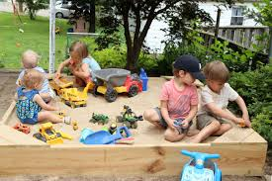
MEMBERSHIP
Strategy 2: Build A Membership Team

Slide 69
MEMBERSHIP
Who is the Membership Team?

Slide 70

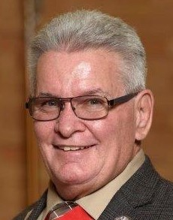
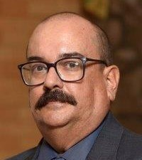
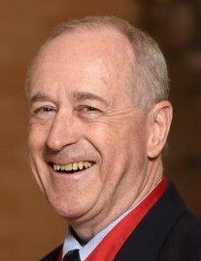
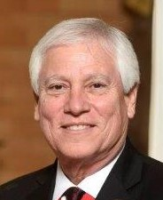
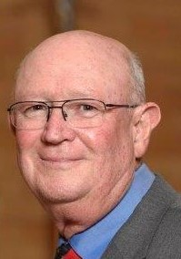
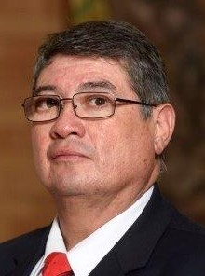
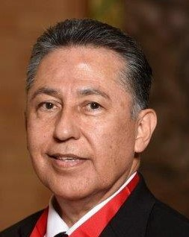
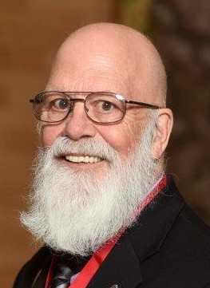
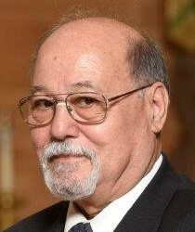
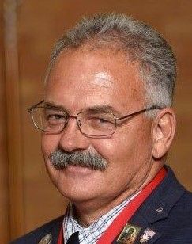
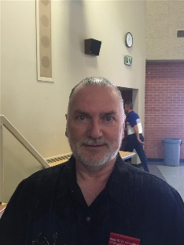
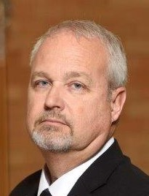
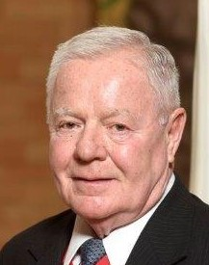
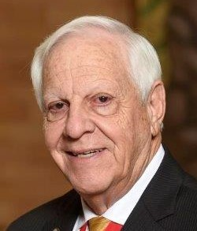
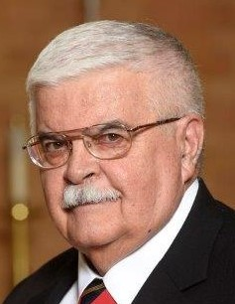
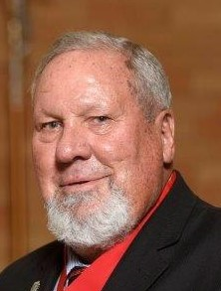
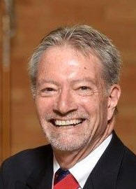
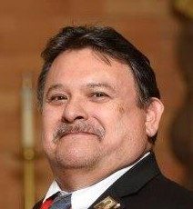
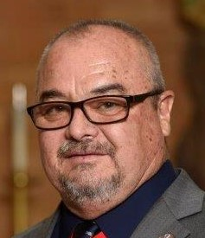
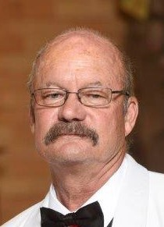
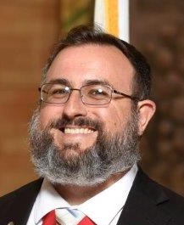
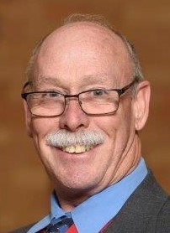
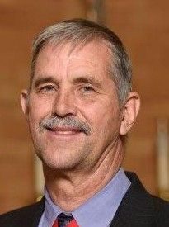
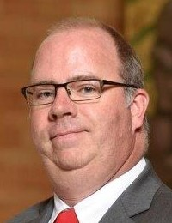




Arizona Knights of Columbus
2018 Membership
Team

Slide 71

MEMBERSHIP
Strategy 3: Make-over State Web Site

Slide 72

MEMBERSHIP
State Calendar

Slide 73
MEMBERSHIP

Slide 74

MEMBERSHIP

Slide 75

MEMBERSHIP
Strategy 4: Promote eMembership
NEW eMEMBERS
JUL18 5
AUG18 16
SEP18 12
OCT18 11
NOV18 10
Y-T-D TOTAL: 55

Slide 76
MEMBERSHIP

Slide 77

MEMBERSHIP
Strategy 5: Implement Shepherd Program
The Shepherd Program is designed to Mentor New Knights and make them feel welcome in their new Council. It should also help to get them involved with the business of the Council right away. Creating a sense of belonging and purpose from the very start will generate enthusiasm, improve retention, and strengthen the bonds of Brotherhood.
Each New Member to the Council will be assigned a Shepherd, usually this will be their Sponsor. One idea used for this program to ask inactive members of the Council become the Mentors. The purpose of this is two-fold: approaching inactive members with an honorable duty to perform, and provides a productive way to reduce inactive members.
The program is designed to last three months.
Members will be “Graduated” from the Program once they have become fully engaged with the Council and involved in Council Activities

Slide 78
MEMBERSHIP
Shepherd Program Milestones
Involvement in Parish Ministries (EM, Lector, Usher, Choir)
Meeting with the local Field Agent
Attend three (3) council meetings
Participate in three (3) council events
Complete Formation and Knighthood Degrees
Recruit one (1) new member

Slide 79

MEMBERSHIP
Strategy 6: Practice AMP Philosophy
ALTAR
SUPPORT
MEMBERSHIP
GROWTH
PROGRAMS

Slide 80

MEMBERSHIP
AMP: Altar Support
Does your Parish Priest fully support and promote the Knights?
Is your Parish Priest your Council Chaplain?
Does your Grand Knight meet regularly with your Parish Priest?

Slide 81

MEMBERSHIP
AMP: Membership Growth
What is your Council plan for Recruiting?
Does your Council recruit at its various local
events and programs?
Has your Council held a Church Drive in the
last three years?
Does your Council promote ABR?
Is your Council having success Recruiting?

Slide 82




MEMBERSHIP
AMP: Programs
Would you consider your Council well-rounded and active with
numerous quality Programs?
Has your Council adopted the Faith In Action Program Model?
Is your Council the “First Responder” or “Right arm of the Church?”

Slide 83

MEMBERSHIP
Strategy 7: Improve Incentives

Slide 84
MEMBERSHIP
“Fast Start” Council Incentive
Contest Period: July 1, 2018 to September 29, 2018
Council #17036 125% to Goal-Level 4 Winner
Council #14804 100% to Goal-Level 3 Winner
Council #5221 83.3% to Goal-Level 2 Winner
Council #1806 66.67% to Goal-Level 1 Winner
Council #7626 50.00% to Goal-Level 1 Winner
“Fast Start” Recruiter Incentive
Contest Period: July 1, 2018 to December 31, 2018

Slide 85

MEMBERSHIP
Star Recruiter Council Incentive
Contest Period: July 1, 2018 to May 1, 2019
Contest Rules: Contest winner will be announced at the 2019 Arizona State Council Convention. The Council with the highest percentage of Membership Growth during the contest period will receive:
Grand Knight 2019 State Convention VIP Package
Star Recruiter Council Plaque
Knights of Columbus T-Shirt

Slide 86
MEMBERSHIP
Star Recruiter Incentive
Contest Period: July 1, 2018 to May 1, 2019
Contest Rules: Contest winner will be announced at the 2019 Arizona State Council Convention. The Knight who recruits the most New Members during the contest period will receive:
2019 State Convention VIP Package
$150 Visa Gift Card
Star Recruiter Plaque
Knights of Columbus T-Shirt

Slide 87


MEMBERSHIP
eMembership Star Recruiter Council Incentive
Contest Period: July 1, 2018 to May 1, 2019
Contest Rules: Contest winner will be announced at the 2019 Arizona State Council Convention. The Council who recruits and transfers the most new eMembers into their Council will receive:
$200 Visa Gift Card
Star eMembership Recruiting Council Plaque
Knights of Columbus T-Shirt

Slide 88

MEMBERSHIP
“3-in-3” Church Drive Incentives:
Contest Period: July 1, 2018 to May 1, 2019
Contest Rules: Councils who Sponsor a “3-in-3” Church Drive that brings in three (or more) new Council Members will receive the following:
$50 Visa Gift Card
Knights T-Shirts for the Grand Knight, Membership and Program Directors
Star Recruiter Pin for each Sponsor (Sponsor MUST ATTEND Degree with Candidate)

Slide 89
MEMBERSHIP
New Council Development Chairman
Chet Yancy 602-309-1246
cryancy@aol.com

Slide 90

MEMBERSHIP
Welcome Aboard!
Council #1729
Immaculate Heart of Mary
District Deputy 18 Albert Ustaszewski

Slide 91
MEMBERSHIP
New Council Development Opportunities
Holy Family Parish-Phoenix, AZ
District Deputy 28-Gonzalo Ortiz
St. Jude Thaddeus Church-San Luis, AZ
District Deputy 18-Albert Ustaszewski
Lady of the Angels Parish-Sonita, AZ
St. Theresa Parish-Patagonia, AZ
District Deputy 2-Luis Leyva
St. Margaret Parish-Tempe, AZ
District Deputy 9-Dominic Conn

Slide 92
MEMBERSHIP
Council Reactivation Chairman
Stan Schroeder 480-239-6452
stankofc@gmail.com

Slide 93
MEMBERSHIP
Council Reactivation Opportunities
Council #6788-Page, AZ
District Deputy 20-Paul Holbrook
Council #10915-El Mirage, AZ
District Deputy 11-Vince Melluse
Council #12375-Coolidge, AZ
District Deputy 26-Dennis Sullivan
Council #6858-Tucson, AZ
District Deputy 3-Frank Islas

Slide 94
MEMBERSHIP
State Round Table Chairman
Bobby Nielsen 520-349-0728
Nielsen200@comcast.net

Slide 95

MEMBERSHIP
Parish Round Table Update
GOAL: 25
ATTAINED: 14
NEED: 11

Slide 96

MEMBERSHIP

Slide 97
MEMBERSHIP
DISCUSSION & QUESTIONS

Slide 98
MEMBERSHIP
00863 01158 01189 01729
03395 03419 04260 04426
04737 05313 05471 05542
06612 06788 07114 07243
07306 07513 07562 07646
07912 07949 08090 08091
08105 08358 08540 08813
09312 09380 09446 09485
09801 09995 10915 11116
11858 11912 12144 12338
12375 12708 12737 13024
13435 13497 13568 14033
14089 14139 14157 14185
14340 14583 14610 14621
15497 15576 15704 16776
NUMBER OF ACTIVE ARIZONA
COUNCILS WHICH HAVE NOT
RECORDED ANY MEMBERSHIP
ADDITIONS DURING THE
CURRENT FRATERNAL YEAR…
62

Slide 99
MEMBERSHIP
ABR!

Slide 101
State Program Director
Lawrence A. Power
Programs@kofc-az.org
(702) 827-8135

Slide 102




Faith In Action
Required Programs
Faith: Spiritual Reflection Program
Family: Consecration to the Holy Family
Community: Helping Hands
Life: Novena for Life

Slide 103


Spiritual Reflection
Plan a day of reflection or weekend retreat. This can be an event run by council members or for council members and men of the parish.
Build public interest for the event in all of the Surrounding Parishes!
Consider Into the Breach as a Starting Point

Slide 104

Consecration to the Holy Family
Working with your pastor, obtain his permission and recommendations on conducting a Consecration to the Holy Family in your parish.
December 30, 2018?
Order Prayer Cards
Advertise at least 2 weeks!

Slide 105


Helping Hands
More than 40,000 young people under 25 are experiencing homelessness on their own.
Families make up one-third of the needy population in the United States

Slide 106
Helping Hands
Program looks towards helping groups vs. Individuals
Ideas:
As a parish, cook and/or serve food at no charge at a local soup kitchen or parish hall
Clean and repair the facilities of a local nonprofit organization
Organize collection drives for specific supplies such as blankets, backpacks, toiletries, and clothing.
Raise money for a local soup kitchen, homeless shelter or other nonprofit organization through various events.

Slide 107

Ultrasound Initiative
We are receiving matching funds
Aid to Women Center Tempe
Rose of Life – Is there one on your car?

Slide 108
Ultrasound Initiative
Ask Priest for permission to accept donations for Roses
Emphasize Supreme’s Matching Donation
Bulletin Announcements
Have roses available after Council’s Novena

Slide 109



Novena for Life
Required of every Council to be eligible for the Columbian Award
Councils have many options
9 Days for Life: January 14-22, 2019
Make Part of 40 Days for Life
Schedule it to precede a major feast day or pro-life event

Slide 110
Organ Donor Program
Jay McCall
jmccall415@msn.com
(520) 887-7847
April 7, 2018

Slide 111

Novena for Life
Join District 9’s Aid to Women Center Novena

Slide 112
Novena for Life
Saturday, November 24, 2018 Council #9482 St Andrews
Saturday, December 1, 2018 Council #6627 Our Lady of Mt Carmel
Saturday, December 8, 2018 Council #13836 Resurrection
Saturday, December 15, 2018 Council #9446 Queen of Peace
Saturday, December 22, 2018 Council #9482 St Andrews
Saturday, December 29, 2018 Council #6627 Our Lady of Mt Carmel
Saturday, January 5, 2019 Council # 13836 Resurrection
Saturday, January 12, 2019 Council #9446 Queen of Peace
Saturday, January 19, 2019 Joint representation all four Councils
http://www.kofc.org/en/programs/life/novena-life.html#/Action%20Steps

Slide 113




Marian Icons
MARIAN PRAYER - OUR LADY HELP OF PERSECUTED CHRISTIANS
Work With Your Pastor
Identify Dates
https://kofc-az.org/marian-icon-program

Slide 114
Free Throw Championship
Joe Danko
State Youth Director
joedanko@cox.net
602-710-0418
Tom Bayham
State Free Throw Chairman
tmb@tuslaw.com
(520) 790-9663

Slide 115
Free Throw Competition
Council Contests in January
District Championships February
State Championship March

Slide 116
Free Throw Championship
Host Council
  Location Brophy College Preparatory
  4701 N Central Ave, Phoenix, AZ 85012
  Registration is from 8:30 to 9:30
  State Youth Activity for girls and boys 9 through 14
  First, Second and Third place for each age and gender

Slide 117

Christian Refugee Relief
Help save persecuted and at-risk Christians facing genocide all over the world, particularly in the Middle East
Distribute Solidarity Crosses to those who donate a minimum of $5 to the Christian Refugee Relief Fund. These crosses were originally made by Christians in the Holy Land and all proceeds go towards their aid.

Slide 118
Christian Refugee Fund

Slide 119

Keep Christ in Christmas
Poster Contest
December 31 –Council –January 15, 2019 DDs
Journey to the Inn
Blessing of the Nativity
Caroling
Collecting Food/Clothing
Family Social Hot Chocolate
Think about Cards for next year

Slide 120
People With Intellectual Disabilities
Lawrence A. Powers
lapowers1@msn.com
(702) 827-8135

Slide 121
PWID
Deadline for Expense Forms 12/31/18
Councils Reported: 43 – 91K
  Grant Deadline 1/31/18
    Grant requests received 3
All forms and Program Guidelines are available online on the State Website

Slide 123
112th Annual Arizona State Convention
May 17 – 18, 2019
Hosted by
St Gabriel the Archangel Council 13286
Cave Creek, AZ

Slide 124
2019 State Convention
Held at Sheraton Crescent Hotel
  2620 W Dunlap Ave, Phoenix, AZ 85021
  Northeast corner of I-17 & Dunlap Ave
Convention Registration
  Primary method by website
    Goes live January 15, 2019
  Secondary method by mail
    Forms to be mailed to Fin/Sec & on website
  All registrations due by May 3, 2019
    $10 Late Processing Fee added after that date

Slide 125
2019 State Convention
  Hotel Reservations
  Made directly with hotel, either online or by phone
  Refer to Hotel Registration page on convention website for details
Hospitality Suites – Available, but LIMITED
  Reserve suites through Council Hotel Liaison
    SK Phil Vicinanza
Advertisements in Program Book
  Must be submitted by April 17, 2019
  We ask all Councils and Assemblies to advertise

Slide 126
2019 State Convention
Friday
  State Chaplain’s Opening Mass (10:00 AM)
    Bishops/Priests/Chaplains/Friars invited
    Encourage GK & FN to invite their priest to attend
  Live Music Under The Stars
    Immediately after the State Program Award Dinner
    Patio Garden Area
    Attire is “Tropical Casual” (Caribbean/Hawaiian)

Slide 127
2019 State Convention
Saturday
  Ladies Luncheon (11:30 AM)
    Preceded by a wine-reception at 11:00 AM
    Theme: EVERTHING IS A CHOICE
    Guest Speaker: Brittany Ehrick
      Author, life coach
      Interactive, uplifting, and inspiring program which will show that good can come out of life’s hardships and challenges
    50/50 Drawing & Gift Baskets raffled
    Donations / Proceeds for Maggie’s Place
      Community of seven homes for pregnant and parenting women in need

Slide 128
2019 State Convention
Information Packets found in DD boxes
SK William J Pokorny
Registration Chair
Phone Number: 623-217-3388
Email: info@azkofcstateconvention.org
Vivat Jesus!

