Slide 1
2018 Mid-year meeting
Arizona State Knights of Columbus
Sunday, December 2
Sierra Vista, AZ
Hosted by Councils 4584 & 10799

Slide 2
Knight’s Prayer
Our Lady, Queen of the Knights, bless all the activities of our Order. Keep us true to our pledge, to extend the kingship of thy divine son on earth.
Through Thine intercession, win for us the grace, ever to exemplify in our public and private lives, the virtues that should characterize those especially dedicated to the service of the heavenly court.
Make us always aware that as your Knights, we are constantly observed, our faith judged, and our Order appreciated.
Accept, O Mary, this renewed pledge of fealty and devotion, of Thy Servants, the Knights of Columbus.

Slide 3
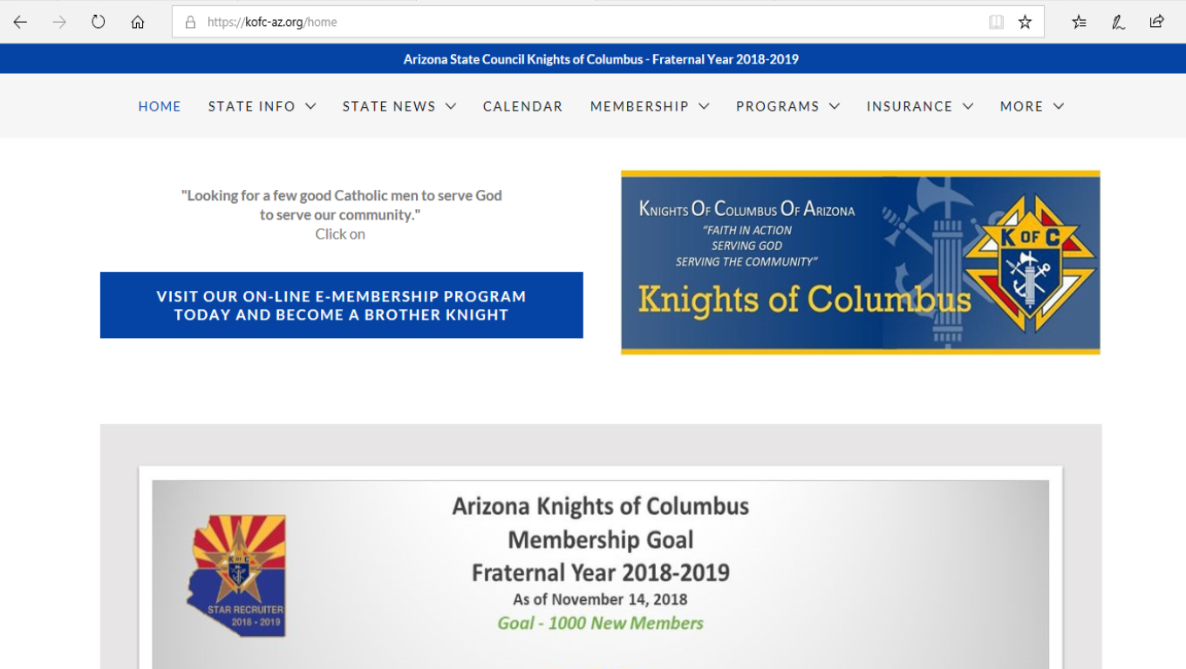
KOFC-AZ.ORG
Arizona State Website
Since the launch of the Arizona State Website these are the STATS:
At the start till 11/27/2018 – 5,787 visitors
In the last 30 days – 948 visitors

Slide 4
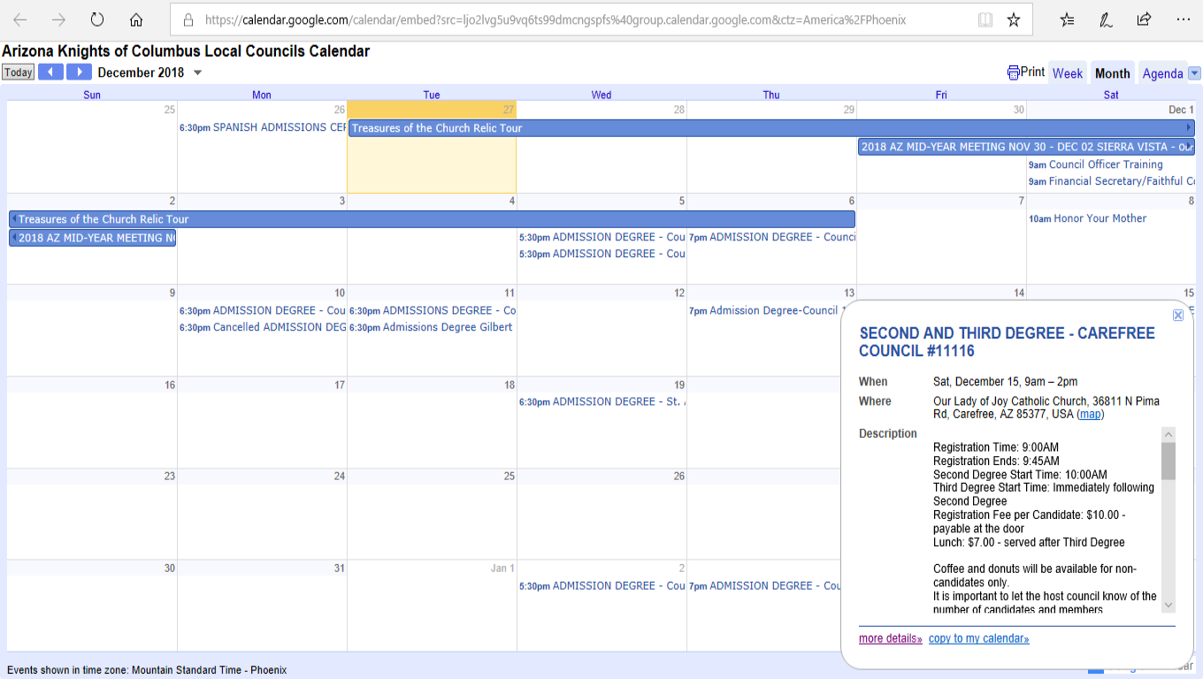
KOFC-AZ.ORG
Arizona State Website
State Calendar

Slide 5
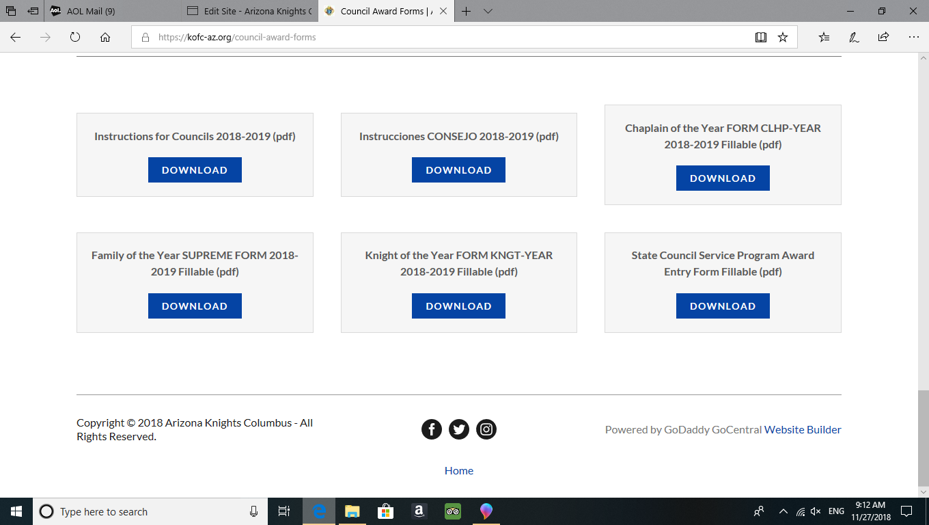
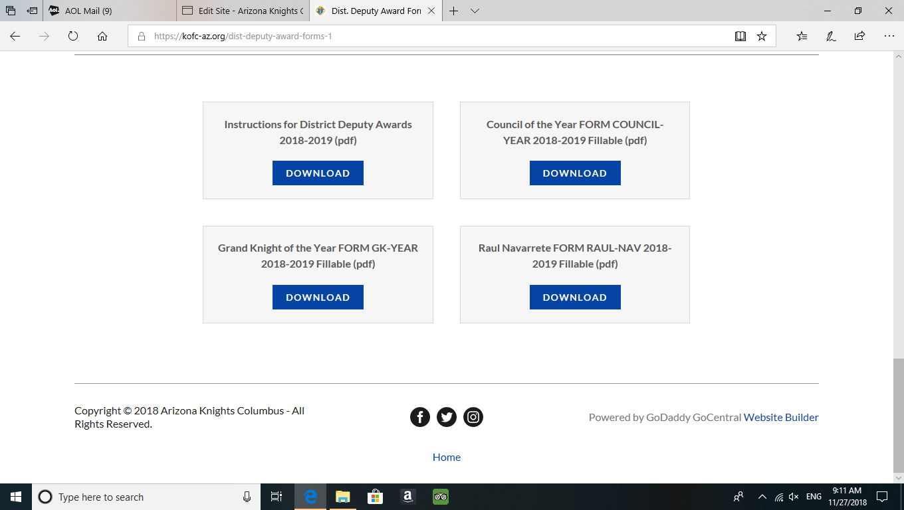
KOFC-AZ.ORG
Arizona State Website
Council Award Forms and Instructions
District Deputy Award Forms and Instructions

Slide 6
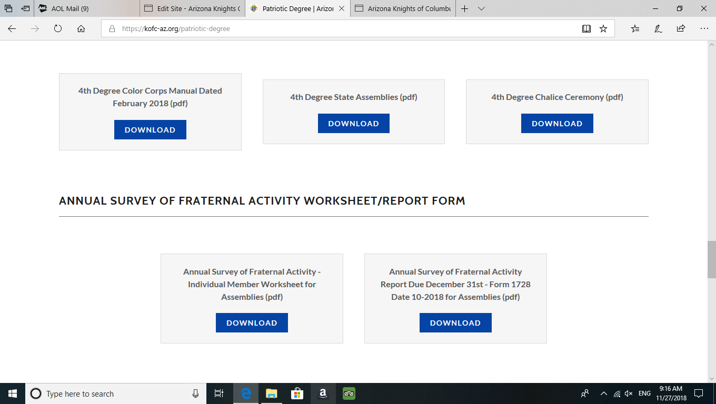
KOFC-AZ.ORG
Arizona State Website
Fourth Degree Annual Survey Worksheets and Report

Slide 7
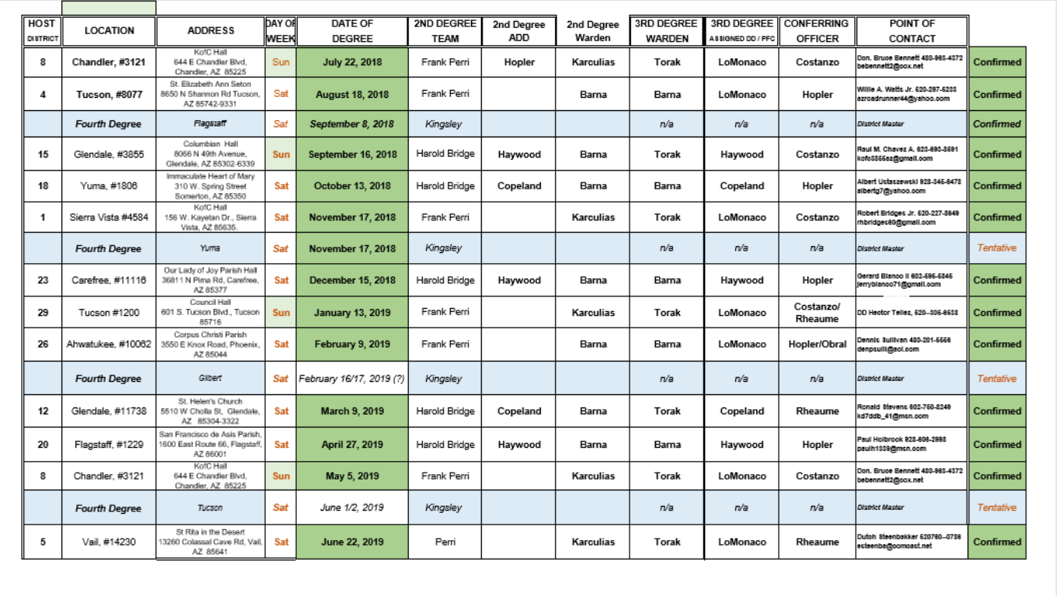
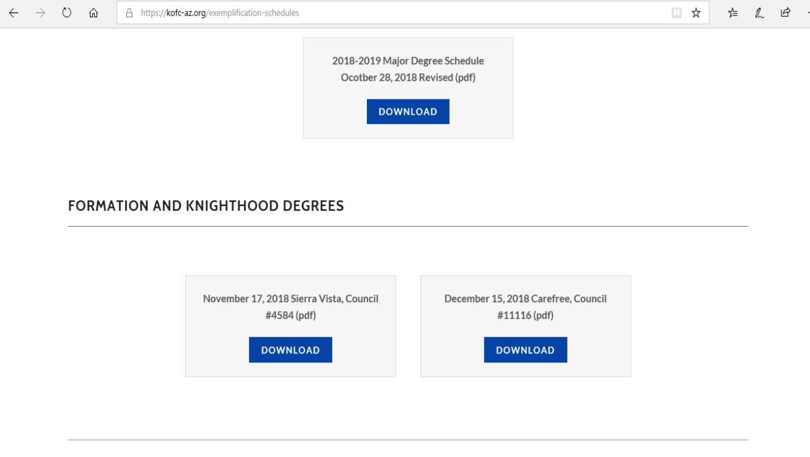
KOFC-AZ.ORG
Arizona State Website

Slide 8
Processing Council Funds & Checks
Luigi

Slide 9
Ceremonials
Ceremonial Baldrics
  Who needs them? Why?
  When to use them
  Where to get them
  Proper dress

Slide 10
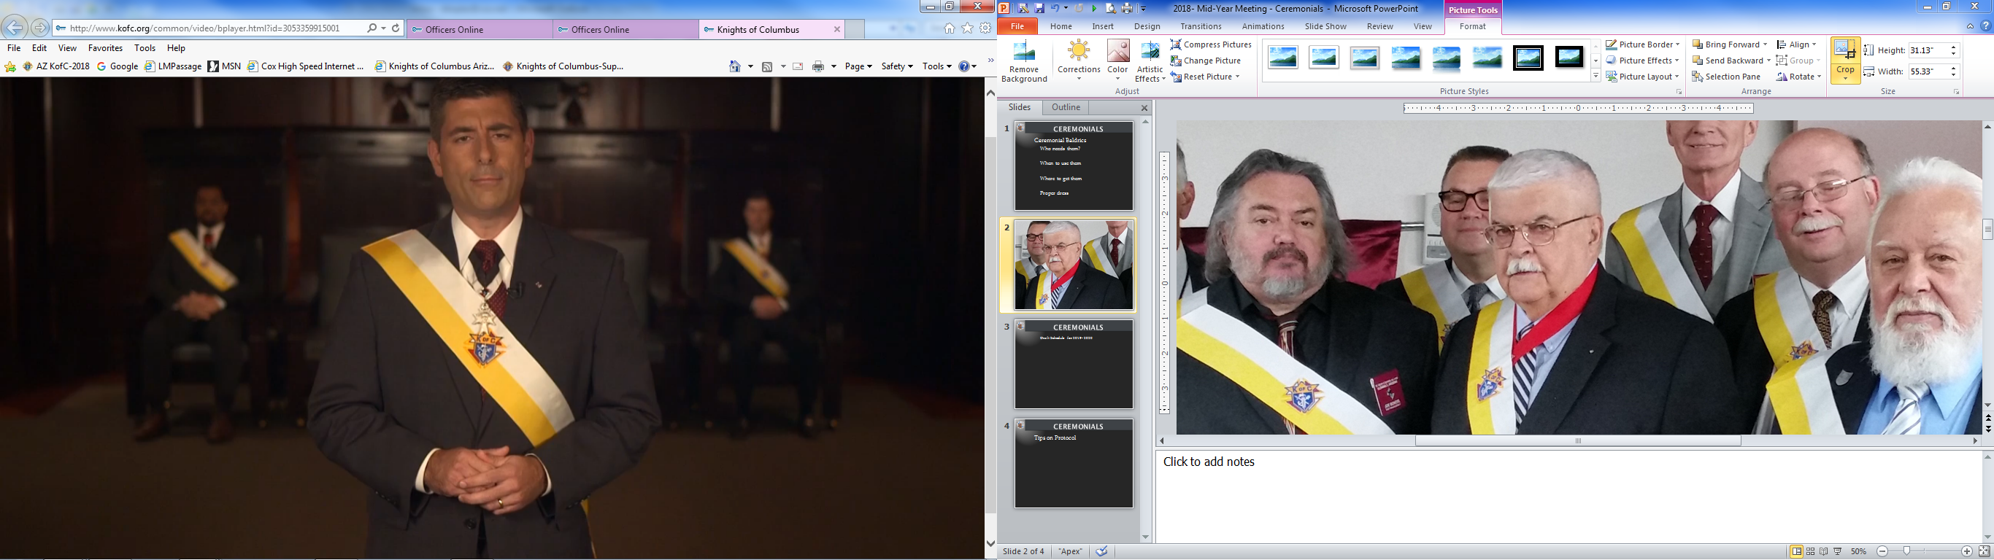
Ceremonials
  Draft Schedule for 2019- 2020

Slide 11

Ceremonials
Tips on Protocol
https://www.kofc.org/un/en/forms/leadership/protocol-booklet1612.pdf

Slide 12
Ceremonials
Tips on Protocol
- District Deputy and Grand Knight
- State Deputy or State Officer visits
- Personal Introductions
- Speakers and speeches
- Introduction of Guests and Dignitaries

Slide 13
Ceremonials
Second Half Schedule
HOST | LOCATION | ADDRESS | DAY OF | DATE OF
DISTRICT |  |  | WEEK | DEGREE
29 | Tucson #1200 | Council Hall 601 S. Tucson Blvd., Tucson 85716 | Sun | January 13, 2019
26 | Ahwatukee, #10062 | Corpus Christi Parish 3550 E Knox Road, Phoenix, AZ 85044 | Sat | February 9, 2019
 | Fourth Degree | Gilbert | Sat | February 16, 2019 (?)
12 | Glendale, #11738 | St. Helen's Church 5510 W Cholla St, Glendale, AZ 85304-3322 | Sat | March 9, 2019
20 | Flagstaff, #1229 | San Francisco de Asis Parish, 1600 East Route 66, Flagstaff, AZ 86001 | Sat | April 27, 2019
8 | Chandler, #3121 | KofC Hall 644 E Chandler Blvd, Chandler, AZ 85225 | Sun | May 5, 2019
 | Fourth Degree | Tucson | Sat | June 1, 2019 (?)
5 | Vail, #14230 | St Rita in the Desert 13260 Colassal Cave Rd, Vail, AZ 85641 | Sat | June 22, 2019

Slide 14
Ceremonials
FY 2019 - 2020
JULY | Chandler |  | JANUARY | Tucson
AUGUST | Tucson |  | FEBRUARY | Ahwatukee
SEPTEMBER | Glendale |  | MARCH | Glendale
OCTOBER | Casa Grande |  | APRIL | Flagstaff/Show Low
NOVEMBER | Sierra Vista |  | MAY | Chandler
DECEMBER | Phoenix |  | JUNE | Green Valley

Slide 15
Ceremonials
Remember:
Ceremonials show the face and substance of who we are as Knights of Columbus

Slide 16
ROLE of ASO & relationship with his district deputies
Mario Vassallo
State Secretary
Cell: 520-481-1250
Email: statesecretary@kofc-az.org

Slide 17
ASO Credentials
An ASO is a very experienced Knight of Columbus Member
  State Officer
  Former State Chairman
  Former District Deputy
  Past Grand Knight & possibly Past Faithful Navigator

Slide 18
Role of ASO
An ASO
  Is assigned 7-8 DDs to supervise (IPSD has 3)
  Should be a mentor
  Should frequently communicate with his DDs through
    Emails
    Phone Calls
    GoTo Meetings

Slide 19
DD – ASO Relationship
A DD should
  Communicate with his ASO when in need
  Keep his ASO in the loop by
    Copying ASO on emails sent to GKs & Councils
    Copying ASO when sending in
      District Monthly Reports
      Form 450s
      …
    Inform ASO on upcoming Admissions Degrees in District
  Invite his ASO to his District Meetings
    Give ASO advance notice
  Ask GKs to invite ASO to the Council’s Installation of Officers

Slide 20
DD-ASO Relationship
Vivat Jesus!

Slide 21
Open Discussion

