Slide 1
Arizona Knights of Columbus 2019 Org Meeting
Knights serving god – serving the community
This is who we are – this is what we do
1

Slide 2
Opening Prayer
Our Father
Prayer to Our Lady of Guadalupe
Knights Prayer

Slide 3
Our Lady of Guadalupe, mystical rose, make intercession for the Holy Church, protect the Sovereign Pontiff, help all those who invoke thee in their necessities, and since thou art the ever Virgin Mary and Mother of God, obtain for us from thy most holy Son the grace of keeping our faith, sweet hope in the midst of the bitterness of life, burning charity and the precious gift of final perseverance. Amen.

Slide 4
Our Lady, Queen of the Knights, bless all the activities of our Order. Keep us true to our pledge, to extend the kingship of thy divine son on earth. Through Thine intercession, win for us the grace, ever to exemplify in our public and private lives, the virtues that should characterize those especially dedicated to the service of the heavenly court. Make us always aware that as your Knights, we are constantly observed, our faith judged, and our Order appreciated. Accept, O Mary, this renewed pledge of fealty and devotion, of Thy Servants, the Knights of Columbus.

Slide 5
Arizona Knights of Columbus 2019 Org Meeting
Lawrence A. Powers Friday June 22, 2019
State Program Director
5

Slide 6
Faith in Action
Organize at least TWO activities from each of these four areas
Member
Family
Parish
Community
Participating councils will receive a commemorative Holy Family icon

Slide 7
SP-7 Columbian Award

Slide 8
DD State Awards
Council of the Year
Grand Knight of the Year
Raul Navarrete Vocations Award

Slide 9
Faith In Action
Faith: Spiritual Reflection; Holy Hour; Sacramental Gifts.
Family: Family Prayer Night; Good Friday Family Promotion.
Community: Helping Hands.
Life: Novena for Life, Mass for People with
Special Needs; Pregnancy Center Support.

Slide 10
Holy Hour
Encourage deep personal encounter with God. Councils work with their pastors to organize a regular Holy Hour of Eucharistic adoration. A Knights of Columbus Holy Hour, prepared for the men of the parish, could include a reflection, communal rosary, prayers for intercession by Venerable Michael J. McGivney or St. Joseph, and various other aspects as decided by the council.
The structure for a Holy Hour is broad and left to the discretion of your council. The primary objective is that all in attendance grow closer in faith with their brothers through a prayerful interaction with the Eucharist and with each other.

Slide 11
Holy Hour
Rosary
Litanies
Reflections
Particular intentions
Scripture (particularly the daily readings)
Liturgy of the Hours
Hymns
Prayers for intercession by our founder or saints
Sacrament of reconciliation
Participation in perpetual adoration

Slide 12
Sacramental Gifts
Working with your pastor, obtain his permission and recommendations on conducting the Sacramental Gifts Program.
Learn how many people will be receiving the sacrament from your pastor or other parish representative.
Order enough Sacramental Gifts Kits
Before the sacramental Mass, inform the parents or recipients of the council’s intent to present gifts at the Mass.
Complete and submit all associated reporting forms to the Supreme Council Department of Fraternal Mission.

Slide 13
Family Prayer Night
Strengthen the bonds within our parishes and build faith-filled families. This is an opportunity for council members, their families, and the whole parish community to come together once a month for an evening of prayer, dinner, and fellowship.
Family Prayer Night is an opportunity for children to be exposed to regular people living their faith in a casual setting. Families of council members, as well as other Catholic families within the parish and community, will gather for prayer, dinner and fellowship. Multiple groups can be formed and families are encouraged to rotate between these groups.

Slide 14
Good Friday Family Promotion
Setting an example for their community, Knights will attend Good Friday services with their families and work with their pastors to encourage increased parishioner involvement at these liturgies. In conjunction with these efforts, councils will also work to educate their parishes about the plight of Christians in the Holy Land

Slide 15
Good Friday Family Promotion
Beginning on Ash Wednesday, promote Good Friday services at Friday Fish Fries and other parish and council meetings and events throughout the Lenten season.
Ask council members to take direct action and encourage their family and friends to attend.
Provide council members and the parish community a copy of Christ: Lord and Savior (#358) to help them contemplate who Jesus is and the sacrifices he made.
Have the Christian Refugee Relief Prayer Cards (#10340) available in the parish and council hall to raise visibility of the issues affecting the Middle East.

Slide 16
Family of the Month
Each month, hold a committee meeting to select the Family of the Month. To be selected as Family of the Month, each family should stand out as an exemplary model to others in the parish. They should meet the following criteria:
Is the family tight-knit?
Does the family spend quality time together?
Does the family attend weekly Mass together?
Does the family pray together outside of Mass?
Has the family made significant contributions to the parish and church community?
Does the family serve as a model of Catholic family values?

Slide 17
Arizona Membership Director Bobby Nielsen
membership@kofc-az.org
520 349-0728

Slide 18
Arizona Membership Team
Ceremonial Chairman Skip Hopler 602-677-2029 ehopler@cox.net
Council Reactivation Chairman Stan Schroeder 480 239-6452 stankofc@gmail.com
Council Retention Chairman Kevin McCarthy 602 684-8125 StateWarden@kofc-az.org
Retention Chairman Len Rheaume 602 738-5607 lrhemume@msn.com
Online Membership Chairman Larry Becker 480 760-5122 azlarry@cox.net
Round Table Chairman Joe Shanks 253 468-0722 hotrodtiki@aol.com
Hispanic Council Development Luis Leyva 520 313-0141 leyva.azkofc2@gmail.com
New Council Development Chet Yancy 602 309-1246 cryancy@aol.com

Slide 19
How Did We Finish?
Supreme intake goal of 950 new members, we missed that by less than 100
Supreme Star Council goal of 26, we had about half of that
Membership, Insurance, Forms and Compliance all played rolls

Slide 20
Membership Team Is Here For You
I will accompany every DD in the State to one of their District or Council Meetings or activity
Faith in Action
DELTA Church Drives
Online Membership
Prospect Landing Page
Retention
Assist with needed forms and compliance
The Membership Team is available to answer questions and provide support.
If requested we will assist at membership recruiting events

Slide 21
Communication
You can call, text or email me anytime
If it is a group text please don’t reply on that text stream
Important emails will often be followed up with a call or text
If many people are on an email, don’t “reply all” to that email
We can communicate a message to all State Councils in one day

Slide 22
Inactive Members
A Knight who has resigned or been suspended and no longer pays dues, but has K of C Insurance
The number of inactive members a council has will show up on the monthly statement
If they agree to a reactivation they count as a new member and a new insurance member
Agents can give Financial Secretaries or Membership Chairman the contact information for these men

Slide 23
Big Goals Achieved with Small Steps
Our Supreme goal is an intake of 955, this includes Online Membership
A solid July and August will pay off for the rest of the fraternal year
33 Districts, each recruits 3 new Knights a month equals 99 new Knights, that's 1188 new Knights a year!
As a team we need to be consistent and work with our councils every month to recruit new Knights

Slide 24
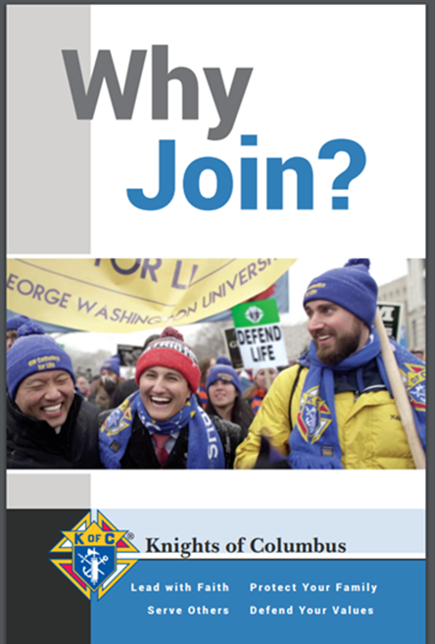
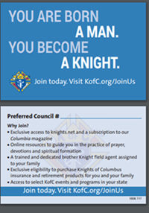
Online Membership Promotional Materials
Financial Secretaries can order at KofC Supplies Online
#10536 – Join Us Business Card
#10537 – Why Join? Bi-fold Brochure
These are not available via KnightsGear
35 second commercial www.KofC.org/joinus

Slide 25
Star District Award
100% of District’s Membership Quota
100% of Districts Insurance Quota
1 of the Districts Councils must be a Star Council

Slide 26
Per Capita Refund In 2019-2020
Per Capita Refund has already been announced
Any councils receiving the Star Council Award will receive the refund
$4.50 credit for each billable member on their roster July 1, 2020
$3.50 towards Per Capita and $1.00 towards Catholic Advertising

Slide 27
We Need To Sell Incentives
To be effective, incentives need to motivate
To motivate, incentives need to be broadcasted widely
This years incentives have quick, significant payoffs
Take these incentives back to the councils, so they can be rewarded

Slide 28
*District Deputy Incentive*
Contest Period: July 1, 2019 to October 31, 2019
Contest Prize $100 to be awarded at the Mid-Year Meeting
Contest Rules:
For the 4-month contest period, a District Deputy
Needs his assigned Councils to recruit an equal
Number of new Knights as the number of Councils
the DD is assigned. Example: A DD has 5 active
Councils assigned to his District; he needs to have
5 new Knights brought in each month of July, August, September and October. The 5 new Knights each
month may all be from one of the DD’s Councils or can be spread out in any way throughout the District

Slide 29
Fast Start Recruit a New Knight

Slide 30
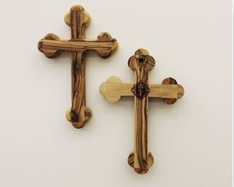
*Fast Start Recruit a New Knight*
Contest Period:
July 1, 2019 until 200 Knights recruit a new member
Contest winners will be mailed the Solidarity Cross.
Only one cross will be awarded to a Knight during the
contest period.
Contest Rules:
A Knight who recruits one new member during
the contest period will receive a Solidarity Cross.
This is in addition to the Star Recruiting Pin.
This handcrafted olive wood cross comes from
the Bethlehem Region. This cross is a symbol of
solidarity with prosecuted Christians. It measures
approximately 3.5 inches x 5 inches.

Slide 31
The Council That Has Not Grown
23 Councils did not add one new member in 2018-2019
Grand Knight doesn't recruit
The Church is small
The Officers don’t do anything
Nobody goes to their meetings

Slide 32
IF WE KEEP DOING WHAT WE ARE DOING WE WILL KEEP GETTING WHAT WE ARE GETTING

Slide 33
Arizona Membership Director Bobby Nielsen
membership@kofc-az.org
520 349-0728

Slide 34
Arizona Knights of Columbus 2019 Org Meeting
Success PLANNER & FRATERNAL TRAINING
34

Slide 35
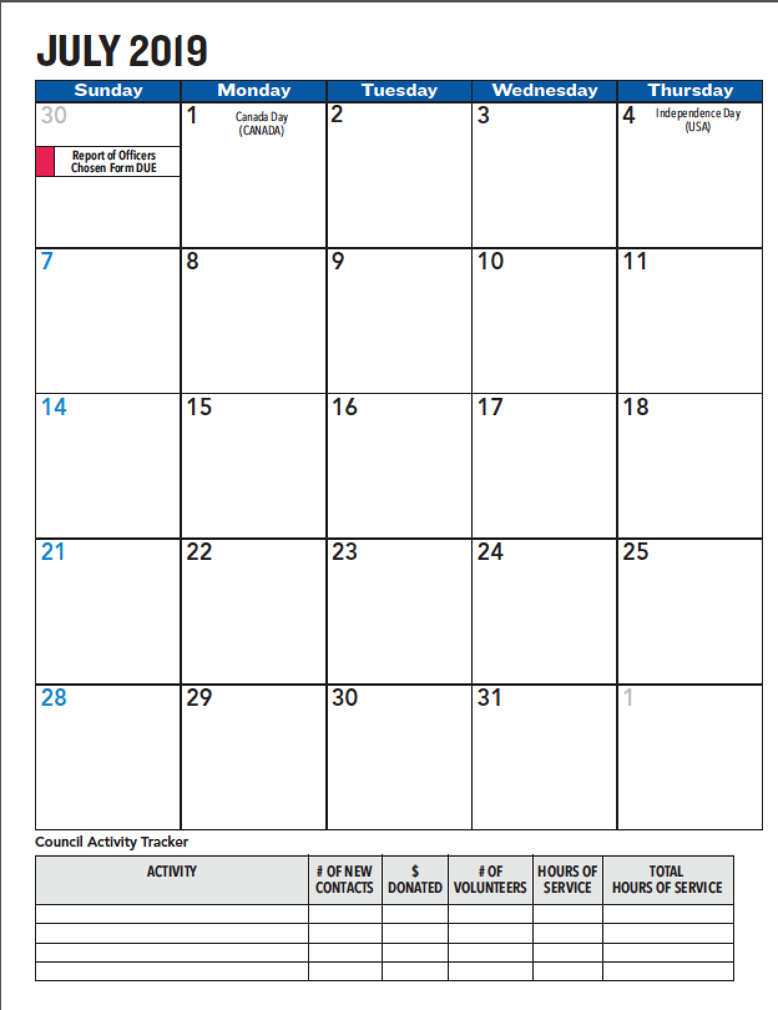
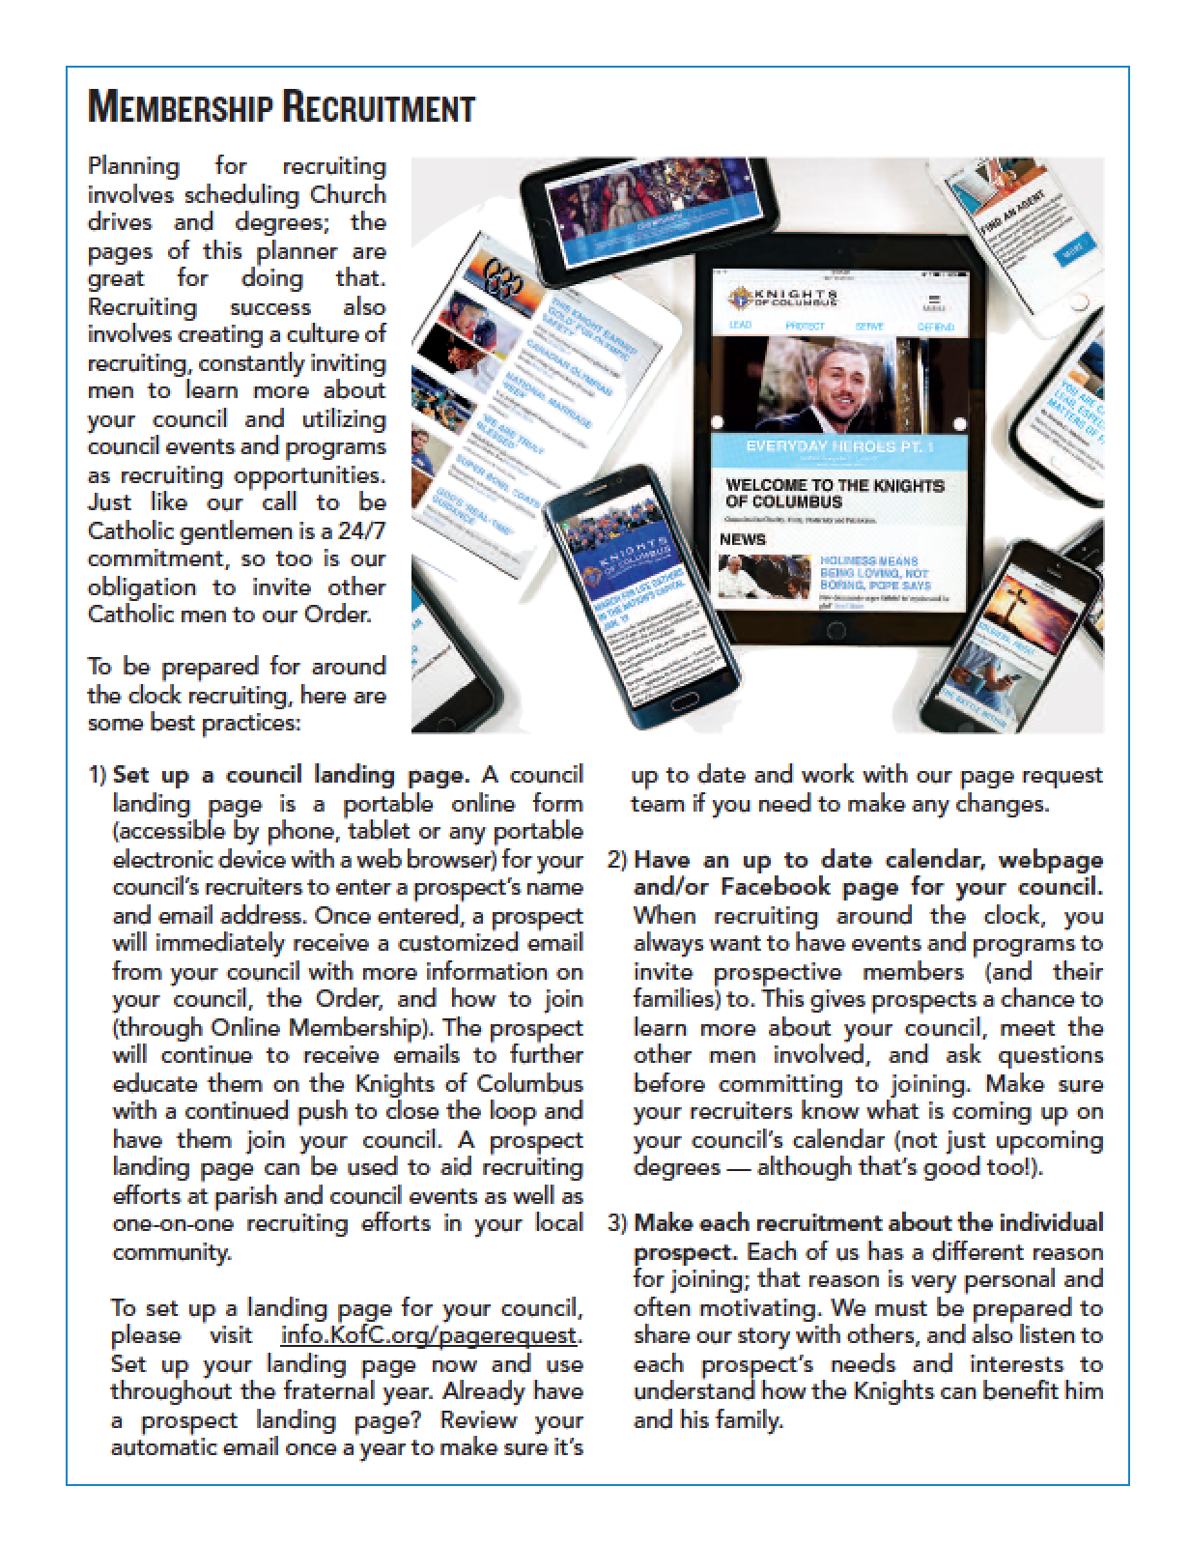
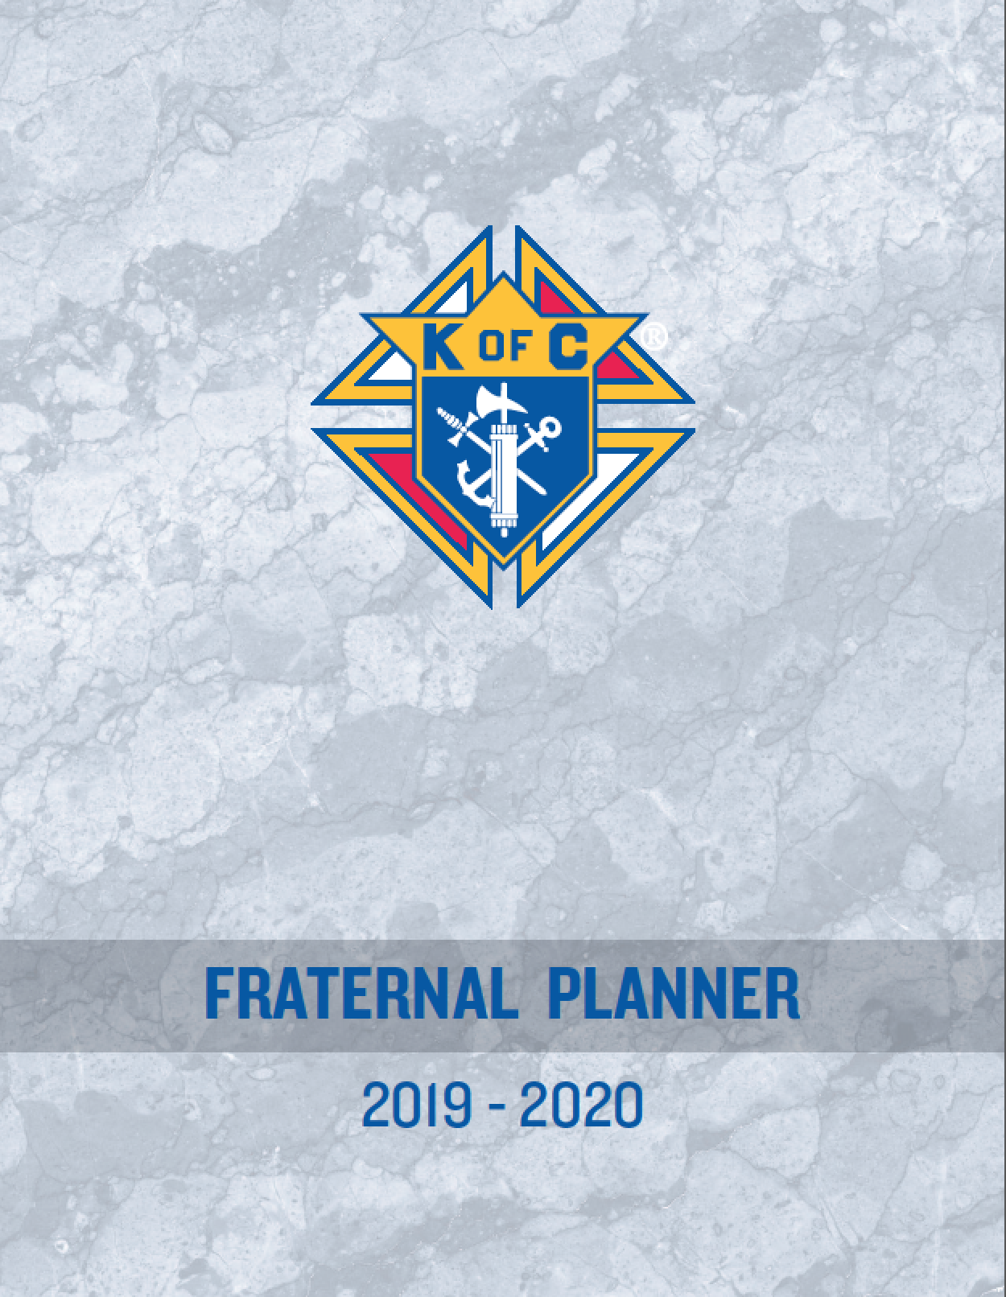
Fraternal Planner #5033

Slide 36
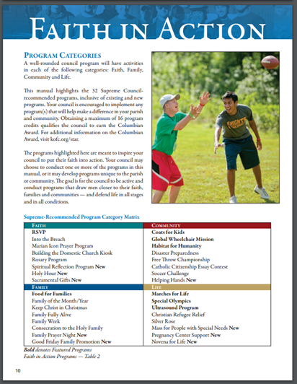
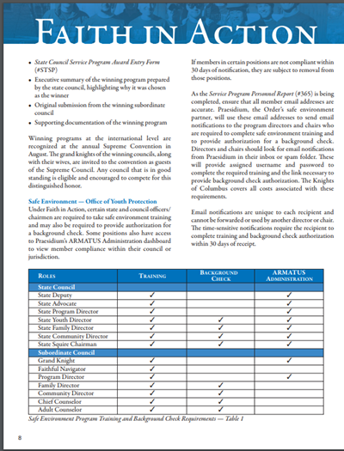
Faith in Action Program Guidebook #10590

Slide 37
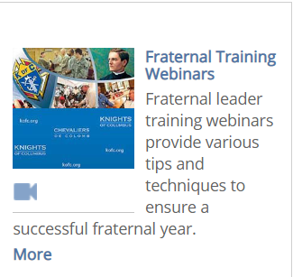
Fraternal Training
Webinars Open to ALL Members
Access from KofC.org home page. Fraternal Training Webinars
WEBINARS ON DEMAND
Specific Officers Training available

Slide 38
For Officers – Officers Online

Slide 39
Fraternal Training Portal

Slide 41
God, our Father, protector of the poor and defender of the widow and orphan, you called your priest, Father Michael J. McGivney, to be an apostle of Christian family life and to lead the young to the generous service of their neighbor. Through the example of his life and virtue may we follow your Son, Jesus Christ, more closely, fulfilling his commandment of charity and building up his Body which is the Church. Let the inspiration of your servant prompt us to greater confidence in your love so that we may continue his work of caring for the needy and the outcast. We humbly ask that you glorify your servant Father Michael J. McGivney on earth according to the design of your holy will. Through his intercession, grant the favor I now present (here make your request). Through Christ our Lord. Amen.

