Slide 1
Arizona Knights of Columbus
2019 Organization Meeting
Knights serving god – serving the community
This is who we are – this is what we do
1

Slide 2
Rosary Apostles Creed
I believe in God, the Father Almighty, Creator of heaven and earth; and in Jesus Christ, His only Son, our Lord:
Who was conceived by the Holy Spirit, born of the Virgin Mary;
suffered under Pontius Pilate, was crucified, died and was buried. He descended into hell;
the third day He rose again from the dead;
He ascended into heaven, is seated at the right hand of God the Father Almighty; from thence He shall come to judge the living and the dead.
I believe in the Holy Spirit, the Holy Catholic Church, the communion of Saints, the forgiveness of sins, the resurrection of the body, and life everlasting. Amen.

Slide 3
Joyful Mysteries
Annunciation
Visitation
Nativity of Our Lord
Presentation
Finding of Jesus in the Temple

Slide 4
Salve Regina
Hail Holy Queen, Mother of Mercy, our life our sweetness and our hope. To thee do we cry, poor banished children of Eve; To thee do we send up our sighs, mourning and weeping in this valley of tears. Turn then, most gracious advocate, thine eyes of mercy toward us and after this our exile show unto us the blessed fruit of thy womb, Jesus.
O clement, O loving, O sweet Virgin Mary!

Slide 5
Let us pray.
O God, whose only begotten Son, by his Life, Death and Resurrection, has purchased for us the rewards of eternal life, grant, we beseech thee, that we who meditate on these mysteries of the most holy Rosary of the blessed Virgin Mary, may both imitate what they contain and obtain what they promise, through the same Christ our Lord. Amen.

Slide 6
Our Lady, Queen of the Knights, bless all the activities of our Order. Keep us true to our pledge, to extend the kingship of thy divine son on earth. Through Thine intercession, win for us the grace, ever to exemplify in our public and private lives, the virtues that should characterize those especially dedicated to the service of the heavenly court. Make us always aware that as your Knights, we are constantly observed, our faith judged, and our Order appreciated. Accept, O Mary, this renewed pledge of fealty and devotion, of Thy Servants, the Knights of Columbus.

Slide 7

Knights Serving God – Serving the Community
This is who we are – This is what we do

Slide 8
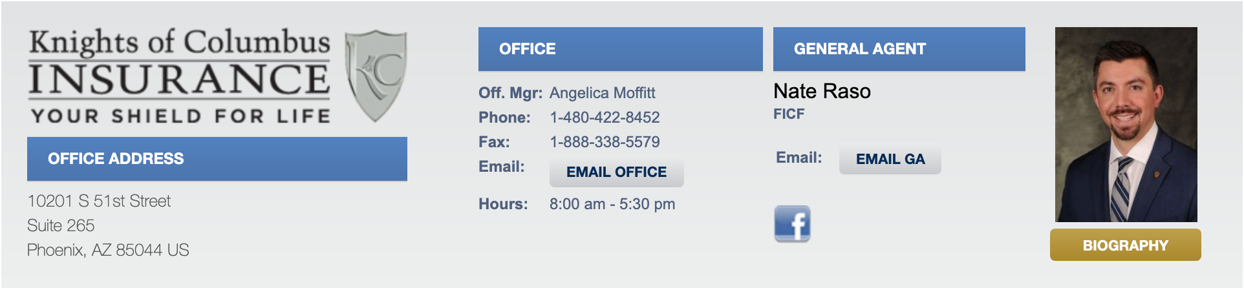
General Agent Insurance Report
Nate Raso
Nate.Raso@kofc.org
http://www.azknights.com/

Slide 9
Knights Serving God – Serving the Community
This is who we are – This is what we do

Slide 10
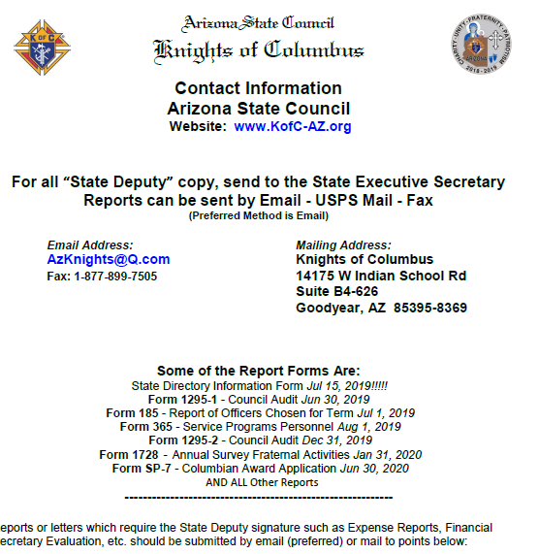
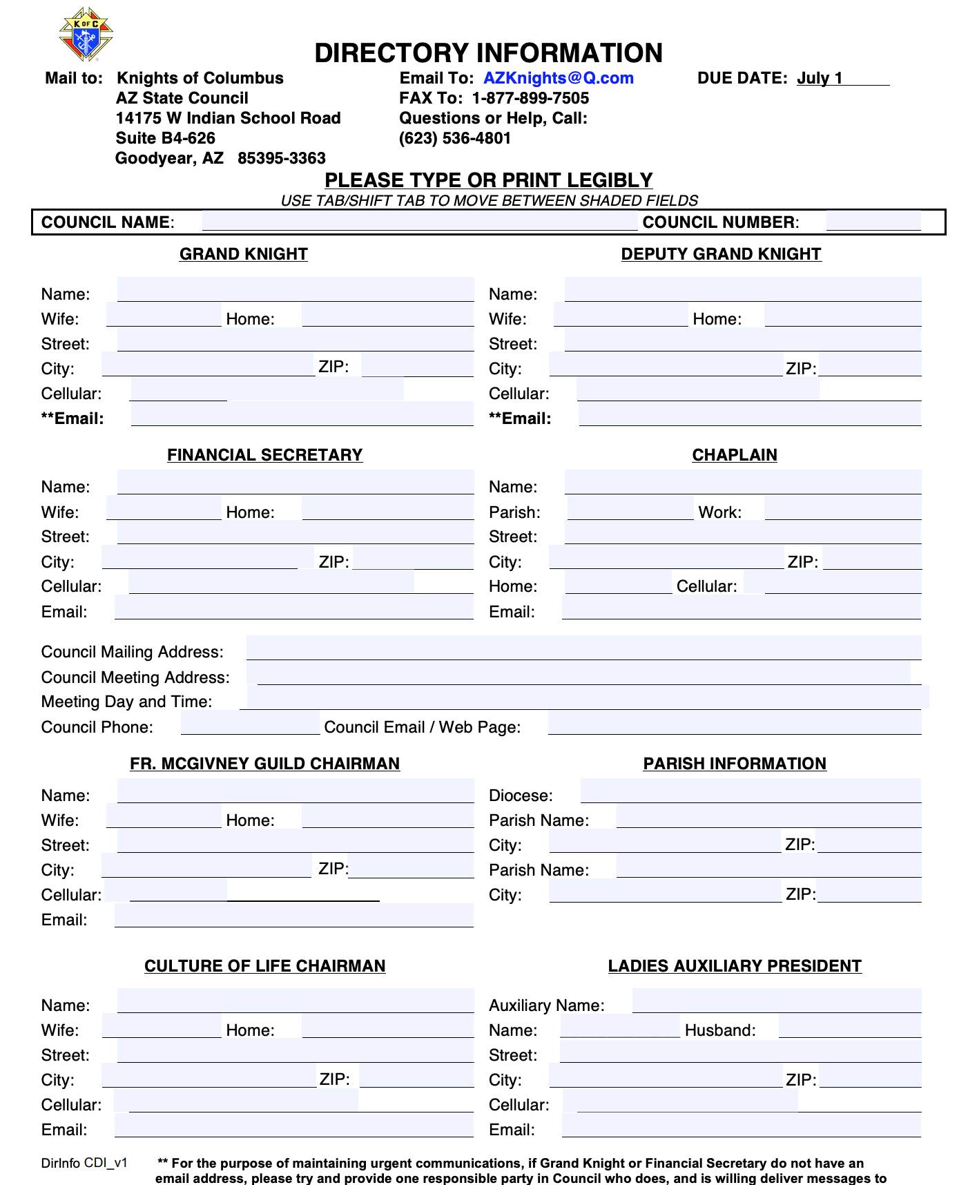
Forms

Slide 11
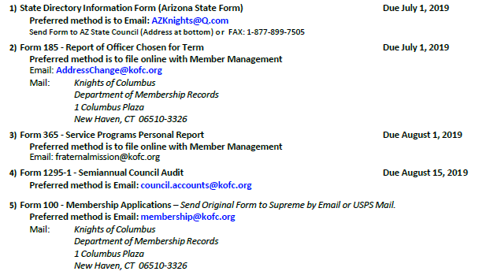
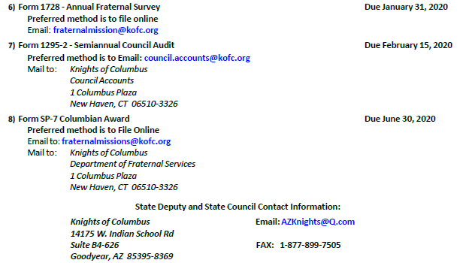

Slide 12
Arizona Knights of Columbus
2019 Org Meeting
Lawrence A. Powers
State Program Director
12

Slide 13

Faith In Action

Slide 14

Why Faith In Action
Grow in their faith
Engage their family in mission
Serve their parish and community
Defend the dignity of human life
Evangelize through action

Slide 15
Required Programs
Grow in their faith
Engage the family in mission
Serve their parish and community
Defend the dignity of human life
Faith: Spiritual Reflection
Family: Consecration to the Holy Family
Community: Helping Hands
Life: Novena for Life

Slide 16
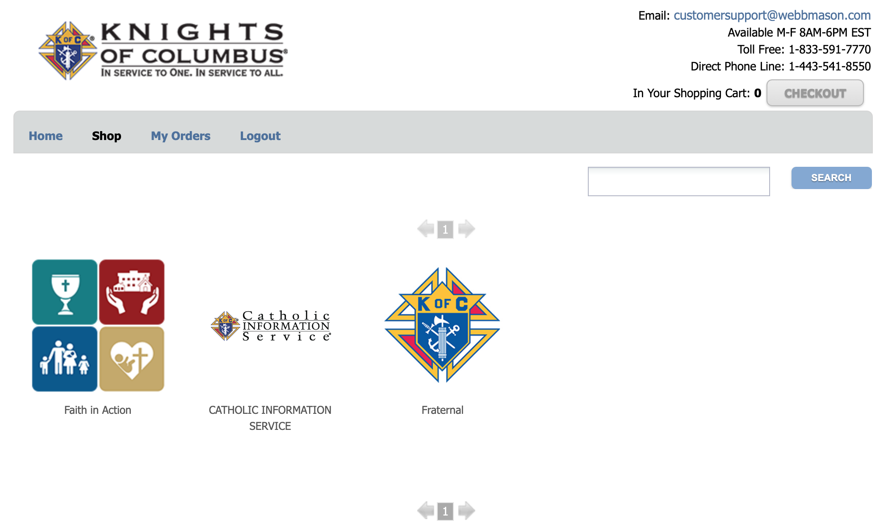
Supplies on Line

Slide 17
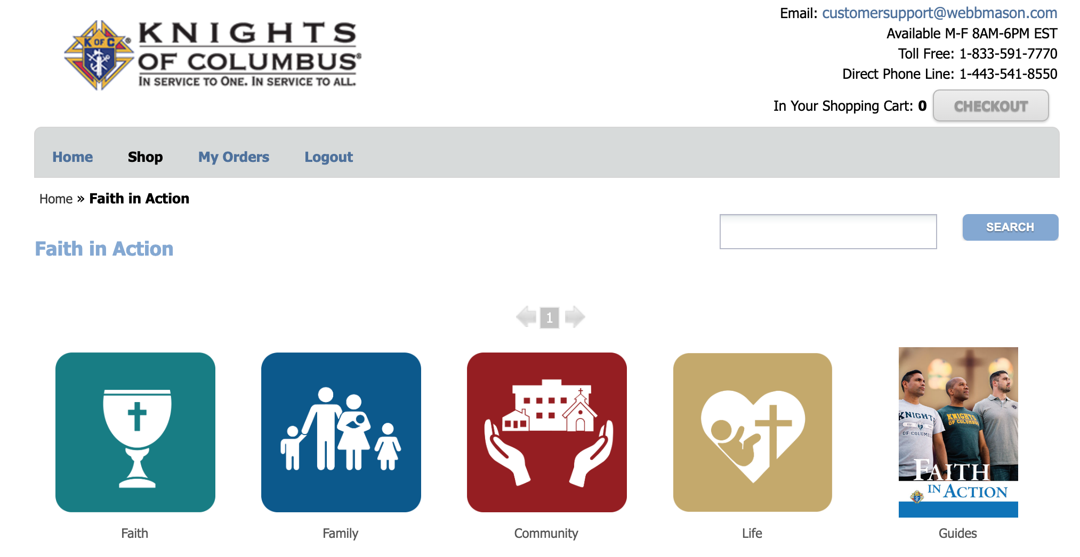
Supplies on Line - Faith

Slide 18
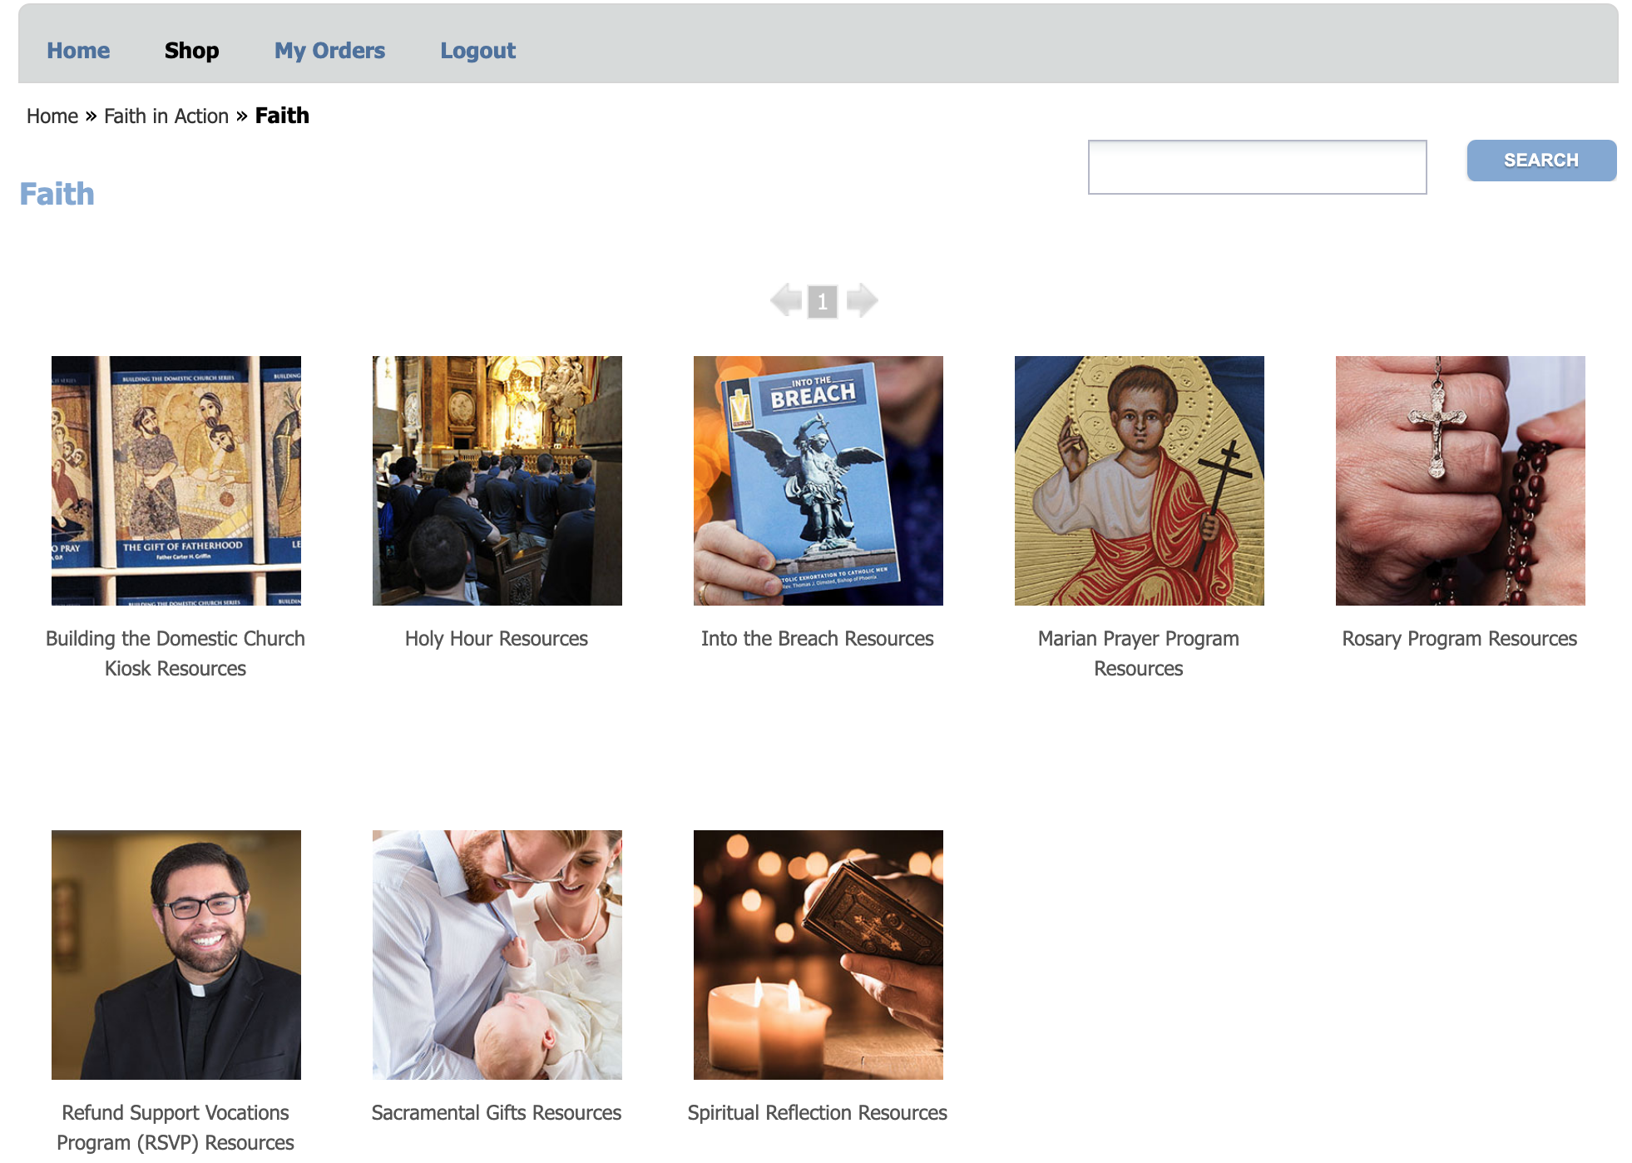
Spiritual Reflection

Slide 19
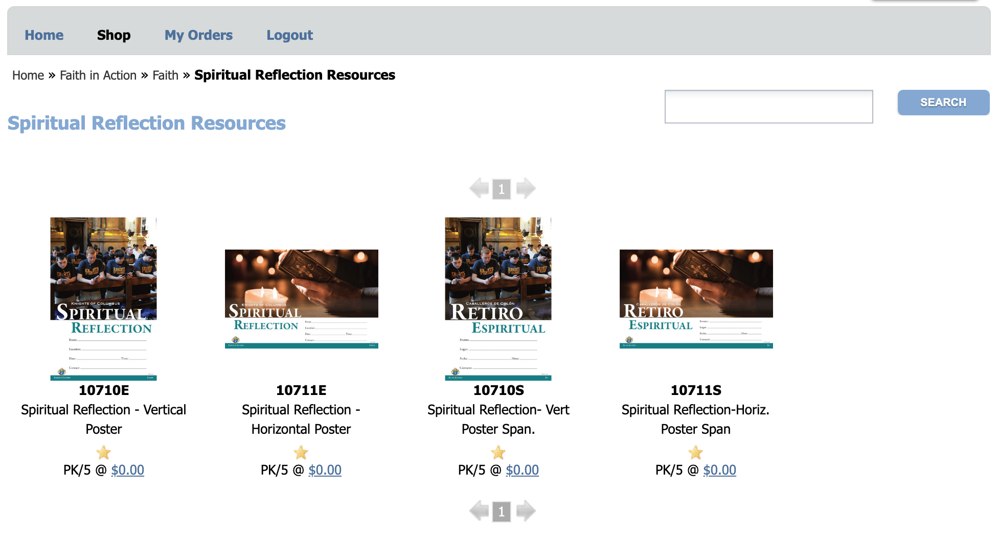
Spiritual Reflection

Slide 20
Supplies on Line - Family

Slide 21
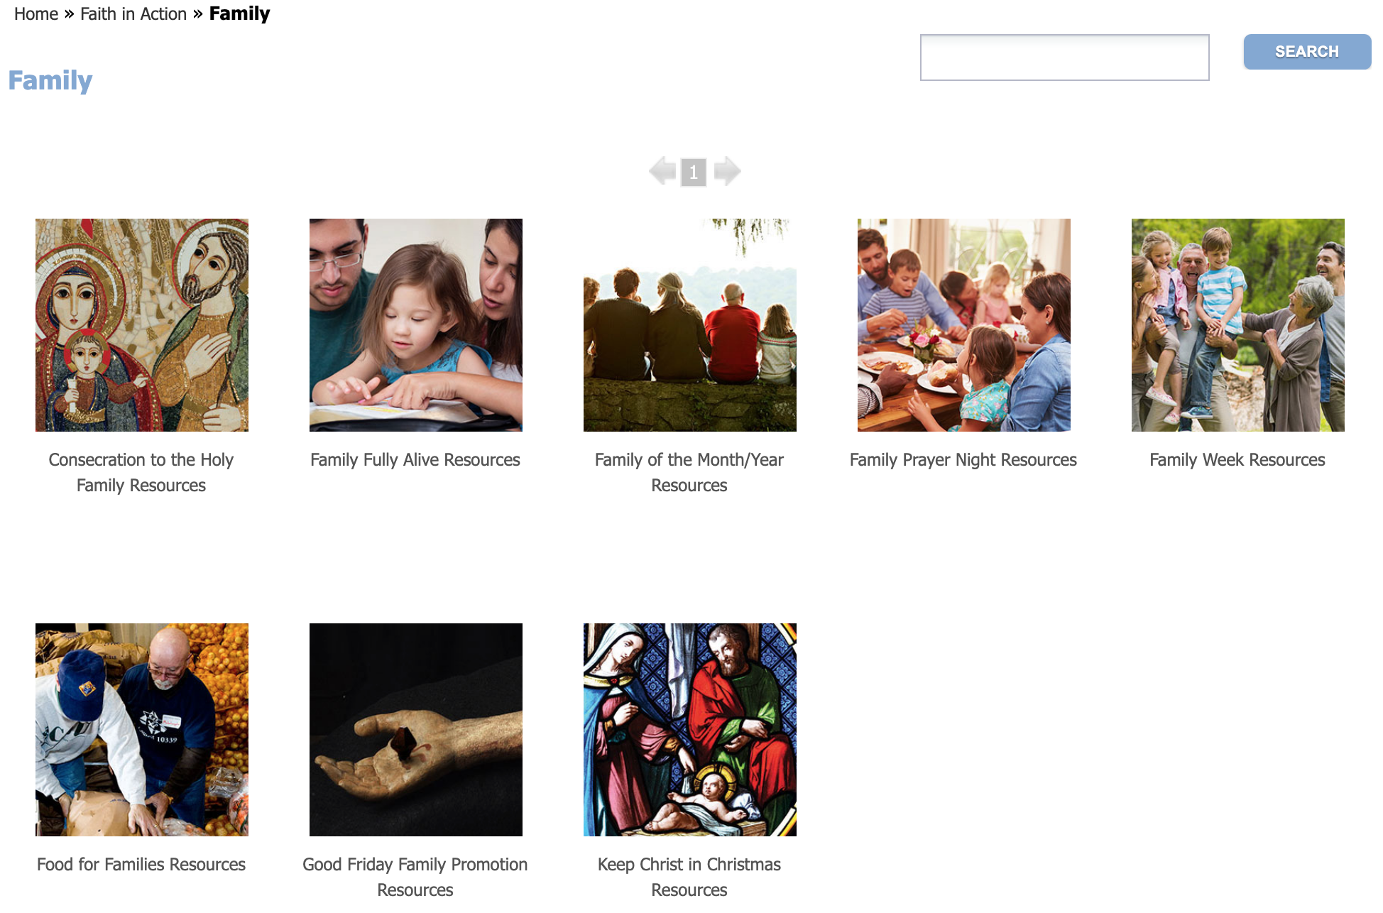
Consecration to the Holy Family

Slide 22
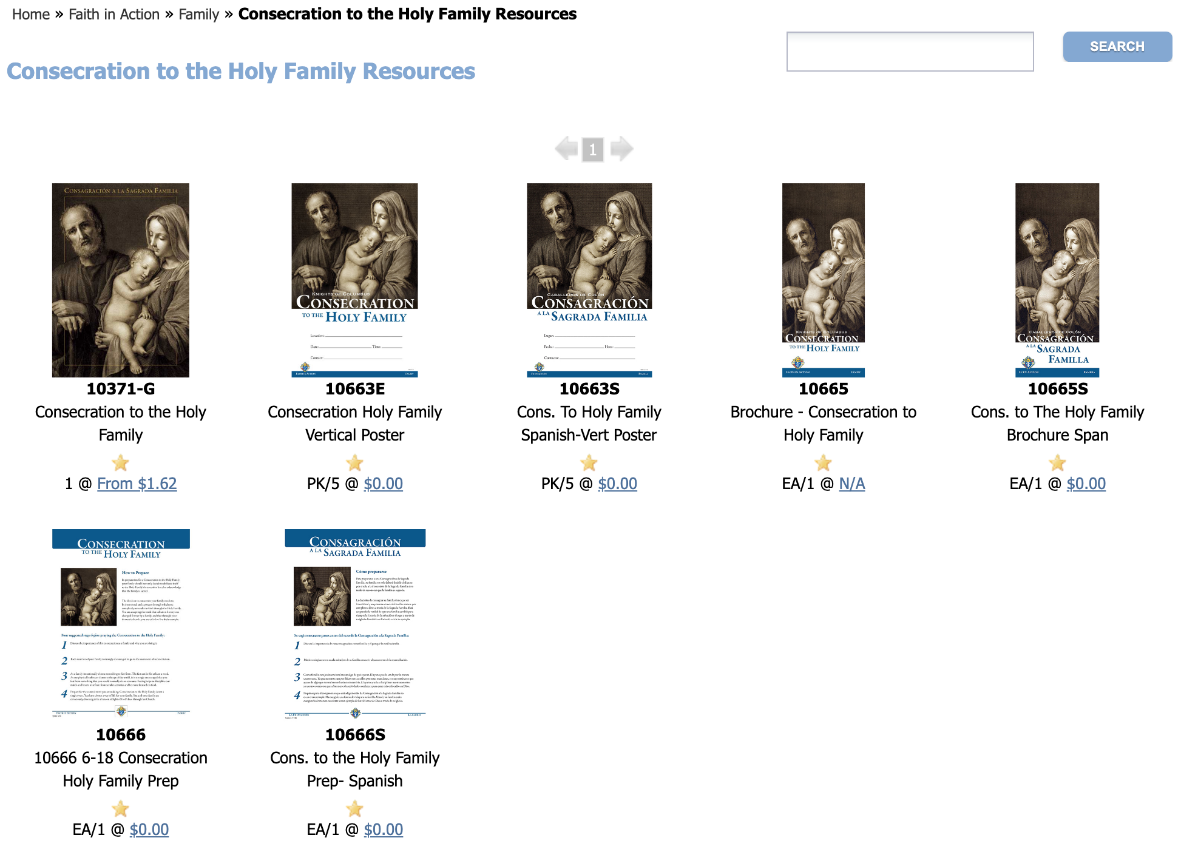
Consecration to the Holy Family

Slide 23
Supplies on Line - Community

Slide 24
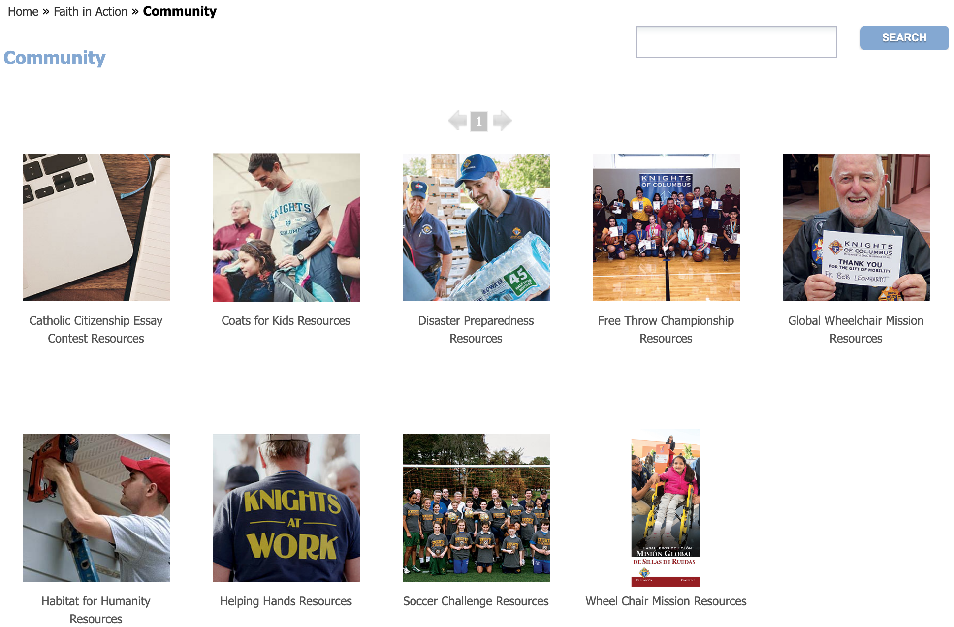
Helping Hands

Slide 25
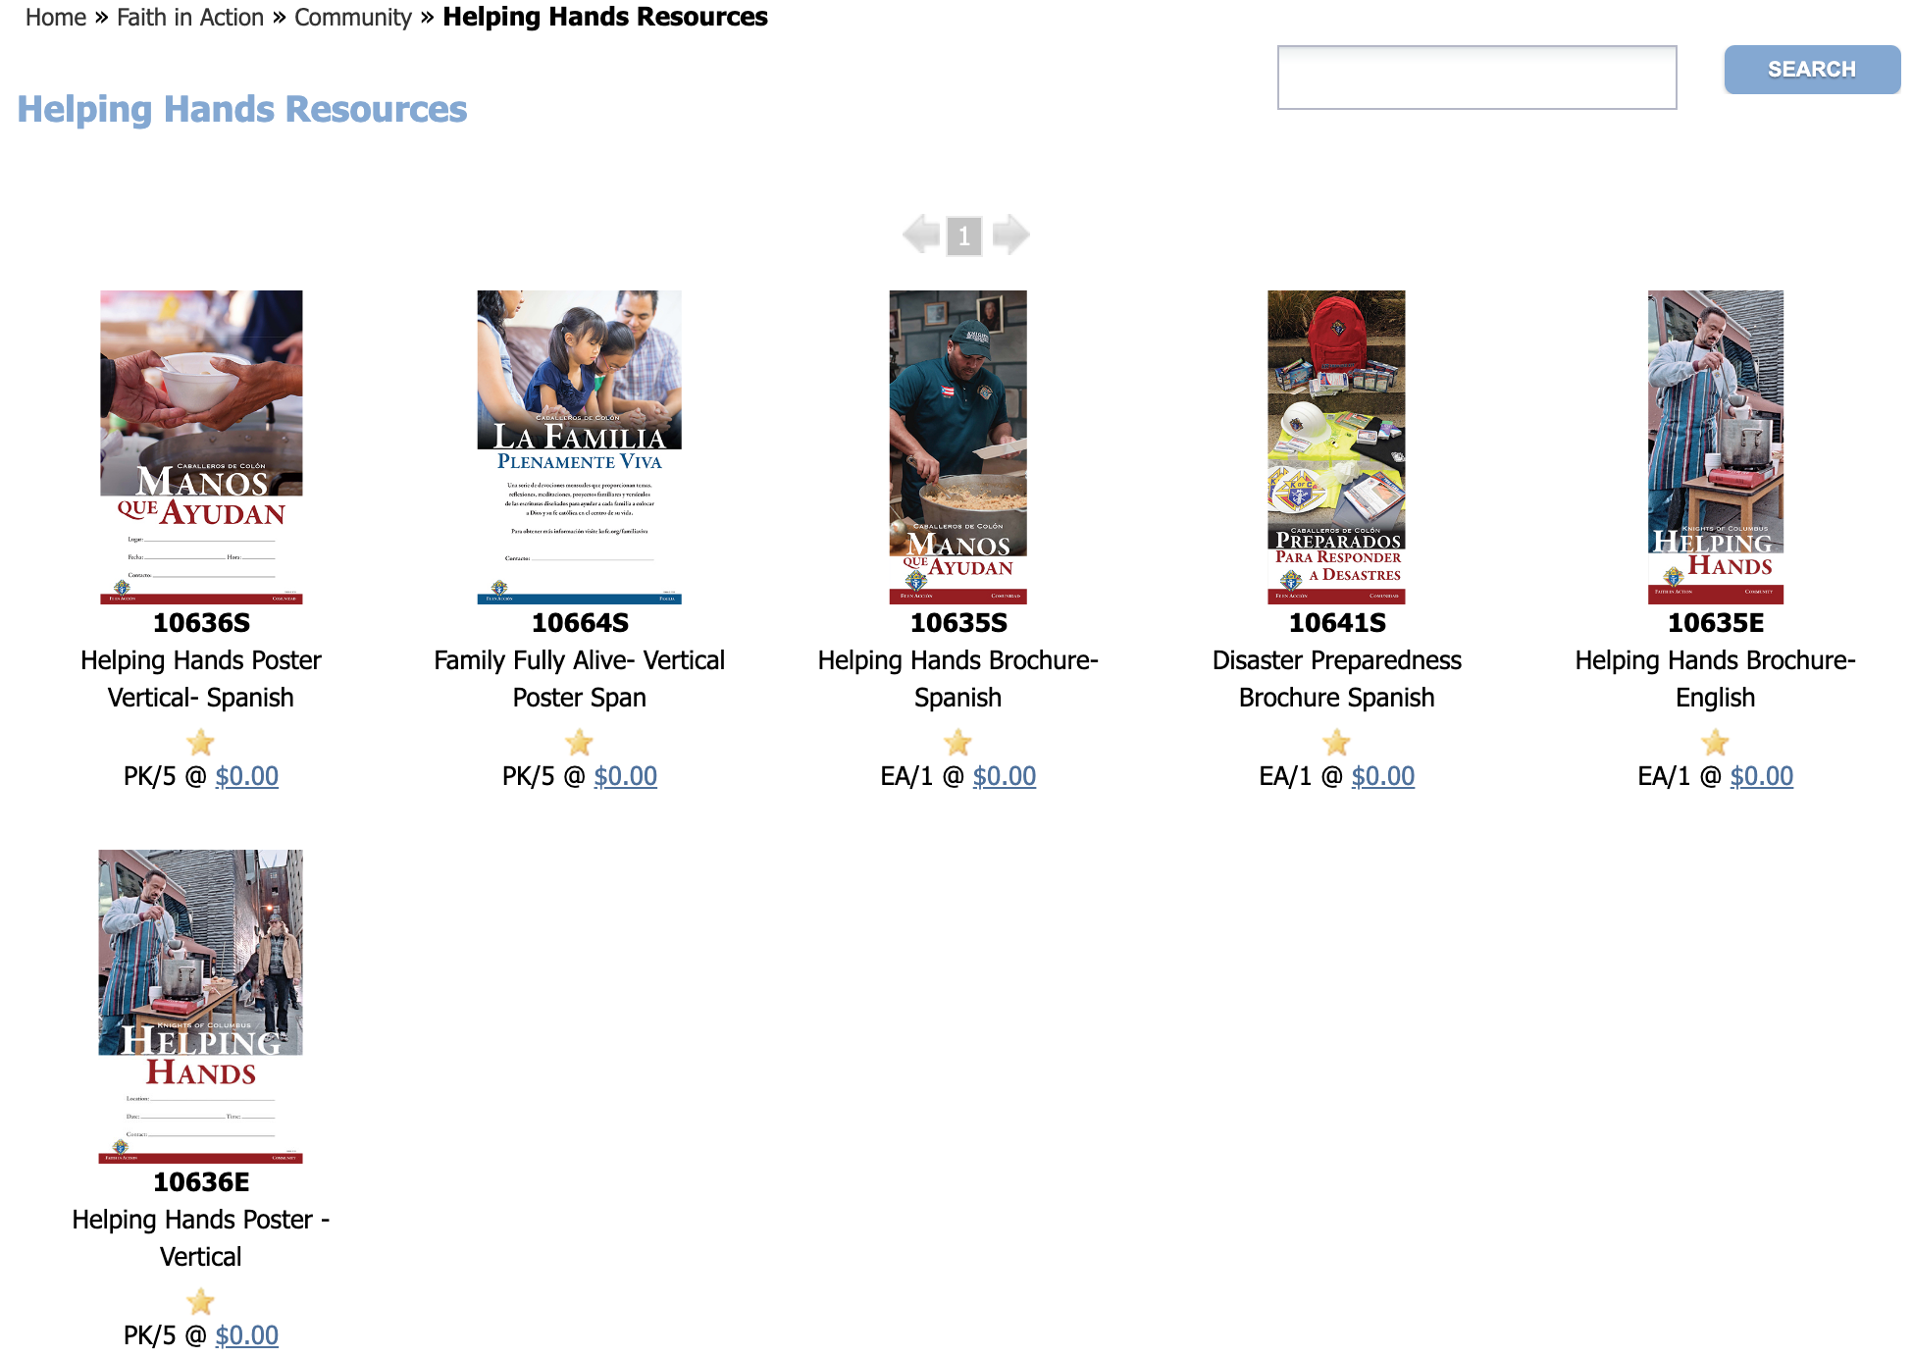
Helping Hands

Slide 26
Supplies on Line - Life

Slide 27
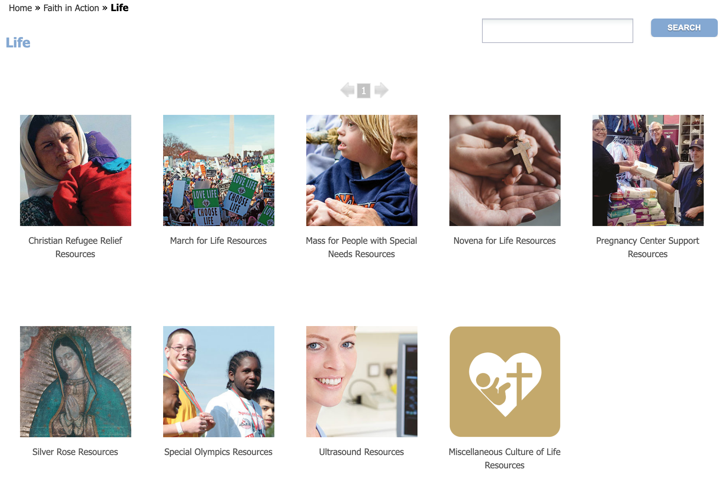
Novena For Life

Slide 28
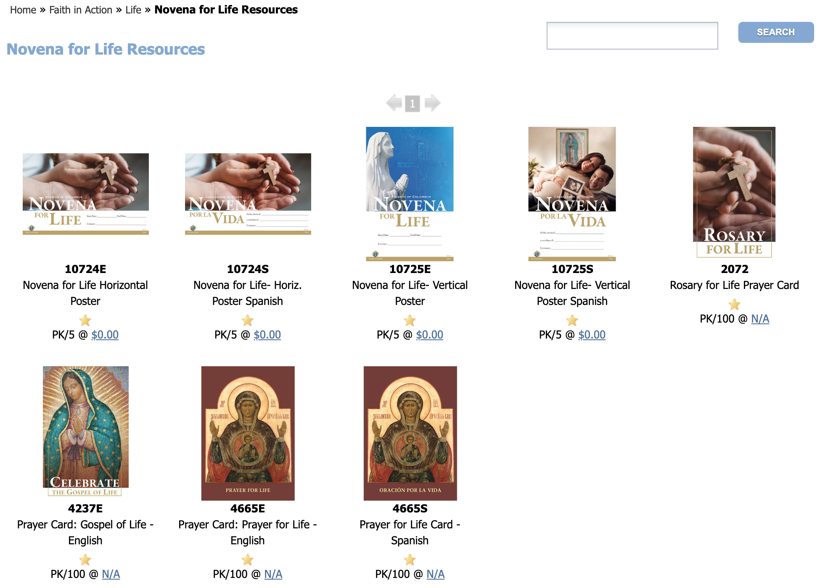
Novena For Life

Slide 29

Other Ideas: Spiritual Reflection https://www.sufferingchurchbook.com/

Slide 30
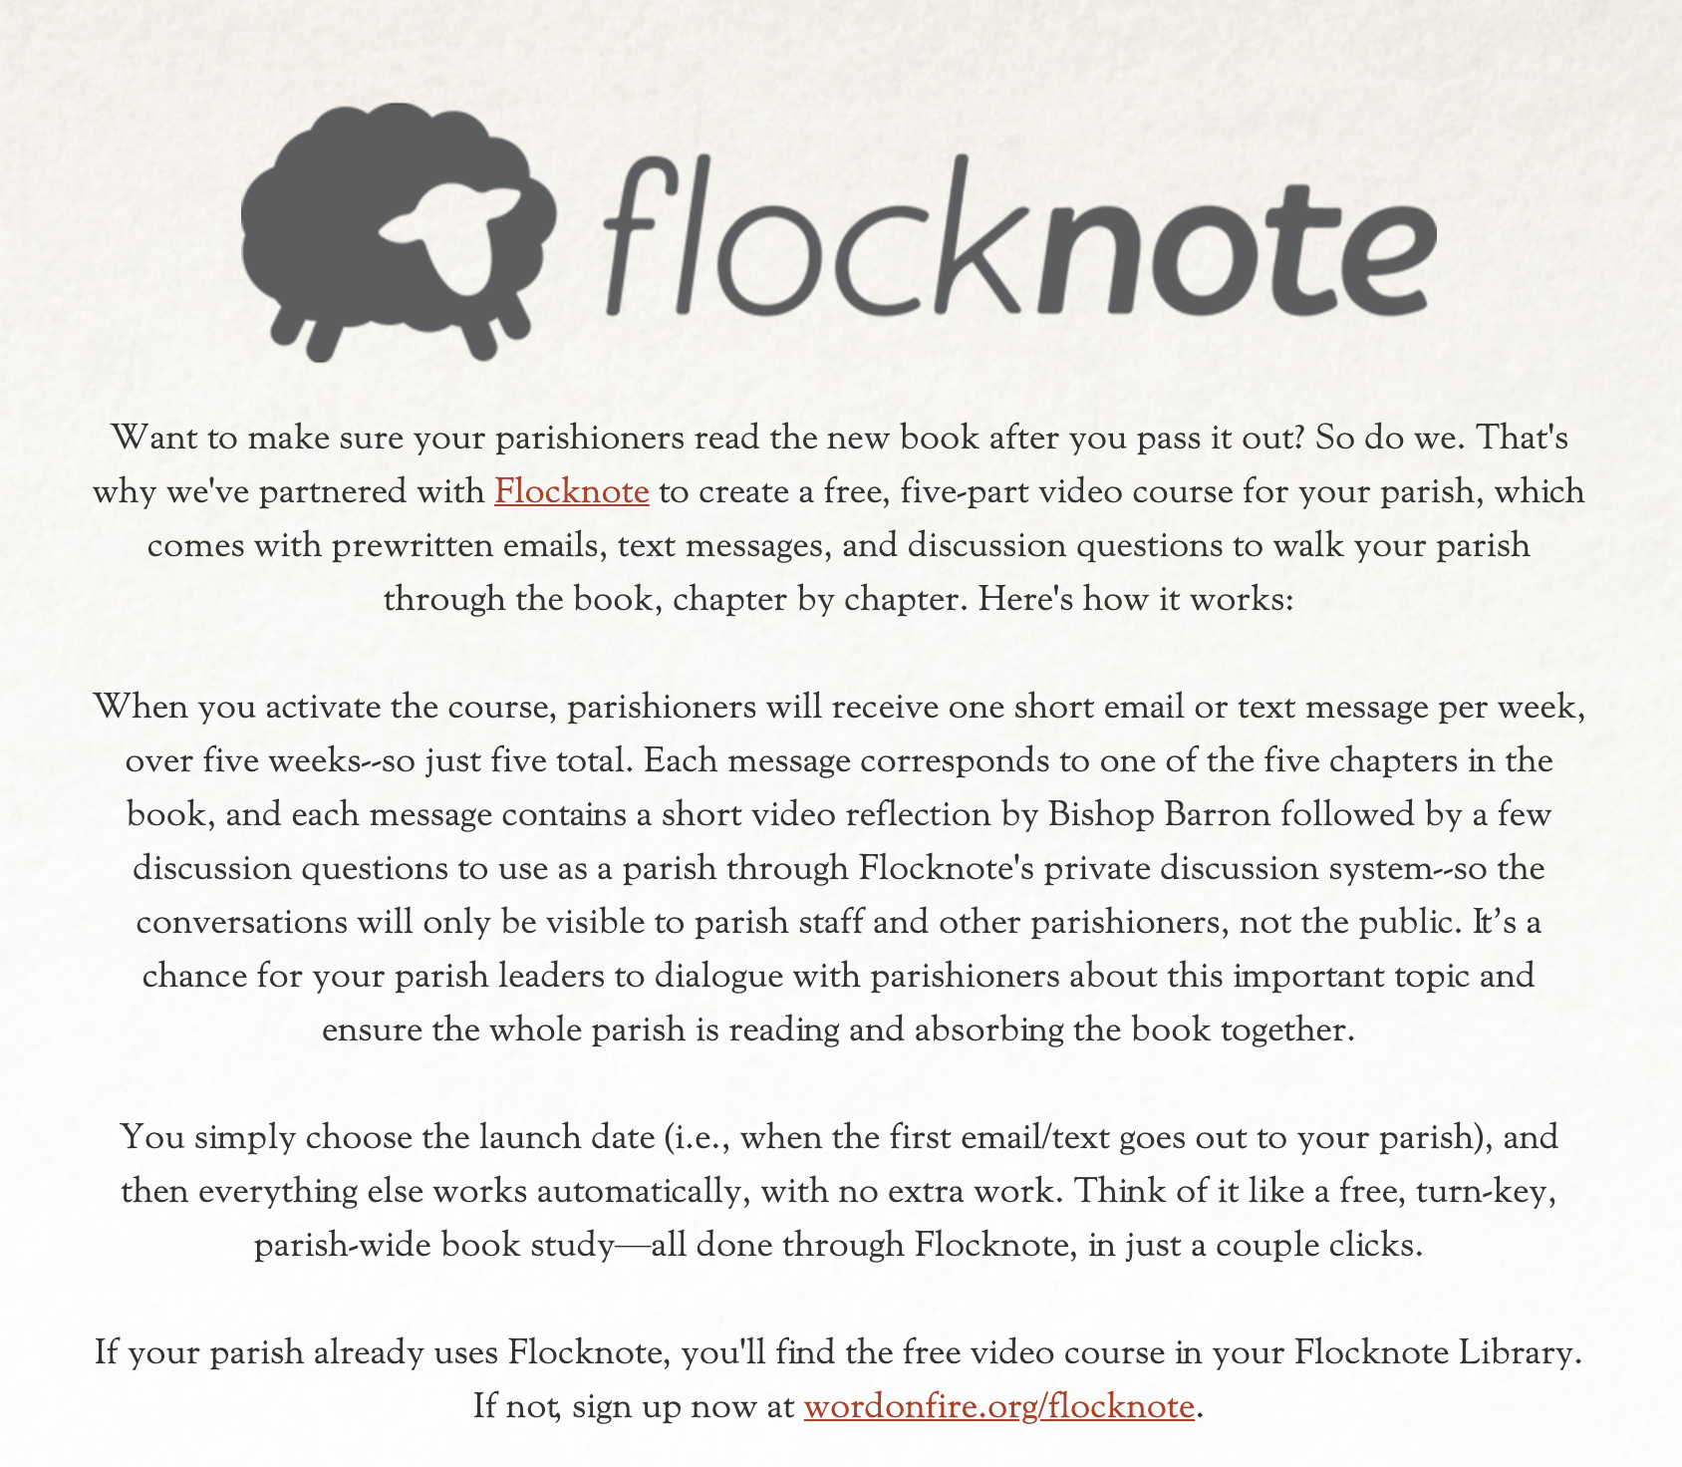
Other Ideas: Spiritual Reflection https://www.sufferingchurchbook.com/

Slide 31
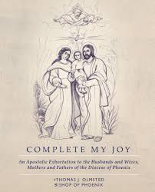
Other Ideas: Spiritual Reflection

Slide 32
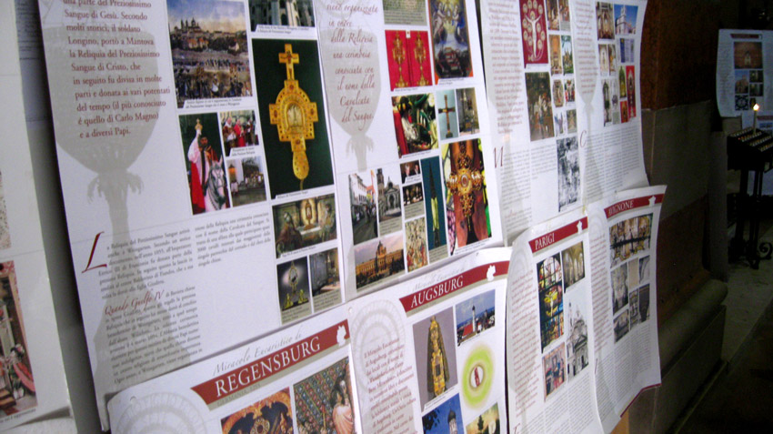
Eucharistic Miracles

Slide 33
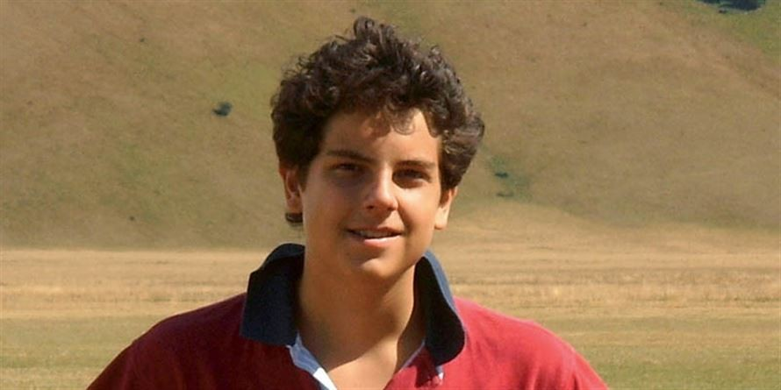
Venerable Carlo Acutis

Slide 34
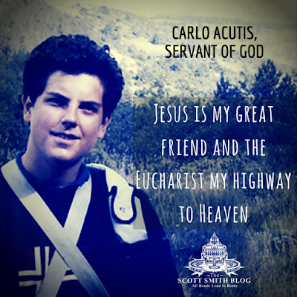
Venerable Carlo Acutis

Slide 35
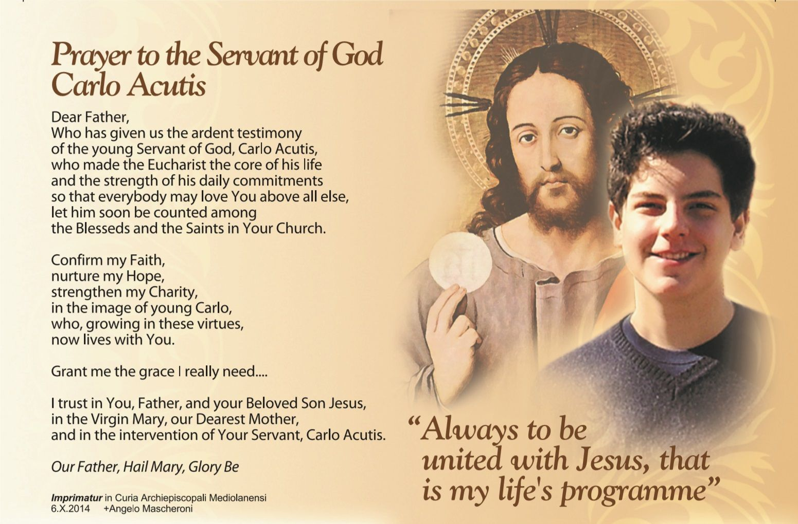
Venerable Carlo Acutis

Slide 36
Other Ideas Helping Hands
Repairing or Cleaning Homeless Facilities
Distributing Cold Water to the Homeless
Christmas in July
Work with Parishioners

Slide 37
2019 Knights at the Ballpark
Saturday, September 28th 2019 at 5:10pm
Arizona D-Backs vs. San Diego Padres
$32 – Lower Level – Baseline Reserve- Sections 133-135
$18 – Upper Level – Infield Reserve – Sections 318-320
D-Backs Express is available for pickup at Foothills Mall at 2pm
  $25 for adults
  $20 for kids 12 and under
Rich Ryan: 602-425-815 or rryan2708@gmail.com

Slide 38

PWID
(People With Intellectual Disabilities)

Slide 39
PWID
(People With Intellectual Disabilities)
Dates: September 27th & 28th
Location:
Let’s get creative
Fry’s Food Stores and Safeway
are no longer options

Slide 40

PWID
(People With Intellectual Disabilities)

Slide 41
PWID
(People With Intellectual Disabilities)
AZ State PWID Director
Joe Curran
520-331-4883
JC22925@gmail.com

Slide 42
Special Olympics
SOA is divided into geographic areas under an area management system.
We have emulated the same structure as SOA. The goal is to have a Knights joining the area SOA leadership team, and coordinating with Councils that fall under the SOA geographic area.

Slide 43
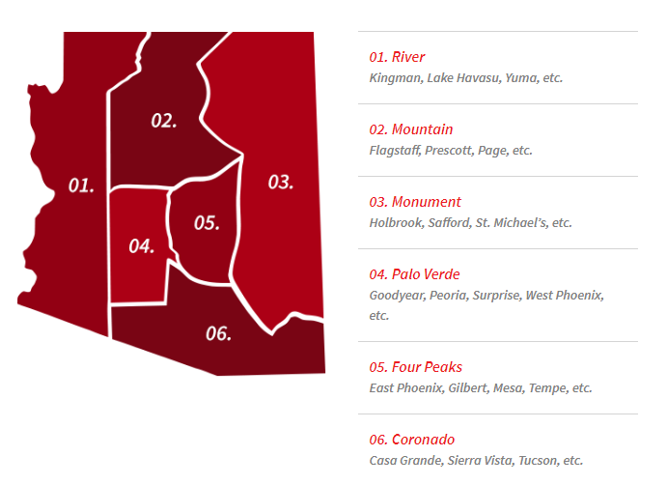
Special Olympics

Slide 44
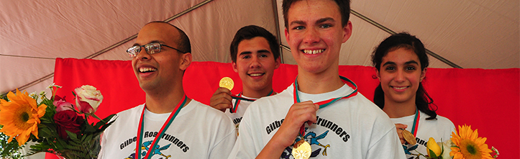
Special Olympics
DD’s & GK’s I will be asking for you to complete the
“Special Olympics Faith In Action Life Partnership Profile Report Form”
This is how the AZ State Council receives funds for Special Olympics from Supreme.

Slide 45
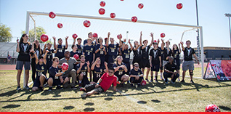
Special Olympics
Shawn Lynch
Shawn.t.lynch12@Gmail.com
Joe Curran
JC22925@Gmail.com

Slide 46
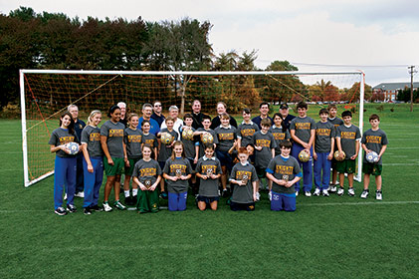
State Soccer Challenge
Joe Danko, State Youth Director
joedanko@cox.net
602-719-0418
Howard Birnbaum, Soccer Chairman
buckbirn@aol.com
602-809-5442
Info at:
http://www.kofc.org/en/programs/community/soccer-challenge.html#/

Slide 47
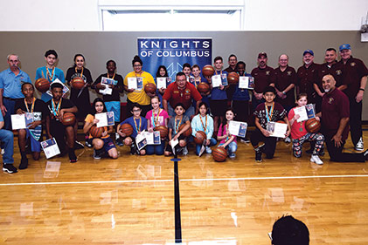
Free Throw
Joe Danko, State Youth Director
joedanko@cox.net
602-719-0418
Ray Cruz
Info at:
http://www.kofc.org/en/programs/community/free-throw-championship.html#/

Slide 48
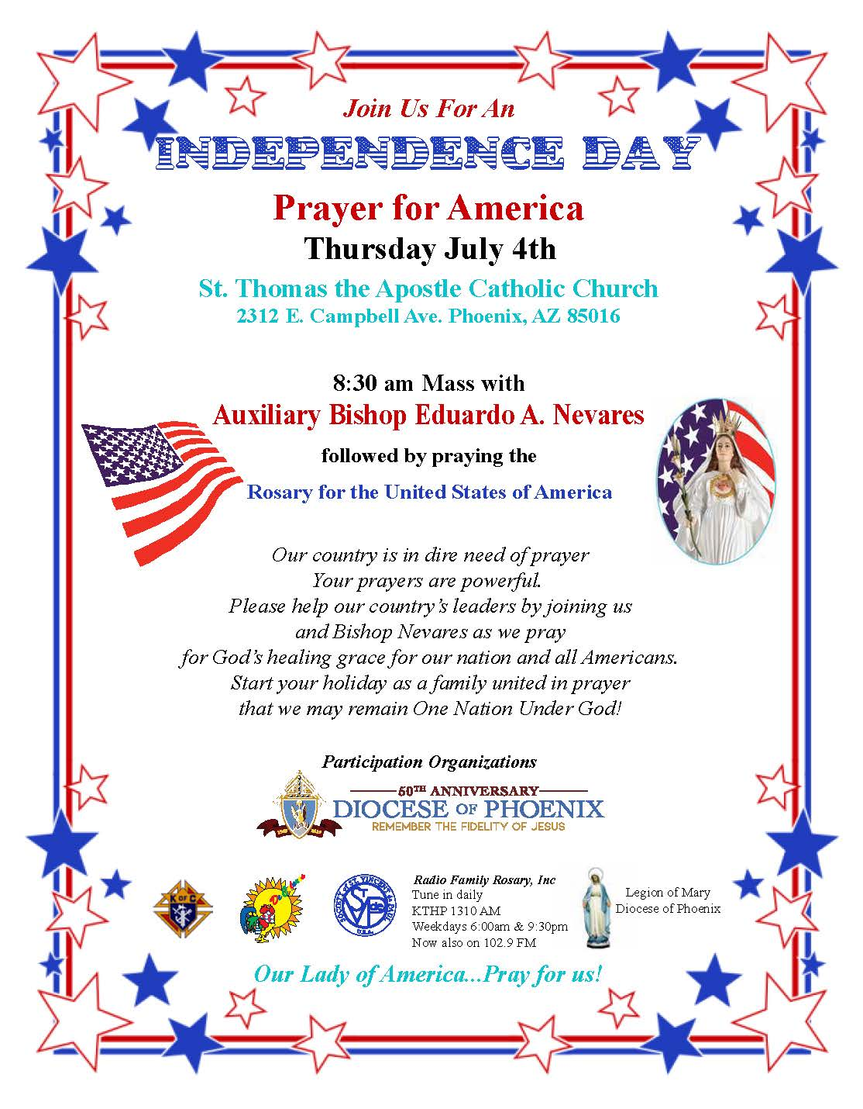
Independence Day
Mass & Rosary for America

Slide 49
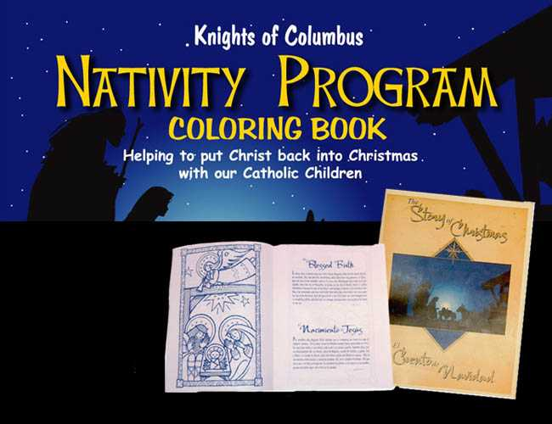
KofC Nativity Coloring Book Program

Slide 50
Keep Christ in Christmas
Dennis Schauer, Chairman
480-363-8791
djschauer@cox.net
Order Christmas Cards and Products through the Knights of Columbus to evangelize the Birth of Christ
Sell to parishioners, fellow Knights, family, friends...
Promote and coordinate the Christmas coloring contest for parish youth
Show your Faith in Action, a Qualifying Family Program
View products @ www.CHRISTisCHRISTmas.com

Slide 51
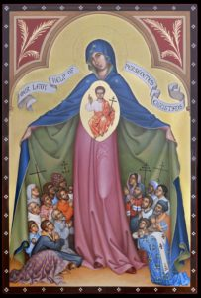
Marion Prayer Program
Bryant Sayers, District Master
(520) 456-7172
Bryant.Sayers@gmail.com

Slide 52
Arizona Rosary Celebration
44th Anniversary
October 19 & 20, 2019
Larry Costanzo, State Chairman
    lcostanzo1@cox.net
Tucson Chairmen:
Karen McEwen
  kmcewen@seastucson.org
Al Tucker, Tucson Co-Chair
  altucker@yahoo.com
Phoenix Chairmen:
Danny Haywood, Phoenix Chairman
  dhaywood65@gmail.com
Greg Mattingly, Phoenix Co-Chair
  gmattingly3855@live.com
52

Slide 53
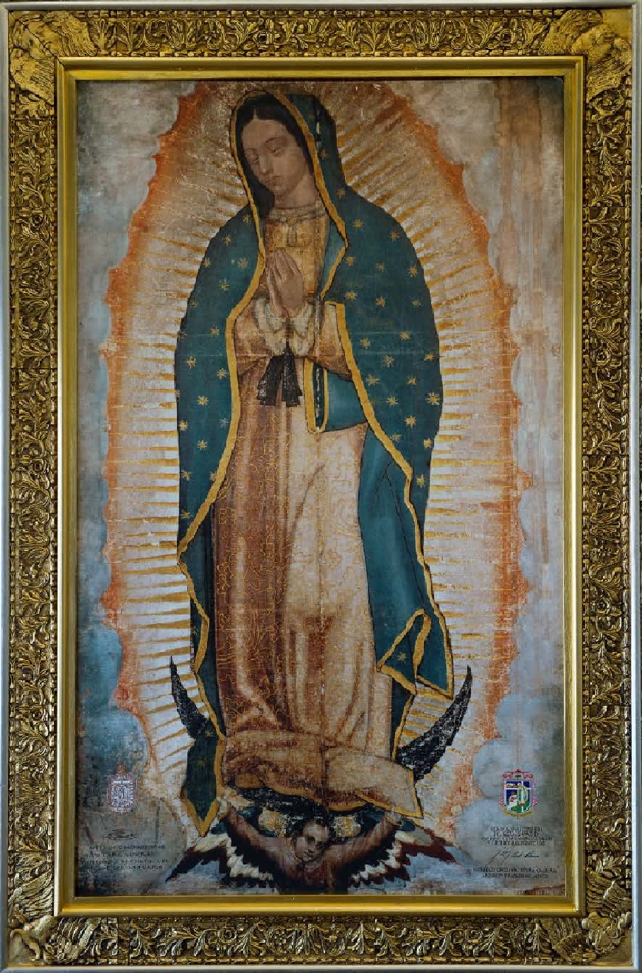
Arizona Rosary Celebration
44th Anniversary
October 19 & 20, 2019
Each Year Honor Mary under one of her many titles on a rotation basis
This year:
Our Lady of Guadalupe
53

Slide 54
TUCSON, ARIZONA
Saturday, October 19, 2019
9:00 a.m. to 11:00 p.m.
St. Augustine Cathedral
192 S Stone Avenue
Tucson, AZ 85742
Most Rev. Edward Weisenburger
Bishop of Tucson, Presiding
Guest Speaker: Rev. Robert Gonzalez, St. John Evangelist Parish, Tucson
54

Slide 55
PHOENIX, ARIZONA
Sunday, October 20, 2019
2:00 p.m. to 4:15 p.m.
Phoenix Convention Ctr, Halls F & G
100 N. 3rd Street
Phoenix, AZ 85004
Most Rev. Thomas J. Olmstead Bishop of Phoenix, Presiding
Guest Speaker: Rev Robert Gonzalez, St. John Evangelist Parish, Tucson
55

Slide 56
Arizona Rosary Celebration
44th Anniversary
October 19 & 20, 2019
  PROGRAM
Pre Program Concert
Bishop Procession
  4th Deg Knights, Altar Servers, Rosary Leaders, Bishop
  Blessing Procession
  Organizations with banners, Parish Reps,
  Guest Speaker
  Collection
  Blessed Sacrament Processional
  Entrance and exposure of the Blessed Sacrament
  Rosary
  Benediction
  Blessed Sacrament Recessional
56

Slide 57
Arizona Rosary Celebration
44th Anniversary
October 19 & 20, 2019
K OF C COUNCILS WE NEED YOUR HELP
We need your assistance
  DD’s Please Communicate Information to your Councils
    Outlying areas are not hearing about this Celebration and how they can support it.
Want to have every Council/Assembly Banner in the Blessing processions
Assistance on committees
AD Chair Phoenix and Tucson
Backups for all committee people
Act as parish Reps if pastor does not appoint one
Ushers
Many positions need help
TO MAKE ARIZONA ROSARY CELEBRATION A SUCCESS
Arizona Knights of Columbus
2019 Organization Meeting
57

Slide 58
Arizona Rosary Celebration
44th Anniversary
October 19 & 20, 2019
PARISH REPRESENTATIVES
Represent the Pastor for Arizona Rosary Celebration
Integral Part of the Organization
  Advertise Rosary Celebration in each parish
  Hand out flyers; hang up posters; bulletin notices
  Outlying areas need to get the word
  Info on Arizona Rosary Celebration will be sent to those Grand Knights of parishes where there is no Rep
  K of C project: We need ALL councils onboard!!
58

Slide 59
Arizona Rosary Celebration
44th Anniversary
October 19 & 20, 2019
  WE NEED YOUR HELP
  PROGRAM BOOK
  Primary Source of income
    Only ad sales
      No outside funding from our Diocese or grants
    What we need
      Ads from many sources:
      Councils, Assemblies, Parishes, Parish Bulletin Advertisers, Barber Shops, Restaurants, Stores, Doctors, Patrons, etc.
      (no insurance and must be pro-life).
        (74 of 134 Councils (55 percent) /31 of 52 Assemblies (52 percent) participation)
        In 2018 Councils and Assemblies bought $24,000.00 in adds! 1/3 of the cost !
        We do have ability to take Credit Cards
  WE NEED ADS FROM EVERY COUNCIL AND ASSEMBLY!!
  We now have a 501(c)(3) designation so donations are
  tax deductible according to law
59

Slide 60
Arizona Rosary Celebration
44th Anniversary
October 19 & 20, 2019
  WE NEED YOUR HELP
  Cost for Program in Phoenix and Tucson $80,000.00
  Annual expenses:
Program Book/Flyers/Printing $27,100.00
Event expenses: Phoenix/Tucson $43,000.00
Convention Ctr, audio/Visual, Facilities
  Other - Pins, Advertising, Misc. $7,400.00
  Total Income $78,400.00
  Total Expenses $77,500.00
  $ 900.00
  Cost so far in 2019 $ 5,900.00
60

Slide 61
Arizona Rosary Celebration
44th Anniversary
October 19 & 20, 2019
ROSARY CELEBRATION INFORMATION
Information on your tables
Updates and Printable Forms are available on the
Arizona Rosary Celebration web site:
http://www.azrosary.net
Email for information or questions:
  azrosary@yahoo.com
61

Slide 62
Arizona Rosary Celebration
44th Anniversary
October 19 & 20, 2019
As Knights we devote ourselves to the Blessed Mother in all her titles and the Rosary through our First Degree.
Every Council and Assembly should be represented in the Blessing Procession with a banner.
Lets put our words into action Gentleman!
LETS BE THE LEADERS IN 2019!
62

Slide 63
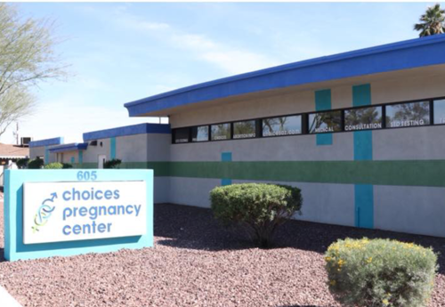
Ultrasound Initative

Slide 64
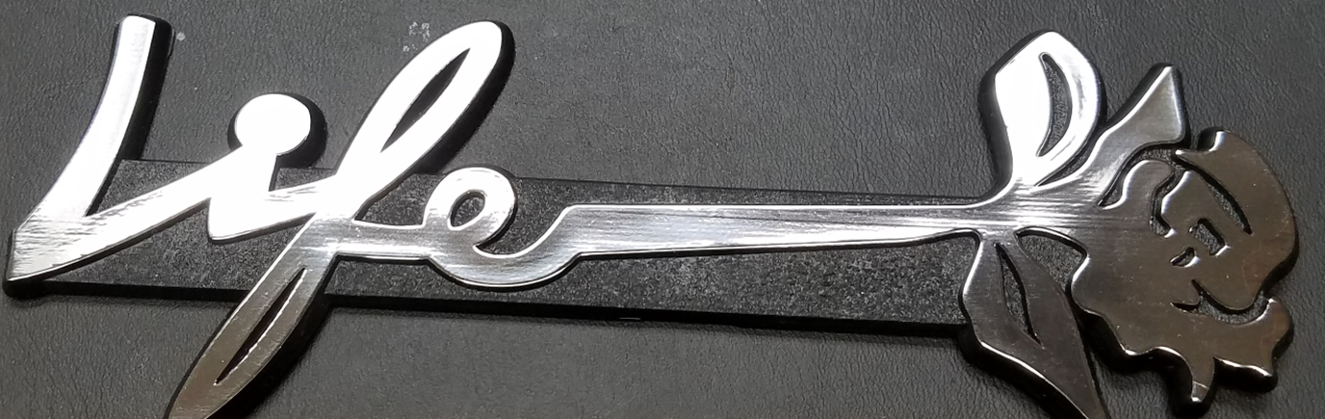
Ultrasound Initiative
Centers
Is there one on your Car?
Aid to Women
Hope Pregnancy Center
Care Net Sierra Vista
Choices Tempe

Slide 65
Ultrasound Initiative
Joe Kramer
7417 West Fawn Drive Laveen Village, AZ 85339
(702) 468-5035
pgkjoe@gmail.com
Make checks out to AZ Knights of Columbus Charity INC

Slide 66
Vivat Jesus

Slide 67
Knights Serving God – Serving the Community
This is who we are – This is what we do

Slide 68
Arizona Knights of Columbus
2019 Org Meeting
Per Capita, Reports and Awards
68

Slide 69
Topics
Per Capita Assessment
DD Reports
Form 994A/B – Semiannual Report on Council Status
Supreme Expense Form
Monthly District Activity Report
District and Council Awards
Council Reports
Form SP-7 – Columbian Award Application
Form 185 – Report of Officers Chosen for the Term
Form 365 – Service Program Personnel Report
Form 1728 - Survey of Fraternal Activities

Slide 70
Per Capita Assessment
Council Half-year Per Capita Assessment:
$3.50 per active member
$2.25 per inactive member
Number of Council Members for each category (established by Supreme on July 1 and January 1)
In this example we have:
214 Active Members * $3.50 = $749.00
21 Inactive Members * $2.25 = $ 47.25
TOTAL = $796.25
Rebate for paying early ($0.10 per active member) = $21.40
St. Joseph Youth Camp –$1.00 per Active Taxable Member = $214
Navarrete Vocation (a penny per day per active member): $389.48

Slide 71
Form 450
What you need to do as DD
Attend each Degree Exemplification in your district
If you cannot attend, you should delegate to your District Warden
At an Admission Degree, you should address the newly exemplified brother knights
Fill in Form 450 as soon after the Degree is completed
Submit Form 450 to Supreme Council
  Email: membershiprecords@kofc.org
Send a copy of Form 450 to the SD
Keep a copy for your records
This form can be filled online

Slide 72
Form 994A/B: Semiannual Report on Council Status
Why are DDs required to submit these forms?
It is vital for SDs and Supreme to know the health and status of each council
No one knows a council better than its DD.
When to file
Form 994A – by December 31
Form 994B – by June 30
Whom to file with
SD and Supreme Office
  Email: council.accounts@kofc.org
DD should keep a copy for his files

Slide 73
Supreme Expense Form
What you need to do
Keep a copy of Expense Report with you when traveling on Knights of Columbus business
Enter a record in Expense Report, detailing your trip.
Submit Expense Report to SD for approval quarterly
Submit all receipts with form.
Keep a copy for your records.

Slide 74
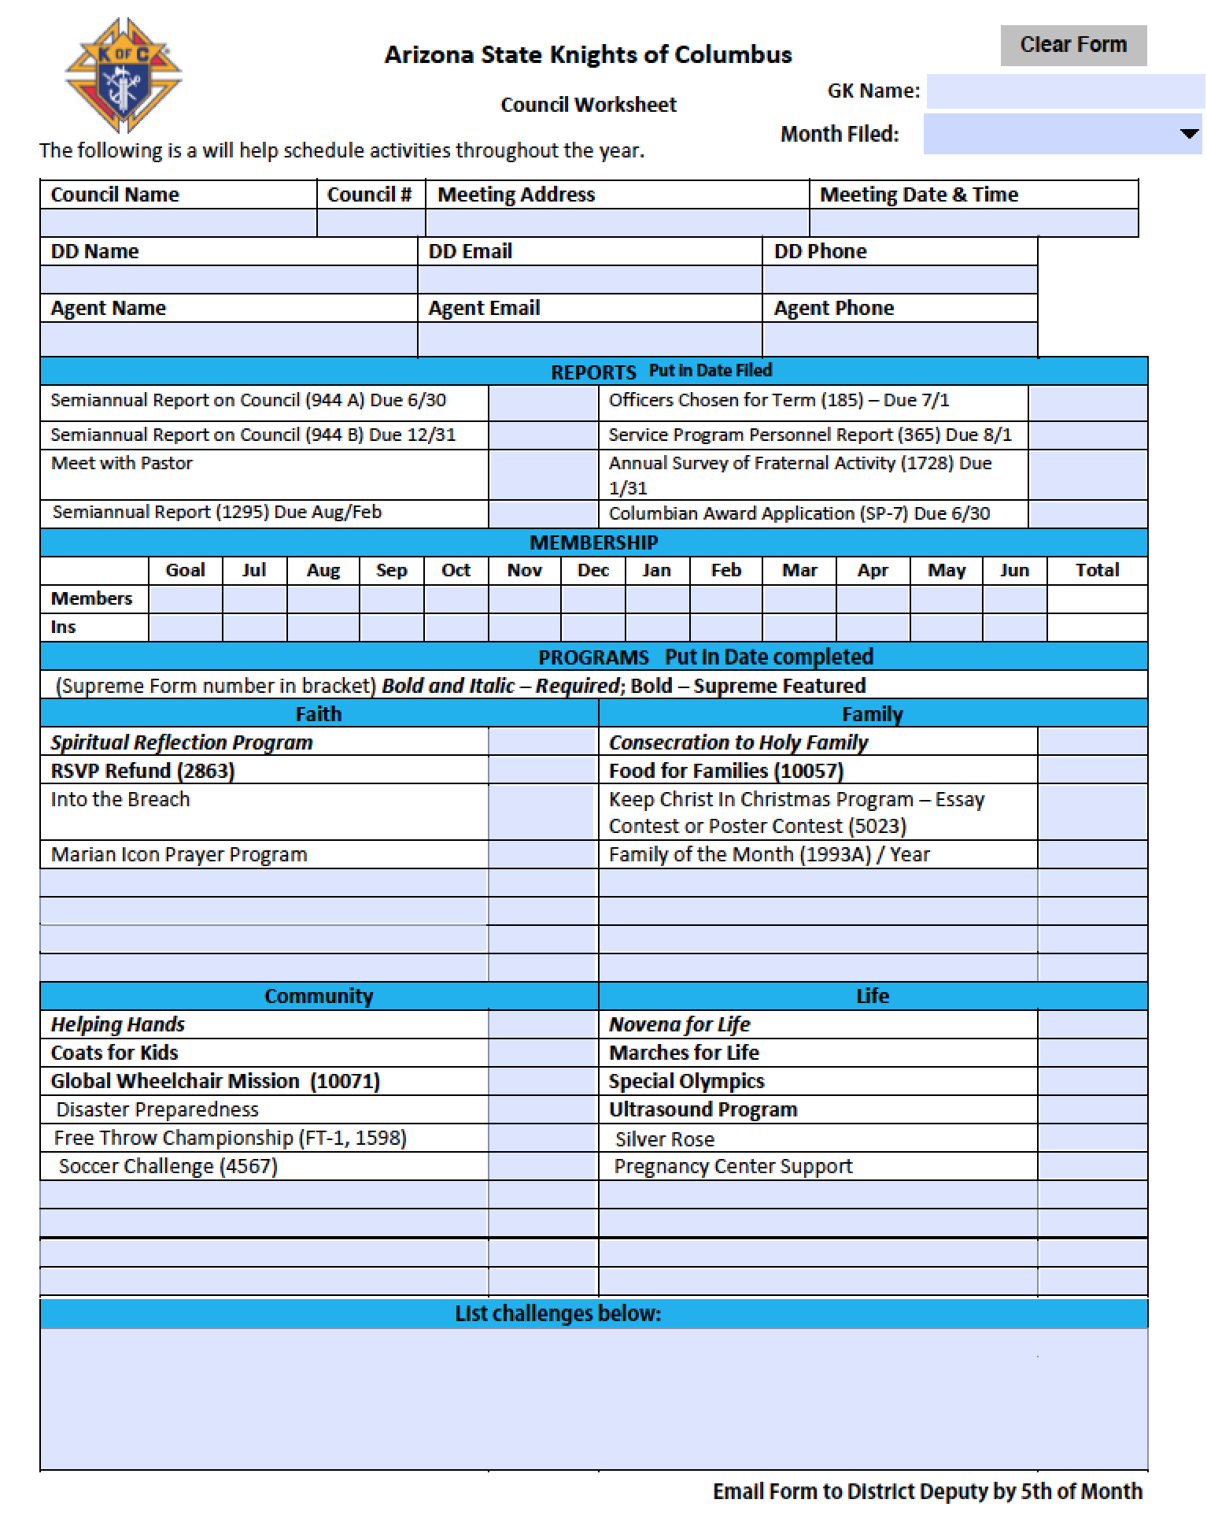
Monthly Council Activity Report
Dropdown list for month filing report
Date Filed
Goal and number by month
Example: Filing for September: if 3 new members, put 3 in Sep
Date Program Done
Challenges for month
Send to DD by 5th of month

Slide 75
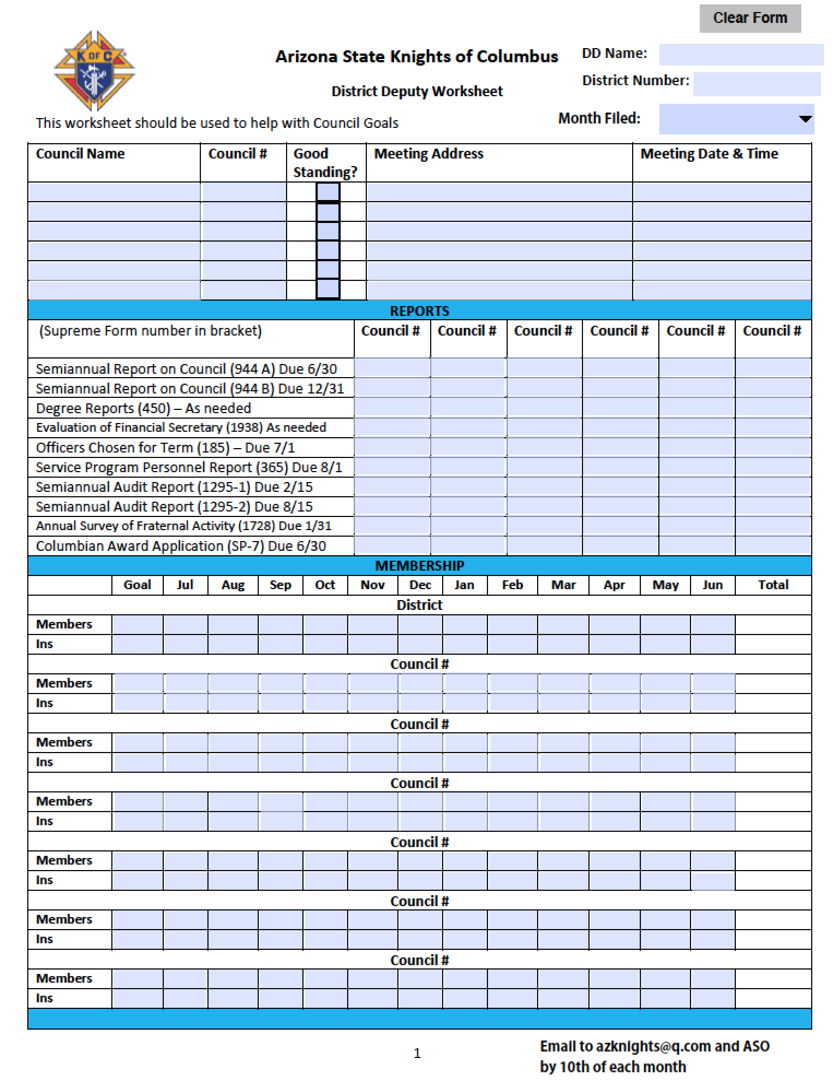
Monthly District Activity Report
What you need to do as DD
Remind your GKs to submit their Council Activity report by not later than the 5th of each month
Use the information from your councils’ reports to fill in yours
Select the main activities/challenges to report
Submit report by email to the SD
  Email: AZKnights@q.com
Send a copy to your ASO
Submit report by not later than the 10th of each month

Slide 76
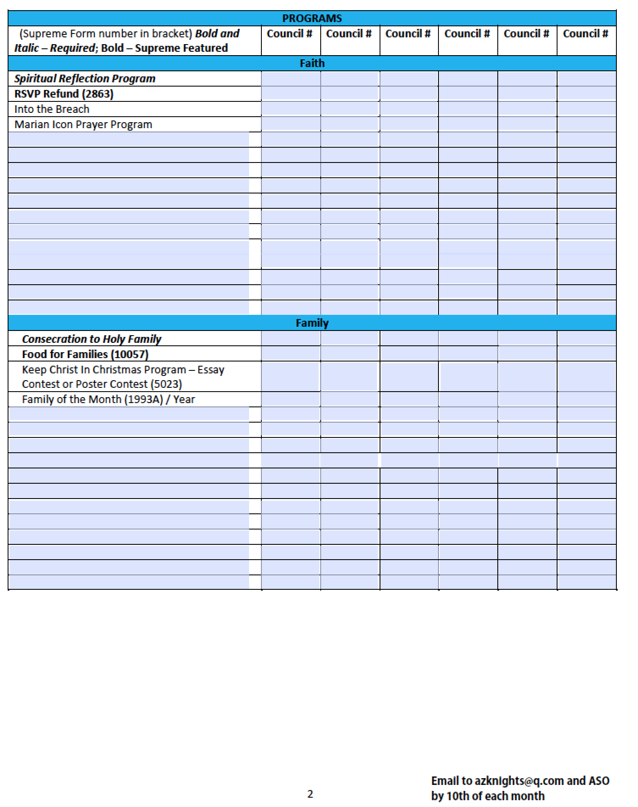
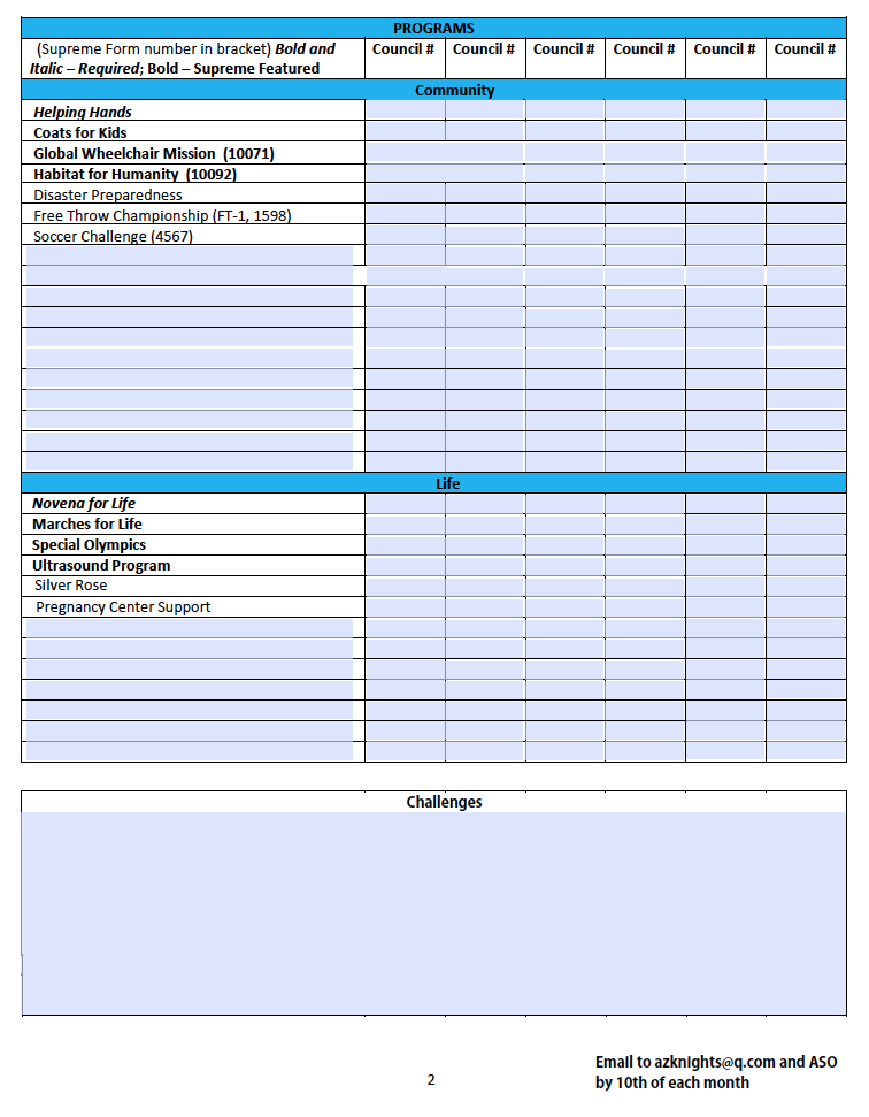
Monthly District Activity Report

Slide 77
District Awards
New Council Award
  Given to a district deputy responsible for the development of a new council.
  Plaque with a miniature charter of the new council and name of the DD below.
Star District Award
  Given to a district deputy who attains 100 percent or more of the district membership net gain quota and the district insurance net gain quota and has at least one of the councils in the district earn one of the levels of the Star Council Award.
All Star District Award
  Given to a district deputy who attains the Star District Award requirements and have all of his active councils earn the Star Council Award. Must have a minimum of three active councils to be All Star and only available in insurance territories.

Slide 78
Council Awards
Father McGivney Award
  Recognizes excellence in council membership growth
  Supreme Council assigns a membership quota for each council
  Council Membership Growth is considered to be net increase over losses through suspension or withdrawal. Deaths and transfers in and out do not count against quota.
Founders’ Award
  Recognizes excellence in the promotion of our insurance and fraternal benefits
  Growth is considered to be net gain above losses through suspensions, withdrawals and transfers from insurance to associate membership
Columbian Award
  Recognizes a council’s charitable service activities and fraternal programs in each of four Faith in Action categories (Faith, Community, Family, Life)

Slide 79
Star Council Award
In order for a council to earn the Star Council Award, it has to:
Earn the Father McGivney Award for membership growth;
Earn the Founders’ Award for insurance growth;
Earn the Columbian Award for well- rounded council programs by submitting the Columbian Award Application (#SP-7);
Submit the Service Program Personnel Report (#365);
Submit the Annual Survey of Fraternal Activity (#1728);
Comply with the Safe Environment Requirements
Remain current with assessments charged by Supreme
Reference: Visit kofc.org/star

Slide 80
Contest of Champions Award
Contest of Champions Award
  Awarded to two councils in each jurisdiction:
  The council with the highest percentage growth in membership, and
  The council with the highest numerical net gain in membership.
  No application is required as eligibility is automatically determined by the Supreme Council.

Slide 81
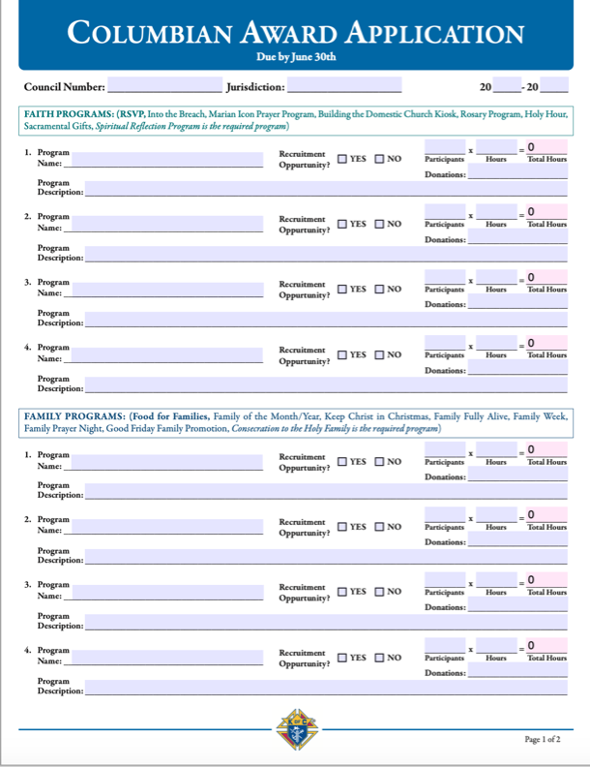
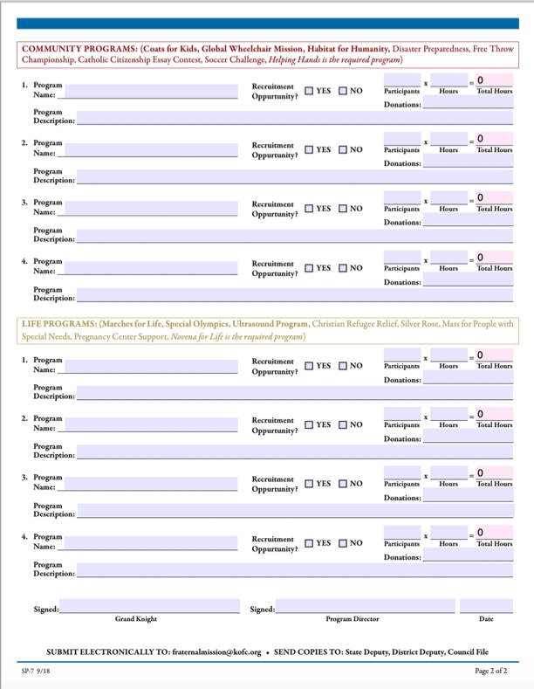
Columbian Award Application - Form SP-7

Slide 82
Columbian Award Application - Form SP-7
In order to qualify for the Columbian Award, your council must:
Annually conduct and report at least four(4) major involvement programs in each of the sections: Community Programs, Faith Program, Family Programs, and Life Programs.
Recommended programs and the required program for each category are listed on the application. Councils are permitted to report programs that are not part of the recommended group as long as the program is reported in the proper category.
If your council reports a featured program in any category, ensure that the program’s minimum requirements are met and reported on the designated form in order to receive credit for two activities in that category. The minimum requirements for each featured program are located in the Faith In Action Guidebook (#10590).
Submit the Annual Survey of Fraternal Activity(#1728). New councils instituted after November 1 of the current fraternal year do not need to meet this requirement.
Submit the Service Program Personnel Report(#365) with required roles and meet the Safe Environment Program compliance requirement. The most efficient way for submission is by using the Member Management Application.
Maintain compliance with the Safe Environment Program throughout the fraternal year. Report all updates for the Community Director, Family Director, and Program Director roles in a timely manner so that training and background checks can be completed before the end of the fraternal year.

Slide 83
Columbian Award Application - Form SP-7
Form SP-7
Due on June 30 (by 10:00am MST)
Needed for Star Council eligibility
Can be submitted as early as April 1
Can be filled in online
Form SP-7 should be used as an event planner
Form SP-7 can be filled in as council holds its events
Need to be Safe Environment Training compliant – GK & Directors
Submit SP-7 to Supreme Council, Department of Fraternal Services
  Email: fraternalmission@kofc.org
Send copies of SP-7 to SD and DD
Council should keep a copy on file
The submission of Form SP-7 does not guarantee approval
Early submission may allow time for revision and resubmission

Slide 84
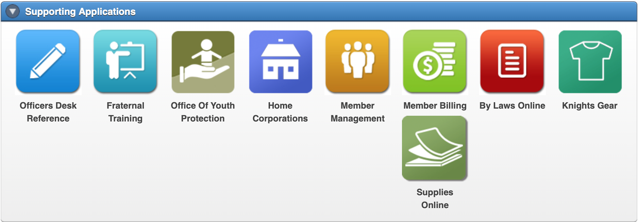
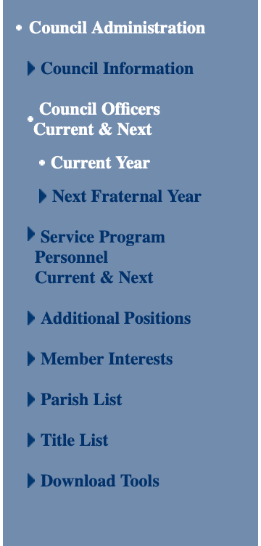
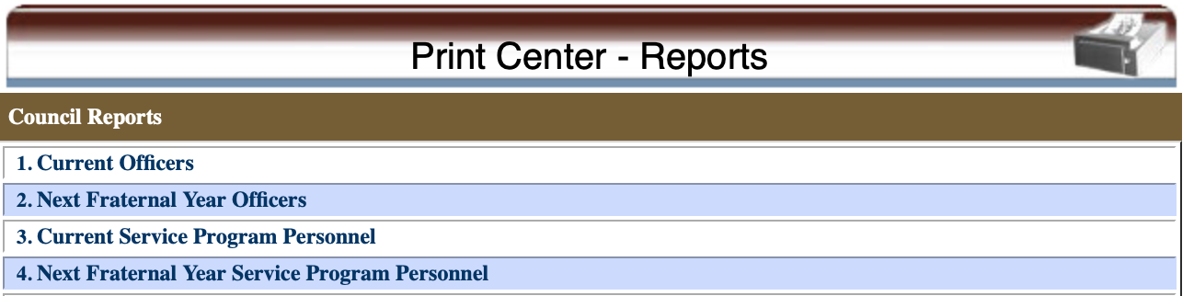
Report of Officers Chosen for the Term
Due on June 30 (of prior FY)
USE MEMBER MANAGEMENT!!
EMAIL COPIES TO AZKNIGHTS@Q.COM and DD!
What you need to do as DD
Remind councils to fill in and submit form
Make sure the form is submitted on time.
Form can still be submitted late.
Form can be submitted multiple times during year.
Help council fill and submit the report if necessary.

Slide 85
Report of Officers Chosen for the Term – Form 185
Due on June 30 (of prior FY)
Needs to be submitted to Membership Records
  Email: membershiprecords@kofc.org
Copies sent to SD and DD. Copy kept in Council Records
Can be filled online.
What you need to do as DD
Remind councils to fill in and submit form
Make sure the form is submitted on time.
Form can still be submitted late.
Form can be submitted multiple times during year.
Help council fill and submit the report if necessary.

Slide 86
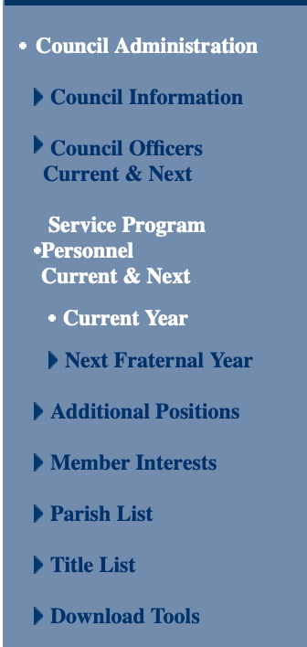
Service Program Personnel Report
What you need to do as DD
Remind council to fill in and submit form
Make sure the form is submitted on time.
Form can still be submitted late.
Form can be submitted multiple times during year.
Help council fill and submit the report if necessary.
Due on August 1
Needed for Star Council eligibility
USE MEMBER MANAGEMENT!!!
EMAIL COPIES TO AZKNIGHTS@Q.COM and DD!

Slide 87
Form 365 – Service Program Personnel Report
Due on August 1
Needed for Star Council eligibility
Needs to be submitted to Fraternal Mission Department
  Email: fraternalmission@kofc.org
Copies sent to SD and DD. Copy kept in Council Records
Can be filled online.
What you need to do as DD
Remind council to fill in and submit form
Make sure the form is submitted on time.
Form can still be submitted late.
Form can be submitted multiple times during year.
Help council fill and submit the report if necessary.

Slide 88
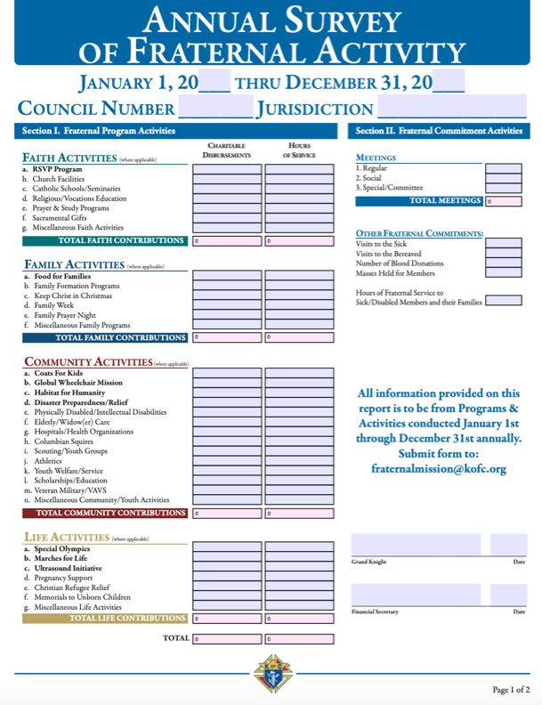
Form 1728 – Survey of Fraternal Activities
Due on January 31
Needed for Star Council eligibility
Needs to be submitted to Fraternal Mission Department
  Email: fraternalmission@kofc.org
Copies sent to SD and DD. Copy kept in Council Records
Can be filled in online.
Suggestions
Method 1:
When FS sends out dues notices in December to each council member, he should also send a survey form on Annual Fraternal Activity.
Data on returned survey forms is added up to fill Form 1728
Method 2:
Council creates an event form which includes information on
  Number of members that helped out
  Estimate of the number of total hours spent on event by all volunteers
Data from all event forms is added up to fill form 1728

Slide 89
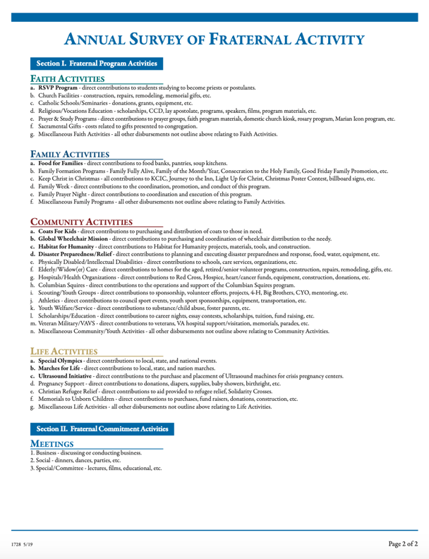
Form 1728 – Survey of Fraternal Activities

Slide 90
Vivat Jesus!

Slide 91
Angelus
Leader: The Angel of the Lord declared unto Mary.
All: And she conceived of the Holy Spirit.
All: Hail Mary…..
Leader: Behold the handmaid of the Lord.
All: Be it done unto me according to thy word.
All: Hail Mary…..
Leader: And the Word was made Flesh.
All: And dwelt among us.
All: Hail Mary…..
Leader: Pray for us, O Holy Mother of God.
All: That we may be made worthy of the promises of Christ.
Leader: Let us pray.
All: Pour forth, we beseech thee, O Lord, thy grace into our hearts, that we, to whom the Incarnation of Christ, your Son, was made known by the message of an Angel, may by His Passion and Cross, be brought to the glory of His Resurrection. through the same Christ our Lord.
All: Amen.

Slide 92
Knights Serving God – Serving the Community
This is who we are – This is what we do

Slide 93
Prayer to St. Michael the Archangel
St Michael the Archangel, Defend us in battle
Be our protection against the wickedness and snares of the Devil
May God rebuke him, we humbly pray
And do thou, oh prince of the heavenly hosts,
By the Divine Power of God,
Cast into hell Satan and all evil spirits
who prowl about the world seeking the ruins of souls.

