Slide 1
Arizona Membership Director Bobby Nielsen
membership@kofc-az.org
520 349-0728

Slide 2
Arizona Membership Team
Ceremonial Chairman Skip Hopler 602-677-2029 ehopler@cox,net
Council Reactivation Chairman Stan Schroeder 480 239-6452 stankofc@gmail.com
Council Retention Chairman Kevin McCarthy 602 684-8125 StateWarden@kofc-az.org
Retention Chairman Len Rheaume 602 738-5607 lrheaume@msn.com
Online Membership Chairman Larry Becker 480 760-5122 azlarry@cox.net
Round Table Chairman Joe Shanks 253 468-0722 hotrodtiki@aol.com
Hispanic Council Development Luis Leyva 520 313-0141 leyva.azkofc2@gmail.com
New Council Development Chet Yancy 602 309-1246 cryancy@aol.com

Slide 3
How Did We Finish?
Supreme intake goal of 950 new members, we missed that by less than 100
Supreme Star Council goal of 26, we fell short
Membership, Insurance, Forms and Compliance all played rolls

Slide 4
Goals
No successful organization – no matter the industry – succeeds without goals
Goals help align teams
Goals give focus and direction
We need goals that are both relevant and fair

Slide 5
955 Supreme Intake Goal

Slide 6
But What Is Our Focus?
What is truly important to us?
What will really make our Councils stronger?
Where should we put our time and energy?

Slide 7
133 Our Current Number of Active Councils

Slide 8
Who Will Lead Arizona
Supreme Growth and Training Directors will be focused
The State Officers will be focused
The Membership Team will be focused
Membership Team is available to answer questions and provide support. If requested we will assist at membership recruiting events

Slide 9
33 Districts Deputies in Arizona

Slide 10
Why Do We Need To Grow?
Every year our Brothers are aging, and some are dying
Without growth our struggling Councils will fold
Without growth our active Councils will struggle
Our Catholic Brothers need the Knights of Columbus, their families need our Order!

Slide 11
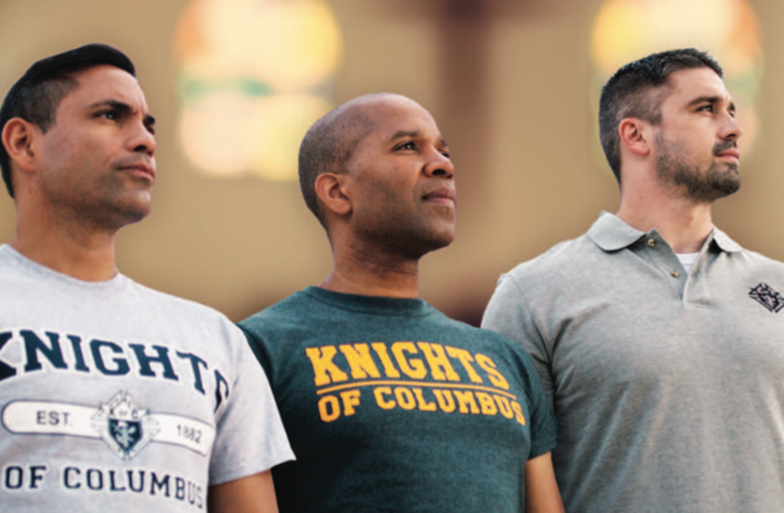
Faith In Action
Everything a Council needs is spelled out for us
This helps our Parish
This helps our Priests
This helps our Catholic Brothers and their families

Slide 12
PROGRAMS
March for Life
Special Olympics
Habitat For Humanity
Coats for Kids
Family of the Month
Consecration to the Holy Family
Soccer Challenge
Helping Hands
Silver Rose
Holy Hour
Family Prayer Night
Free Throw Championship

Slide 13
How Do We Help Our Councils?
What Tools Do We Have?
DELTA Church Drives
Prospect Landing Page
Online Membership
The Best Insurance available on the planet
The best agents on any planet
Hispanic Membership Growth Chairman
A true understanding of Retention

Slide 14
Star Council Requirements
McGivney Award for Membership
Founders’ Award for Insurance
Columbian Award for Programs
Annual Survey of Fraternal Activity
Service Program Personnel Report
Be Compliant with Safe Environment Requirements
Be in Good Standing with Supreme

Slide 15
2019-2020 Per Capita Rebate
Any Council receiving the Council Star Award will receive a $4.50 credit ($3.50 per capita and $1 Catholic Advertising) for each billable member on their roster as of July 1, 2020

Slide 16
IF WE KEEP DOING WHAT WE ARE DOING WE WILL KEEP GETTING WHAT WE ARE GETTING

Slide 17
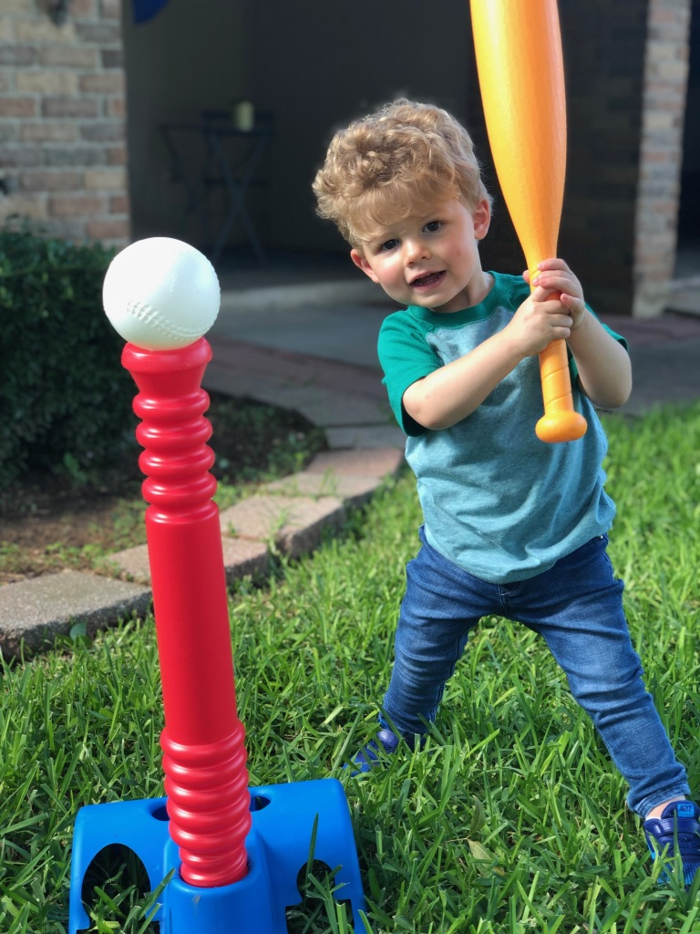
This Is Our Future. This Is Why We Need To Grow

Slide 18
Membership Incentives

Slide 19
Council Fast Start
Contest Period: July 1, 2019 to October 31, 2019
Contest Rules:
Councils achieving the incentive levels listed by October 31, 2019 will be awarded the corresponding prizes. Contest winners will be awarded their prizes at the Arizona State Convention

Slide 20
Council Fast Start
Level 1
Councils at 50% of Yearly Supreme Membership Goal receive: $50 for the Council and a Star Recruiter pin for the Grand Knight, Membership Director and Program Director
Level 2
Councils at 75% of Yearly Supreme Membership Goal receive: $75 for the Council and a Star Recruiter pin for the Grand Knight, Membership Director and Program Director

Slide 21
Council Fast Start
Level 3
Councils at 100% of Yearly Supreme Membership Goal receive: $100 for the Council, a Star Recruiter Pin for the Grand Knight, Membership Director and Program Director
Level 4
Councils at 125%+ of Yearly Supreme Membership Goal receive: $125 for the Council, a Star Recruiter Pin for the Grand Knight, Membership Director and Program Director

Slide 22
Fast Start Recruit a New Knight

Slide 23
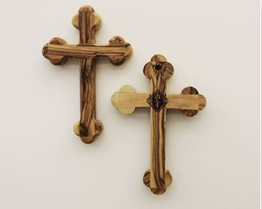
*Fast Start Recruit a New Knight*
Contest Period:
July 1, 2019 until 200 Knights recruit a new member
Contest winners will be mailed the Solidarity Cross.
Only one cross will be awarded to a Knight during the
contest period.
Contest Rules:
A Knight who recruits one new member during
the contest period will receive a Solidarity Cross.
This is in addition to the Star Recruiting Pin.
This handcrafted olive wood cross comes from
the Bethlehem Region. This cross is a symbol of
solidarity with prosecuted Christians. It measures
approximately 3.5 inches x 5 inches.

Slide 24
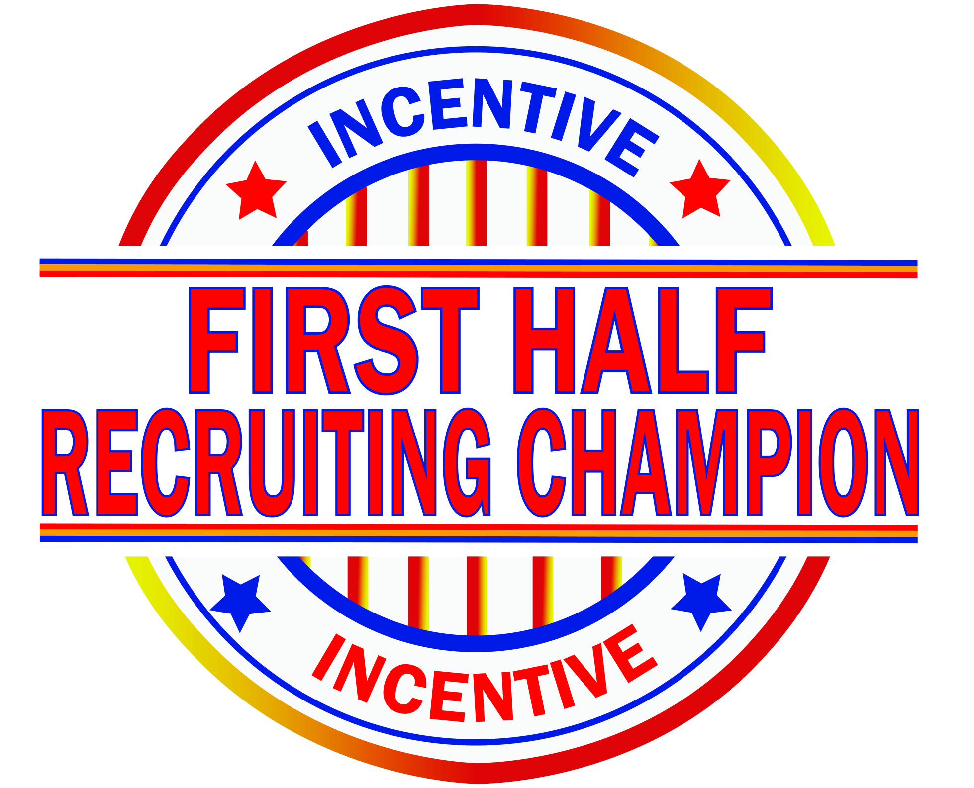
*Fraternal Year 1st Half Recruiting Champions*
Contest period: July 1, 2019 to December 31, 2019
Contest winners will be announced at the 2020 Arizona State Convention
Contest Rules:
A Knight who recruits the most new members during the contest period will be awarded: Star Recruiter Pin, Patriotic Hat, 7-function Pocketknife, a K of C Computer Backpack and $100.
A Knight who recruits the second most new members during the contest period will be awarded: Star Recruiter Pin, Patriotic Hat, 7-function Pocketknife and a K of Computer Backpack.

Slide 25
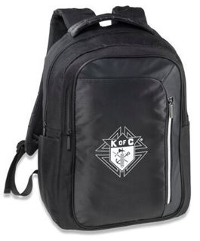
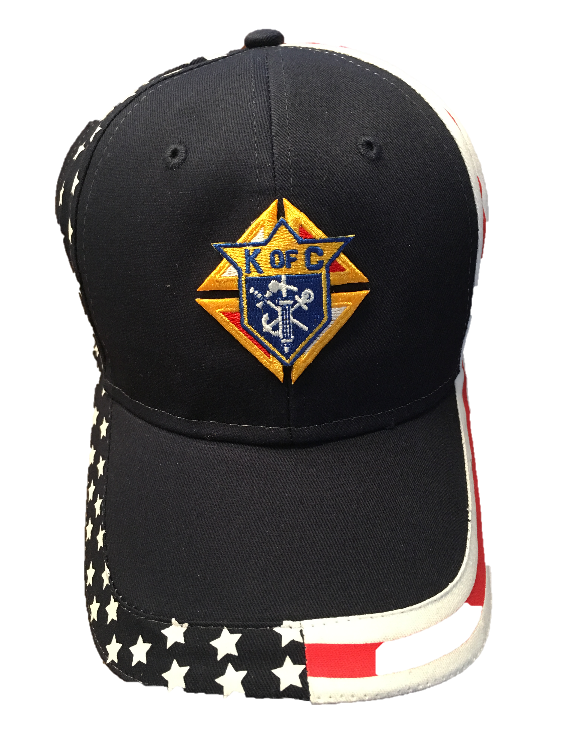
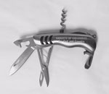
*Fraternal Year 1st Half Recruiting Champions*

Slide 26
*Star Recruiter*
Contest period: July 1, 2019 to May 1, 2020
Contest winners will be announced at the 2020 Arizona State Convention
Contest Rules:
A Knight who recruits the most new members during the contest period will receive:
2020 Arizona State Convention VIP Package,
Star Recruiter Plaque
$100

Slide 27
*Star Recruiter Council*
Contest Period: July 1, 2019 to May 1, 2020
Contest winner will be announced at the 2020 Arizona State Convention
Contest Rules:
The Council with the highest percentage of membership growth during the contest period will receive:
Grand Knight 2020 Arizona VIP Convention Package
Star Recruiter Pin
Star Recruiter Plaque
$100

Slide 28
*Recruit A New Knight*
Contest Period:
July 1, 2019 to June 30, 2020
Contest winner will be mailed the prize throughout the year except as noted. Only one pin will be awarded to a Knight in the fraternal year.

Slide 29
*Recruit A New Knight*
Contest Rules:
•A Knight recruiting one new member during the contest period will receive: Star Recruiter Pin
• A Knight recruiting five or more new members during the contest period will receive: Stainless steel, three-inch-long, seven-function pocketknife engraved with “Knights of Columbus - For God and Country
• A Knight recruiting ten or more new members during the contest period will receive: $5 for every Knight recruited. This award will be presented at the 2020 Arizona State Convention

Slide 30
MEMBERSHIP DIRECTOR
Bobby Nielsen
membership@kofc-az.org
520 349-0728

Slide 31
Online Membership
Larry Becker, PSD, State On-Line Membership Coordinator
azlarry@cox.net
Cell: 480.760.5122

Slide 32
Online Membership Keys to Success
Talk About The Program – The program is most successful when it’s a frequent topic of discussion. Having open, honest discussion with your councils helps them better understand the program, and makes them more likely to utilize it as a recruiting tool. And you can’t just talk about it once. Districts that have excelled on Online Membership have talked about it continuously. You should too.
Engage Your Members – Let your members ask questions! Discussion about the program is critical! Question and answer sessions are very helpful to clear up confusion. Address it head on. And most of all, listen to your membership.

Slide 33
Online Membership Keys to Success
Be A Positive Leader – If you treat this program as something that you don’t want to do, your membership will adopt the same attitude. This program is a powerful tool that you and your councils can use to invite men to take that first step toward lifelong council based membership in the Order. If you treat it that way, your councils will follow.
Recruit – The online membership initiative provides a simpler way for men to join. Train your councils to use it. Utilize online membership at church drives, council events, and men’s conferences. If they don’t sign up right on the spot, don’t worry. Collect email addresses and we will put them into a marketing campaign that tells them more about why they should join. We can also personalize emails from you, your chaplain, or your membership director for large-scale events. And don’t forget to invite men to join who have told you that they didn’t have time in the past!

Slide 34
Online Membership Keys to Success
Make Online Members Feel Included – The online membership program is set up to take an online experience offline. Promote your councils and events to online members. Invite them to volunteer. And don’t be afraid to brag a little. The more online members hear about the great work you do, and the more they feel included, the more they’ll want to join councils.

Slide 35
How To Transfer Online Members
You can now find, track and transfer Online Members in Officers Online.
The State On-Line Coordinator assigns online members as member-prospects to a specific local council based on where they live, or where they attend Church.
If the council accepts that member’s application for transfer, they can complete the transfer process without submitting a Form 100. All you have to do enter the member’s first degree date in Officers Online.
If men who join online say they want to join a council, don’t make them wait! Let’s make sure we make it happen.

Slide 36
How Credit Is Assigned
Online Members count towards Circle of Honor and Star Council goals.
States receive a +1 for any man who joins online in their state. And, states WILL NOT receive a -1 quota hit if online members do not renew their online membership the next year.
Councils receive a +1 when online members transfer to local council membership. And if they are an insurance client, the council will receive a +1 for that too.

Slide 37
How Dues Adjustments Are Given
When an online member converts to a local council, the council receives a dues adjustment credit.
That credit is determined based on what has already been assessed to the member. He paid $30 when he joined online.
If his account been assessed for state or supreme per capita (depending on the time of year), the council will receive the full $30 as a dues adjustment credit.
If his account has already been assessed for state and/or supreme per capita, the council will receive the $30 LESS that amount.

Slide 38
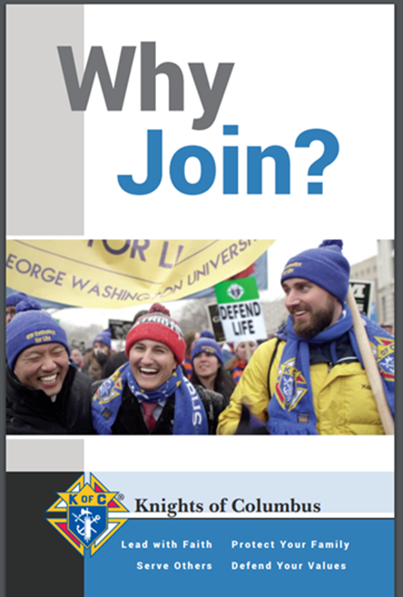
Online Membership Promotional Materials
Financial Secretaries can order at KofC Supplies Online
#10536 – Join Us Business Card
#10537 – Why Join? Bi-fold Brochure
These are not available via KnightsGear
90 second commercial www.KofC.org/joinus

Slide 39
ONLINE MEMBERSHIP
Larry Becker, PSD, State
On-Line Membership Coordinator
azlarry@cox.net
Cell: 480.760.5122

Slide 40
Arizona Knights of Columbus 2019 Org Meeting
Retention
Len Rheaume
602-738-5607
LRHEAUME@MSN.COM
40

Slide 41
RETENTION 365
WHEN DOES RETENTION BEGIN?
Recruitment
Interview
Admission Degree
First Meeting
First Program

Slide 42
RETENTION 365
Successful Membership Retention Requires:
Promoting Best Practices, State Council Support and Consistent Accountability in these four areas:
Recruitment
Onboarding – “orientation”
Member Retention
Formation

Slide 43
RETENTION 365
Onboarding: Best Practices
Shining Armor: Guide to new member activity
Be involved in at least three council service programs
Attend at least three council meetings
Receive their Second and Third degrees
Meet with their council’s insurance representative
Recruit at least one new member

Slide 44
RETENTION 365
State Council Support and Accountability for Member Onboarding
District Deputies:
Promote the Shining Armor Award
Encourage GKs to engage new Knights
Provide monthly updates for Membership Retention Chairman

Slide 45
RETENTION 365
What are your councils currently doing to welcome new members?
Are they utilizing the Shining Armor Award?
How are you coaching the Grand Knights?
Have you discussed and documented best practices? And shared them?

Slide 46
RETENTION 365
Communication:
Asking the member what they are looking for
Sharing what the council expects out of them – Shining Armor Award
Engagement: Do we know our members?
Shared worship – Mass, Prayer, Retreats
Meetings – vision for why
Events/Programs – Faith in Action
Everyday Interactions
Proper Billing Procedures:
Do we share “why” and what we do with it
Proactively remind before a deadline is missed
Fraternal Benefits:
Are we able to articulate our fraternal benefits and how great they are?

Slide 47
RETENTION 365
Council Retention Committee
Proactive & Reactive
Meets: Monthly
Made up of: Officers, Trustees, Chairmen and/or 1 member for every 10 Knights
Discusses: Member review, Delinquent members & who is following up with each member

Slide 48
DOCUMENTATION
Standardized form
Permanent record
Establishes that the committee has done it’s work
Assists the fin sec in keeping the roster current
Allows the council to rescue lost Knights
kofc-az.org/Links/State Forms

Slide 49
RETENTION 365
Several councils have reduced their backlog of delinquent members by utilizing these methods.
One council went from 20 members pending suspension to 8.
My home council is still working on their list, but so far has gone from 48 Down To 6.
By retaining the members that we already have, we will continue to grow our councils and the order.

Slide 50
RETENTION 365
Get him interested and keep him interested
Most suspended knights are first degree members
Use your benefits agent to help located delinquent insured members
Retention committee should be working all year round

Slide 51
RETENTION
LEN RHEAUME
LRHEAUME@MSN.COM
602-738-5607

Slide 52
Ceremonials
Skip Hopler, Ceremonial Chairman
623-979-6075
ehopler@cox.net
52

Slide 53
Ceremonial Notes
District Deputy Responsibilities and Authority (First, Second, Third Degrees, Installations, Meetings)
Hosting and supporting Formation and Knighthood Degrees
Factors in scheduling annual Formation and Knighthood Degrees
Schedule for FY 2019 - 2020

Slide 54
First Half 2019 - 2020
HOST | LOCATION | ADDRESS | DAY OF | DATE OF | Host
DISTRICT |  |  | WEEK | DEGREE | DD
8 | Chandler, #3121 | KofC Hall 644 E Chandler Blvd, Chandler, AZ 85225 | Sun | July 21, 2019 | Jim Walsh
4 | Tucson, #8077 | St. Elizabeth Ann Seton 8650 N Shannon Rd Tucson, AZ 85742 | Sat | August 17, 2018 | Ben Jimenez
 | Fourth Degree |  | Sat | September 28, 2019
15 | Phoenix, #7465 | St. Jerome 10815 N. 35th Ave Phoenix, AZ 85029 | Sat | September 14, 2019 | Raul Chavez
17 | LHC, #6442 | St. Thomas More 186 London Bridge Rd Lake Hav. City 86403 | Sat | October 26, 2019 | Gerry Czarnowski
33 | Green Valley, #6842 | Our Lady of the Valley 505 N. La Canada Drive Green Valley, AZ | Sat | November 30, 2018 | Jack Costonas
 | Fourth Degree |  | Sat | November 16, 2019
15 | Glendale, #3855 | Columbian Hall 8066 N 49th Avenue, Glendale, AZ 85302 | Sun | December 15, 2019 | Raul Chavez

Slide 55
Second Half 2019 - 2020
HOST | LOCATION | ADDRESS | DAY OF | DATE OF | Host
DISTRICT |  |  | WEEK | DEGREE | DD
26 | Casa Grande, #3136 | St. Anthony of Padua 201 N Picacito St, Casa Grande, AZ 8512 | Sat | January 11, 2020 | Dennis Sullivan
9 | Chandler, #9482 | St. Andrew the Apostle 3450 W. Ray Rd. Chandler AZ 85226 | Sat | February 1, 2020 | Dominic Conn
 | Fourth Degree |  | Sat | February 15 2020
19 | Cottonwood #2493 | Immaculate Conception 700 N Bill Gray Rd Cottonwood, AZ 86326 | Sat | March 21, 2020 | Jon Martinez
6 | Oro Valley, #13272 | Our Lady of the Rosary 2727 W. Tangerine Road Oro Valley, AZ 85742 | Sat | April 25, 2020 | Richard Robinson
12 | Glendale, #11738 | St. Helen's Church 5510 W Cholla St, Glendale, AZ 85304 | Sun | May 9, 2020 | Randy Hughes
 | Fourth Degree |  | Sat | June 6, 2020
29 | Tucson, #1200 | Council Hall 601 S. Tucson Blvd. Tucson 85716 | Sun | June 14, 2020 | Hector Tellez

Slide 56
Ceremonials
Skip Hopler, Ceremonial Chairman
623-979-6075
ehopler@cox.net
56

Slide 57
Hispanic/Ethnic Membership
Luis L. Leyva Hispanic Membership Coordinator
Mobile: 520-313-0141 e-mail: leyva.azkofcd2@gmail.com

Slide 58
Hispanic / Ethnic Membership
Matthew 28 18-20
Jesus came up and spoke to them. He said, 'All authority in heaven and on earth has been given to me.
Go, therefore, make disciples of all nations; baptize them in the name of the Father and of the Son and of the Holy Spirit, and teach them to observe all the commands I gave you. And look, I am with you always; yes, to the end of time.'
58
58

Slide 59
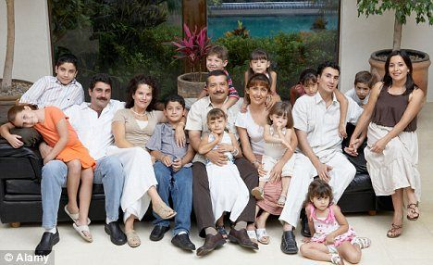
Hispanic / Ethnic Membership
As per the United States Census Department, Arizona Hispanic growth is larger than years before.
59
59

Slide 60
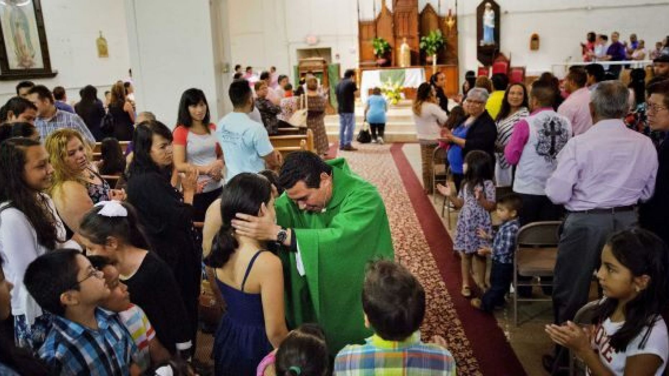
Hispanic / Ethnic Membership
Hispanic youth loves being part of the Catholic Church
60
60

Slide 61
Hispanic / Ethnic Membership

Slide 62
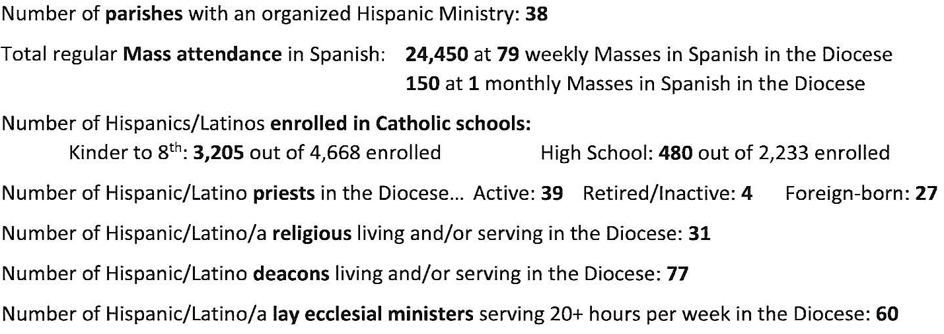
Hispanic / Ethnic Membership

Slide 63
Hispanic / Ethnic Membership

Slide 64
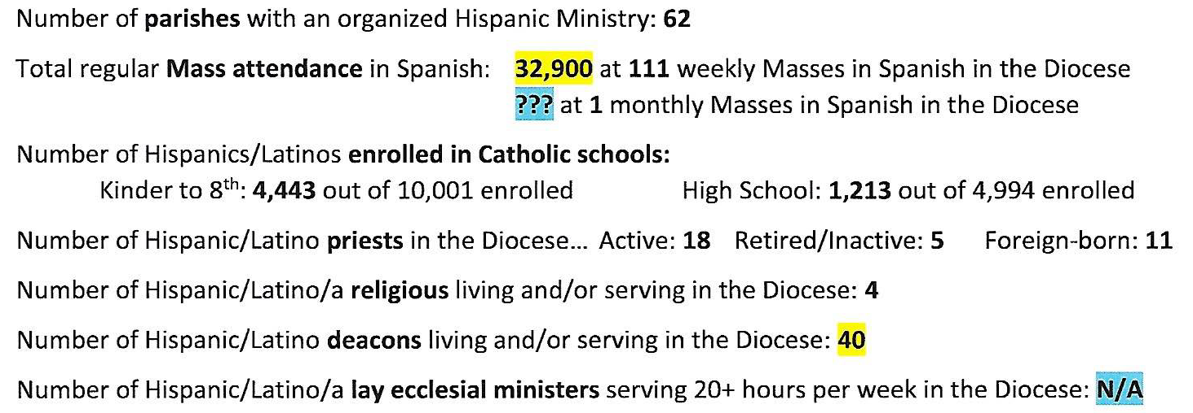
Hispanic / Ethnic Membership

Slide 65
Hispanic / Ethnic Membership
Matthew 25, 20-21
²⁰ The man who had received the five talents came forward bringing five more. "Sir," he said, "you entrusted me with five talents; here are five more that I have made."
²¹ His master said to him, "Well done, good and trustworthy servant; you have shown you are trustworthy in small things;
I will trust you with greater; come and join in your master's happiness."

Slide 66
Hispanic / Ethnic Membership
This is the right moment in time to target these individuals at our Parishes, our Catholic Schools, and Communities.
Let’s give every single Catholic man, the same opportunity that we have been given by that Knight that recruited us in name of Father Michael J. McGivney.

Slide 67
Hispanic / Ethnic Membership
Luis L. Leyva
Hispanic Membership Coordinator
Mobile: 520-313-0141
e-mail: leyva.azkofcd2@gmail.com

Slide 68
Viva Cristo Rey!

Slide 70
Prayer to St. Michael the Archangel
St Michael the Archangel, Defend us in battle
Be our protection against the wickedness and snares of the Devil
May God rebuke him, we humbly pray
And do thou, oh prince of the heavenly hosts,
By the Divine Power of God,
Cast into hell Satan and all evil spirits
who prowl about the world seeking the ruins of souls.

