Slide 1
Forms Training
Council Forms Training

Slide 2
Council Forms for the year
Report of Officers Chosen for Term – 185
Service Program Personnel Report – 365
State Directory Information - https://kofc-az.org/state-forms%2Freports
Family of the Month – Each council should be considering this. The family of the month then gets submitted to Supreme a chance to become family of the year.

Slide 3
Log into Officers Online Go to Member Management

Slide 4
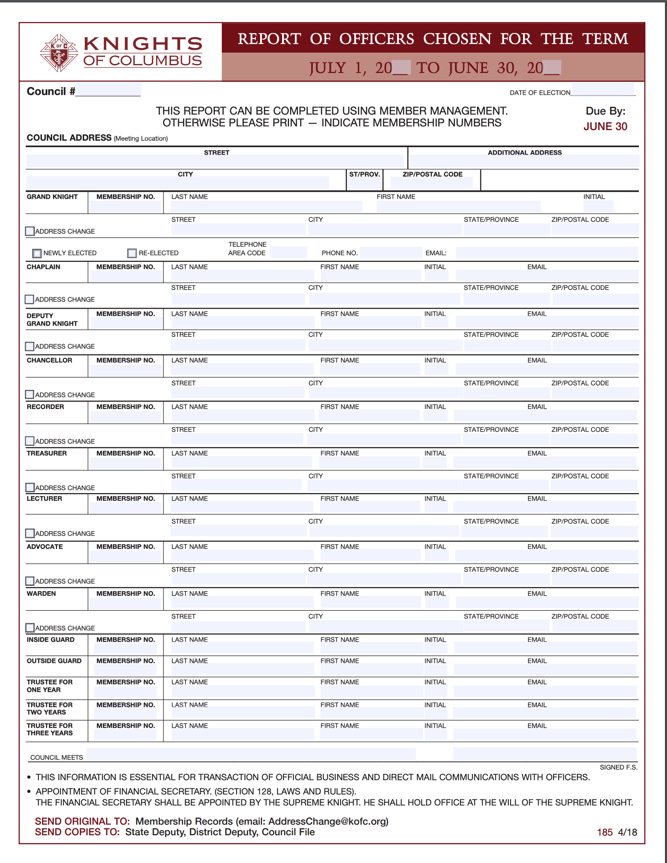
Council Officers – Form 185
The fun part of the Online Submission
No where on the form does it say Form 185!

Slide 5
Click on Live
Click on Live

Slide 6
Click on Council Administration

Slide 7
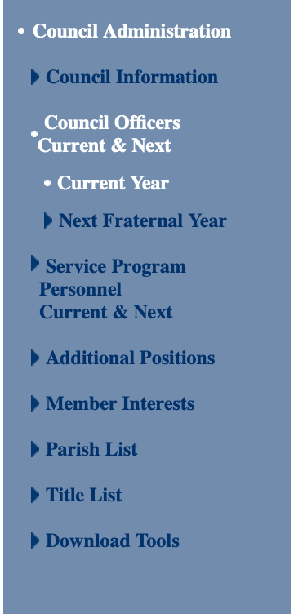
Choose Council Officers Current & Next
Choose next fraternal year

Slide 8
Adding in names
5. Put in Start date
2. Click on Search by
Last Name
3. Click on Search
1. Choose the Role
6. Click on Assign
4. Highlight the name

Slide 9
The name pops up. Change the roles for all roles you are filling.

Slide 10
Click on Submit once done

Slide 11
Notes
The only positions that you need filled are:
Grand Knight
Financial Secretary
If you do not have all the positions filled, don’t worry. Submit anyway.

Slide 12
Once complete, go to Print Center-MM
Choose “2. Next Fraternal Year Officers” if doing prior to July 1
Choose “1. Current Officers” after July 1

Slide 13
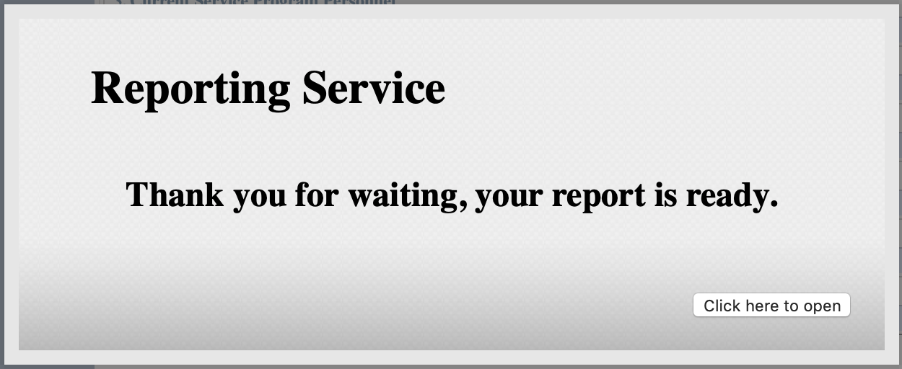
Click ”Click here to open” to open the report

Slide 14
Report
This will open the report in a PDF. Save the file to your hard drive! Check your “Downloads” folder if you cannot find it. It is called “NextFraternalYearOfficers.pdf”
Rename the file to append the Fraternal Year and Council Number.
Example: NextFraternalYearOfficers-2019-2020-10062.pdf
Email this to:
Rick Garrison – azknights@q.com
Your District Deputy
If you make changes, make sure you email the updates!

Slide 15
Service Program Personnel Current & Next
The fun part of this form – No where on the form does it say Form 365!

Slide 16
Click on Council Administration

Slide 17
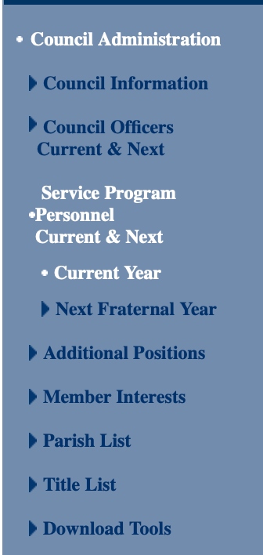
Choose Service Program Personnel Current & Next
Choose next fraternal year

Slide 18
Quirkiness…. You have to choose “Copy Current Year” to proceed.
If not, you get this when trying to assign

Slide 19
Service personnel
2. Click on Search by Last Name
5. Put in Start date
1. Choose the Role
3. Click on Search
6. Click on Assign
4. Highlight the name

Slide 20
The name pops up. Change the roles for all roles you are filling.

Slide 21
Click on Submit once done

Slide 22
Notes
There are only 5 roles that are Required:
Program Director
Community Director
Family Director
Membership Director
Retention Chairman
Bolded members are required to take Safe Envioronment training.

Slide 23
Once complete, go to Print Center-MM
Choose “4. Next Fraternal Year Service Program Personnel” if doing prior to July 1
Choose “3. Current Service Program Personnel” after July 1

Slide 24
Click ”Click here to open” to open the report

Slide 25
Report
This will open the report in a PDF. Save the file to your hard drive! Check your “Downloads” folder if you cannot find it. It is called “NextProgramPositions.pdf” or ”CurrentProgramPositions.pdf”
Rename the file to append the Fraternal Year and Council Number.
Example: NextProgramPositions-2019-2020-10062.pdf
Email this to:
Rick Garrison – azknights@q.com
Your District Deputy
If you make changes, make sure you email the updates!

Slide 26
Fill out the State Directory Forms State Directory Information - https://kofc-az.org/state-forms%2Freports Send to azknights@q.com

Slide 27
Why 2 separate forms with the same information????
The first Officers Chosen for Fraternal Year is a Supreme Form. Supreme automatically gets this when you fill it out online.
Unless councils sends a copy of the PDF to azknights@q.com, we don’t have access to it.
The ONLY way we get it currently is through the State Directory.
This is CRITICAL for disseminating information to Grand Knights and Officers throughout the year.

Slide 28
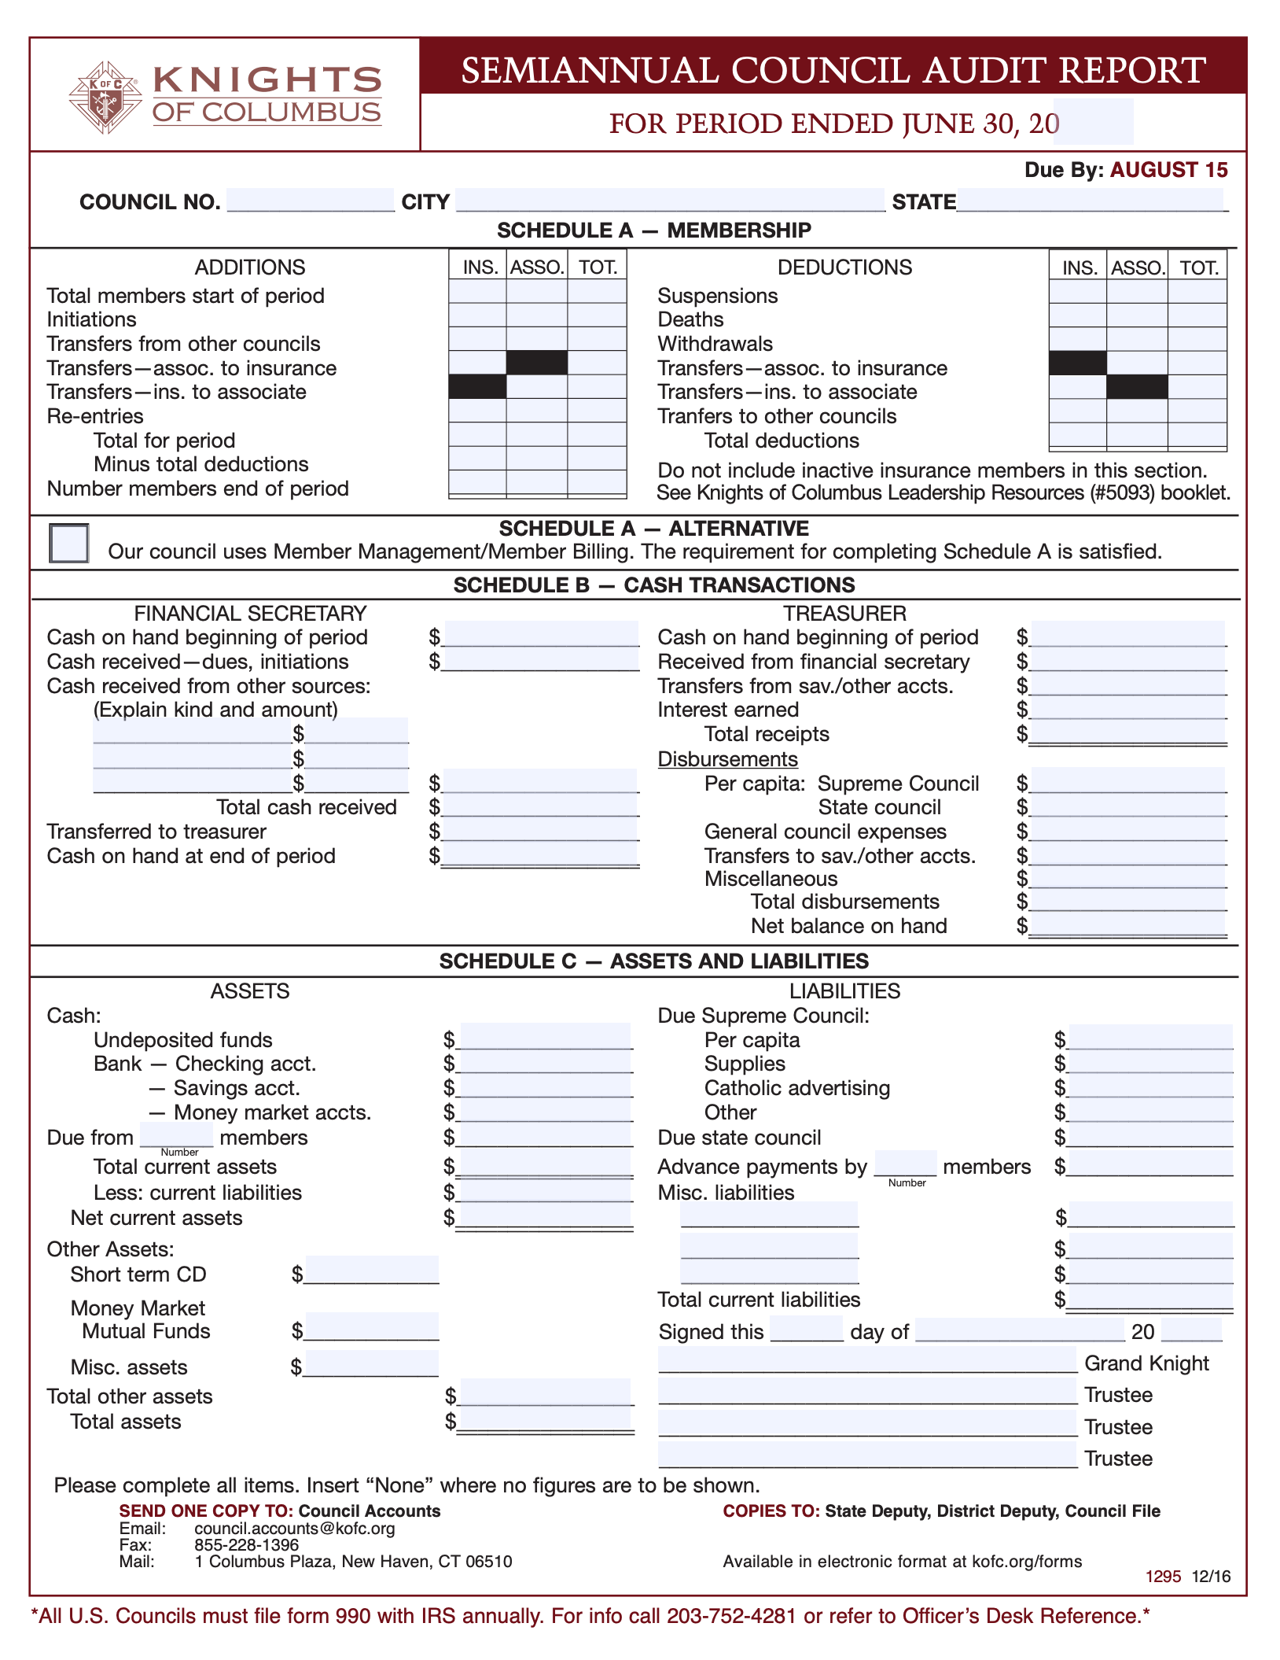
Semi Annual Audit
This is still a manual form to fill out.
If you are using Member Management, click on checkbox.
Fin Sec – Fill out the Cash Sections from Jan 1 – June 30 for 1295 Due in August
Treasurer – These are your bank statements, checks, etc
Schedule C- Assets
These are outstanding assets
Due from Members- HOW MANY MEMBERS HAVE NOT PAID!!!!! How much is owed to council?
Send to azknights@q.com, District Deputy
SCAN AND EMAIL TO SUPREME!!

Slide 29
Financial Secretary
Cash on Hand – Amount from last audit
Cash received – If collected dues and new members
Other Sources – All other cash received. Yes, there are not enough lines. List 2 main ones and then sum up all others to the 3rd line.
Transfer to treasurer
Cash on hand at end of period

Slide 30
Treasurer
Cash on Hand – Amount from last audit
Received from Fin Sec – The same amount from the Fin Sec “Transferred to Treasurer” line
Per capita – Supreme and State
Any transfers
Any miscellaneous disbursements.
Add them all for Net balance on hand

Slide 31
SIDE BAR
Use Email to send as many forms as possible to Supreme. Try not to snail mail.
If you don’t have a scanner, use your phone! There are apps out there for both Android and Apple: CamScanner, Tiny Scanner.
REMEMBER TO SAVE AS PDF TO EMAIL TO SUPREME!

Slide 32
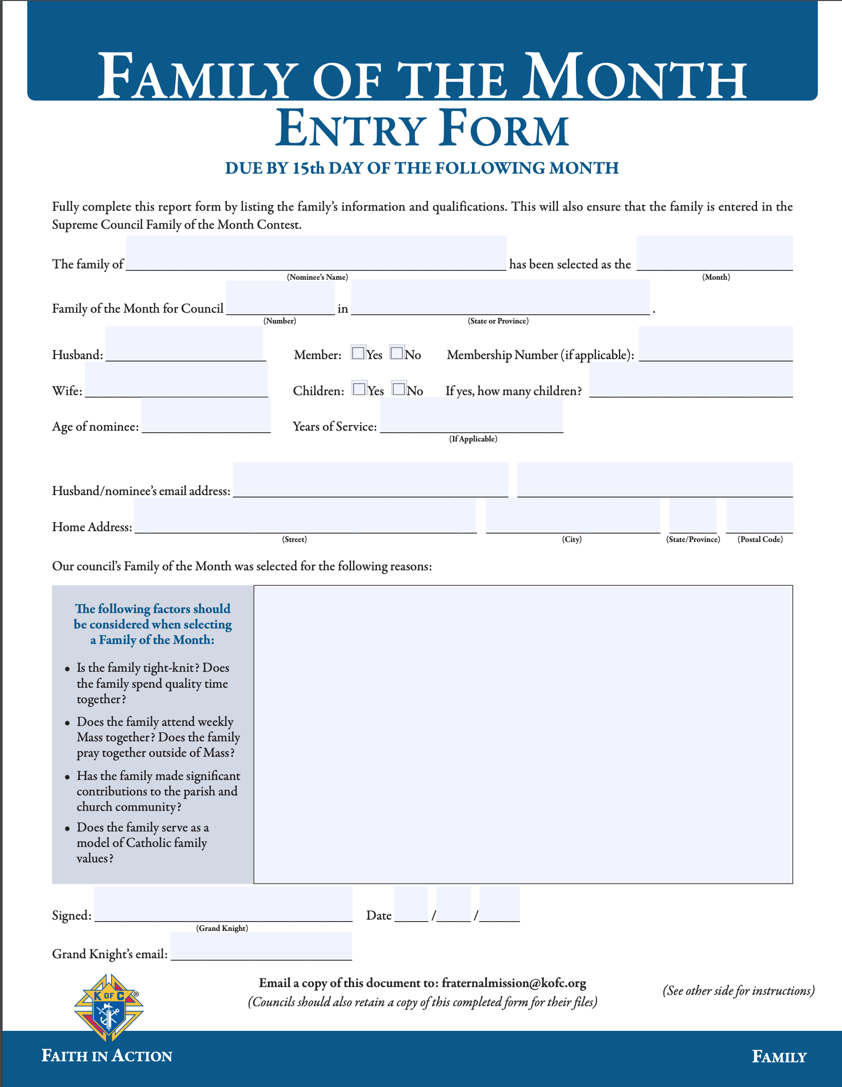
Family of the month – #10668
Due 15th day of following month
To be selected as Family of the month, each family should stand out as an exemplary model to others in the parish.
The following factors should be considered when selecting a Family of the month:
• Is the family tight-knit? Does the family spend quality time together?
• Does the family attend weekly Mass together?
• Does the family pray together outside of Mass?
• Has the family made significant contributions to the parish and church community?
• Does the family serve as a model of Catholic family values?
Talk to Pastor about presenting Family of the Month at a mass the Family attends
You can use this as a soft ”recruiting” event.
SEND TO SUPREME AND azknights@q.com

Slide 33
Questions???

