Slide 1
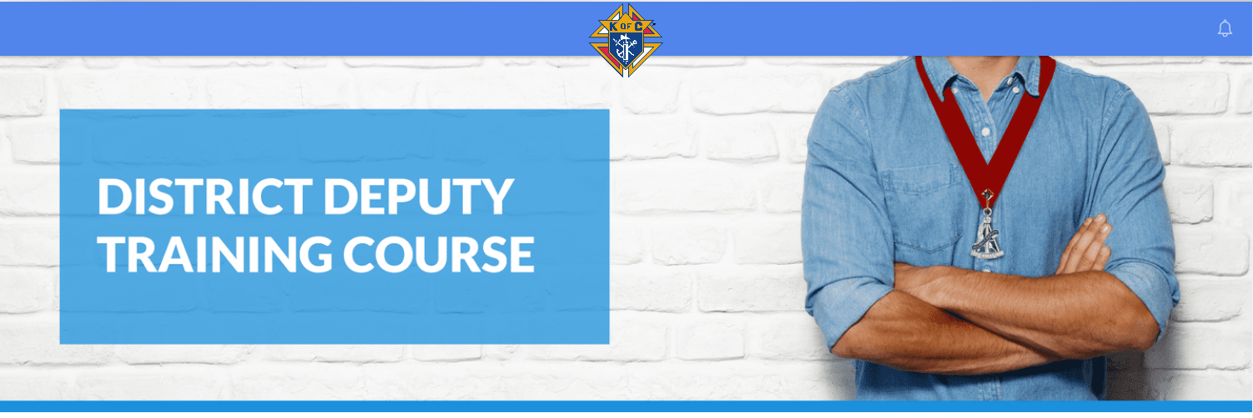
9+----------`
Please click on the module you would like to view.

Slide 3
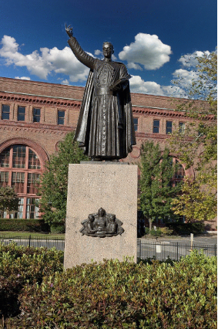
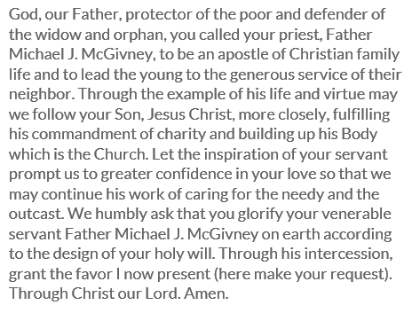

Slide 4
Learning Objectives

Slide 5
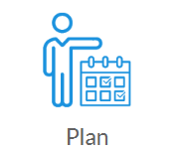
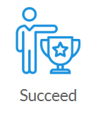
Commit yourself to be
the best District Deputy
you can be
Attend state meetings
and all training sessions
Help each council to
have a better year than
they did last fraternal
year

Slide 6
Learning Objectives
By understanding your duties and responsibilities, you will help your councils to engage in the Order’s initiatives and also be the “go-to guys” in their parish focusing on charitable good works.

Slide 8
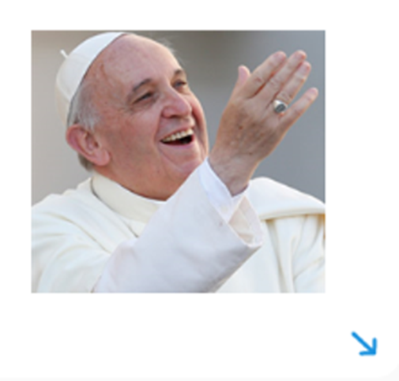
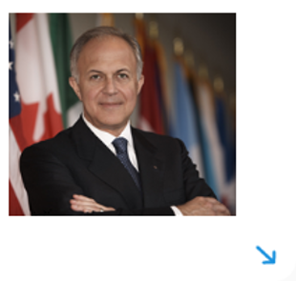
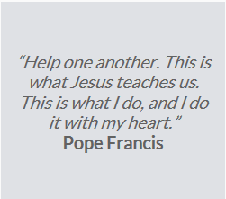
Role of Service

Slide 9
Role of Service
Charitable outreach brings tangible help to those in need. Our members, working through their councils, accomplish far more than individuals acting alone.
As District Deputy, helping the councils and fraternal leaders in your district is not only a key to success, it is also a key to happiness. Be a leader of great service.

Slide 10
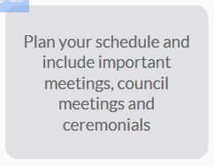
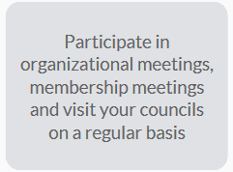

Slide 11
As District Deputy, you represent the Supreme Knight and your State Deputy and to do so effectively, you become an “agent” for change. An “Agent for Change” helps his councils decide, not between a good or bad program, but rather, between a good or better program in the spirit of our founder. In your role, remember these three key points:
You have been appointed to provide leadership to the councils in your assigned district.
Through your example of Faith, Charity and Good Judgment, you provide the model for Council Officers in your District to follow.
When you set a tone that is open and engaging you help ensure you District's growth in charitable outreach and membership.

Slide 12
In most cases, the State Deputy will assign you to three to six councils, which will form a district. You need to be aware of your duties as a District Deputy AND the duties of your fellow Council Officers.

Slide 13
Represent
Exemplify
Install

Slide 14
Promote
Supervise
Encourage

Slide 15
Manage
Report
Inspect

Slide 16
Follow
Assign
Perform

Slide 18
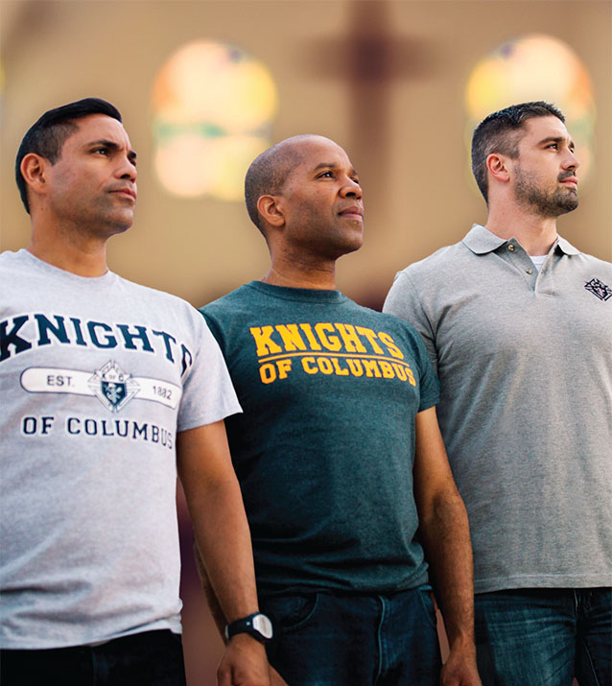
As a District Deputy you should set an example, and a good place to start is to personally recruit new members into YOUR council.
You are showing your council, and the councils in your district, that recruitment is important to you, and that the growth of the Order is vital to our long-term success.
Instill into your council officers, from the beginning of the Fraternal year, the importance of having great council programs and how those programs will promote recruitment.
The most valuable asset in any council is its members along with their combined knowledge and skills. How you engage the fraternal leaders in your district will determine outcomes by the end of your term of service.
FAITH
IN ACTION

Slide 20
Each year you will be expected to submit a report on the state of your councils and their activities to your jurisdiction’s Annual Convention.
Encourage each council to be represented by both elected representatives, who are expected to be the current Grand Knight and Immediate Past Grand Knight. Others should attend, like the Deputy Grand Knight. The Delegates are to report back to their councils.
Active participation by the councils in your district is what creates a successful convention.

Slide 22
Fraternal Training Portal
Training courses for your officers will help them become engaged in council action and service. All courses are free to Knights of Columbus members. Non-officers can go to the Open Enrollment Microsite to take any course.

Slide 25
As District Deputy you are in a service leadership role. Your primary focus is to:

Slide 26
The District Deputy is a key fraternal leader in his jurisdiction, representing both the Supreme Knight and the State Deputy.
Though some duties are ceremonial, all duties are important. Each duty leads to building a stronger group of councils that are able to react to local needs.

Slide 30
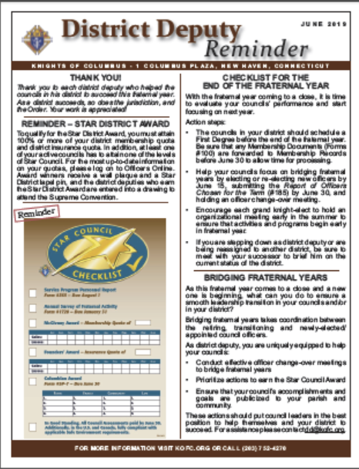
Leadership Resources Handbook (#5093)
The Leadership Resources Handbook is a guide for council officers with special focus on the Roles, Duties, and Responsibilities of the District Deputy, Grand Knight , and Financial Secretary.
District Deputy Reminder
The District Deputy Reminder highlights current Knights of Columbus initiatives and is forwarded on a monthly basis. The newsletter is a great source of information for presentation at council visits. It reminds councils leaders about upcoming deadlines and offers suggestions for relevant “Faith in Action” programs, recruitment activities, ad charitable outreach programs.
The current District Deputy Reminder , and past issues, are available on kofc.org/ddreminder. On the Members Page, under Leadership Communications.

Slide 32
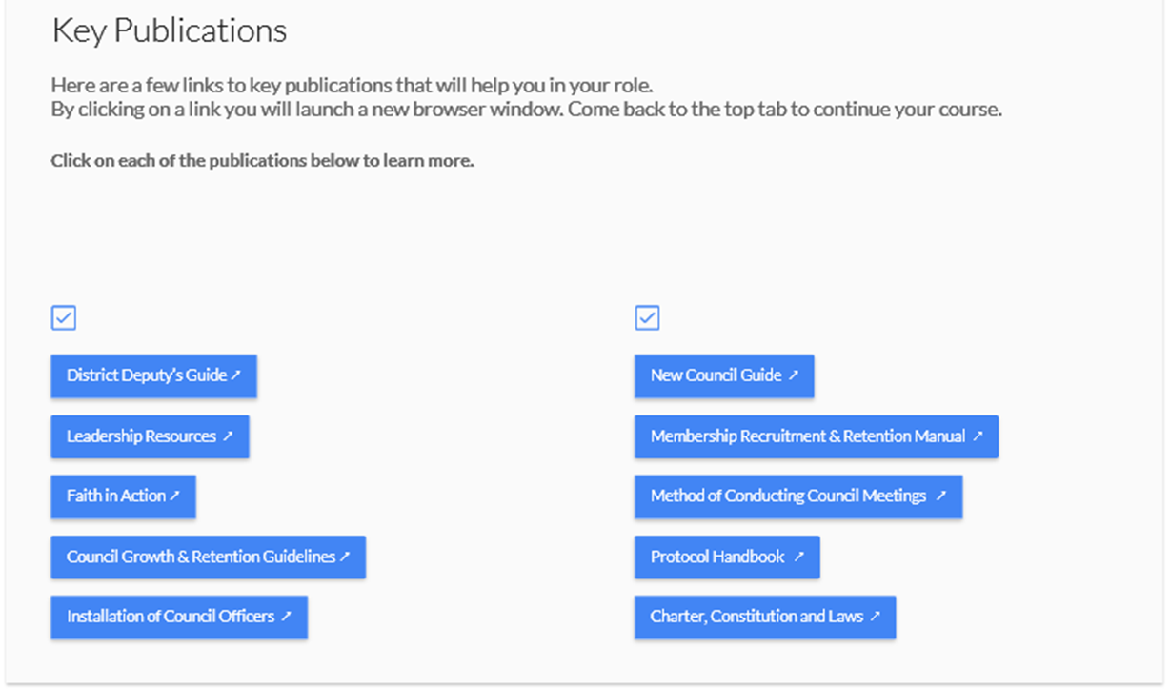

Slide 33
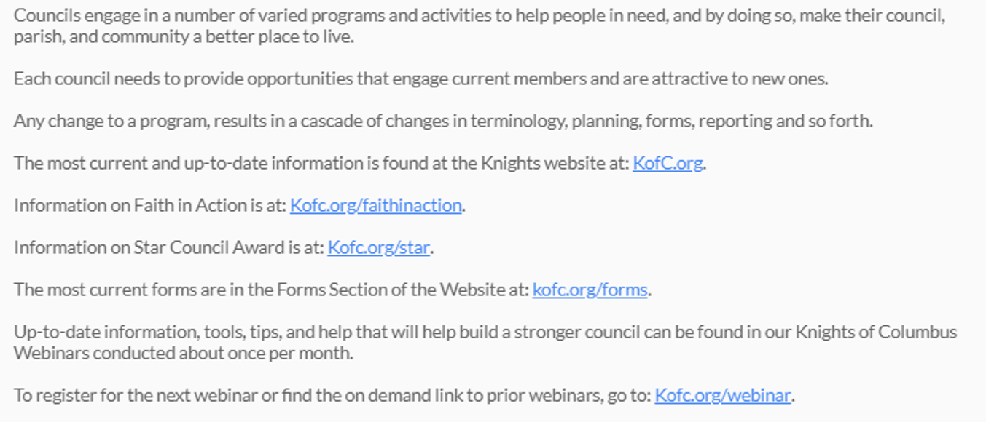
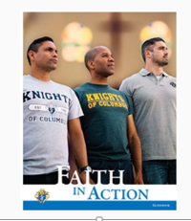
Faith in Action

Slide 34
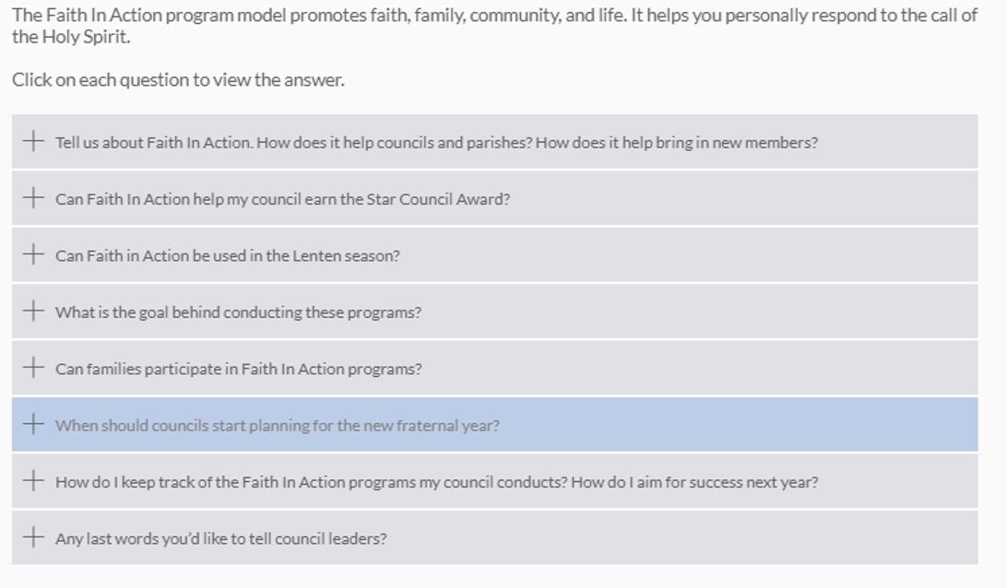
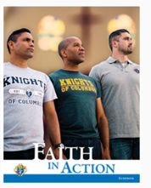
How Faith In Action Helps You

Slide 35
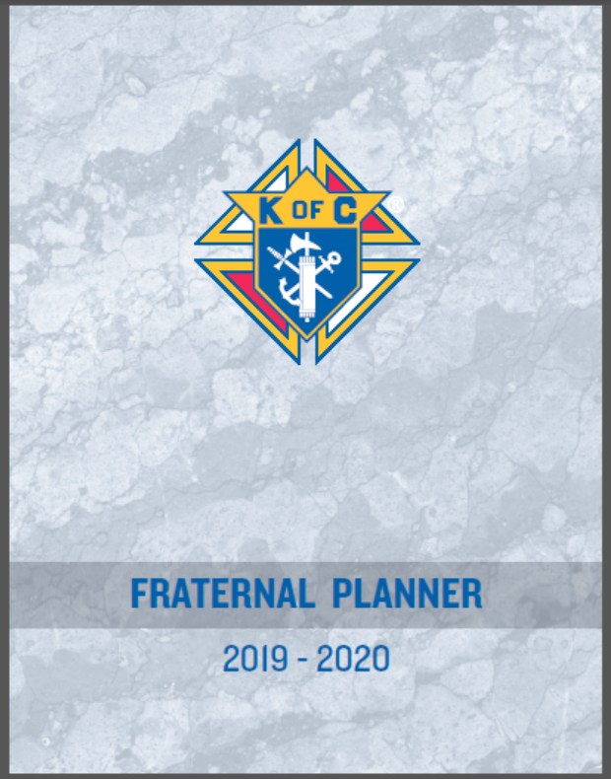
The Tools for Success
Here we can see some of the resources that will help you understand your responsibilities as a fraternal leader.

Slide 37
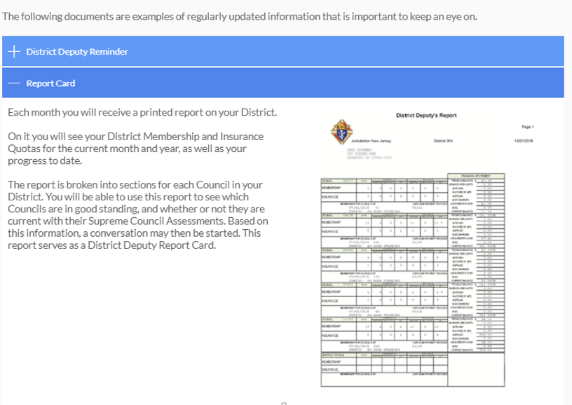

Slide 38
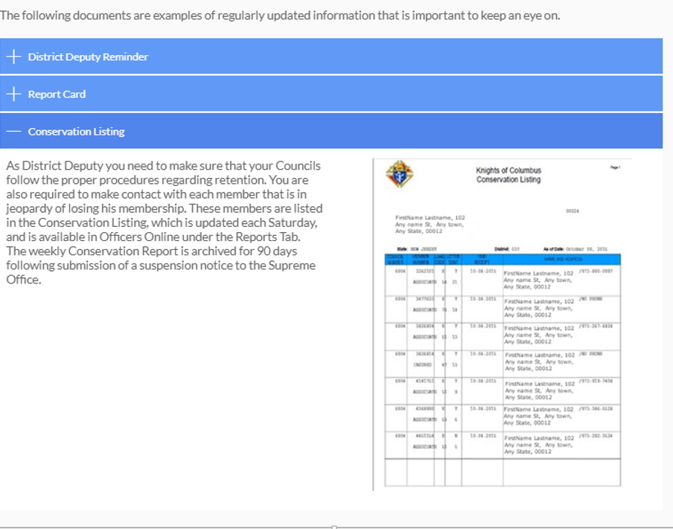

Slide 40
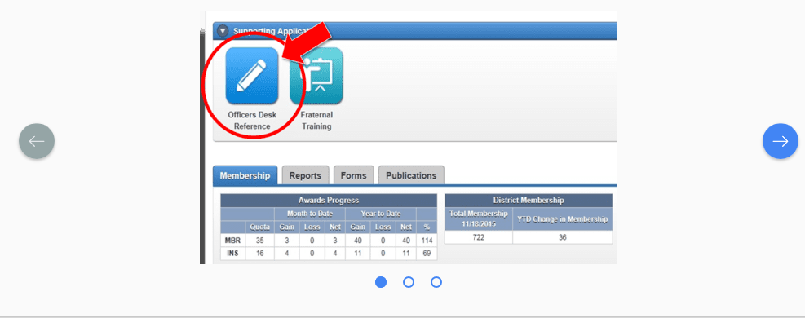
Officers Desk Reference

Slide 41
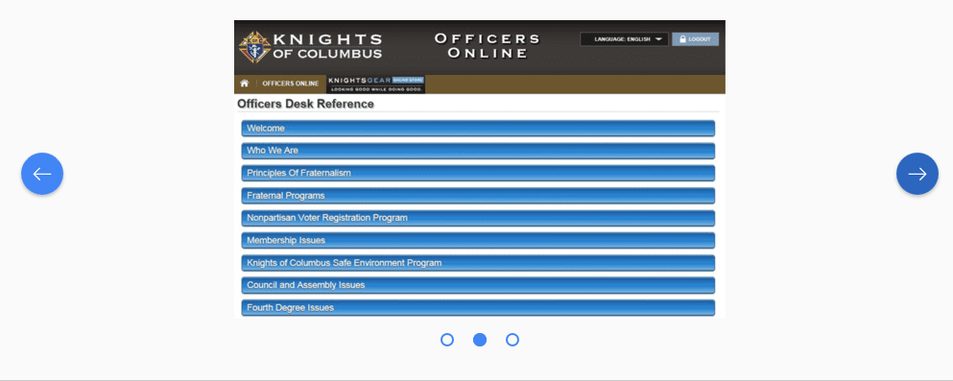
Officers Desk Reference

Slide 42
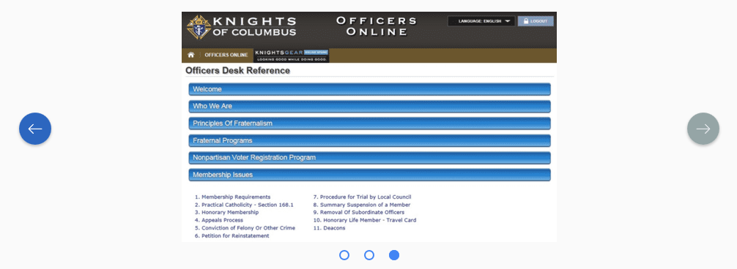

Slide 43
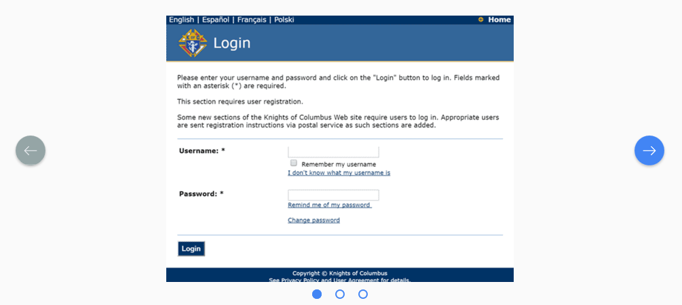
Officers Online

Slide 44
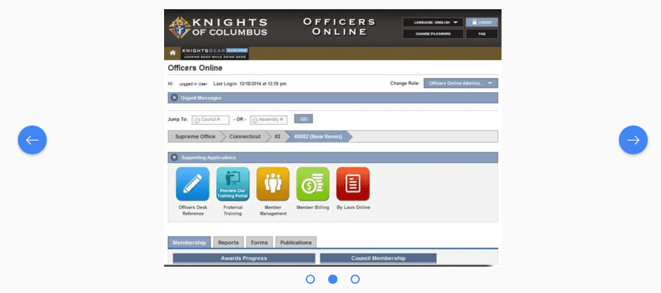

Slide 45
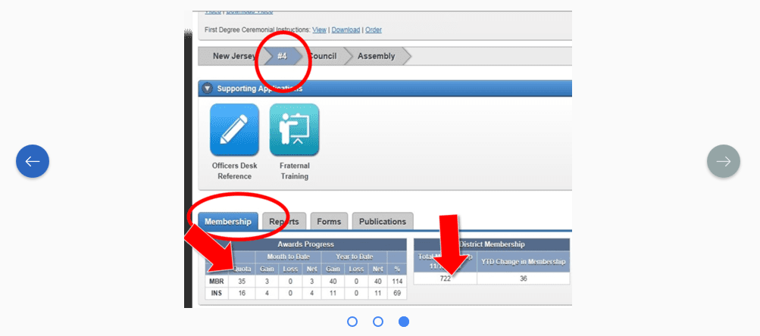

Slide 46
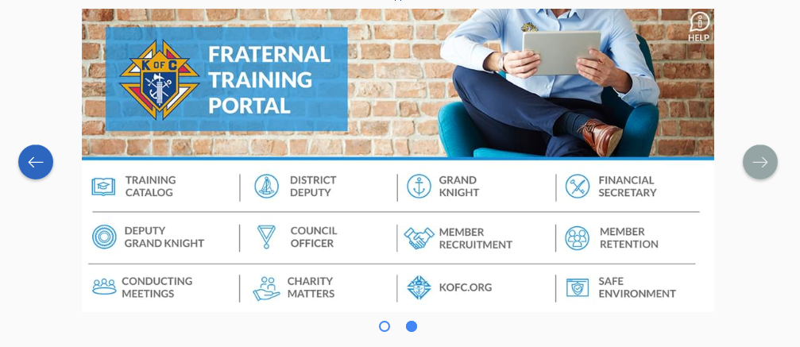
Fraternal Training Portal

Slide 47
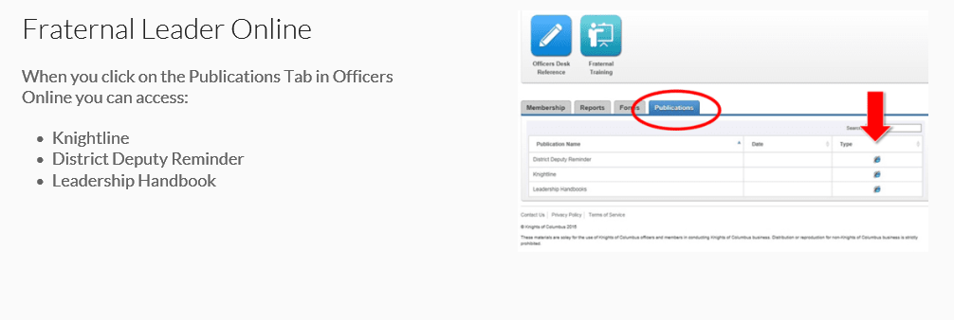
Fraternal Leader Online

Slide 48
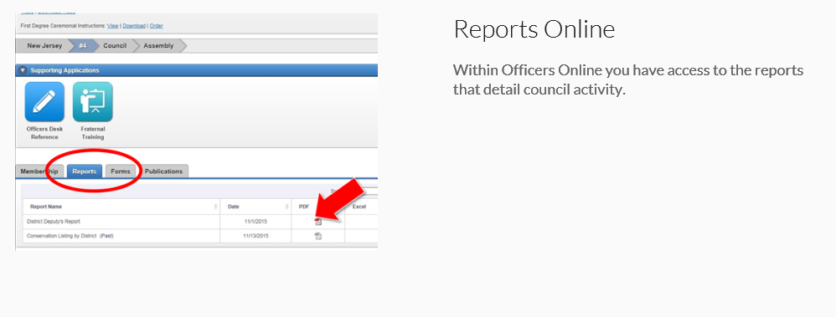
Fraternal Leader Online

Slide 49
Many resources are available to fraternal leaders. What is key for a District Deputy to know about all of the resources.

Slide 50
One of your key roles is to set a good example as a lay Catholic leader and to be a resource for all of your councils. You are going to get asked questions. You do not need to always have the answer, but you do need to know where to find the information being requested. All of the resources discussed here are available online and in print.
Leadership Resources are designed to help fraternal leaders become successful in their roles and are available 24/7 online.
As District Deputy, using the resources available helps you guide growth in charitable outreach and in membership recruitment.

Slide 53
The Laws of the Order define your duties.
It is your responsibility to be a leader and take action, which includes holding officers and members accountable.
Your actions set the tone for the fraternal leaders in your district.

Slide 54
Know Your District

Slide 55
Working with your Councils
Encourage continued activity by councils that build upon the vision and mission of the Order.
Work with councils in your district to guide them closer to alignment with the vision and mission of the Order.
Take steps to reach out to councils that have not recruited members of conducted programs and start building a bridge to relevance and visibility.
Work with pastors of councils that are no longer meeting or conducting any programs and determine a path forward to reactivate the council.

Slide 56
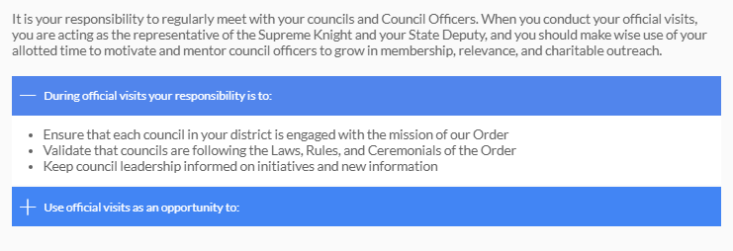
Official visits to your Councils

Slide 57
Official Visits to Your Councils

Slide 58
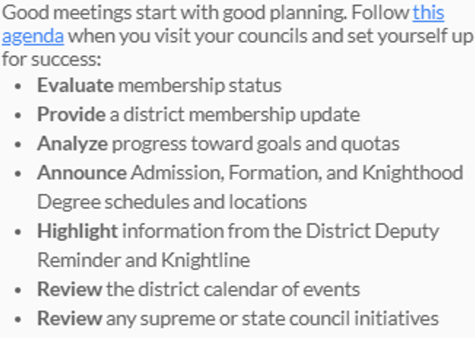
Agenda for Council “Official” Visits

Slide 59
District Meetings of Council Officers

Slide 62
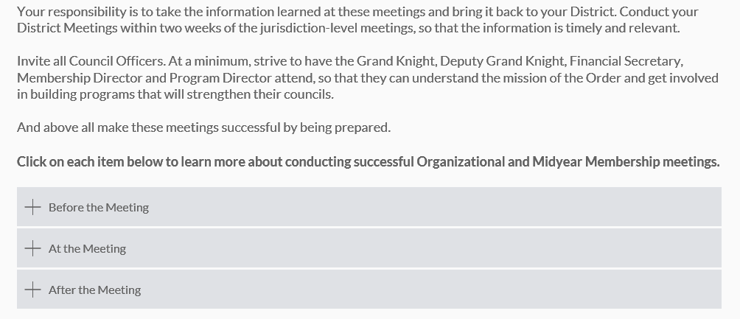
Leadership provides vision and mission

Slide 63
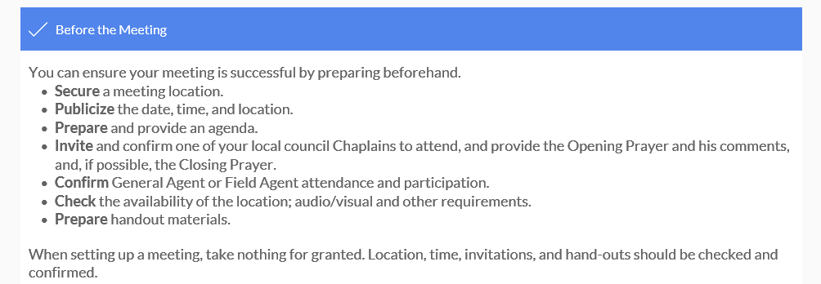

Slide 66
SAMPLE SUGGESTED DISTRICT MEETING AGENDA
Opening Prayer, Salute to Country, Welcome, Introductions
District Deputy Meeting Overview
Chaplain’s Message
Building the Domestic Church While Strengthening Our Parish
How well did each council assist the pastor (In the last fraternal year or in the last 6 months)
What new programs did each council initiate
Fraternal Leader Success Planner
Measuring Success
What has been accomplished? (In the last fraternal year or in the last 6 months)
Planning Ahead for Success
How to help more people, raise additional charitable dollars, and increase volunteer hours?
Council Progress toward Earning the Star Council Award
Membership Initiatives
Introduce/Review Recruitment Plan and Incentives
Supreme Council Incentives and Recruitment Plan
State Council Goals and Action Plan
District and Council Action Plan
Review Membership Recruiting Materials
Outline Retention Program
Review Current Schedule of Degrees and Requests
Admission Degree Council Schedule
Formation Degree Schedule (and requests)
Knighthood Degree Schedule (and requests)
Insurance Initiatives
General/Field Agent Report and Remarks
Supreme Council News
Program Spotlight
Fraternal Benefits Nights
Helping councils to attain their insurance goals
Program Initiatives
Supreme Council Initiatives
State Council Programs
Area Council Events of Note
Correspondence and Reports
Open Discussion
District Deputy Closing Remarks
Closing Prayer

Slide 67
SAMPLE SUGGESTED DISTRICT MEETING AGENDA
Opening Prayer, Salute to Country, Welcome, Introductions
District Deputy Meeting Overview
Chaplain’s Message
Building the Domestic Church While Strengthening Our Parish
How well did each council assist the pastor (In the last fraternal year or in the last 6 months)
What new programs did each council initiate
Fraternal Leader Success Planner
Measuring Success
What has been accomplished? (In the last fraternal year or in the last 6 months)
Planning Ahead for Success
How to help more people, raise additional charitable dollars, and increase volunteer hours?
Council Progress toward Earning the Star Council Award
Membership Initiatives
Introduce/Review Recruitment Plan and Incentives
Supreme Council Incentives and Recruitment Plan
State Council Goals and Action Plan
District and Council Action Plan
Review Membership Recruiting Materials
Outline Retention Program
Review Current Schedule of Degrees and Requests
Admission Degree Council Schedule
Formation Degree Schedule (and requests)
Knighthood Degree Schedule (and requests)
Insurance Initiatives
General/Field Agent Report and Remarks
Supreme Council News
Program Spotlight
Fraternal Benefits Nights
Helping councils to attain their insurance goals
Program Initiatives
Supreme Council Initiatives
State Council Programs
Area Council Events of Note
Correspondence and Reports
Open Discussion
District Deputy Closing Remarks
Closing Prayer

Slide 68
SAMPLE SUGGESTED DISTRICT MEETING AGENDA
Opening Prayer, Salute to Country, Welcome, Introductions
District Deputy Meeting Overview
Chaplain’s Message
Building the Domestic Church While Strengthening Our Parish
How well did each council assist the pastor (In the last fraternal year or in the last 6 months)
What new programs did each council initiate
Fraternal Leader Success Planner
Measuring Success
What has been accomplished? (In the last fraternal year or in the last 6 months)
Planning Ahead for Success
How to help more people, raise additional charitable dollars, and increase volunteer hours?
Council Progress toward Earning the Star Council Award
Membership Initiatives
Introduce/Review Recruitment Plan and Incentives
Supreme Council Incentives and Recruitment Plan
State Council Goals and Action Plan
District and Council Action Plan
Review Membership Recruiting Materials
Outline Retention Program
Review Current Schedule of Degrees and Requests
Admission Degree Council Schedule
Formation Degree Schedule (and requests)
Knighthood Degree Schedule (and requests)
Insurance Initiatives
General/Field Agent Report and Remarks
Supreme Council News
Program Spotlight
Fraternal Benefits Nights
Helping councils to attain their insurance goals
Program Initiatives
Supreme Council Initiatives
State Council Programs
Area Council Events of Note
Correspondence and Reports
Open Discussion
District Deputy Closing Remarks
Closing Prayer

Slide 69
SAMPLE SUGGESTED DISTRICT MEETING AGENDA
Opening Prayer, Salute to Country, Welcome, Introductions
District Deputy Meeting Overview
Chaplain’s Message
Building the Domestic Church While Strengthening Our Parish
How well did each council assist the pastor (In the last fraternal year or in the last 6 months)
What new programs did each council initiate
Fraternal Leader Success Planner
Measuring Success
What has been accomplished? (In the last fraternal year or in the last 6 months)
Planning Ahead for Success
How to help more people, raise additional charitable dollars, and increase volunteer hours?
Council Progress toward Earning the Star Council Award
Membership Initiatives
Introduce/Review Recruitment Plan and Incentives
Supreme Council Incentives and Recruitment Plan
State Council Goals and Action Plan
District and Council Action Plan
Review Membership Recruiting Materials
Outline Retention Program
Review Current Schedule of Degrees and Requests
Admission Degree Council Schedule
Formation Degree Schedule (and requests)
Knighthood Degree Schedule (and requests)
Insurance Initiatives
General/Field Agent Report and Remarks
Supreme Council News
Program Spotlight
Fraternal Benefits Nights
Helping councils to attain their insurance goals
Program Initiatives
Supreme Council Initiatives
State Council Programs
Area Council Events of Note
Correspondence and Reports
Open Discussion
District Deputy Closing Remarks
Closing Prayer

Slide 70
SAMPLE SUGGESTED DISTRICT MEETING AGENDA
Opening Prayer, Salute to Country, Welcome, Introductions
District Deputy Meeting Overview
Chaplain’s Message
Building the Domestic Church While Strengthening Our Parish
How well did each council assist the pastor (In the last fraternal year or in the last 6 months)
What new programs did each council initiate
Fraternal Leader Success Planner
Measuring Success
What has been accomplished? (In the last fraternal year or in the last 6 months)
Planning Ahead for Success
How to help more people, raise additional charitable dollars, and increase volunteer hours?
Council Progress toward Earning the Star Council Award
Membership Initiatives
Introduce/Review Recruitment Plan and Incentives
Supreme Council Incentives and Recruitment Plan
State Council Goals and Action Plan
District and Council Action Plan
Review Membership Recruiting Materials
Outline Retention Program
Review Current Schedule of Degrees and Requests
Admission Degree Council Schedule
Formation Degree Schedule (and requests)
Knighthood Degree Schedule (and requests)
Insurance Initiatives
General/Field Agent Report and Remarks
Supreme Council News
Program Spotlight
Fraternal Benefits Nights
Helping councils to attain their insurance goals
Program Initiatives
Supreme Council Initiatives
State Council Programs
Area Council Events of Note
Correspondence and Reports
Open Discussion
District Deputy Closing Remarks
Closing Prayer

Slide 71
SAMPLE SUGGESTED DISTRICT MEETING AGENDA
Opening Prayer, Salute to Country, Welcome, Introductions
District Deputy Meeting Overview
Chaplain’s Message
Building the Domestic Church While Strengthening Our Parish
How well did each council assist the pastor (In the last fraternal year or in the last 6 months)
What new programs did each council initiate
Fraternal Leader Success Planner
Measuring Success
What has been accomplished? (In the last fraternal year or in the last 6 months)
Planning Ahead for Success
How to help more people, raise additional charitable dollars, and increase volunteer hours?
Council Progress toward Earning the Star Council Award
Membership Initiatives
Introduce/Review Recruitment Plan and Incentives
Supreme Council Incentives and Recruitment Plan
State Council Goals and Action Plan
District and Council Action Plan
Review Membership Recruiting Materials
Outline Retention Program
Review Current Schedule of Degrees and Requests
Admission Degree Council Schedule
Formation Degree Schedule (and requests)
Knighthood Degree Schedule (and requests)
Insurance Initiatives
General/Field Agent Report and Remarks
Supreme Council News
Program Spotlight
Fraternal Benefits Nights
Helping councils to attain their insurance goals
Program Initiatives
Supreme Council Initiatives
State Council Programs
Area Council Events of Note
Correspondence and Reports
Open Discussion
District Deputy Closing Remarks
Closing Prayer

Slide 72
SAMPLE SUGGESTED DISTRICT MEETING AGENDA
Opening Prayer, Salute to Country, Welcome, Introductions
District Deputy Meeting Overview
Chaplain’s Message
Building the Domestic Church While Strengthening Our Parish
How well did each council assist the pastor (In the last fraternal year or in the last 6 months)
What new programs did each council initiate
Fraternal Leader Success Planner
Measuring Success
What has been accomplished? (In the last fraternal year or in the last 6 months)
Planning Ahead for Success
How to help more people, raise additional charitable dollars, and increase volunteer hours?
Council Progress toward Earning the Star Council Award
Membership Initiatives
Introduce/Review Recruitment Plan and Incentives
Supreme Council Incentives and Recruitment Plan
State Council Goals and Action Plan
District and Council Action Plan
Review Membership Recruiting Materials
Outline Retention Program
Review Current Schedule of Degrees and Requests
Admission Degree Council Schedule
Formation Degree Schedule (and requests)
Knighthood Degree Schedule (and requests)
Insurance Initiatives
General/Field Agent Report and Remarks
Supreme Council News
Program Spotlight
Fraternal Benefits Nights
Helping councils to attain their insurance goals
Program Initiatives
Supreme Council Initiatives
State Council Programs
Area Council Events of Note
Correspondence and Reports
Open Discussion
District Deputy Closing Remarks
Closing Prayer

Slide 76
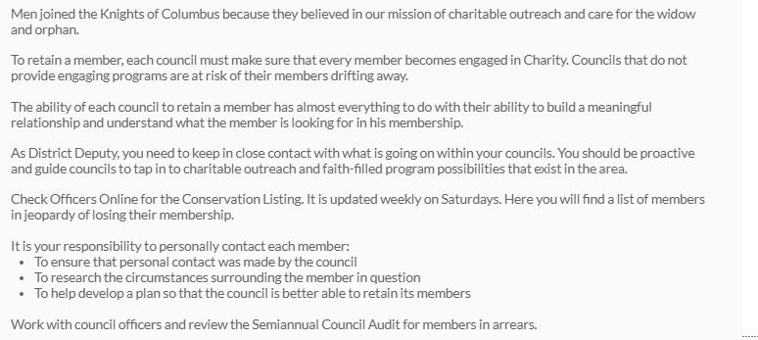
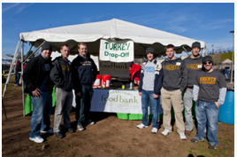
Member Retention- Not Dues Collection

Slide 77
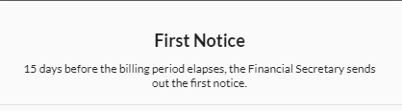
Member Retention Timetable

Slide 78
Member Retention Timetable

Slide 79
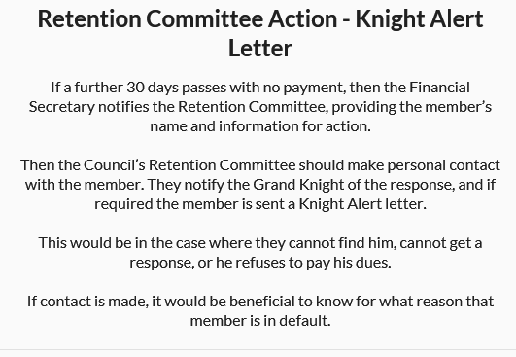
Member Retention Timetable

Slide 80
Member Retention Timetable

Slide 81
Member Retention Timetable

Slide 83
As District Deputy a key responsibility is to:

Slide 92
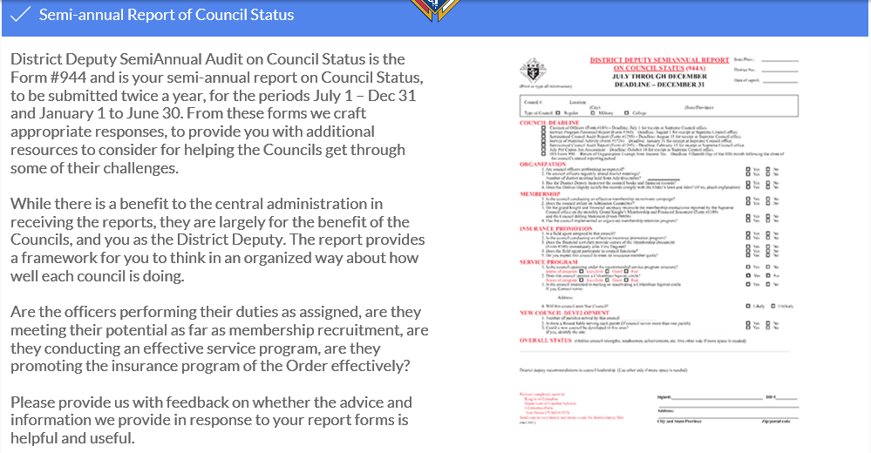

Slide 94
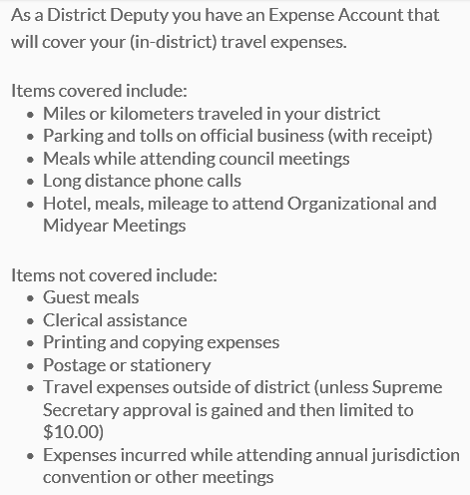
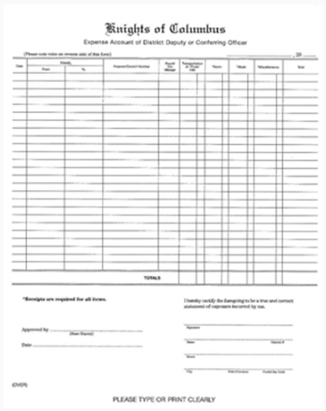

Slide 97
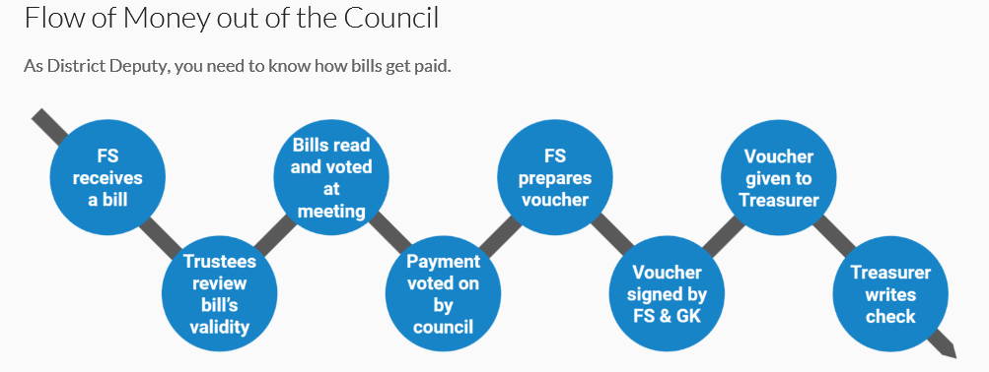

Slide 99
As District Deputy, administrative duties are important and will take some time. What should you do to be the most productive?

Slide 100
Outreach is our mission, but administration is important to deliver on that mission.
It is important to help each council in your district to stay on track.
Give your administrative duties your full attention, and make certain your councils do likewise.

Slide 103
We want you to be successful in your District Deputy Role. Your goal should be to leave your District in a Better condition than you found it. From the experience of current and former District Deputies we have Distilled Ten Keys to Success to guide you.
You can find the Ten Keys in your Leadership Resources Guide.

Slide 104
1 – Communicate Priorities
There are many tools available for communicating your priorities, initiatives and
goals to your fellow Knights. Use or set up a district newsletter, email blasts or a
website. Councils in your district that focus on common priorities, which are
aligned with the mission of the Knights of Columbus, will foster positive growth.
Also, make time to attend council activities in your district (especially recruitment
drives and charitable events). Councils will appreciate seeing you at their events,
and it will help instill confidence in you and your role.

Slide 105
2 – Charitable Works
The councils in your district have a commitment to providing charitable service
to their parishes and communities and to live the mission of our founder, Father
Michael McGivney. To ensure success in your district, each council should be
living the ideals of a charity that evangelizes by putting Father McGivney’s vision
into action.

Slide 106
3 - Recruitment
Membership growth is essential to the success of each council and our Order.
With the addition of each new member, each council is better able to serve its
parish, its community and our Order. By increasing the number of council
members, for example, there are more men available to participate in charitable
service programs. When a man is offered membership in his local council, he has
the opportunity to grow in his faith through service to God and neighbor. Each
member also gains access to our exclusive, top-rated insurance, which can provide
protection for his family. For information on recruiting, visit kofc.org/drive.

Slide 107
4 – Star Council Award
The Star Council Award recognizes those councils that conduct well-rounded
service programs, while succeeding with membership recruitment and insurance
growth. Thriving in these three areas means that the council, and its leadership,
understand and are successful in meeting Father McGivney’s vision for the Order.
See the Knights of Columbus Leadership Resources (#5093) booklet for the
requirements to earn the Star Council Award or visit kofc.org/star.

Slide 108
5 – Insurance Program
Encourage the general agent and field agents to speak at council meetings
Encourage councils to plan frequent fraternal benefits nights
Encourage members and their families to consider taking advantage of our insurance products
Use the information available at kofc.org/insurance to learn more about our insurance products

Slide 109
6 – Set Realistic Goals
On your official council visits, ask the questions: Is the council better than it was
previously? What can be done to help more people? How can we do this better?
Did the council meet its goals? Were the goals achievable? The answers to these
questions will help move the council forward.

Slide 110
7 – Community
Enlist the support of the priests in your district and develop working
relationships with organizations in each community to ensure successful
charitable service projects and membership growth
An important part of each council’s recruitment strategy is to enlist the aid of its
chaplain or pastor in asking qualified men to join the council. An invitation from
a priest to become a Knight will carry a lot of weight toward having a positive
impact and acceptance into the council. Councils should be asking their pastors
what they can do to help and letting them know that Knights are there for their
parish.

Slide 111
8 – Meetings
Meetings need to be concise and productive, and they must serve a purpose.
District-wide organizational and midyear membership meetings should address
Orderwide initiatives, new charitable service program ideas, and membership and
insurance goals for the district. Separate strategy sessions (quarterly or as needed)
with each council ensure that all are working toward meeting your district goals.

Slide 112
9 – Value Members
Councils should be building a team atmosphere among their members by showing
them that their opinions and services are valued. Encourage council leadership
to ask members for advice, seek out their members’ hidden talents (web design,
writing ability, sales experience, etc.), and regularly consult with members and
keep them informed of the council’s initiatives to encourage team building.
Council officers should always make it a point to first listen and evaluate, and
then be ready to explain the reasons for final decisions. Also, council leaders
should be keeping younger members interested and engaged so they are prepared
to take leadership roles in their council.

Slide 113
10 – State Councils Officers
Councils should be building a team atmosphere among their members by showing them that their opinions and services are valued. Encourage council leadership to ask members for advice, seek out their members’ hidden talents (web design, writing ability, sales experience, etc.), and regularly consult with members and keep them informed of the council’s initiatives to encourage team building.
Council officers should always make it a point to first listen and evaluate, and then be ready to explain the reasons for final decisions. Also, council leaders should be keeping younger members interested and engaged so they are prepared to take leadership roles in their council.

Slide 115
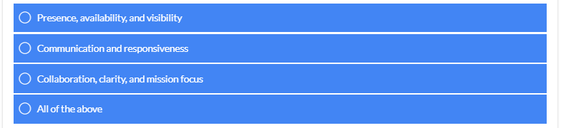
The Keys for Success for District Deputies is fully dependent upon:

Slide 116
The Ten Keys to Success is a guide to help you become a more effective leader. As District Deputy, the actions you take help ensure growth in faith-filled programs, charitable outreach, membership recruitment and family protection. As District Deputy, your ultimate goal is to motivate the councils in your district to be visible and relevant.
All actions have a cause and effect; the actions you don’t take also have consequences.
A District Deputy is a key fraternal leader and your importance in the life of the Knights of Columbus cannot be understated. You should not take your important Catholic lay leadership role for granted.

Slide 119
This training was designed to help you become successful in your role as District Deputy and outline how important your fraternal leadership is to your councils and to the Order. You should have acquired a better understanding of:
Your duties, resources, responsibilities, administrative duties, and the Ten Keys to Success.
We want to help you be a step ahead, to be prepared to be successful in your role as District Deputy. In this way your fraternal leadership will be of great benefit to your council.
In the end, it all comes down to what you do. Be active, and be successful.

Slide 120
Congratulations, you have completed the Knights of Columbus District Deputy Leadership Training Course.
You should now understand and implement the steps to becoming a successful District Deputy.
Good luck in your term of office, and God Bless you as you work to fulfill the mission of the Order and grow your District through Charitable Outreach and Fraternal Leadership.

Slide 126
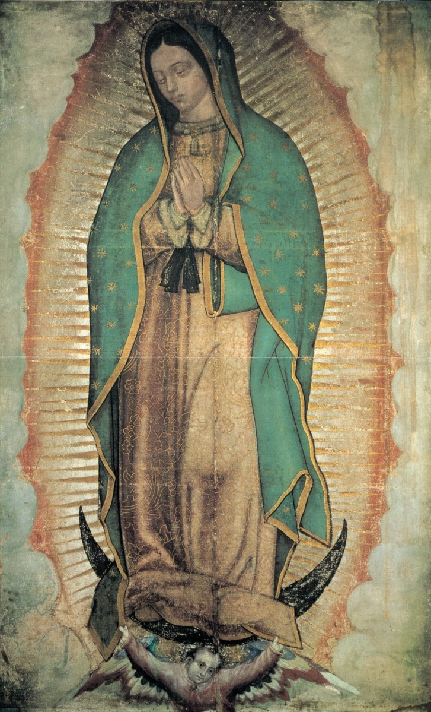
Closing Prayer
Thank you for participating in the Fraternal Training session for District Deputies. We close with this prayer to Our Lady of Guadalupe, to whom our Order has been entrusted:
In the name of the Father, and of the Son, and of the Holy Spirit.
God of power and mercy, You blessed the Americas at Tepeyac with the presence of the Virgin Mary of Guadalupe, May her prayers help all men and women to accept each other as brothers and sisters. Through Your justice present in our hearts, may Your peace reign in the world. We ask this through our Lord Jesus Christ, Your Son, who lives and reigns with You and the Holy Spirit, one God, for ever and ever. Amen.

