Slide 1
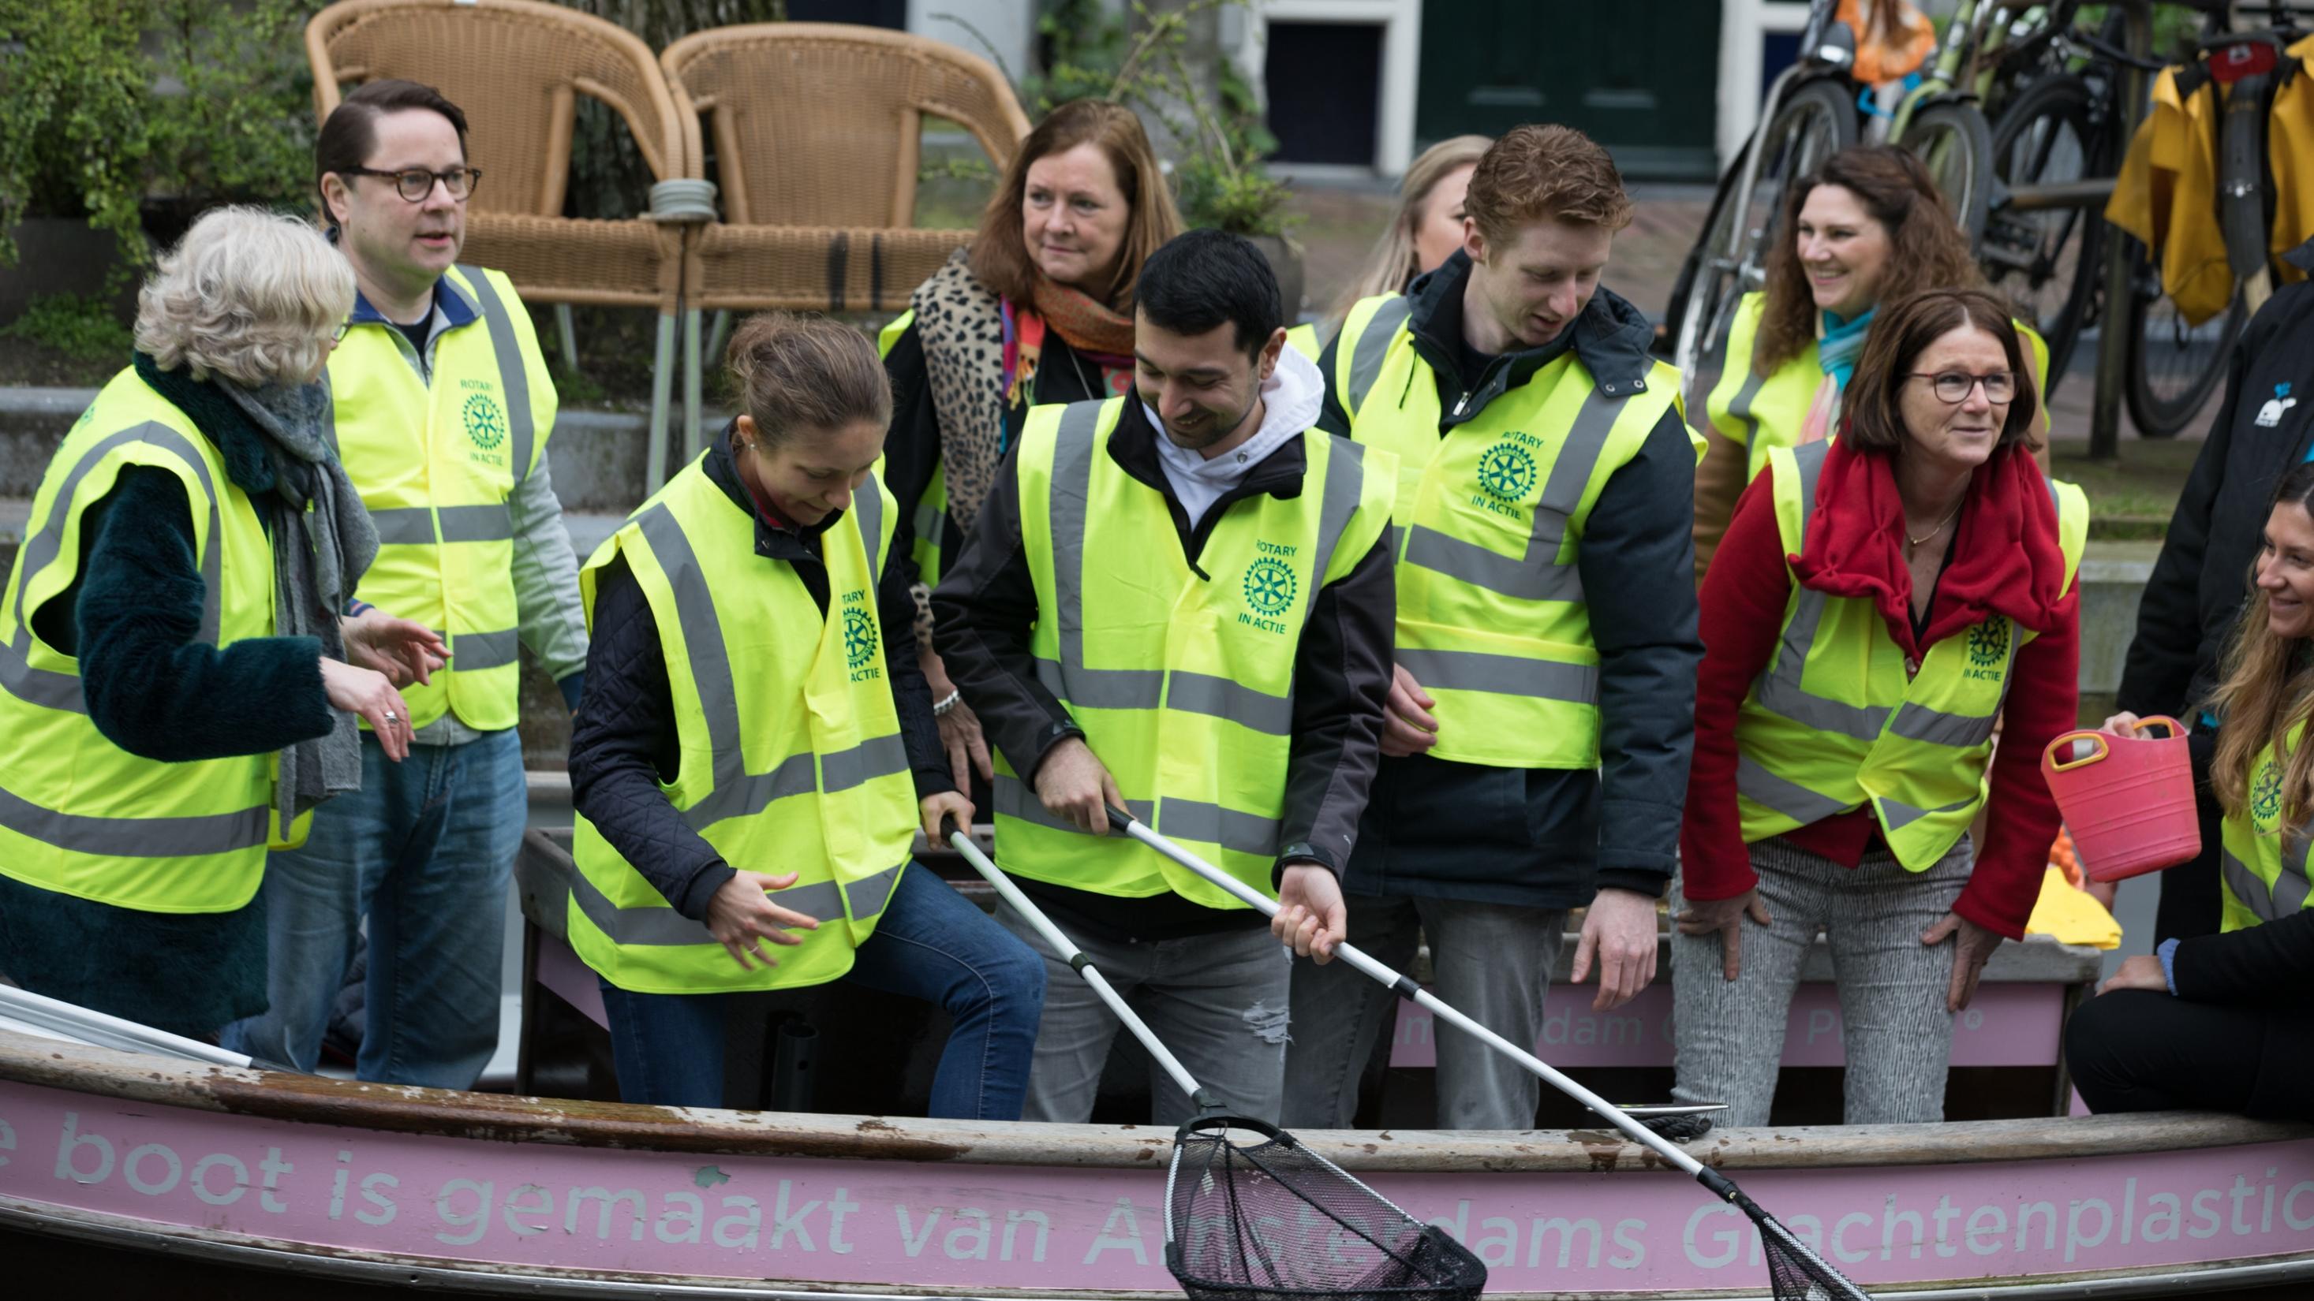
CONNECT FOR GOOD
Get Involved and Make a Difference
Notes:
NOTES TO SPEAKER: This presentation can be given to prospective members during public events, like open houses and fireside chats, or as part of a new member orientation program. It is designed to be customized to meet your region’s needs. Add content and images specific to your club, and have prospective member brochures available.
We are so excited you want to learn more about Rotary! The most important thing to know is that when you join a club, your potential to make a difference in the world grows exponentially. That’s because you’re joining a global network of 1.2 million neighbors, friends, leaders, and problem-solvers who see a world where people unite and take action to create lasting change – across the globe, in their communities, and in themselves.
During our time together, we’ll talk briefly about the history and structure of Rotary, the principles that guide the work we do, the value of belonging to a club, and the many ways you can get involved.

Slide 2
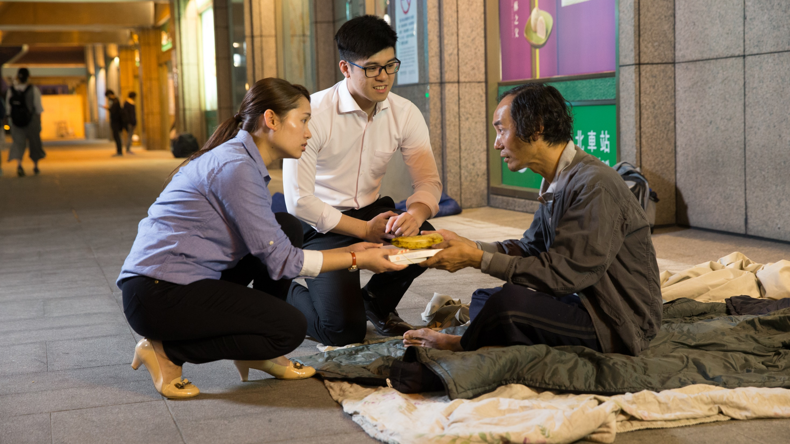
subhead
“Whatever Rotary may mean to us, to the world it will be known by the
results it achieves.”
— Paul Harris, 1914
ROTARY.ORG/HISTORY
Notes:
Where did the vision for this international membership organization begin? The first Rotary club was started in Chicago, Illinois, USA, in 1905 by an attorney named Paul Harris. Harris wanted to bring together a group of professionals with different backgrounds and skills as a way to exchange ideas and form meaningful friendships.
In August 1910, the 16 Rotary clubs then in the United States formed the National Association of Rotary Clubs, now Rotary International. In 1912, Rotary expanded to a few more countries, and by July 1925, Rotary clubs existed on six continents. Today, there are more than 35,000 clubs, in almost every country in the world. For more information about Rotary’s history, go to Rotary.org/history.

Slide 3
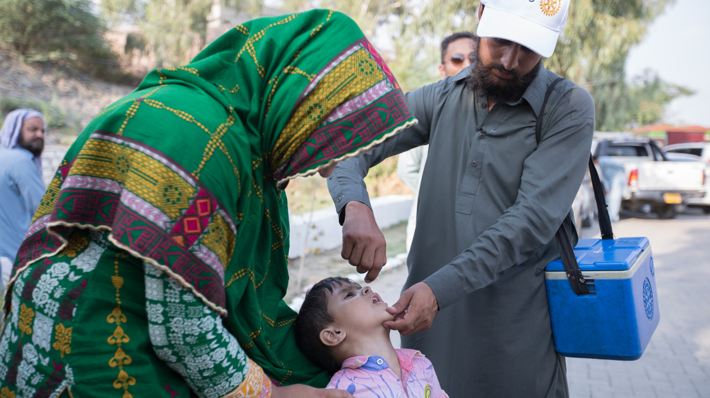
Eradicating polio worldwide
Since 1979
Notes:
Our largest and proudest collective effort is our work to eradicate polio-- through our fundraising efforts, our awareness campaigns, and our work with global partners, including the Bill & Melinda Gates Foundation. In 1988, an estimated 350,000 cases of polio occurred in 125 countries. In 2018, 33 cases of wild poliovirus were reported in only two countries: Afghanistan and Pakistan. That’s a 99.9 percent reduction in global polio cases.

Slide 4

Our structure
Notes:
So, when you join Rotary, are you joining a club or are you joining Rotary International? Rotary is actually made up of three parts: our clubs, Rotary International, and The Rotary Foundation.

Slide 5
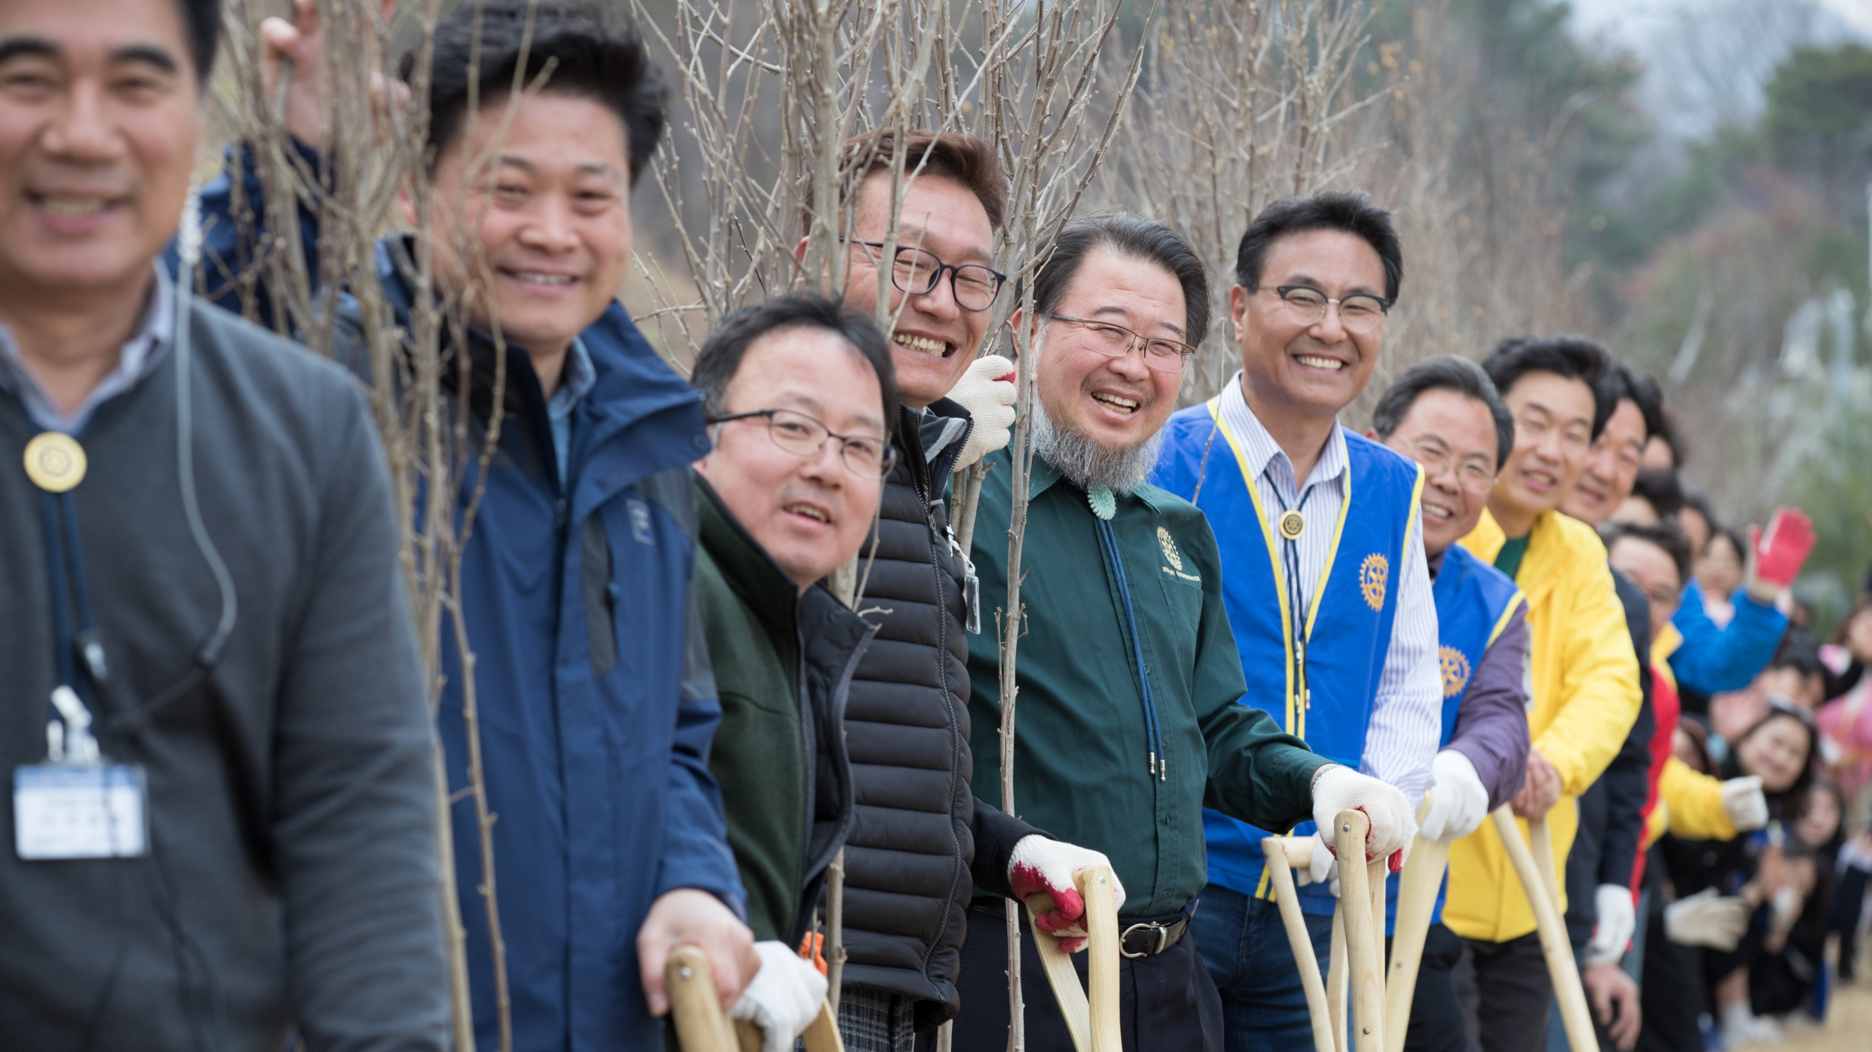
subhead
ROTARY CLUBS
Most often, people join to
connect with and give back
to their communities.
These are the same reasons members stay in Rotary
year after year.
Notes:
NOTE TO SPEAKER: Customize this slide with photos of your club and a club logo which you can create at https://brandcenter.rotary.org/en-GB (under “create your own).
While Rotary clubs share the same values, no two are the same, and there are a couple reasons for that. The first is that communities have unique needs, and clubs are formed to do the most good based on those needs. The second is that clubs have the freedom to create a club experience that works best for all of their members, and have the autonomy to choose when, where, and how they meet, as well as who to welcome as active members.
One thing is true of all clubs however: they provide the best path to strengthen connections to friends and neighbors and deliver on a commitment to improving lives.

Slide 6
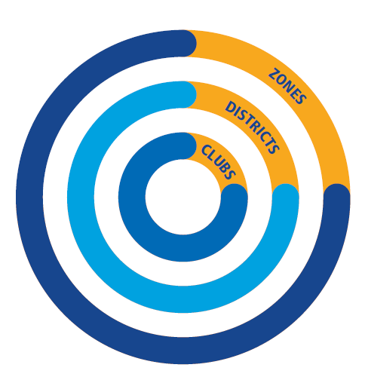
How clubs
are organized
There are over 35,000 clubs grouped into about 530 districts.
These districts are organized into
34 regional zones.
There are leadership opportunities
at every level.
Notes:
Those Rotary clubs are grouped into districts. Districts are organized into regional zones, each led by a team of regional leaders. District governors serve a one-year term, leading a team of assistant governors and district committees to support and strengthen clubs and motivate them to carry out service projects. Governors visit each club in the district during the year, oversee the development of new clubs, and plan the district conference and other special events.

Slide 7
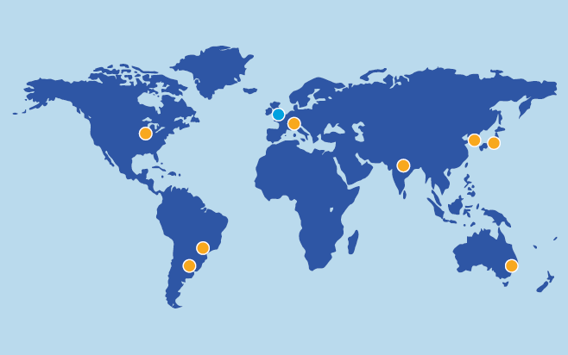

Notes:
Those 35,000 clubs belong to belong to the global association, known as Rotary International (RI), and is led by the RI president and the RI Board of Directors. The Board of Directors establishes Rotary International’s policies and provides guidance that helps our clubs thrive. As you can see from this map, Rotary International has offices all over the world.

Slide 8
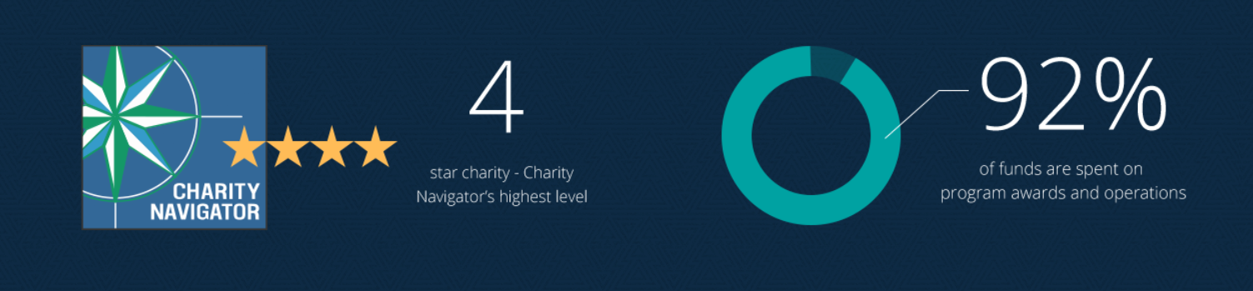

Notes:
The Rotary Foundation is organized as a public charity operated exclusively for charitable purposes and is governed by a Board of Trustees. The Rotary Foundation was founded in 1917, and helps clubs and districts work together to perform meaningful, sustainable service. Our top-rated, award-winning Foundation has spent more than $3.7 billion on life-changing, sustainable projects that help people in need around the world get clean water, medical care, literacy classes, and other essentials.

Slide 9

OUR LEADERS:
President, Rotary International
Chair, The Rotary Foundation
District Governor
President, the Rotary Club of xx
Notes:
NOTES TO SPEAKER: Customize this slide with names and photos. https://www.rotary.org/en/about-rotary/our-leaders. If you plan to use this slide, make sure to “unhide” (use the Slide Show menu) so it’s visible during the presentation.
Our leaders at Rotary exemplify all of the qualities that make our members extraordinary: integrity, expertise, and a commitment to service.

Slide 10
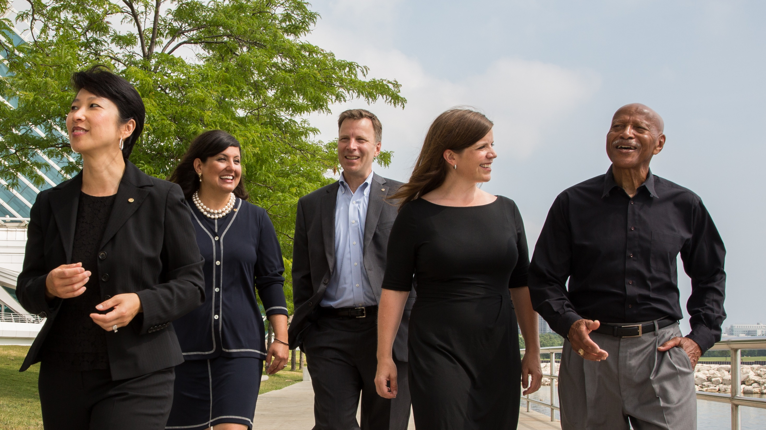
What we value
Integrity, diversity, service, leadership, and fellowship
ROTARY.ORG/DEI
Notes:
Rotary was founded on principles that remain at the heart of the organization today. These principles reflect our core values — integrity, diversity, service, leadership, and fellowship, or friendship. Our core values emerge as themes in our guiding principles.
Important to note is that Rotary is apolitical and nonreligious, and does not discriminate on the basis of gender, race, color, faith, national origin, or sexual orientation.
Each club strives to reflect the diversity of its community by including members from a mix of professions, genders, ages, and ethnicities. Having members with different backgrounds and viewpoints gives each club a broader understanding of the community and its problems, and better equips it to find solutions.

Slide 11
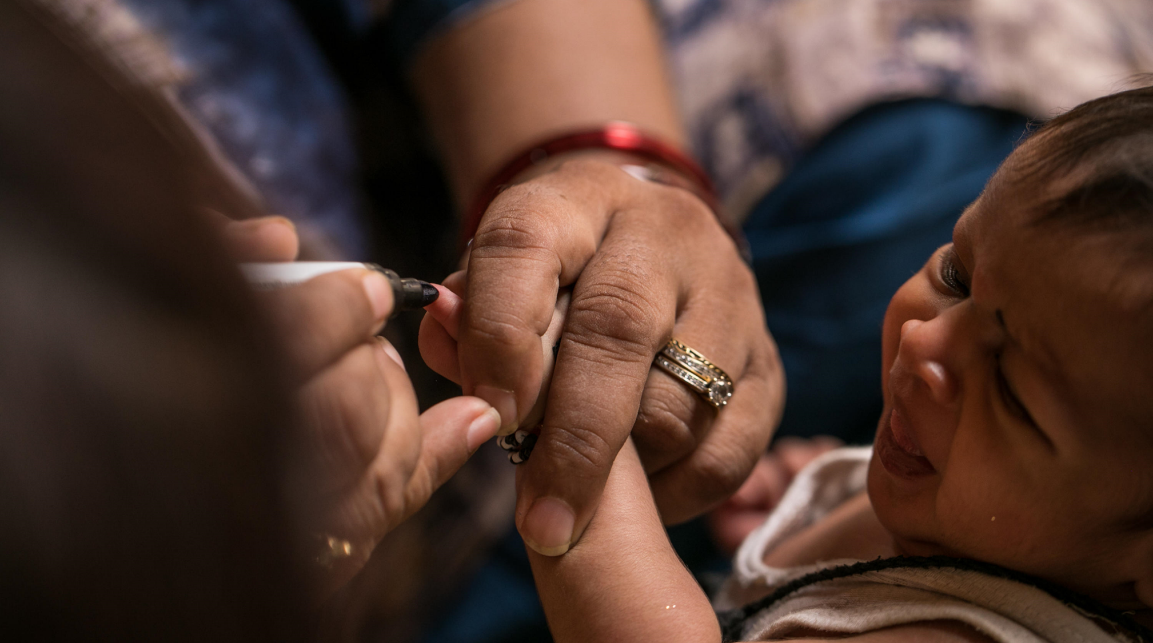
subhead
Our causes
Support the environment
Promote peace
Fight disease
Provide clean water, sanitation, and hygiene
Save mothers and children
Support education
Grow local economies
Notes:
The collective leadership and expertise of our 1.2 million members helps us tackle some of the world’s biggest challenges, locally and globally. We are united by common values and vision for the future as we sharpen our focus with targeted specific causes that will reach communities most in need.
Rotary members believe that we have a shared responsibility to take action on our world’s most persistent issues. Our 35,000+ clubs work together to:
Support the environment
Promote peace
Fight disease
Provide clean water, sanitation, and hygiene
Save mothers and children
Support education
Grow local economies

Slide 12
About the Rotary Club of xxxx
Founded in xxxx
Xx number of members (xx% women)
We are known for (signature project)
Our hope for the future is…
We are looking for members who…
We expect our members to…
Notes:
NOTES TO SPEAKER: Customize this slide with information about your club. If you plan to use this slide, make sure to “unhide” (use the Slide Show menu) so it’s visible during the presentation. Consider including:
Any relevant history
Projects that have impacted the community
Your current size and demographic information
When, where, and how you meet
The value you bring to your members and community
What you are looking for in new members
Expectations you have of club members (attendance, dues, etc)

Slide 13
Get involved
Make a difference
Empower leaders
Learn new skills
Support the Rotary Foundation
Connect across continents
Build lifelong friendships
There are countless ways to engage
with Rotary and your Rotary club.
You choose how — and how much
— to get involved
Notes:
When you get involved with Rotary, it’s not just your community that benefits. You benefit, too. As an active Rotarian, you’ll make connections, develop skills, meet community leaders and tackle local and global issues that are important to you and your fellow club members. You’ll feel the shared sense of purpose that comes from working together to better your community. Here are some a ways to get involved with Rotary without having to be a member of a club.

Slide 14

subhead
Empower leaders
Interact
Rotaract
RYLA
Youth Exchange
Peace Centers
Rotary Community Corps
Rotary Action Groups
ROTARY.ORG/EMPOWER-LEADERS
Notes:
Rotary’s programs are developing the next generation of leaders, providing funding to make the world a better place, and making peace a priority. You can help develop leaders in your community and club by getting involved in Rotary programs and activities. Empower young people through Interact and Rotaract. Encourage community involvement by sponsoring a Rotary Community Corps. Or share your expertise in a Rotary Action Group.

Slide 15
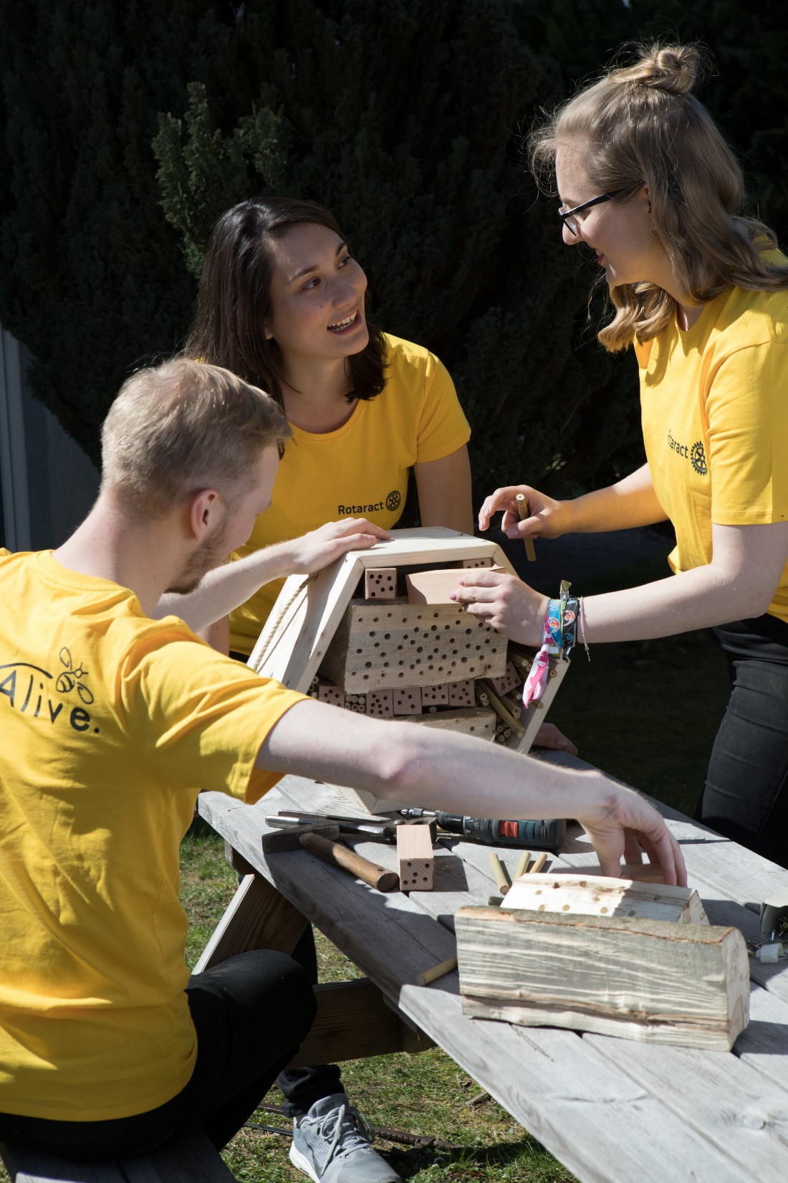
subhead
Build lifelong friendships
Being part of a fellowship is a fun way to make friends around the world, explore a hobby or profession, and enhance your Rotary experience.
ROTARY.ORG/FELLOWSHIPS
Notes:
Rotary Fellowships consist are designed for those who share a common interest in recreational activities, sports, hobbies, or professions. These groups help expand skills, foster vocational development, and enhance the Rotary experience by exploring interests while developing connections around the world.

Slide 16

subhead
Learn new skills
Learn everywhere and anytime with Rotary’s Learning Center:
Toastmasters Courses, designed for Rotary
Public Image
Mentoring
Leading Change
ROTARY.ORG/LEARN
Notes:
And finally, anyone can take advantage of a wealth of training materials designed to help you learn new skills and become more successful in what you do. Take courses, find resources, connect with an online community, talk with other registrants and course moderators, customize your user profile, and track your progress. Sign in with your My Rotary account at rotary.org/learn, or find the link on My Rotary under the Learning & Reference tab.

Slide 17
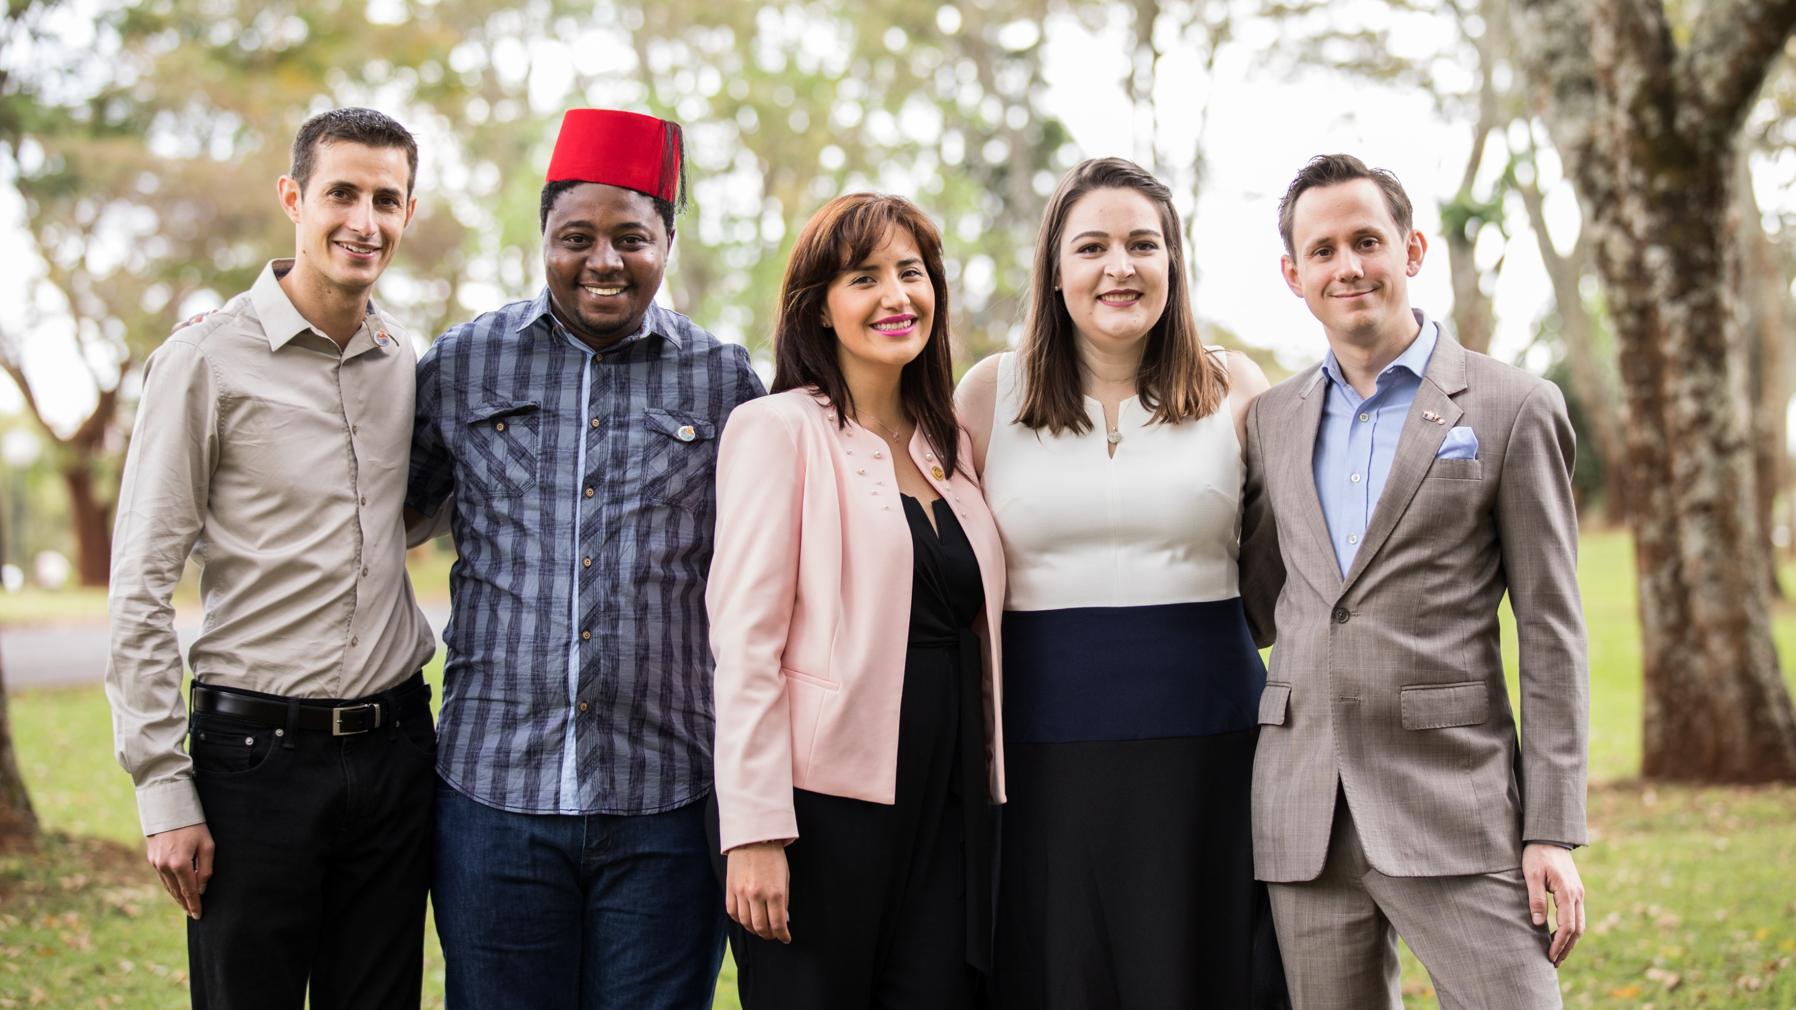
Interested?
Rotary.org/join
Contact us: [INSERT CLUB LOGO]
[INSERT CLUB NAME AND CONTACT INFORMATION
Notes:
You don't have to be a Rotary member to get involved with Rotary. Connect with a local Rotary club near you to find out what's available and how you can be involved.
Are there any questions I can answer?

Slide 18
QUESTIONS

